Slide 1
Chapter 23
Examples
1,2,3,5,8,10,11

Slide 2
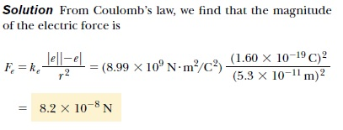
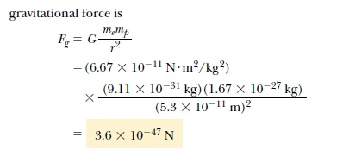
Ex1. The electron and proton of a hydrogen atom are separated (on the average) by a distance of approximately 5.3 x 10⁻¹¹ m. Find the magnitudes of the electric force and the gravitational force between the two particles.

Slide 3
Ex.2 Consider three point charges located at the corners of a right triangle as shown in Figure, where q1 = q3 = 5.0 μC, q2 =- 2.0 μC, and a = 0.10 m. Find the resultant force exerted on q3.

Slide 4
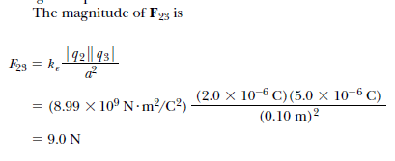
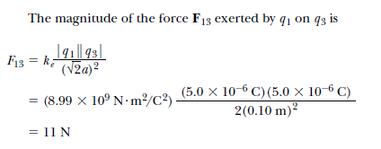

Slide 5
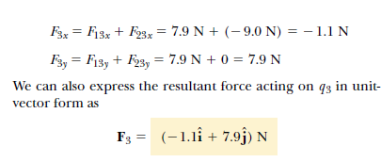

Slide 6
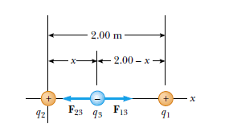
Ex 3

Slide 7
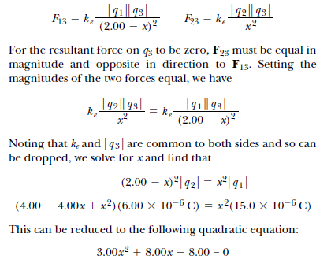

Slide 9
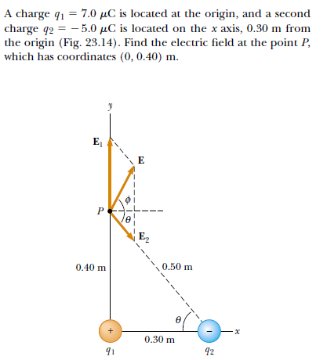
Ex 4

Slide 10
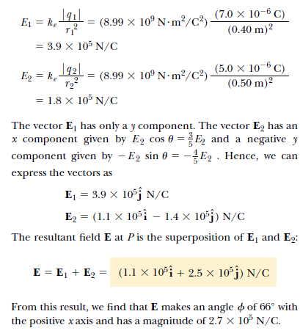

Slide 11
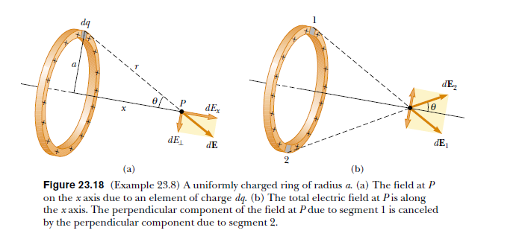
Ex.8 A ring of radius a carries a uniformly distributed positive total charge Q. Calculate the electric field due to the ring at a point P lying a distance x from its center along the central axis perpendicular to the plane of the ring (Fig. 23.18a).

Slide 12
