Slide 1
Chapter 20: An Introduction to Derivative Markets and Securities

Slide 2
An Overview of Derivatives
Value is depends directly on, or is derived from, the value of another security or commodity, called the underlying asset
Forward contracts are agreements between two parties - the buyer agrees to purchase an asset, the seller agrees to sell the asset, at a specific date at a price agreed upon now
Futures contracts are similar, but are standardized and traded on an organized exchange

Slide 3
An Overview of Derivatives
Options offer the buyer the right, but not the obligation, to buy or sell and underlying asset at a fixed price up to or on a specific date
Buyer is long in the contract
Seller or “writer” is short the contract
The price at which the transaction would we made is the exercise or strike price
The profit or loss on an option
Basic types of derivative positions (Exhibit 20.1)

Slide 4
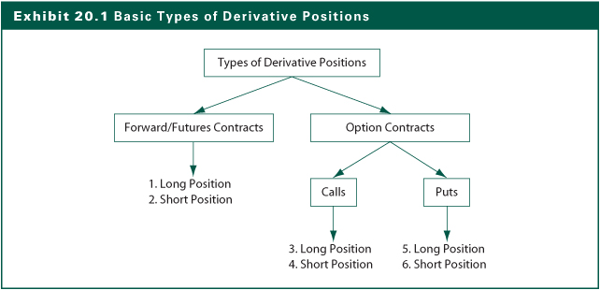
Exhibit 20.1

Slide 5
The Language and Structure of Forward and Futures Markets
Forward contract gives its holder both the right and the full obligation to conduct a transaction involving another security or commodity the underlying asset
At a predetermined date (maturity date)
At a predetermined price (contract price)
There must be two parties (counterparties) to a forward transaction
The eventual buyer (or long position)
The eventual seller (or short position)

Slide 6
The Language and Structure of Forward and Futures Markets
Forward and Spot Markets
A forward contract is basically a trade agreement
The terms that must be considered in forming a forward contract are the same as those necessary for a bond transaction that settled immediately (i.e., a spot market transaction)
The settlement date, at time T rather than 0
The contract price, F_{0, T} rather than S₀
No payments until expiration

Slide 7
The Language and Structure of Forward and Futures Markets
Forward and Futures Markets
Forward contracts are negotiated in the over-the-counter market, involve credit (or default) risk, and is quite often illiquid
Futures contracts try to solve these problems with
Standardized terms
Central market (futures exchange)
More liquidity
Less default risk: Margin requirements
Settlement price: Daily “marking to market”

Slide 8
Interpreting Futures Price Quotations
Exhibit 20.3 shows spot and futures prices for contracts on the Standard & Poor’s 500 index as of January 4, 2011
Expiration date
Contract size
Exhibit 20.4 summarizes the payoff and net profit for from a long position’s point of view, assuming a hypothetical set of S&P index levels on the March expiration date
F_{0, T} = 1,265.30
Zero-sum game

Slide 9
Exhibit 20.3

Slide 10
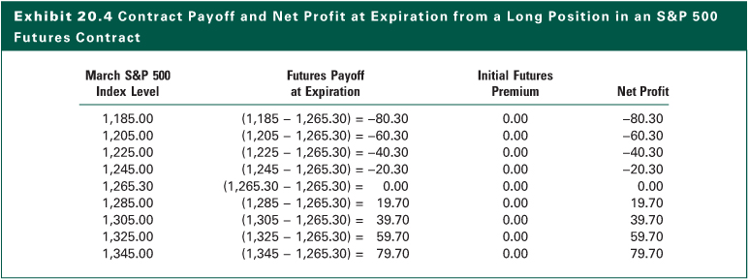
Exhibit 20.4

Slide 11
The Language and Structure of Option Markets
An option contract gives the holder the right-but not the obligation to buy or to sell an underlying security or commodity at a predetermined future date and at a predetermined price
Option to buy is a call option
Option to sell is a put option
Buyer has the long position in the contract
Seller (writer) has the short position in the contract
Buyer and seller are counterparties in the transaction

Slide 12
The Language and Structure of Option Markets
Option Contract Terms
The exercise price (X) is the price the call buyer will pay to-or the put buyer will receive from-the option seller if the option is exercised
The option premium (C_{0,T}) is the price that the option buyer must pay to the seller at Date 0 to acquire the option contract
European options can only be exercised only at maturity (Date T)
American options can be exercised any time before and at the expiration date

Slide 13
The Language and Structure of Option Markets
Option Valuation Basics
Intrinsic value represents the value that the buyer could extract from the option if he or she exercise the option immediately
In the money: An option with positive intrinsic value
Out of the money: The intrinsic value is zero
At the money: When the stock price is equal to exercise price, S₀ = X
The time premium component is simply the difference between the whole option premium and the intrinsic component

Slide 14
Interpreting Option Price Quotations
Option Trading Markets-options trade both in over-the-counter markets and on exchanges
Exhibit 20.6 shows data for a variety of call and put options on the S&P 500 index as of January 4, 2011
Expiration date
Bid and ask prices
Contract size

Slide 15
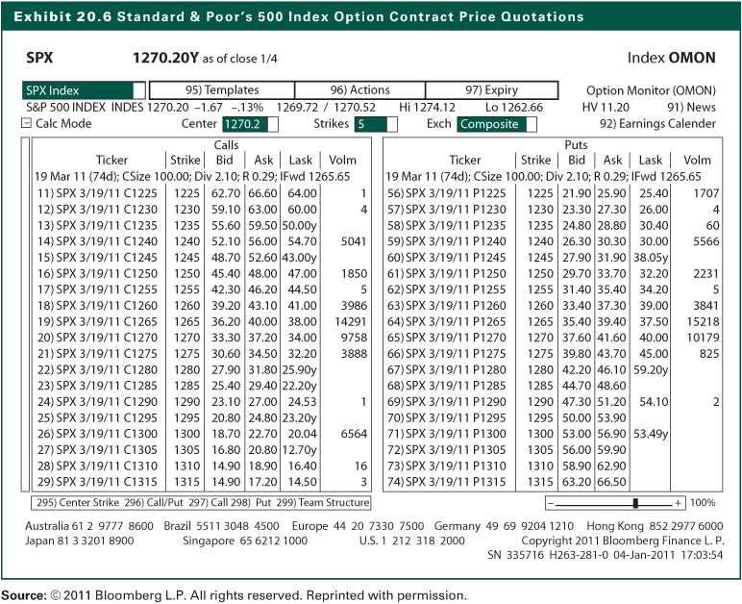
Exhibit 20.6

Slide 16
Investing With Derivative Securities
Key Difference between Forward and Option
Call option
Requires up front payment
Allows but does not require future settlement payment
Forward contract
Does not require front-end payment
Requires future settlement payment

Slide 17
Investing With Derivative Securities
Basic Payoff and Profit Diagrams for Forward Contracts
The payoffs to both long and short positions in the forward contract are symmetric, or two-sided, around the contract price
The payoffs to the short and long positions are mirror images of each other; in market jargon, forward contracts are zero-sum games
See Exhibit 20.10

Slide 18
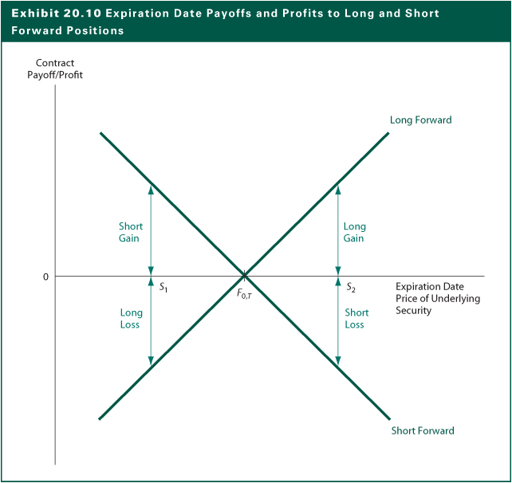
Exhibit 20.10

Slide 19
Investing With Derivative Securities
Basic Payoff and Profit Diagrams for Option Contracts
The investor receives expiration date payoffs that are asymmetric, or one-sided. For instance, a call option buyer has unlimited upside potential with limited downside risk
The difference between payoff and profit is the option premium (cost), a sunk cost
The payoffs and profits for option buyers and sellers (writers) are mirror images around horizontal line, a result of zero-sum games

Slide 20
Profits to Buyer of Call Option
Profit from Strategy
3,000
2,500
Exercise Price = $70
Option Price = $6.125
2,000
1,500
1,000
500
0
Stock Price at Expiration
(500)
(1,000)
40
50
60
70
80
90
100

Slide 21
Profits to Seller of Call Option
Profit from Strategy
1,000
Exercise Price = $70
Option Price = $6.125
500
0
(500)
(1,000)
(1,500)
(2,000)
(2,500)
Stock Price at Expiration
(3,000)
40
50
60
70
80
90
100

Slide 22
Profits to Buyer of Put Option
Profit from Strategy
3,000
2,500
2,000
Exercise Price = $70
Option Price = $2.25
1,500
1,000
500
0
Stock Price at Expiration
(500)
(1,000)
40
50
60
70
80
90
100

Slide 23
Profits to Seller of Put Option
Profit from Strategy
1,000
500
0
(500)
Exercise Price = $70
Option Price = $2.25
(1,000)
(1,500)
(2,000)
Stock Price at Expiration
(2,500)
(3,000)
40
50
60
70
80
90
100

Slide 24
Investing With Derivative Securities
Options Pricing Relationships
A positive sign shows a positive impact of the factor on option price
A negative sign shows a negative impact of the factor on option price
Factor Call Option Put Option
Stock price + -
Exercise price - +
Time to expiration + +
Interest rate + -
Volatility of the stock price + +

Slide 25
The Relationship Between Forward and Option Contracts
Put-Call-Spot Parity
Suppose that at Date 0, an investor forms the following portfolio involving three securities related to Company WYZ:
Buy a WYZ common stock at price of S₀
Purchase a put option for P_{0, T} to deliver WYZ stock at an exercise price of X on expiration date, T
Sell a call option for C_{0, T} to purchase WYZ stock at an exercise price of X on expiration date, T
See Exhibit 20.16

Slide 26
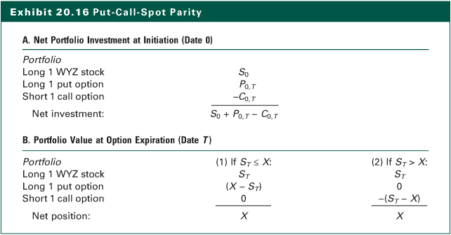
Exhibit 20.16

Slide 27
The Relationship Between Forward and Option Contracts
The Implication of Put-Call-Spot Parity
The net investment required to acquire this portfolio is (S₀ + P_{0,T} – C_{0,T})
The net positive at expiration date no matter at what level the stock price is would be the same, X
The result is a risk-free investment
Since the risk-free rate equals the T-bill rate:
(long stock)+(long put)+(short call)=(long T-bill)
X
S
+
P
−
C
=
0
0
,
T
0
,
T
(
1
+
RFR
)
T

Slide 28
Creating Synthetic Securities Using Put-Call Parity
Risk-free portfolio could be created using three risky securities:
stock,
a put option,
and a call option
With Treasury-bill as the fourth security, any one of the four may be replaced with combinations of the other three

Slide 29
Adjusting Put-Call Spot Parity For Dividends
The owners of derivative instruments do not participate directly in payment of dividends to holders of the underlying stock
If the dividend amounts and payment dates are known when puts and calls are written those are adjusted into the option prices
(long stock) + (long put) + (short call)
= (long T-bill) + (long present value of dividends)

Slide 30
Put-Call-Forward Parity
Instead of buying stock, take a long position in a forward contract to buy stock
Supplement this transaction by purchasing a put option and selling a call option, each with the same exercise price and expiration date
This reduces the net initial investment vs. buying the stock in the spot market
The difference between put and call prices must equal the discounted difference between the common exercise price and the contract price of the forward agreement

Slide 31
An Introduction To The Use Of Derivatives In Portfolio Management
Restructuring Asset Portfolios With Forward Contracts
Switching funds between current equity holding and other portfolios mimicking different asset classes
Tactical asset allocation to time general market movements instead of company-specific trends
Hedge position with payoffs that are negatively correlated with existing exposure
Converts beta of stock to zero, making a synthetic t-bill, affecting portfolio beta

Slide 32
An Introduction To The Use Of Derivatives In Portfolio Management
Protecting Portfolio Value With Put Options
The purpose is to have a derivative contract that allows stock sales when prices fall but keep the stock when prices rise
The purchase of a put option to hedge the downside risk of an underlying security holding is called a protective put position
Methods
Hold the shares and purchase a put option, or
Sell the shares and buy a T-bill and a call option
Portfolio insurance
See Exhibit 20.23

Slide 33
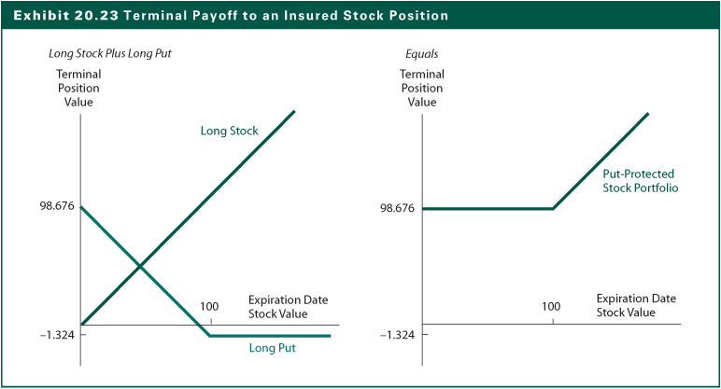
Exhibit 20.23

Slide 34
An Introduction To The Use Of Derivatives In Portfolio Management
An Alternative Way to Pay for a Protective Put
Collar Agreement: The simultaneous purchase of an out-of-the-money put and sale of an out-of-the-money call on the same underlying asset and with the same expiration date and market price
There is no initial cost to construct a strategy to protect against potential stock price declines by surrendering the potential future stock gains
See Exhibits 20.4 and 20.25

Slide 35
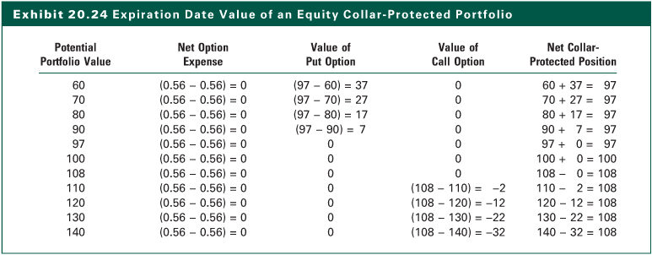
Exhibit 20.24

Slide 36
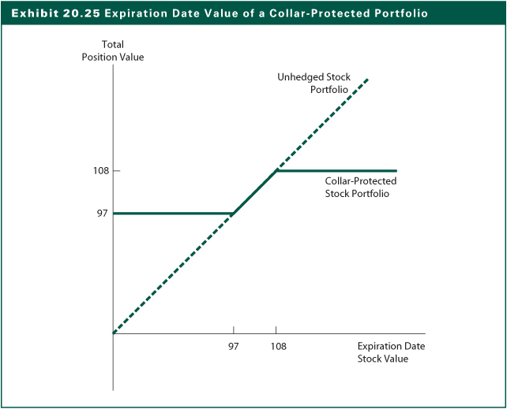
Exhibit 20.25

Slide 37
The Internet Investments Online
http://www.cboe.com
http://www.cmegroup.com
http://www.onechicago.com
http://www.euronext.com
http://www.schaeffersresearch.com
http://www.eurexus.com
http://www.ise.com
http://www.site-by-site.com/usa/optfut.htm

