Slide 1
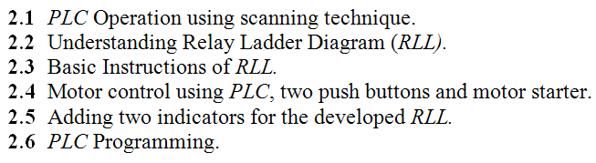
Chapter 2
Programmable Logic Controller (PLC) and Relay Ladder Logic (RLL).

Slide 2
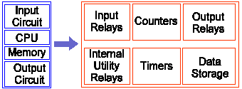
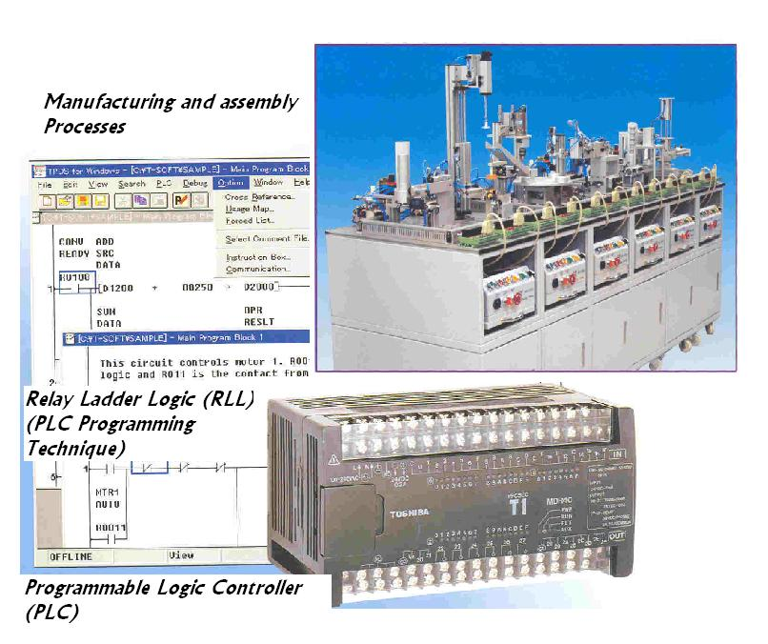
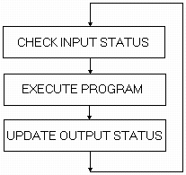
2.1 PLC Operation using scanning technique
Analog
Input
Networking module
Analog
Ouput
Modem
Fig. 2.1 Internal structure of a PLC.
Fig. 2.3 Scanning technique in PLC.

Slide 3
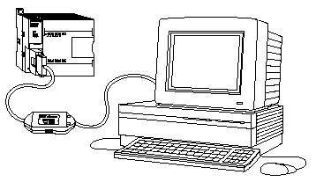

2.1 PLC Operation using scanning technique
Two modes of operations:
Programming mode.
Automatic or running mode(scanning mode)
Fig. 2.16 PLC Programming technique using PC computer through serial port.

Slide 4
2.2 Understanding Relay Ladder Diagram (RLL)
Power circuit
Control circuit
Fig. 2.6 A typical industrial relay.
Switch
Relay Coil
Fig. 2.5 Simple control circuit of a bell
Relay Ladder Development

Slide 5


2.2 Understanding Relay Ladder Diagram (RLL)
Fig. 2.7 Contact relay symbol (RLL).
+ -
Fig. 2.8 Output relay symbol (RLL).
Switch
Relay Coil
Relay Ladder Development
Main input instructions
Normally open contact :
Normally closed contact :
Main output instructions
  Normally open relay
  Normally closed relay
Fig. 2.9 RLL for bell control circuit.

Slide 6

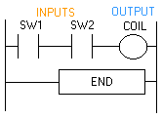
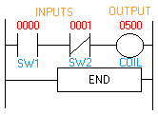
2.3 Basic Instructions of RLL
Some simple illustrated RLL circuit
Fig.2.11 Control and RLL for AND Boolean operation.
Fig. 2.12 Amended RLL using Normally closed switch for switch SW2.
The Boolean logic equation will be : Coil = SW1 . SW2

Slide 7
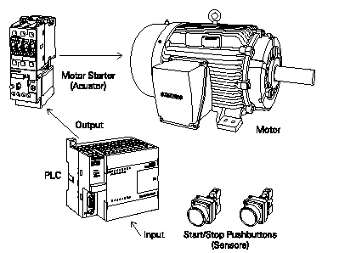
2.4 Motor control RLL network, two push buttons and motor starter
  Here two push buttons switches (Start/Stop) are used to switch the motor on/off. These switches are connected to the two PLC inputs discrete type), as shown in Fig. 2.13.
  One of the output ports (discrete outputs) of the PLC used to switch motor starter on/off, which will start/stop the electric motor.
Motor starter
Output
Motor
PLC
Input
Two bush bottom switches
Fig. 2.13 Motor control using PLC, motor starter and two push bottoms.

Slide 8
2.4 Motor control RLL network, two push buttons and motor starter
Relay Coil “R1”
S1
Q1.1
1
Current flow (Scan 1)
Motor starter
S1
Q1.1
2
Output
Motor
Current flow (Scan 1)
Q1.1
PLC
Current flow (Scan 2)
S1
Q1.1
Input
Two bush bottom switches
3
Switch “S1” and “S2”
Latch conditions
Q1.1
Current flow (Scan 2)

Slide 9
2.4 Motor control RLL network, two push buttons and motor starter
S1
S2
Q1.1
3
Relay Coil “R1”
Q1.1
Motor starter
Output
Motor
S1
S2
Q1.1
4
PLC
Q1.1
Input
Two bush bottom switches
Switch “S1” and “S2”
S1
S2
Q1.1
5
S1
S2
Q1.1
6
Q1.1
Q1.1

Slide 10
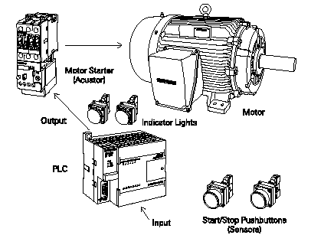
2.5 Motor control RLL network, two push buttons and motor starter
Adding Two Indicators Green (G) and Red (R)
S1
S2
R1
Motor starter
R1
Output
Two indicators
R1
Q1.1
Input
Two push bottom switches
G
Fig. 2.15 Amended RLL for motor control after adding two indicators.
R1
R

Slide 11
2.5 Motor control RLL network, two push buttons and motor starter
Adding Two Indicators Green (G) and Red (R)
Memory Unit
S1
S2
R1
Motor starter
R1
Relay coil
Output
Two indicators
R1
Q1.1
Green indictor
Input
Two push bottom switches
G
Fig. 2.15 Amended RLL for motor control after adding two indicators.
R1
R
Reed indictor

Slide 12
2.5 Motor control RLL network, two push buttons and motor starter
Adding Two Indicators Green (G) and Red (R) + Overload Switch (OV)
Memory Unit
S1
S2
R1
OL
Motor starter
R1
Relay coil
Output
Two indicators
R1
Q1.1
Green indictor
Input
Two push bottom switches
G
Fig. 2.15 Amended RLL for motor control after adding two indicators.
R1
R
Reed indictor

Slide 13
2.5 Setting and resetting memory elements using ADD and OR gates
R1
Memory Unit
AND Gate for setting
S1
S2
S3
R1
R1
Memory Unit
OR Gate for setting
S1
S3
S2
R1

Slide 14
2.5 Setting and resetting memory elements using ADD and OR gates
S3
R1
Memory Unit
OR Gate for Resetting
S1
S2
R1
Memory Unit
AND Gate for Resetting
S1
S2
R1
S3
R1

Slide 15
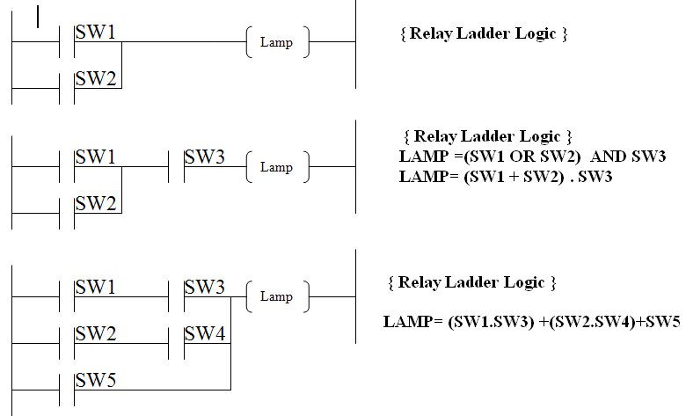
2.5 PLC Programming and Networks

Slide 16
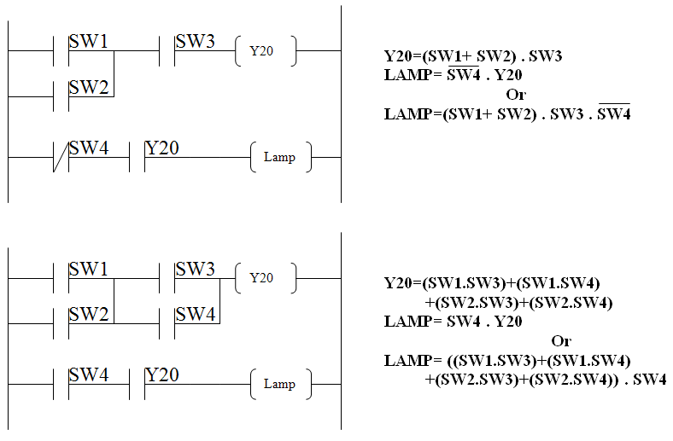
2.5 PLC Programming and Networks

Slide 17
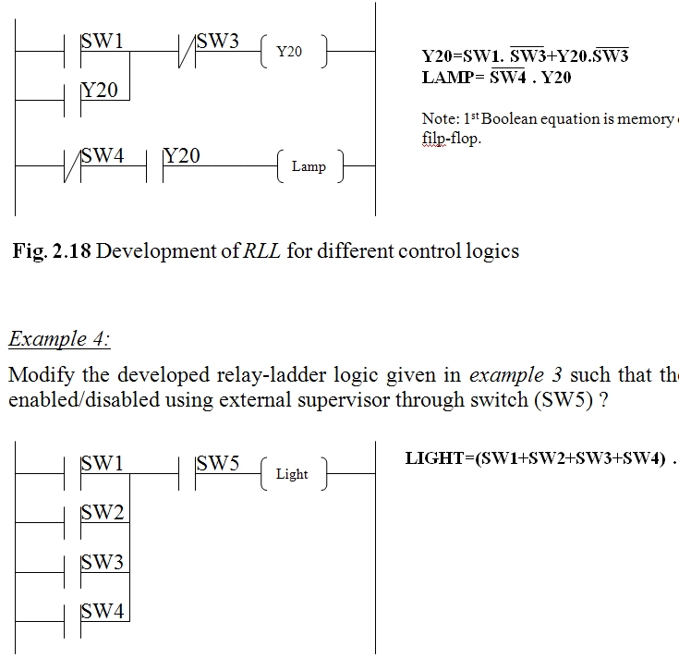
2.5 PLC Programming and Networks

Slide 18
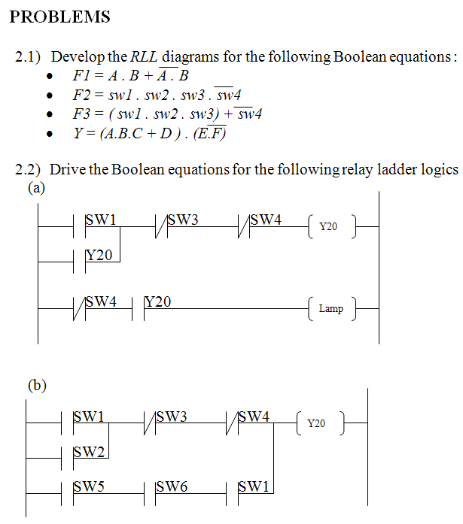

Slide 19
