Slide 1
Chapter 2: The Asset Allocation Decision

Slide 2
What is Asset Allocation?
Asset Allocation: It is the process of deciding how to distribute an investor’s wealth among different countries and asset classes for investment purposes.
Asset Class: It refers to the group of securities that have similar characteristics, attributes, and risk/return relationships.
Investor: Depending on the type of investors, investment objectives and constraints vary
Individual investors
Institutional investors

Slide 3
Individual Investor Life Cycle
Financial Plan Preliminaries
Life Insurance: Providing death benefits and, possibly, additional cash values
Term life and whole life insurance
Universal and variable life insurance
Non-life Insurance
Health insurance & Disability insurance
Automobile insurance & Home/rental insurance
Cash Reserve
To meet emergency needs
Equal to six months living expenses

Slide 4
Individual Investor Life Cycle
Life Cycle Phases (Exhibit 2.1)
Accumulation phase: Early to middle years of working career (Exhibit 2.2)
Consolidation phase: Past midpoint of careers. Earnings greater than expenses
Spending/Gifting phase: Begins after retirement
Life Cycle Investment Goals
Near-term, high-priority goals
Long-term, high-priority goals
Lower-priority goals

Slide 5
The Portfolio Management Process
Policy Statement
Specifies investment goals and acceptable risk levels
Should be reviewed periodically
Guides all investment decisions
Study Current Financial and Economic conditions and forecast future trends
Determine strategies to meet goals
Requires monitoring and updating

Slide 6
The Portfolio Management Process
Construct the Portfolio
Allocate available funds to minimize investor’s risks and meet investment goals
Monitor and Update
Evaluate portfolio performance
Monitor investor’s needs and market conditions
Revise policy statement as needed
Modify investment strategy accordingly

Slide 7
The Portfolio Management Process
Exhibit 2.3
1. Policy Statement
Focus: Investor’s short-term and long-term needs, familiarity with capital market history, and expectations
2. Examine current and project financial, economic, political, and social conditions
Focus: Short-term and intermediate-term expected conditions to use in constructing a specific portfolio
3. Implement the plan by constructing the portfolio
Focus: Meet the investor’s needs at the minimum risk levels
4. Feedback loop: Monitor and update investor needs, environmental conditions, portfolio performance

Slide 8
The Need For A Policy Statement
Understand investor’s needs and articulate realistic investment objectives and constraints
What are the real risks of an adverse financial outcome, and what emotional reactions will I have?
How knowledgeable am I about investments and the financial markets?
What other capital or income sources do I have? How important is this particular portfolio to my overall financial position?
What, if any, legal restrictions affect me?
How would any unanticipated portfolio value change might affect my investment policy?

Slide 9
The Need For A Policy Statement
Sets standards for evaluating portfolio performance
The statement provides a comparison standard in judging the performance of the portfolio manager.
A benchmark portfolio or comparison standard is used to reflect the risk an return objectives specified in the policy statement.
It should act as a starting point for periodic portfolio review and client communication with the manager.

Slide 10
The Need For A Policy Statement
Other Benefits
It helps reduces the possibility of inappropriate or unethical behavior on the part of the portfolio manager.
A clearly written policy statement will help create seamless transition from one money manager to another without costly delays.
It also provides the framework to help resolve any potential disagreements between the client and the manager.

Slide 11
Constructing the Policy Statement
Constructing the policy statement begins with a profile analysis of the investor’s current and future financial situations and a discussion of investment objectives and constraints.
Objectives
Risk
Return
Constraints
Liquidity, time horizon, tax factors, legal and regulatory constraints, and unique needs and preferences

Slide 12
Investment Objectives
Risk Objectives
Risk objective should be based on investor’s ability to take risk and willingness to take risk.
Risk tolerance depends on an investor’s current net worth and income expectations and age.
More net worth allows more risk taking
Younger people can take more risk
A careful analysis of the client’s risk tolerance should precede any discussion of return objectives.

Slide 13
Investment Objectives
Return Objectives
The return objective may be stated in terms of an absolute or a relative percentage return.
Capital Preservation: Minimize risk of real losses
Capital Appreciation: Growth of the portfolio in real terms to meet future need
Current Income: Focus is in generating income rather than capital gains
Total Return: Increase portfolio value by capital gains and by reinvesting current income with moderate risk exposure

Slide 14
Investment Constraints
Liquidity Needs
Vary between investors depending upon age, employment, tax status, etc.
Planned vacation expenses and house down payment are some of the liquidity needs.
Time Horizons
Influences liquidity needs and risk tolerance.
Longer investment horizons generally requires less liquidity and more risk tolerance.
Two general time horizons are pre-retirement and post-retirement periods.

Slide 15
Legal and Regulatory Factors
Limitations or penalties on withdrawals
Fiduciary responsibilities
The “Prudent Investor Rule” normally apply
Investment laws prohibit insider trading
Institutional investors deserve special attentions since legal and regulatory factors may affect them quite differently (e.g. banks vs. endowment funds).

Slide 16
Unique Needs and Preferences
Personal preferences such as socially conscious investments could influence investment choice.
Time constraints or lack of expertise for managing the portfolio may require professional management.
Large investment in employer’s stock may require consideration of diversification needs.
Institutional investors needs.

Slide 17
The Importance of Asset Allocation
An investment strategy is based on four decisions
What asset classes to consider for investment
What policy weights to assign to each eligible class
What allocation ranges are allowed based on policy weights
What specific securities to purchase for the portfolio
According to research studies, most (90%) of the overall investment return is due to the first two decisions, not the selection of individual investments (see Exhibit 2.7)

Slide 18
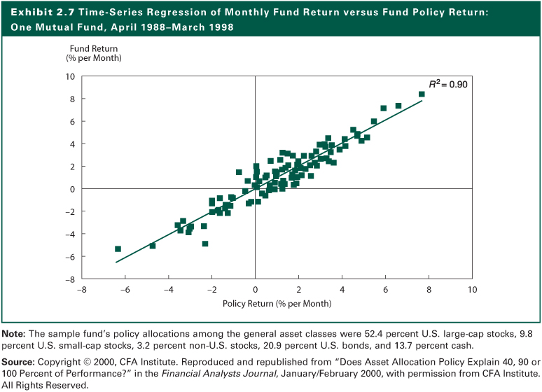
Exhibit 2.7

Slide 19
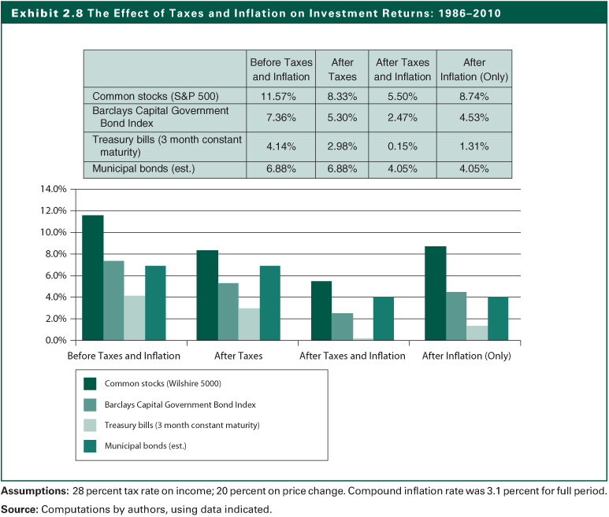
Exhibit 2.8

Slide 20
The Importance of Asset Allocation
Returns and Risks of Different Asset Classes
Historically, small company stocks have generated the highest returns, so have the volatility
Inflation and taxes have a major impact on returns
Returns on Treasury Bills have barely kept pace with inflation
Measuring risk by the probability of not meeting your investment return objective indicates risk of equities is small and that of T-bills is large because of their differences in expected returns
Focusing only on return variability as a measure of risk ignores reinvestment risk

Slide 21
Exhibit 2.9

Slide 22
Asset Allocation Summary
Policy statement determines types of assets to include in portfolio
Asset allocation determines portfolio return more than stock selection
Over long time periods, sizable allocation to equity will improve results
Risk of a strategy depends on the investor’s goals and time horizon

Slide 23
Asset Allocation Summary
Asset Allocation and Cultural Differences
Social, political, and tax environments influence the asset allocation decision
Equity allocations of U.S. pension funds average 58%
In the United Kingdom, equities make up 78% of assets
In Germany, equity allocation averages 8%
In Japan, equities are 37% of assets
See Exhibits 2.11 and 2.12
2-23

Slide 24
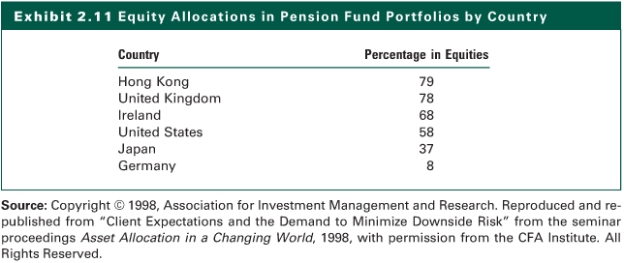
Exhibit 2.11

Slide 25
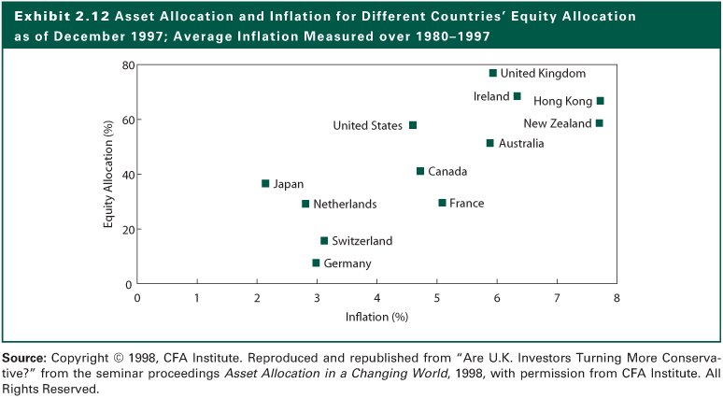
Exhibit 2.12

Slide 26
The Internet Investments Online
http://www.ssa.gov
http://ww.ibbotson.com
http://www.mfea.com/
http://InvestmentStrategies/Calculators/default.asp
http://www.asec.org
http://www.financialengines.com
http://www.cfainstitute.org
http://www.troweprice.com
http://www.theamericancollege.edu
http://www.cfp.net
http://www.napfa.org
http://www.fpanet.org
http://www.decisioneering.com

