Slide 1
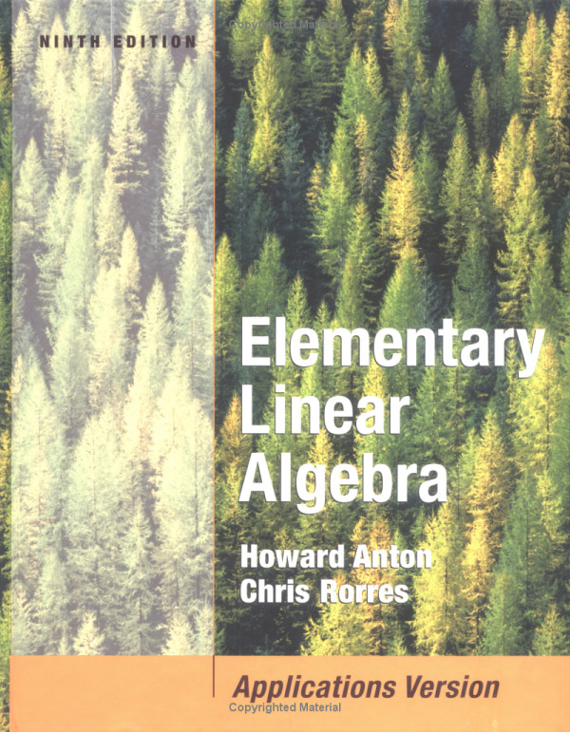

Slide 2
C H A P T E R 1
Systems of Linear Equations and Matrices
1.1 INTRODUCTION TO SYSTEMS OF LINEAR EQUATIONS
Linear Equations
Any straight line in the x-y plane can be represented algebraically by an equation of the form
where a1 , a2 and b are real constants a1 and a2 are not both zero. An equation of this form is called a linear equation in the variables x and y.
More generally, we define a linear equation in the n variables x2,x1 , …,xn to be one that can be expressed in the form
where a1,a2 , …,an , and b are real constants. The variables in a linear equation are sometimes called unknowns.

Slide 3
EXAMPLE 1
The equations
are linear. Observe that a linear equation does not involve any products or roots of variables. All variables occur only to the first power and do not appear as arguments for trigonometric, logarithmic, or exponential functions. The equations
are not linear.

Slide 4
Solution
A solution of a linear equation is a sequence of n numbers
s1,s2,s3,…..sn, such that the equation is satisfied when we substitute
The set of all solutions of the equation is called its solution set or sometimes the general solution of the equation.
EXAMPLE 2 : Finding a Solution Set of
we obtain
or

Slide 5
Linear Systems
A finite set of linear equations in the variables is called a system of linear equations or a linear system. A sequence of numbers is called a solution of the system if is a solution of every equation in the system. For example, the system
has the solution since these values satisfy both equations. However is not a solution since these values satisfy only the first equation in the system.

Slide 6
Not all systems of linear equations have solutions. For example, if we multiply the second equation of the system
by 1/2 , it becomes evident that there are no solutions since the resulting equivalent system has contradictory equations.
A system of equations that has no solutions is said to be inconsistent; if there is at least one solution of the system, it is called consistent. To illustrate the possibilities that can occur in solving systems of linear equations, consider a general system of two linear equations in the unknowns x and y:

Slide 7
The lines l₁ and l₂ may be parallel, in which case there is no intersection and consequently no solution to the system.
The lines l₁ and l₂ may intersect at only one point, in which case the system has exactly one solution.
The lines l₁ and l₂ may coincide, in which case there are infinitely many points of intersection and consequently infinitely many solutions to the system.

Slide 8
An arbitrary system of m linear equations in n unknowns can be written as
where are the unknowns and the subscripted a's and b's denote constants
Augmented Matrices

Slide 9
For example, the augmented matrix for the system of equations
is

Slide 10
The basic method for solving a system of linear equations is to replace the given system by a new system that has the same solution set but is easier to solve. This new system is generally obtained in a series of steps by applying the following three types of operations to eliminate unknowns systematically:
1. Multiply an equation through by a nonzero constant.
2. Interchange two equations.
3. Add a multiple of one equation to another.
Since the rows (horizontal lines) of an augmented matrix correspond to the equations in the associated system, these three operations correspond to the following operations on the rows of the augmented matrix:
1. Multiply a row through by a nonzero constant.
2. Interchange two rows.
3. Add a multiple of one row to another row.
These are called elementary row operations

Slide 11
EXAMPLE 3: Using Elementary Row Operations
The solution is
x= 1,
y= 2,
And z= 3

Slide 12
GAUSSIAN ELIMINATION
Echelon Forms
A matrix in a reduced row-echelon form must have the following properties:
1. If a row does not consist entirely of zeros, then the first nonzero number in the row is a 1. We call this a leading 1.
2. If there are any rows that consist entirely of zeros, then they are grouped together at the bottom of the matrix.
3. In any two successive rows that do not consist entirely of zeros, the leading 1 in the lower row occurs farther to the right than the leading 1 in the higher row.
4. Each column that contains a leading 1 has zeros everywhere else in that column.
A matrix that has the first three properties is said to be in row-echelon form

Slide 13
EXAMPLE 1: Row-Echelon and Reduced Row-Echelon Form
The following matrices are in reduced row-echelon form.
The following matrices are in row-echelon form.
Note: a matrix in reduced row-echelon form is of necessity in row-echelon form, but not conversely

Slide 14
Elimination Methods
Solve by elimination method
Step 1.
Step 2.
Step 3.
Step 4.

Slide 15
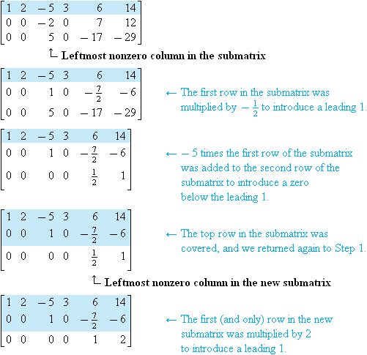
Step 5.

Slide 16
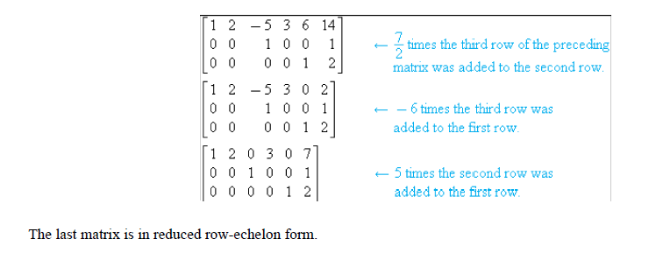
Step 6.

Slide 17
EXAMPLE 4:
Solve by Gauss–Jordan Elimination
reduced row-echelon form

Slide 18
Back-Substitution

Slide 19
EXAMPLE 6
Solve by Gaussian elimination and back-substitution.
Convert the system to the augmented matrix
to the row-echelon form
The system corresponding to this matrix is
The solution is x=1, y= 2 and z= 3.

Slide 20
Homogeneous Linear Systems
A system of linear equations is said to be homogeneous if the constant terms are all zero; that is, the system has the form
Every homogeneous system of linear equations is consistent, since all such systems have
as a solution. This solution is called the trivial solution; if there are other solutions, they are called nontrivial solutions.
There are only two possibilities for a homogeneous linear system solutions:
The system has only the trivial solution.
The system has infinitely many solutions in addition to the trivial solution.

Slide 21
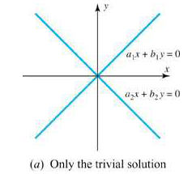
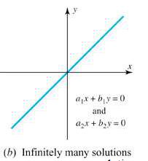
In the special case of a homogeneous linear system of two equations in two unknowns, say
The graphs of the equations are lines through the origin, and the trivial solution corresponds to the point of intersection at the origin

Slide 22
EXAMPLE 7
Solve the following homogeneous system of linear equations by using Gauss–Jordan elimination.
The augmented matrix for the system is
Reducing this matrix to reduced row-echelon form,

Slide 23
The corresponding system of equations is
Solving for the leading variables yields
Thus, the general solution is
Note that the trivial solution is obtained when s = t =0

Slide 24
THEOREM 1.2.1
A homogeneous system of linear equations with more unknowns than equations has infinitely many solutions.
MATRICES AND MATRIX OPERATIONS
DEFINITION
A matrix is a rectangular array of numbers. The numbers in the array are called the entries in the matrix.

Slide 25
The size of a matrix is described in terms of the number of rows (horizontal lines) and columns (vertical lines) it contains.
For example,
the matrix has three rows and two columns, so its size is 3 by 2 (written 3x2).
1x1
1x4
2x1
3x2
3x3

Slide 26
The entry that occurs in row i and column j of a matrix A will be denoted by a_{ij} or (A)_{ij}
For the matrix
we have (A)₁₁= 2 , (A)₁₂ =-3, (A)₂₁ =7, and (A)₂₂ =0.

Slide 27
A matrix A with n rows and n columns is called a square matrix of order n, and the shaded entries , (A)₁₁ , (A)₂₂ … (A)_{nn} , in 2 are
said to be on the main diagonal of A.
Operations on Matrices
DEFINITION
Two matrices are defined to be equal if they have the same size and their corresponding entries are equal.

Slide 28
EXAMPLE 2 Equality of Matrices
Consider the matrices
If x=5, then A=B, but for all other values of x the matrices A and B are not equal, since not all of their corresponding entries are equal. There is no value of x for which A=C since A and C have different sizes.

Slide 29
DEFINITION
If A and B are matrices of the same size, then the sum A+B is the matrix obtained by adding the entries of B to the corresponding entries of A, and the difference A-B is the matrix obtained by subtracting the entries of B from the corresponding entries of A. Matrices of different sizes cannot be added or subtracted.
In matrix notation, if and have the same size, then
EXAMPLE 3 Addition and Subtraction
Consider the matrices
Then find A+B, A-B, A+C, A-C, B+C and B-C
The expressions A+C, B+C, A-C, and B-C are undefined.

Slide 30
DEFINITION
If A is any matrix and c is any scalar, then the product cA is the matrix obtained by multiplying each entry of the matrix A by c. The matrix cA is said to be a scalar multiple of A.
In matrix notation, if , then
EXAMPLE 4 Scalar Multiples
For the matrices
Find 2A, -B and 1/3 C.

Slide 31
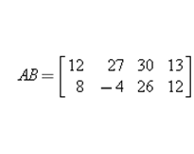
DEFINITION
If A is an matrix mxr and B is an matrix rxn, then the product AB is the mxn matrix whose entries are determined as follows. To find the entry in row i and column j of AB , single out row i from the matrix A and column j from the matrix B. Multiply the corresponding entries from the row and column together, and then add up the resulting products.
EXAMPLE 5 Multiplying Matrices
Consider the matrices
Find AB
2x4
2x3
3x4
(11)
(12)
(13)
(14)
(21)
(22)
(23)
(24)

Slide 32
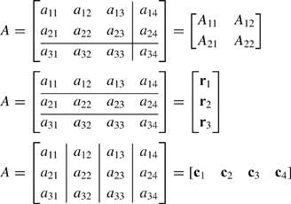
If is an mxr matrix and is an rxn matrix, then,
the entry (AB_{ij}) in row i and column j of AB is given by
Partitioned Matrices

Slide 33
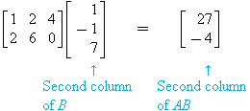
Matrix Multiplication by Columns and by Rows
EXAMPLE 7 Example 5 Revisited
If A and B are the matrices, then find
second column matrix of AB
first row matrix of AB

Slide 34
Matrix Products as Linear Combinations
Row and column matrices provide an alternative way of thinking about matrix multiplication. For example, suppose that
Then

Slide 35
EXAMPLE 8 Linear Combinations
The matrix product
can be written as the linear combination of column matrices
The matrix product
can be written as the linear combination of row matrices

Slide 36
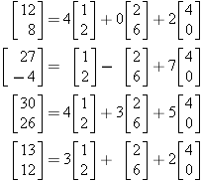
EXAMPLE 9 Columns of a Product as Linear Combinations
We showed in Example 5 that
The column matrices of can be expressed as linear combinations of the column matrices of A as follows:

Slide 37
Matrix Form of a Linear System
Ax=b
The matrix A in this equation is called the coefficient matrix of the system

Slide 38
Matrices Defining Functions
EXAMPLE 10 A Function Using Matrices
Consider the following matrices.
The product y= Ax is
The product y=Bx is

Slide 39
Transpose of a Matrix
DEFINITION
If A is any mxn matrix, then the transpose of A, denoted by A^{T}, is defined to be the nxm matrix that results from interchanging the rows and columns of A; that is, the first column of A^{T} is the first row of A, the second column of A^{T} is the second row of A, and so forth.

Slide 40
EXAMPLE 11 Some Transposes
The following are some examples of matrices and their transposes.

Slide 41
Trace of a Matrix
DEFINITION
If A is a square matrix, then the trace of A, denoted by tr(A) , is defined to be the sum of the entries on the main diagonal of A. The trace of A is undefined if A is not a square matrix.
EXAMPLE 12 Trace of a Matrix
The following are examples of matrices and their traces.

Slide 42
INVERSES; RULES OF MATRIX ARITHMETIC
Properties of Matrix Operations
AB and BA Need Not Be Equal
EXAMPLE 1
Consider the matrices
Multiplying gives
Thus, AB≠BA.

Slide 43
Properties of Matrix Arithmetic
Assuming that the sizes of the matrices are such that the indicated operations can be performed, the following rules of
matrix arithmetic are valid.

Slide 45
EXAMPLE 2 Associativity of Matrix Multiplication

Slide 46
Zero Matrices
A matrix, all of whose entries are zero, such as
is called a zero matrix. A zero matrix will be denoted by 0; if it is important to emphasize the size, we shall write for the mxn zero matrix

Slide 47
Properties of Zero Matrices
Assuming that the sizes of the matrices are such that the indicated operations can be performed, the following rules of matrix arithmetic are valid.
(a)
(b)
(c)
(d)

Slide 48
EXAMPLE 3 The Cancellation Law Does Not Hold
Consider the matrices
You should verify that

Slide 49
Identity Matrices
Of special interest are square matrices with 1's on the main diagonal and 0's off the main diagonal, such as
If A is an mxn matrix, then, as illustrated in the next example,

Slide 50
EXAMPLE 4 Multiplication by an Identity Matrix
Consider the matrix
Then
and

Slide 51
DEFINITION
If A is a square matrix, and if a matrix B of the same size can be found such that , then A is said to be invertible and B is called an inverse of A. If no such matrix B can be found, then A is said to be singular.
EXAMPLE 5 Verifying the Inverse Requirements
The matrix
Since
and

Slide 52
EXAMPLE 6 A Matrix with No Inverse
The matrix
is singular. To see why, let
be any 3x3 matrix. The third column of BA is
Thus

Slide 53
THEOREM 1.4.4
If B and C are both inverses of the matrix A, then B=C.
THEOREM 1.4.5
The matrix
is invertible if , in which case the inverse is given by the formula

Slide 54
THEOREM 1.4.6
If A and B are invertible matrices of the same size, then AB is invertible and
EXAMPLE 7 Inverse of a Product
Consider the matrices
Applying the formula in Theorem 1.4.5, we obtain

Slide 55
Also,
Therefore, , as guaranteed by Theorem 1.4.6.
DEFINITION
If A is a square matrix, then we define the nonnegative integer powers of A to be
Moreover, if A is invertible, then we define the negative integer powers to be

Slide 56
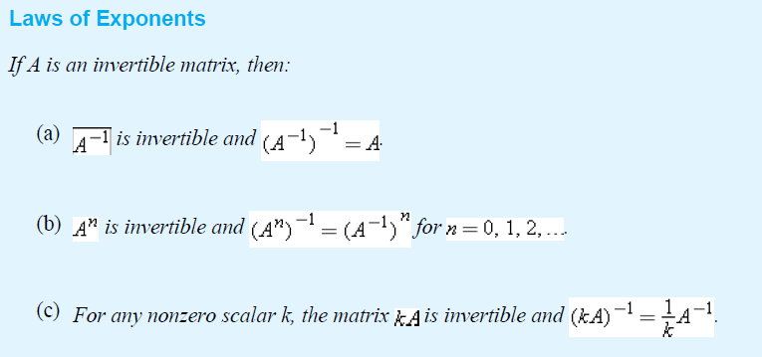
Laws of Exponents
If A is a square matrix and r and s are integers, then

Slide 57
EXAMPLE 8 Powers of a Matrix
Let A and A⁻¹be as in Example 7; that is,
Then

Slide 59
EXAMPLE 9 Matrix Polynomial
If
then

Slide 60
Properties of the Transpose
If the sizes of the matrices are such that the stated operations can be performed, then
(a)
(b) and
(c) , where k is any scalar
(d)

Slide 61
Invertibility of a Transpose
THEOREM 1.4.10
If A is an invertible matrix, then A^{T} is also invertible and
EXAMPLE 10 Verifying Theorem 1.4.10
Consider the matrices
Applying Theorem 1.4.5 yields

Slide 62
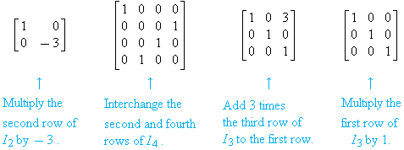
ELEMENTARY MATRICES AND A METHOD FOR
FINDING A⁻¹
DEFINITION
An matrix nxn is called an elementary matrix if it can be obtained from the nxn identity matrix I_{n}by performing a single
elementary row operation.
EXAMPLE 1 Elementary Matrices and Row Operations
Listed below are four elementary matrices and the operations that produce them.
When a matrix A is multiplied on the left by an elementary matrix E, the effect is to perform an elementary row operation on A.

Slide 63
THEOREM 1.5.1
Row Operations by Matrix Multiplication
If the elementary matrix E results from performing a certain row operation on I_{m} and if A is an mxn matrix, then the product EA
is the matrix that results when this same row operation is performed on A.

Slide 64
EXAMPLE 2 Using Elementary Matrices
Consider the matrix
and consider the elementary matrix
which results from adding 3 times the first row of I₃ to the third row. The product EA is
which is precisely the same matrix that results when we add 3 times the first row of A to the third row.

Slide 65
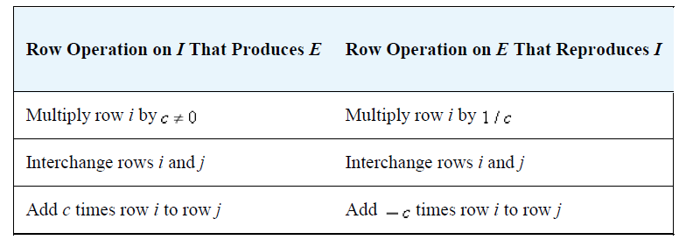

Slide 66
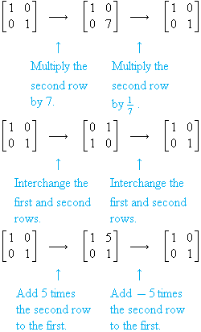
EXAMPLE 3 Row Operations and Inverse Row Operations

Slide 67
THEOREM 1.5.2
Every elementary matrix is invertible, and the inverse is also an elementary matrix.
THEOREM 1.5.3 Equivalent Statements
If A is an nxn matrix, then the following statements are equivalent, that is, all true or all false.
(a) A is invertible.
(b) Ax=0 has only the trivial solution.
(c) The reduced row-echelon form of A is I_{n} .
(d) A is expressible as a product of elementary matrices.

Slide 68
A Method for Inverting Matrices
To find the inverse of an invertible matrix A, we must find a sequence of elementary row operations that reduces A to the identity and then perform this same sequence of operations on I_{n} to obtain A⁻¹ .
EXAMPLE 4 Using Row Operations to Find A⁻¹
Find the inverse of

Slide 69
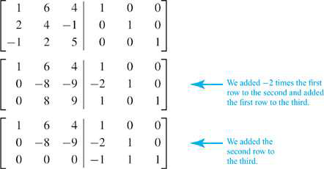
EXAMPLE 5 Showing That a Matrix Is Not Invertible
Consider the matrix
Applying the procedure of Example 4 yields
Since we have obtained a row of zeros on the left side, A is not invertible.

Slide 70
EXAMPLE 6 A Consequence of Invertibility
In Example 4 we showed that
is an invertible matrix. From Theorem 3, it follows that the homogeneous system
has only the trivial solution.

Slide 71
FURTHER RESULTS ON SYSTEMS OF EQUATIONS AND INVERTIBILITY
THEOREM 1.6.1
Every system of linear equations has no solutions, or has exactly one solution, or has infinitely many solutions.
THEOREM 1.6.2
If A is an invertible nxn matrix, then for nx1 each matrix b, the system of equations Ax=b has exactly one solution, namely ,
x= A⁻¹b.

Slide 72
EXAMPLE 1 Solution of a Linear System Using A⁻¹
Consider the system of linear equations
In matrix form this system can be written as Ax=b , where
In Example 4 of the preceding section, we showed that A is invertible and
By Theorem 1.6.2, the solution of the system is

Slide 73
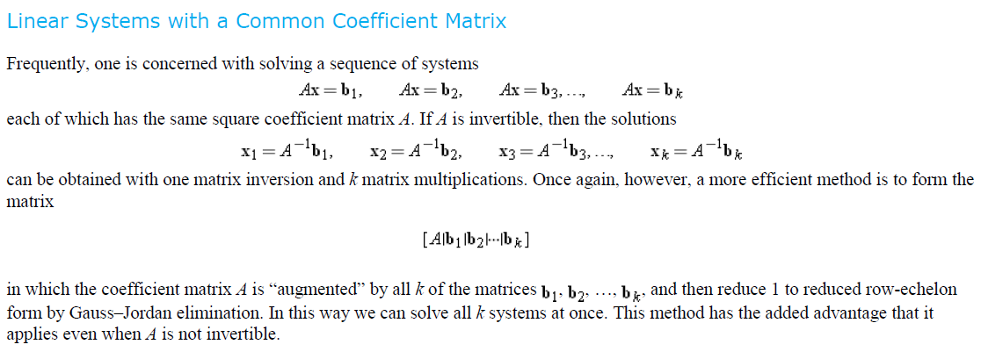

Slide 74
EXAMPLE 2 Solving Two Linear Systems at Once
Solve the systems
(a)
(b)

Slide 75
Properties of Invertible Matrices
THEOREM 1.6.3
Let A be a square matrix.
(a) If B is a square matrix satisfying AB=I , then B= A⁻¹ .
(b) If B is a square matrix satisfying BA=I , then B= A⁻¹ .

Slide 77
THEOREM 1.6.5
Let A and B be square matrices of the same size. If AB is invertible, then A and B must also be invertible.

Slide 78
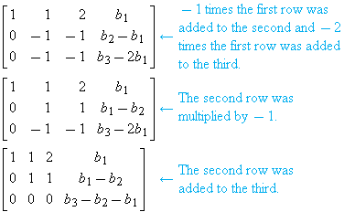
The augmented matrix is
which can be reduced to row-echelon form as follows:

Slide 79
To express this condition another way, Ax=b is consistent if and only if b is a matrix of the form

Slide 80
DIAGONAL, TRIANGULAR, AND SYMMETRIC MATRICES
Diagonal Matrices
A square matrix in which all the entries off the main diagonal are zero is called a diagonal matrix. Here are some examples:
A general diagonal matrix D can be written as

Slide 81
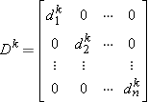
A diagonal matrix is invertible if and only if all of its diagonal entries are nonzero; in this case the inverse of 1 is
The reader should verify that .
Powers of diagonal matrices are easy to compute; we leave it for the reader to verify that if D is the diagonal matrix 1 and k is a
positive integer, then

Slide 82
EXAMPLE 1 Inverses and Powers of Diagonal Matrices
If
then

Slide 83
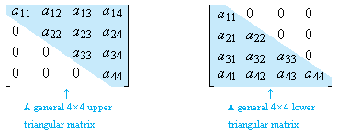
Triangular Matrices
A square matrix in which all the entries above the main diagonal are zero is called lower triangular, and a square matrix in
which all the entries below the main diagonal are zero is called upper triangular. A matrix that is either upper triangular or
lower triangular is called triangular.
EXAMPLE 2 Upper and Lower Triangular Matrices

Slide 84
THEOREM 1.7.1
(a) The transpose of a lower triangular matrix is upper triangular, and the transpose of an upper triangular matrix is
lower triangular.
(b) The product of lower triangular matrices is lower triangular, and the product of upper triangular matrices is upper
triangular.
(c) A triangular matrix is invertible if and only if its diagonal entries are all nonzero.
(d) The inverse of an invertible lower triangular matrix is lower triangular, and the inverse of an invertible upper
triangular matrix is upper triangular.

Slide 85
EXAMPLE 3 Upper Triangular Matrices
Consider the upper triangular matrices
The matrix A is invertible, since its diagonal entries are nonzero, but the matrix B is not. We leave it for the reader to calculate
the inverse of A
This inverse is upper triangular, as guaranteed by part (d) of Theorem 1.7.1.

Slide 86
This product is upper triangular, as guaranteed by part (b) of Theorem 1.7.1.

Slide 87
EXAMPLE 4 Symmetric Matrices
The following matrices are symmetric, since each is equal to its own transpose .
It is easy to recognize symmetric matrices by inspection: The entries on the main diagonal may be arbitrary, but as shown in
2,“mirror images” of entries across the main diagonal must be equal.
5

Slide 88
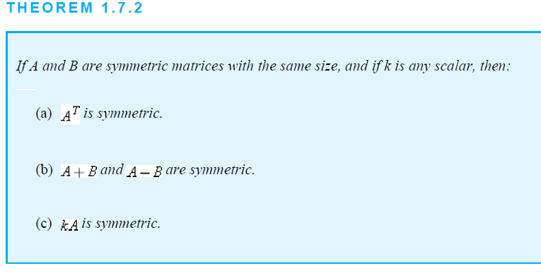

Slide 89
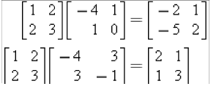
EXAMPLE 5 Products of Symmetric Matrices
The first of the following equations shows a product of symmetric matrices that is not symmetric, and the second shows a product of symmetric matrices that is symmetric. We conclude that the factors in the first equation do not commute, but those in the second equation do.
The product of two symmetric matrices is symmetric if and only if the matrices commute.
THEOREM 1.7.3
If A is an invertible symmetric matrix, then A⁻¹ is symmetric.

Slide 90
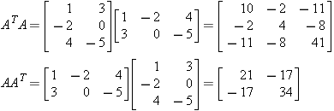
EXAMPLE 6 The Product of a Matrix and Its Transpose Is Symmetric
Let A be the 2x3 matrix
Then
Observe that and are symmetric as expected.

Slide 91
THEOREM 1.7.4

Slide 92
1.9 Applications of Linear Systems
There is generally some numerical measure of the rate at which the medium flows through a branch. For example, the flow rate of electricity is often measured in amperes.
In most networks, the branches meet at points, called nodes or junctions, where the flow divides.

Slide 93
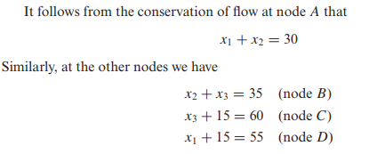
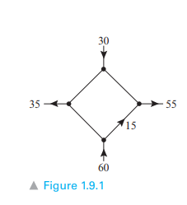
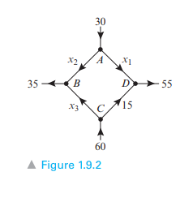
EXAMPLE : Network Analysis Using Linear Systems
Figure 1.9.1 shows a network with four nodes in which the flow rate and direction of flow in certain branches are known. Find the flow rates and directions of flow in the remaining branches.

Slide 94
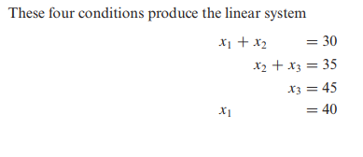

Slide 95
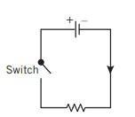
Electrical Circuits

Slide 96
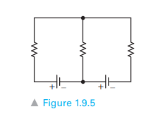
Closed loops
A typical electrical network will have multiple batteries and resistors joined by some configuration of wires. A point at which three or more wires in a network are joined is called a node (or junction point). A branch is a wire connecting two nodes, and a closed loop is a succession of connected branches that begin and end at the same node. For example, the electrical network in Figure 1.9.5 has two nodes and three closed loops two inner loops and one outer loop.

Slide 97
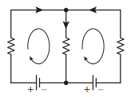
Kirchhoff’s Laws

Slide 99
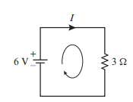
EXAMPLE : A Circuit with One Closed Loop
Determine the current I in the circuit shown in Figure
3I = 6

Slide 100
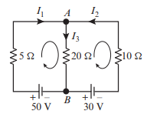
EXAMPLE : A Circuit with Three Closed Loops
Determine the currents I₁, I₂, and I₃ in the circuit shown in Figure

Slide 102
I₁ = 6, I₂ = −5, and I₃ = 1.

