Slide 1
Creating Stored Procedures and Functions

Slide 2
Objectives
• Differentiate between anonymous blocks and subprograms
• Create a simple procedure and invoke it from an anonymous block
• Create a simple function
• Create a simple function that accepts a parameter
• Differentiate between procedures and functions

Slide 6
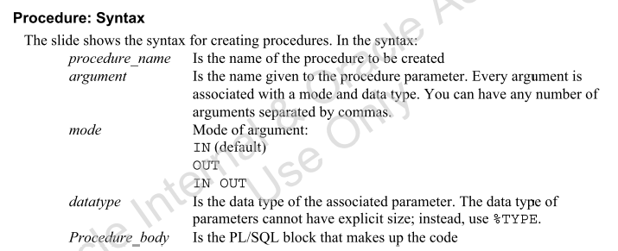

Slide 10
