Slide 1
Phys 110 Chapter 12 Elasticity

Slide 2
LECTURE OUTLINE
12.4 Elastic Properties of Solids
Stress
Strain
Elastic modulus
Young’s modulus
Shear modulus
Bulk modulus

Slide 3
We can describe the elastic properties of a substance using the concepts of stress and strain .
Stress is a quantity that is proportional to the force causing a deformation
Stress is the external force acting on an object per unit cross-sectional area.
The result of a stress is strain, which is a measure of the degree of deformation.
Strain is proportional to stress; the constant of proportionality is called the elastic modulus.
The elastic modulus is therefore deﬁned as the ratio of the stress to the resulting strain:
.

Slide 4
We consider three types of deformation and deﬁne an elastic modulus
for each:

Slide 5
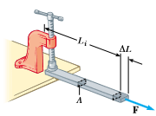
Young’s modulus: Elasticity in Length

Slide 6
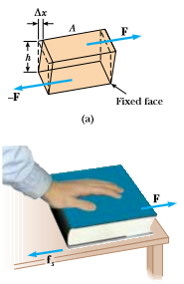
Shear modulus : Elasticity of Shape

Slide 7
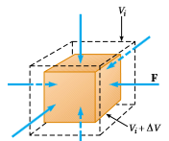
Bulk modulus : Volume Elasticity

Slide 8
Quick Quiz 12.4
A block of iron is sliding across a horizontal ﬂoor. The friction force between the block and the ﬂoor causes the block to deform. To describe the relationship between stress and strain for the block, you would use (a) Young’s modulus (b) shear modulus (c) bulk modulus (d) none of these.
Quick Quiz 12.5
A trapeze artist swings through a circular arc. At the bottom of the swing, the wires supporting the trapeze are longer than when the trapeze artist simply hangs from the trapeze, due to the increased tension in them. To describe the relationship between stress and strain for the wires, you would use (a) Young’s modulus (b) shear modulus (c) bulk modulus (d) none of these.
Quick Quiz 12.6
A spacecraft carries a steel sphere to a planet on which atmospheric pressure is much higher than on the Earth. The higher pressure causes the radius of the sphere to decrease. To describe the relationship between stress and strain for the sphere, you would use (a) Young’s modulus (b) shear modulus (c) bulk modulus (d) none of these.

Slide 9
12.4 (b). The friction force on the block as it slides along the surface is parallel to the lower surface and will cause the block to undergo a shear deformation.
12.5 (a). The stretching of the wire due to the increased tension is described by Young’s modulus.
12.6 (c). The pressure of the atmosphere results in a force of uniform magnitude perpendicular at all points on the surface of the sphere.

Slide 10
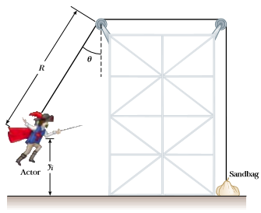
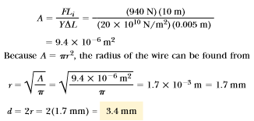
Example 12.6:
As shown in figure below a cable used to support an actor as he swung onto the stage. Suppose that the tension in the cable is 940 N as the actor reaches the lowest point. What diameter should a 10-m-long steel wire have if we do not want it to stretch more than 0.5 cm under these conditions?

Slide 11
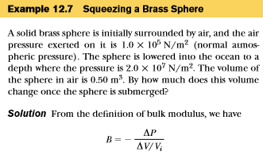
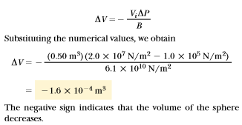

Slide 12
Problems
27. A 200-kg load is hung on a wire having a length of 4.00 m, cross-sectional area 0.200 x 10⁴ m², and Young’s modulus 8.00 x 10¹⁰ N/m². What is its increase in length?

Slide 13
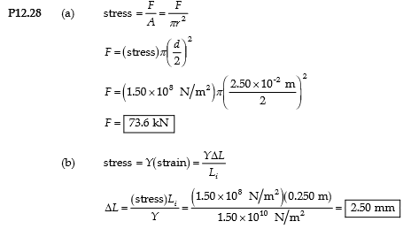

Slide 14
31. A child slides across a ﬂoor in a pair of rubber-soled shoes. The friction force acting on each foot is 20.0 N. The footprint area of each shoe sole is 14.0 cm², and the thickness of each sole is 5.00 mm. Find the horizontal distance by which the upper and lower surfaces of each sole are offset. The shear modulus of the rubber is 3.00 MN/m².

Slide 15
35. When water freezes, it expands by about 9.00%. What pressure increase would occur inside your automobile engine block if the water in it froze? (The bulk modulus of ice is 2.00x10⁹ N/m².)

Slide 16
36. The deepest point in the ocean is in the Mariana Trench, about 11 km deep. The pressure at this depth is huge, about 1.13 x 10⁸ N/m². (a) Calculate the change in volume of 1.00 m³ of seawater carried from the surface to this deepest point in the Paciﬁc ocean. (b) The density of seawater at the surface is 1.03 x 10³ kg/m³. Find its density at the bottom.

