Slide 1
Chapter 1 Physics and Measurement

Slide 2
LECTURE OUTLINE
1.1 Standards of Length, Mass, and Time
1.3 Density and Atomic Mass
1.4 Dimensional Analysis
1.5 Conversion of Units

Slide 3
1.1 Standards of Length, Mass, and Time
In mechanics, there are three basic quantities: length, mass, and time
All other quantities in mechanics can be expressed in terms of these three.
In1960, an international committee established a set of standards for the fundamental quantities of science. It is called the SI (Système International)
In the SI:
Units of length: meter (m)
Units of mass : kilogram (Kg)
Units of time : second (s)

Slide 4
In many situations, you may have to derive or check a specific equation. A useful and powerful procedure called dimensional analysis can be used to assist in the derivation or to check your final expression.
As a simple method:
Left Hand Side must = Right Hand Side

Slide 5
Some Prefixes for Powers Used with “Metric” (SI and cgs) Units
Power | Prefix | Abbreviation
10¹⁸ | Exa | E
10¹⁵ | Peta | P
10¹² | Tera or Viga | T or V
10⁹ | Giga | G
10⁶ | Mega | M
10³ | Kilo | K
10¹ | Deca | D
10⁰ =1 | xxxxxxxx
10⁻¹ | deci | d
10⁻² | centi | c
10⁻³ | milli | m
10⁻⁶ | micro | µ
10⁻⁹ | nano | n
10⁻¹² | pico | p
10⁻¹⁵ | femto | f
10⁻¹⁸ | atto | a

Slide 6
1.3 Density and Atomic Mass
The density of a substance is deﬁned as its mass per unit volume: ρ = m/V
Different substances have different densities mainly because of differences in their atomic masses and atomic arrangements.
The numbers of protons and neutrons in the nucleus of an atom of an element are related to the atomic mass of the element, which is deﬁned as the mass of a single atom of the element measured in atomic mass units (u) where:
1 u = 1.660 538 7 × 10 ⁻²⁷ kg.

Slide 7
As an Example: the atomic mass of lead is 207 u and that of aluminum is 27.0 u.
Example 1.1: A solid cube of aluminum (density 2.70 g/cm³) has a volume of 0.200 cm³. It is known that 27.0 g of aluminum contains 6.02 ×10²³ atoms. How many aluminum atoms are contained in the cube?
Solution: Because density equals mass per unit volume, the mass of the cube is:
m = ρ V = (2.70 g/cm³)(0.200 cm³) = 0.540 g
,$N=\frac{m N_{A}}{M_{w} }=\frac{0.540×6.02×{10}^{23} }{27.0 } = 1.20×{10}^{22}atoms$

Slide 8
1.4 Dimensional Analysis
Dimension: it denotes the physical nature of a quantity
Example: distance: could be in meters, yards, or micrometers. But over all it is: a length.
In 1960, an international committee agreed on a standard system of units for the fundamental quantities of science, called SI (Système International). Its units of length (meter), mass (kilogram) and time are the meter (second):(mks units).
Symbols we are going to use are:
dimension of length: [L]
dimension of mass: [M]
dimension of time: [T]

Slide 9
Quantity | Abbreviation | Unit
Length or Distance | Ɩ, x, d, r, h | m
Mass | m | Kg
time | t | S
Force | F= mg | Newton | kg m/s²
Capacitance | C | Farad
Charge | Q, q | Coulomb
Temperature | T | ºC, K, ºF
Energy | K (KE), U (PE) | Joule | kg m²/s²

Slide 10
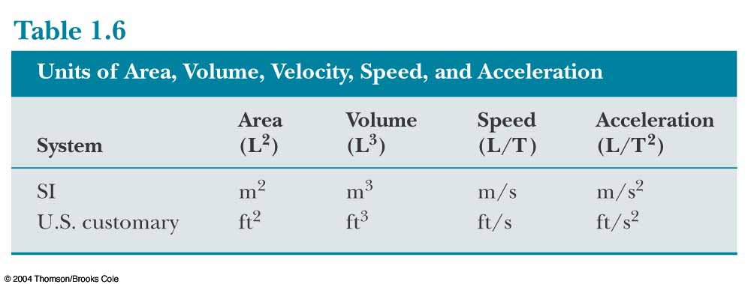

Slide 11
1.4 Dimensional Analysis
Example: Use dimensional analysis to check the equation:
$$x=\frac{1}{2}at^{2}$$
Solution:
$$L=\frac{L}{T^{2}}.T^{2}=L$$
Example: Show that $v=at$ is dimensionally correct.
Solution:
L.H.S.:$\left[v\right]=\frac{L}{T} and R.H.S \left[at\right]=\frac{L}{T^{2}}.T =\frac{L}{T}$
L.H.S=R.H.S
So the equation is dimensionally correct

Slide 12
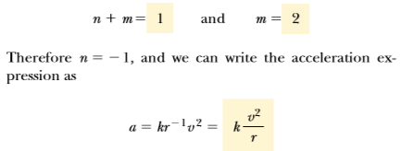
Example 1.3: Suppose we are told that the acceleration a of a particle moving with uniform speed v in a circle of radius r is proportional to some power of r, say r^{n}, and some power of v, say v^{m}. Determine the values of n and m and write the simplest form of an equation for the acceleration.
Solution: Let us take a to be:
a = k r^{n} v^{m}
where k is a dimensionless constant of proportionality. Knowing the dimensions of a, r, and v, we see that the dimensional equation must be:

Slide 13
PROBLEMS (H.W)
Section 1.4 Dimensional Analysis
13. The position of a particle moving under uniform acceleration is some function of time and the acceleration. Suppose we write this position
$$S=ka^{m}t^{n}$$
where k is a dimensionless constant. Show by dimensional analysis that this expression is satisfied if m = 1 and n = 2. Can this analysis give the value of k?

Slide 14
PROBLEMS
Section 1.4 Dimensional Analysis
15. The position of a particle moving under uniform
Which of the following equations are dimensionally correct?
$v_{f}=v_{i}+ax$
$y=\left(2m\right)\cos\left(kx\right), where k=2m^{−1}$

Slide 15
1.5 Conversion of Units
Other Unit System
U.S. customary system: foot, slug, second
Cgs system: cm, gram, second
We will use SI units in this course, but it is useful to know conversions between systems.
1 mile = 1609 m = 1.609 km 1 ft = 0.3048 m = 30.48 cm
1 m = 39.37 in. = 3.281 ft 1 in. = 0.0254 m = 2.54 cm
1 lb = 0.465 kg 1 oz = 28.35 g 1 slug = 14.59 kg
1 day = 24 hours = 24 * 60 minutes = 24 * 60 * 60 seconds
More can be found in Appendices A & D in your textbook.

Slide 16
PROBLEMS
Section 1.5 Conversion of Units
21. A rectangular building lot is 100 ft by 150 ft. Determine the area of this lot in m².
……………………………………………………………25. A solid piece of lead has a mass of 23.94 g and a volume of 2.10 cm³. From these data, calculate the density of lead in SI units (kg/m³).
……………………………………………………………31. One gallon of paint (volume=3.78 ×10⁻³ m³) covers an area of 25.0 m². What is the thickness of the paint on the wall?

