Slide 1
Database Security

Slide 2
Database Security
Multi-user database systems like Oracle include security to control how the database is accessed and used for example security Mechanisms:
Prevent unauthorized database access
Prevent unauthorized access to schema objects
Control disk usage
Audit user actions

Slide 3
Database security
Data security
system security

Slide 4
System Security
covers access and use of the database at the system level, such as:
the username and password
the disk space allocated to users,
and the system operations that users can perform

Slide 5
Data security
covers access and use of the database objects and the actions that those users can have on the objects such as selecting data from a table or retrieving a value from a sequence

Slide 6
Privileges
Privileges are the right to execute particular SQL statements. The database administrator (DBA) is a high-level user with the ability to grant users access to the database and its objects
System privileges: Gaining access to the database
Object privileges: Manipulating the content of the database objects

Slide 7
schema
A schema is a collection of objects, such as tables, views, and sequences.
The schema is owned by a database user and has the same name as that user.

Slide 8
System Privileges
More than 100 privileges are available. • The database administrator has high-level system privileges for tasks such as: – Creating new users – Removing users – Removing tables – Backing up tables

Slide 9
Operations Authorized | System Privilege
Grantee can create other Oracle users (a privilege required for a DBA role). | CREATE USER
Grantee can drop another user. | DROP USER
Grantee can drop a table in any schema. | DROP ANY TABLE
Grantee can back up any table in any schema with the export utility | BACKUP ANY TABLE
Grantee can create tables in any schema. | CREATE ANY TABLE
Grantee can query tables, views, or snapshots in any schema | SELECT ANY TABLE

Slide 10
Creating Users
The DBA creates the user by executing the CREATE USER statement.
The user does not have any privileges at this point.
The DBA can then grant privileges to that user.
These privileges determine what the user can do at the database level.

Slide 11
Creating Users
The syntax for creating a user is:
CREATE USER user
IDENTIFIED BY password
DEFAULT TABLESPACE system
TEMPORARY TABLESPACE temp
QUOTA UNLIMITED on system;
Example:
CREATE USER demo
IDENTIFIED BY demo
DEFAULT TABLESPACE system
TEMPORARY TABLESPACE temp
QUOTA UNLIMITED on system;
User created.

Slide 12
User System Privileges
Once a user is created, the DBA can grant specific system privileges to a user. GRANT privilege TO user; • An application developer, for example, may have the following system privileges: – CREATE SESSION – CREATE TABLE – CREATE SEQUENCE – CREATE VIEW – CREATE PROCEDURE

Slide 13
User System Privileges

Slide 14
Granting System Privileges
The DBA can grant a user specific system privileges. Example:
GRANT create session, create table, create sequence, create view TO Demo;

Slide 15
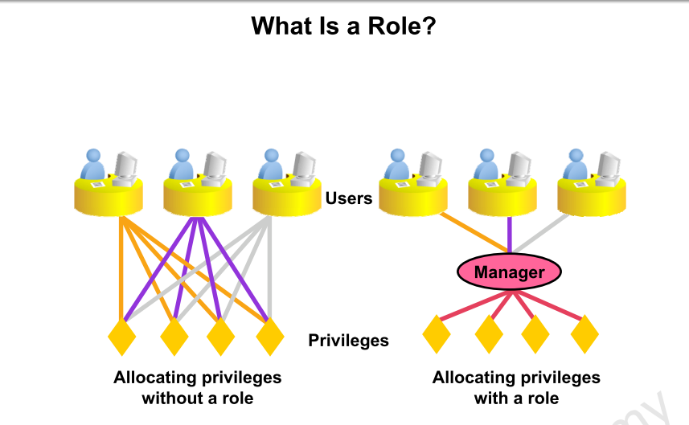

Slide 16
What Is a Role?
A role is a named group of related privileges that can be granted to the user.
This method makes it easier to revoke and maintain privileges.
user can have access to several roles, and several users can be assigned the same role

Slide 17
Creating and Assigning a Role
First, the DBA must create the role. Then the DBA can assign privileges to the role and users to the role. Syntax CREATE ROLE role;

Slide 18
Creating and Granting Privileges to a Role
Create a role CREATE ROLE manager;
Grant privileges to a role GRANT create table, create view TO manager;
Grant a role to users GRANT manager TO Maha, Nora;

Slide 19
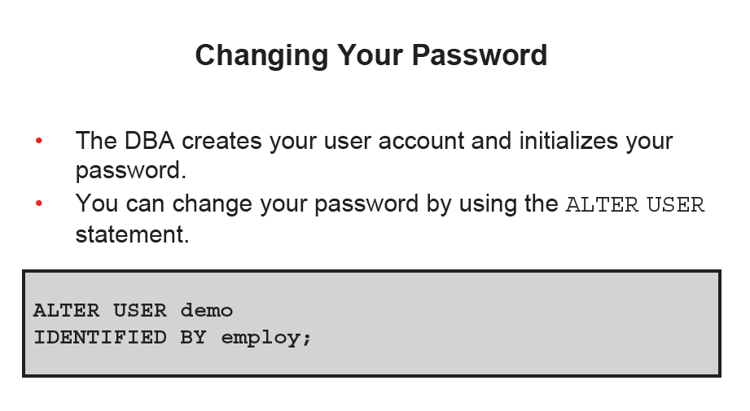

Slide 20
Object Privileges
An object privilege is a privilege or right to perform a particular action on a specific (object) table, view, sequence, or procedure
Each object has a particular set of grantable privileges. The table in the next slide lists the privileges for various objects

Slide 21
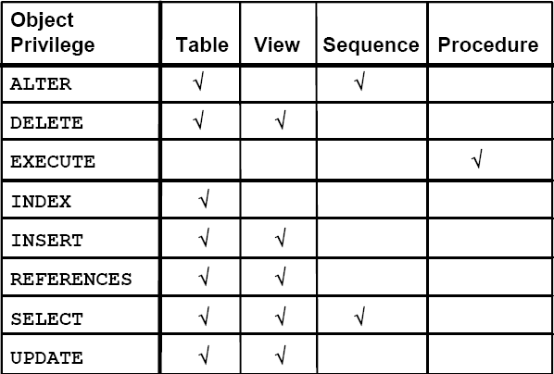
Object Privileges

Slide 22
Object Privileges
Object privileges vary from object to object.
An owner has all the privileges on the object.
An owner can give specific privileges on that owner’s object.
Syntax:
GRANT object_privilege [(columns)] ON object TO user [WITH GRANT OPTION];
If the grant includes WITH GRANT OPTION, then the grantee can further grant the object privilege to other users; otherwise, the grantee can use the privilege but cannot grant it to other users.

Slide 23
Granting Object Privileges
Grant query privileges on the EMPLOYEES table. GRANT select ON employees TO norah, sarah; • Grant privileges to update specific columns to users and roles. GRANT update (department_name, location_id) ON departments TO demo, manager;

Slide 24
Using the WITH GRANT OPTION and PUBLIC Keywords
Give a user authority to pass along privileges. GRANT select, insert ON departments TO demo WITH GRANT OPTION; • Allow all users on the system to query data from Alice’s DEPARTMENTS table. GRANT select ON alice.departments TO PUBLIC;

Slide 25
Guidelines
To grant privileges on an object, the object must be in your own schema, or you must have been granted the object privileges WITH GRANT OPTION . • An object owner can grant any object privilege on the object to any other user or role of the database. • The owner of an object automatically acquires all object privileges on that object.

Slide 26
How to Revoke Object Privileges
Remove privileges granted to other users by using the REVOKE statement. When you use the REVOKEstatement you prevent the user from doing specific actions depending on the privileges you revoke from the user.

Slide 27
How to Revoke Object Privileges
Syntax:
REVOKE privilege ,ALL
ON object FROM user,role,PUBLIC; Example:
REVOKE select, insert ON departments FROM demo;

Slide 28
How to Revoke Object Privileges
Privileges granted to others through the WITH GRANT OPTION clause are also revoked.
For example, if user A grants SELECT privilege on a table to user B including the WITH GRANT OPTION clause, user B can grant to user C the SELECT privilege with the WITH GRANT OPTION clause as well, and user C can then grant to user D the SELECT privilege. If user A revokes privilege from user B, then the privileges granted to users C and D are also revoked.

