Slide 1
Cryptography and Network Security
Chapter 9 - Public-Key Cryptography
Fifth Edition
by William Stallings
Lecture slides by Lawrie Brown
Notes:
Lecture slides by Lawrie Brown for “Cryptography and Network Security”, 5/e, by William Stallings, Chapter 9 – “Public Key Cryptography and RSA”.

Slide 2
Why Public-Key Cryptography?
developed to address two key issues:
  key distribution – how to have secure communications in general without having to trust a KDC with your key
  digital signatures – how to verify a message comes intact from the claimed sender
public invention due to Whitfield Diffie & Martin Hellman at Stanford Uni in 1976
  known earlier in classified community
Notes:
The concept of public-key cryptography evolved from an attempt to attack two of the most difficult problems associated with symmetric encryption: key distribution and digital signatures. The first problem is that of key distribution, which under symmetric encryption requires either (1) that two communicants already share a key, which somehow has been distributed to them; or (2) the use of a key distribution center. This seemed to negated the very essence of cryptography: the ability to maintain total secrecy over your own communication. The second was that of "digital signatures." If the use of cryptography was to become widespread, not just in military situations but for commercial and private purposes, then electronic messages and documents would need the equivalent of signatures used in paper documents.
The idea of public key schemes, and the first practical scheme, which was for key distribution only, was published in 1976 by Diffie & Hellman. The concept had been previously described in a classified report in 1970 by James Ellis (UK CESG) - and subsequently declassified [ELLI99]. Its interesting to note that they discovered RSA first, then Diffie-Hellman, opposite to the order of public discovery! There is also a claim that the NSA knew of the concept in the mid-60’s [SIMM93].

Slide 3
Public-Key Cryptography
Symmetric algorithms used same secret key for encryption and decryption
Asymmetric algorithms in public-key cryptography use one key for encryption and different but related key for decryption
Characteristics of asymmetric algorithms:
  Require: Computationally infeasible to determine
  decryption key given only algorithm and encryption key
  Optional: Either of two related keys can be used for
  encryption, with other used for decryption
Notes:
Will now discuss the radically different public key systems, in which two keys are used. Public-key cryptography provides a radical departure from all that has gone before. The development of public-key cryptography is the greatest and perhaps the only true revolution in the entire history of cryptography. It is asymmetric, involving the use of two separate keys, in contrast to symmetric encryption, that uses only one key. Anyone knowing the public key can encrypt messages or verify signatures, but cannot decrypt messages or create signatures, counter-intuitive though this may seem. The use of two keys has profound consequences in the areas of confidentiality, key distribution, and authentication. It works by the clever use of number theory problems that are easy one way but hard the other. Note that public key schemes are neither more nor less secure than private key (security depends on the key size for both), nor do they replace private key schemes (they are too slow to do so), rather they complement them. Both also have issues with key distribution, requiring the use of some suitable protocol.

Slide 4
Keys of Public-Key Cryptography
public-key/two-key/asymmetric cryptography involves the use of two keys:
  a public-key, which may be known by anybody, and can be used to encrypt messages, and verify signatures
  a related private-key, known only to the recipient, used to decrypt messages, and sign (create) signatures
infeasible to determine private key from public
is asymmetric because
  those who encrypt messages or verify signatures cannot decrypt messages or create signatures
Notes:
Asymmetric algorithms rely on one key for encryption and a different but related key for decryption. These algorithms have the following important characteristic:
• It is computationally infeasible to determine the decryption key given only knowledge of the cryptographic algorithm and the encryption key.
In addition, some algorithms, such as RSA, also exhibit the following characteristic:
• Either of the two related keys can be used for encryption, with the other used for decryption.
Anyone knowing the public key can encrypt messages or verify signatures, but cannot decrypt messages or create signatures, thanks to some clever use of number theory.

Slide 5
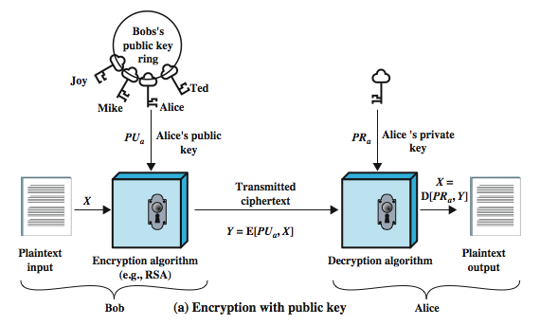
Public-Key Cryptography
For confidentiality
Notes:
Stallings Figure 9.1a “Public-Key Cryptography”, shows that a public-key encryption scheme has six ingredients:
• Plaintext: the readable message /data fed into the algorithm as input.
• Encryption algorithm: performs various transformations on the plaintext.
• Public and private keys: a pair of keys selected so that if one is used for encryption, the other is used for decryption. The exact transformations performed by the algorithm depend on the public or private key that is provided as input.
• Ciphertext: the scrambled message produced as output. It depends on the plaintext and the key. For a given message, two different keys will produce two different ciphertexts.
• Decryption algorithm: accepts the ciphertext and matching key and produces the original plaintext.
Consider the following analogy using padlocked boxes: traditional schemes involve the sender putting a message in a box and locking it, sending that to the receiver, and somehow securely also sending them the key to unlock the box. The radical advance in public key schemes was to turn this around, the receiver sends an unlocked box (their public key) to the sender, who puts the message in the box and locks it (easy - and having locked it cannot get at the message), and sends the locked box to the receiver who can unlock it (also easy), having the (private) key. An attacker would have to pick the lock on the box (hard).

Slide 6
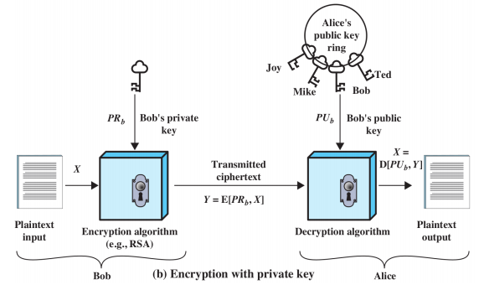
Public-Key Cryptography
For authentication

Slide 7
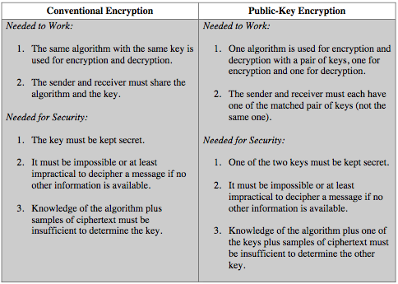
Symmetric vs Public-Key
Notes:
Stallings Table 9.2 summarizes some of the important aspects of symmetric and public-key encryption. To discriminate between the two, we refer to the key used in symmetric encryption as a secret key. The two keys used for asymmetric encryption are referred to as the public key and the private key. Invariably, the private key is kept secret, but it is referred to as a private key rather than a secret key to avoid confusion with symmetric encryption.

Slide 8
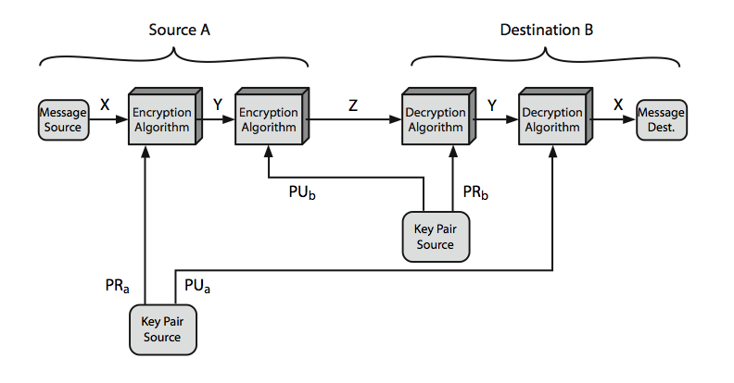
Public-Key Cryptosystems
Notes:
Stallings Figure 9.4 “Public-Key Cryptosystems: Secrecy and Authentication” illustrates the essential elements of a public-key encryption scheme.
Note that public-key schemes can be used for either secrecy or authentication, or both (as shown here). There is some source A that produces a message in plaintext X The M elements of X are letters in some finite alphabet. The message is intended for destination B. B generates a related pair of keys: a public key, PUb, and a private key, PRb. PRb is known only to B, whereas PUb is publicly available and therefore accessible by A. With the message X and the encryption key PUb as input, A forms the ciphertext Y = E(PUb, X) The intended receiver, in possession of the matching private key, is able to invert the transformation: X = D(PRb, Y) An adversary, observing Y and having access to PUb, but not having access to PRb or X, must attempt to recover X and/or PRb. This provides confidentiality. Can also use a public-key encryption to provide authentication: Y = E(PRa, X); X = D(PUa, Y) To provide both the authentication function and confidentiality have a double use of the public-key scheme (as shown here): Z = E(PUb, E(PRa, X)) X = D(PUa, D(PRb, Z)) In this case, separate key pairs are used for each of these purposes. The receiver owns and creates secrecy keys, sender owns and creates authentication keys.
In practice typically DO NOT do this, because of the computational cost of public-key schemes. Rather encrypt a session key which is then used with a block cipher to encrypt the actual message, and separately sign a hash of the message as a digital signature - this will be discussed more later.

Slide 9
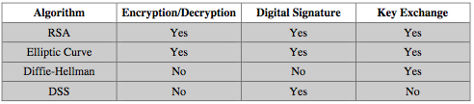
Public-Key Applications
can classify uses into 3 categories:
  encryption/decryption (provide secrecy)
  digital signatures (provide authentication)
  key exchange (of session keys)
some algorithms are suitable for all uses, others are specific to one
Notes:
Public-key systems are characterized by the use of a cryptographic type of algorithm with two keys. Depending on the application, the sender uses either the sender’s private key or the receiver’s public key, or both, to perform some type of cryptographic function. In broad terms, we can classify the use of public-key cryptosystems into the three categories:
• Encryption/decryption: The sender encrypts a message with the recipient’s public key.
• Digital signature: The sender “signs” a message with its private key, either to the whole message or to a small block of data that is a function of the message.
• Key exchange: Two sides cooperate to exchange a session key. Several different approaches are possible, involving the private key(s) of one or both parties.
Some algorithms are suitable for all three applications, whereas others can be used only for one or two of these applications. Stallings Table 9.3 (shown here) indicates the applications supported by the algorithms discussed in this book.

Slide 10


Public-Key Requirements
  Computationally easy for B to generate pair (PU_{b},PR_{b})
  Computationally easy for A, knowing PUb and message M, to generate ciphertext:
  Computationally easy for B to decrypt ciphertext using
  PRb:
  computationally infeasible for attacker, knowing PU_{b} and C, to determine PR_{b}
  Computationally infeasible for attacher, knowing PU_{b} and C, to determine M
  (Optional) Two keys can be applied in either order:
Notes:
The cryptosystem illustrated in Figures 9.2 through 9.4 depends on a cryptographic algorithm based on two related keys. Diffie and Hellman postulated this system without demonstrating that such algorithms exist. However, they did lay out the conditions that such algorithms must fulfill:
It is computationally easy for a party B to generate a pair (public key PUb, private key PRb).
It is computationally easy for a sender A, knowing the public key and the message to be encrypted, M, to generate the corresponding ciphertext: C = E(PUb, M)
It is computationally easy for the receiver B to decrypt the resulting ciphertext using the private key to recover the original message: M = D(PRb, C) = D[PRb, E(PUb, M)
It is computationally infeasible for an adversary, knowing the public key, Pb, to determine the private key, PRb
It is computationally infeasible for an adversary, knowing the public key, Pb, and a ciphertext, C, to recover the original message, M.
(optional) The two keys can be applied in either order:
M = D[PU , E(PR, M)] = D[PR, E(PU, M)]
These are formidable requirements, as evidenced by the fact that only a few algorithms (RSA, elliptic curve cryptography, Diffie-Hellman, DSS) have received widespread acceptance in the several decades since the concept of public-key cryptography was proposed.

Slide 11
Public-Key Requirements
need a trapdoor one-way function
one-way function has
  Y = f(X) easy
  X = f^{–1}(Y) infeasible
a trap-door one-way function has
  Y = f_{k}(X) easy, if k and X are known
  X = f_{k}^{–1}(Y) easy, if k and Y are known
  X = f_{k}^{–1}(Y) infeasible, if Y known but k not known
a practical public-key scheme depends on a suitable trap-door one-way function
Notes:
The requirements boil down to the need for a trap-door one-way function. A one-way function is one that maps a domain into a range such that every function value has a unique inverse, with the condition that the calculation of the function is easy whereas the calculation of the inverse is infeasible:
Y = f(X) easy
X = f^{–1}(Y) infeasible
Generally, easy is defined to mean a problem that can be solved in polynomial time as a function of input length. The term infeasible is a much fuzzier concept. In general, we can say a problem
Now consider a trap-door one-way function, which is easy to calculate in one direction and infeasible to calculate in the other direction unless certain additional information is known. With the additional information the inverse can be calculated in polynomial time. We can summarize as follows: A trap-door one-way function is a family of invertible functions f_{k}, such that:
Y = f_{k}(X) easy, if k and X are known
X = f_{k}^{–1}(Y) easy, if k and Y are known
X = f_{k}^{–1}(Y) infeasible, if Y known but k not known
Thus, the development of a practical public-key scheme depends on discovery of a suitable trap-door one-way function.

Slide 12
Security of Public Key Schemes
Brute Force Attacks
  Use large key to avoid brute force attacks
  Public key algorithms less efficient with larger keys
  Public-key cryptography mainly used for key management and signatures
Compute Private Key from Public Key
  No known feasible methods using standard computing
Probable-Message Attack
  Encrypt all possible M' using PU_{b}|for the C'that matches C, attacker knows M
  Only feasible of M is short
  Solution for short messages: append random bits to make it longer
Notes:
Public key schemes are no more or less secure than private key schemes - in both cases the size of the key determines the security. As with symmetric encryption, a public-key encryption scheme is vulnerable to a brute-force attack. The countermeasure is the same: Use large keys. However, there is a tradeoff to be considered. Public-key systems depend on the use of some sort of invertible mathematical function. The complexity of calculating these functions may not scale linearly with the number of bits in the key but grow more rapidly than that. Thus, the key size must be large enough to make brute-force attack impractical but small enough for practical encryption and decryption. In practice, the key sizes that have been proposed do make brute-force attack impractical but result in encryption/decryption speeds that are too slow for general-purpose use. Instead, as was mentioned earlier, public-key encryption is currently confined to key management and signature applications. Another form of attack is to find some way to compute the private key given the public key. To date, it has not been mathematically proven that this form of attack is infeasible for a particular public-key algorithm.
Note also that you can't compare key sizes - a 64-bit private key scheme has very roughly similar security to a 512-bit RSA - both could be broken given sufficient resources. But with public key schemes at least there is usually a firmer theoretical basis for determining the security since its based on well-known and well studied number theory problems.

Slide 13
RSA
Ron Rivest, Adi Shamir and Len Adleman
Created in 1978; RSA Security sells related products
Most widely used public-key algorithm
Block cipher: plaintext and ciphertext are integers
Notes:
RSA is the best known, and by far the most widely used general public key encryption algorithm, and was first published by Rivest, Shamir & Adleman of MIT in 1978 [RIVE78]. The Rivest-Shamir-Adleman (RSA) scheme has since that time reigned supreme as the most widely accepted and implemented general-purpose approach to public-key encryption. It is based on exponentiation in a finite (Galois) field over integers modulo a prime, using large integers (eg. 1024 bits). Its security is due to the cost of factoring large numbers.

Slide 14
The RSA Algorithm
Plaintext encrypted in blocks, each block binary value less than n
In practice, block size i bits where 2^{i} < n <= 2^{i+1}; n is 1024 bits
Encryption of plaintext M:
C = Me mod n
Decryption of ciphertext C:
M = C^{d} mod n= (Me)^{d} mod n = M^{ed} mod n
Sender A and receiver B know n; Sender A knows e;Receiver B knows d
PU_{b} = {e, n}, PR_{b} = {d,n}

Slide 15
RSA Requirements
Possible to fi nd values of e, d, n such that: M^{ed} mod n = M for all M < n
Easy to calculate Me mod n and C^{d} mod n for all values of M < n
Infeasible to determine d given e and n
Requirement 1 met if e and d are relatively prime
Choose primes p and q, and calculate:
      N=pq
      1 < e < ϕ(n)
      ed ≡1 (mod ϕ(n)) or d= e⁻¹ ⁽mod ϕ(n))
n and e are public; p, q and d are private

Slide 16
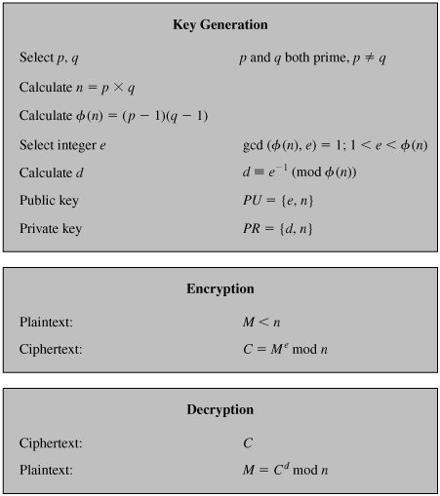
RSA algorithm
Notes:
The required moduls and exponent values are chosen during key setup. RSA key setup is done once (rarely) when a user establishes (or replaces) their public key, using the steps as shown. The exponent e is usually fairly small, just must be relatively prime to ø(n). Need to compute its inverse mod ø(n) to find d. It is critically important that the factors p & q of the modulus n are kept secret, since if they become known, the system can be broken. Note that different users will have different moduli n.

Slide 17
RSA Example - Key Setup
Select primes: p=17 & q=11
Calculate n = pq =17 x 11=187
Calculate ø(n)=(p–1)(q-1)=16x10=160
Select e: gcd(e,160)=1; choose e=7
Determine d: de=1 mod 160 and d < 160 Value is d=23 since 23x7=161= 10x160+1
Publish public key PU={7,187}
Keep secret private key PR={23,187}
Notes:
Stallings provides an example of RSA key generation using “trivial” sized numbers.
Selecting primes requires the use of a primality test.
Finding d as inverse of e mod ø(n) requires use of Euclid’s Inverse algorithm (see Ch4)

Slide 18
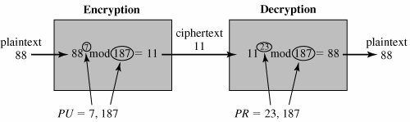
RSA Example - En/Decryption
http://www.calculatorpro.com/calculator/modulo-calculator/
sample RSA encryption/decryption is:
given message M = 88 (nb. 88<187)
encryption:
  C = 88⁷ mod 187 = 11
decryption:
  M = 11²³ mod 187 = 88
Notes:
Then show that the encryption and decryption operations are simple exponentiations mod 187.
Rather than having to laborious repeatedly multiply, can use the "square and multiply" algorithm with modulo reductions to implement all exponentiations quickly and efficiently (see next).

Slide 19
RSA Key Generation
Encryption and decryption require exponentiation
  Very large numbers; using properties of modular arithmetic makes it easier:
  [(a mod n) (b mod n)] mod n = (a b) mod n
Choosing e
  Values such as 3, 17 and 65537 are popular: make exponentiation faster
  Small e vulnerable to attack: add random padding to each M
Choosing d
  Small d vulnerable to attack
  Decryption using large d made faster using Chinese Remainder Theorem and Fermat's Theorem
Choosing p and q
  p and q must be very large primes
  Choose random odd number and test if its prime(probabilistic test)
Notes:
Before the application of the public-key cryptosystem, each participant must generate a pair of keys, which requires finding primes and computing inverses. Both the prime generation and the derivation of a suitable pair of inverse exponents may involve trying a number of alternatives. Typically make random guesses for a possible p or q, and check using a probabalistic primality test whether the guessed number is indeed prime. If not, try again. Note that the prime number theorem shows that the average number of guesses needed is not too large. Then compute decryption exponent d using Euclid’s Inverse Algorithm, which is quite efficient.

Slide 20
RSA Security
Brute-Force attack:
  choose large d (but makes algorithm slower)
Mathematical attacks:
  Factor n into its two prime factors
  Determine (n) directly, without determining p or q
  Determine d directly, without determining (n)
  Factoring n is considered fastest approach; hence used as measure of RSA security
Timing attacks: practical, but countermeasures easy to add (e.g. random delay). 2 to 10% performance penalty
Chosen ciphertext attack: countermeasure is to use padding (Optimal Asymmetric Encryption Padding)
Notes:
Note some possible possible approaches to attacking the RSA algorithm, as shown.
The defense against the brute-force approach is the same for RSA as for other cryptosystems, namely, use a large key space. Thus the larger the number of bits in d, the better. However because the calculations involved both in key generation and in encryption/decryption are complex, the larger the size of the key, the slower the system will run.
Will now review the other possible types of attacks.

Slide 21
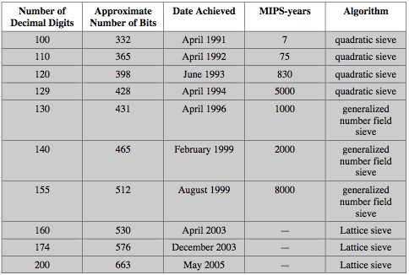
Progress in Factoring
Notes:
Stallings Table 9.5 shows the progress in factoring to date. The level of effort is measured in MIPS-years: a million-instructions-per-second processor running for one year, which is about 3 x 10¹³ instructions executed. A 1 GHz Pentium is about a 250-MIPS machine.

Slide 22
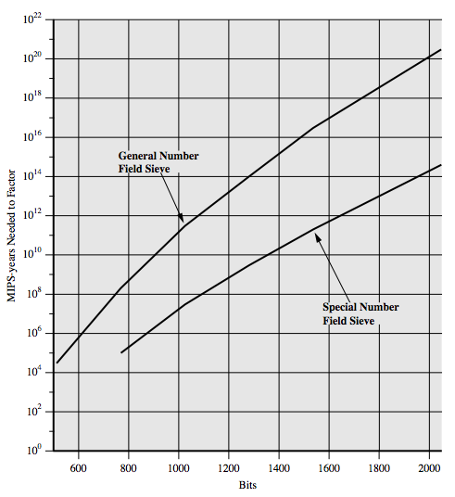
Progress in Factoring
Notes:
The threat to larger key sizes is twofold: the continuing increase in computing power, and the continuing refinement of factoring algorithms. We have seen that the move to a different algorithm resulted in a tremendous speedup. We can expect further refinements in the GNFS, and the use of an even better algorithm is also a possibility. In fact, a related algorithm, the special number field sieve (SNFS), can factor numbers with a specialized form considerably faster than the generalized number field sieve. Stallings Figure 9.9 compares the performance of the two algorithms. It is reasonable to expect a breakthrough that would enable a general factoring performance in about the same time as SNFS, or even better.

Slide 23
Summary
have considered:
  principles of public-key cryptography
  RSA algorithm, implementation, security
Notes:
Chapter 9 summary.

