Slide 1
Chapter 4: Portfolio Management Performance

Slide 2
WHAT IS REQUIRED OF A PORTFOLIO MANAGER?
There are two major requirements of a portfolio manager:
The ability to derive above-average returns for a given risk class
2. The ability to diversify the portfolio completely to eliminate all unsystematic risk, relative to the portfolio’s benchmark

Slide 3
Treynor Portfolio Performance Measure
Treynor developed the first composite measure of portfolio performance that included risk.
He postulated two components of risk: (1) risk produced by general market fluctuations and (2) risk resulting from unique fluctuations in the portfolio securities.
To identify risk due to market fluctuations, of return for a portfolio over time and the rates of return for an appropriate market portfolio,

Slide 4
Treynor Portfolio Performance Measure
Treynor was interested in a measure of performance that would apply to all investors regardless of their risk preferences.
Building on developments in capital market theory, he introduced a risk-free asset that could be combined with different portfolios to form a straight portfolio possibility line.
He showed that rational, risk-averse investors would always prefer portfolio possibility lines with larger slopes because such high-slope lines would place investors on higher utility levels.

Slide 5
Treynor = (Average Return-FRF)/beta
$$T=\frac{\overline{R−FRF}}{β_{p}}$$
$\overline{R }$the average rate of return for portfolio i during a specified time period
$β﷮p$: the slope of the fund’s characteristic line during that time period (this indicates the portfolio’s relative volatility)
$\overline{RFR }$the average rate of return on a risk-free investment during the same time period

Slide 6
A larger T value indicates a larger slope and a better portfolio for all investors (regardless of their risk preferences).
Because the numerator of this ratio is the risk premium and the denominator is a measure of risk, the total expression indicates the portfolio’s risk premium return per unit of risk. All risk-averse investors would prefer to maximize this value.
Note that the risk variable beta measures stematic risk and tells us nothing about the diversification of the portfolio.
It implicitly assumes a completely diversified portfolio, which means that systematic risk is the relevant risk measure.

Slide 7
Treynor Portfolio Performance Measure
Comparing a portfolio’s T value to a similar measure for the market portfolio indicates whether the portfolio would plot above the SML. Calculate the T value for the aggregate market as follows:
$$T_{M}=\frac{\overline{R_{M}−FRF}}{β_{M}}$$

Slide 8
In this expression, βM equals 1.0 (the market’s beta) and indicates the slope of the SML.
Therefore, a portfolio with a higher T value than the market portfolio plots above the SML, indicating superior risk-adjusted performance.

Slide 9
How to use Treynor Measure?
To understand how to use and interpret this measure of performance, suppose that during the most recent 10-year period, the average annual total rate of return (including dividends) on an aggregate market portfolio, such as the S&P 500, was 14 percent (RM = 0.14) and the average nominal rate of return on government T-bills was 8 percent (RFR = 0.08).
Assume that, as administrator of a large pension fund that has been divided among three money managers during the past 10 years, you must decide whether to renew your investment management contracts with all three managers. To do this, you must measure how they have performed.

Slide 10
How to use Treynor Measure?
Investment Manager | Average annual return | beta | Tp
W | 12% | 0.9 | 0.044
X | 16% | 1.05 | 0.076
Y | 18% | 1.20 | 0.083
TM=(0.14-0.08)/1.00=0.060
These results indicate that Investment Manager W not only ranked the lowest of the three managers but did not perform as well as the aggregate market.
In contrast, both X and Y beat the market portfolio, and Manager Y performed somewhat better than Manager X.
In terms of the SML, both of their portfolios plotted above the line, as shown in the following graph

Slide 11
How to use Treynor Measure?
Very poor return performance or very good performance with very low risk may yield negative T values.
An example of poor performance is a portfolio with both an average rate of return below the risk-free rate and a positive beta.
For instance, in the preceding case, assume that a fourth portfolio manager, Z, had a portfolio beta of 0.50 but an average rate of return of only 0.07. The T value would be

Slide 12
How to use Treynor Measure?
$T_{Z}=\frac{0.07−0.08}{0.5}$=-0.02
Obviously, this performance would plot below the SML in the graph

Slide 13
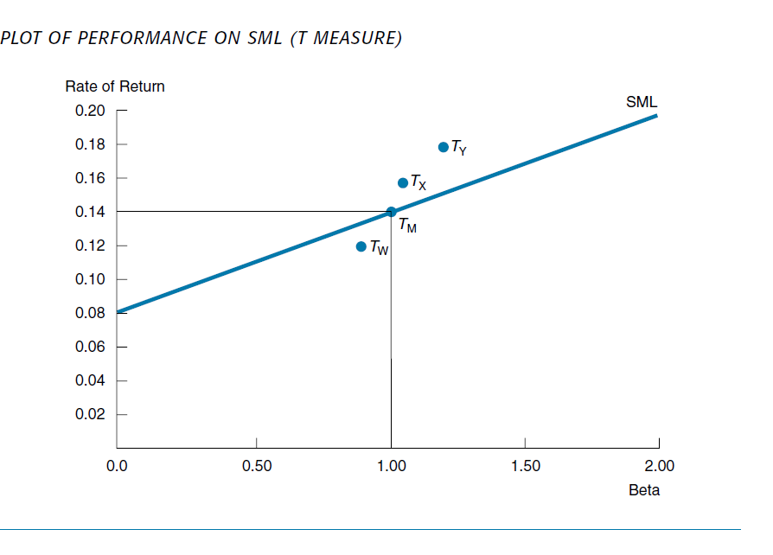

Slide 14
The Sharpe Measure
Sharpe likewise conceived of a composite measure to evaluate the performance of mutual funds.6
The measure followed closely his earlier work on the capital asset pricing model (CAPM), dealing specifically with the capital market line (CML).
The Sharpe measure of portfolio performance (designated S) is stated as follows:

Slide 15
The Sharpe Measure
$$S_{p}=\frac{\overline{R_{p}−FRF}}{σ_{p}}$$
where:
$R_{p}$the average rate of return for portfolio i during a specified time period
$FRF$ = the average rate of return on risk-free assets during the same time period
$σ_{p}$= the standard deviation of the rate of return for portfolio i during the time period

Slide 16
The Sharpe Measure
This composite measure of portfolio performance clearly is similar to the Treynor measure;
However, it seeks to measure the total risk of the portfolio by including the standard deviation of returns rather than considering only the systematic risk summarized by beta.
Because the numerator is the portfolio’s risk premium, this measure indicates the risk premium return earned per unit of total risk.

Slide 17
The Sharpe Measure
In terms of capital market theory, this portfolio performance measure uses total risk to compare portfolios to the CML, whereas the Treynor measure examines portfolio performance in relation to the SML.
Finally, notice that in practice the standard deviation can be calculated using either total portfolio returns or portfolio returns in excess of the risk-free rate.

Slide 18
Application
Assume that RM = 0.14 and RFR= 0.08. Suppose you are told that the standard deviation of the annual rate of return for the market portfolio over the past 10 years was 20% (σM = 0.20). Now you want to examine the performance of the following portfolios:

Slide 19
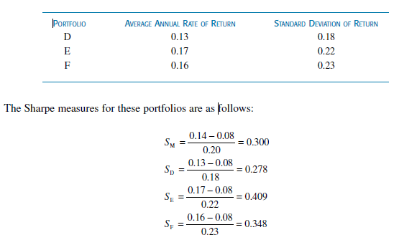
Application

Slide 20
Comments
The D portfolio had the lowest risk premium return per unit of total risk, failing even to perform as well as the aggregate market portfolio.
In contrast, Portfolios E and F performed better than the aggregate market: Portfolio E did better than Portfolio F.
Given the market portfolio results during this period, it is possible to draw the CML. If we plot the results for Portfolios D, E, and F on this graph, we see that
Portfolio D plots below the line, whereas the E and F portfolios are above the line, indicating superior risk-adjusted performance.

Slide 21
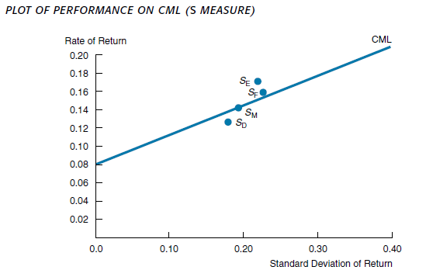
Plot of Performance on CML

Slide 22
Treynor versus Sharpe Measure
The Sharpe portfolio performance measure uses the
standard deviation of returns as the measure of total risk, whereas the Treynor performance measure uses beta (systematic risk).
The Sharpe measure, therefore, evaluates the portfolio manager on the basis of both rate of return performance and diversification.

Slide 23
Treynor versus Sharpe Measure
For a completely diversified portfolio, one without any unsystematic risk, the two measures give identical rankings because the total variance of the completely diversified portfolio is its systematic variance.
Alternatively, a poorly diversified portfolio could have a high ranking on the basis of the Treynor performance measure but a much lower ranking on the basis of the Sharpe performance measure. Any difference in rank would come directly from a difference in diversification.

Slide 24
Treynor versus Sharpe Measure
Therefore, these two performance measures provide complementary yet different information, and both measures should be used.
If you are dealing with a group of well-diversified portfolios, as many mutual funds are, the two measures provide similar rankings.

Slide 25
The Jensen measure
The Jensen measure is similar to the measures already discussed because it is based on the capital asset pricing model (CAPM).
${E\left(Rj\right)=RFR+β_{j}(E\left(RM\right)−RFR))}_{}$
The CAPM can be written as follows:
$E\left(Rj\right)−RFR=α_{j}+β_{j}(E\left(RM\right)−RFR))$jj

Slide 26
The Jensen measure
The αj value indicates whether the portfolio manager is superior or inferior in market timing and/or stock selection.
A superior manager has a positive α (or “alpha”) value because of the consistent positive residuals.
In contrast, an inferior manager’s returns consistently fall short of expectations based on the CAPM model giving consistently negative residuals. In such a case, α is a negative value.

Slide 27
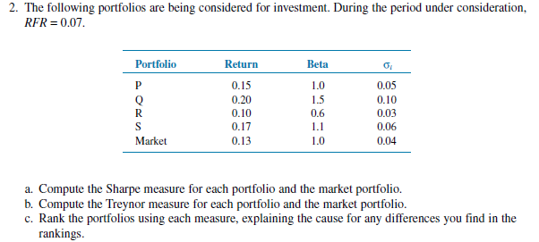
Exercise

