Slide 1
Introduction to Computer and
Network Security
Chapter #1 in the text book ( Stallings)

Slide 2
Introduction to Computer and Network Security
Computer security concepts
The OSI security architecture
Security attacks
Security services
Security mechanisms

Slide 3
Computer Security
Computer Security
The protection afforded to an automated information system in order to attain the applicable objectives of preserving the integrity, availability, and congeniality of information system resources.
  NIST Computer Security Handbook
Network and Internet Security
Measures to deter, prevent, detect, and correct security violations that involve transmission of information.
  Stallings, Cryptography and Network Security
Notes:
The NIST Computer Security Handbook [NIST95] defines the term computer security
as follows:
Computer Security: The protection afforded to an automated information system
in order to attain the applicable objectives of preserving the integrity, availability,
and confidentiality of information system resources (includes hardware, software,
firmware, information/data, and telecommunications).

Slide 4
Computer Security Objectives
Confidentiality
Data confidentiality
Assures that private or confidential information is not made available or disclosed to unauthorized individuals
Privacy
Assures that individuals control or influence what information related to them may be collected and stored and by whom and to whom that information may be disclosed
Integrity
Data integrity
Assures that information and programs are changed only in a specified and authorized manner
System integrity
Assures that a system performs its intended function in an unimpaired manner, free from deliberate or inadvertent unauthorized manipulation of the system
Availability
Assures that systems work promptly and service is not denied to authorized users
Notes:
This definition introduces three key objectives that are at the heart of computer
security:
• Confidentiality: This term covers two related concepts:
Data confidentiality: Assures that private or confidential information is
not made available or disclosed to unauthorized individuals.
Privacy: Assures that individuals control or influence what information
related to them may be collected and stored and by whom and to whom
that information may be disclosed.
•Integrity: This term covers two related concepts:
Data integrity: Assures that information and programs are changed only in
a specified and authorized manner.
System integrity: Assures that a system performs its intended function in
an unimpaired manner, free from deliberate or inadvertent unauthorized
manipulation of the system.
• Availability: Assures that systems work promptly and service is not denied to
authorized users.

Slide 5
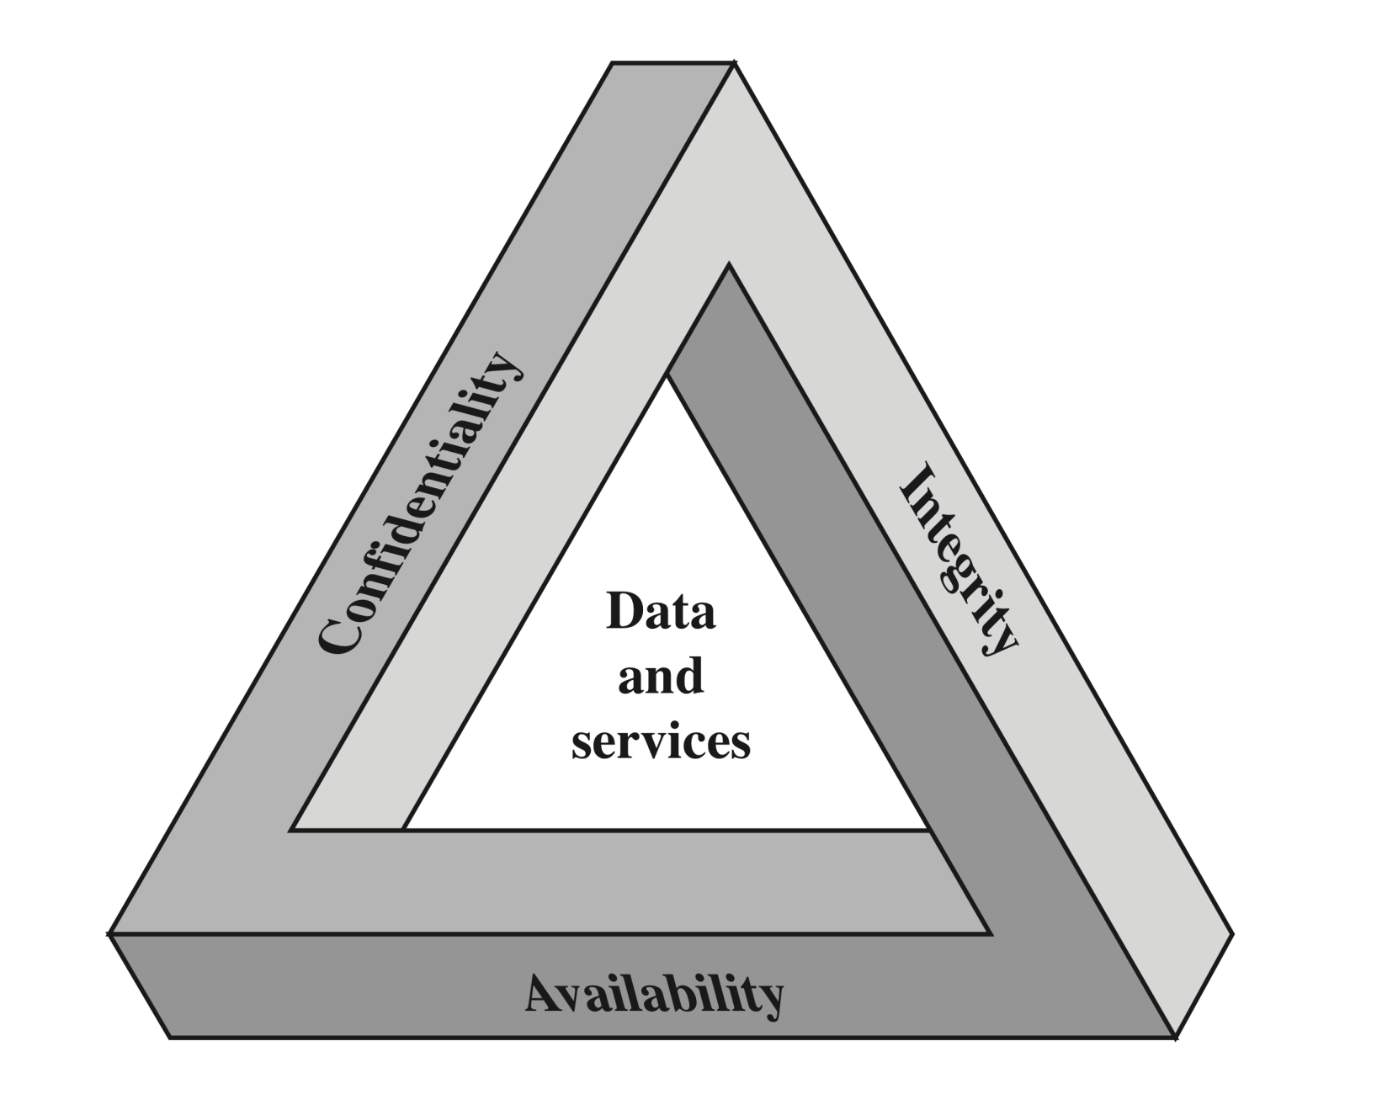
CIA Triad
Notes:
These three concepts form what is often referred to as the CIA triad . The three
concepts embody the fundamental security objectives for both data and for information
and computing services. For example, the NIST standard FIPS 199 (Standards
for Security Categorization of Federal Information and Information Systems ) lists
confidentiality, integrity, and availability as the three security objectives for information
and for information systems. FIPS 199 provides a useful characterization of
these three objectives in terms of requirements and the definition of a loss of security
in each category:
• Confidentiality: Preserving authorized restrictions on information access
and disclosure, including means for protecting personal privacy and proprietary
information. A loss of confidentiality is the unauthorized disclosure of
information.
• Integrity: Guarding against improper information modification or destruction,
including ensuring information nonrepudiation and authenticity. A loss
of integrity is the unauthorized modification or destruction of information.
• Availability: Ensuring timely and reliable access to and use of information.
A loss of availability is the disruption of access to or use of information or an
information system.

Slide 6
Possible additional concepts:
Authenticity
Verifying that users are who they say they are and that each input arriving at the system came from a trusted source
Accountability
The security goal that generates the requirement for actions of an entity to be traced uniquely to that entity
Notes:
Although the use of the CIA triad to define security objectives is well established,
some in the security field feel that additional concepts are needed to present
a complete picture. Two of the most commonly mentioned are as follows:
• Authenticity: The property of being genuine and being able to be verified and
trusted; confidence in the validity of a transmission, a message, or message
originator. This means verifying that users are who they say they are and that
each input arriving at the system came from a trusted source.
• Accountability: The security goal that generates the requirement for actions
of an entity to be traced uniquely to that entity. This supports nonrepudiation,
deterrence, fault isolation, intrusion detection and prevention, and after action
recovery and legal action. Because truly secure systems are not yet an
achievable goal, we must be able to trace a security breach to a responsible
party. Systems must keep records of their activities to permit later forensic
analysis to trace security breaches or to aid in transaction disputes.

Slide 7
Example: Bank
Confidentiality: an employee should not disclose a customer’s account information to another customer.
Integrity: an employee should not improperly modify a customer’s account balance.
Availability: system should be usable when customers purchase with credit cards.

Slide 8
Example: Healthcare
Confidentiality: doctors should not disclose patients’ medical records without consent.
Integrity: patients’ medical records should not be illegally modified or deleted.
Availability: patients’ medical records should be accessible in case of emergencies.

Slide 9
Group exercise
Please classify each of the following as a violation of confidentiality, integrity, availability, authenticity, or some combination of these
John copies Mary’s homework.
Paul crashes Linda’s system.
Gina forges Roger’s signature on a deed.
Rhonda registers the domain name “AddisonWesley.com” and refuses to let the publishing house buy or use that domain name.
Henry spoofs Julie’s IP address to pretend to be her.

Slide 10
Solution
John copying Mary's homework is a violation of confidentiality.
Paul crashing Linda's system is a violation of availability.
Gina forging Roger's signature on a deed is a violation of integrity (specifically, integrity of origin). The deed appears to have come from Roger, when in fact it came from Gina
Rhonda registering the domain name "AddisonWesley.com" and refusing to let the publishing house buy or use that domain name is a violation of availability.
Henry spoofing Julie's IP address to gain access to her computer is a violation of integrity (specifically, integrity of origin). The messages from Henry appear to come from Julie's IP address, when in fact they do not.

Slide 11
OSI Security Architecture
Security attack
  Any action that compromises the security of information owned by an organization
Security mechanism
  A process (or a device incorporating such a process) that is designed to detect, prevent, or recover from a security attack
Security service
  A processing or communication service that enhances the security of the data processing systems and the information transfers of an organization
  Intended to counter security attacks, and they make use of one or more security mechanisms to provide the service
Notes:
To assess effectively the security needs of an organization and to evaluate and
choose various security products and policies, the manager responsible for security
needs some systematic way of defining the requirements for security and characterizing
the approaches to satisfying those requirements. This is difficult enough in a
centralized data processing environment; with the use of local and wide area networks,
the problems are compounded.
ITU-T Recommendation X.800, Security Architecture for OSI , defines such a
systematic approach. The OSI security architecture is useful to managers as a way
of organizing the task of providing security. Furthermore, because this architecture
was developed as an international standard, computer and communications vendors
have developed security features for their products and services that relate to this
structured definition of services and mechanisms.
For our purposes, the OSI security architecture provides a useful, if abstract,
overview of many of the concepts that this book deals with. The OSI security architecture
focuses on security attacks, mechanisms, and services. These can be defined
briefly as
• Security attack: Any action that compromises the security of information
owned by an organization.
• Security mechanism: A process (or a device incorporating such a process) that
is designed to detect, prevent, or recover from a security attack.
• Security service: A processing or communication service that enhances the
security of the data processing systems and the information transfers of an
organization. The services are intended to counter security attacks, and they
make use of one or more security mechanisms to provide the service.

Slide 12
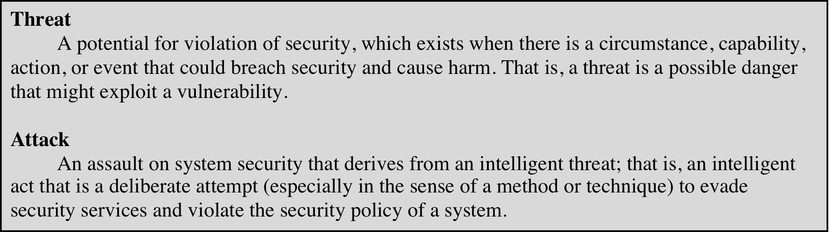
Table 1.1
Threats and Attacks (RFC 4949)
Notes:
In the literature, the terms threat and attack are commonly used to mean more
or less the same thing. Table 1.1 provides definitions taken from RFC 4949, Internet
Security Glossary.

Slide 13
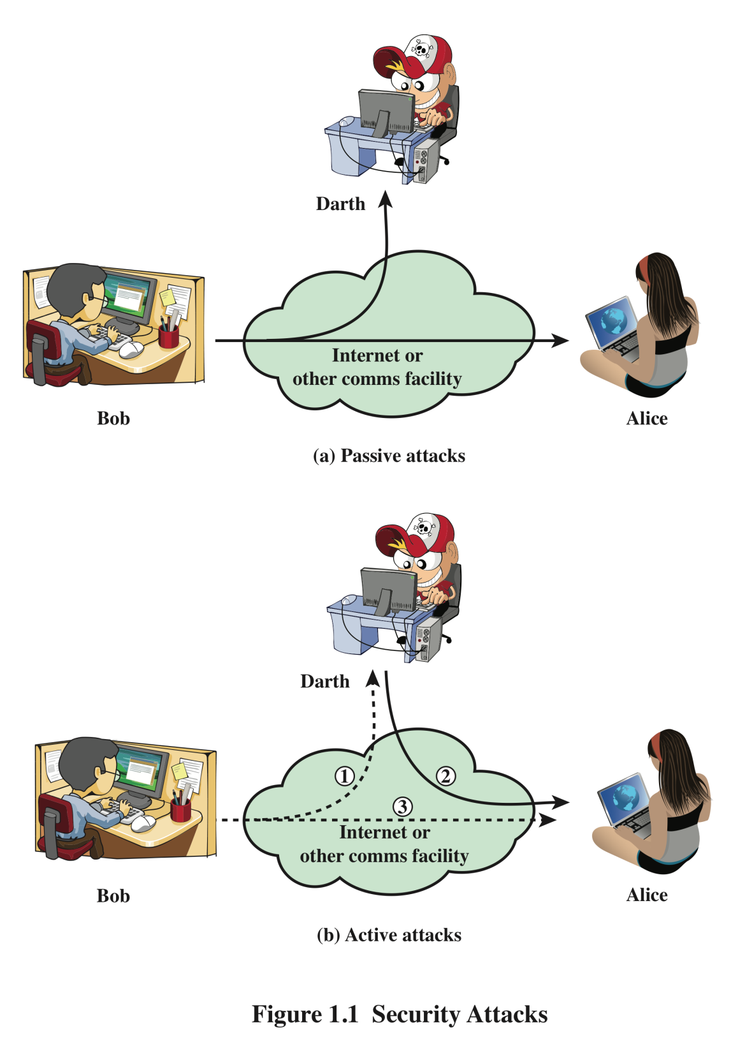
Security Attacks
A means of classifying security attacks, used both in X.800 and RFC 4949, is in terms of passive attacks and active attacks
A passive attack attempts to learn or make use of information from the system but does not affect system resources
An active attack attempts to alter system resources or affect their operation
Notes:
A useful means of classifying security attacks, used both in X.800 and RFC 4949, is in
terms of passive attacks and active attacks (Figure 1.1). A passive attack attempts to
learn or make use of information from the system but does not affect system resources.
An active attack attempts to alter system resources or affect their operation.

Slide 14
Passive Attacks
Are in the nature of eavesdropping on, or monitoring of, transmissions
Goal of the opponent is to obtain information that is being transmitted
Two types of passive attacks are:
  The release of message contents
  Traffic analysis
Notes:
Passive attacks (Figure 1.1) are in the nature of eavesdropping on, or monitoring
of, transmissions. The goal of the opponent is to obtain information that is being
transmitted. Two types of passive attacks are the release of message contents and
traffic analysis.
The release of message contents is easily understood. A telephone conversation,
an electronic mail message, and a transferred file may contain sensitive or
confidential information. We would like to prevent an opponent from learning the
contents of these transmissions.
A second type of passive attack, traffic analysis , is subtler. Suppose that we
had a way of masking the contents of messages or other information traffic so that
opponents, even if they captured the message, could not extract the information
from the message. The common technique for masking contents is encryption. If we
had encryption protection in place, an opponent might still be able to observe the
pattern of these messages. The opponent could determine the location and identity
of communicating hosts and could observe the frequency and length of messages
being exchanged. This information might be useful in guessing the nature of the
communication that was taking place.
Passive attacks are very difficult to detect, because they do not involve any
alteration of the data. Typically, the message traffic is sent and received in an apparently
normal fashion, and neither the sender nor receiver is aware that a third party
has read the messages or observed the traffic pattern. However, it is feasible to prevent
the success of these attacks, usually by means of encryption. Thus, the emphasis
in dealing with passive attacks is on prevention rather than detection.

Slide 15
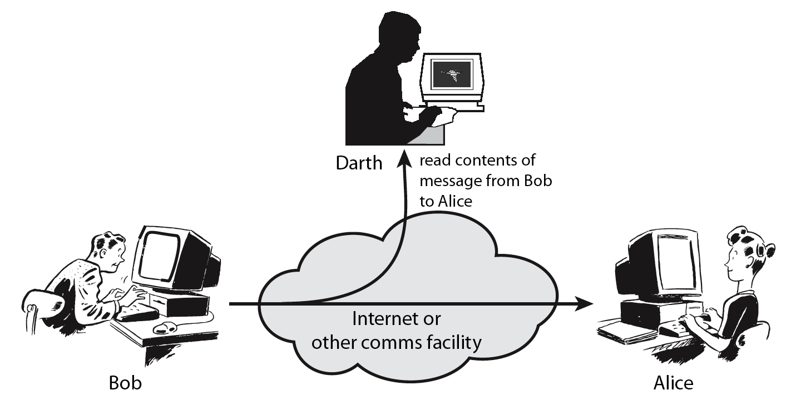
Passive Attacks
Disclosure of message contents

Slide 16
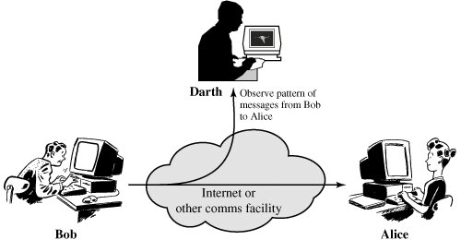
Passive Attacks
Traffic analysis

Slide 17
Active Attacks
Involve some modification of the data stream or the creation of a false stream
Difficult to prevent because of the wide variety of potential physical, software, and network vulnerabilities
Goal is to detect attacks and to recover from any disruption or delays caused by them
Masquerade
Takes place when one entity pretends to be a different entity
Usually includes one of the other forms of active attack
Replay
Involves the passive capture of a data unit and its subsequent retransmission to produce an unauthorized effect
Modification of messages
Some portion of a legitimate message is altered, or messages are delayed or reordered to produce an unauthorized effect
Denial of service
Prevents or inhibits the normal use or management of communications facilities
Notes:
Active attacks (Figure 1.1b) involve some modification of the data stream or the
creation of a false stream and can be subdivided into four categories: masquerade,
replay, modification of messages, and denial of service.
A masquerade takes place when one entity pretends to be a different entity
(path 2 of Figure 1.1b is active). A masquerade attack usually includes one of the
other forms of active attack. For example, authentication sequences can be captured
and replayed after a valid authentication sequence has taken place, thus enabling an
authorized entity with few privileges to obtain extra privileges by impersonating an
entity that has those privileges.
Replay involves the passive capture of a data unit and its subsequent retransmission
to produce an unauthorized effect (paths 1, 2, and 3 active).
Modification of messages simply means that some portion of a legitimate
message is altered, or that messages are delayed or reordered, to produce an
unauthorized effect (paths 1 and 2 active). For example, a message meaning “Allow
John Smith to read confidential file accounts ” is modified to mean “Allow Fred
Brown to read confidential file accounts. ”
The denial of service prevents or inhibits the normal use or management of
communications facilities (path 3 active). This attack may have a specific target; for
example, an entity may suppress all messages directed to a particular destination
(e.g., the security audit service). Another form of service denial is the disruption
of an entire network, either by disabling the network or by overloading it with
messages so as to degrade performance.
Active attacks present the opposite characteristics of passive attacks. Whereas
passive attacks are difficult to detect, measures are available to prevent their success.
On the other hand, it is quite difficult to prevent active attacks absolutely
because of the wide variety of potential physical, software, and network vulnerabilities.
Instead, the goal is to detect active attacks and to recover from any disruption
or delays caused by them. If the detection has a deterrent effect, it may also
contribute to prevention.

Slide 18
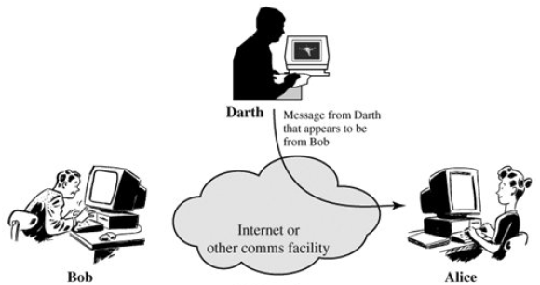
Active Attacks
Masquerade

Slide 19
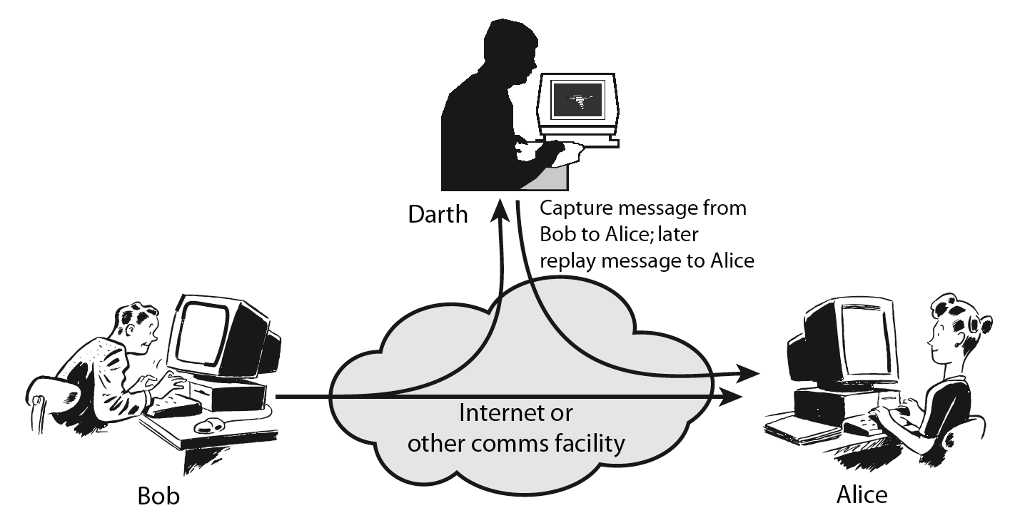
Active Attacks
Replay

Slide 20

Active Attacks
Modification

Slide 21
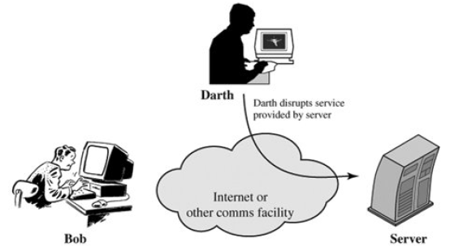
Active Attacks
Denial of Service (DoS)

Slide 22
Attacks Continued…
Attacks on confidentiality:
Eavesdropping,
packet sniffing,
illegal copying
network

Slide 23
Attacks Continued…
Attacks on integrity:
Intercept messages,
tamper, release again,
discard
network

Slide 24
Attacks Continued…
Attacks on availability: DoS, DDoS attacks (SYN flooding, smurfing)
Overwhelm or crash servers,
disrupt infrastructure
network

Slide 25
Security Services
Defined by X.800 as:
  A service provided by a protocol layer of communicating open systems and that ensures adequate security of the systems or of data transfers
  Defined by RFC 4949 as:
  A processing or communication service provided by a system to give a specific kind of protection to system resources
Notes:
X.800 defines a security service as a service that is provided by a protocol layer of
communicating open systems and that ensures adequate security of the systems
or of data transfers. Perhaps a clearer definition is found in RFC 4949, which
provides the following definition: a processing or communication service that is
provided by a system to give a specific kind of protection to system resources;
security services implement security policies and are implemented by security
mechanisms.

Slide 26
X.800 Service Categories
Authentication Assure that the communicating entity is the one that it claims to be. (Peer entity and data origin authentication)
Access Control Prevent unauthorised use of a resource
Data Condentiality Protect data from unauthorised disclosure
Data Integrity Assure data received are exactly as sent by authorised entity
Nonrepudiation Protect against denial of one entity involved in communications of having participated in communications
Availability System is accessible and usable on demand by authorized users according to intended goal

Slide 27
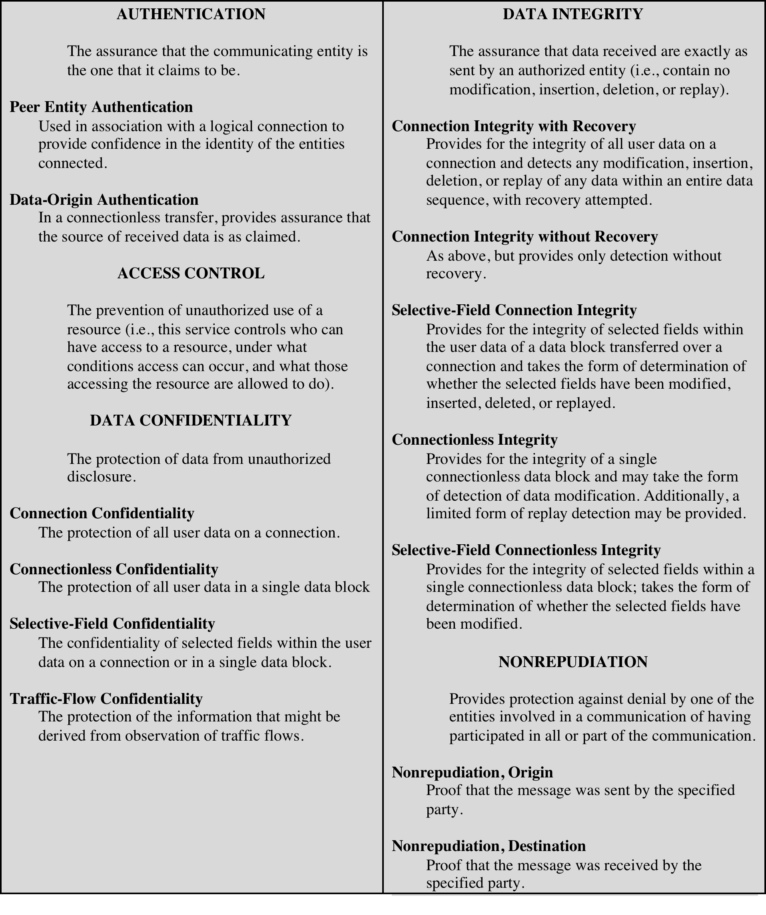
Table 1.2
Security Services
(X.800)
(This table is found on page 18 in textbook)
Notes:
X.800 divides these services into five categories and fourteen specific services
(Table 1.2).

Slide 28
Security Mechanisms (X.800)
Specific Security Mechanisms
Encipherment
Digital signatures
Access controls
Data integrity
Authentication exchange
Traffic padding
Routing control
Notarization
Pervasive Security Mechanisms
Trusted functionality
Security labels
Event detection
Security audit trails
Security recovery
Notes:
X.800 security mechanisms.

Slide 29
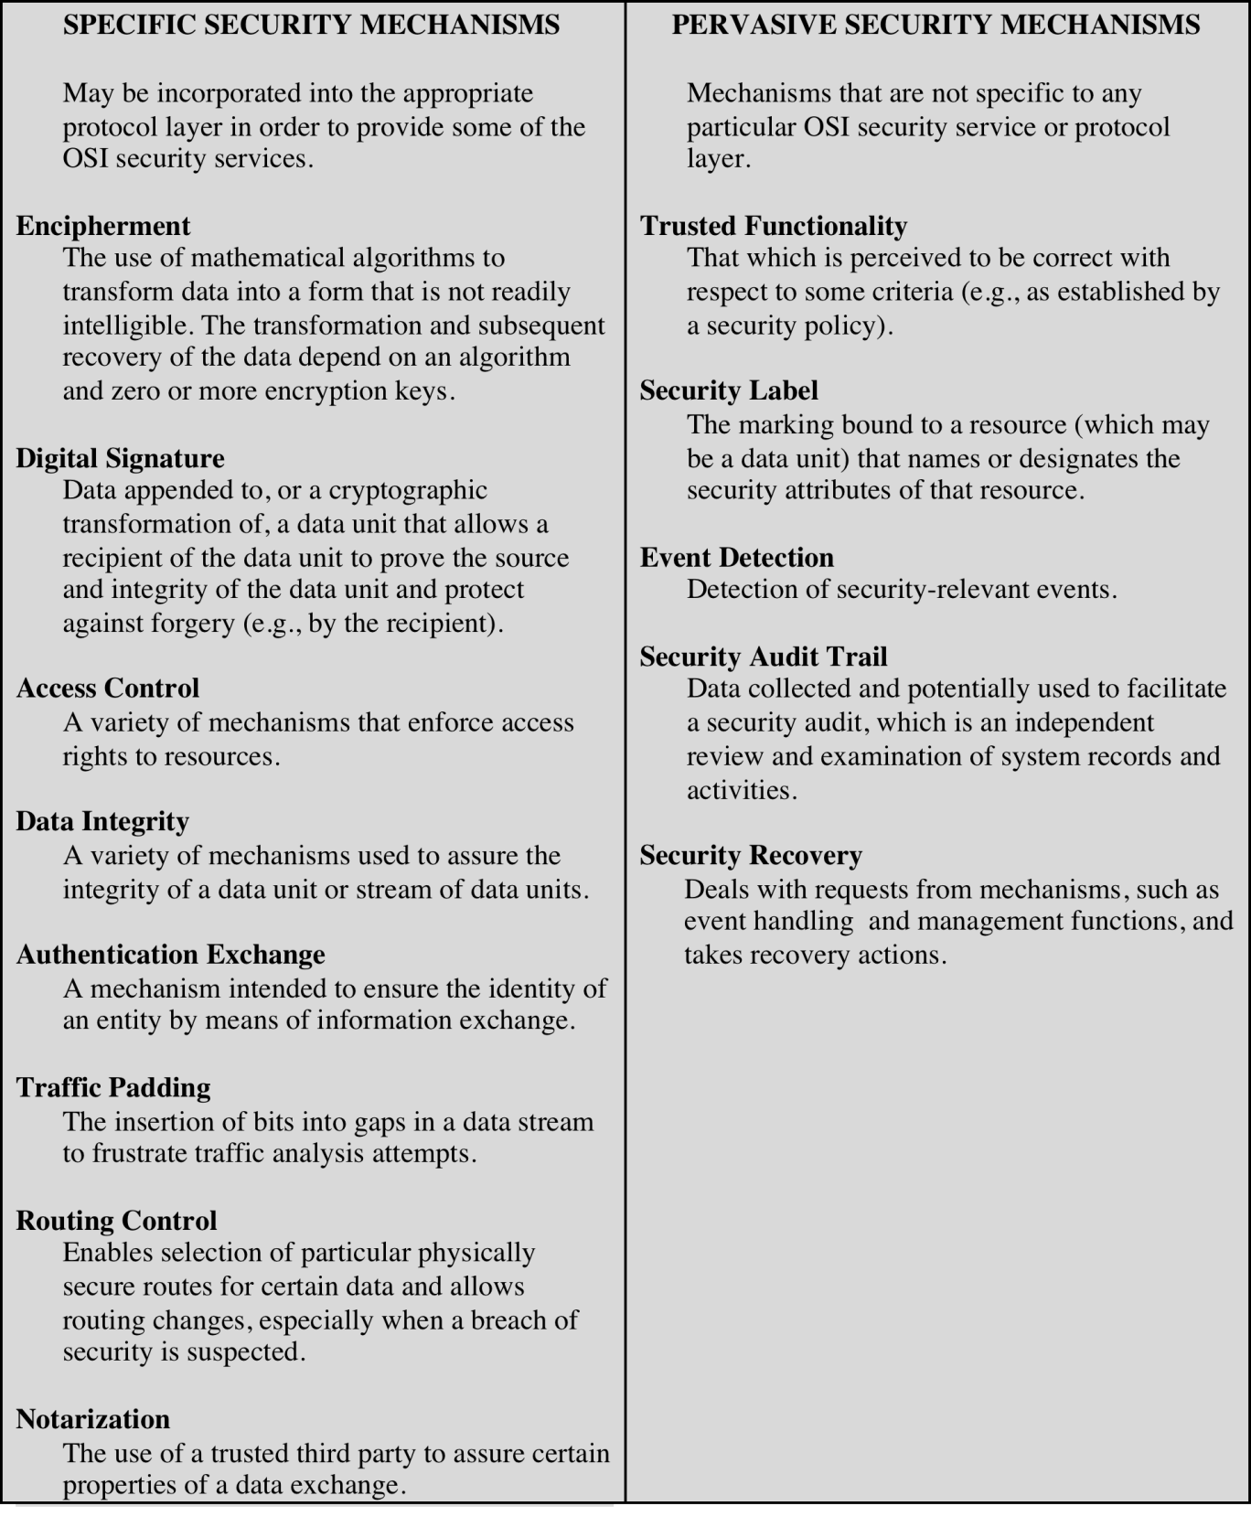
Table 1.3
Security Mechanisms
(X.800)
(This table is found on pages 20-21 in textbook)
Notes:
Table 1.3 lists the security mechanisms defined in X.800. The mechanisms are
divided into those that are implemented in a specific protocol layer, such as TCP
or an application-layer protocol, and those that are not specific to any particular
protocol layer or security service. These mechanisms will be covered in the
appropriate places in the book. So we do not elaborate now, except to comment
on the definition of encipherment. X.800 distinguishes between reversible encipherment
mechanisms and irreversible encipherment mechanisms. A reversible
encipherment mechanism is simply an encryption algorithm that allows data to
be encrypted and subsequently decrypted. Irreversible encipherment mechanisms
include hash algorithms and message authentication codes, which are used in digital
signature and message authentication applications.

Slide 30
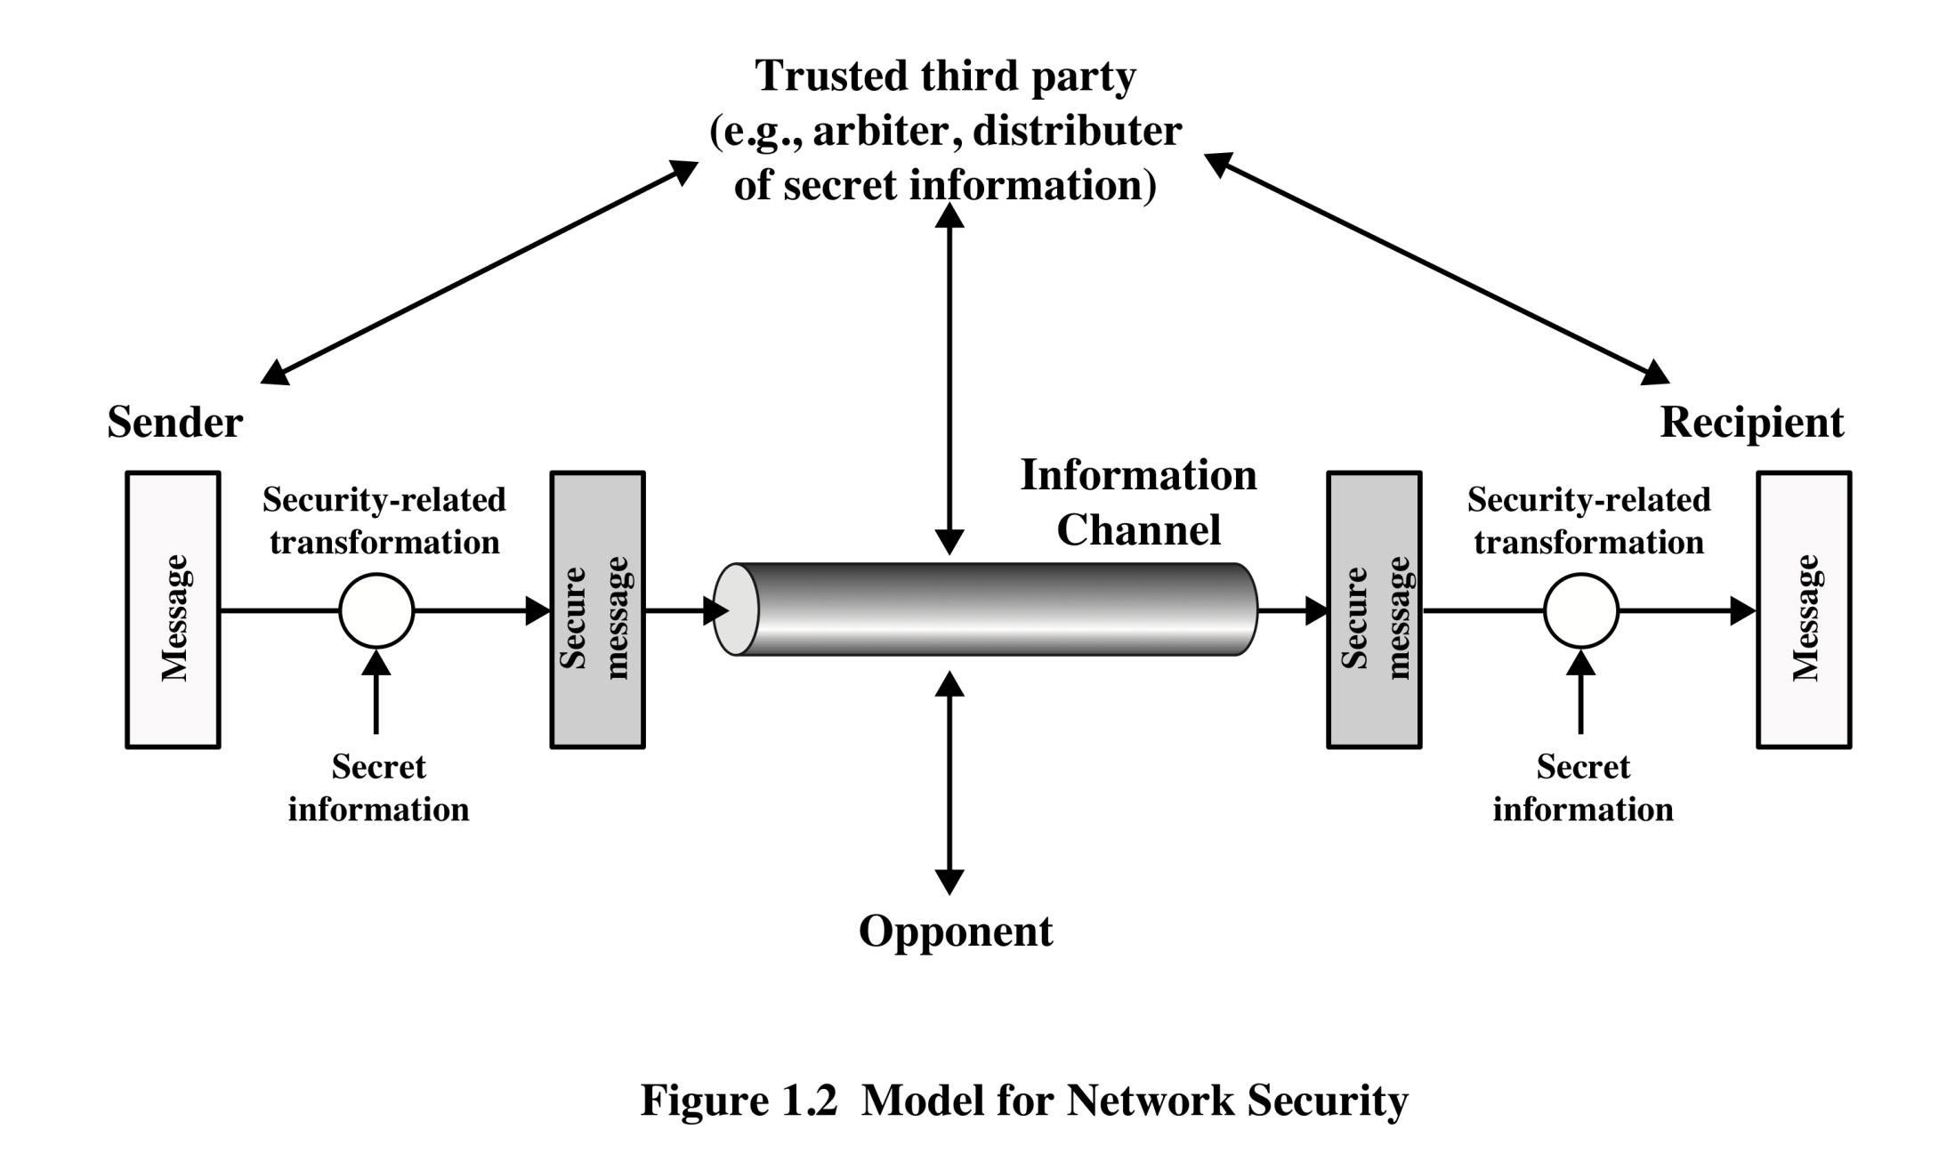
Model for Network Security
Notes:
A model for much of what we will be discussing is captured, in very general terms, innFigure 1.2. A message is to be transferred from one party to another across some sort of Internet service. The two parties, who are the principals in this transaction, must cooperate for the exchange to take place. A logical information channel is established by defining a route through the Internet from source to destination and by the cooperative use of communication protocols (e.g., TCP/IP) by the two principals.
Security aspects come into play when it is necessary or desirable to protect the information transmission from an opponent who may present a threat to confidentiality, authenticity, and so on. All the techniques for providing security have two components:
• A security-related transformation on the information to be sent. Examples include the encryption of the message, which scrambles the message so that it is unreadable by the opponent, and the addition of a code based on the contents of the message, which can be used to verify the identity of the sender.
• Some secret information shared by the two principals and, it is hoped, unknown to the opponent. An example is an encryption key used in conjunction with the transformation to scramble the message before transmission and unscramble it on reception.
A trusted third party may be needed to achieve secure transmission. For example, a third party may be responsible for distributing the secret information to the two principals while keeping it from any opponent. Or a third party may be needed to arbitrate disputes between the two principals concerning the authenticity of a message transmission.
This general model shows that there are four basic tasks in designing a particular
security service:
1. Design an algorithm for performing the security-related transformation. The algorithm should be such that an opponent cannot defeat its purpose.
2. Generate the secret information to be used with the algorithm.
3. Develop methods for the distribution and sharing of the secret information.
4. Specify a protocol to be used by the two principals that makes use of the security algorithm and the secret information to achieve a particular security service.

Slide 31
Model for Network Security
using this model requires us to:
  design a suitable algorithm for the security transformation
  generate the secret information (keys) used by the algorithm
  develop methods to distribute and share the secret information
  specify a protocol enabling the principals to use the transformation and secret information for a security service
Notes:
This general model shows that there are four basic tasks in designing a particular security service, as listed.

Slide 32
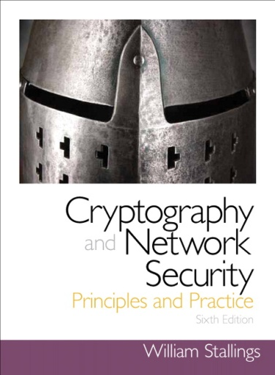
Summary
Computer security concepts
  Definition
  Examples
  Challenges
The OSI security architecture
Security attacks
  Passive attacks
  Active attacks
Security services
  Authentication
  Access control
  Data confidentiality
  Data integrity
  Nonrepudiation
  Availability service
Security mechanisms models for network (access) security
Notes:
Chapter 1 summary.

