Slide 1
Modern Systems Analysis and Design Fourth Edition
Chapter 9
Structuring System Requirements:
Logic Modeling

Slide 2
Logic Modeling
Data flow diagrams do not show the logic inside the processes – what occurs within a a process? How input data is converted into output information
Logic modeling involves representing internal structure and functionality of processes depicted on a DFD.
Processes must be clearly described before translating them into programming language.
Logic modeling can also be used to show when processes on a DFD occur.
Logic modeling will be generic without taking syntax of a particular programming language

Slide 3
Logic Modeling Deliverables and Outcomes
Each process on the lowest level DFD will be represented by one or more of the following:
Structured English
Decision Tables
Decision Trees
State-transition diagrams
Sequence diagrams
Activity diagrams

Slide 4
Modeling Logic with Structured English
Structured English is a modified form of English used to specify the logic of information processes
Uses a subset of English vocabulary to express process procedures
Action verbs – read, write, print, move, merge, add, sort
Noun phrases – name, address
No adjectives or adverbs
No specific standards – each analyst will have his own way
File and variable names are CAPITALIZED
Logical comparisons are spelled out and not used symbols
Structured English is used to represent processes in a shorthand manner that is relatively easy for users and programmers to read and understand

Slide 5
Modeling Logic with Structured English
It is possible to represent all three processes used in structured programming: sequence, conditional, repetition
Sequence – no special structure but one statement following another
Conditional – IF THEN ELSE statement; CASE statement
Repetition – DO-UNTIL loops or DO-WHILE loops
Structured English does not initialize variables, open and close files, or find related records in separate files – all are done in later design process

Slide 6
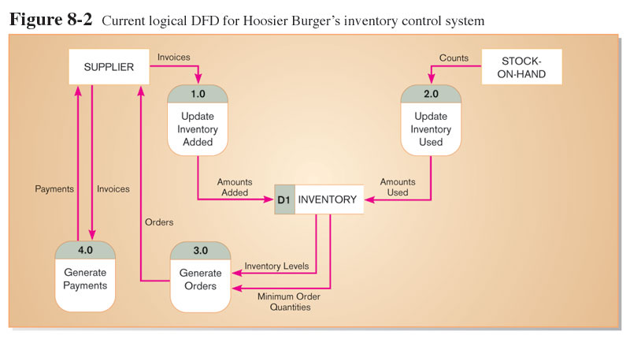

Slide 7
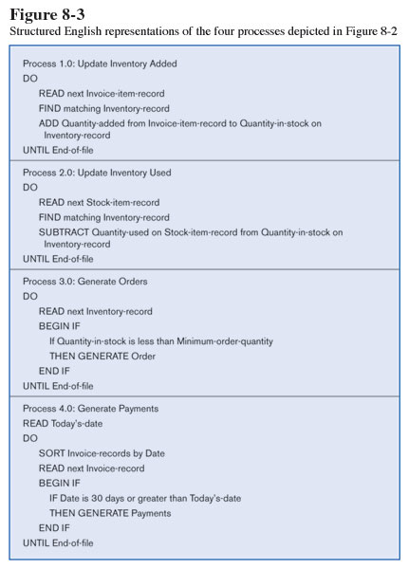
Structured English is used here to describe input and output.

Slide 8
Structured English is used here to describe arithmetic operations.

Slide 9
Structured English is used here to describe repetition.

Slide 10
Structured English is used here to describe decisions.

Slide 11
Structured English is used here to describe invoking other processes.

Slide 12
Modeling Logic with Decision Tables
Structured English is not good to represent complicated logic (having several different conditions) as it becomes difficult to understand
Decision table: A matrix representation of the logic of a decision
Specifies all the possible conditions and the resulting actions in a tabular form
Best used for complicated decision logic
3 Parts of a Decision Table
Condition stubs
Lists condition relevant to decision
Action stubs
Actions that result from a given set of conditions
Rules
Specify which actions are to be followed for a given set of conditions
Indifferent Condition
Condition whose value does not affect which action is taken for two or more rules

Slide 13
Procedure for Creating Decision Tables
Name the conditions and values each condition can assume
some conditions values will be just “yes” or “no” and some may have many values (called an extended entry)
Name all possible actions that can occur
List all possible rules
Create exhaustive set of rules – every possible combination of conditions must be represented
Some rules may be redundant or make no sense that can be altered later
Number of rules = number of values for condition 1 X number of values for condition 2 X …..X number of values for condition n
Define the actions for each rule
If an action doesn’t make sense create an “impossible” row for that action
If the action is not known place a ? for that rule
Simplify the table
Remove any rules with impossible actions

Slide 14
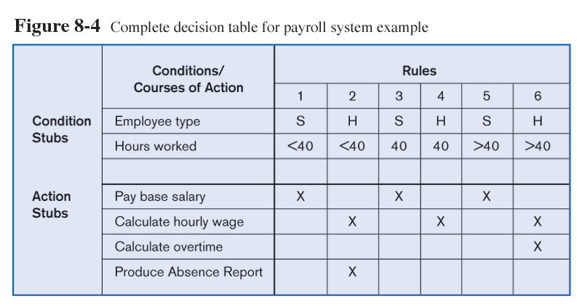
Decision Table
Note: for salaried employees the action stub chosen will always be the same…therefore hours worked is an indifferent condition

Slide 15
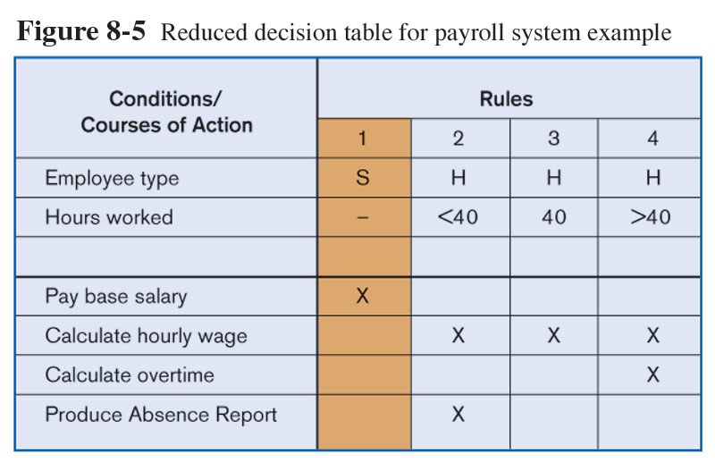
Reduced Decision Table
Because of indifferent condition, the complete decision table can be reduced to one with fewer rules

Slide 16
Modeling Logic with Decision Trees
A decision tree is a graphical representation of a decision situation
Decision situation points (nodes) are connected together by arcs and terminate in ovals
Main components
Decision points represented by nodes
Actions represented by ovals
Particular choices from a decision point represented by arcs
To read a decision tree – begin at root node on far left
Each node is numbered and each number corresponds to a choice
Choices are spelled out in a legend
From each node there are at least two paths leading to next step – another decision point or an action
All possible actions are listed on the far right in leaf nodes
Each rule is represented by tracing a series of paths from root node to the next node and so on until an action oval is reached

Slide 17
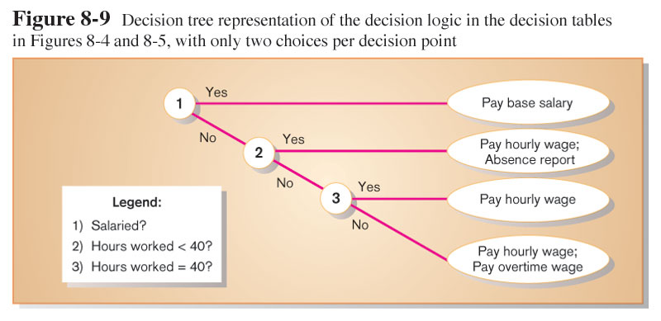
Decision tree representation of salary decision

Slide 18
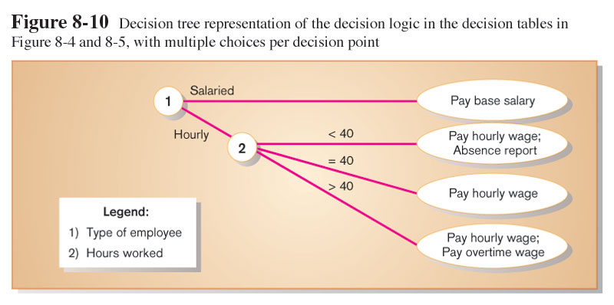
Alternative decision tree representation of salary decision

