Slide 1
Chapter 2
Global Market-Entry Strategies

Slide 2
Learning Objectives
Explain the advantages and disadvantages of using licensing as a market-entry strategy.
Compare and contrast the different forms that a company’s foreign investments can take.
Discuss the factors that contribute to the successful launch of a global strategic partnership.
Explain the growth of cooperative strategies in the 21st century.

Slide 3
Introduction
Trade barriers are falling around the world
Companies need to have a strategy to enter world markets.

Slide 4
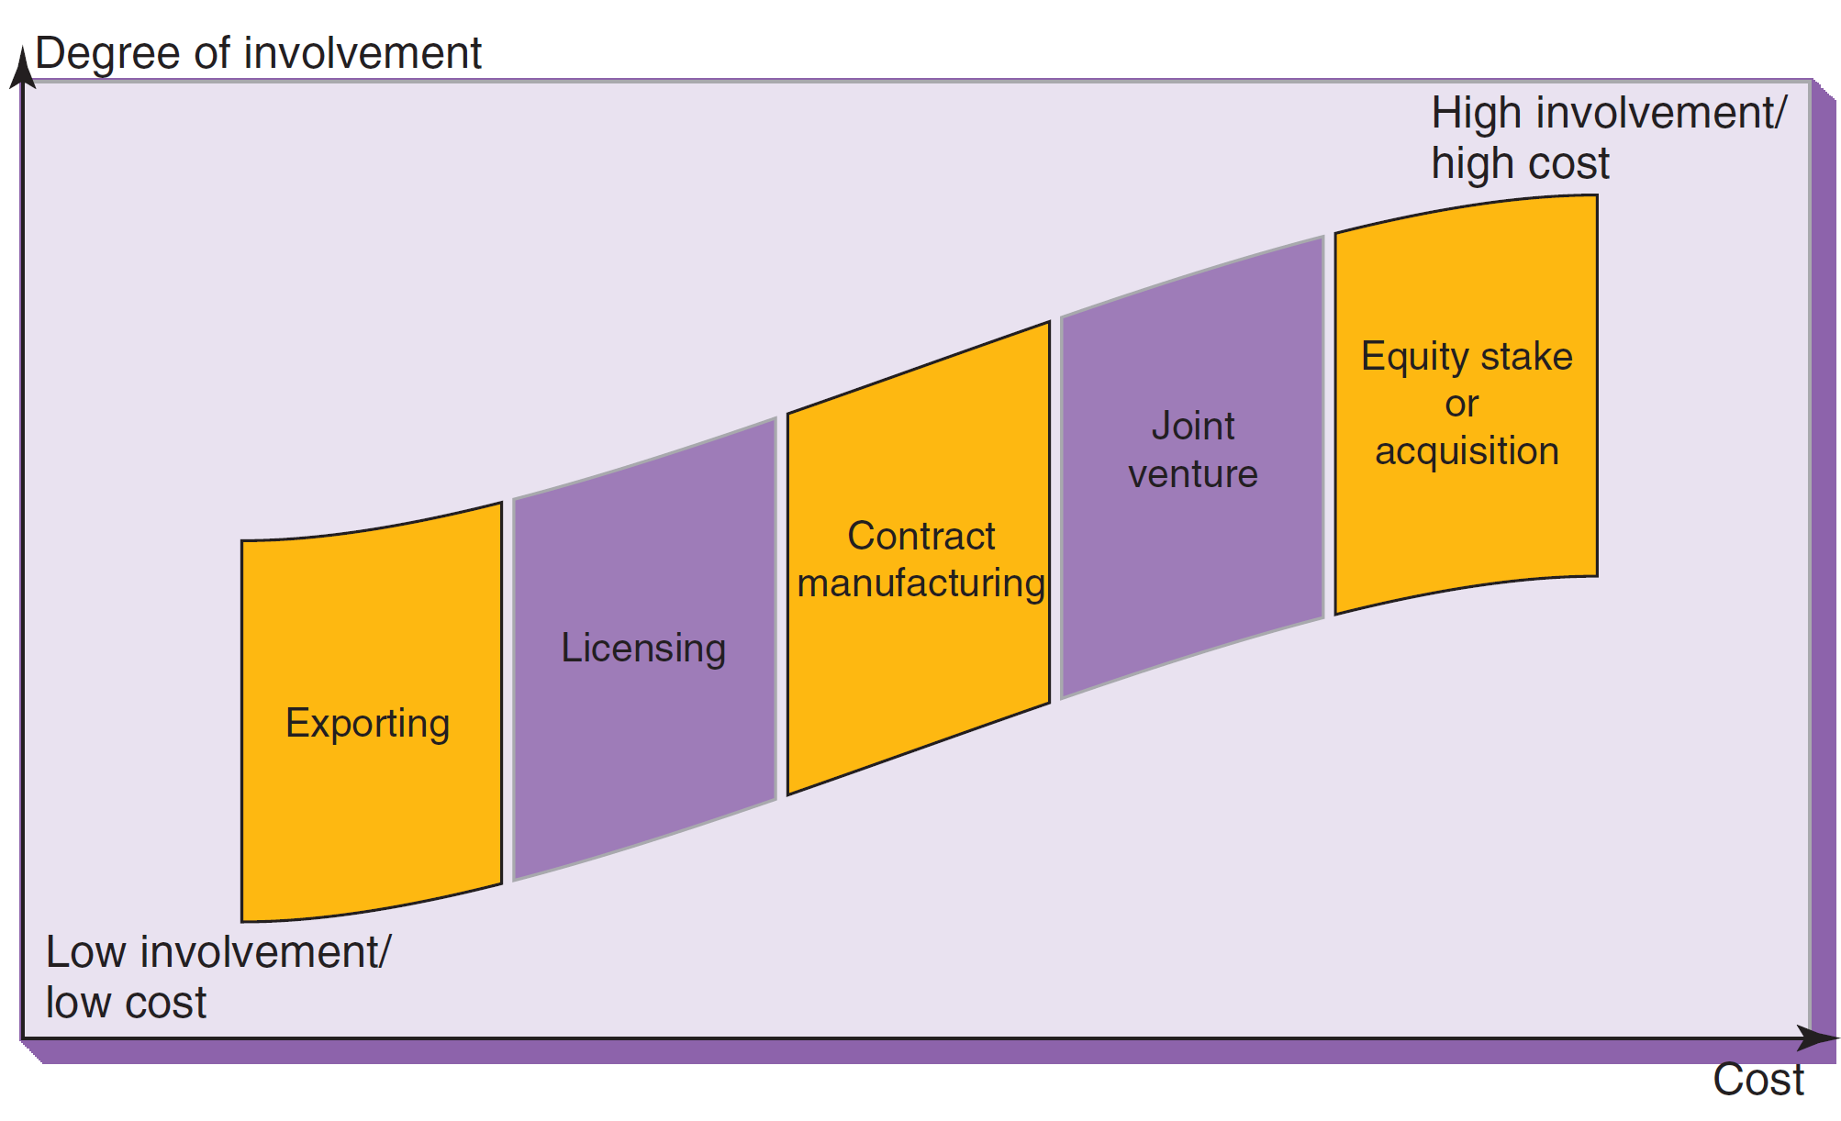
Investment Cost of Marketing Entry Strategies
Notes:
The various entry mode options form a continuum. As shown on this slide, the level of involvement, risk, and financial reward increases as a company moves from market entry strategies such as licensing to joint ventures and ultimately, various forms of investment. When a global company seeks to enter a developing country market, there is an additional strategy issue to address: Whether to replicate the strategy that served the company well in developed markets without significant adaptation. To the extent that the objective of entering the market is to achieve penetration, executives at global companies are well advised to consider embracing a mass-market mind-set. This may well mandate an adaptation strategy.

Slide 5
Which Strategy Should Be Used?
It depends on:
Vision
Attitude toward risk
Available investment capital
How much control is desired
Starbucks plans to have 1,500 stores in China by 2015.

Slide 7
How Do Firms Go International?
Foreign market entry strategies vary in:
Degree of risk they present,
The control and commitment of resources they require, and
The return on investment they promise.

Slide 8
Which strategy should be used?
It depends on:
Vision
Attitude toward risk
How much investment capital is available
How much control is desired

Slide 9
Foreign market entry strategies
Licensing
Export-import trade
Entry Strategies
Foreign direct
investment
Franchising
Management contracts

Slide 10
Licensing
A contractual agreement whereby one company (the licensor) makes an asset available to another company (the licensee) in exchange for royalties, license fees, or some other form of compensation.
Worldwide sales of licensed goods
totaled $241.5 billion in 2014.
Disney is the world’s top licensor.
Notes:
Licensing is a contractual arrangement whereby one company (the licensor) makes a legally protected asset available to another company (the licensee) in exchange for royalties, license fees, or some other form of compensation. The licensed asset may be a brand name, company name, patent, trade secret, or product formulation.
Some companies use licensing extensively: Apparel designers (Hugo Boss, Bill Blass, Ralph Lauren), Coca-Cola, Disney, Caterpillar, and the National Basketball Association. Licensing agreements allow companies to extend their brands and generate substantial revenue. It can contribute ROI if performance levels are stated in contracts.
There are two key advantages associated with licensing as a market entry mode. First, because the licensee is typically a local business that will produce and market the goods on a local or regional basis, licensing enables companies to circumvent tariffs, quotas, or similar export barriers discussed in Chapter 8. Second, when appropriate, licensees are granted considerable autonomy and are free to adapt the licensed goods to local tastes.
According to the international Licensing Industry Merchandisers Association (LIMA), worldwide sales of licensed goods totaled $241.5 billion in 2014. LIMA also has reported that the United States and Canada account for about 60 percent of licensed goods sales.
Licensing allows Disney to create synergies based on its core theme park, motion picture, and television businesses. Its licensees are allowed considerable leeway to adapt colors, materials, or other design elements to local tastes. In China, licensed goods were practically unknown until a few years ago; by 2001, annual sales of all licensed goods totaled $600 million. Industry observers expect that figure to grow by 10% or more in the next few years.

Slide 11
Advantages to Licensing
Provides additional profitability with little initial investment.
Provides method of avoiding tariffs, quotas, and other export barriers.
Low costs to implement.
Licensees have autonomy to adapt products to local tastes.
Notes:
Licensing is a global market-entry and expansion strategy with considerable appeal. It can offer an attractive return on investment for the life of the agreement, provided that the necessary performance clauses are included in the contract. The only cost is signing the agreement and policing its implementation.
Two key advantages are associated with licensing as a market-entry mode. First, because the licensee is typically a local business that will produce and market the goods on a local or regional basis, licensing enables companies to circumvent tariffs, quotas, or similar export barriers discussed in Chapter 8. Second, when appropriate, licensees are granted considerable autonomy and are free to adapt the licensed goods to local tastes. Perhaps the most famous example of the opportunity costs associated with licensing dates back to the mid-1950s, when Sony co-founder Masaru Ibuka obtained a licensing agreement for the transistor from AT&T's Bell Laboratories. Ibuka dreamed of using transistors to make small, battery-powered radios. However, the Bell engineers with whom he spoke insisted that it was impossible to manufacture transistors that could handle the high frequencies required for a radio; they advised him to try making hearing aids. Undeterred, Ibuka presented the challenge to his Japanese engineers who spent many months improving high-frequency output. Sony was not the first company to unveil a transistor radio; a U.S.-built product, the Regency, featured transistors from Texas Instruments and a colorful plastic case. However, it was Sony's high quality, distinctive approach to styling and marketing savvy that ultimately translated into worldwide success.

Slide 12
Disadvantages to Licensing
Limited market control.
Returns may be lost.
The agreement may be short-lived.
Licensee may become competitor.
Notes:
First, licensing agreements offer limited market control. Because the licensor typically does not become involved in the licensee’s marketing program, potential returns from marketing may be lost. The second disadvantage is that the agreement may have a short life if the licensee develops its own know-how and begins to innovate in the licensed product or technology area. In a worst-case scenario (from the licensor’s point of view), licensees—especially those working with process technologies—can develop into strong competitors in the local market and, eventually, into First, licensing agreements offer limited market control. Because the licensor typically does not become involved in the licensee’s marketing program, potential returns from marketing may be lost. The second disadvantage is that the agreement may have a short life if the licensee develops its own know-how and begins to innovate in the licensed product or technology area. In a worst-case scenario (from the licensor’s point of view), licensees—especially those working with process technologies—can develop into strong competitors in the local market and, eventually, into industry leaders.
Companies may find that the upfront easy money obtained from licensing turns out to be a very expensive source of revenue. To prevent a licensor-competitor from gaining unilateral benefit, licensing agreements should provide for a cross-technology exchange among all parties. At the absolute minimum, any company that plans to remain in business must ensure that its license agreements include a provision for full cross-licensing (i.e., that the licensee shares its developments with the licensor). Overall, the licensing strategy must ensure ongoing competitive advantage. For example, license arrangements can create export market opportunities and open the door to low-risk manufacturing relationships. They can also speed diffusion of new products.

Slide 13
Joint Ventures
Entry strategy for a single target country in which the partners share ownership of a newly-created business entity
Builds upon each partner’s strengths.
Examples: Budweiser and Kirin (Japan), GM and Toyota, GM and Daewoo in S. Korea, Ford and Mazda.
Notes:
A joint venture with a local partner represents a more extensive form of participation in foreign markets than either exporting or licensing. Strictly speaking, a joint venture is an entry strategy for a single target country in which the partners share ownership of a newly created business entity.

Slide 14
Joint Ventures
Advantages
Allows for risk sharing–financial and political
Provides opportunity to learn new environment
Provides opportunity to achieve interaction by combining strengths of partners
May be the only way to enter market given barriers to entry
Disadvantages
Requires more investment than a licensing agreement
Must share rewards as well as risks
Requires strong coordination
Potential for conflict among partners
Partner may become a competitor
Notes:
Joint venture investment is growing rapidly. China is a case in point; for many companies, the price of market entry is the willingness to pursue a joint venture with a local partner. Procter & Gamble has several joint ventures in China. China Great Wall Computer Group is a joint-venture factory in which IBM is the majority partner with a 51 percent stake.
As one global marketing expert warns, "In an alliance you have to learn skills of the partner, rather than just see it as a way to get a product to sell while avoiding a big investment." Yet, compared with U.S. and European firms, Japanese and Korean firms seem to excel in their ability to leverage new knowledge that comes out of a joint venture. For example, Toyota learned many new things from its partnership with GM—about U.S. supply and transportation and managing American workers—that have been subsequently applied at its Camry plant in Kentucky. However, some American managers involved in the venture complained that the manufacturing expertise they gained was not applied broadly throughout GM. To the extent that this complaint has validity, GM has missed opportunities to leverage new learning. Still, many companies have achieved great successes in joint ventures.

Slide 15
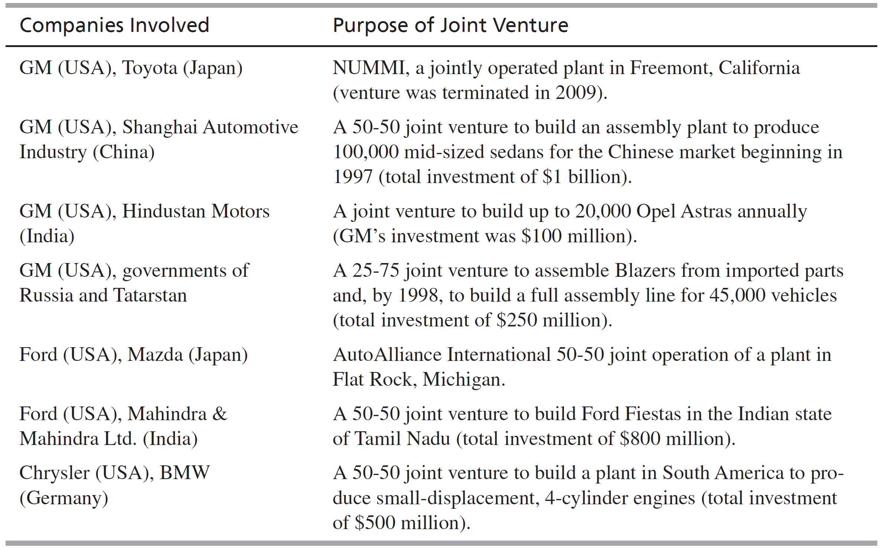
Examples of Market Entry & Expansion by Joint Venture

Slide 16
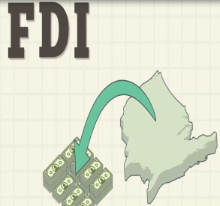
Foreign Direct Investment (FDI)
Foreign direct investment (FDI) happens when a firm invests directly in new facilities to produce and/or market in a foreign country.
Example :
Starbuck purchases an existing UK firm, “British Coffee,” to sell coffee, tea and desserts in the UK.

Slide 17
Indirect investments
Direct investments are when companies make physical investments and purchases in buildings, factories, machines, and other equipment outside of their home country.
Indirect investments are when companies or financial institutions purchase shares in companies on a foreign stock exchange.
No managerial involvement = portfolio investment (Indirect Investment).

Slide 18
Foreign Direct Investment (FDI)
FDI Involves ownership of unit abroad for:
Production
Marketing/service
R&D
Raw materials or other resource access
Parent company has direct managerial control.
The degree of direct managerial control depends on the extent of ownership of the foreign entity and on other contractual terms of the FDI.

Slide 20
Forms of FDI
1. Purchase of existing assets:
Quick entry,
local market know-how,
local financing may be possible,
Eliminate competitor,
Buying problems.

Slide 21
Forms of FDI
2. New investment :
No local entity exists or is available for sale,
local financial incentives may encourage,
No inherited problems,
long lead time to generation of sales or other desired outcome.
3. Participation in an international joint-venture:
Shared ownership with local and/or other non-local partner.

Slide 22
3. Franchising
Franchising:
Franchising is a form of business in which a firm that already has a successful product or service (franchisor) licenses its trademark and method of doing business to another business or individual (franchisee) in exchange for a franchise fee and an ongoing regular payments.

Slide 23
Franchisor–Franchisee relationship
Regulated by contract which usually covers:
Initial fee.
Royalty fee/Management fee.
Capital required from franchisee.
Area of operation.
Duration of license and renewal
Termination (End).

Slide 24
Management contracts
A management contract: is an arrangement under which operational functions of a company is assigned by contract to another company which performs the necessary managerial functions in return for a fee.
Management contracts involve not just selling a method of doing things but involve actually doing them.
A management contract can involve a wide range of functions, such as management of personnel, accounting, marketing services and training.

Slide 25
Management Contracts- Examples
Sports Facility Managers
Property Management
Artist Managers

Slide 26
Contract Manufacturing
Contract Manufacturing:
A firm producing goods under the brand name of a different firm.
In the computer and electronics fields, thousands of products are manufactured by contract manufacturers.
These products are ordered by and branded with the OEM's "original design manufacturer“ name, which sells them to its customers.

Slide 27
Global Strategic Partnerships
Possible terms:
Collaborative agreements
Strategic alliances
Strategic international alliances
Global strategic partnerships
Oneworld is a GSP made up of American Airlines and other airlines around the world.
Notes:
Recent changes in the political, economic, sociocultural, and technological environments of the global firm have combined to change the relative importance of those strategies. Trade barriers have fallen, markets have globalized, consumer needs and wants have converged, product life cycles have shortened, and new communications, technologies, and trends have emerged. Although these developments provide unprecedented market opportunities, there are strong strategic implications for the global organization and new challenges for the global marketer. Such strategies will undoubtedly incorporate—or may even be structured around—a variety of collaborations. Once thought of only as joint ventures with the more dominant party reaping most of the benefits (or losses) of the partnership, cross-border alliances are taking on surprising new configurations and even more surprising players.

Slide 28
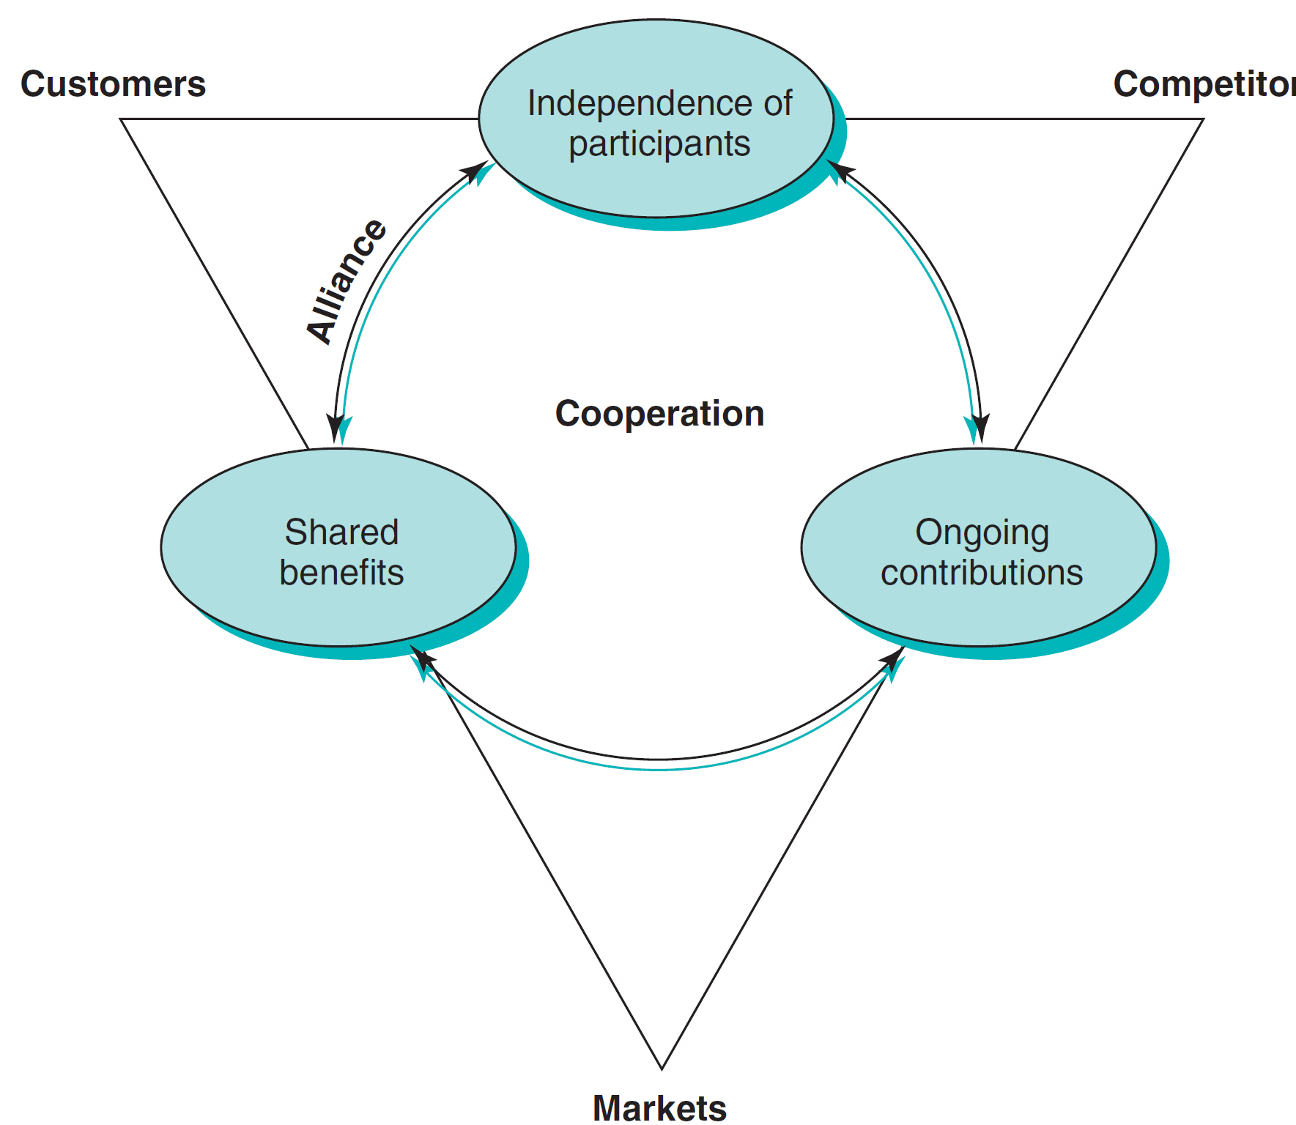
The Nature of Global Strategic Partnerships
Notes:
The terminology used to describe the new forms of cooperation strategies varies widely. The phrases collaborative agreements, strategic alliances, strategic international alliances, and global strategic partnerships (GSPs) are frequently used to refer to linkages between companies from different countries who jointly pursue a common goal. A broad spectrum of inter-firm agreements, including joint ventures, can be covered by this terminology. However, the strategic alliances discussed here exhibit three characteristics which are highlighted in this diagram and discussed on the next slide.

Slide 29
Characteristics of Global Strategic Partnerships
Participants remain independent following formation of the alliance
Participants share benefits of alliance as well as control over performance of assigned tasks
Participants make ongoing contributions in technology, products, and other key strategic areas

Slide 30
Success Factors of Alliances
Mission: Successful GSPs create win-win situations, where participants pursue objectives on the basis of related need or advantage.
Strategy: A company may establish separate GSPs with different partners; strategy must be thought out up front to avoid conflicts.
Governance: Discussion and agreement must be the norms. Partners must be viewed as equals.

Slide 31
Success Factors (Con’t)
Culture: Personal chemistry is important, as is the successful development of a shared set of values.
Organization: Innovative structures and designs may be needed to balance the complexity of multi-country management.
Management: Potentially divisive issues must be identified in advance and clear, unitary lines of authority established that will result in commitment by all partners.

Slide 32
21st Century Cooperative Strategies: Targeting the Digital Future
Alliances between companies in several industries that are undergoing transformation and convergence
Computers
Communications
Consumer electronics
Entertainment
Notes:
Increasing numbers of companies in all parts of the world are entering into alliances that resemble keiretsu. In fact, the phrase digital keiretsu is frequently used to describe alliances between companies in several industries—computers, communications, consumer electronics, and entertainment—that are undergoing transformation and convergence. These processes are the result of tremendous advances in the ability to transmit and manipulate vast quantities of audio, video, and data and the rapidly approaching era of a global electronic "superhighway" composed of fiber optic cable and digital switching equipment.

Slide 33
Market Expansion Strategies
Companies must decide to expand by:
Seeking new markets in existing countries
Seeking new country markets for already identified and served market segments
Notes:
The table illustrates the following strategies:
Strategy 1, country and market concentration, involves targeting a limited number of customer segments in a few countries. This is typically a starting point for most companies. It matches company resources and market investment needs.
Strategy 2, country concentration and segment diversification, a company serves many markets in a few countries. This strategy was implemented by many European companies that remained in Europe and sought growth by expanding into new markets.
Strategy 3, country diversification and market concentration, is the classic global strategy whereby a company seeks out the world market for a product.
Strategy 4, country and segment diversification, is the corporate strategy of a global, multi-business company such as Matsushita. Overall, Matsushita is multi-country in scope and its various business units and groups serve multiple segments.

Slide 34
The End

