Slide 1
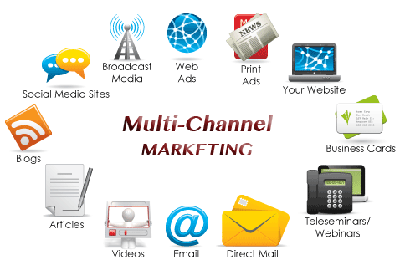
Chapter One
Marketing Channel Concepts

Slide 2
The growing importance of marketing channels
The definition of marketing channels
How marketing channels relate to strategic variables in the marketing mix
The flows in the marketing channels and their relationship to channel management
The principles of specialization, division of labor, and contractual efficiency
The definition of Distribution Channels

Slide 3
Marketing channel
Marketing channel : A marketing channel is the people, organizations, and activities necessary to transfer the ownership of goods from the point of production to the point of consumption.
It is the way products get to the end-user, the consumer; and is also known as a distribution channel.

Slide 4

7Rs - Marketing Channel
1. Right product in 2. Right quantity in 3. Right condition at the 4. Right time and 5. Right place for the 6. Right customer at 7. Right cost .

Slide 5
Distribution Channels
Exist because producers cannot reach all their consumers.
Provide efficiency to the marketing process.
Facilitate smooth flow and create time, place and possession utilities.
Have the core competence and reach .
Provide contact, experience, specialization and scales of operation.

Slide 6
Why the growing importance of marketing channels?
The increase of information technology and E-commerce.
A greater difficulty in gaining a sustainable competitive advantage.
The growing power of distributors, especially retailers in marketing channels.
The need to reduce distribution costs.

Slide 7
A greater difficulty in gaining a sustainable competitive advantage
Place (distribution), or Marketing Channel Strategy
Potential for gaining
competitive advantage
because place is more
difficult for competitors
to copy
Sustainable competitive advantage

Slide 8
The need to reduce distribution costs
Marketing channels are the most recent target for
reducing distribution costs.
The focus is on channel structure and management.

Slide 9
Reasons for increasing importance of marketing channels
Channel strategy is long term.
Channel strategy usually requires a structure.
Channel strategy is based on relationships and people.

Slide 10
What is a channel manager?
Anyone in a firm or organization who is involved in marketing channel decision making

Slide 11
The change of focus to channel strategy
Why Recently More Focus On Channel Strategy ?
Creates competitive advantage with long-term viability.
Builds strong relationships between manufacturers and channel members.
Based on trust, confidence, and people power.

Slide 12
Marketing channel and Marketing management strategy
Marketing channel strategy:
Product flow
Negotiation flow
Ownership flow
Information flow
Promotion flow
Marketing management strategy:
Product
Price
Promotion
Place (Distribution)

Slide 13
Marketing Channel Strategy
Product Flow
Negotiation Flow
Ownership Flow
Information Flow
Promotion Flow

Slide 14
Product Flow
Manufacturer
Transportation Company
Wholesalers
Retailers
Consumer

Slide 15
Negotiation Flow
Manufacturer
Wholesalers
Retailers
Consumer

Slide 16
Ownership Flow
Manufacturer
Wholesalers
Retailers
Consumer

Slide 17
Information Flow
Manufacturer
Transportation Company
Wholesalers
Retailers
Consumer

Slide 18
Promotion Flow
Manufacturer
Advertising Agency
Wholesalers
Retailers
Consumer

Slide 19
The Marketing Mix
Product
Place
Price
Promotion
Distribution channels help in the ‘place’ aspect of the marketing mix
Distribution provides place, time and possession utility to the consumer.

Slide 20
How does marketing channel strategy relate to the rest of the marketing mix?
Marketing Mix or the four Ps | Challenges
Product | Limited ability to gain and hold competitive advantage
Price | Price wars decrease profitability & provide unstable basis for sustaining competitive advantage
Promotion | Expensive and short-lived
Place (Distribution) | Marketing channels support & enhance other Ps to meet demands of target markets

