Slide 1
Phys 110
Chapter 8b
Potential Energy

Slide 2
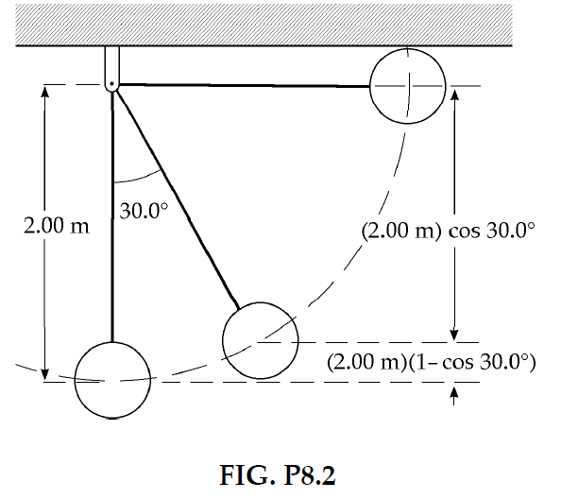

PROBLEMS
Section 8.1 Potential Energy of a System
2. A 400-N child is in a swing that is attached to ropes 2.00 m long. Find the gravitational potential energy of the child–Earth system relative to the child’s lowest position when (a) the ropes are horizontal, (b) the ropes make a 30.0° angle with the vertical, and (c) the child is at the bottom of the circular arc.
SOLUTIONS TO PROBLEM:
$$U_{g}=mgy$$
$$y=2$$
$$y=2(1−\cos{θ})$$
$$y=0$$

Slide 3

PROBLEMS
Section 8.1 Potential Energy of a System
6. Dave Johnson, the bronze medalist at the 1992 Olympic decathlon in Barcelona, leaves the ground at the high jump with vertical velocity component 6.00 m/s. How far does his center of mass move up as he makes the jump?
SOLUTIONS TO PROBLEM:
$$K_{i}+U_{i}=K_{f}+U_{f}$$
$$\frac{1}{2}mv^{2}+0=0+mgy$$

Slide 4
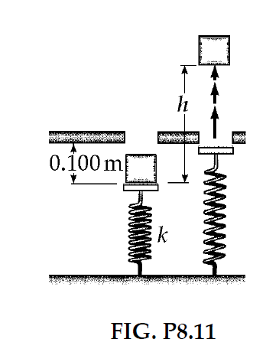
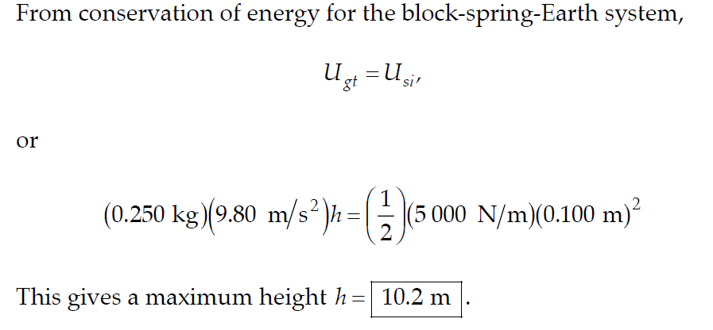
PROBLEMS
Section 8.1 Potential Energy of a System
11. A block of mass 0.250 kg is placed on top of a light vertical spring of force constant 5 000 N/m and pushed downward so that the spring is compressed by 0.100 m. After the block is released from rest, it travels upward and then leaves the spring. To what maximum height above the point of release does it rise?
SOLUTIONS TO PROBLEM:

Slide 5
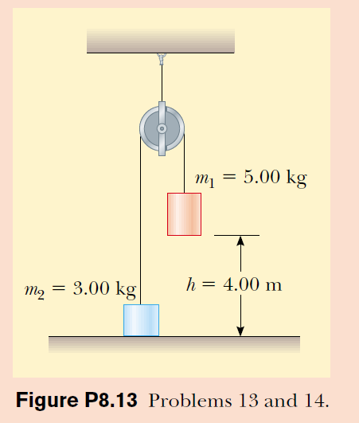
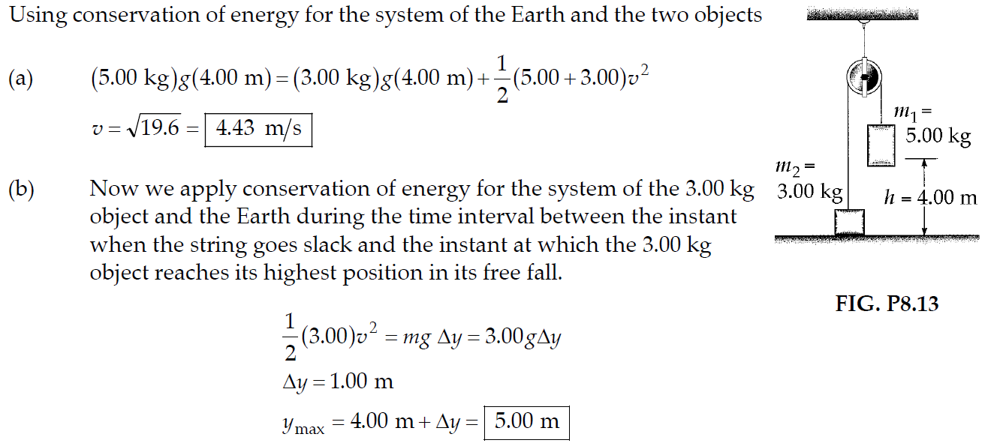
PROBLEMS
Section 8.1 Potential Energy of a System
13. Two objects are connected by a light string passing over a light frictionless pulley as shown in Figure P8.13. The object of mass 5.00 kg is released from rest. Using the principle of conservation of energy, (a) determine the speed of the 3.00-kg object just as the 5.00-kg object hits the ground. (b) Find the maximum height to which the 3.00-kg object rises.
SOLUTIONS TO PROBLEM:
Notes:
a) Ki+Ui=Kf+Uf , 0+(m1gh+0)=1/2 (m1+m2)vf2 +(m2gh+0).
b) Ki+Ui=Kf+Uf , ½ m2v2+0+ (m2gh+0)=0+m2gymax then, ymax=5m.

Slide 6
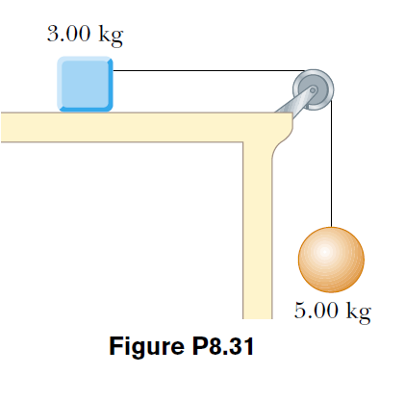
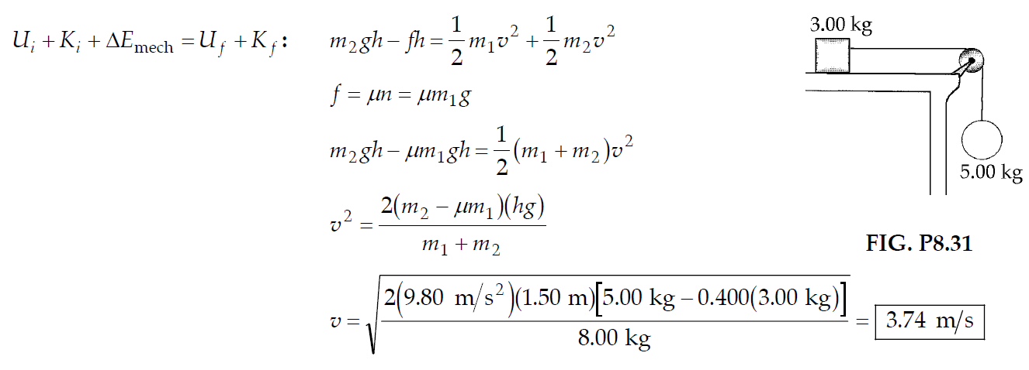
PROBLEMS
Section 8.4 Changes in Mechanical Energy for Nonconservative Forces
31. The coefficient of friction between the 3.00-kg block and the surface in Figure P8.31 is 0.400. The system starts from rest. What is the speed of the 5.00-kg ball when it has fallen 1.50 m?
SOLUTIONS TO PROBLEM:
Notes:
(Kf-Ki)+(Uf-Ui)=-fh+w other forces
½(m1+m2)v2-0+ [m2g(y-h)-m2gy=-fh

Slide 7
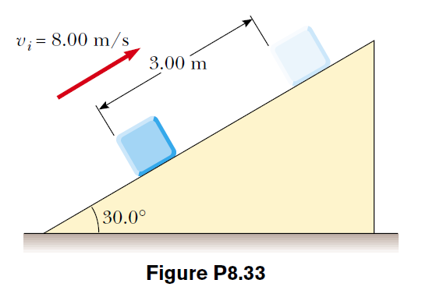
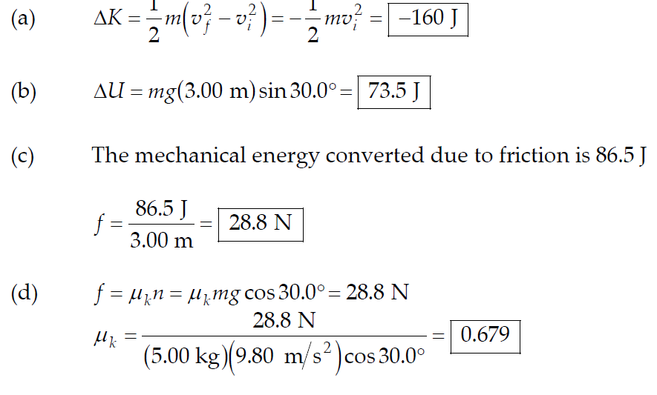
PROBLEMS
Section 8.4 Changes in Mechanical Energy for Nonconservative Forces
33. A 5.00-kg block is set into motion up an inclined plane with an initial speed of 8.00 m/s (Fig. P8.33). The block comes to rest after traveling 3.00 m along the plane, which is inclined at an angle of 30.0° to the horizontal. For this motion determine
(a) the change in the block’s kinetic energy, (b) the change in the potential energy of the block–Earth system, and (c) the friction force exerted on the block (assumed to be constant). (d) What is the coefficient of kinetic friction?
SOLUTIONS TO PROBLEM:

Slide 8
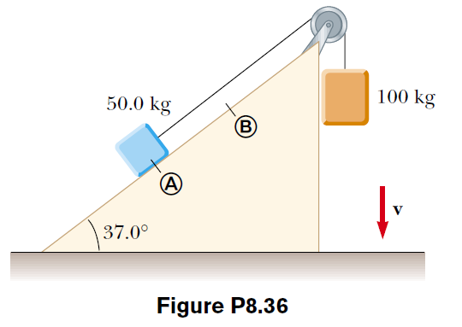
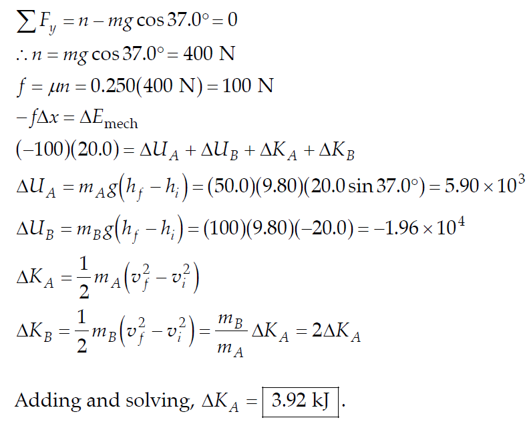
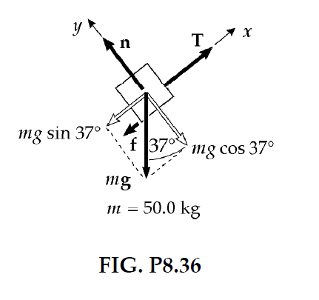
PROBLEMS
Section 8.4 Changes in Mechanical Energy for Nonconservative Forces
36. A 50.0-kg block and a 100-kg block are connected by a string as in Figure P8.36. The pulley is frictionless and of negligible mass. The coefficient of kinetic friction between the 50.0 kg block and incline is 0.250. Determine the change in the kinetic energy of the 50.0-kg block as it moves from A to B, a distance of 20.0 m.
SOLUTIONS TO PROBLEM:

Slide 9
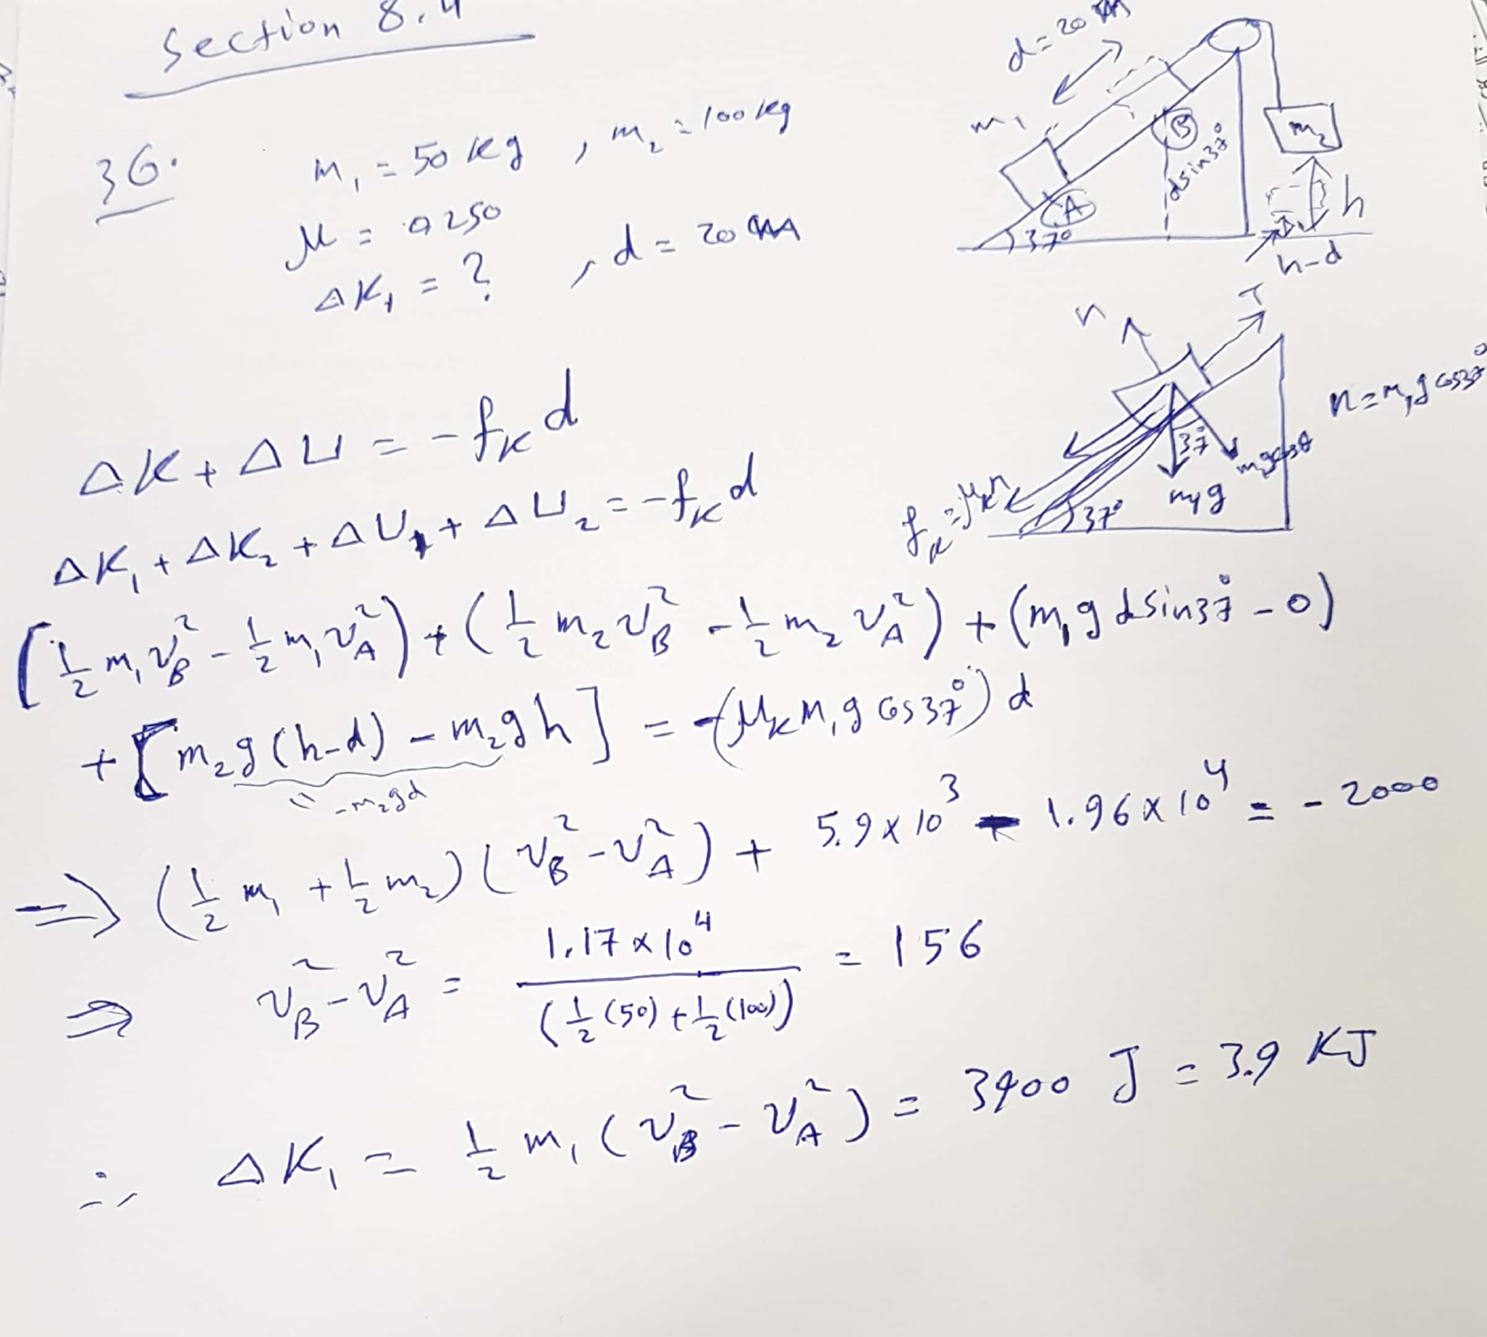

Slide 10
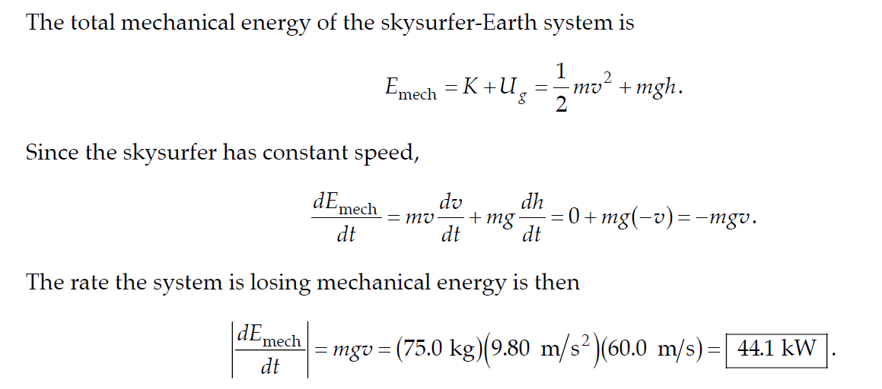
PROBLEMS
Section 8.4 Changes in Mechanical Energy for Nonconservative Forces
38. A 75.0-kg skysurfer is falling straight down with terminal speed 60.0 m/s. Determine the rate at which the skysurfer–Earth system is losing mechanical energy.
SOLUTIONS TO PROBLEM:

Slide 11
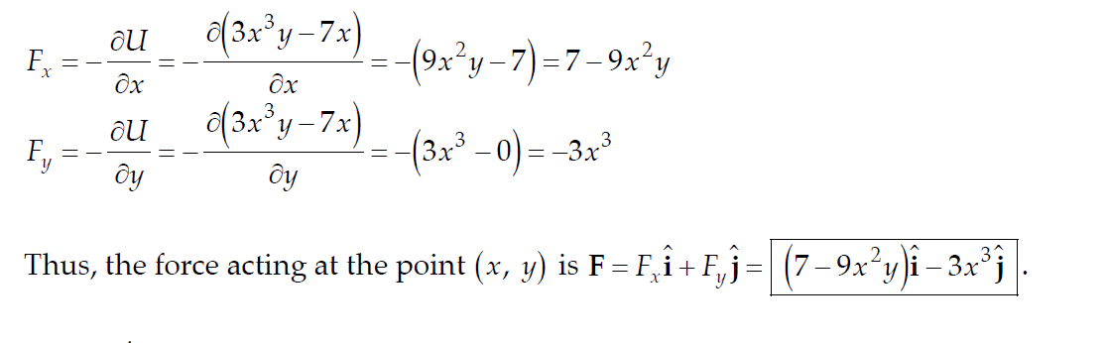
PROBLEMS
Section 8.5 Relationship Between Conservative Forces and Potential Energy
42. A potential-energy function for a two-dimensional force is of the form
U =3x³y - 7x.
Find the force that acts at the point (x, y).
SOLUTIONS TO PROBLEM:

Slide 12
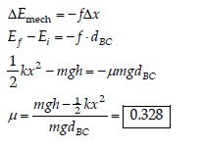
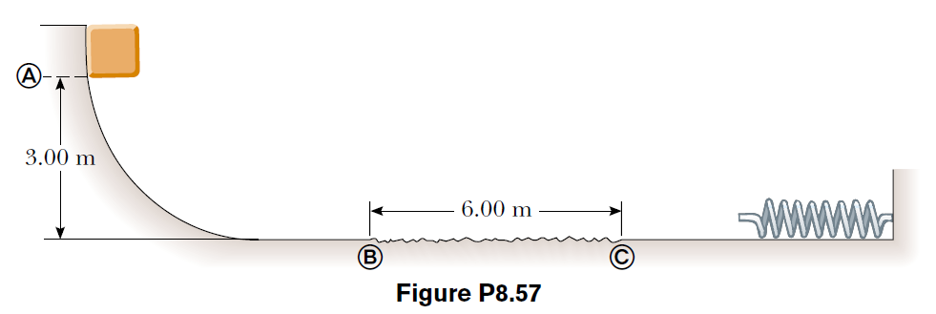
PROBLEMS
Additional Problems
57. A 10.0-kg block is released from point A in Figure P8.57. The track is frictionless except for the portion between points B and C , which has a length of 6.00 m. The block travels down the track, hits a spring of force constant 2 250 N/m, and compresses the spring 0.300 m from its equilibrium position before coming to rest momentarily.
Determine the coefficient of kinetic friction between the block and the rough surface between B and C.
SOLUTIONS TO PROBLEM:

