Slide 1
Phys 110
Chapter 7
Energy and Energy Transfer
By
Prof. Dr. Bandar Ali Al-Asbahi

Slide 2
LECTURE OUTLINE
7.2 Work Done by a Constant Force
7.3 The Scalar Product of Two Vectors
7.4 Work Done by a Varying Force
7.5 Kinetic Energy and the Work–Kinetic Energy Theorem
7.6 The Nonisolated System—Conservation of Energy
7.7 Situations Involving Kinetic Friction
7.8 Power

Slide 3
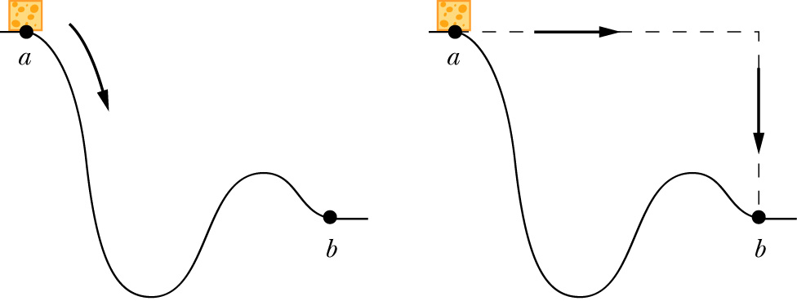
Why Energy?
Why do we need a concept of energy?
The energy approach to describing motion is particularly useful when Newton’s Laws are difficult or impossible to use
Energy is a scalar quantity. It does not have a direction associated with it

Slide 4
What is Energy?
Energy is a property of the state of a system, not a property of individual objects: we have to broaden our view.
Some forms of energy:
  Mechanical:
    Kinetic energy (associated with motion, within system)
    Potential energy (associated with position, within system)
  Chemical
  Electromagnetic
  Nuclear
Energy is conserved. It can be transferred from one object to another or change in form, but cannot be created or destroyed

Slide 5
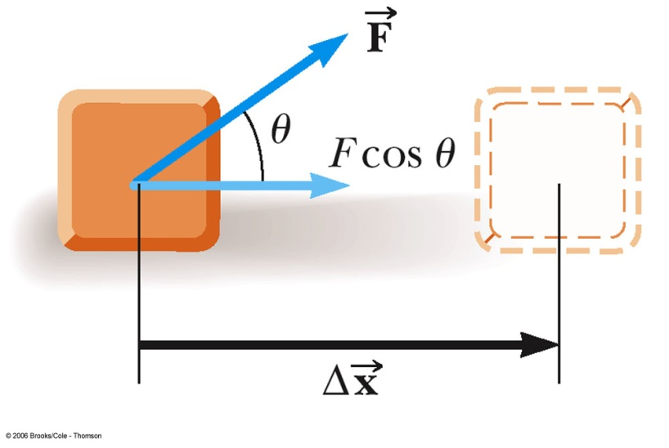
Definition of Work W
7.2 Work Done by a Constant Force
The work, W, done by a constant force on an object is defined as the product of the component of the force along the direction of displacement and the magnitude of the displacement
  F is the magnitude of the force
  Δ x is the magnitude of the
  object’s displacement
  θ is the angle between

Slide 6
Work Unit
This gives no information about
  the time it took for the displacement to occur
  the velocity or acceleration of the object
Work is a scalar quantity
SI Unit
  Newton • meter = Joule
    N • m = J
    J = kg • m² / s² = ( kg • m / s² ) • m

Slide 7

Work: + or -?
Work can be positive, negative, or zero. The sign of the work depends on the direction of the force relative to the displacement
  Work positive: W > 0 if 90°> θ > 0°
  Work negative: W < 0 if 180°> θ > 90°
  Work zero: W = 0 if θ = 90°
  Work maximum if θ = 0°
  Work minimum if θ = 180°

Slide 8
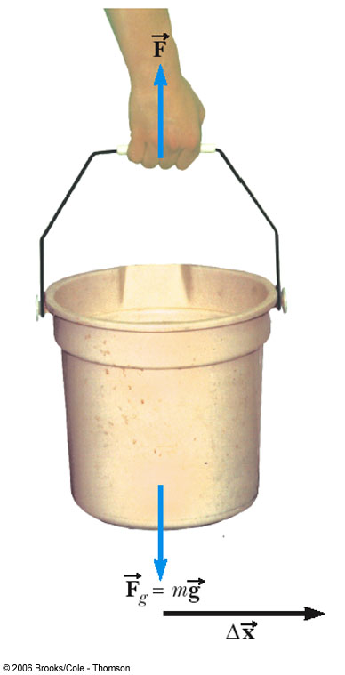
Example: When Work is Zero
A man carries a bucket of water horizontally at constant velocity.
The force does no work on the bucket
Displacement is horizontal
Force is vertical
cos 90° = 0

Slide 9
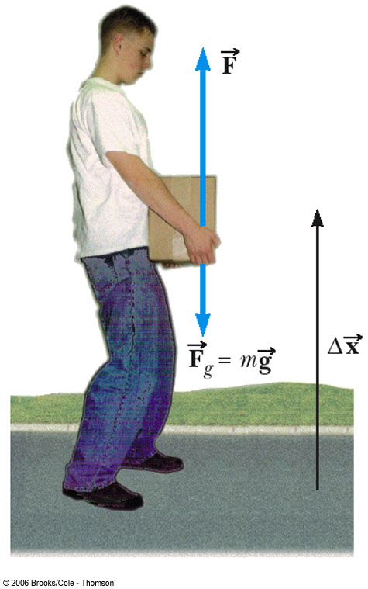
Example: Work Can be Positive or Negative
Work is positive when lifting the box
Work would be negative if lowering the box
  The force would still be upward, but the displacement would be downward

Slide 10
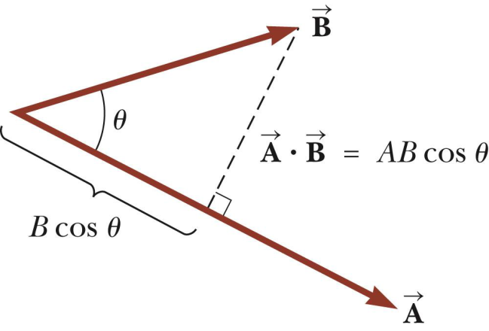
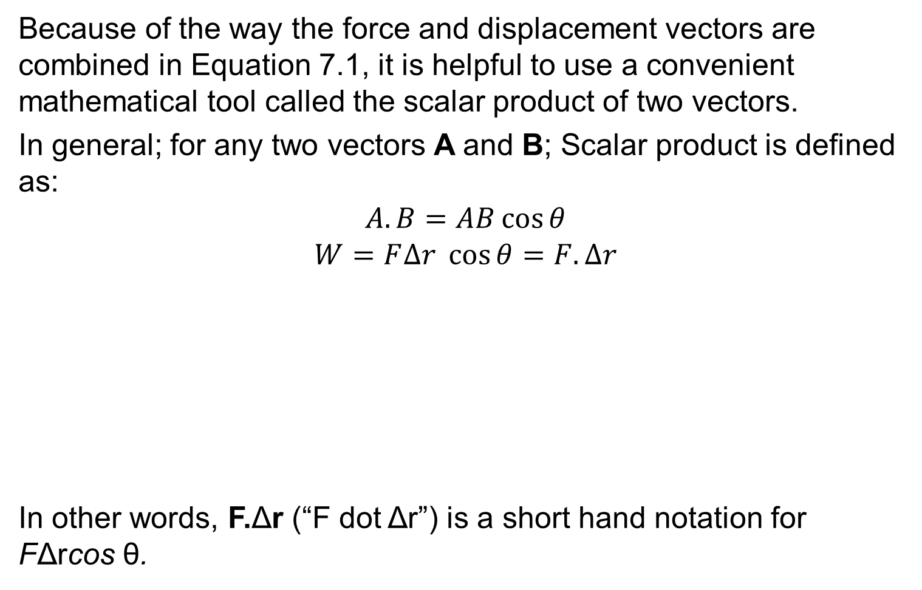
7.3 The Scalar Product of Two Vectors
Because of the way the force and displacement vectors are combined in Equation 7.1, it is helpful to use a convenient mathematical tool called the scalar product of two vectors.
In general; for any two vectors A and B; Scalar product is defined as:
$$A.B=AB\cos{θ}$$
$$W=F∆r \cos{θ=F.∆r}$$
In other words, F.Δr (“F dot Δr”) is a short hand notation for FΔrcos θ.

Slide 11
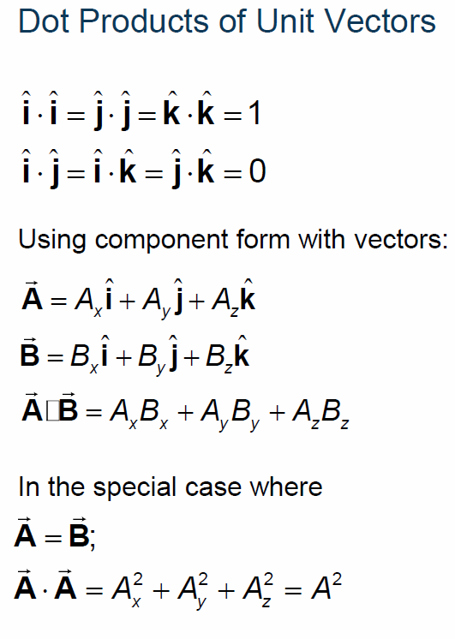
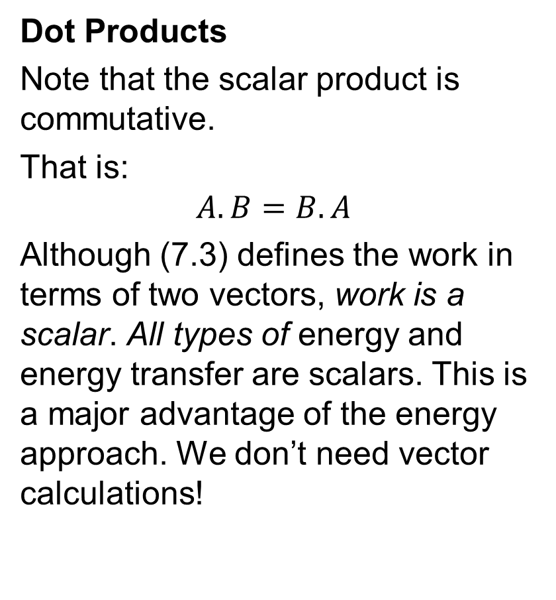
7.3 The Scalar Product of Two Vectors
Dot Products
Note that the scalar product is commutative.
That is:
$$A.B=B.A$$
Although (7.3) defines the work in terms of two vectors, work is a scalar. All types of energy and energy transfer are scalars. This is a major advantage of the energy approach. We don’t need vector calculations!

Slide 12
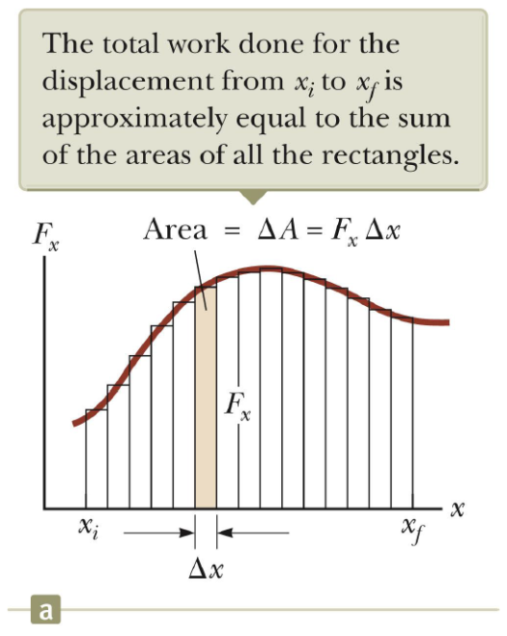
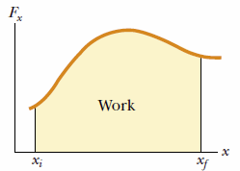

7.4 Work Done by a Varying Force
If a force F_{x} is varying with position, x, we can express the work done by F_{x} as the particle moves from x_{i} to x_{f} as:
$$W≈\sum_{x_{i}}^{x_{f}}{F_{x} ∆x}$$
or
$$W=\int_{x_{i}}^{x_{f}}{F_{x} dx}$$
The work done by the component F_{x} of the varying force as the particle moves from x_{i} to x_{f} exactly equal to the area under this curve.
$$W=\int_{x_{i}}^{x_{f}}{F_{x} dx}$$

Slide 13
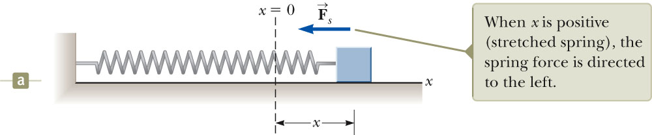
Work Done By a Spring
Spring force

Slide 14
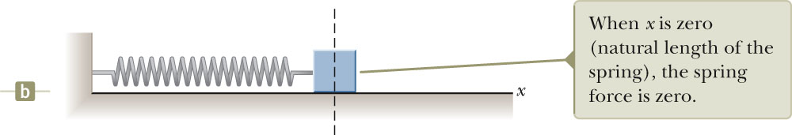
Spring at Equilibrium
F = 0

Slide 15
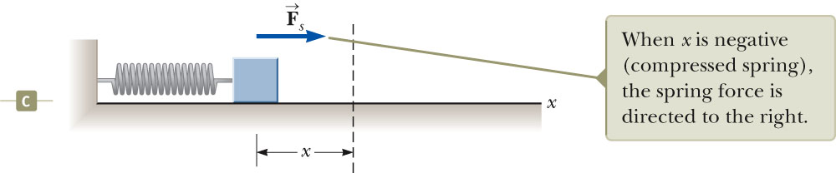
Spring Compressed

Slide 16
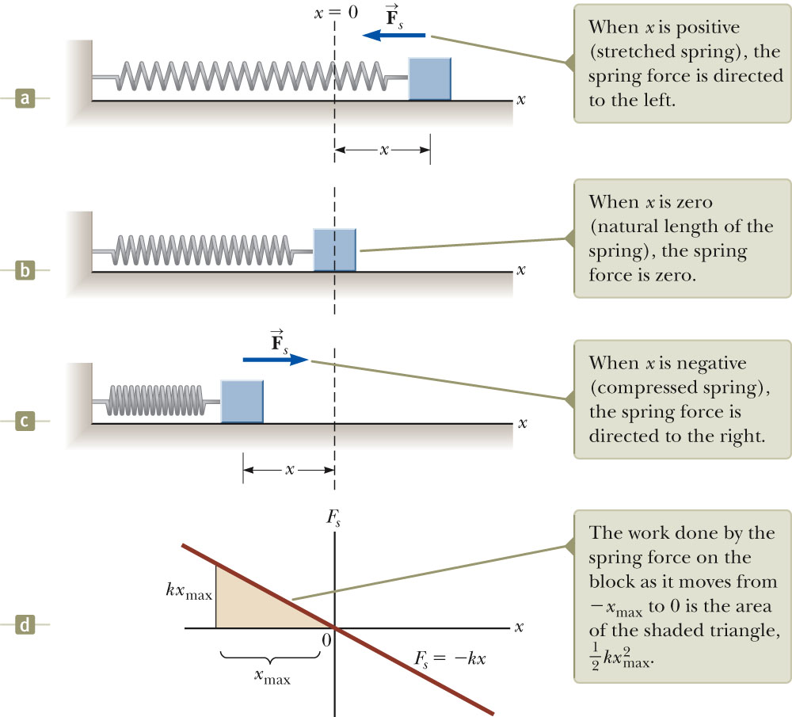
Work done by
spring on block
Fig. 7.9, p. 173
Notes:
The force exerted by a spring on a block varies with the block’s position x relative to the equilibrium position x = 0. (a) x is positive. (b) x is zero. (c) x is negative. (d) Graph of Fs versus x for the block–spring system.

Slide 17
Quick Quiz
A dart is loaded into a spring-loaded toy dart gun by pushing the spring in by a distance d. For the next loading, the spring is compressed a distance 2d. How much work is required to load the second dart compared to that required to load the first?
(a) four times as much (b) two times as much (c) the same (d) half as
much (e) one-fourth as much.
(a). Because the work done in compressing a spring is proportional to the square of the compression distance x, doubling the value of x causes the work to increase fourfold.

Slide 18
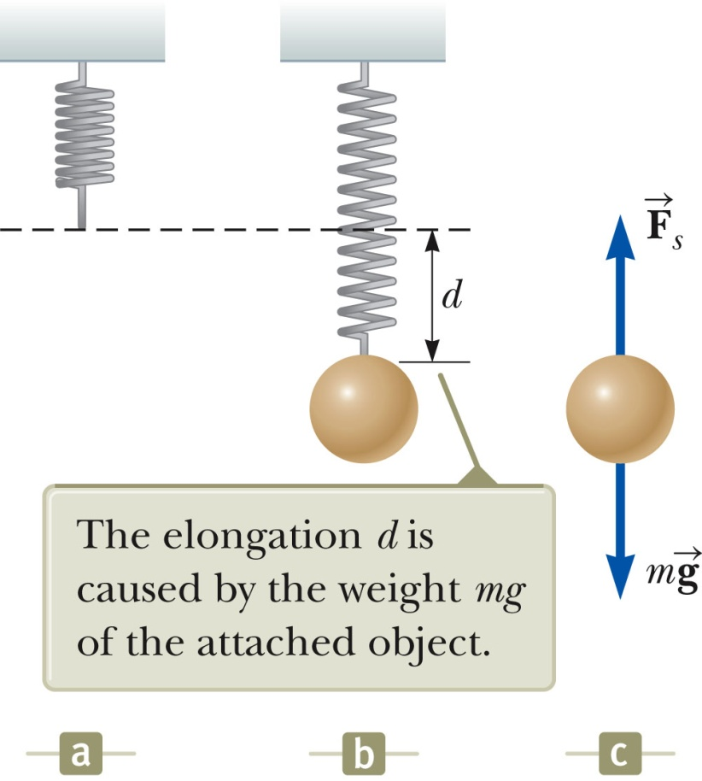
Measuring Spring Constant
Start with spring at its natural equilibrium length.
Hang a mass on spring and let it hang to distance d (stationary)
From
so can get spring constant.

Slide 19
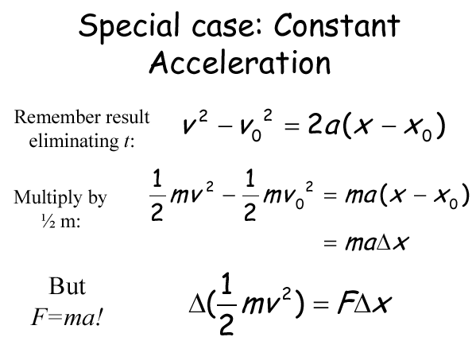
7.5 Kinetic Energy and the Work–Kinetic Energy Theorem

Slide 20
Work-Kinetic Energy Theorem
When work is done by a net force on an object and the only change in the object is its speed, the work done is equal to the change in the object’s kinetic energy
  Speed will increase if work is positive
  Speed will decrease if work is negative

Slide 21
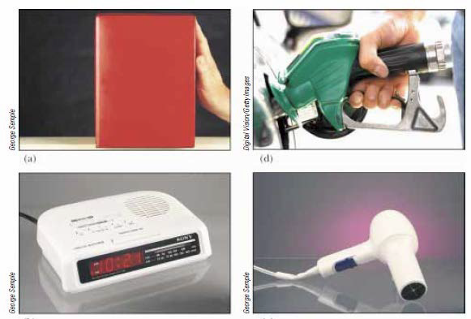
7.6 The Nonisolated System-Conservation of Energy
A particle, that is acted on by various forces, resulting in a change in its kinetic energy is an example of nonisolated system.
Another example: when a body slides on a surface, heat will be generated although kinetic energy of the surface has not changed.
Methods of Energy Transfer:Work
Mechanical Waves
Heat
Matter transfer
Electrical Transmission
Electromagnetic radiation

Slide 22

7.6 The Nonisolated System-Conservation of Energy
We can neither create nor destroy energy—energy is always conserved. Thus, if the total amount of energy in a system changes, it can only be due to the fact that energy has crossed the boundary of the system by a transfer mechanism such as one of the methods listed above. This is a general statement of the principle of conservation of energy.
$$∆E_{system}=\sum{T}$$
Change in the total energy of the system = the amount of energy transferred across the system boundary by some mechanism

Slide 23


7.7 Situations Involving Kinetic Friction
Change in Kinetic energy is linked to the work done by a frictional force as:
Or:
If there are other forces besides friction acting on an object, the change in kinetic energy is the sum of that due to the other forces from the work–kinetic energy theorem, and that due to friction:
.
The result of a friction force is to transform kinetic energy into internal energy, and the increase in internal energy is equal to the decrease in kinetic energy.

Slide 24
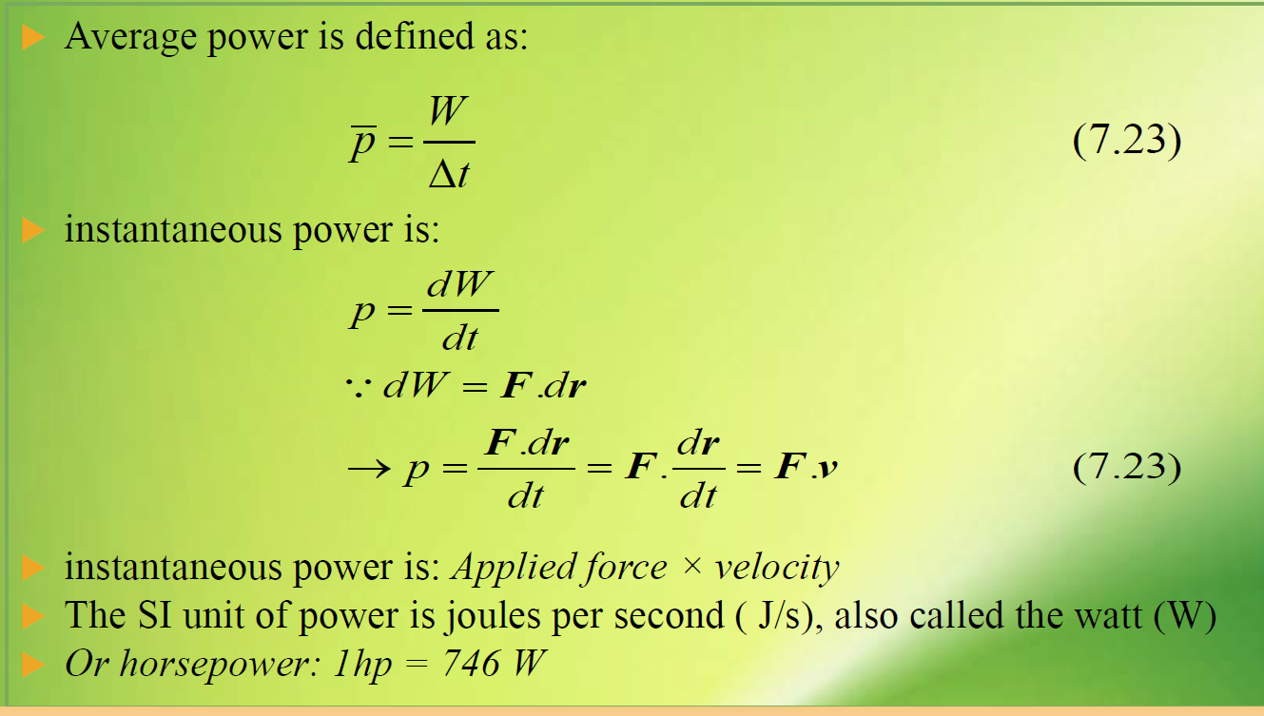
7.8 Power
.

Slide 25
Quick Quiz
An older model car accelerates from rest to speed v in 10 seconds. A newer, more powerful sports car accelerates from rest to 2v in the same time period. What is the ratio of the power of the newer car to that of the older car?
0.25 (b) 0.5 (c) 1 (d) 2 (e) 4
(e). Because the speed is doubled, the kinetic energy is four times as large. This kinetic energy was attained for the newer car in the same time interval as the smaller kinetic energy for the older car, so the power is four times as large.

Slide 26


Lecture Summary
The work W done on a system by an agent exerting a constant force on the system is :
$$W=F.∆r=F∆r\cos{θ}$$
If a force F_{x} is varying with position, x, we can express the work done by F_{x} as the particle moves from x_{i} to x_{f} as:
$$W=\int_{x_{i}}^{x_{f}}{F_{x} dx}$$
Work done by spring on block:
The work–kinetic energy theorem, and that due to friction:

