Slide 1
Phys 110
Chapter 2
Motion in One Dimension

Slide 2
LECTURE OUTLINE
2.1 Position, Velocity, and Speed
2.2 Instantaneous Velocity and Speed
2.3 Acceleration
2.5 One-Dimensional Motion with Constant Acceleration
2.6 Freely Falling Objects

Slide 3
Introduction
Kinematics:
Describes motion while ignoring the external agents that might have caused or modified the motion.
For now, will consider motion in one dimension
along a straight line .
Motion represents a continuous change in the position of an object.

Slide 4
Introduction
Types of Motion
Translational
An example is a car traveling on a highway. Rotational
An example is the Earth’s spin on its axis. Vibrational
An example is the back-and-forth movement of a pendulum.

Slide 5
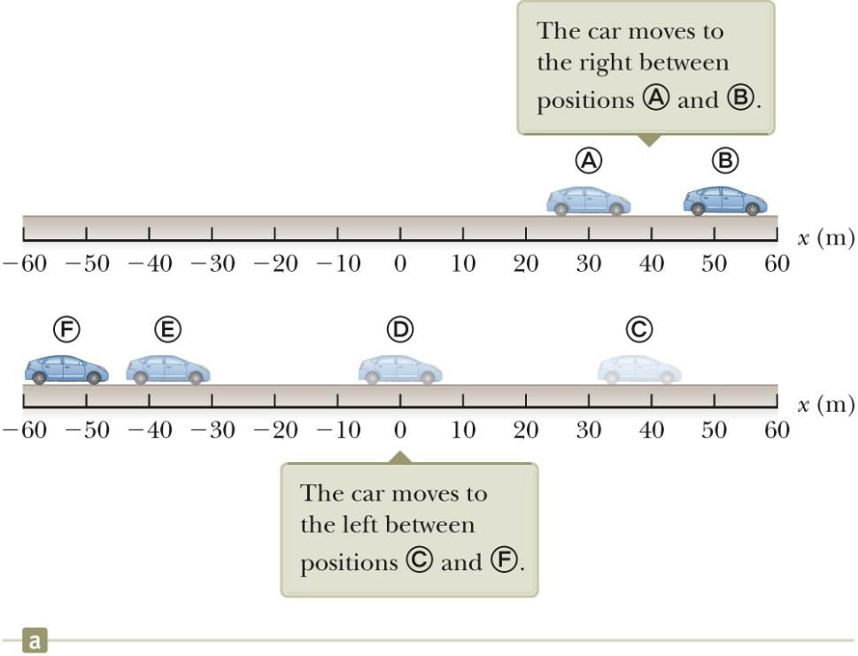
2.1 Position, Velocity, and Speed
Position
The object’s position is its location with respect to a chosen reference point.
Consider the point to be the origin of a coordinate system. Only interested in the car’s translational motion, so model as a particle

Slide 6
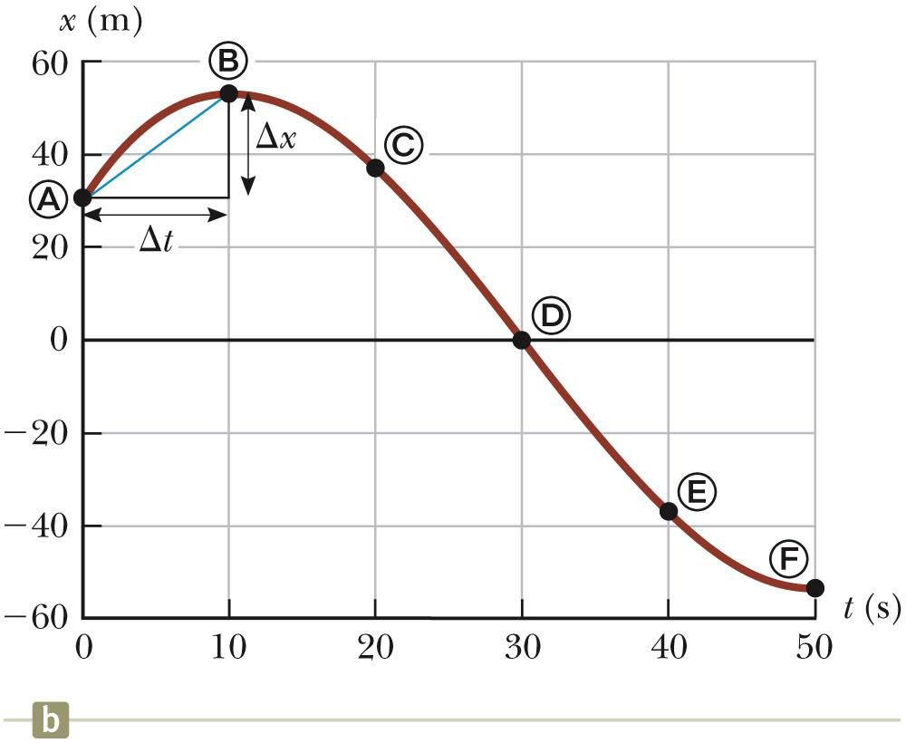
2.1 Position, Velocity, and Speed
Position-Time Graph
The position-time graph shows the motion of the particle (car). The smooth curve is a guess as to what happened between the data points.

Slide 7

2.1 Position, Velocity, and Speed
Displacement
The displacement of a particle is defined as its change in position in some time interval.
$$∆x=x_{f}−x_{i}\left\{\begin{matrix}∆x>0 or x_{f}>x_{i}\text{ :}\text{motion} \text{to} \text{th}\text{e} \text{right}→+ \\ ∆x<0 or x_{f}<x_{i} \text{:}\text{motion} \text{to} \text{the} \text{left} ←− \\ \begin{aligned}∆x=0 or x_{f}=x_{i}\text{ :}\text{object} \text{returned} \text{to} \\ \text{its} \text{initial} \text{position}\text{,}\text{or} \text{there} \text{was} \text{no} \text{motion} \end{aligned}\end{matrix}\right.$$
Displacement is an example of a vector quantity.
(requires the specification of both direction and magnitude)
Distance
Distance is the length of a path followed by a particle.
Distance is an example of a scalar quantity.
(scalar quantity has a numerical value and no direction.)

Slide 8
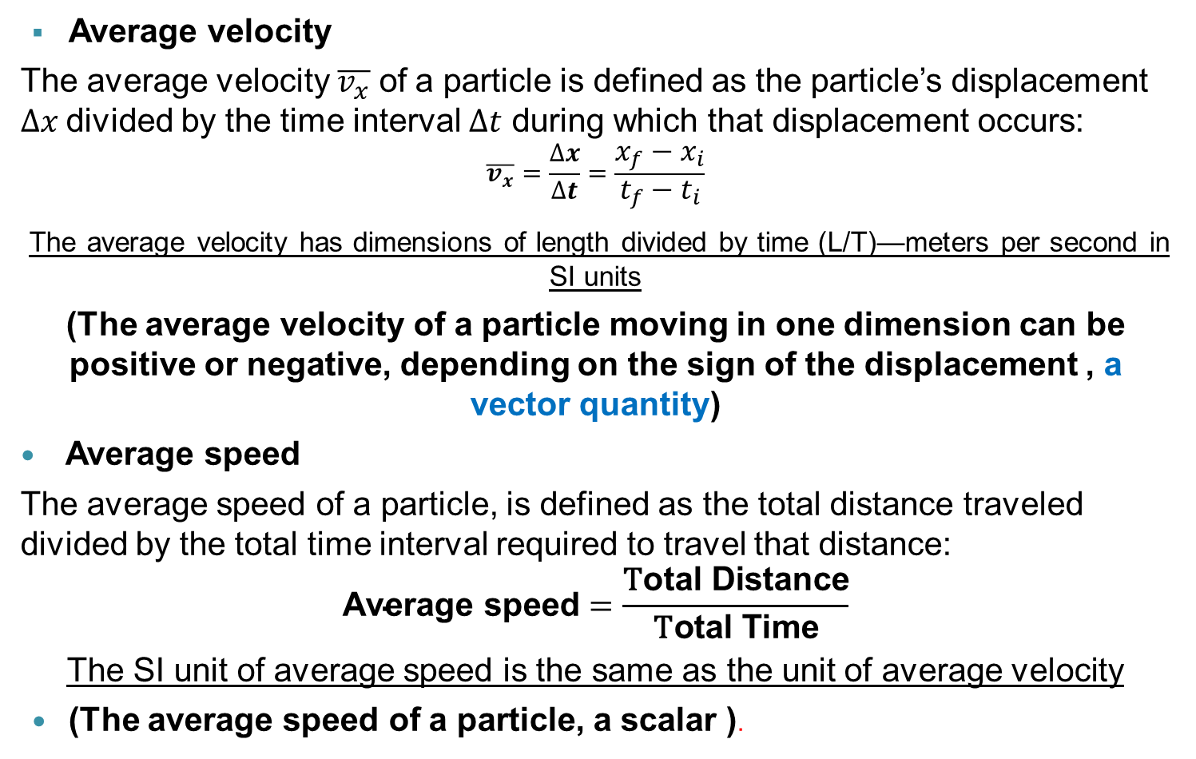
2.1 Position, Velocity, and Speed
Average velocity
The average velocity $\overline{v_{x}}$ of a particle is defined as the particle’s displacement $∆x$divided by the time interval $∆t$ during which that displacement occurs:
$$\overline{v_{x}}=\frac{∆x}{∆t}=\frac{x_{f}−x_{i}}{t_{f}−t_{i}}$$
The average velocity has dimensions of length divided by time (L/T)—meters per second in SI units
(The average velocity of a particle moving in one dimension can be positive or negative, depending on the sign of the displacement , a vector quantity)
Average speed
The average speed of a particle, is defined as the total distance traveled divided by the total time interval required to travel that distance:
$$\text{Average} \text{speed}=\frac{\text{T}\text{otal} \text{D}\text{istance}}{\text{T}\text{otal} \text{T}\text{ime}}$$
The SI unit of average speed is the same as the unit of average velocity
(The average speed of a particle, a scalar ).

Slide 9
Quick Quiz 2.1 Under which of the following conditions is the magnitude of the average velocity of a particle moving in one dimension smaller than the average speed over some time interval? (a) A particle moves in the +x direction without reversing. (b) A particle moves in the -x direction without reversing. (c) A particle moves in the +x direction and then reverses the direction of its motion. (d) There are no conditions for which this is true.
c)If the particle moves along a line without changing direction, the displacement and distance traveled over any time interval will be the same. As a result, the magnitude of the average velocity and the average speed will be the same. If the particle reverses direction, however, the displacement will be less than the distance traveled. In turn, the magnitude of the average velocity will be smaller than the average speed.

Slide 10
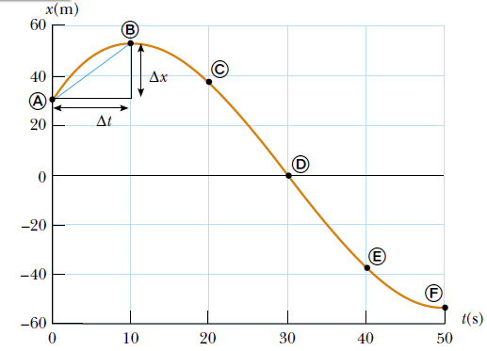

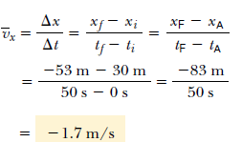
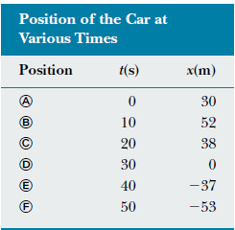
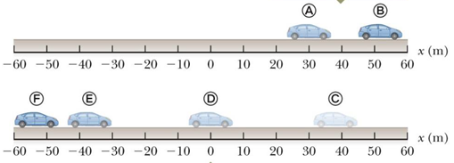

2.1 Position, Velocity, and Speed
Average velocity and Average speed
Example 2.1 Calculating the Average Velocity and Speed
Find the displacement, average velocity, and average speed of the car in Figure 2.1a between positions A and F.
Solution From the position–time graph given in Figure 2.1b, note that XA = 30 m at tA =0 s and that XF =53 m at tF=50 s. Using these values along with the definition of
displacement, Equation 2.1, we find that
Notes:
Average speed=(22+52+53)/50 = 127/50 = 2.5 m/s

Slide 11
Homework
A particle moves according to the equation x = 10t² where x is in meters and t is in seconds. (a) Find the average velocity for the time interval from 2.00 s to 3.00 s. (b) Find the average velocity for the time interval from 2.00 to 2.10 s.
A person walks first at a constant speed of 5.00 m/s along a straight line from point A to point B and then back along the line from B to A at a constant speed of 3.00 m/s.
What is (a) his average speed over the entire trip? (b) his average velocity over the entire trip?

Slide 12
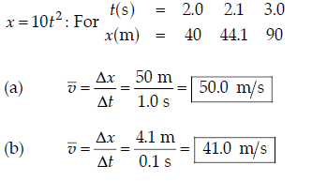
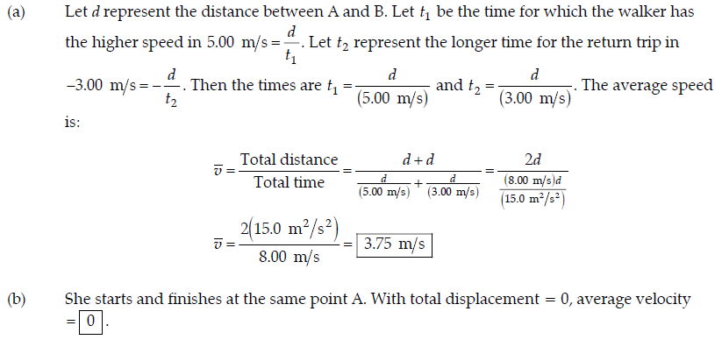

Slide 13
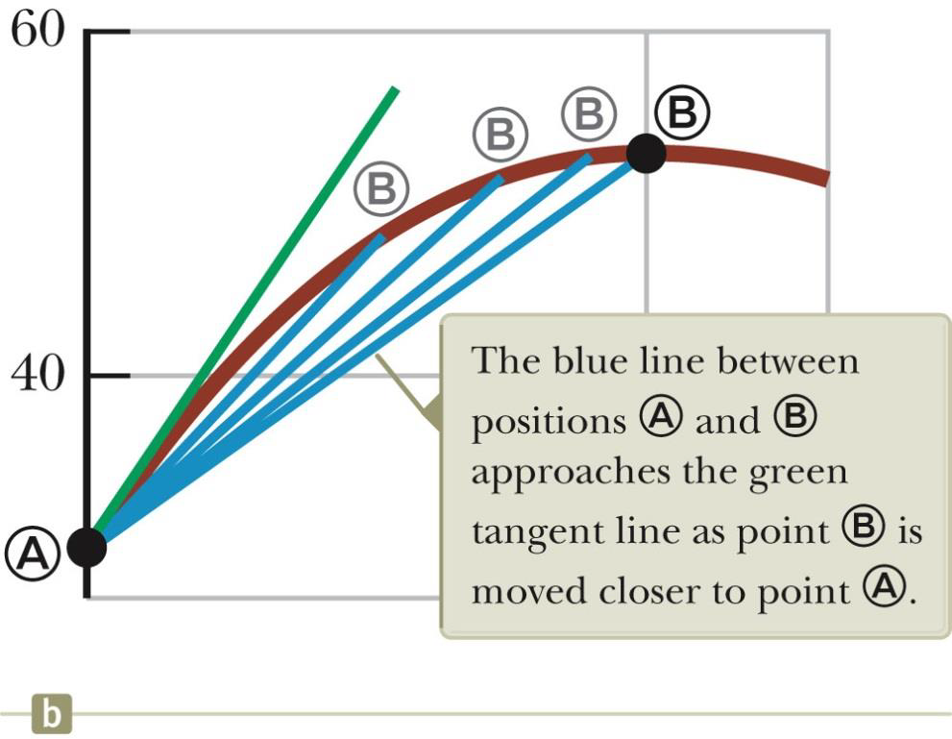

2.2 Instantaneous Velocity and Speed
Instantaneous Velocity
The limit of the average velocity as the time interval becomes infinitesimally short, or as the time interval approaches zero.
$$v_{x}=\lim_{∆t→0}{\frac{∆x}{∆t}=\frac{dx}{dt}}$$
$v_{x}=0$(at maxima or minima) particle is momentarily at rest
The instantaneous velocity indicates what is happening at every point of time.
Instantaneous Speed
The instantaneous speed is the magnitude of the instantaneous velocity.
The instantaneous speed has no direction associated with it and hence carries no algebraic sign.

Slide 14
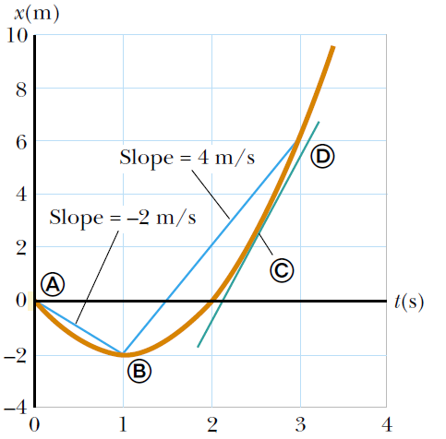
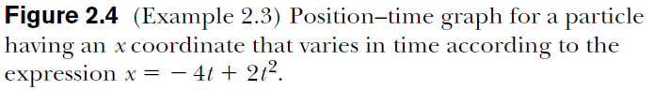

2.2 Instantaneous Velocity and Speed
Example 2.3 Average and Instantaneous Velocity
A particle moves along the x axis. Its position varies with time according to the expression x =-4t + 2t² where x is in meters and t is in seconds. The position–time graph for this motion is shown in Figure . Note that the particle moves in the negative x direction for the first second of motion, is momentarily at rest at the moment t = 1 s, and moves in the positive x direction at times $t>1s$ .

Slide 15
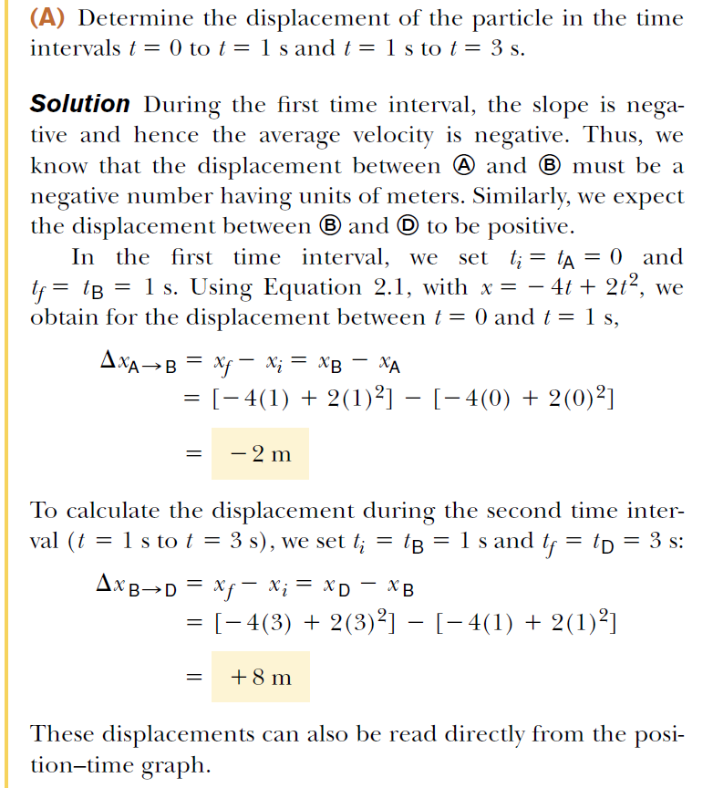
2.2 Instantaneous Velocity and Speed
Example 2.3 Average and Instantaneous Velocity

Slide 16
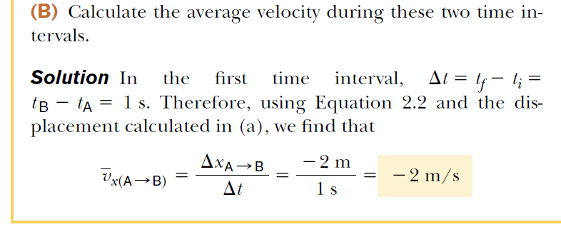
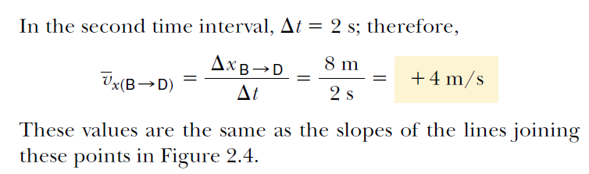
2.2 Instantaneous Velocity and Speed
Example 2.3 Average and Instantaneous Velocity

Slide 17
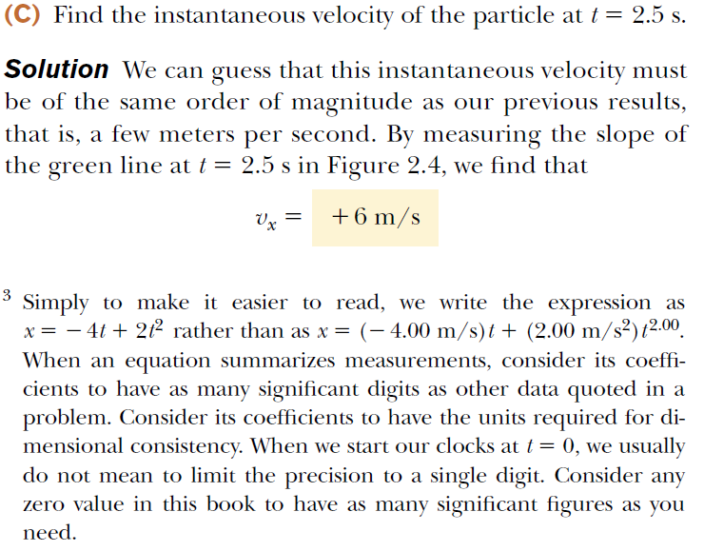
2.2 Instantaneous Velocity and Speed
Example 2.3 Average and Instantaneous Velocity

Slide 18

Lecture Summary
After a particle moves along the x axis from some initial position $x_{i}$ to some final position $x_{f}$, its displacement is
$$∆x=x_{f}−x_{i}$$
The average velocity of a particle during some time interval is the displacement Δx divided by the time interval Δt during which that displacement occus:
$$\overline{v_{x}}=\frac{∆x}{∆t}=\frac{x_{f}−x_{i}}{∆t}$$
The average speed of a particle is equal to the ratio of the total distance it travels to the total time interval during which it travels that distance:
$$\text{Average} \text{speed}=\frac{\text{T}\text{otal} \text{Distance}}{\text{T}\text{otal} \text{Time}}$$

Slide 19

Lecture Summary
The instantaneous velocity of a particle is defined as:
$$v_{x}=\lim_{∆t→0}{\frac{∆x}{∆t}=\frac{dx}{dt}}$$
The instantaneous speed of a particle is equal to the magnitude of its instantaneous velocity.

Slide 20
Homework
A particle moves along the x axis according to the equation
x = 2.00 + 3.00 t – 1.00 t², where x is in meters and t is in seconds. At t = 3.00 s, find:
(a) the position of the particle,
(b) its velocity
(c) its acceleration.

