Slide 1
Phys 110
Chapter 14
Fluid Mechanics

Slide 2
LECTURE OUTLINE
14.1 Pressure
14.2 Variation of Pressure with Depth
14.3 Pressure Measurements
14.4 Buoyant Forces and Archimedes’s Principle
14.5 Fluid Dynamics
14.6 Bernoulli’s Equation

Slide 3
A ﬂuid is a collection of molecules that are randomly arranged and held together by weak cohesive forces and by forces exerted by the walls of a container. Both liquids and gases are ﬂuids.

Slide 4
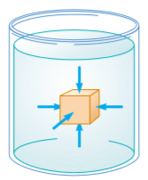

14.1 Pressure
The force exerted by a static ﬂuid on an object is always perpendicular to the surfaces of the object, as shown in Figure below.
The pressure P in a fluid is the force per unit area exerted by the fluid on a surface: P$=\frac{F}{A}$
SI unit of pressure is pascal (Pa): 1 Pa =1 N/m
.

Slide 5
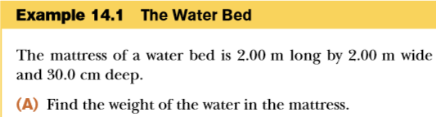

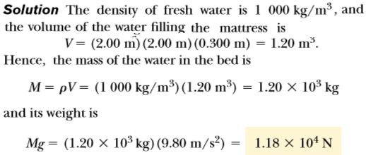


Slide 6
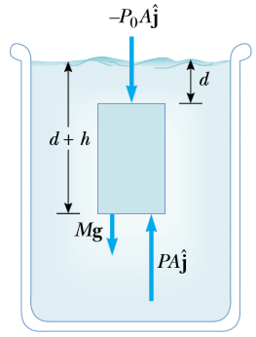


14.2 Variation of Pressure with Depth
The mass of liquid in the cylinder is M=ρv = ρAh, therefore,
the weight of the liquid in the cylinder is Mg =ρAhg.
Because the cylinder is in equilibrium, the net force acting on it must be zero:
This eq. implies that the pressure is the same at all points having the same depth, independent of the shape of the container.

Slide 7
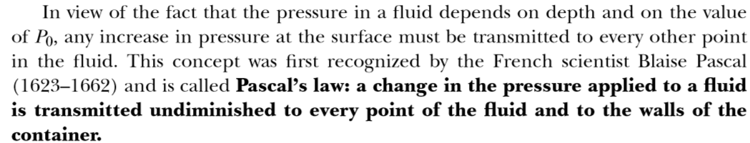
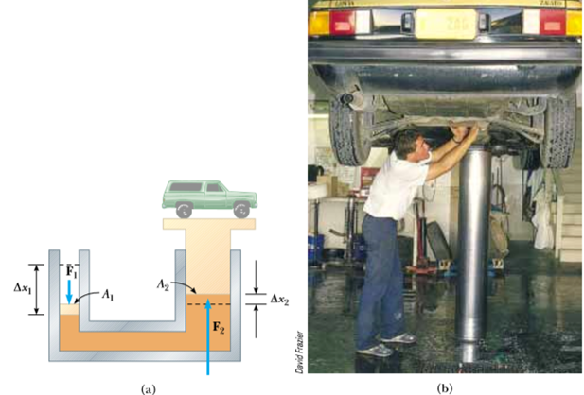
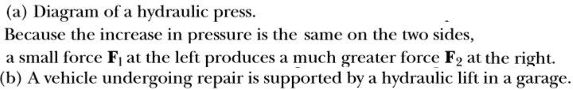

Slide 8
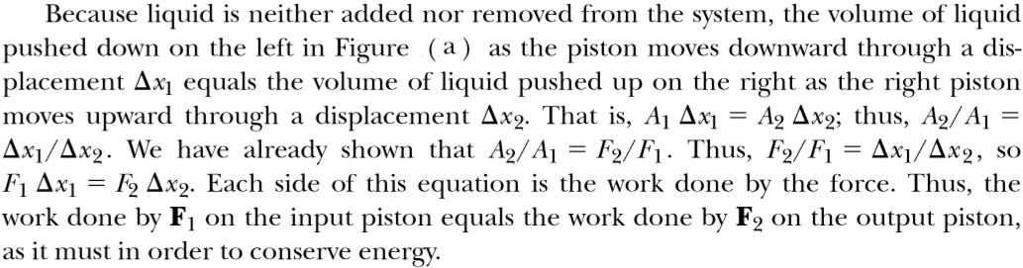
A force of magnitude F1 is applied to a small piston of surface area A1. The pressure is transmitted through an incompressible liquid to a larger piston of surface area A2. Because the pressure must be the same on both sides, P=F1/A1=F2/A2. Therefore, the force F2 is greater than the force F1 by a factor A2/A1.

Slide 9
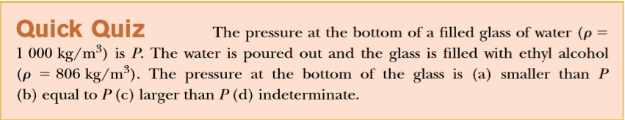
(a). Because both ﬂuids have the same depth, the one with the smaller density (alcohol) will exert the smaller pressure.

Slide 10
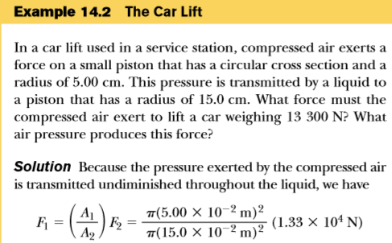
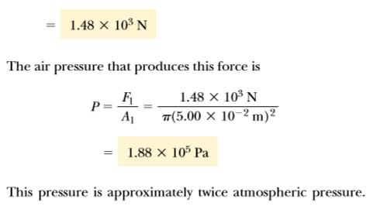

Slide 11

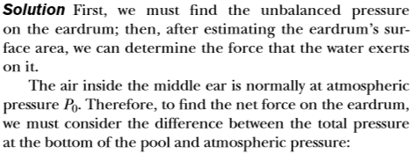
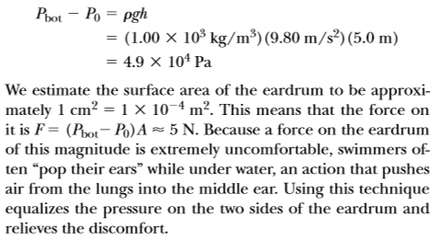

Slide 12
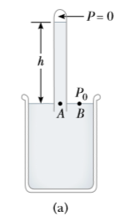
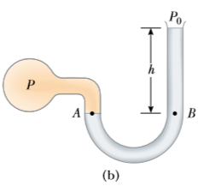

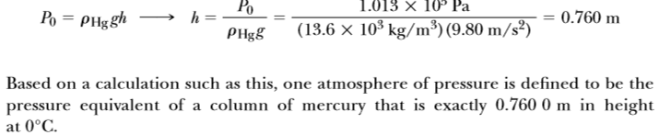
14.3 Pressure Measurements

Slide 13
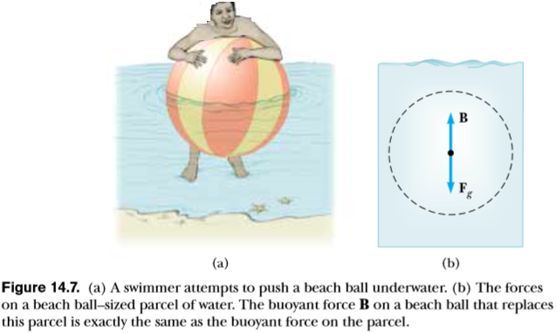

14.4 Buoyant Forces and Archimedes’s Principle
The upward force exerted by a ﬂuid on any immersed object is called a buoyant force.
The magnitude of the buoyant force always equals the weight of the ﬂuid displaced by the object.This statement is known as Archimedes’s principle.
where V is the volume of the ﬂuid displaced by the cube, Mg is the weight of the ﬂuid displaced by the cube.

Slide 14
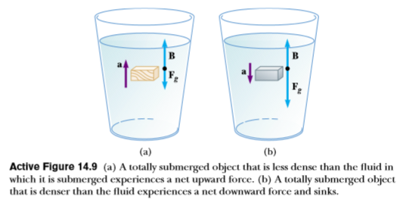
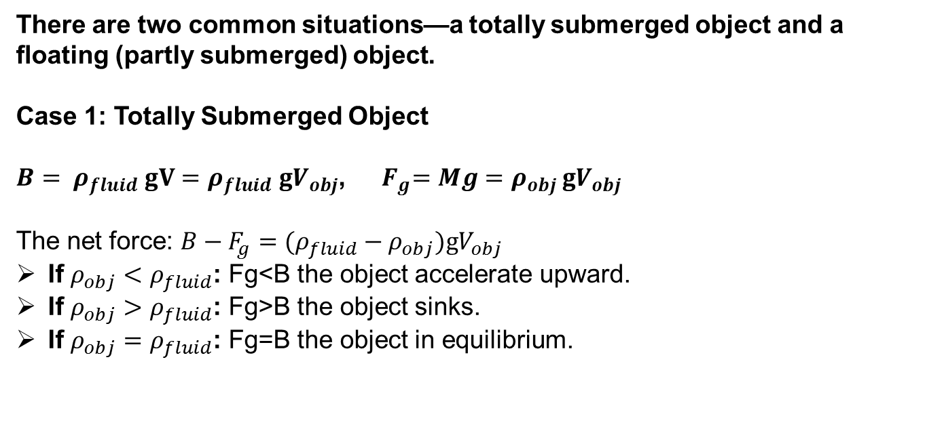
There are two common situations—a totally submerged object and a ﬂoating (partly submerged) object.
Case 1: Totally Submerged Object
$B= ρ_{fluid} gV=ρ_{fluid} {gV}_{obj}$, ${ F}_{g}=Mg=ρ_{obj }{gV}_{obj}$
The net force: $B−F_{g}=(ρ_{fluid}−ρ_{obj}){gV}_{obj}$
If $ρ_{obj}<ρ_{fluid}$: Fg<B the object accelerate upward.
If $ρ_{obj}>ρ_{fluid}$: Fg>B the object sinks.
If $ρ_{obj}=ρ_{fluid}$: Fg=B the object in equilibrium.

Slide 15
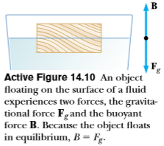
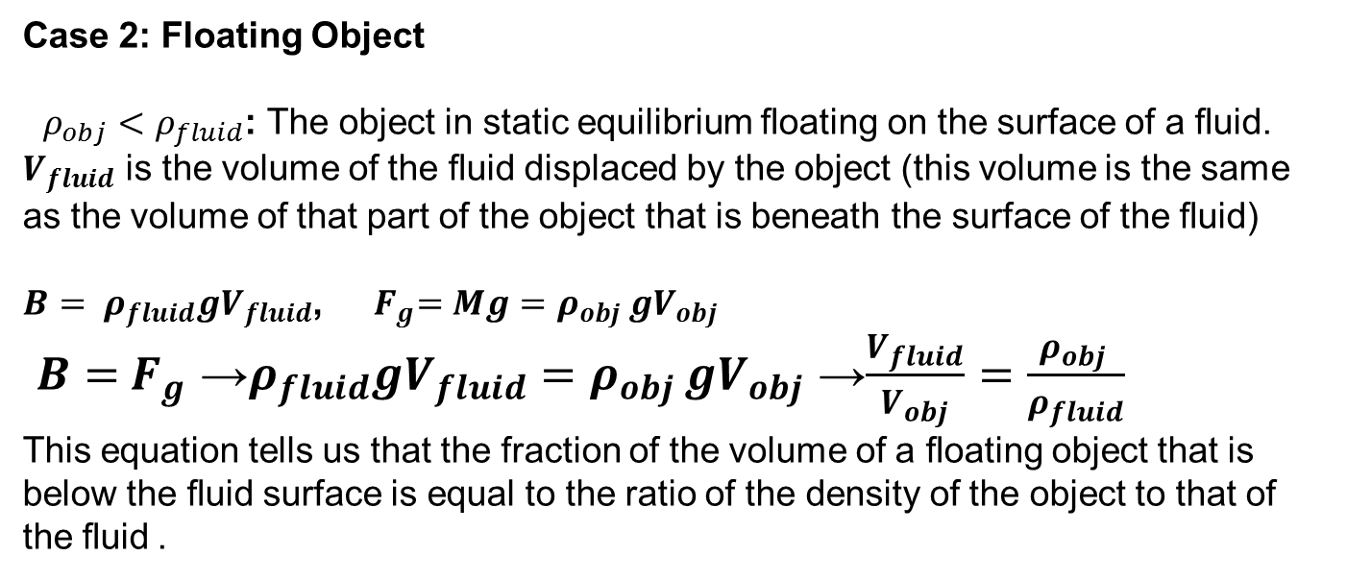
Case 2: Floating Object
$ρ_{obj}<ρ_{fluid}$: The object in static equilibrium ﬂoating on the surface of a ﬂuid.
$V_{fluid}$ is the volume of the ﬂuid displaced by the object (this volume is the same as the volume of that part of the object that is beneath the surface of the ﬂuid)
$B= ρ_{fluid}{gV}_{fluid}$, ${ F}_{g}=Mg=ρ_{obj }gV_{obj}$
$B={ F}_{g}$ →$ρ_{fluid}{gV}_{fluid}=ρ_{obj }gV_{obj}$ →$\frac{V_{fluid}}{V_{obj}}=\frac{ρ_{obj }}{ρ_{fluid}}$
This equation tells us that the fraction of the volume of a ﬂoating object that is below the ﬂuid surface is equal to the ratio of the density of the object to that of the ﬂuid.

Slide 16
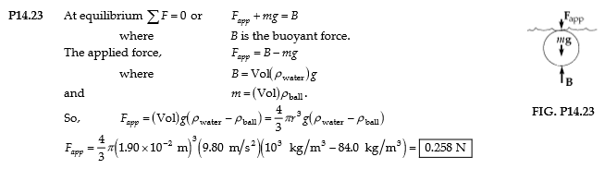
H.W. Problems
23. A Ping-Pong ball has a diameter of 3.80 cm and average density of 0.084 0 g/cm³. What force is required to hold it completely submerged under water?

Slide 17
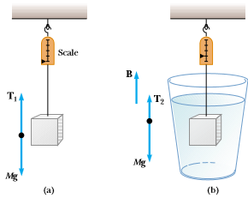
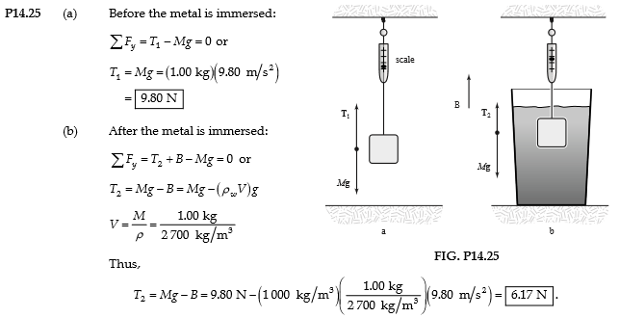
H.W. Problems
25. A piece of aluminum with mass 1.00 kg and density 2 700 kg/m³ is suspended from a string and then completely immersed in a container of water (Figure below). Calculate the tension in the string (a) before and (b) after the metal is immersed.

Slide 18
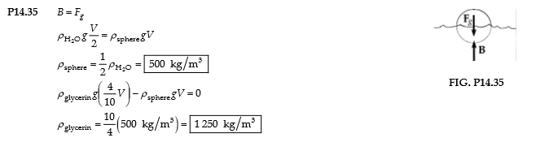
H.W. Problems
35. A plastic sphere ﬂoats in water with 50.0 percent of its volume submerged. This same sphere ﬂoats in glycerin with 40.0 percent of its volume submerged. Determine the densities of the glycerin and the sphere.

Slide 19
14.5 Fluid Dynamics
For ideal ﬂuid ﬂow,there are four assumptions:
The ﬂuid is nonviscous.
In a nonviscous ﬂuid, internal friction is neglected. An object moving through the ﬂuid experiences no viscous force.
2. The flow is steady.
In steady (laminar) ﬂow, the velocity of the ﬂuid at each point remains constant.
3. The ﬂuid is incompressible.
The density of an incompressible ﬂuid is constant.
4. The ﬂow is irrotational.
In irrotational ﬂow, the ﬂuid has no angular momentum about any point.

Slide 20
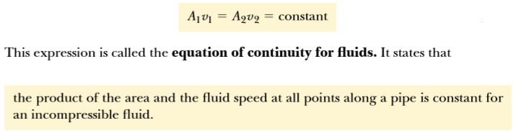
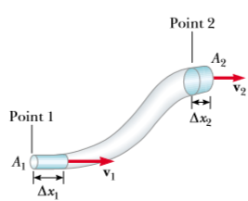
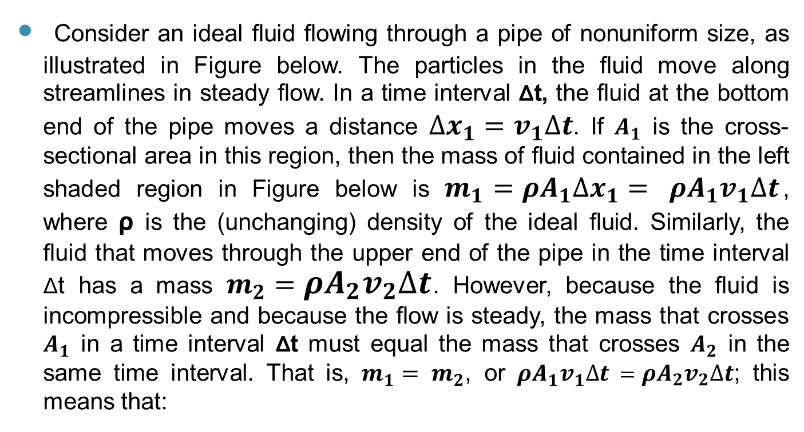
Consider an ideal ﬂuid ﬂowing through a pipe of nonuniform size, as illustrated in Figure below. The particles in the ﬂuid move along streamlines in steady ﬂow. In a time interval Δt, the ﬂuid at the bottom end of the pipe moves a distance $∆x_{1}=v_{1}∆t$. If $A_{1}$ is the cross-sectional area in this region, then the mass of ﬂuid contained in the left shaded region in Figure below is $m_{1}={ρA}_{1}∆x_{1}=$ ${ρA}_{1}v_{1}∆t$, where ρ is the (unchanging) density of the ideal ﬂuid. Similarly, the ﬂuid that moves through the upper end of the pipe in the time interval Δt has a mass $m_{2}={ρA}_{2}v_{2}∆t$. However, because the ﬂuid is incompressible and because the ﬂow is steady, the mass that crosses $A_{1}$ in a time interval Δt must equal the mass that crosses $A_{2}$ in the same time interval. That is, $m_{1}=$ $m_{2}$, or ${ρA}_{1}v_{1}∆t$ $={ρA}_{2}v_{2}∆t$; this means that:

Slide 21
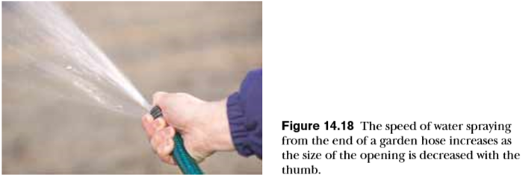


Slide 22
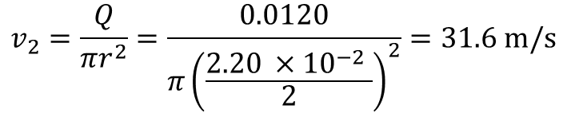
H.W. Problems
41. Water ﬂows through a ﬁre hose of diameter 6.35 cm at a rate of 0.0120 m³/s. The ﬁre hose ends in a nozzle of inner diameter 2.20 cm. What is the speed with which the water exits the nozzle?
$$v_{2}=\frac{Q}{πr^{2}}=\frac{0.0120}{π{\left(\frac{2.20 ×{10}^{−2} }{2}\right)}^{2}}=31.6 m/s$$

Slide 23
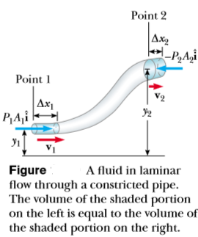
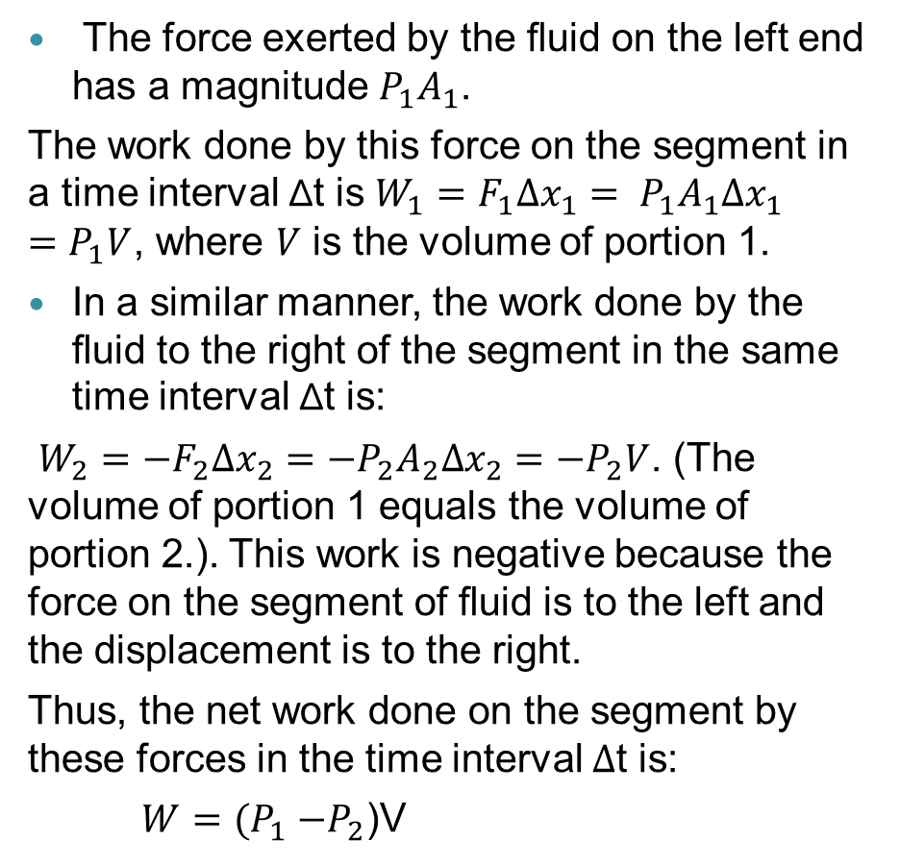
14.6 Bernoulli’s Equation
The force exerted by the ﬂuid on the left end has a magnitude $P_{1}A_{1}$.
The work done by this force on the segment in a time interval Δt is $W_{1}=F_{1}∆x_{1}= P_{1}A_{1}∆x_{1}=P_{1}V$, where $V$ is the volume of portion 1.
In a similar manner, the work done by the ﬂuid to the right of the segment in the same time interval Δt is:
$W_{2}={−F}_{2}∆x_{2}={−P}_{2}A_{2}∆x_{2}=−P_{2}V$. (The volume of portion 1 equals the volume of portion 2.). This work is negative because the force on the segment of ﬂuid is to the left and the displacement is to the right.
Thus, the net work done on the segment by these forces in the time interval $∆$t is:
$W=(P_{1}{−P}_{2}$)V

Slide 24


The change in the kinetic energy of the segment of ﬂuid is:
where m is the mass of both portion 1 and portion 2. (Because the volumes of both portions are the same, they also have the same mass.)
The change in gravitational potential energy is:
The total work done on the system by the ﬂuid:
W=ΔK+ΔU

Slide 25
The Bernoulli’s expression shows that:
1- the pressure of a ﬂuid decreases as the speed of the ﬂuid increases.
2- the pressure decreases as the elevation increases. This explains why water pressure from faucets on the upper ﬂoors of a tall building is weak unless measures are taken to provide higher pressure for these upper ﬂoors.
When the ﬂuid is at rest, v1 = v2 = 0 and the Equation
becomes:

Slide 26
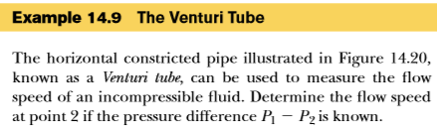
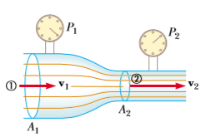
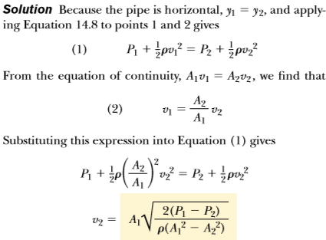
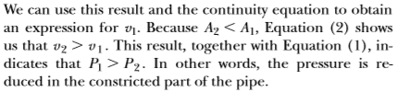

Slide 27
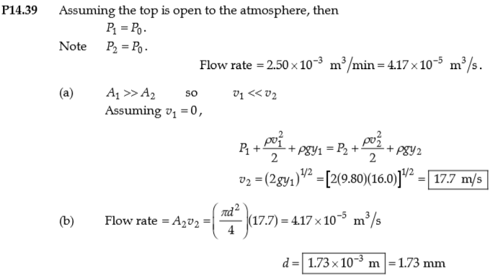
H.W. Problems
39. A large storage tank, open at the top and ﬁlled with water, develops a small hole in its side at a point 16.0 m below the water level. If the rate of ﬂow from the leak is equal to 2.50 x10³ m³/min, determine (a) the speed at which the water leaves the hole and (b) the diameter of the hole.

Slide 28
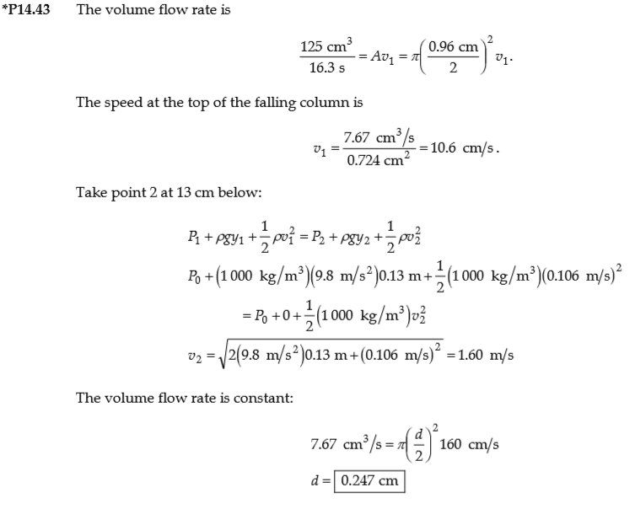
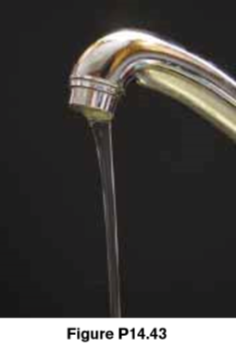
H.W. Problems
43. Figure below shows a stream of water in steady ﬂow from a kitchen faucet. At the faucet the diameter of the stream is 0.960 cm. The stream ﬁlls a 125-cm³ container in 16.3 s. Find the diameter of the stream 13.0 cm below the opening of the faucet.

