Slide 1
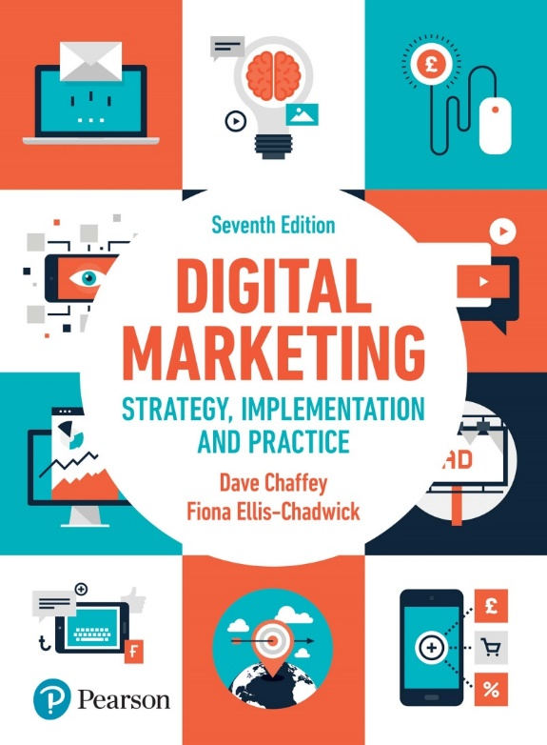
Chapter 3: Marketing communications using digital media channels

Slide 2
Chapter 9 Marketing Communications using digital media channels
Main Topics:
Search engine marketing
Online public relations and influencer relationship management
Online partnerships including affiliate marketing
Interactive display advertising
Opt-in email marketing and mobile messaging
Social media and viral marketing
Offline promotion techniques

Slide 3
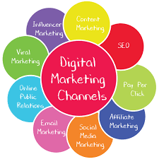
Introduction
Digital media channel: Online communications technique such as search engine marketing, affiliate marketing and display advertising used to engage web users on third-party sites, encourage them to visit an organisation’s site or purchase through traditional channels such as by phone or in store.
Digital marketing managers use many different digital media channels, such as affiliate, email, and search engine marketing, to attract visitors to their websites.

Slide 4
Introduction
Traditional communications disciplines such as advertising remain important in generating awareness and favourability about brands and in encouraging visits to a business’s online presence.
Choosing the most cost-effective digital communications techniques and refining them to attract visitors and new customers is now a major marketing activity, for both online and multichannel businesses.

Slide 5
Search engine marketing
Search engine marketing (SEM): Promoting an organisation through search engines to meet its objectives by delivering relevant content in the search listings for searchers and encouraging them to click through to a destination site.
Search engine marketing is a key technique for generating quality visitors to a website.
We all now naturally turn to a search engine when we are seeking a new product, service or entertainment.
Navigational (or brand) search Searchers use a search engine such as Google to find information deeper within a company site by appending a qualifier such as a product name to the brand or site name.
Organisations need to check that relevant pages are available in the search results pages for these situations.

Slide 6
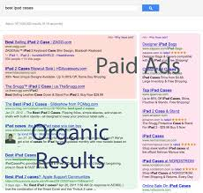
Search engine results pages (SERPS): The page(s) containing the results after a user types a key phrase into a search engine. SERPS contain both natural or organic listings and paid or sponsored listings.
Natural or organic listings: The pages listing results from a search engine query, which are displayed in a sequence according to relevance of match between the keyword phrase typed into a search engine and a web page according to a ranking algorithm used by the search engine.
Universal search: The natural listings incorporate other relevant results from vertical searches related to a query, such as video, books, news, real-time social media recommendations, site links and images.

Slide 7
There are two main types of SEM that are quite distinct in the marketing activities needed to manage them
Search engine optimisation (SEO) A structured approach used to increase the position of a company or its products in search engine natural or organic results listings for selected keywords or phrases.
Paid search (pay-per-click) marketing (PPC) A relevant text ad with a link to a company page is displayed on the SERPs when the user of a search engine types in a specific phrase. A fee is charged for every click of each link, with the amount bid for the click mainly determining its position. PPC may involve advertising through a display network of third-party sites.
Although many searchers prefer to click on the natural listings, a sufficient number do click on the paid listings such that they are highly profitable for companies such as Google, and a well-designed paid-search campaign can drive a significant amount of business for companies.

Slide 8
Figure 9.3 Popularity of different Google Search features for a selection of 10,000 keywords
Source: MozCast (http://mozcast.com/features)

Slide 9
What is SEO
Improving positions in the natural listings is dependent on marketers understanding the process whereby search engines compile an index by sending out spiders or robots to crawl around sites that are registered with that search engine
Robots or spiders: Spiders are software processes, technically known as robots, employed by search engines to index web pages of registered sites on a regular basis. They follow or crawl links between pages and record the reference URL of a page for future analysis.

Slide 10
Search engine ranking factors
Google has stated that it uses more than 200 factors or signals within its search ranking algorithms.
These include positive ranking factors that help boost position, and negative factors or filters that are used to remove search engine spam from the index where SEO companies have used unethical approaches such as automatically creat-ing links to mislead the Google algorithms.
The importance of ranking factors are much disputed by SEOs, since with so many factors it is difficult to isolate their impact to prove a correlation or, more importantly, a causative relationship between.

Slide 11
At a top level, the two most important factors for good ranking positions in all the main search engines are:
Matching between web page copy and the key phrases searched.
Links into the page (inbound or backlinks): Google counts each link to a page from another page or another site as a vote for this page. So pages and sites with more external links from other sites will be ranked more highly.
Backlink: Hyperlink that links to a particular web page (or website). Also known as an inbound link.

Slide 12
Paid search marketing
Although SEO has proved a popular form of digital marketing, paid search marketing is still of great relevance since it gives much more control on the appearance in the listings, subject to the amount bid and the relevance of the ad.

Slide 13
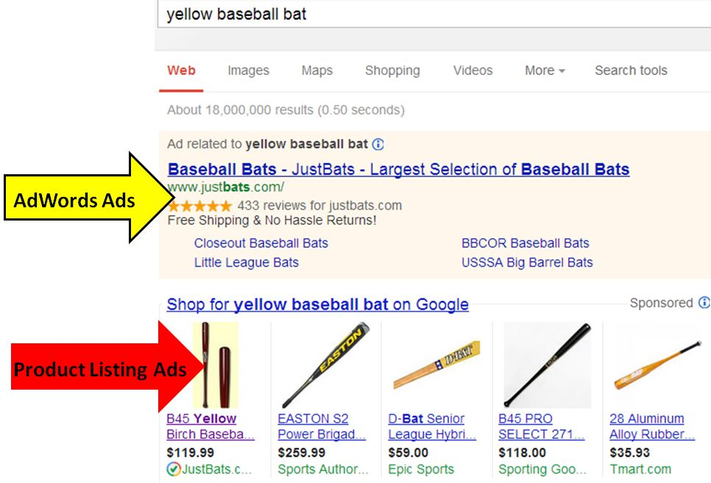
What is paid search marketing
Retailers have an additional option for paid search known as Product Listing Ads (PLAs), which are ads showing product images and prices that you may have seen when searching for retail products.

Slide 14
Paid search content network
Paid listings are also available through the display network of the search engines such as Google AdSense and Yahoo! Content Match.
These contextual ads are automatically dis-played according to the page content.
They can be paid for on a CPC or CPM basis and include not only text ads but also options for graphical display ads or video ads.

Slide 15
What controls position in paid search
In early pay-per-click programs, the relative ranking of sponsored listings was simply based on the highest bided cost-per-click (CPC) for each keyword phrase.
Since only a small proportion of visitors to a site clicking from the ad will convert, it is difficult to generate a positive return-on-investment for these generic terms.
Contrary to what many web users may believe, today it is not necessarily the company that is prepared to pay the most per click that will get top spot.
The search engines also take the relative click-through rates of the ads dependent on their position into account when ranking the sponsored links, so ads that do not appear relevant, because fewer people are clicking on them, will drop down or may even disappear of the listing.

Slide 16
Online public relations & influencer relationship management
Public relations (PR) The management of the awareness, understanding and reputation of an organisation or brand, primarily achieved through influencing exposure in the media.
Digital media have become a very important element of public relations (PR) and the Internet has influenced PR practices.
Online PR is relevant for businesses and relatively cost-effective and so appeals to small businesses and start-ups who can potentially make a big impact with online PR, coupled with content marketing if they harness it effectively

Slide 17
From a practical marketing communications and traffic building perspective, the main PR activities are media relations or managing influencer outreach with different types of online influencers or Key Opinion Leaders (KOLs), which can be used to reach and influence potential customers.
Online influencers or Key Opinion Leaders Online influencers can include any type of person who publishes online who has a significant following. They can include journalists, bloggers or celebrities.
Online public relations (e-PR) Maximising favourable mentions of your company, brands, products or websites on third-party websites that are likely to be visited by your target audience. Online PR can extend reach and awareness of a brand within an audience and will also generate backlinks vital to SEO. It can also be used to support viral or word-of-mouth marketing activities in other media.

Slide 18
The main element of online PR is maximising favourable mentions of an organisation, its brands, products or websites on third-party websites that are likely to be visited by its target audience.
Online influencer outreach Identifying online influencers such as bloggers, media owners or individuals with a large online following in the social networks and then approaching them to partner together to communicate with their audience.
Minimising unfavourable mentions, for example monitoring and influencing conversations in blogs and social networks through online reputation management, is also an aspect of online PR.
Influencer relationship management (IRM) A structured process to continuously manage and measure influencer outreach as a programme of campaigns based on content-assets and ‘always-on’ activities against defined goals. Today, online PR and influencer outreach are often managed as a continuous, year-round process.

Slide 19
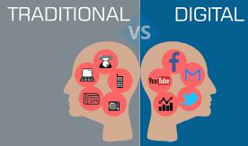
Differences between online PR and traditional PR
For a marketer the main differences are:
Less easy to control.
More options to create their own stories.
Need for faster response.
Opportunities for proactive real-time campaigns.
Easier to monitor.

Slide 20
Online partnerships including affiliate marketing
Resources must be devoted to managing your online partners. Many large organisations have specific staff to manage these relationships.
In smaller organisations partnership management is often neglected, which is a missed opportunity.
There are three key types of online partnerships that need to be managed:
Affiliate marketing.
Online sponsorship.
Co-marketing and influencer outreach.

Slide 21
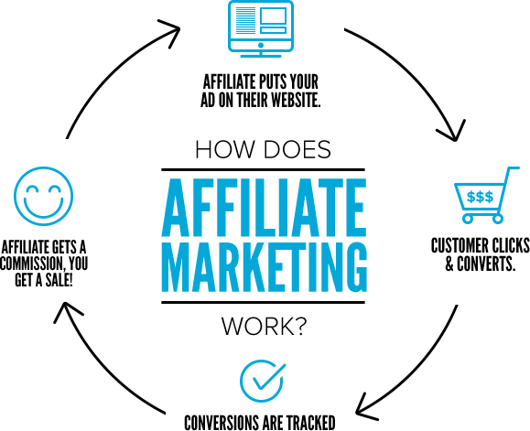
Affiliate marketing
Affiliate marketing A commission-based arrangement where referring sites (publishers) receive a commission on sales or leads by merchants (retailers or other transactional sites).
Commission is usually based on a percentage of product sale price or a fixed amount for each sale, but may also sometimes be based on a per-click basis.
There is no doubt that affiliates can generate more sales at a controlled cost, the question is whether these sales would have occurred anyway if a brand is well known.

Slide 22
What is affiliate marketing
Affiliate marketing is the ultimate form of marketing communications since it is what is known as a ‘pay-per-performance marketing’ method and it’s a commission-based arrangement where the merchant only pays when they make the sale or get a lead.
It’s not so suitable though for business products or lower-priced consumer products since it will not sufficiently profitable for the affiliates, and it may be difficult to recruit sufficient affiliates.
Increasingly, affiliate marketing is known as Performance Marketing (PM), so it is a broader term including other online paid media such as display advertising and biddable media including pay-per-click and programmatic advertising.

Slide 23
Figure 9.9 The affiliate marketing model (note that the tracking software and fee payment may be managed through an independent affiliate network manager)

Slide 24
Online Sponsorship
Online sponsorship is not straightforward. It’s not just a case of mirroring existing ‘real-world’ sponsorship arrangements in the ‘virtual world’, although this is a valid option.
There are many additional opportunities for sponsorship online that can be sought out, even if you don’t have a big budget at your disposal.
For the advertiser, online sponsorship has the benefit that their name is associated with an online brand that the site visitor is already familiar with. So, sponsorship builds on this existing relationship and trust.
Co-branding is a lower-cost method of sponsorship and can exploit synergies between different companies.

Slide 25
Co-branding
Co-branding an arrangement between two or more companies that agree to jointly display content and perform joint promotion using brand logos, email marketing or banner advertisements.
The aim is that the brands are strengthened if they are seen as complementary.
Co-branding is often a reciprocal arrangement, which can occur without payment as part of a wider agreement between partners.

Slide 26
Co-branding & contra-deals
Contra-deals A reciprocal agreement in the form of an exchange where payment doesn’t take place. Instead services or ad space to promote another company as part of co-branding occurs.
These contra-deals typically occur where there is an association between two brands, and they are complementary but not competitive.

Slide 27
Interactive display advertising
Display advertising Display ads are paid ad placements using graphical or rich media ad units within a web page to achieve goals of delivering brand awareness, familiarity, favourability and purchase intent.
Many ads encourage interaction through prompting the viewer to interact or rollover to play videos, complete an online form or to view more details by clicking through to a site.
Ad serving The term for displaying an advertisement on a website. Often the advertisement will be served from a web server different from the site on which it is placed.
Display advertising is still colloquially known as banner advertising.

Slide 28
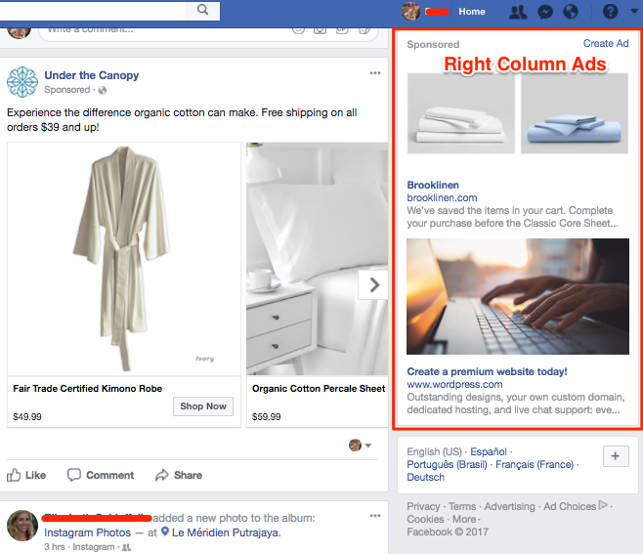
Purchasing ad placements
When media is purchased, it is either purchased on a specific site such as The Times or New York Times, or it is purchased across several sites, which are known as an ad network.
Traditionally, the most common payment is according to the number of customers who view the page as a cost-per-thousand (CPM) ad or page impressions.

Slide 29
Opt-in email marketing
Email marketing
When devising plans for email marketing communications, marketers need to plan for:
Outbound email marketing: Emails are sent to customers and prospects from an organisation, where email campaigns are used as a form of direct marketing to encourage trial and purchases and as part of a CRM dialogue
Inbound email marketing, Management of emails from customers by an organisation, such as service enquiries

Slide 30
Opt-in email options for customer acquisition
For acquiring new visitors and customers to a site, there are three main options for email marketing. From the point of view of the recipient, these are:
Cold email campaign List rental is not practical today under privacy laws since permission hasn’t been sought. Instead, co-branded emails are used.
Co-branded email. Here, the recipient receives an email with an offer from a company they have an affinity with and from whom they have agreed to receive ads.
Third-party e-newsletter. In this visitor acquisition option, a company publicises itself in a third-party e-newsletter. This could be in the form of an ad, sponsorship or PR in a publisher newsletter.

Slide 31
Opt-in email options for prospect conversion
Email is most widely used as a prospect conversion and customer retention tool using an opt-in house list of prospects and customers who have given permission to an organisation to contact them.
Successful email marketers adopt a strategic approach to email and develop a contact or touch strategy that plans the frequency and content of email communications.

Slide 32
Some options for in-house email marketing include:
Conversion email. Someone visits a website and expresses interest in a product or service by registering and providing their email address. Automated follow-up emails can be sent out. Similarly, retailers will follow-up with ‘abandoned basket’ emails.
Regular e-newsletter type. These are commonly used to update consumers on the latest products or promotions, or business customers on developments within a market.
House-list campaign. These are periodic emails to support different objectives such as encouraging trial of a service or newly launched product, repeat purchases or reactivation of customers who no longer use a service.
Event-triggered or behavioural emails and sequences. The marketing automation services send out a series of emails, with the interval between emails and messages determined by the marketer. Examples include welcome or reactivation sequences.

Slide 33
Social media & Viral marketing
Social media marketing Monitoring and facilitating customer interaction and participation throughout the web to encourage positive engagement with a company and its brands. Interactions may occur on a company site, social networks and other third-party sites.
Social media marketing is an important category of digital marketing that involves encouraging customer communications.
It can be applied as a traditional broadcast medium, However, to take advantage of the benefits of social media it is important to start to participate in customer conversations.
These can be related to products, promotions or customer service and are aimed at learning more about customers and providing support, thus improving the way a brand is perceived.

Slide 34
Viral marketing
Viral marketing Online viral marketing, or buzz marketing, is a form of electronic word-of-mouth marketing. Brands and promotions are discussed and awareness of them transmitted in two main forms, either as pass-along email or discussion in a social network.
Social media marketing is closely related to viral marketing since social media naturally involves ‘social media amplification’, where content is shared.
Viral marketing is a specific approach that involves harnessing the network effect of the Internet and can be effective in reaching a large number of people rapidly as a marketing message is quickly transmitted to many people in the same way as a natural virus or a computer virus.
When planning integrated campaigns, it is important to note that the online viral affect can be amplified through offline media mentions or advertising either on TV and radio or in print.

Slide 35
WOM
Word-of-mouth (WOM) marketing According to the Word-of-Mouth Marketing Association (WOMMA) it is giving people a reason to talk about your products and services and making it easier for that conversation to take place. It is the art and science of building active, mutually beneficial consumer-to-consumer and consumer-to-marketer communications.
It is an established concept closely related to viral marketing, but broader in context.
In an online context, word-of-mouth marketing is important since there is great potential for facilitating electronic word of mouth.
It is very important for online marketers to under-stand how WOM can be generated and influenced since research, shows that recommendations from friends, family or even other online consumers are trusted and are a major consideration in product and supplier selection.

Slide 36
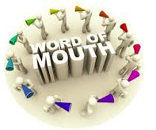
WOMMA explain that all word-of-mouth marketing techniques are based on the concepts of customer satisfaction, two-way dialogue and transparent communications.
The basic elements are:
Educating people about your products and services;
Identifying people most likely to share their opinions;
Providing tools that make it easier to share information;
Studying how, where and when opinions are being shared;
Listening and responding to supporters, detractors and neutrals.

Slide 37
WOMMA identifies different approaches for facilitating WOM. The ones that are most relevant to online marketing are:
Buzz marketing. Using high-profile entertainment or news to get people to talk about your brand.
Viral marketing. Creating entertaining or informative messages that are designed to be passed along in an exponential fashion, often electronically or by email.
Community marketing. Forming or supporting niche communities that are likely to share interests about the brand and providing tools, content and information to support them.
Influencer marketing. Identifying key communities and opinion leaders who are likely to talk about products and have the ability to influence the opinions of others.
Conversation creation. Interesting or fun advertising, emails, catchphrases, entertainment or promotions designed to start word-of-mouth activity.
Brand blogging. Creating blogs and participating in the blogosphere, in the spirit of open, transparent communications.
Referral programmes. Creating tools that enable satisfied customers to refer their friends.

Slide 38
Offline promotion techniques
The importance of offline communications in driving visitors to a website is well known by site owners, who find that greater levels of investment in offline advertising using TV, print or radio results in a greater number of direct visitors to websites.
Multi-screening enhances this effect, since simultaneous use of devices such as TV, smartphone and tablet is so common.
If someone sees an ad on TV, they can easily search via their mobile device for a brand or the category.
The influence of TV can be tracked by web analytics, which shows an increase in searches containing the brand or campaign name or the web address, or direct visitors who enter the site URL into the address bar.

Slide 39
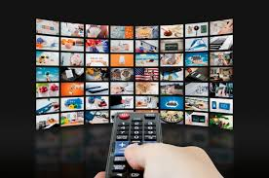
Research has identified that there is a clear correlation between investment in offline advertising and visits to a website.
Online website promotion techniques such as search engine marketing and banner advertising often take prominence when discussing methods of traffic building, But we start with using offline communications to generate site visitors since it is one of the most effective techniques to generate site traffic and the characteristics of offline media are such that they often have a higher impact and are more creative, which can help explain the online value proposition.
Offline promotion refers to using communications tools such as advertising and PR delivered by traditional media such as TV, radio and print in order to direct visitors to an online presence.

Slide 40
Despite the range of opportunities for using new online communications tools, traditional communications using offline media such as TV, print and direct mail and others remain a significant form of investment in marketing communications for most.
Even organisations that transact a large proportion of their business online continue to invest heavily in offline communications.
When the web analytics data about referring visitors are assessed, for most companies that are not online-only businesses we find that over half the visitors are typically marked as ‘No referrer’.
This means that they visited the site direct by typing the web address into the address bar in response to awareness of the brand generated through real-world communications.

Slide 41
Online promotion techniques
Source: The Hitwise UK Media Impact Report, September 2006
Notes:
Figure 9.13 Sky spend by medium compared with market share of UK internet searches, 5 June–6 March

Slide 42
Incidental & Specific advertising of the online presence
Two types of offline advertising can be identified: incidental and specific.
Incidental offline advertising Driving traffic to the website is not a primary objective of the advert. Reference to the website is incidental offline advertising if the main aim of the advert is to advertise a particular product or promotion and the website is available as an ancillary source of information if required by the viewer.
Traditionally, much promotion of the website in the offline media by traditional companies has been incidental, simply consisting of highlighting the existence of the website by including the URL at the bottom of an advertisement.
Specific offline advertising Driving traffic to the website or explaining the online proposition is a primary objective of the advert. The advert will highlight the offers or services available at the website, such as sales promotions or online customer service.

