Slide 1

General Chemistry
CHEM 101
(3+1+0)

Slide 2
Chapter 4
Thermochemistry

Slide 3
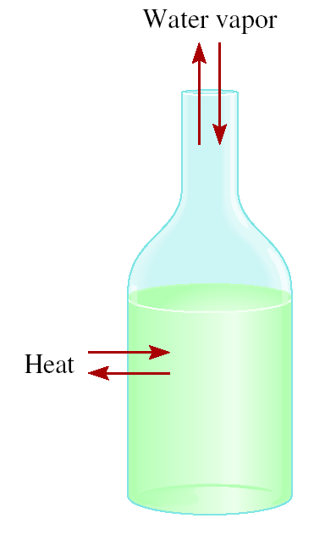
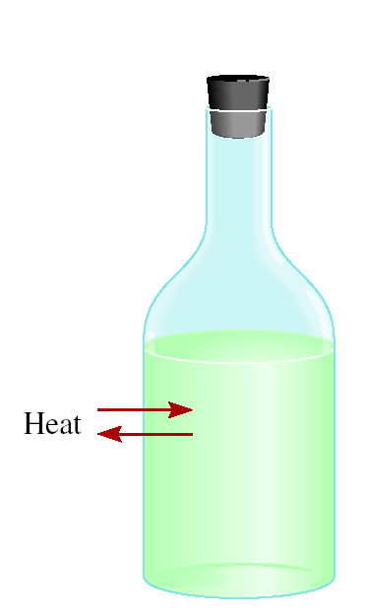

Energy Changes in Chemical Reactions
Thermochemistry is the study of heat change in chemical reactions.
The system is the specific part of the universe that is of interest in the study.
The surroundings are the rest of the universe outside the system.
open
closed
isolated
Exchange:
mass & energy
energy
nothing

Slide 4
Energy Changes in Chemical Reactions
Exothermic process is any process that gives off heat – transfers thermal energy from the system to the surroundings.
2H₂ (g) + O₂ (g) 2H₂O (l) + energy
H₂O (g) H₂O (l) + energy
Endothermic process is any process in which heat has to be supplied to the system from the surroundings.
energy + 2HgO (s) 2Hg (l) + O₂ (g)
energy + H₂O (s) H₂O (l)

Slide 5
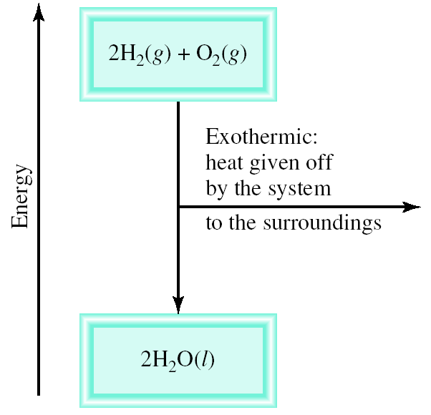
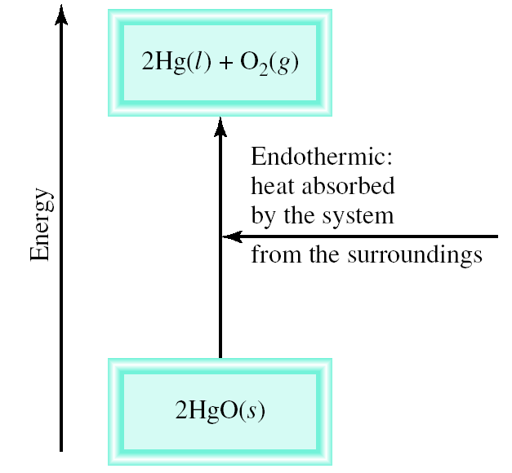
Energy Changes in Chemical Reactions
Schematic of Exothermic and Endothermic Processes

Slide 6

Introduction to Thermodynamics
Thermodynamics is the scientific study of the interconversion of heat and other kinds of energy.
State functions are properties that are determined by the state of the system, regardless of how that condition was achieved.
energy
, pressure, volume, temperature
ΔE = E_{final} - E_{initial}
ΔP = P_{final} - P_{initial}
ΔV = V_{final} - V_{initial}
ΔT = T_{final} - T_{initial}
Potential energy of hiker 1 and hiker 2 is the same even though they took different paths.

Slide 7
Introduction to Thermodynamics
First law of thermodynamics - energy can be converted from one form to another, but cannot be created or destroyed.
The transfer of energy from the system to the surroundings does not change the total energy of the universe. That is, the sum of the energy changes must be zero:
ΔE_{system} + ΔE_{surroundings} = 0
or
ΔE_{system} = -ΔE_{surroundings}
If one system undergoes an energy change ΔE_{sys} , the rest of the universe, or the surroundings, must undergo a change in energy that is equal in magnitude but opposite in sign (-ΔE_{surr} );
Chemical energy lost by combustion = Energy gained by the surroundings
system
surroundings
C₃H₈ + 5O₂ 3CO₂ + 4H₂O
Exothermic chemical reaction!

Slide 8
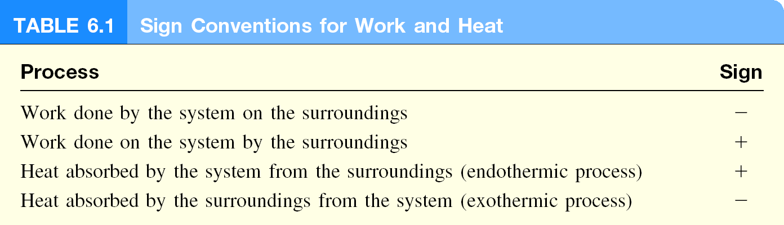
Introduction to Thermodynamics
Another form of the first law for ΔE_{system}
ΔE = q + w
ΔE is the change in internal energy of a system
q is the heat exchange between the system and the surroundings
w is the work done on (or by) the system
w = -PΔV when a gas expands against a constant external pressure
If a system loses heat to the surroundings or does work on the surroundings, its internal energy to decrease because those are energy-depleting processes; both q and w are negative.
If heat is added to the system or if work is done on the system, the internal energy of the system would increase; both q and w are positive.

Slide 9
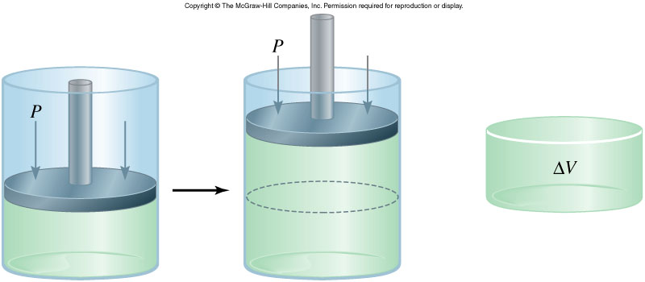
Introduction to Thermodynamics
Work and Heat
w = F x d
ΔV > 0
w = -P ΔV
-PΔV < 0
F
P x V = x d³ = F x d = w
d²
w_{sys} < 0
Work is not a state function.
Δw = w_{final} - w_{initial}
initial
final
The units for work done by or on a gas are liters atmospheres.
1 L . atm = 101.3 J

Slide 10
Introduction to Thermodynamics
A sample of nitrogen gas expands in volume from 1.6 L to 5.4 L at constant temperature. What is the work done in joules if the gas expands (a) against a vacuum and (b) against a constant pressure of 3.7 atm?
w = -P ΔV
(a)
ΔV = 5.4 L – 1.6 L = 3.8 L
P = 0 atm
W = -0 atm x 3.8 L = 0 L•atm = 0 joules
(b)
ΔV = 5.4 L – 1.6 L = 3.8 L
P = 3.7 atm
w = -3.7 atm x 3.8 L = -14.1 L•atm
101.3 J
w = -14.1 L•atm x
= -1430 J
1L•atm

Slide 11
Enthalpy of Chemical Reactions
Enthalpy and First law of thermodynamics;
If a chemical reaction is run at constant volume, then ΔV = 0
ΔE = q + w
ΔE = q - PΔV
Enthalpy
ΔE = q_{v}
A new thermodynamic function of a system called enthalpy ( H )
H = E + PV
At constant pressure:
ΔE = q_{p} - PΔV
q = ΔH and w = -PΔV
ΔE = ΔH - PΔV
ΔH = ΔE + PΔV

Slide 12
Enthalpy of Chemical Reactions
Enthalpy of Chemical Reactions
For any reaction of the type
Reactants products
Enthalpy (H) is used to quantify the heat flow into or out of a system in a process that occurs at constant pressure.
Enthalpy of reaction, ΔH, as the difference between the enthalpies of the products and the enthalpies of the reactants:
ΔH = H (products) – H (reactants)
ΔH = heat given off or absorbed during a reaction at constant pressure

Slide 13
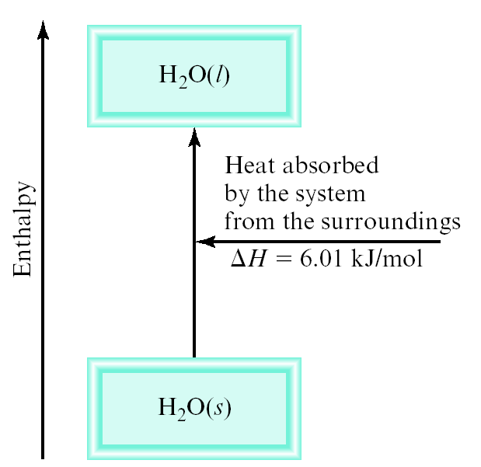
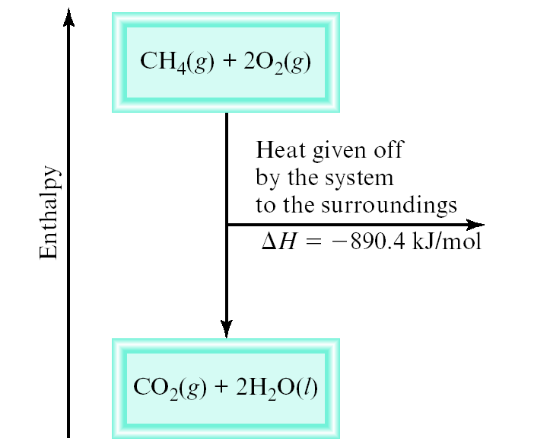
Enthalpy of Chemical Reactions
Enthalpy of Chemical Reactions
For an endothermic process
ΔH is positive (that is, ΔH > 0).
For an exothermic process
ΔH is negative (that is, ΔH < 0).
H_{products} < H_{reactants}
H_{products} > H_{reactants}

Slide 14
Enthalpy of Chemical Reactions
Thermochemical Equations
Thermochemical equations, which show the enthalpy changes as well as the mass relationships.
Is ΔH negative or positive?
System absorbs heat
Endothermic
ΔH > 0
6.01 kJ are absorbed for every 1 mole of ice that melts at 0⁰C and 1 atm.
H₂O (s) H₂O (l)
ΔH = 6.01 kJ/mol

Slide 15
Enthalpy of Chemical Reactions
Thermochemical Equations
Is ΔH negative or positive?
System gives off heat
Exothermic
ΔH < 0
890.4 kJ are released for every 1 mole of methane that is combusted at 25⁰C and 1 atm.
CH₄ (g) + 2O₂ (g) CO₂ (g) + 2H₂O (l)
ΔH = -890.4 kJ/mol

Slide 16
Enthalpy of Chemical Reactions
Thermochemical Equations
The stoichiometric coefficients always refer to the number of moles of a substance
H₂O (s) H₂O (l)
ΔH = 6.01 kJ/mol
If you reverse a reaction, the sign of ΔH changes
H₂O (l) H₂O (s)
ΔH = -6.01 kJ/mol
If you multiply both sides of the equation by a factor n, then ΔH must change by the same factor n.
2H₂O (s) 2H₂O (l)
ΔH = 2 x 6.01 = 12.0 kJ

Slide 17
Enthalpy of Chemical Reactions
Thermochemical Equations
The physical states of all reactants and products must be specified in thermochemical equations.
H₂O (s) H₂O (l)
ΔH = 6.01 kJ/mol
H₂O (l) H₂O (g)
ΔH = 44.0 kJ/mol
How much heat is evolved when 266 g of white phosphorus (P₄) burn in air?
P₄ (s) + 5O₂ (g) P₄O₁₀ (s) ΔH = -3013 kJ/mol
1 mol P₄
3013 kJ
266 g P₄
x
x
= 6470 kJ
123.9 g P₄
1 mol P₄

Slide 18
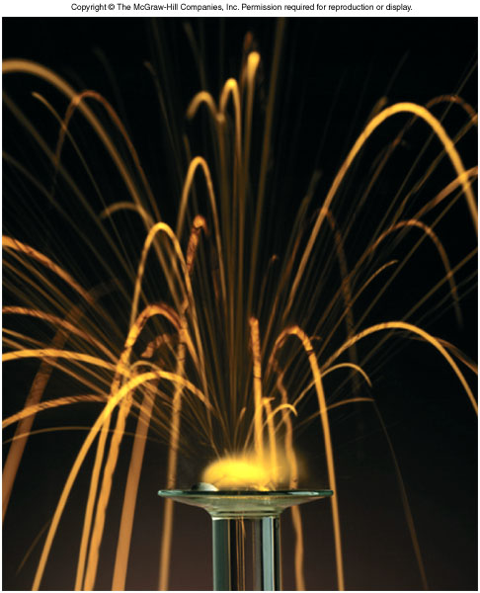
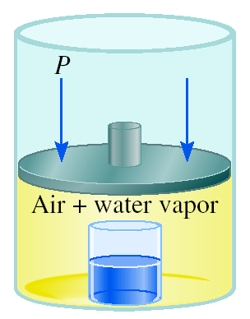
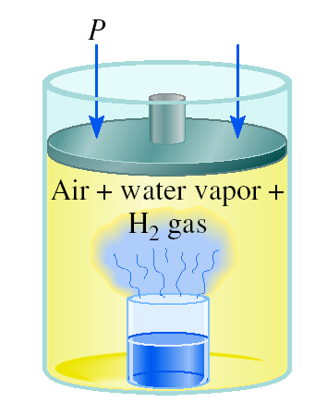
Enthalpy of Chemical Reactions
A Comparison of ΔH and ΔE
2Na (s) + 2H₂O (l) 2NaOH (aq) + H₂ (g) ΔH = -367.5 kJ/mol
ΔE = ΔH - PΔV
At 25 ºC, 1 mole H₂ = 24.5 L at 1 atm
PΔV = 1 atm x 24.5 L = 2.5 kJ
ΔE = -367.5 kJ/mol – 2.5 kJ/mol = -370.0 kJ/mol
The reason ΔH is smaller than ΔE in magnitude is that some of the internal energy released is used to do gas expansion work, so less heat is evolved.

Slide 19
Enthalpy of Chemical Reactions

Slide 20
Enthalpy of Chemical Reactions
A Comparison of ΔH and ΔE
To calculate the internal energy change of a gaseous reaction is to assume ideal gas behavior and constant temperature

Slide 21
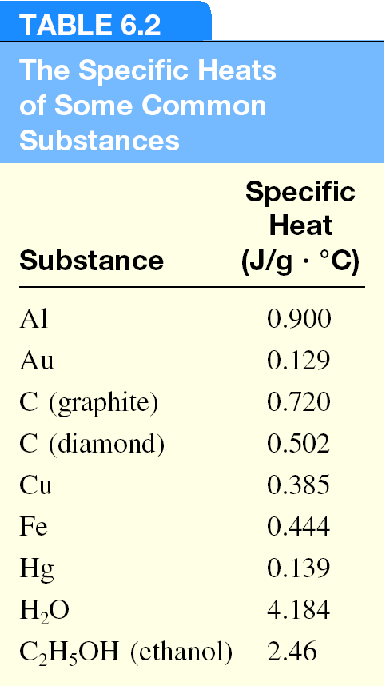
Calorimetry: specific heat and heat capacity
The specific heat (s) of a substance is the amount of heat (q) required to raise the temperature of one gram of the substance by one degree Celsius.
The heat capacity (C) of a substance is the amount of heat (q) required to raise the temperature of a given quantity (m) of the substance by one degree Celsius.
C = m x s
Heat (q) absorbed or released:
q = m x s x Δt
q = C x Δt
Δt = t_{final} - t_{initial}

Slide 22

Calorimetry: specific heat and heat capacity
How much heat is given off when an 869 g iron bar cools from 94ºC to 5ºC?
s of Fe = 0.444 J/g • ºC
Δt = t_{final} – t_{initial} = 5ºC – 94ºC = -89ºC
q = msΔt
= 869 g x 0.444 J/g • ºC x –89ºC
= -34,000 J

Slide 23
Calorimetry: specific heat and heat capacity

Slide 24
Standard Enthalpy of Formation and Reaction
Because there is no way to measure the absolute value of the enthalpy of a substance, must I measure the enthalpy change for every reaction of interest?
Establish an arbitrary scale with the standard enthalpy of formation (ΔH⁰) as a reference point for all enthalpy expressions.
f
Standard enthalpy of formation (ΔH⁰) is the heat change that results when one mole of a compound is formed from its elements at a pressure of 1 atm.
f
The standard enthalpy of formation of any element in its most stable form is zero.
ΔH⁰ (C, graphite) = 0
ΔH⁰ (O₂) = 0
f
f
ΔH⁰ (C, diamond) = 1.90 kJ/mol
ΔH⁰ (O₃) = 142 kJ/mol
f
f

Slide 25
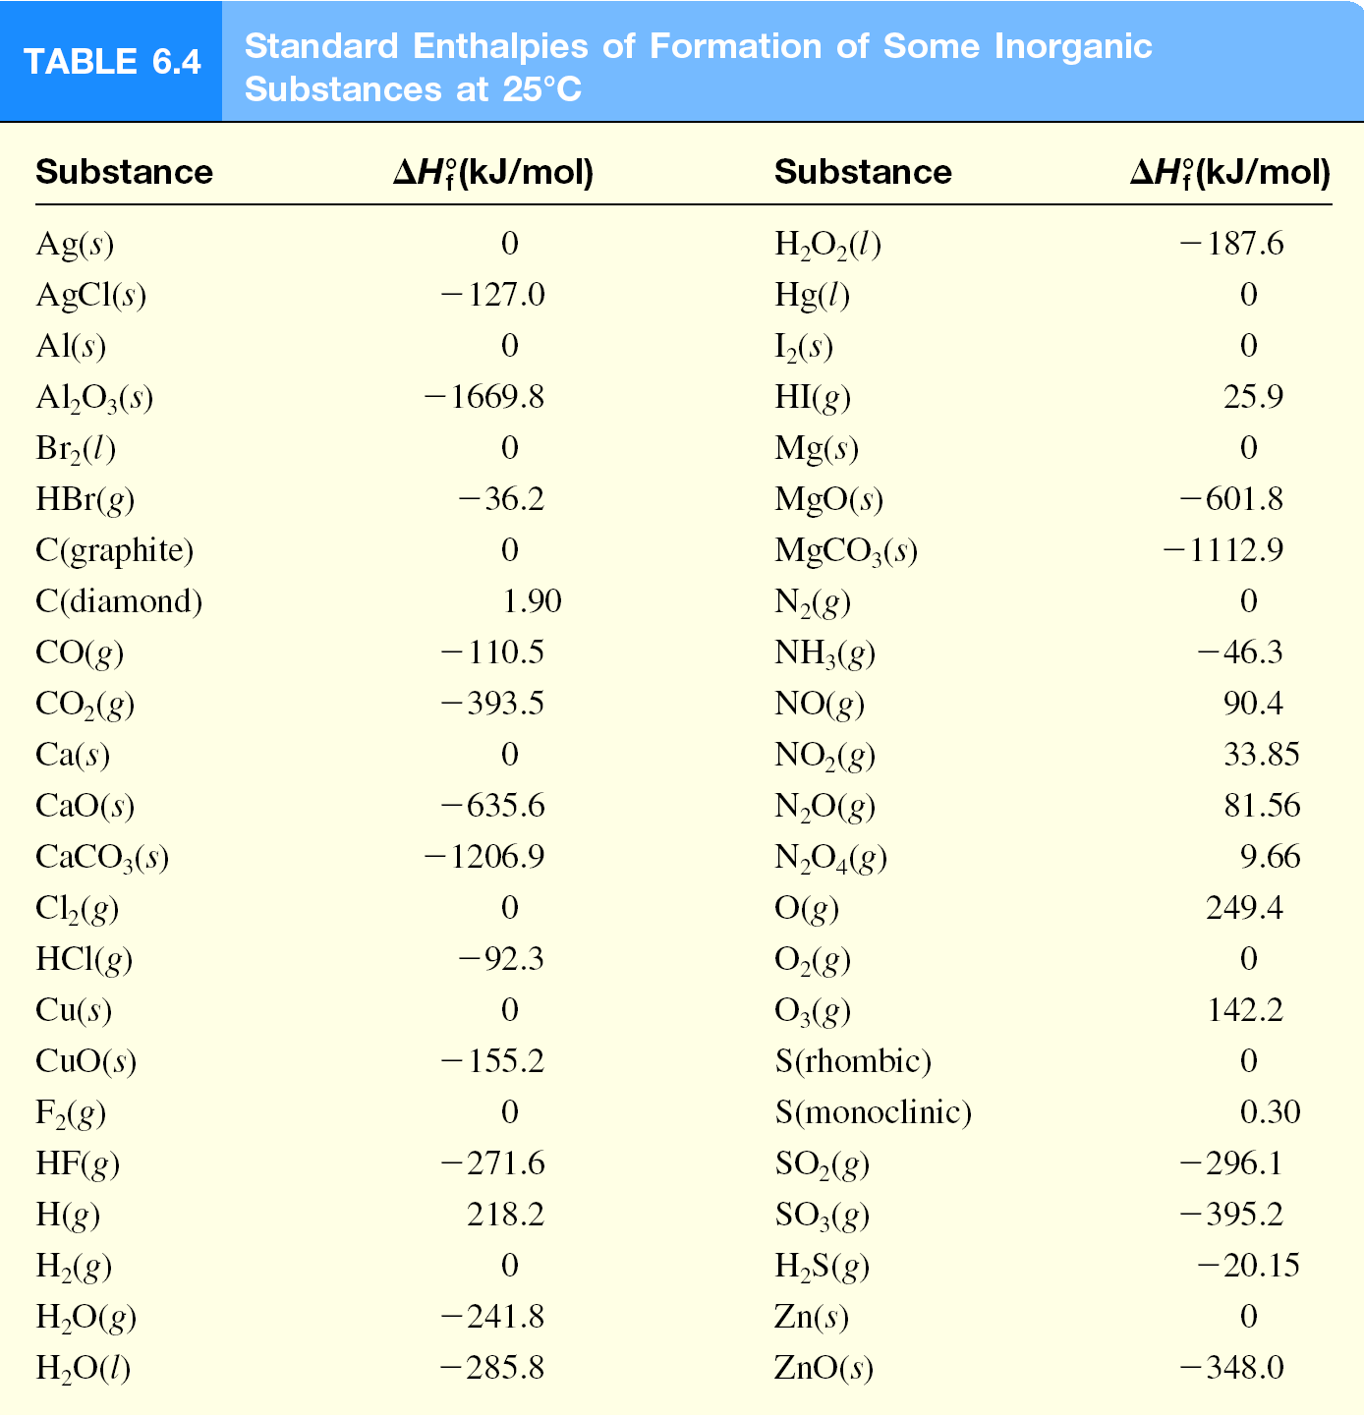
Standard Enthalpy of Formation and Reaction

Slide 26
Standard Enthalpy of Formation and Reaction
The standard enthalpy of reaction (ΔH⁰ ) is the enthalpy of a reaction carried out at 1 atm.
rxn
aA + bB cC + dD
ΔH⁰
cΔH⁰ (C)
dΔH⁰ (D)
-
aΔH⁰ (A)
bΔH⁰ (B)
=
[
+
]
[
+
]
rxn
f
f
f
f
ΔH⁰
=
Σ
nΔH⁰ (products)
-
Σ
mΔH⁰ (reactants)
rxn
f
f

Slide 27
Standard Enthalpy of Formation and Reaction
The direct Method
Suppose we want to know the enthalpy of formation of carbon dioxide.
We must measure the enthalpy of the reaction when carbon (graphite) and molecular oxygen in their standard states are converted to carbon dioxide in its standard state:
ΔH⁰
=
Σ
nΔH⁰ (products)
-
Σ
mΔH⁰ (reactants)
rxn
f
f

Slide 28
Standard Enthalpy of Formation and Reaction
The Indirect Method (Hess’s Law)
Many compounds cannot be directly synthesized from their elements.
The reaction proceeds too slowly, or side reactions produce substances other than the desired compound.
Hess’s Law: When reactants are converted to products, the change in enthalpy is the same whether the reaction takes place in one step or in a series of steps.
(Enthalpy is a state function. It doesn’t matter how you get there, only where you start and end.)

Slide 29
Standard Enthalpy of Formation and Reaction
Let’s say we are interested in the standard enthalpy of formation of carbon monoxide (CO).
However, burning graphite also produces some carbon dioxide (CO₂), so we cannot measure the enthalpy change for CO directly.
We must employ an indirect route, based on Hess’s law.
It is possible to carry out the following two separate reactions:
First, we reverse Equation (b) to get
we carry out the operation (a) + (c) and obtain

Slide 30
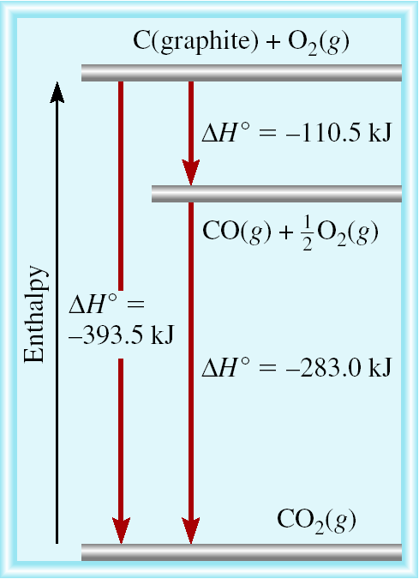
Standard Enthalpy of Formation and Reaction
C (graphite) + 1/2O₂ (g) CO (g)
CO (g) + 1/2O₂ (g) CO₂ (g)
C (graphite) + O₂ (g) CO₂ (g)

Slide 31
Benzene (C₆H₆) burns in air to produce carbon dioxide and liquid water. How much heat is released per mole of benzene combusted? The standard enthalpy of formation of benzene is 49.04 kJ/mol.
2C₆H₆ (l) + 15O₂ (g) 12CO₂ (g) + 6H₂O (l)
ΔH⁰
=
Σ
nΔH⁰ (products)
-
Σ
mΔH⁰ (reactants)
rxn
f
f
ΔH⁰
12ΔH⁰ (CO₂)
6ΔH⁰ (H₂O)
-
[
2ΔH⁰ (C₆H₆)
=
[
+
]
]
rxn
f
f
f
ΔH⁰
=
[ 12x–393.5 + 6x–187.6 ] – [ 2x49.04 ] = -5946 kJ
rxn
-5946 kJ
= - 2973 kJ/mol C₆H₆
2 mol

Slide 32
Some types of Endothermic and exothermic physical changes and chemical reactions (Enthalpy of fusion, vaporization)

Slide 33
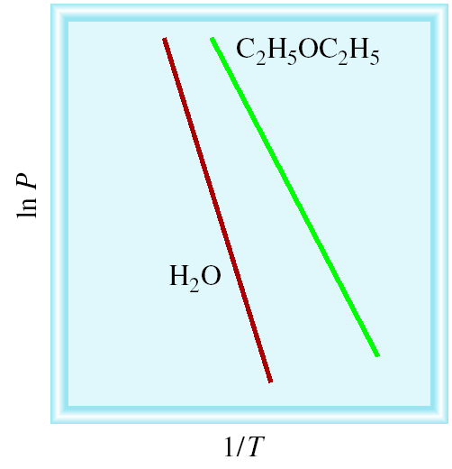
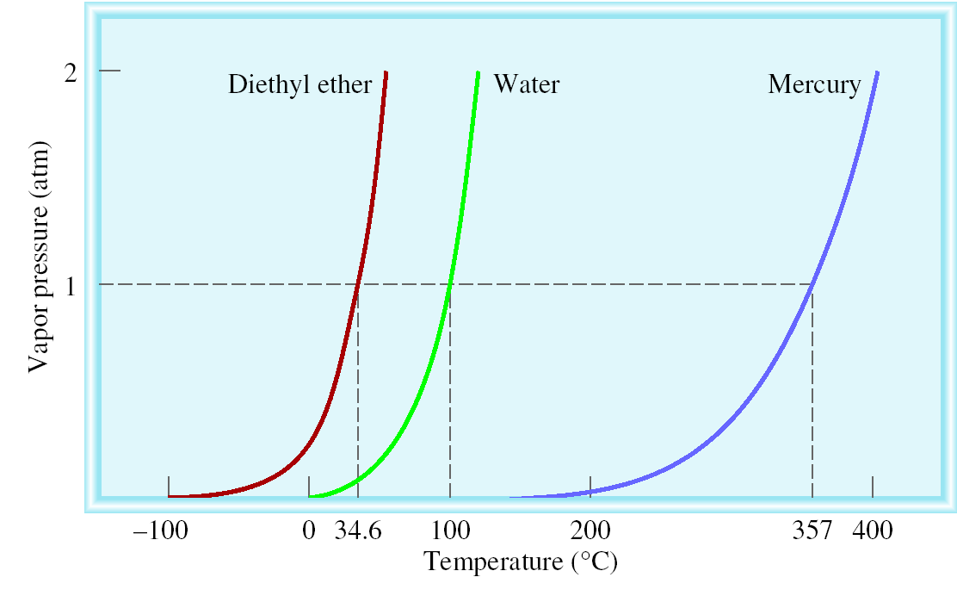
Molar heat of vaporization (ΔH_{vap}) is the energy required to vaporize 1 mole of a liquid at its boiling point.
Clausius-Clapeyron Equation
ΔH_{vap}
P = (equilibrium) vapor pressure
ln P = -
+ C
RT
T = temperature (K)
R = gas constant (8.314 J/K•mol)
Vapor Pressure Versus Temperature

Slide 34
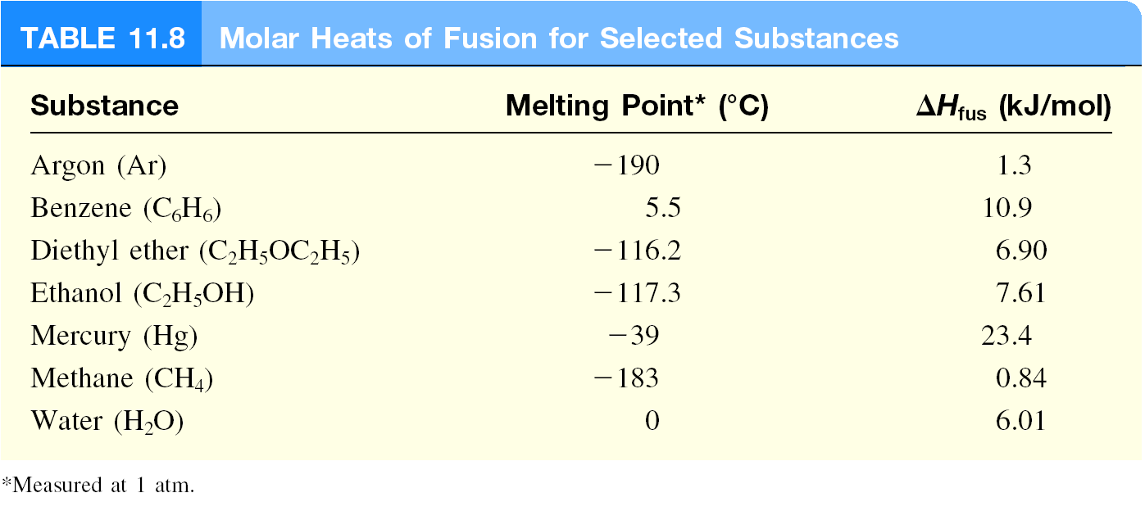
Molar heat of fusion (ΔH_{fus}) is the energy required to melt 1 mole of a solid substance at its freezing point.

