Slide 1
The Marketing Program
Add by Dr.Heyam Al Mousa

Slide 2
Introduction
The marketing program refers to the strategic combination of the four basic marketing mix elements: product, price, distribution, and promotion.
The product receives the most attention because it is most responsible for fulfilling the customers’ needs and wants.
The outcome of the marketing program is
1-complete “offering” that consists of an array of physical (tangible).
2-service (intangible).
3- symbolic (perceptual) attributes designed to satisfy customers' needs and wants

Slide 3
The best marketing strategy is likely to be one that combines the product, price, distribution, and promotion elements in a way that maximizes the tangible, intangible, and perceptual attributes of the complete offering.
Given the state of commoditization in many markets, the core product (the element that satisfies the basic customer need) typically becomes incapable of differentiating the offering from those of the competition.

Slide 4
The product Portfolio
Product offerings in and of themselves have little value to customers. Rather, an offering’s real value comes from its ability to deliver benefits that enhance a customer's situation or solve a customer's problems.
Products fall into two general categories:
1-Consumer products (used for personal use and enjoyment) .
2- Business products (purchased for resale, to make other products, or for use in a firm’s operations). [Exhibit 6.1]

Slide 5
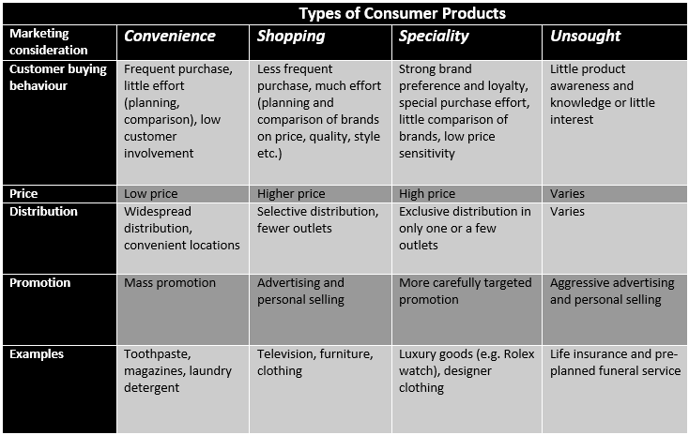

Slide 8
The Product Portfolio
Most firms sell a variety of products to fulfill a variety of different needs.
The products sold by a firm can be described with respect to :
1- Product Line
A group of closely related product items
2-Product Mix or Portfolio
The total group of products offered by the firm

Slide 11
Decisions regarding product lines and product mixes are important strategic considerations for most firms:
The number of product lines to offer (Variety ) the width or variety of the product mix) is an important strategic decision.
The depth of each product line ( assortment) is an important marketing tool. Firms attract a wide range of customers and market segments by offering a deep assortment of products in a specific line.

Slide 12
Potential Benefits of Offering a Large Portfolio of Product
a)Economies of Scale—in production, bulk buying, and promotion.
b)Package Uniformity—all packages in a product line have the same look and feel.
c)Standardization—product lines can use the same component parts.
d)Sales and Distribution Efficiency—sales personnel can offer a full range of choices and options to customers.
e)Equivalent Quality Beliefs—customers expect and believe that all products in a line are equal in terms of quality and performance.

Slide 13
The Challenges of Service Products
1.Firms lying closer to the intangible end of the product spectrum face unique challenges in developing marketing strategy.
2.Services possess many unique characteristics. [Exhibit 6.3]
3.Because of the intangibility of service, it is difficult for customers to evaluate a service before they actually purchase and consume it.

Slide 14
4.Because most services are dependent upon people (employees, customers) for their delivery, they are susceptible to variations in quality and inconsistency.
5.Customers typically have few problems in expressing needs for tangible goods, but they often have difficulty in expressing or explaining needs for services.

Slide 15
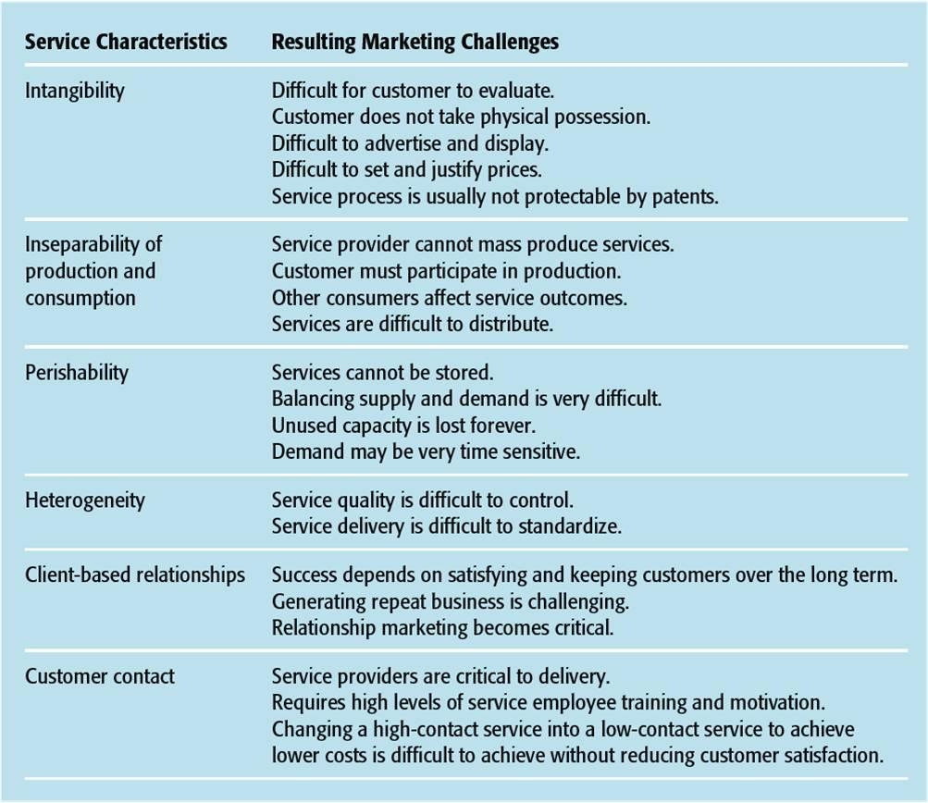

Slide 16
Developing New Products
One of the key issues in product strategy deals with the introduction of new products.
The development and commercialization of new products is a vital part of a firm's efforts to sustain growth and profits over time.
The success of new products depends on the products fit with the firms strengths and defined market opportunity.

Slide 17
Six Strategic Options for Newness of Product
1- New-to-the-World Products (Discontinuous Innovations)—These products involve a pioneering effort by a firm that eventually leads to the creation of an entirely new market.
2- New Product Lines—These products represent new offerings by the firm, but the firm introduces them into established markets.
3- Product Line Extensions—These products supplement an existing product line with new styles, models, features, or flavors.

Slide 18
4- Improvements or Revisions of Existing Products—These products offer customers improved performance or greater perceived value.
5-Repositioning—This strategy involves targeting existing products at new markets or segments.
6-Cost Reductions—This strategy involves modifying products to offer performance similar to competing products at a lower price.
* The key to new product success is to create a differential advantage for the new product. This advantage can be real or based on image.

Slide 19
Five typical stages of the new product development process are:
1-Idea Generation
2-Screening and Evaluation
3-Development
4-Test Marketing
5-Commercialization

Slide 20
1-Idea Generation New product ideas can be obtained from a number of sources,including customers, employees, basic research, competitors, and supply chain partners.
2- Screening and Evaluation New product ideas are screened for their match with the firm’s capabilities and the degree to which they meet customers’ needs and wants. In some cases, prototype products are developed to further test the commercial viability of a product concept. New product concepts are also evaluated with respect to projected costs, revenues, and profit potential.
2-Development At this stage, product specifications are set, the product design is finalized, and initial production begins. In addition, the full marketing plan is developed in order to acquire the resources and collaborat

Slide 21
4-Test Marketing As a final test before launch, the new product is test marketed in either real or simulated situations to determine its performance relative to customer needs and competing products.
5- Commercialization In this final stage, the product is launched with a complete marketing program designed to stimulate customer awareness and acceptance of the new product.

Slide 22
Pricing Strategy
There is no other component of the marketing program that firms become more infatuated with than pricing. There are at least four reasons for this attention:
1.There are only two ways for a firm to grow revenue: increase prices or increase the volume of product sold.
2.Pricing is the easiest of all marketing variables to change.
3.Firms take considerable pains to discover and anticipate the pricing strategies and tactics of other firms.
**Price is considered to be one of the few ways to differentiate a product in commoditized and mature markets.

Slide 23
Key Issues in Pricing Strategy
The Firm’s Cost Structure
Perceived Value
The Price/Revenue Relationship
Pricing Objectives
Price Elasticity

Slide 24
1-The Firm's Cost Structure
A firm that fails to cover both its direct costs (e.g., finished goods/components, materials, supplies, sales commission, transportation) and its indirect costs (e.g., administrative expenses, utilities, rent) will not make a profit. A popular way to associate costs and prices is through breakeven pricing:
Breakeven in Units= Total Fixed Costs
Unit Price - Unit Variable Costs

Slide 25
Cost-plus pricing is another strategy that is commonly used in retailing. Here, the firm sets prices based on average unit costs and its planned markup percentage:
Selling Price= Average Unit Cost
1 - Markup Percent (decimal)
A firm's cost structure should not be the driving force behind pricing strategy because different firms have different cost structures.

Slide 26
2-Perceived Value
Value can be defined as a customer’s subjective evaluation of benefits relative to costs to determine the worth of a firm’s product offering relative to other product offerings. A simple formula:
Perceived Value=Customer Benefits
Customer Costs
Value is a key component in setting a viable pricing strategy. In fact, value is intricately tied to every element in the marketing program and is a key factor in customer satisfaction and retention

Slide 27
3-The Price/Revenue Relationship
Virtually all firms face intense price competition from their rivals, which tends to hold prices down.
Although it is natural for firms to see price-cutting as a viable means of increasing sales, all price cuts affect the firm's bottom line. There are two general pricing myths:
1.Myth #1: When business is good, a price cut will capture greater market share.
2.Myth #2: When business is bad, a price cut will stimulate sales.

Slide 28
The reality is that any price cut must be offset by an increase in sales volume just to maintain the same level of revenue.
Percent Change in Unit Volume=
Gross Margin % _____________________________________ – 1
Gross Margin % ± Price Change %
It is often better for a firm to find ways to build value into the product and justify the current price, or even a higher price, rather than cut the price.

Slide 29
4-Pricing Objectives [Exhibit 6.4]
Pricing objectives must be realistic, measurable, and attainable.
Firms make money on profit margin, volume, or some combination of the two. A firm's pricing objectives will always reflect this market reality.

Slide 30
5-Price Elasticity
aPrice elasticity refers to customers' responsiveness or sensitivity to changes in price. A more precise definition defines elasticity as the relative impact on the demand for a product, given specific increases or decreases in the price charged for that product.
Firms cannot base prices solely on price elasticity calculations because they will rarely know the elasticity for any product with great precision over time.
Since the same product can have different elasticities in different times, places, and situations, firms often consider price elasticity in regard to differing customer behavior patterns or purchase situations.

Slide 31
Situations That Increase Price Sensitivity
Availability of product substitutes – When customers can choose among a number of different product substitutes, they will be more price sensitive.
Higher total expenditure – The higher the total expenditure to purchase and use a product, the more elastic the demand for that product will be.
Noticeable differences – Products that have their prices heavily promoted tend to experience more elastic demand.
Easy price comparison – Customers will become more price sensitive if they can easily compare prices among competing products.

Slide 32
Price Elasticity of Demand (1 of 2)

Slide 33
Situations That Decrease Price Sensitivity
Lack of product substitutes – When customers have few choices in terms of product substitutes, they will be much less sensitive to price.
Product differentiation – The goal of differentiation is to make the demand curve for a product more inelastic. Differentiation reduces the number of perceived substitutes for a product.
Real or perceived necessities – Many products have extremely inelastic demand because customers have real or perceived needs for them.
Complementary products – If the price of a product falls,customers will become less price sensitive with respect to complementary products.
Perceived product benefits – For some customers, certain products are just worth the price.
Situational influences – The circumstances that surround a purchase situation can vastly alter the elasticity of demand for a product. Many of these situational influences occur because time pressures or purchase risk increase.

Slide 34
Pricing Service Products
When it comes to buying services, customers have a difficult time determining quality prior to purchase.
Services pricing becomes more important—and more difficult—when:
1.service quality is hard to detect prior to purchase.
2.the costs associated with providing the service are difficult to determine
3.customers are unfamiliar with the service process
4.brand names are not well established
5.the customer can perform the service themselves
6.the service has poorly defined units of consumption
7.advertising within a service category is limited
8.the total price of the service experience is difficult to state beforehand

Slide 35
Due to limited capacity, service pricing is also a key issue with respect to balancing supply and demand during peak and off-peak demand times.
1.Many service firms use yield management to balance pricing and revenueconsiderations with their need to fill unfilled capacity. [Exhibit 8.3]
2.Yield management allows the service firm to simultaneously control capacity and demand in order to maximize revenue and capacitutilization.
a)The service firm controls capacity by limiting the available capacity at certain price points.
b)The service firm controls demand through price changes over time and by overbooking capacity.
3.Yield management systems are also useful in their ability to segment markets based on price elasticity. That is, yield management allows a firm to offer the same basic service to different market segments at different price points.

Slide 36
Yield Management for a Hypothetical Hotel

Slide 37
Base Pricing Strategies
A firm's base pricing strategy establishes the initial price and sets the range of possible price movements throughout the product's life cycle.
Base pricing approaches:
1)Price Skimming—occurs when a firm intentionally sets a high price relative to the competition.
2)Price Penetration—occurs when a firm sets a relatively low initial price to maximize sales, gain widespread market acceptance, and capture a large market share quickly.

Slide 38
3)Prestige Pricing—setting prices at the top end of all competing products in a category to promote an image of exclusivity and superior quality.
4)Value-based Pricing (EDLP)—setting reasonably low prices, but still offering high quality products and adequate customer services.
5)Competitive Matching—focuses on matching competitors' prices and price changes.
6)Non-Price Strategies—building a marketing program around factors other than price.

Slide 39
Adjusting Prices in Consumer Markets
1-Promotional Discounting – using sales or other special promotions to attract customers and create excitement.
2-Reference Pricing – comparing the actual selling price to an internal or external reference price.
a)All customers use internal reference prices, or the internal expectation for what a product should cost.
b)External reference prices are typically provided by the manufacturer or retailer.
3-Odd-Even Pricing – prices are rarely set at whole, round numbers.
4-Price Bundling – bringing together two or more complementary products for a single price

Slide 40
Adjusting Prices in Business Markets
1-Trade Discounts – Manufacturers will reduce prices for certain intermediaries based on the functions that the intermediary performs.
2-Discounts and Allowances – Business buyers can take advantage of sales and other price breaks including discounts for cash, quantity or bulk discounts, seasonal discounts, or trade allowances for participation in advertising or sales support programs.
3-Geographic Pricing – Selling firms often quote prices in terms of reductions or increases based on transportation costs or the actual physical distance between the seller and the buyer.
4-Transfer Pricing – Transfer pricing occurs when one unit in an organization sells products to another unit.
5-Barter and Countertrade – In business exchanges across national boundaries, companies use products, rather than cash, for payments.

Slide 41
Supply Chain Strategy
chain management is essentially invisible to customers because the process occurs behind the scenes. Customers take these processes for granted and only notice interruptions of the supply chain.
The picture is drastically different from the firm's perspective. Supply chain concerns now rank at the top of the list for achieving a sustainable advantage and true differentiation in the marketplace.

Slide 42
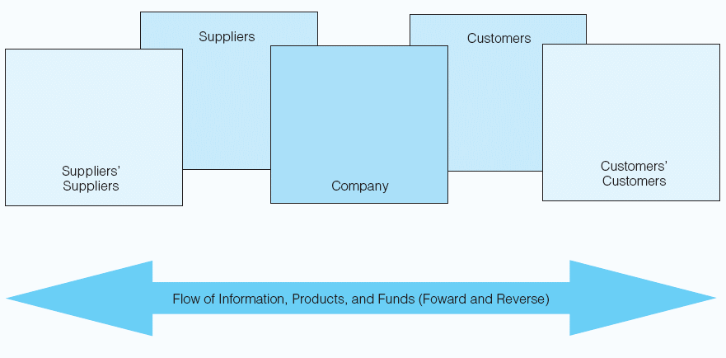
Graphical Depiction of a Supply Chain

Slide 43
Supply chain management consists of two interrelated components:
1.Marketing channels—an organized system of marketing institutions, through which products, resources, information, funds, and/or product ownership flow from the point of production to the final user.
2.Physical distribution—coordinating the flow of information and products among members of the channel to ensure the availability of products in the right places, in the right quantities, at the right times, and in a cost- efficient manner.

Slide 44
The term supply chain expresses the connection and integration of all members of the marketing channel.
Creating an extended enterprise requires investments in and commitment to three key factors:
1-connectivity----the informational and technological linkages among firms in the supply chain network.
-Connectiviy ensures that firms can access real-time information about the flow in the supply chain network.
2-community----the sense of compatible goals and objectives among firms in the supply chain network.
3-collaboration----the recognition of mutual interdependence among members of the supply chain metwork.
The goal of channel integration is to create a seamless network of collaborating suppliers, vendors, buyers

Slide 45
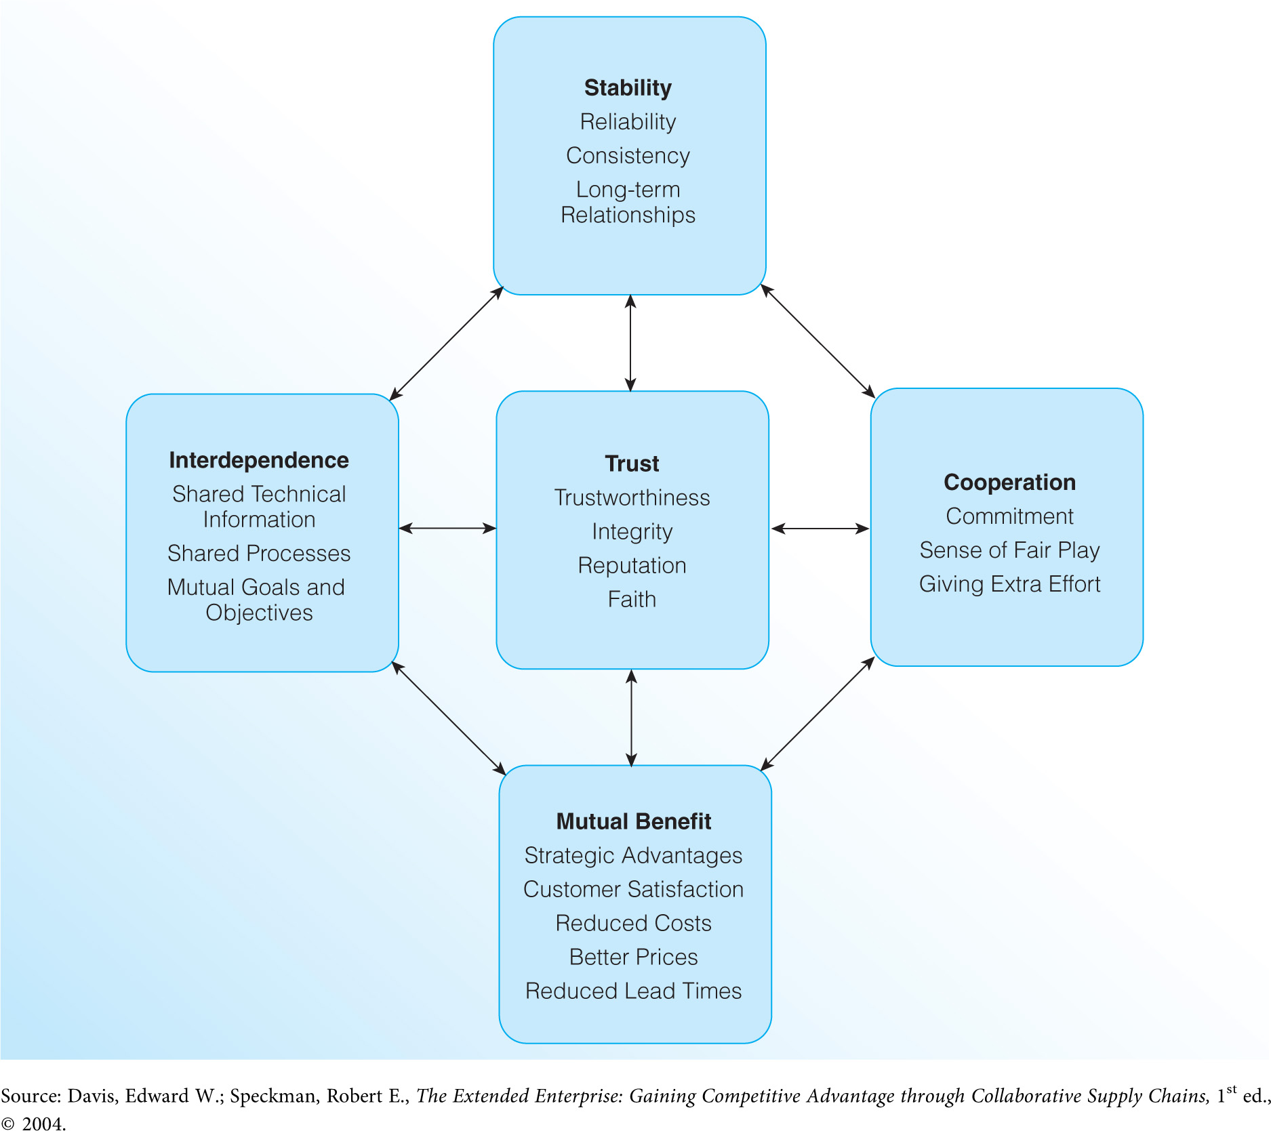
One of the best and most widespread collaborative supply chain initiatives is category management, an ongoing and highly successful initiative by innovative members of food product distribution channels. [Exhibit6.6]
Factors in Successful Supply Chain Integration

Slide 46
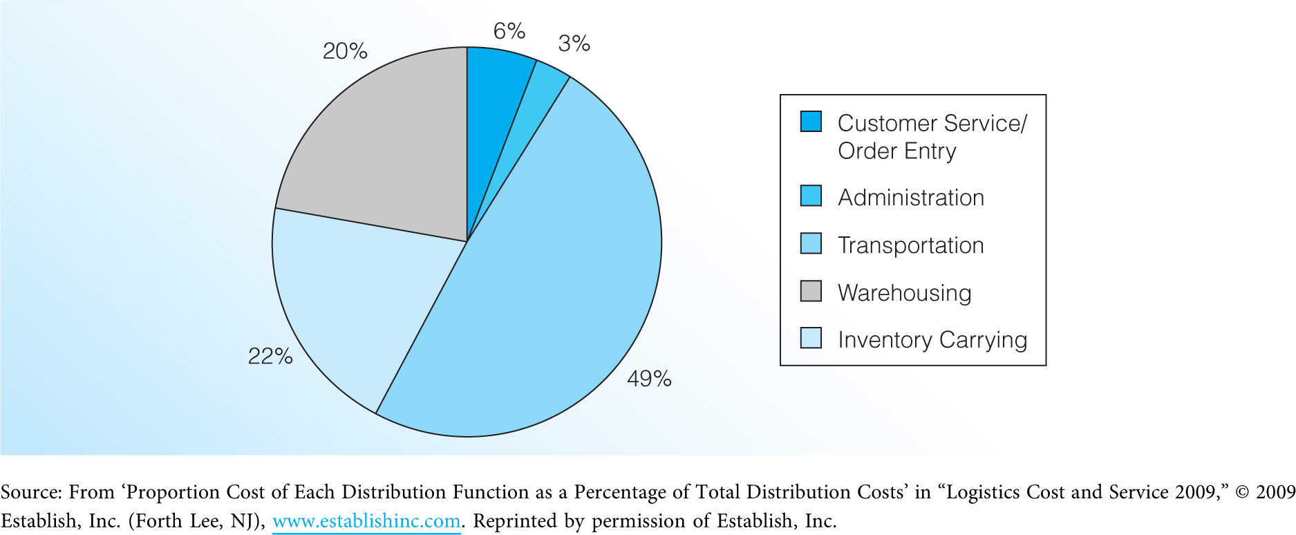
Strategic Supply Chain Issues
The importance of the supply chain ultimately comes down to providing time, place, and possession utility for consumer and business buyers. However, the expense of distribution requires that firms balance customers' needs with their own need to minimize costs. [Exhibit 6.7]
Breakdown of Total Distribution Costs

Slide 47
Marketing Channel Functions
1.The most basic benefit of marketing channels is contact efficiency, where channels reduce the number of contacts necessary to exchange products.
2.Channel intermediaries typically attain a level of specialization in one or more functions:
a)Sorting – Manufacturers make one or a few products while customers need a wide variety and deep assortment of different products. Intermediaries overcome this discrepancy of assortment.

Slide 48
b)Breaking Bulk – Manufacturers produce large quantities of a product; however, customers typically want only one of a particular item. Intermediaries—particularly retailers—overcome this discrepancy of quantity.
c)Maintaining Inventories – Manufacturers cannot make products on demand, so the channel must store products for future purchase and use. Intermediaries overcome this temporal (time) discrepancy.This issue does not apply to services.
d)Maintaining Convenient Locations – Since manufacturers and customers have a geographic separation, the channel must overcome this spatial discrepancy.

Slide 49
e)Provide Services – Channels add value to products by offering facilitating services and standardizing the exchange process.
3.It does not matter which intermediary performs these functions; the fact remains that they must be performed.

Slide 50
Marketing Channel Structure
There are three basic structural options for distribution in terms of the amount of market coverage and level of exclusivity between vendor and retailer:
1-Exclusive distribution, the most restrictive type of market coverage, occurs when a firm gives one merchant or outlet the sole right to sell a product within a defined geographic region.
2-Selective distribution, a somewhat restrictive type of market coverage, occurs when a firm gives several merchants or outlets the right to sell a product in a defined geographic region.
3-Intensive distribution, the least restrictive type of market coverage, occurs when a firm makes a product available in the maximum number of merchants or outlets in each area to gain as much exposure and as many sales opportunities as possible.

Slide 51
Channel structure is clearly linked to other elements in the marketing program and can be an integral part of both branding strategy and product positioning.
Power in the Supply Chain
True supply chain integration requires a fundamental change in how channel members work together, including moving from a "win‑lose" competitive attitude to a "win‑win" collaborative approach.
Each firm in a supply chain has its own mission, goals, objectives, and strategies. It is not surprising that firms often assess their own interests before considering others in the supply chain.

Slide 52
Power can be defined as the influence one channel member has over others in the supply chain.
1)Legitimate power deals with the firm's position in the supply chain—this power balance shifted to large retailers in the 1990s.
2)Reward power involves the ability to help other parties reach their goals and objectives.
3)Coercive power stems from the ability to take positive outcomes away from other channel members, or the ability to inflict punishment on other channel members.
4)Information power comes from having and sharing knowledge among members of the supply chain.
5)Referent power is based in personal relationships and the fact that one party likes another party.

Slide 53
Trends in Supply Chain Strategy
1-Technological Improvements
E-commerce
Radio frequency identification (RFID)
2-Out Sourcing Channel Functions
Outsourcing vs. offshoring
3-Growth of Non-Traditional Channels
Catalog and direct marketing
Direct selling
Home shopping networks
Vending
Direct response advertising

Slide 54
1-Technological Improvements
Significant advancements in information processing and digital communication have created new methods for placing and filling orders for both business buyers and consumers.
E-commerce now accounts for 46 percent of transactions in manufacturing, 25 percent of transactions in wholesaling, and 4.4 percent of retail transactions.
Radio frequency identification (RFID) involves the use of tiny computer chips with radio transmitters that can be attached to a product or its packaging

Slide 55
2-Outsourcing Channel Functions
Outsourcing has traditionally been used as a way of cutting expenses associated with labor, transportation, or other overhead costs.
Today, the desire of many firms to focus on core competencies drives outsourcing decisions.
Many firms have shifted to offshoring their own activities (rather than outsourcing) to maintain some control over operations.

Slide 56
The Trend in Outsourcing
Exhibit 9.6

Slide 57
3-Growth of Non-Traditional Channels
Customers' demands for lower prices and greater convenience have put pressure on all channel intermediaries to justify their existence.
When margins get squeezed, the channel typically evolves into a more direct form. The most obvious example of this evolution is the growth of e-commerce.
Other forms of nontraditional channels:
1)Catalog and direct marketing
2)Direct selling
3)Home shopping networks
4)Vending
5)Direct response advertising

Slide 58
Dual distribution (the use of multiple channels to offer two or more lines of the same merchandise) is a direct outgrowth of the increased use of nontraditional channels. However, it often creates conflict between the manufacturer and its supply chain members

Slide 59
Integrated Marketing Communications
Integrated marketing communications (IMC) refers to the strategic, coordinated use of promotion to create one consistent message across multiple channels to ensure maximum persuasive impact on the firm's current and potential customers.
IMC takes a 360-degree view of the customer that considers each and every contact that a customer or potential customer may have in their relationship with the firm. [Exhibit 6.9]

Slide 60
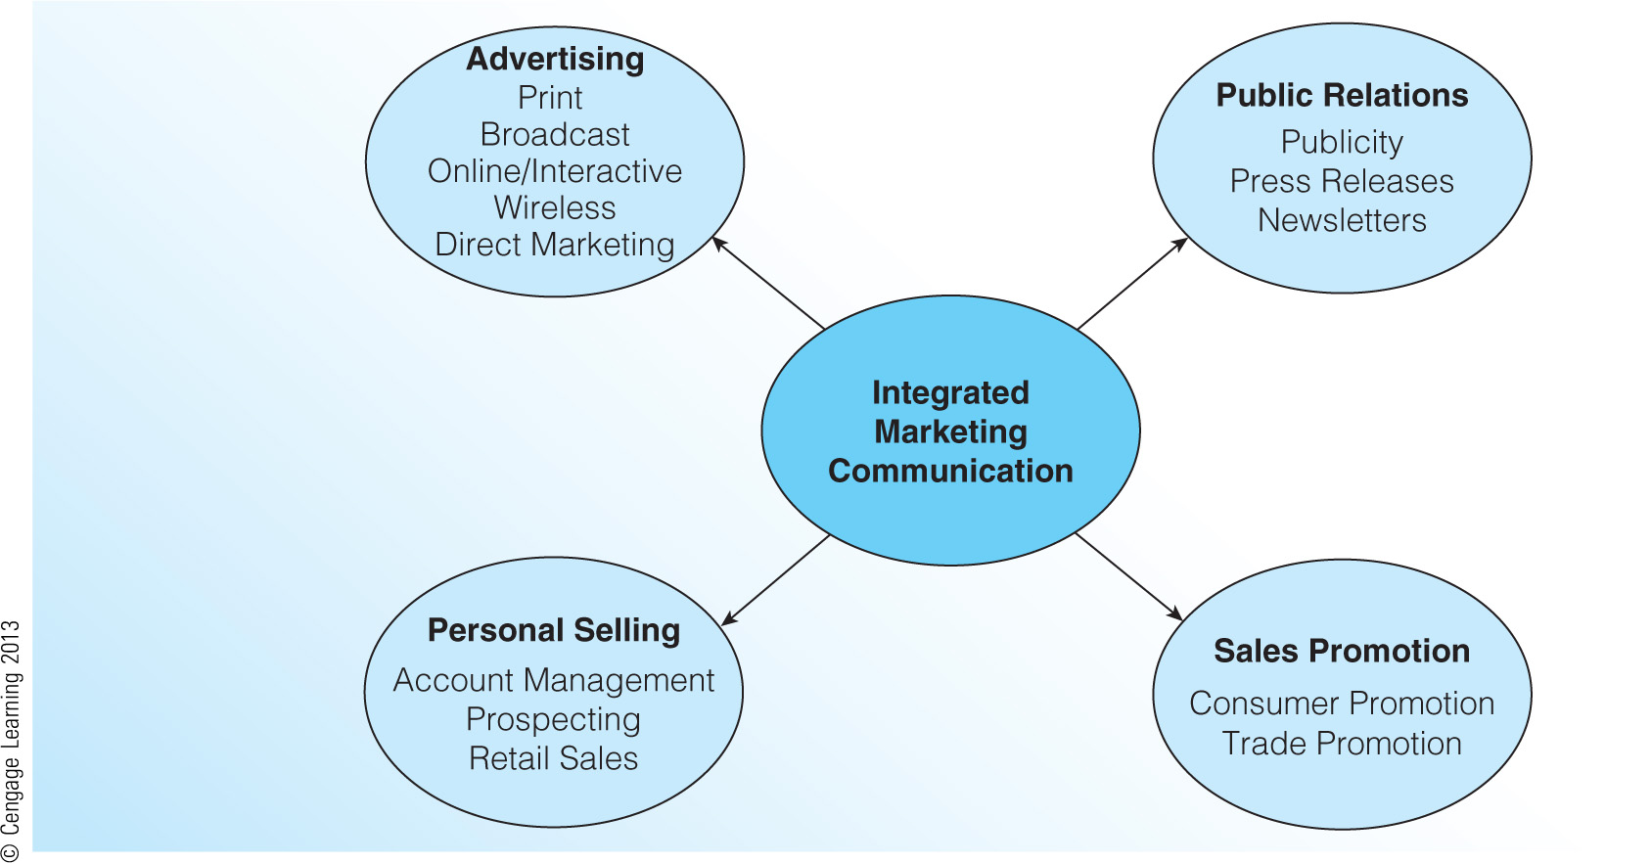
Components of IMC Strategy (Exhibit 6.9)

Slide 61
Strategic Issues in Integrated Marketing Communications
The classic model for outlining promotional goals is the AIDA model:
a)Attention—the first major goal of any promotional campaign is to attract the attention of potential customers.
b)Interest—the firm must spark interest in the product by demonstrating its features, uses, and benefits.
c)Desire—good promotion will stimulate desire by convincing potential customers of the product's superiority and its ability to satisfy needs.
d)Action—promotion must push customers toward the actual purchase.

Slide 62
The firm must also consider its promotional goals with respect to the supply chain.
a)Firms use a pull strategy when they focus their promotional efforts toward stimulating demand among final customers, who then exert pressure on the supply chain to carry the product.
b)Firms use a push strategy when they focus their promotional efforts on members of the supply chain to motivate them to spend extra time and effort on selling the product.

Slide 63
The Four key elements that comprise most IMC peograms:
1- Advertising.
2-Public Relations.
3-Personal selling and sales management.
4-Sales promotion.

Slide 64
1-Advertising
Advertising is paid, nonpersonal communication transmitted through mass media such as television, radio, magazines, newspapers, direct mail, outdoor displays, the Internet, and mobile devices. [Exhibit 6.10]
Online advertising is growing rapidly due to its ability to reach highly specialized markets at a relatively low cost. [Exhibit 6.11]
Though the initial expense for advertising can be quite high, it can be a cost efficient means of reaching a large number of people.

Slide 65
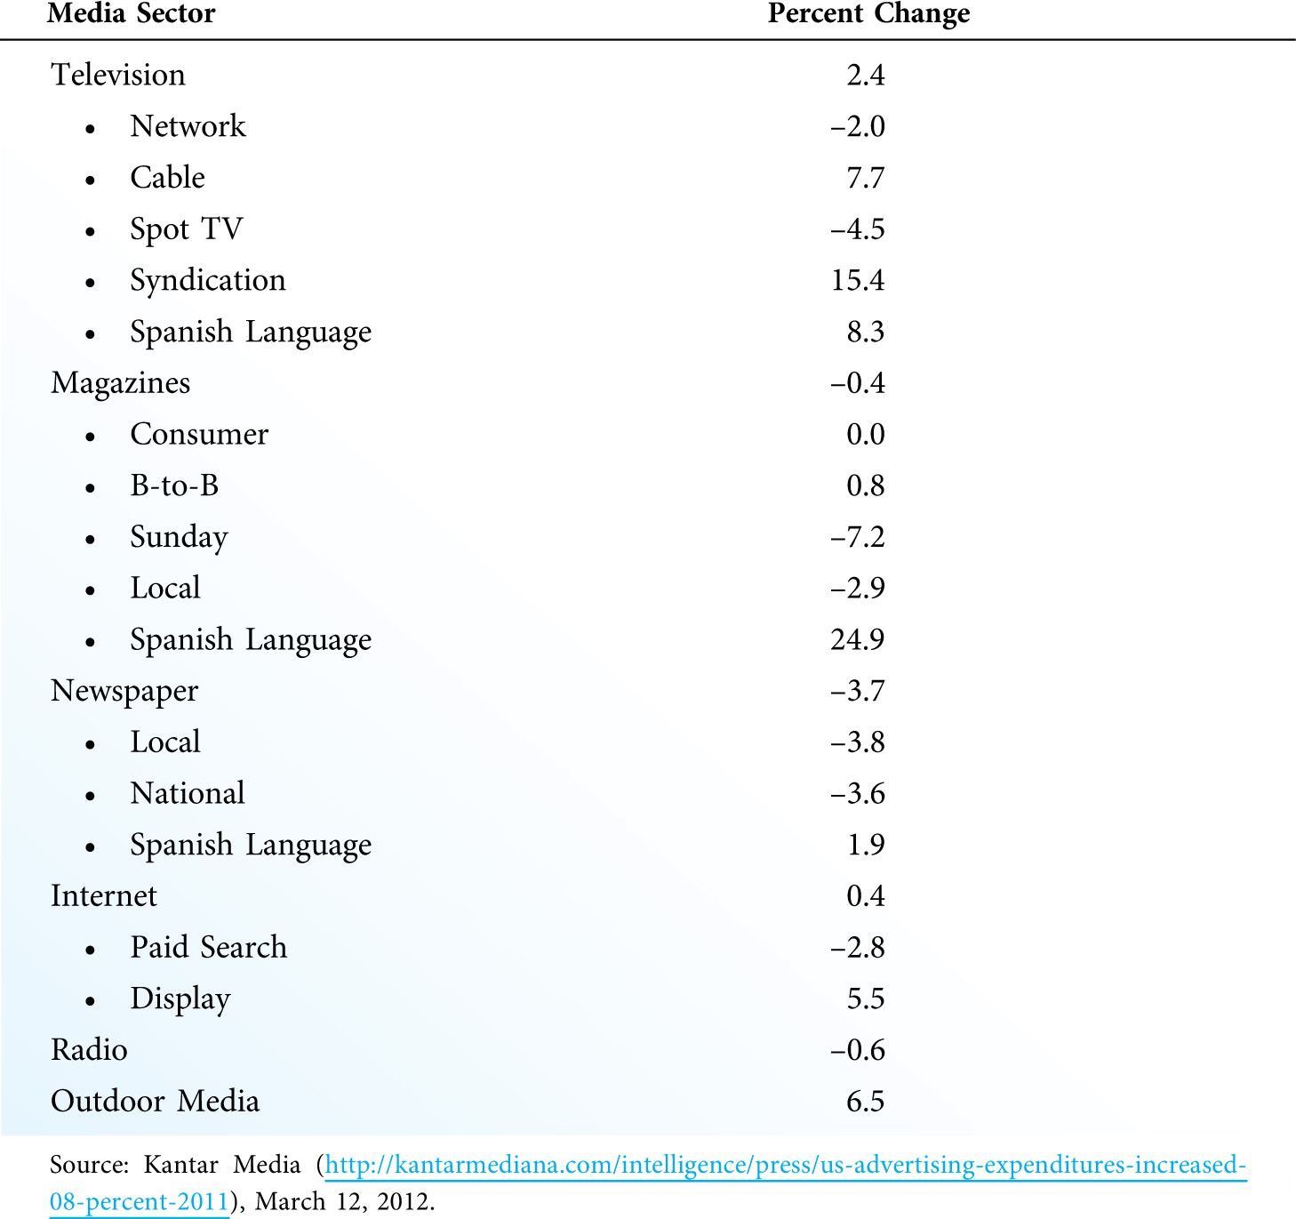
Change in U.S. Measured Ad Spending, 2010-2011 (Exhibit 6.10)

Slide 66
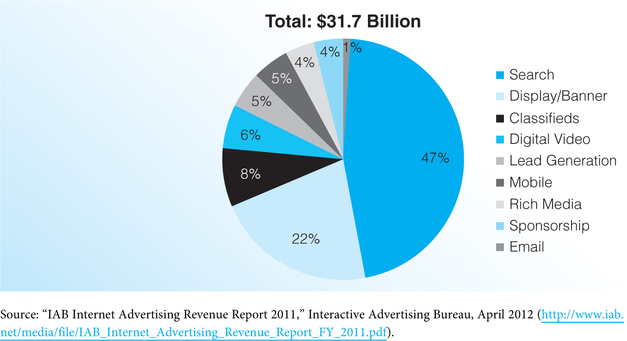
Internet Ad Revenues by Advertising Format, 2011 (Exhibit 6.11)

Slide 67
Setting the advertising budget too high will obviously result in overspending, waste, and lower profits. However, setting the budget too low may be even worse. Firms that do not spend enough on advertising find it very difficult to stand out in an extremely crowded market for customer attention.
Evaluating the effectiveness of advertising is one of the most challenging tasks facing marketers.
a)Many of the effects and outcomes of advertising take a long time to develop.
b)The effect of advertising on sales is lagged in some cases, with the effect occurring long after the campaign has ended.
Most marketers struggle with the fine line between what is permissible and not permissible in advertising.

Slide 68
2-Public Relations
Public relations, an element of a firm’s corporate affairs activities, tracks public attitudes, identifies issues that may elicit public concern, and develops programs to create and maintain positive relationships between a firm and its stakeholders.
Public relations can be used to promote the firm, its people, its ideas, and its image; and can even create an internal shared understanding among employees.

Slide 69
Public Relations Methods
a)Firms use a number of public relations methods to convey messages and to create the right attitudes, images, and opinions: news (or press) releases, feature articles, white papers, press conferences, event sponsorship, and employee relations.
b)Public relations often becomes confused with publicity. Publicity is more narrowly defined to include the firm's activities designed to gain media attention through articles, editorials, or news stories.
Although public relations activities are often seen as being more credible, they are often difficult for the firm to control.

Slide 70
There are a number of different methods used in public relations and publicity efforts:
-News (or Press) Releases A news release is a few pages of typewritten copy—typically fewer than 300 words—used to draw attention to a company event,product, or person affiliated with the firm.
-Feature Articles A feature article is a full-length story prepared for a specific purpose or target audience.
-White Papers White papers are similar to feature articles; however, they are more technical and focus on very specific topics of interest to the firm’s stakeholders.
-Press Conferences A press conference is a meeting with news media called to announce or respond to major events.
-Event Sponsorship Corporate sponsorship of major events has become an entire industry in itself.

Slide 71
Product Placement, product placement in movies and television programs is a rapidly growing practice, especially among highly identifiable brands like computers, clothing, and automobiles.
-Employee Relations Employee relations are every bit as important as public and investor relations. Employee relations activities provide organizational support for employees with respect to their jobs and lives

Slide 72
3-Personal Selling and Sales Management
Personal selling is paid personal communication that attempts to inform customers about products and persuade them to purchase those products.
Compared to other types of promotion, personal selling is the most precise form of communication because it assures companies that they are in direct contact with an excellent prospect.
The most serious drawback of personal selling is the cost per contact.
Because firms depend on repeat sales and ongoing customer relationships, personal selling activities must include elements of customer service and marketing research.

Slide 73
The Sales Management Process:
a)Developing Sales Force Objectives—objectives must be fully integrated with the objectives and activities of other promotional elements.
b)Determining Sales Force Size—size is a function of many variables, including the type of salespeople used, specific sales objectives, and the importance of personal selling within the IMC program.
c)Recruiting and Training Salespeople—should be a continuous activity as firms must ensure that new salespeople are consistently available to sustain the sales program.
d)Controlling and Evaluating the Sales Force—requires a comparison of sales objectives with actual sales performance. [Exhibit 6.12]

Slide 74
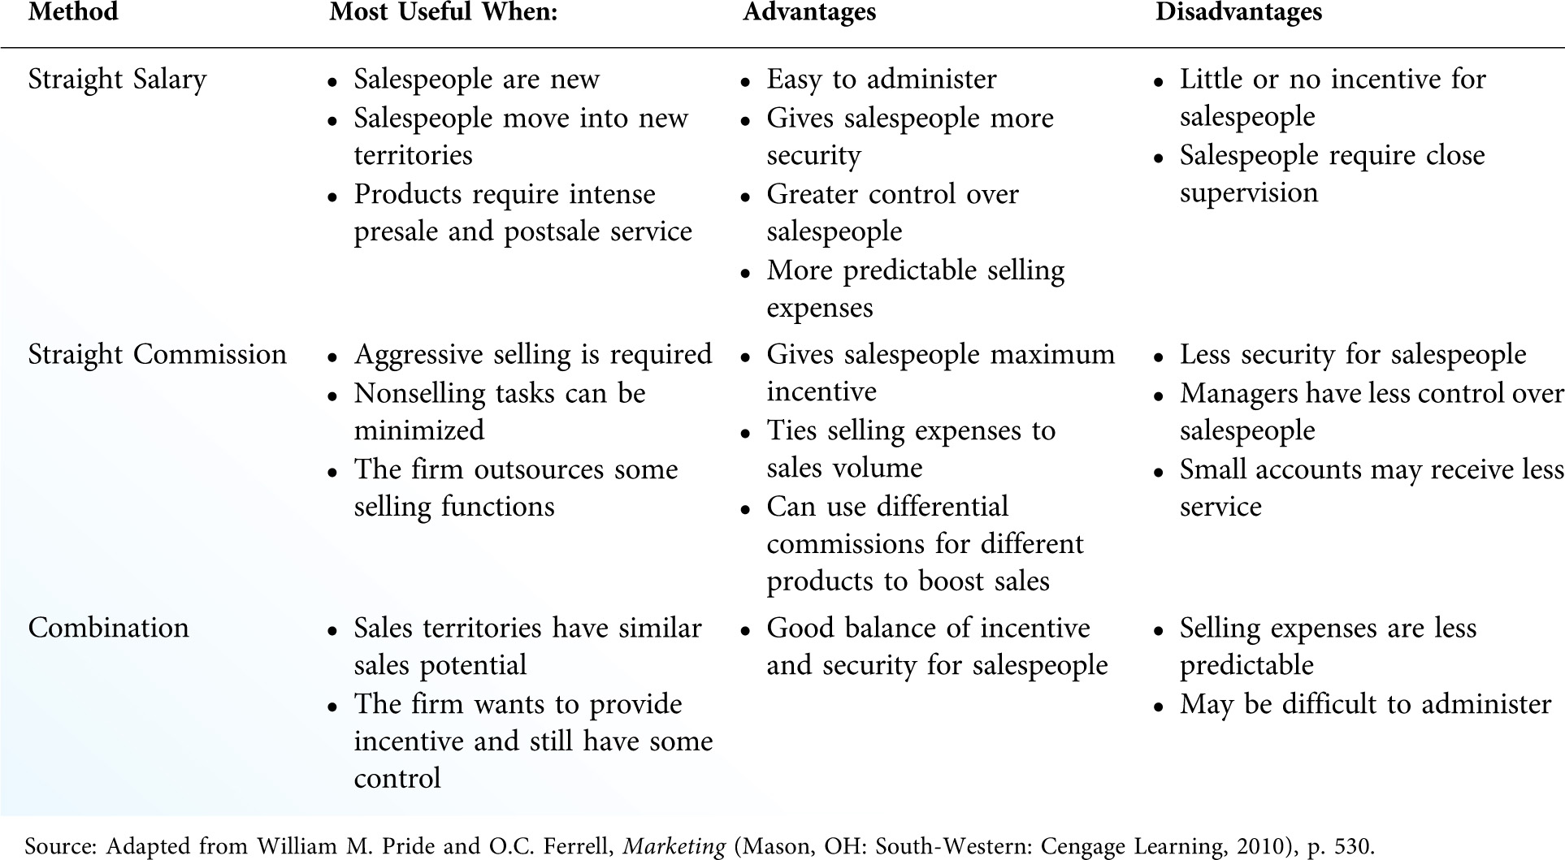
Sales Force Compensation Methods (Exhibit 6.13)

Slide 75
4-Sales Promotion
Sales promotion involves activities that create buyer incentives to purchase a product, or that add value for the buyer or the trade.
Sales promotion activities account for the bulk of promotional spending in many firms.
Consumer Sales Promotion
a)Coupons are used to reduce the price of a product and encourage customers to try new or established brands. [Exhibit 6.13]
b)Rebates are similar to coupons except that they require much more effort on the consumer's part to obtain the price reduction. Most firms prefer rebates to coupons.

Slide 76
e)Samples stimulate trial of a product, increase volume in the early stages of the product's life cycle, and encourage consumers to actively search for a product.
f)Loyalty programs reward loyal customers who engage in repeat purchases.
i)Point-of-purchase (POP) promotion includes displays, counter pieces, display racks, or self-service cartons that are designed to build traffic, advertise a product, or induce impulse purchases.
k)Premiums are items offered free or at a minimum cost as a bonus for purchasing a product.

Slide 77
h)Contests and sweepstakes encourage potential consumers to compete for prizes or try their luck by submitting their names in a drawing for prizes.
q)Direct mail, which includes catalog marketing and other printed material mailed to individual consumers, is a unique category because it incorporates elements of advertising, sales promotion, and distribution into a coordinated effort to induce customers to buy.

Slide 78
Business (Trade) Sales Promotion;
a)Trade allowances include both merchandise and price allowances for bulk buying or for special promotional considerations.
b)Free merchandise is sometimes offered to intermediaries instead of quantity discounts.
c)Cooperative advertising is an arrangement where a manufacturer agrees to pay a certain amount of an intermediary's media cost for advertising the manufacturer's products.
d)Training assistance and sales incentives are sometimes offered to intermediaries. Sales incentives come in two general forms: push money and sales contests.

