Slide 1
International Parity Relationships and Forecasting Foreign Exchange Rates
Chapter Six
Copyright © 2021 by the McGraw-Hill Companies, Inc. All rights reserved.

Slide 2
Chapter Outline
Interest Rate Parity
Covered Interest Arbitrage
IRP and Exchange Rate Determination
Currency Carry Trade
Reasons for Deviations from IRP
Purchasing Power Parity
PPP Deviations and the Real Exchange Rate
Evidence on Purchasing Power Parity
Fisher Effects
Forecasting Exchange Rates
Efficient Market Approach
Fundamental Approach
Technical Approach
Performance of the Forecasters
Copyright © 2021 by the McGraw-Hill Companies, Inc. All rights reserved.
6-2

Slide 3
International Parity Relationships
Law of one price (LOP)
Requirement that similar commodities or securities should be trading at the same or similar prices
Prevails when the same or equivalent things are trading at the same price across different locations or markets, precluding profitable arbitrage opportunities
Arbitrage equilibrium
Arbitrage is the act of simultaneously buying and selling the same or equivalent assets or commodities for the purpose of making certain, guaranteed profits
Copyright © 2021 by the McGraw-Hill Companies, Inc. All rights reserved.
6-3

Slide 4
Interest Rate Parity Defined
Interest rate parity (IRP) is an arbitrage condition that must hold when international financial markets are in equilibrium
Manifestation of the LOP applied to international money market instruments and provides a linkage between interest rates in two different countries
Copyright © 2021 by the McGraw-Hill Companies, Inc. All rights reserved.
6-4
Notes:
Interest rate parity (IRP) is a concept which states that the interest rate differential between two countries is the same as the differential between the forwarding exchange rate and the spot exchange rate. Put simply, the interest rate parity suggests a relationship between interest rates, spot exchange rates, and forward exchange rates—which means investors can be indifferent to interest rates between countries.

Slide 5
Interest Rate Parity - Example
Suppose you have $1 to invest over a one-year period, and you will only consider default-free investments.
There are two alternative ways on investing your fund:
Invest domestically at the U.S. interest rate
If you choose this option, the maturity value in one year will be $1(1 + i_{s}), where i_{s} is the U.S. interest rate
Copyright © 2021 by the McGraw-Hill Companies, Inc. All rights reserved.
6-5

Slide 6
Interest Rate Parity – Example (Continued)
Suppose you have $1 to invest over a one-year period. There are two alternative ways on investing your fund:
Invest in a foreign country, say, the U.K., at the foreign interest rate and hedge the exchange risk by selling the maturity value of the foreign investment forward. This option requires the following steps:
Exchange $1 for a pound, that is, £(1/S) amount at the prevailing spot exchange rate (S)
Invest the pound amount at the U.K. interest rate (i£), with the maturity value of £(1/S)(1+i£)
Sell the maturity value of the U.K. investment forward in exchange for a predetermined dollar amount, that is, $[(1/S)(1+i£)]F, where F denotes the forward exchange rate
Copyright © 2021 by the McGraw-Hill Companies, Inc. All rights reserved.
6-6

Slide 7
The exchange risk is completely hedged.
Because, as with the U.S. investment, you are assured of receiving a predetermined dollar amount, your U.K. investment coupled with forward hedging is a perfect substitute for the domestic U.S. investment. Because you’ve hedged the exchange risk by a forward contract, you’ve effectively redenominated the U.K. investment in dollar terms.

Slide 8
Interest Rate Parity: Equivalent Investments
Effective dollar interest rate from the U.K. investment alternative is given by:
U.S. and U.K. investment examples are equivalent
Future dollar proceeds from investing in the two equivalent investments must be the same, implying the following:
or
Copyright © 2021 by the McGraw-Hill Companies, Inc. All rights reserved.
6-8

Slide 9
Arbitrage
IRP can be derived by constructing an arbitrage portfolio, which involves the following:
No net investment
No risk
No net cash flow generated in equilibrium
When IRP does not hold, the situation gives rise to covered interest arbitrage opportunities, allowing certain arbitrage profits to be made without the arbitrageur investing any money out of pocket or bearing any risk
Copyright © 2021 by the McGraw-Hill Companies, Inc. All rights reserved.
6-9

Slide 10
IRP and Exchange Rate Determination
Reformulating the IRP relationship in terms of the spot exchange rate yields:
Forward exchange rate can be viewed as the expected future spot exchange rate conditional on all relevant information being available
Combining the two equations yields the following:
Copyright © 2021 by the McGraw-Hill Companies, Inc. All rights reserved.
6-10
Notes:
S_{t+1} is the future spot rate when the forward contract matures
I_{t} denotes the set of information currently available

Slide 11
IRP and Exchange Rate Determination Continued
Two things are noteworthy from the following equation (presented on previous slide):
“Expectation” plays a key role in exchange rate determination (i.e., when people “expect” the exchange rate to go up in the future, it goes up now)
Exchange rate behavior will be driven by news events
Copyright © 2021 by the McGraw-Hill Companies, Inc. All rights reserved.
6-11

Slide 12
Covered Interest Arbitrage
To understand the covered interest arbitrage (CIA) process, it is best to work with a numerical example.
Copyright © 2021 by the McGraw-Hill Companies, Inc. All rights reserved.
6-12

Slide 13
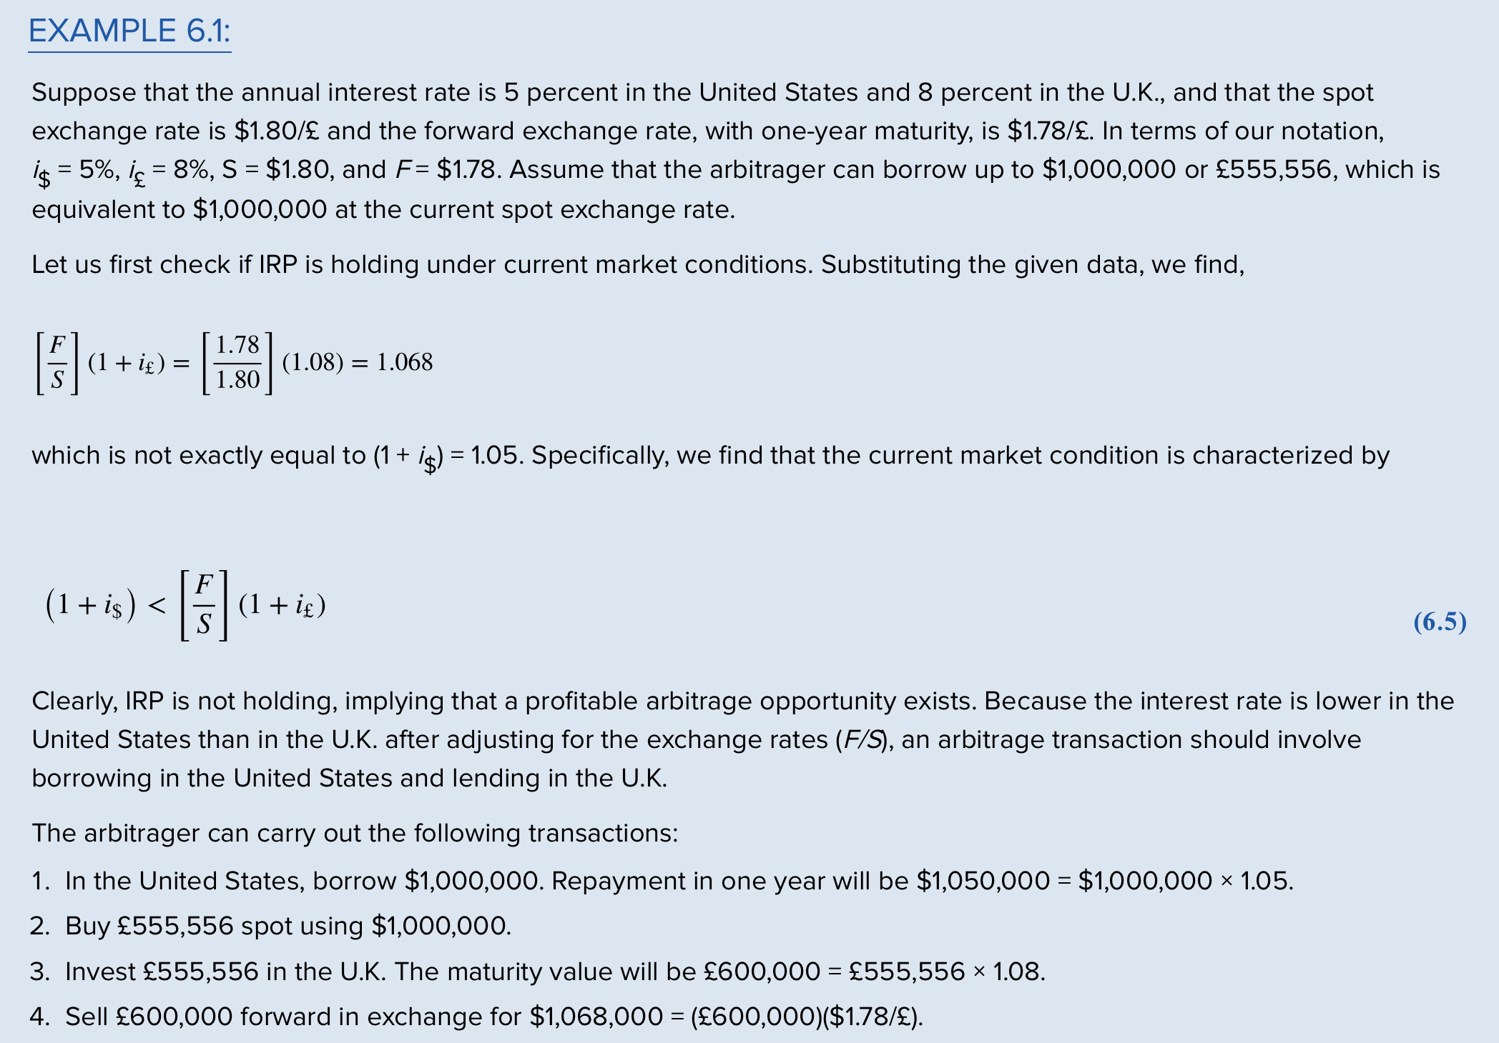

Slide 14
Covered Interest Arbitrage

Slide 15
Uncovered Interest Rate Parity
When the forward exchange rate F is replaced by the expected future spot exchange rate, E(S_{t+1}), we obtain:
Where E(e) is the expected rate of change in the exchange rate, that is, [E(S_{t+1}) − S_{t}]/S_{t}.
The equation states that the interest rate differential between a pair of countries is (approximately) equal to the expected rate of change in the exchange rate.
This relationship is known as the uncovered interest rate parity.
Copyright © 2021 by the McGraw-Hill Companies, Inc. All rights reserved.
6-15
Notes:
E(e) is the expected rate of change in the exchange rate

Slide 16
If, for instance, the annual interest rate is 5 percent in the United States and 8 percent in the U.K., as assumed in our numerical example, the uncovered IRP suggests that the pound is expected to depreciate against the dollar by about 3 percent, that is, E (e) ≈ −3%.
Uncovered interest rate parity
Interest rate differential between a pair of countries is (approximately) equal to the expected rate of change in the exchange rate

Slide 17
Currency Carry Trade
Unlike IRP, the uncovered interest rate parity often does not hold, giving rise to uncovered interest arbitrage opportunities
A popular example of such trade is provided by currency carry trade.
Currency carry trade involves buying a high-yielding currency and funding it with a low-yielding currency, without any hedging
The carry trade is profitable if the interest rate differential is greater than the appreciation of the funding currency against the investment currency.
Since the interest rate in Japan has been near zero since the mid-1990s, the yen has been the most popular funding currency for carry trade, followed by the Swiss franc.
Copyright © 2021 by the McGraw-Hill Companies, Inc. All rights reserved.
6-17
Notes:
Since the interest rate in Japan has been near zero since the mid-1990s, the yen has been the most popular funding currency for carry trade, followed by the Swiss franc.

Slide 18
Currency Carry Trade
Due to the low-interest-rate policy of the Federal Reserve to combat the Great Recession, the U.S. dollar has also become a popular funding currency in recent years.
Popular investment currencies, on the other hand, include the Australian dollar, New Zealand dollar, and British pound, due to relatively high interest rates prevalent in these countries.
Suppose you borrow in Japanese yen and invest in the Australian dollar. Your carry trade then will be profitable as long as the interest rate spread between the Australian dollar and Japanese yen, i_{A$} − i¥, is greater than the rate of appreciation (e_{A$,¥}) of the yen against the Australian dollar during the carry period, that is, i_{A$} − i¥ > e_{A$,¥}.
Copyright © 2021 by the McGraw-Hill Companies, Inc. All rights reserved.
6-18
Notes:
Since the interest rate in Japan has been near zero since the mid-1990s, the yen has been the most popular funding currency for carry trade, followed by the Swiss franc.

Slide 19
If many investors carry out the preceding trade on a massive scale, the yen may even depreciate, at least in the short run, against the Australian dollar, which is contrary to the prediction of the uncovered interest rate parity.
The yen may depreciate in the short run as investors are selling the yen for the Australian dollar. If the yen depreciates against the Australian dollar by more than the Japanese interest rate, the funding cost for this carry trade would be effectively negative, making the carry trade more profitable.
However, if the Japanese yen appreciates against the Australian dollar by more than the interest rate spread, you would lose money from the carry trade. Clearly, currency carry trade is a risky investment, especially when the exchange rate is volatile.

Slide 20
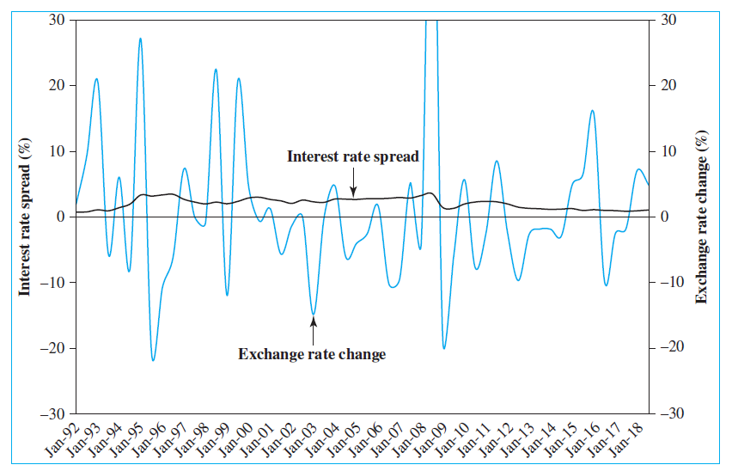
EXHIBIT 6.3 Interest Rate Spreads and Exchange Rate Changes: Six-Month Carry Trade Periods for Australian Dollar–Japanese Yen Pair
Copyright © 2021 by the McGraw-Hill Companies, Inc. All rights reserved.
6-20
Notes:
Note: For interest rates, interbank six-month rates are used for both countries. The interest rate spread and the rate of change in the exchange rate are plotted at the beginning of each six-month carry period.
Source: Interest rates and exchange rates are obtained from Datastream.

Slide 21
Reasons for Deviations from IRP
IRP holds quite well, but it may not hold precisely especially over short periods, all the time due to (primarily) two main reasons:
Transaction costs
Interest rate at which the arbitrager borrows tends to be higher than the rate at which he lends, reflecting the bid-ask spread.
There exist bid-ask spreads in the foreign exchange market as well, as the arbitrager must buy currencies at the higher ask price and sell at the lower bid price
Copyright © 2021 by the McGraw-Hill Companies, Inc. All rights reserved.
6-21
Notes:
For instance, Akram, Rime, and Sarno (2008) examined deviations from the covered IRP using high-frequency data for U.S. dollar exchange rates against euro, pound, and yen and for interest rates over a period of seven months in 2004. Although they found no profitable arbitrage opportunities on average, they documented numerous short-lived deviations from covered IRP that were profitable and long enough to allow traders to exploit these opportunities.

Slide 22
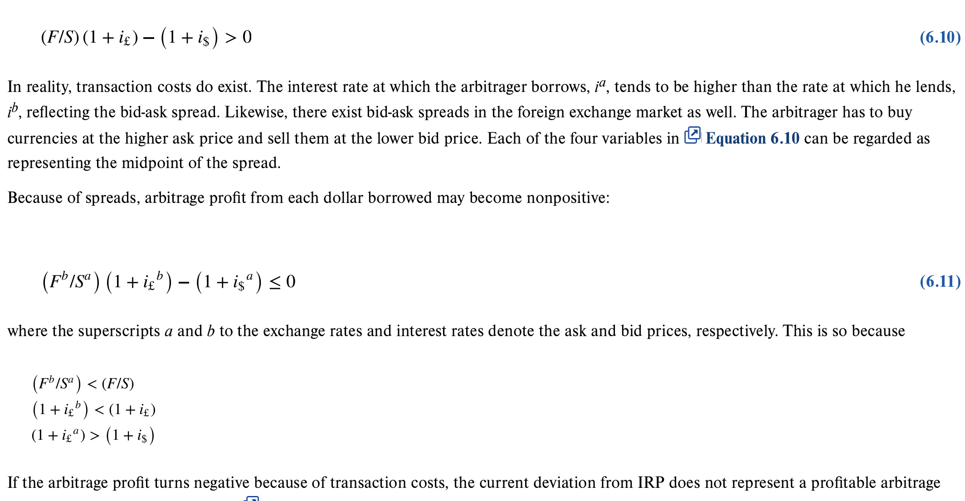

Slide 23
Reasons for Deviations from IRP
IRP holds quite well, but it may not hold precisely, especially over short periods, all the time due to (primarily) two main reasons:
Transaction costs
Interest rate at which the arbitrager borrows tends to be higher than the rate at which he lends, reflecting the bid-ask spread.
There exist bid-ask spreads in the foreign exchange market as well, as the arbitrager must buy currencies at the higher ask price and sell at the lower bid price
Capital controls
Governments sometimes restrict capital flows, inbound and/or outbound via jawboning, imposing taxes, or outright bans
Copyright © 2021 by the McGraw-Hill Companies, Inc. All rights reserved.
6-23
Notes:
For instance, Akram, Rime, and Sarno (2008) examined deviations from the covered IRP using high-frequency data for U.S. dollar exchange rates against euro, pound, and yen and for interest rates over a period of seven months in 2004. Although they found no profitable arbitrage opportunities on average, they documented numerous short-lived deviations from covered IRP that were profitable and long enough to allow traders to exploit these opportunities.

Slide 24
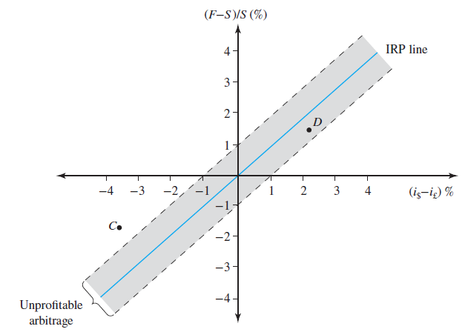
EXHIBIT 6.4 Interest Rate Parity with Transaction Costs
Point C, represent profitable arbitrage opportunities.
IRP deviations within the band, such as point D, would not represent profitable
arbitrage opportunities. The width of this band will depend on the size of transaction
costs.
Copyright © 2021 by the McGraw-Hill Companies, Inc. All rights reserved.
6-24

Slide 25
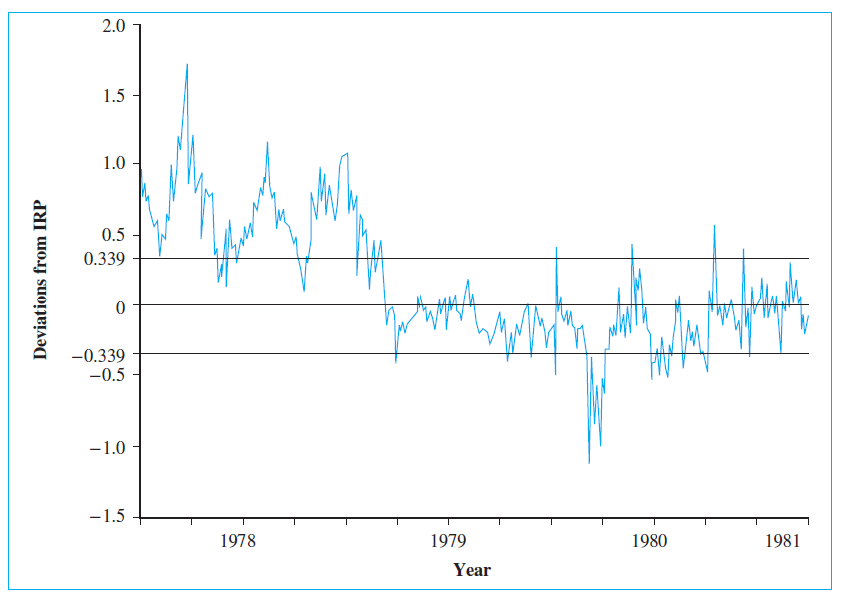
EXHIBIT 6.5: Deviations from Interest Rate Parity: Japan, 1978-1981 (in percent)
Copyright © 2021 by the McGraw-Hill Companies, Inc. All rights reserved.
6-25
Notes:
Note: Daily data were used in computing the deviations. The zone bounded by +0.339 and −0.339 represents the average width of the band around the IRP for the sample period.
Source: Otani, I., and S. Tiwari. (1981). “Capital Controls and Interest Rate Parity: The Japanese Experience, 1978–81,” IMF Staff Papers 28: pp. 793−816.

Slide 26
Purchasing Power Parity
When the law of one price is applied internationally to a standard consumption basket, we obtain the theory of purchasing power parity (PPP)
PPP states the exchange rate between currencies of two countries should be equal to the ratio of the countries’ price levels of a commodity basket
Let P$ be the dollar price of the standard consumption basket in the U.S. and P£ the pound price of the same basket in the U.K.
Copyright © 2021 by the McGraw-Hill Companies, Inc. All rights reserved.
6-26
Notes:
S is the dollar price of one pound.

Slide 27
Absolute version of PPP states the exchange rate between the dollar and pound should be:
where S is the dollar price of one pound.
The PPP relationship in this equation is called the absolute version of PPP.
It implies that if the standard commodity basket costs $225 in the United States and £150 in the U.K., then the exchange rate should be $1.50 per pound:
If the price of the commodity basket is higher in the United States, say, $300, then PPP dictates that the exchange rate should be higher, that is, $2.00/£.

Slide 28
To give an alternative interpretation to PPP, let us rewrite
This equation states that the dollar price of the commodity basket in the United States, P$, must be the same as the dollar price of the basket in the U.K., that is, P£ multiplied by S.
In other words, PPP requires that the price of the standard consumption basket be the same across countries when measured in a common currency.
Clearly, PPP is the manifestation of the law of one price applied to the standard consumption basket.

Slide 29
Purchasing Power Parity Continued
The Economist each year compiles local prices of Big Macs around the world and computes the so-called “Big Mac PPP,” the exchange rate that would equalize the hamburger prices between America and elsewhere.
Comparing this PPP and the actual exchange rate, a currency may be judged to be either undervalued or overvalued.
In January 2019, a Big Mac cost (on average) $5.58 in America and 20.9 yuan in China. Thus, the Big Mac PPP would be about 3.75 yuan per dollar.
The actual exchange rate, however, is 6.85 yuan per dollar, implying that the yuan is substantially undervalued.
In contrast, the Big Mac PPP for Switzerland is 1.16 Swiss francs per dollar, compared with the actual exchange rate of 0.98 francs per dollar.This implies that the Swiss franc is overvalued.
Copyright © 2021 by the McGraw-Hill Companies, Inc. All rights reserved.
6-29
Notes:
e is the rate of change in the exchange rate
π$ and π£ are the inflation rates in the United States and U.K., respectively

Slide 30
Purchasing Power Parity Continued
When the PPP relationship is presented in the “rate of change” form, instead of price level as in the absolute version of PPP, we obtain the relative version of PPP:
Where:
e is the rate of change in the exchange rate
π$ and π£ are the inflation rates in the United States and U.K., respectively.
For example, if the inflation rate is 6 percent per year in the United States and 4 percent in the U.K., then the pound should appreciate against the dollar by about 2 percent, that is, e ≈ 2 percent, per year.
Copyright © 2021 by the McGraw-Hill Companies, Inc. All rights reserved.
6-30
Notes:
e is the rate of change in the exchange rate
π$ and π£ are the inflation rates in the United States and U.K., respectively

Slide 32
PPP Deviations and the Real Exchange Rate
Whether PPP holds or not has important implications for international trade.
If PPP holds and thus the differential inflation rates between countries are exactly offset by exchange rate changes, countries’ competitive positions in world export markets will not be systematically affected by exchange rate changes.
However, if there are deviations from PPP, changes in nominal exchange rates cause changes in the real exchange rates, affecting the international competitive positions of countries.
This, in turn, would affect countries’ trade balances.
Copyright © 2021 by the McGraw-Hill Companies, Inc. All rights reserved.
6-32

Slide 33
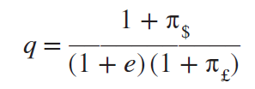
PPP Deviations and the Real Exchange Rate
If there are deviations from PPP, changes in nominal exchange rates cause changes in the real exchange rates, affecting the international competitive positions of countries
Real exchange rate, q, is found by:
If PPP holds, the real exchange rate will be unity (i.e., q = 1), but when PPP is violated, the real exchange rate will deviate from unity
Copyright © 2021 by the McGraw-Hill Companies, Inc. All rights reserved.
6-33

Slide 34
Suppose, for example, the annual inflation rate is 5 percent in the United States and 3.5 percent in the U.K., and the pound appreciated against the dollar by 4.5 percent. Then the real exchange rate is .97:
The dollar depreciated by more than is warranted by PPP, strengthening the competitiveness of U.S. industries in the world market.
To summarize,
q = 1: Competitiveness of the domestic country unaltered.
q < 1: Competitiveness of the domestic country improves.
q > 1: Competitiveness of the domestic country deteriorates.

Slide 35
Evidence on PPP
PPP has been the subject of a series of tests, yielding generally negative results, especially over short horizons
Generally unfavorable evidence about PPP suggests that substantial barriers to international commodity arbitrage exist
As long as there are nontradables (e.g., haircuts, housing, etc.), PPP will not hold in its absolute version
If PPP holds for tradables and the relative prices between tradables and nontradables are maintained, then PPP can hold in its relative version
Copyright © 2021 by the McGraw-Hill Companies, Inc. All rights reserved.
6-35

Slide 36
The price of aspirin (20 units) ranges from $0.69 in Mexico City to $12.15 in Geneva. In general, production and distribution of drugs are tightly regulated by the governments in most countries.
These regulations make it difficult to carry out cross-border arbitrage, resulting in a wide price disparity for these products.
Likewise, the cost of a man’s haircut ranges widely from $9.25 in Yangon, Myanmar to $61.82 in Tokyo, Japan. It costs 568 percent more to have a haircut in Tokyo than in Yangon. The price differential, however, is likely to persist because haircuts are simply not tradable.
In comparison, the price disparity for a hamburger is substantially less. For example, it costs $5.20 in London, $5.59 in Paris, and $5.64 in New York City. The lower price disparity may be attributable to the fact that multinational firms like McDonald’s set the prices across countries on a comparable basis.

Slide 37
Fisher Effects
The Fisher effect holds that an increase (decrease) in the expected inflation rate in a country will cause a proportionate increase (decrease) in the interest rate in the country
Formally, the Fisher effect is written as follows:
Fisher effect implies that the expected inflation rate is the difference between the nominal and real interest rates in each country, that is,
Copyright © 2021 by the McGraw-Hill Companies, Inc. All rights reserved.
6-37
Notes:
ρ$ denotes the equilibrium expected “real” interest rate in the United States

Slide 38
Fisher Effects
For example, suppose the expected real interest rate is 2 percent per year in the United States. Given this, the U.S. (nominal) interest rate will be entirely determined by the expected inflation in the United States.
If, for instance, the expected inflation rate is 4 percent per year, the interest rate will then be set at about 6 percent. With a 6 percent interest rate, the lender will be fully compensated for the expected erosion of the purchasing power of money while still expecting to realize a 2 percent real return.
Of course, the Fisher effect should hold in each country as long as the bond market is efficient.
Copyright © 2021 by the McGraw-Hill Companies, Inc. All rights reserved.
6-38
Notes:
ρ$ denotes the equilibrium expected “real” interest rate in the United States

Slide 39
Fisher Effects Continued
If we assume the real interest rate is the same between countries, that is, ρ$ = ρ£, we obtain the international Fisher effect (IFE), which suggests the nominal interest rate differential reflects the expected change in exchange rate
When the international Fisher effect is combined with IRP, we obtain the forward expectations parity (FEP), which states any forward premium or discount is equal to the expected change in the exchange rate
Copyright © 2021 by the McGraw-Hill Companies, Inc. All rights reserved.
6-39

Slide 40
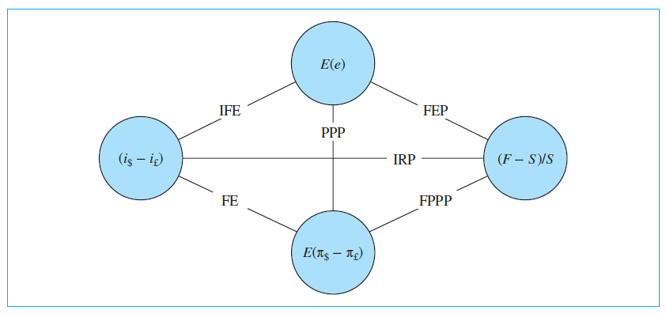
EXHIBIT 6.9: International Parity Relationships among Exchange Rates, Interest Rates, and Inflation Rates
Copyright © 2021 by the McGraw-Hill Companies, Inc. All rights reserved.
6-40
Notes:
Notes:
1. With the assumption of the same real interest rate, the Fisher effect (FE) implies that the interest rate differential is equal to the expected inflation rate differential.
2. If both purchasing power parity (PPP) and forward expectations parity (FEP) hold, then the forward exchange premium or discount will be equal to the expected inflation rate differential. The latter relationship is denoted by the forward-PPP, i.e., FPPP in the exhibit.
3. IFE stands for the international Fisher effect.

Slide 41
Forecasting Exchange Rates
Many business decisions are now made based on forecasts, implicit or explicit, of future exchange rates
Forecasting techniques can be classified into three distinct approaches:
Efficient market approach
Fundamental approach
Technical approach
Copyright © 2021 by the McGraw-Hill Companies, Inc. All rights reserved.
6-41

Slide 42
Efficient Market Approach
Efficient market hypothesis (EMH) states that financial markets are informationally efficient in that the current asset prices reflect all the relevant and available information
Implies that the exchange rate will change only when the market receives new information
Random walk hypothesis suggests today’s exchange rate is the best predictor of tomorrow’s exchange rate
To the extent that interest rates are different between two countries, the forward exchange rate will be different from the current spot exchange rate
Copyright © 2021 by the McGraw-Hill Companies, Inc. All rights reserved.
6-42

Slide 43
Fundamental Approach
Uses various models to forecast exchange rates
Three main difficulties of this approach:
One must forecast a set of independent variables to forecast the exchange rates, and forecasting the former will certainly be subject to errors and may not be necessarily easier than forecasting the latter
Parameter values that are estimated using historical data may change over time because of changes in government policies and/or the underlying structure of the economy
Model itself can be wrong
Copyright © 2021 by the McGraw-Hill Companies, Inc. All rights reserved.
6-43

Slide 44
Technical Approach
First analyzes the past behavior of exchange rates for the purpose of identifying “patterns” and then projects them into the future to generate forecasts
Based on the premise that history repeats itself
At odds with the efficient market approach
Differs from fundamental approach in that it does not use the key economic variables, like money supplies or trade balances, for purpose of forecasting
Two examples of technical analysis:
Moving average crossover rule
Head-and-shoulders pattern
Copyright © 2021 by the McGraw-Hill Companies, Inc. All rights reserved.
6-44

Slide 45
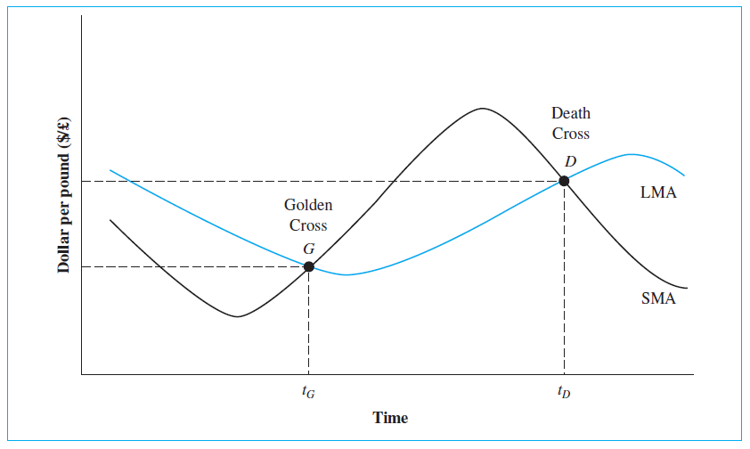
EXHIBIT 6.10: Moving Average Crossover Rule: Golden Cross vs. Death Cross
Copyright © 2021 by the McGraw-Hill Companies, Inc. All rights reserved.
6-45

Slide 46
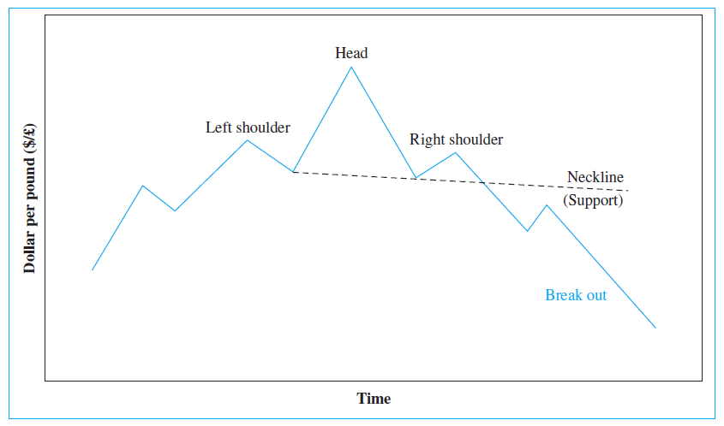
EXHIBIT 6.11: Head-and-Shoulders Pattern: A Reversal Signal
Copyright © 2021 by the McGraw-Hill Companies, Inc. All rights reserved.
6-46

Slide 47
Performance of the Forecasters
Can professional forecasters outperform the market?
Eun and Sabherwal (2002) study found that banks as a whole could not outperform the random walk model, but some banks significantly outperformed the random walk model, especially in the longer run
Beckmann and Czudaj (2017) suggest professionals have a hard time predicting exchange rates, and uncertainty regarding economic policy and macroeconomic and financial conditions significantly affects professionals’ forecast errors
Copyright © 2021 by the McGraw-Hill Companies, Inc. All rights reserved.
6-47

