Slide 1
Ch. 6 Process Safety and Disaster Preparedness
Process Information
Process Analysis
Operating Procedures
Training
Contractor Personnel
Act of Terrorism
Workplace Security

Slide 2
Introduction
Major disasters
Chemical company accident in Bhopal, India
2,500 civilian killed
Phillips Petrochemical Plant explosion in Houston, Texas
24 killed and 128 injured
→ OSHA Process Safety Standard
The scope of the process safety standard
Chemical plant
Petroleum refineries
Poultry processing plant – chlorine for refrigeration
A discrete-items manufacturing plant employed dangerous acids in its planting operation

Slide 3
Process Information
OSHA requires the employer to compile information on
The highly hazardous chemicals to be used or produced by the process
The equipment to be used in the process
The technology of the process itself
Material Safety Data Sheet (MSDS)
This is a document that contains information on the potential hazards (health, fire, reactivity and environmental) and
how to work safely with the chemical product
It is an essential starting point for the development of a complete health and safety program

Slide 4
Process Information
Hazardous chemicals
Material Safety Data Sheet (MSDS, Figure 5-1)
The primary document of information regarding chemicals used within an industrial plant
The MSDS provide all information necessary to comply with process safety requirements
Example: Hazardous chemical information for process safety analysis (Case Study 6.1)
Name of chemical;
Toxicity information;
Permissible exposure limits;
Physical data;
Reactivity data;
Corrosivity data;
Thermal and chemical stability;
Hazardous mixing

Slide 5
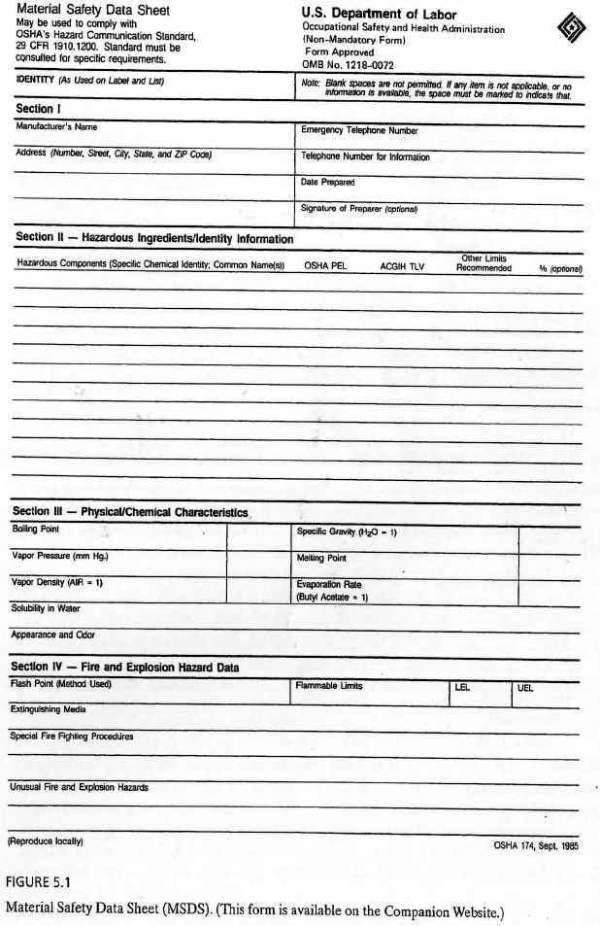
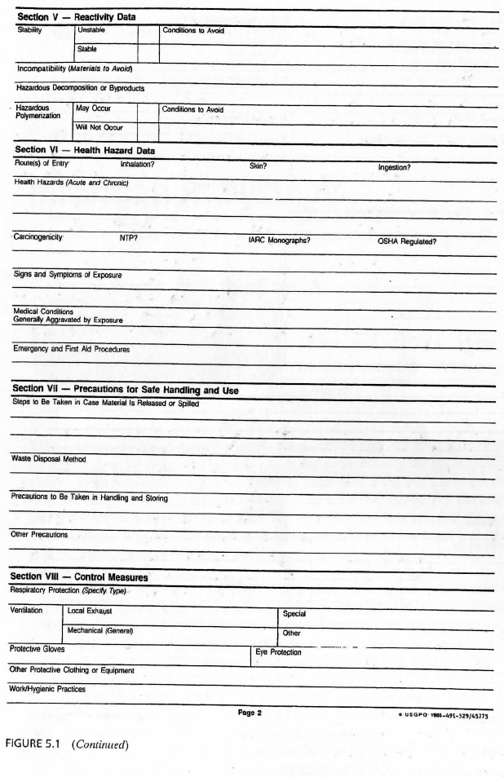

Slide 6
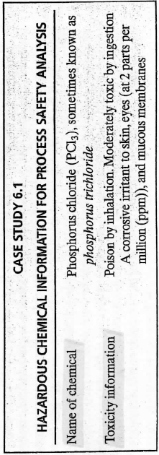
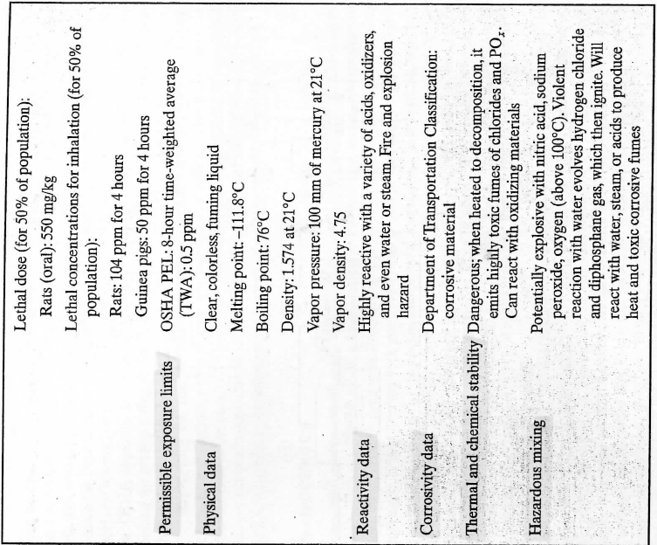

Slide 7
Process Information
Equipment
The federal standards require that process equipment comply with recognized and generally accepted good engineering practices.
It is advisable to utilize a registered professional engineer to make a good engineering practices evaluation of process equipment.
See the figures for process equipment
Technology (= chemical plant)
OSHA wants employers to document the technology of the process, including at least a block flow diagram (Figure 6.1) or a simplified flow process diagram (Figure 6.2).
In addition, process chemistry data, maximum intended inventory, and safe upper and lower limits for temperatures, pressures, flows, or compositions must be provided.

Slide 8
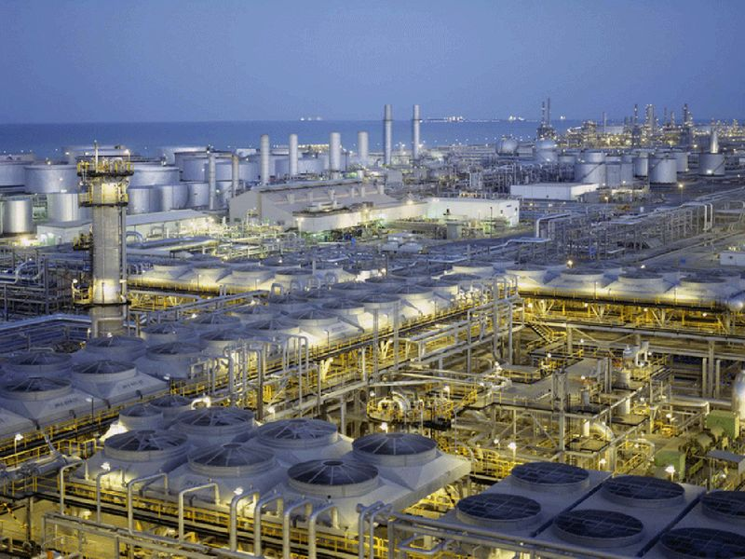
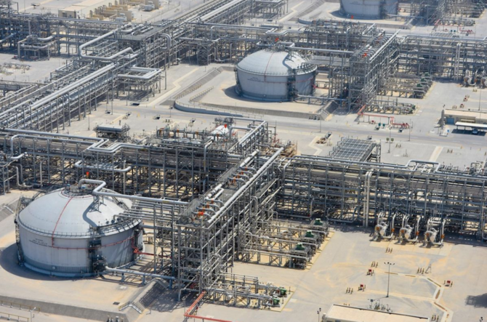
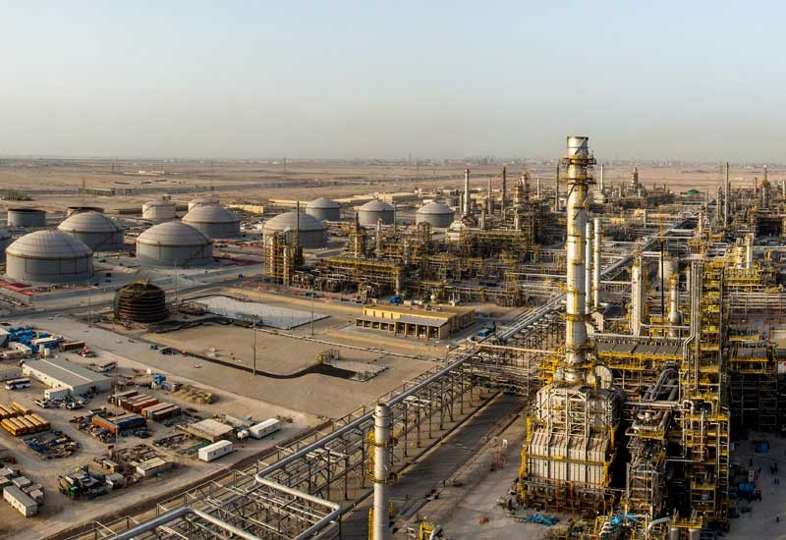
Pictures of ARAMCO

Slide 9
Process Equipment

Slide 10
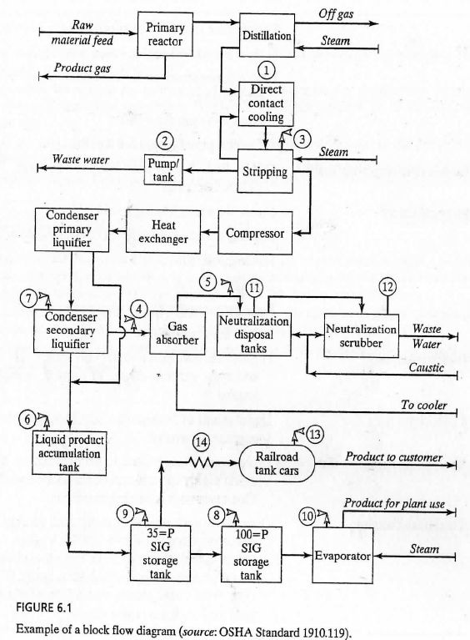
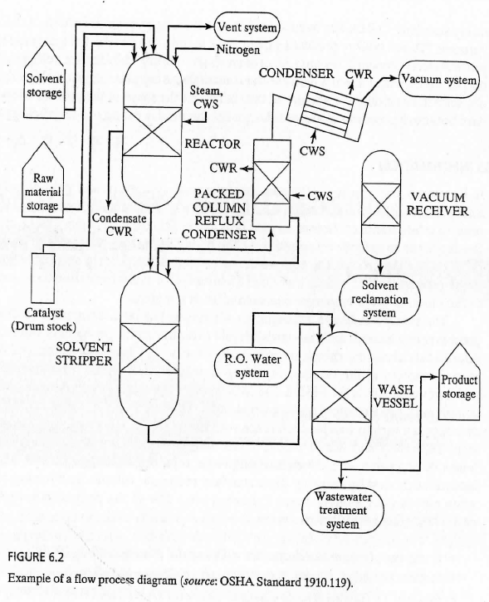
Process Technology

Slide 11
Process Information
How to keep the files
All in one place
This is convenient to OHSA inspector, employee representative, and other interest parties.
This method has difficulties in updates and changes
Road-map approach
This approach leaves required documents in their respective departments of responsibility.
A road map is in a central file
Another possibility is to have a computerized information system with controlled access.

Slide 12
Process Analysis
How to perform process analysis
Fault-tree analysis, failure mode and effect analysis, what-if analysis, and so on.
Considerations:
Engineering control system
detection and early warning of impending catastrophic events (computer-based process monitoring system)
Location of the site of the facility (e.g., earth quake)
Human element (e.g., human failure)
Employer has a responsibility to develop process hazard analysis.
The initial analysis are to be updated and evaluated every five years.
This action must be documented and kept for the life of the process

Slide 13
Operating Procedures
Process information gathering and analyzing
The next step is operating procedure
The conclusions reached must be transformed into operating procedure that anticipated hazards are actually dealt with.
Practice under normal, temporary, and emergency operations
A key feature:
The capability to recognize when something has gone wrong.
Methods:
Setting preset limits to trigger an emergency action
Operating plan should tell workers:
What the consequences of control limit deviations are
What to do to bring the process back under control

Slide 14
Training
An effective training plan has four ingredients:
Initial training for new operators or new processes
Refresh training at prescribe intervals, and in any event at least every 3 years
Verification or testing to prove that employees understand the process and safe procedures
Documentation to confirm that the training and testing have been carried out
Case Study 6.2: Hydrogen Sulfide Poisoning – Fatal Accident
Illustrates a natural result of inadequate respiratory protection, inadequate operating procedures, and inadequate training of personnel.

Slide 15
Contractor Personnel
How to do if
Some of dead and injured workers were employed by outside contractor
Prime employer’s job:
To check into the safety record of prospective contractor firms before contract
Process hazards must be communicated to contractors
Prime employer’s emergency action plan also must be communicated to contractors
To perform periodic evaluation
to assure that the contractor is doing the job with respect to OSHA process safety standards
To maintain an injury and illness log for contractor employees
Contract employer’s job:
Providing safe and healthful workplaces for their own employees
Training
Assure that their own employees follow the prime employer’s rule
even for the safety rules originated by the prime employer for the hazardous process

Slide 16
H.W.
Ch. 6: Exercises and Study Questions
All 25 questions

Slide 17
