Slide 1
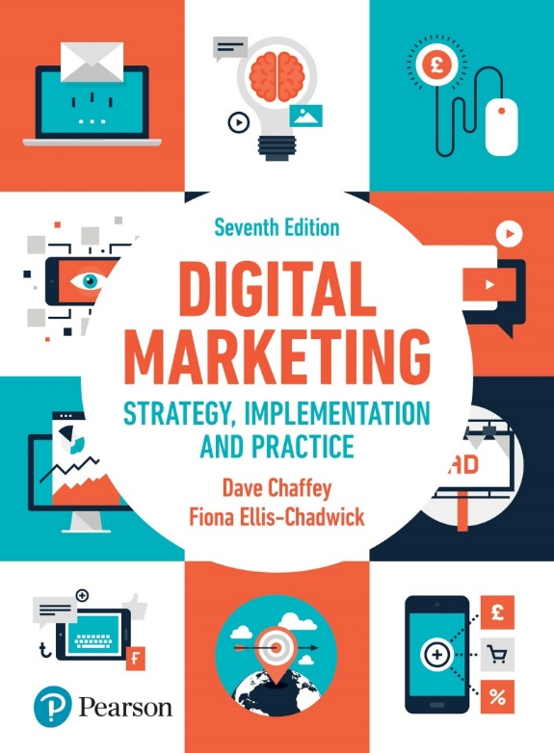
Chapter 3: The Digital macro-environment

Slide 2
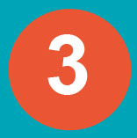
Chapter 3 The Digital macro-environment
Main Topics:
The rate of environmental change
Technological forces
Economic forces
Political forces
Legal Forces
Social Forces

Slide 3
Introduction
We will explore the macro-environment forces, focusing on the potential relevance of each to digital marketing strategy:
Technological forces
Economic forces
Political forces
Legal forces
Social forces

Slide 4
The main reason for keeping track of changes in the macro-environment is to be aware of how changes in social behaviour, new laws and technological innovation can create opportunities or threats.
Organisations that monitor and respond effectively to their macro-environment can create differentiation and competitive advantages that enable the business to survive and prosper

Slide 5
The rate of environmental change
In the digital world, changes in market forces are increasingly rapid.
Firms should respond to these changes, emerging opportunities and threats by developing strategic agility.
Strategic agility: The capability to innovate and gain competitive advantage within a marketplace by monitoring changes within an organisation’s marketplace, and then efficiently evaluating alternative strategies, selecting, reviewing and implementing appropriate candidate strategies.

Slide 6
1- Technological forces
Key factors to consider:
Internet technology
Cyber security
Mobile and SMS messaging and applications
Mobile Apps
Emerging technologies

Slide 7
Internet technology
Internet: The physical network that links computers across the globe. It consists of the infrastructure of network servers and communication links between them that are used to hold and transport the vast amount of information.
Web content is stored on web server computers and then accessed by users who run desktop or mobile web browser software such as Google Chrome, which display the information and allow users to interact and select links to access other websites.
Rich media, such as audio or video content, can also be stored on a web server, or a specialist streaming media server.
Promoting website addresses is important to marketing communications. The technical name for web addresses is uniform (universal) resource locator (URL)

Slide 8
Cyber security
Security is a key technology factor for marketers to consider as it is a major concern for Internet users everywhere.
From a consumer point of view, these are the main security risks involved in an e-commerce transaction:
Confidential details or passwords accessed on user’s computer
Transaction or credit card details stolen in transit
Customer’s credit card details stolen from merchant’s server;
Customer’s details accessed by company staff (or through a hacker);
Merchants or customers are not who they claim to be, and the innocent party can be drawn into a fraudulent (fake) trading situation

Slide 9
Cyber security
Digital marketers should ensure a safe digital environment for their users. Once the security measures are in place, content on the merchant’s site can be used to reassure the customer.

Slide 10
Mobile & SMS messaging & applications
The Short Message Service ‘texting’, is a simple form of person-to-person communication that enables messages to be transferred between mobile phones.
Its use grew for many years, but it is now on the decline as consumers turn to messaging via social networks and new mobile messaging applications such as WhatsApp and Viber, which are billed as SMS replacements.
Texting became increasingly popular as a means for brands to communicate with customers:
banks notify customers of current account
retailers send delivery notifications
airlines send boarding and flight details using SMS.
supply chain management applications for notifying managers of problems or deliveriey.

Slide 11
Mobile Apps
Mobile apps: A software application that is designed for use on a mobile phone, typically downloaded from an App store such as Google Play or App Store.
Research shows that 90 % of mobile time is used in mobile apps. Perhaps not surprising since the majority of app time is in social media applications.
Through reviewing the types of apps that have proved popular, businesses can assess the potential for them to develop applications for their audiences.
The key questions to ask are:
Are apps a strategic priority for us? The goal of apps for most organisations will be to increase awareness and sales, or publisher’s revenue from advertising or subscriptions.
Do we build our own app and/or leverage existing apps? advertising and sponsorship options may be a more cost-effective method to build reach and awareness of a brand.

Slide 12
Free or paid apps? Retailers will generally offer free apps, a freemium approach is the standard approach.
Which category of application to target?
How to best promote mobile apps? the most popular methods of app discovery are:
searching the app store;
recommendations from friends and family;
mention on device or network carrier page;
email promotion;
offline mention in TV and print.
How to refine apps in line with feedback? The success of apps is very dependent on feedback in the App stores and the need to fix bugs (errors) and add enhancements to compete.

Slide 13
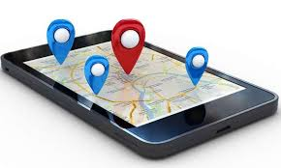
Mobile Apps
Social location-based marketing: Where social media tools give users the option of sharing their location, and hence give businesses the opportunity to use proximity or location-based marketing to deliver targeted offers and messages to consumers and collect data about their preferences and behaviour
For example: Foursquare, TripAdvisor
QR Codes(Quick Response code): A two-dimensional code used for direct response.
>> used in promotional initiatives to allow target consumers to have quick access to a variety of information, such as instant access to email addresses, phone numbers or business cards.

Slide 14
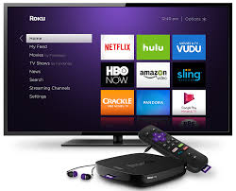
Emerging technologies
In addition to mobile and Wi-Fi access, Internet access technologies for television and radio are available digitally.
Internet TV, or IPTV, is increasingly popular and as bandwidth, download speeds and access devices improve, the number and range of users is increasing.
This technology creates challenges for the digital marketer as they need to access which technology their target audience is using to access which type of content, information and digital services.
One of the challenges for digital marketers is how to successfully assess which new technological innovations can be applied to give competitive advantage.

Slide 15
Emerging Technologies
Depending on the attitude of the manager, decisions can be summarised as:
Cautious, a ‘wait and see’ approach.
Intermediate, sometimes referred to as ‘fast-follower’ approach. Let others take the majority of the risk, but if they are proving successful then rapidly adopt the technique, i.e. copy them.
Risk-taking, an early-adopter approach.
Early adopters : Companies or departments that invest in new technologies and techniques.
Notes:
Figure 3.4 Diffusion-adoption curve

Slide 16
Emerging Technologies
Assessing the marketing value of technology innovation
This diffusion–adoption process classified :
innovators,
early adopters,
early majority,
late majority,
the laggards.
Notes:
Figure 3.4 Diffusion-adoption curve

Slide 17
2- Economic Forces
Globally, economic influences affect the level of success of business.
Economic forces affect supply and demand and consequently it is important for digital markets to identify which economic influences they need to monitor.
Classic economic factors can affect every aspect of business activity and are equally pertinent to off-and online businesses.
Economic Forces include:
Market growth and employment:
Economic growth
Interest and exchange rates
Globalization

Slide 18
Market growth and employment
The economic environment can have a critical impact on the success of companies through its effect on supply and demand.
Companies must choose those economic influences that are relevant to their business and monitor changes.
The impact of changes in demand can have far-reaching implications for digital marketing initiatives as this will affect the strength of market growth.
Sophisticated technology enables companies to analyse purchasing patterns and forecast future demand. But this is only part of the picture of consumption that drives modern global economies.
It is also important to monitor changes to trends in order to be able to make realistic predictions about how consumers and companies are going to behave in the future.

Slide 19
Economic growth
Throughout history there have been periods of strong economic growth followed by eco-nomic downturn and recession.
The dot.com period of boom and bust (beginning of the 21st century) highlighted the fragility of high-tech markets and many of the emerging Internet companies, which had high-value stock market valuations, crashed and no longer exist.
When there is economic growth during periods of boom, companies should be prepared to experience increased demand for their products and services.
During periods of slump, sales may decline as customers revaluate their needs and spending requirements.
The challenge is predicting the next boom or slump as they need to consider investments, research and development and if they fail to correctly anticipate the changing state of the economy they may encounter difficulties or miss opportunities.

Slide 20
Interest and exchange rate
Interest rates are a key monetary tool used by governments in conjunction with banks and financial institutions to manage a country’s economy.
Interest rates represent the price that borrowers have to pay lenders for the use of their money over a specified period of time.
Western economies tend to lower interest rates during hard times in order to stimulate economic activity and encourage borrowing and lending, in the hope that they can avoid a downturn.
Exchange rates are the price of trading one currency against another.
International suppliers and manufacturers often change their prices for a particular currency zone in order to ensure they maintain their prices at the required level.
Digital marketers should carefully consider their markets in relation to currency fluctuations. >> Amazon has developed country-specific operations and trade in the national currencies associated with each domain

Slide 21
Globalization
In recent years the world has become more accessible, global expansion and exports across the world are now possible and the Internet has been an influencing factor in the growth in trade.
In the digital world, globalisation reflects the move towards international trading in a single global marketplace and the blurring (less) of social and cultural differences between countries.
A major driver of Internet adoption by commercial organisations is the opportunity for market expansion in domestic and international markets.
However, digital marketers need to be aware of the implications of trading in global markets and consider :
whether to develop bespoke (customized approach) branding and marketing campaigns
or whether to apply a standardised approach, and should also not lose touch with the needs and wants of local markets.

Slide 22
3- Political forces
Political forces can have implications for digital marketing strategy and planning.
The political environment is shaped by the interplay of government agencies, public opinion and consumer pressure groups and industry-backed organisations. Interaction between these organisations helps to create a trading environment with established regulations and privacy controls.
In order to achieve the Government’s aims to become a world-leading digital economy, the Digital Strategy is built on seven strands (axes):
Connectivity 5. Skills and inclusion
The digital sector 6. The wider economy
Cyber space 7. Digital government
The data economy.

Slide 23
Political forces
Political forces include:
Internet governance
Taxation
Tax Jurisdiction

Slide 24
Internet governance
Internet governance is the control of the operation and use of the Internet.
Governance is traditionally undertaken by government, but the global nature of the Internet makes it less practical for a government to control online.
No one runs the Internet and while there are many individuals, businesses and organisations that have a vested interest in ensuring the stability of the Internet, there is no central governing body.
ICANN oversees the allocation of domain names and Internet protocols.
The network neutrality principle enshrines (preserve) equal access to the Internet such that telecom providers do not discriminate access to data or connectivity for different users

Slide 25
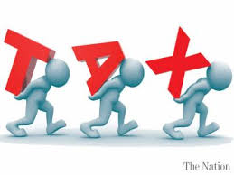
Taxation
How to change tax laws to reflect the globalisation through the Internet is a problem that many governments are grappling with.
The fear is that the Internet may cause significant reductions in tax revenues to national or local governments if existing laws do not cover changes in purchasing patterns.
In the past both Google and Amazon have been accused of routing their tax affairs through low-tax jurisdiction economies; Amazon has been found to be paying 11 times less corporation tax in the UK than other bookstores.

Slide 26
Tax Jurisdiction
Tax jurisdiction determines which country gets the tax income from a transaction.
Under the current system of international tax treaties, the right to tax is divided between the country where the enterprise that receives the income is resident (‘residence’ country) and that from which the enterprise derives that income (‘source’ country).
Laws on taxation are rapidly evolving and vary significantly between countries.

Slide 27
Social media and political change
The rise of use of social media for political purposes is having far-reaching consequences.
Individuals have mobilised various campaigns via social media that have brought about change
Through social media there is a new form of political communication;
politicians have direct contact with voters;
campaigns can go viral and be shared with
millions of social media users;
adverts can be freely posted and shared via YouTube.

Slide 28
4- Legal forces
Laws develop in order to provide a framework of control and regulations that aim to enable individuals and businesses to go about their business in a legal and ethical manner.
However, laws are open to interpretation and there are many legal and ethical considerations in the online trading environments.
Many laws aim to prevent unethical marketing practice, so marketers have to understand and work within this regulatory framework.

Slide 29
Legal and Ethical Standards
Ethical standards: Practices and behaviours that are morally acceptable to society.
Legal activities can be considered unethical ???
>> Digital marketers should respect the law and have ethical standards , but the rate of technological innovation is rapid so the law is often unclear.
In this case, marketers need to tread carefully since unethical action can result in serious damage to the reputation of a company and negative sentiment can result in a reduction in online audience or sales.
The main issue to be considered by the marketer is disclosure of the types of information collection and tracking data used.
There is also the challenge of compliance (conformity) with different laws prevalent in different countries.

Slide 30
The most important legal issues for digital marketers
Data protection and privacy law: Anti-spam legislation
Disability and discrimination law
Brand and trademark protection
Intellectual property rights
Online advertising law

Slide 31
1- Data protection and privacy law
Privacy of personal data, such as our identities, likes and dislikes, is a major concern to consumers, particularly with the dramatic increase in identity theft.
law Privacy: A moral right of individuals to avoid intrusion into their personal affairs.
Identity theft: The misappropriation of the identity of another person, without their knowledge or consent.
BUT Digital marketers can better understand their customers’ needs by using this type of very valuable information.
Through collecting personal information, it becomes possible to develop highly targeted communications and develop products that are more consistent with users’ needs.
An obvious step is to ensure that marketing activities are consistent with the latest data protection and privacy laws.

Slide 32
The main information types used by the digital marketer that are governed by ethics and legislation, are:
Contact information. This is the name, postal address, email address and, for B2B companies, website address.
Profile information. This is information about a customer’s characteristics that can be used for segmentation. It includes age, sex and social group for consumers, and company characteristics and individual role for business customers.
Platform usage information. Through web analytics systems it is possible to collect information on type of computer, browser and screen resolution used by site users.
Behavioural information (on a single site). This is purchase history and the whole of the buying process. Malware can collect additional information such as passwords
Behavioural information (across multiple sites). This can potentially show how a user accesses multiple sites and responds to adverts across sites. These data are collected on cookie or IP addresses

Slide 33
Data Protection Low
Data protection legislation is enacted to protect the individual, to protect their privacy and to prevent misuse of their personal data.
Personal data Any information about an individual stored by companies concerning their customers or employees.
Any company that holds personal data on computers or on file about customers or employees must be registered with a data protection registrar This process is known as notification.

Slide 34
Anti-spam legislation
Laws have been enacted in different countries to protect individual privacy and with the intention of reducing spam or unsolicited commercial email (UCE).
Spam Unsolicited email (usually bulk-mailed and untargeted).
Anti-spam laws do not mean that email cannot be used as a marketing tool, but the recipient has to agree to receive the mailing. This approach is called permission marketing.
Permission marketing Customers agree (opt-in) to be involved in an organisation’s marketing activities, usually as a result of an incentive.

Slide 35
Anti-spam legislation
Permissive email marketing is based on consent or opt-in by customers, and the option to unsubscribe or opt-out is the key to successful email marketing.
Opt-in A customer proactively accepts to receive further information.
Opt-out A customer declines the offer to receive further information.
Cold list Data about individuals that are rented or sold by a third party
House list Data about existing customers used to market products to encourage future purchase.

Slide 36
2- Disability and discrimination law
Laws relating to discriminating against disabled users who may find it more difficult to use websites because of audio, visual or motor impairment are known as accessibility legislation.
Accessibility legislation: Legislation intended to protect website users with disabilities, including visual disability.
Web accessibility refers to enabling all users of a website to interact with it regardless of disabilities they may have or the web browser or platform they are using to access the site.
The visually impaired (or blind) are the main audience whom designing an accessible website can help.

Slide 37
3- Brand and trademark protection
Online brand and trademark protection covers several areas, including use of a brand name within domain names and use of trademarks within other websites and in online adverts.
Domain name registration: Most companies are likely to own several domains, perhaps for different product lines or countries or for specific marketing campaigns.
Domain name disputes can arise when an individual or company has registered a domain name that another company claims they have the right to ‘cybersquatting’.

Slide 38
Reputational damage & Monitoring brand conversations
Companies fear reputational damage through advertising on sites with which they wouldn’t want their brand associated >> because of ad buys on social networks or ad networks where it was not clear what content their ads would be associated with.
Online brand reputation management and alerting software tools offer real-time alerts when comments or mentions about a brand are posted online in different locations, including blogs and social networks.

Slide 39
4- Intellectual property rights
Intellectual property rights These protect the intangible property )designs, ideas and inventions) created by corporations or individuals that is protected under copyright, trade secret and patent laws, it include content and services developed for e-commerce sites.
Closely related is copyright law, which is designed to protect authors, producers, broadcasters and performers by ensuring they see some returns from their works every time they are experienced.
Reputation management services can be used to assess how an organisation’s content, logos and trademarks are being used on other websites
Trademark: A trademark is a unique word or phrase that distinguishes your company.
>> The mark can be registered as plain or designed text, artwork or a combination. In theory, colours, smells and sounds can also be trademarks.

Slide 40
5- Online advertising law
Advertising standards that are enforced by independent agencies also relevant in the Internet environment
One particular challenge of online advertising for consumers is that marketing communications must be clearly identifiable.
Guidance covers these cases:
Unsolicited email marketing communications must be clearly identifiable as marketing communications without the need to open them.
Marketing communications must not wrongly claim or imply that the marketer is acting as a consumer
Marketers and publishers must make clear that advertisement are marketing communications.
This guidance is necessary since the increase in native advertising has meant that many pieces of content masquerading as ads haven’t been disclosed.

Slide 41
Native advertising Online content that it is created to promote or enhance a brand such as a publisher article or social media update.
Such content should be disclosed as advertising by law in many countries, but often it isn’t. However, this form of advertising is becoming increasingly popular

Slide 42
5- Social forces
Social forces are closely linked with culture and have significant implications for digital marketing.
The key factors that make up these forces are social communities based on:
Demographics
Social exclusion
Culture
Analysis of demographic trends can reveal important issues, such as there is a significant group in each national population of at least a quarter of the adult population that does not look using the Internet.
Clearly, the lack of demand for Internet services from this group needs to be taken into account when forecasting future demand.

Slide 43
Social exclusion
Social exclusion is Part of society is excluded from the facilities available to the remainder and so becomes isolated.
The social impact of the Internet : Internet has the potential effect of accentuating differences in quality of life, both within a society in a single country and between different nations.

