Slide 1
Chapter Two
Company and Marketing Strategy
Partnering to Build Customer Relationships
Copyright ©2014 by Pearson Education, Inc. All rights reserved

Slide 2
Company and Marketing Strategy
Topic Outline
Companywide Strategic Planning: Defining Marketing’s Role
Planning Marketing: Partnering to Build Customer Relationships
Marketing Strategy and the Marketing Mix
Managing the Marketing Effort
Measuring and Managing Return on Marketing Investment
Copyright ©2014 by Pearson Education, Inc. All rights reserved
Notes:
In this chapter, we dig deeper into steps two and three of the marketing process: designing customer-driven marketing strategies and constructing marketing programs. First, we look at the organization’s overall strategic planning, which guides marketing strategy and planning. Next, we discuss how, guided by the strategic plan, marketers partner closely with others inside and outside the firm to create value for customers. We then examine marketing strategy and planning—how marketers choose target markets, position their market offerings, develop a marketing mix, and manage their marketing programs. Finally, we look at the important step of measuring and managing return on marketing investment (marketing ROI).

Slide 3
Companywide Strategic Planning
Strategic Planning
Strategic planning is the process of developing and maintaining a strategic fit between the organization’s goals and capabilities and its changing marketing opportunities
Copyright ©2014 by Pearson Education, Inc. All rights reserved
Notes:
Note to Instructor
Discussion Question
How might the strategic plan of the college or university influence decisions in the schools programs and offerings. How might it influence decisions in food services, dormitories, executive education, and undergraduate versus graduate programs?
Strategic planning sets the stage for the rest of planning in the firm. Companies usually prepare annual plans, long-range plans, and strategic plans. The annual and long-range plans deal with the company’s current businesses and how to keep them going. In contrast, the strategic plan involves adapting the firm to take advantage of opportunities in its constantly changing environment.
At the corporate level, the company starts the strategic planning process by defining its overall purpose and mission (see Figure 2.1). This mission is then turned into detailed supporting objectives that guide the entire company. Next, headquarters decides what portfolio of businesses and products is best for the company and how much support to give each one. In turn, each business and product develops detailed marketing and other departmental plans that support the company-wide plan. Thus, marketing planning occurs at the business-unit, product, and market levels. It supports company strategic planning with more detailed plans for specific marketing opportunities.

Slide 4
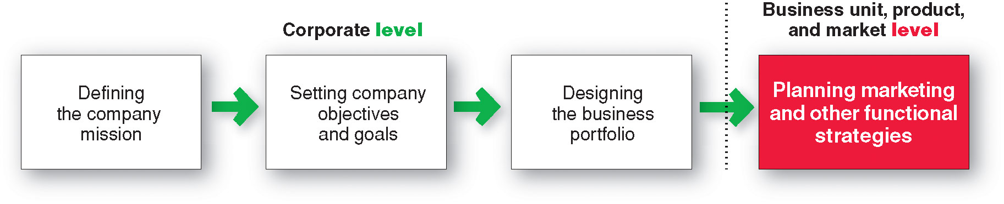
Companywide Strategic Planning
Steps in Strategic Planning
Copyright ©2014 by Pearson Education, Inc. All rights reserved
Notes:
At the corporate level, the company starts the strategic planning process by defining its overall purpose and mission (see Figure 2.1). This mission is then turned into detailed supporting objectives that guide the entire company. Next, headquarters decides what portfolio of businesses and products is best for the company and how much support to give each one. In turn, each business and product develops detailed marketing and other departmental plans that support the company-wide plan. Thus, marketing planning occurs at the business-unit, product, and market levels. It supports company strategic planning with more detailed plans for specific marketing opportunities.

Slide 5

Companywide Strategic Planning
Defining a Market-Oriented Mission
The mission statement is the organization’s purpose, what it wants to accomplish in the larger environment
Market-oriented mission statement defines the business in terms of satisfying basic customer needs
We help you organize the world’s information and make it universally accessible and useful.
Copyright ©2014 by Pearson Education, Inc. All rights reserved
Notes:
Note to Instructor
Forging a sound mission begins with the following questions: What is our business? Who is the customer? What do consumers value? What should our business be? These simple-sounding questions are among the most difficult the company will ever have to answer. Successful companies continuously raise these questions and answer them carefully and completely.
A mission statement should:
Not be myopic in product terms
Meaningful and specific
Motivating
Emphasize the company’s strengths
Contain specific workable guidelines
Not be stated as making sales or profits
Discussion Question:
Ask the students to evaluate how the Google mission statement meets the criteria of a market-oriented mission statement.

Slide 6
Companywide Strategic Planning
Setting Company Objectives and Goals
Business objectives
Build profitable customer relationships
Invest in research
Improve profits
Marketing objectives
Increase market share
Create local partnerships
Increase promotion
Copyright ©2014 by Pearson Education, Inc. All rights reserved
Notes:
The company needs to turn its mission into detailed supporting objectives for each level of management. Each manager should have objectives and be responsible for reaching them
The company can tie a diverse product portfolio together under a mission.
This broad mission leads to a hierarchy of objectives, including business objectives and marketing objectives such as: to build profitable customer relationships by developing superior products.
Improving profits is another example of a major objective.
Profits can be improved by increasing sales or reducing costs. Sales can be increased by improving the company’s share of domestic and international markets. These goals then become the company’s current marketing objectives.
Marketing strategies and programs must be developed to support these marketing objectives such as:
to increase market share by broadening its product lines,
to increase product availability and promotion in existing markets,
to expand into new markets.
Each broad marketing strategy must then be defined in greater detail. For example, increasing the product’s promotion may require more advertising and public relations efforts; if so, both requirements will need to be spelled out. In this way, the firm’s mission is translated into a set of objectives for the current period.

Slide 7
Companywide Strategic Planning
Designing the Business Portfolio
The business portfolio is the collection of businesses and products that make up the company
Portfolio analysis is a major activity in strategic planning whereby management evaluates the products and businesses that make up the company
Copyright ©2014 by Pearson Education, Inc. All rights reserved
Notes:
The best business portfolio is the one that best fits the company’s strengths and weaknesses to opportunities in the environment.
Most large companies have complex portfolios of businesses and brands. Strategic and marketing planning for such business portfolios can be a daunting but critical task.
Business portfolio planning involves two steps. First, the company must analyze its current business portfolio and determine which businesses should receive more, less, or no investment. Second, it must shape the future portfolio by developing strategies for growth and downsizing.

Slide 8
Companywide Strategic Planning
Analyzing the Current Business Portfolio
Strategic business units can be
Company division
Product line within a division
Single product or brand
Copyright ©2014 by Pearson Education, Inc. All rights reserved
Notes:
Note to Instructor
The major activity in strategic planning is business portfolio analysis, whereby management evaluates the products and businesses that make up the company. The company will want to put strong resources into its more profitable businesses and phase down or drop its weaker ones.

Slide 9
Companywide Strategic Planning
Analyzing the Current Business Portfolio
Identify key businesses (strategic business units, or SBUs) that make up the company
Assess the attractiveness of its various SBUs
Decide how much support each SBU deserves
Copyright ©2014 by Pearson Education, Inc. All rights reserved
Notes:
Management’s first step is to identify the key businesses that make up the company, called strategic business units (SBUs). An SBU can be a company division, a product line within a division, or sometimes a single product or brand. The company next assesses the attractiveness of its various SBUs and decides how much support each deserves. When designing a business portfolio, it’s a good idea to add and support products and businesses that fit closely with the firm’s core philosophy and competencies.
The purpose of strategic planning is to find ways in which the company can best use its strengths to take advantage of attractive opportunities in the environment. For this reason, most standard portfolio analysis methods evaluate SBUs on two important dimensions: the attractiveness of the SBU’s market or industry and the strength of the SBU’s position in that market or industry.

Slide 10
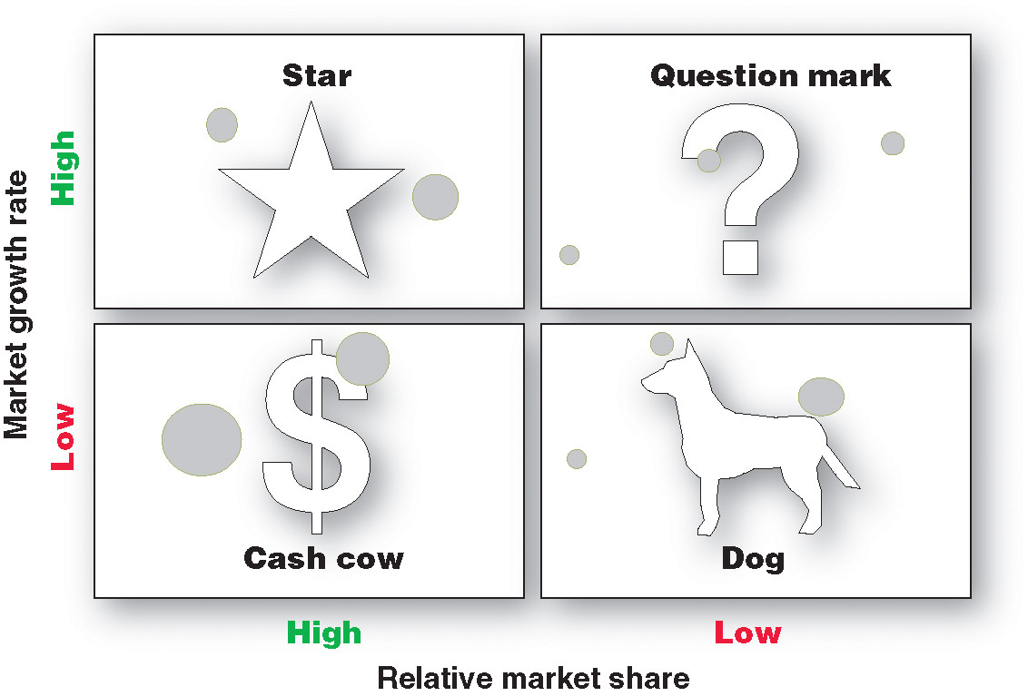
Companywide Strategic Planning:
Notes:
Note to Instructor
Discussion Question
Ask the students to suggest product categories that might fit in each of the BCG quadrants.
The best-known portfolio-planning method is the now-classic Boston Consulting Group (BCG) approach.
A company classifies all its SBUs according to the growth-share matrix
On the vertical axis, market growth rate provides a measure of market attractiveness.
On the horizontal axis, relative market share serves as a measure of company strength in the market.
The growth-share matrix defines four types of SBUs:
Stars are high-growth, high-share businesses or products requiring heavy investment to finance rapid growth. They will eventually turn into cash cows.
Cash cows are low-growth, high-share businesses or products that are established and successful SBUs requiring less investment to maintain market share.
Question marks are low-share business units in high-growth markets requiring a lot of cash to hold their share.
Dogs are low-growth, low-share businesses and products that may generate enough cash to maintain themselves but do not promise to be large sources of cash.

Slide 11
Companywide Strategic Planning
Problems with Matrix Approaches
Difficulty in defining SBUs and measuring market share and growth
Time consuming
Expensive
Focus on current businesses, not future planning
Copyright ©2014 by Pearson Education, Inc. All rights reserved
Notes:
Because of these problems, many companies have dropped formal matrix methods in favor of more customized approaches that better suit their specific situations.
Unlike former strategic-planning efforts that rested mostly in the hands of senior managers at company headquarters, today’s strategic planning has been decentralized.
Increasingly, companies are placing responsibility for strategic planning in the hands of cross-functional teams of divisional managers who are close to their markets.

Slide 12
Companywide Strategic Planning
Developing Strategies for Growth and Downsizing
Product/Market Expansion Grid
Market penetration
Market development
Product development
Diversification
Looks at new products,
existing products, new
markets and existing
markets for company
growth opportunities
Copyright ©2014 by Pearson Education, Inc. All rights reserved
Notes:
Beyond evaluating current businesses, designing the business portfolio involves finding businesses and products the company should consider in the future. Companies need growth if they are to compete more effectively, satisfy their stakeholders, and attract top talent. At the same time, a firm must be careful not to make growth itself an objective. The company’s objective must be to manage “profitable growth.”
Marketing has the main responsibility for achieving profitable growth for the company. Marketing needs to identify, evaluate, and select market opportunities and establish strategies for capturing them. One useful device for identifying growth opportunities is the product/market expansion grid, Figure 2.3.

Slide 13
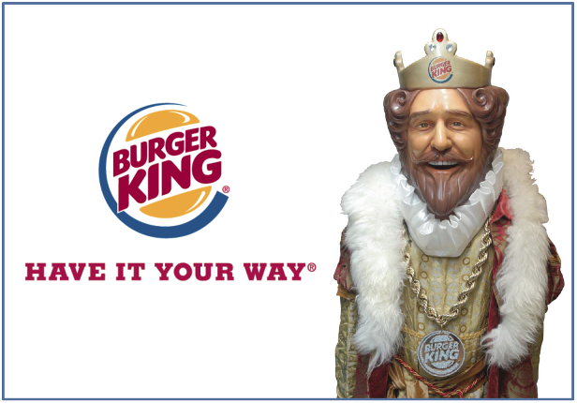
Companywide Strategic Planning
Developing Strategies
for Growth and Downsizing
Market penetration growth by increasing sales to current market segments without changing the product
Market development growth by identifying and developing new market segments for current products
Copyright ©2014 by Pearson Education, Inc. All rights reserved
Notes:
Market penetration—making more sales to current customers without changing its original product such as:
Add new stores in current market areas to make it easier for customers to visit.
Market development—identifying and developing new markets for its current products.
For instance, managers could review new demographic markets. Perhaps new groups—such as seniors—could be encouraged.
Managers could consider new geographic markets. In U.S. markets and in non-U.S. markets, especially Asia.

Slide 14
Companywide Strategic Planning
Developing Strategies
for Growth and Downsizing
Product development is a growth strategy that offers new or modified products to existing market segments
Diversification is a growth strategy through starting up or acquiring businesses outside the company’s current products and markets
Copyright ©2014 by Pearson Education, Inc. All rights reserved
Notes:
Product development—offering modified or new products to current markets.
For instance moving into new product categories
Diversification—starting up or buying businesses beyond its current products and markets.
For example, the company could acquire a company that operates in different market segments with a different product mix.

Slide 15
Companywide Strategic Planning
Developing Strategies
for Growth and Downsizing
Downsizing prune, harvest or divest businesses that are unprofitable or that no longer fit the strategy
Copyright ©2014 by Pearson Education, Inc. All rights reserved
Notes:
Companies must not only develop strategies for growing their business portfolios but also strategies for downsizing them.
A firm might want to abandon products or markets because:
The firm may have grown too fast or entered areas where it lacks experience.
The market environment might change, making some products or markets less profitable.
For example, in difficult economic times, many firms prune out weaker, less-profitable products and markets to focus their more limited resources on the strongest ones.
Some products or business units simply age and die.
When a firm finds brands or businesses that are unprofitable or that no longer fit its overall strategy, it must carefully prune, harvest, or divest them.
Weak businesses usually require a disproportionate amount of management attention.
Managers should focus on promising growth opportunities, not fritter away energy trying to salvage fading ones.

Slide 16

Planning Marketing
Partnering to Build Customer Relationships
Value chain is a series of departments that carry out value-creating activities to design, produce, market, deliver, and support a firm’s products
Copyright ©2014 by Pearson Education, Inc. All rights reserved
Notes:
Marketing plays a key role in the company’s strategic planning in several ways. First, marketing provides a guiding philosophy—the marketing concept—that suggests the company strategy should revolve around building profitable relationships with important consumer groups. Second, marketing provides inputs to strategic planners by helping to identify attractive market opportunities and assessing the firm’s potential to take advantage of them. Finally, within individual business units, marketing designs strategies for reaching the unit’s objectives. Once the unit’s objectives are set, marketing’s task is to help carry them out profitably.
Customer value is the key ingredient in the marketer’s formula for success.
Marketing alone can’t create superior customer value. Under the company-wide strategic plan, marketers must work closely with other departments to form an effective internal company value chain.

Slide 17

Planning Marketing
Partnering to Build Customer Relationships
Value delivery network is made up of the company, suppliers, distributors, and ultimately customers who partner with each other to improve performance of the entire system
Copyright ©2014 by Pearson Education, Inc. All rights reserved
Notes:
Marketing alone can’t create superior customer value. Under the company-wide strategic plan, marketers must work closely with other companies in the marketing system to create an overall external value delivery network that jointly serves customers.
In its quest to create customer value, the firm needs to look beyond its own internal value chain and into the value chains of its suppliers, distributors, and, ultimately, its customers.
More companies today are partnering with other members of the supply chain—suppliers, distributors, and, ultimately, customers—to improve the performance of the customer value delivery network. Competition no longer takes place only between individual competitors. Rather, it takes place between the entire value delivery networks created by these competitors.

Slide 18
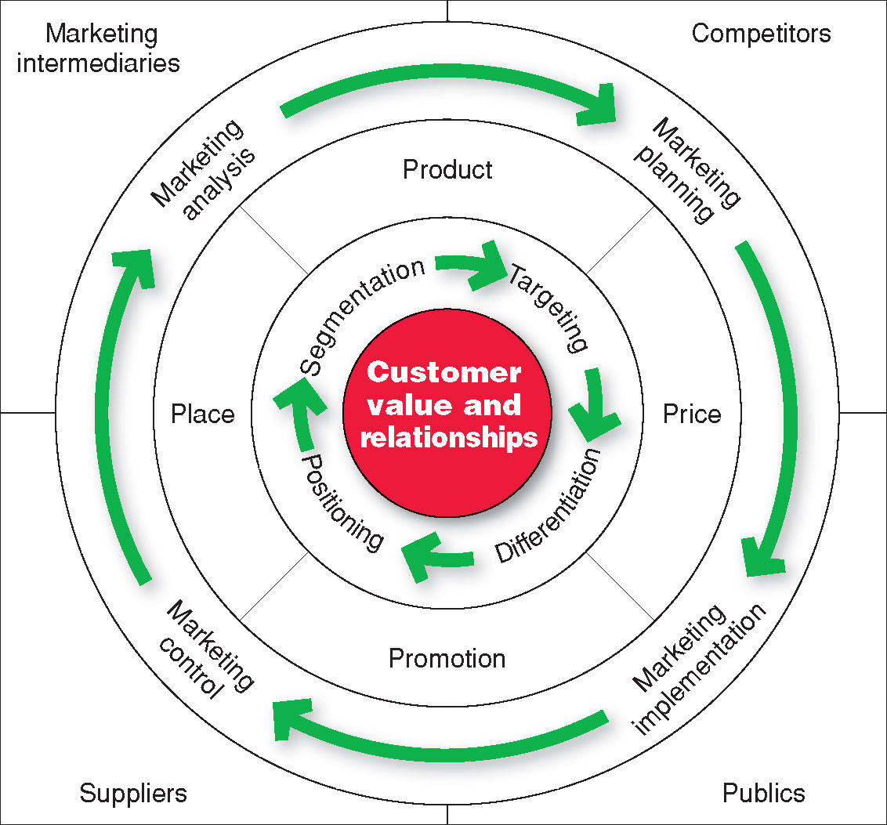
Marketing Strategy and the Marketing Mix
Copyright ©2014 by Pearson Education, Inc. All rights reserved
Notes:
Note to Instructor
See Figure 2.4
Consumers stand in the center. The goal is to create value for customers and build profitable customer relationships. Next comes marketing strategy—the marketing logic by which the company hopes to create this customer value and achieve these profitable relationships. The company decides which customers it will serve (segmentation and targeting) and how (differentiation and positioning). It identifies the total market, then divides it into smaller segments, selects the most promising segments, and focuses on serving and satisfying the customers in these segments. Guided by marketing strategy, the company designs an integrated marketing mix made up of factors under its control—product, price, place, and promotion (the four Ps). To find the best marketing strategy and mix, the company engages in marketing analysis, planning, implementation, and control. Through these activities, the company watches and adapts to the actors and forces in the marketing environment.

Slide 19
Marketing Strategy and the Marketing Mix
Market segmentation is the division of a market into distinct groups of buyers who have different needs, characteristics, or behavior and who might require separate products or marketing mixes
Market segment is a group of consumers who respond in a similar way to a given set of marketing efforts
Copyright ©2014 by Pearson Education, Inc. All rights reserved
Notes:
The market consists of many types of customers, products, and needs. The marketer must determine which segments offer the best opportunities. Consumers can be grouped and served in various ways based on geographic, demographic, psychographic, and behavioral factors. The process of dividing a market into distinct groups of buyers who have different needs, characteristics, or behaviors, and who might require separate products or marketing programs, is called market segmentation.
Every market has segments, but not all ways of segmenting a market are equally useful. For example, Tylenol would gain little by distinguishing between low-income and high-income pain relief users if both respond the same way to marketing efforts. A market segment consists of consumers who respond in a similar way to a given set of marketing efforts. In the car market, for example, consumers who want the biggest, most comfortable car regardless of price make up one market segment. Consumers who care mainly about price and operating economy make up another segment. It would be difficult to make one car model that was the first choice of consumers in both segments. Companies are wise to focus their efforts on meeting the distinct needs of individual market segments.

Slide 20
Marketing Strategy and the Marketing Mix
Market Targeting
Market targeting is the process of evaluating each market segment’s attractiveness and selecting one or more segments to enter
Copyright ©2014 by Pearson Education, Inc. All rights reserved
Notes:
After a company has defined its market segments, it can enter one or many of these segments. Market targeting involves evaluating each market segment’s attractiveness and selecting one or more segments to enter. A company should target segments in which it can profitably generate the greatest customer value and sustain it over time.
A company with limited resources might decide to serve only one or a few special segments or market niches. Such nichers specialize in serving customer segments that major competitors overlook or ignore.
A company might choose to serve several related segments—perhaps those with different kinds of customers but with the same basic wants.
A large company might decide to offer a complete range of products to serve all market segments.
Most companies enter a new market by serving a single segment; if this proves successful, they add more segments.
Discussion Questions (can include the topic of positioning which is on the following slide).
Specific questions for the students:
How does Nike segment their market?
What appears to be their most important segments?
How does Nike position their products in the marketplace?

Slide 21
Marketing Strategy and the Marketing Mix
Market positioning is the arranging for a product to occupy a clear, distinctive, and desirable place relative to competing products in the minds of the target consumer
Copyright ©2014 by Pearson Education, Inc. All rights reserved
Notes:
The company must determine how to differentiate its market offering for each targeted segment and what positions it wants to occupy in those segments.
A product’s position is the place it occupies relative to competitors’ products in consumers’ minds. Marketers want to develop unique market positions for their products. If a product is perceived to be exactly like others on the market, consumers would have no reason to buy it.
Positioning is arranging for a product to occupy a clear, distinctive, and desirable place relative to competing products in the minds of target consumers.
Marketers plan positions that distinguish their products from competing brands and give them the greatest advantage in their target markets.

Slide 22
Marketing Strategy and the Marketing Mix
Differentiation begins the positioning process
Whole marketing plan supports the positioning strategy
Copyright ©2014 by Pearson Education, Inc. All rights reserved
Notes:
In positioning its brand, a company first identifies possible customer value differences that provide competitive advantages on which to build the position. A company can offer greater customer value by either charging lower prices than competitors or offering more benefits to justify higher prices. But if the company promises greater value, it must then deliver that greater value. Thus, effective positioning begins with differentiation—actually differentiating the company’s market offering so that it gives consumers more value. Once the company has chosen a desired position, it must take strong steps to deliver and communicate that position to target consumers. The company’s entire marketing program should support the chosen positioning strategy.

Slide 23
Marketing Strategy and the Marketing Mix
Developing an Integrated Marketing Mix
Marketing mix is the set of controllable tactical marketing tools—product, price, place, and promotion—that the firm blends to produce the response it wants in the target market
Copyright ©2014 by Pearson Education, Inc. All rights reserved
Notes:
After determining its overall marketing strategy, the company is ready to begin planning the details of the marketing mix, one of the major concepts in modern marketing. The marketing mix is the set of tactical marketing tools that the firm blends to produce the response it wants in the target market. The marketing mix consists of everything the firm can do to influence the demand for its product.

Slide 24
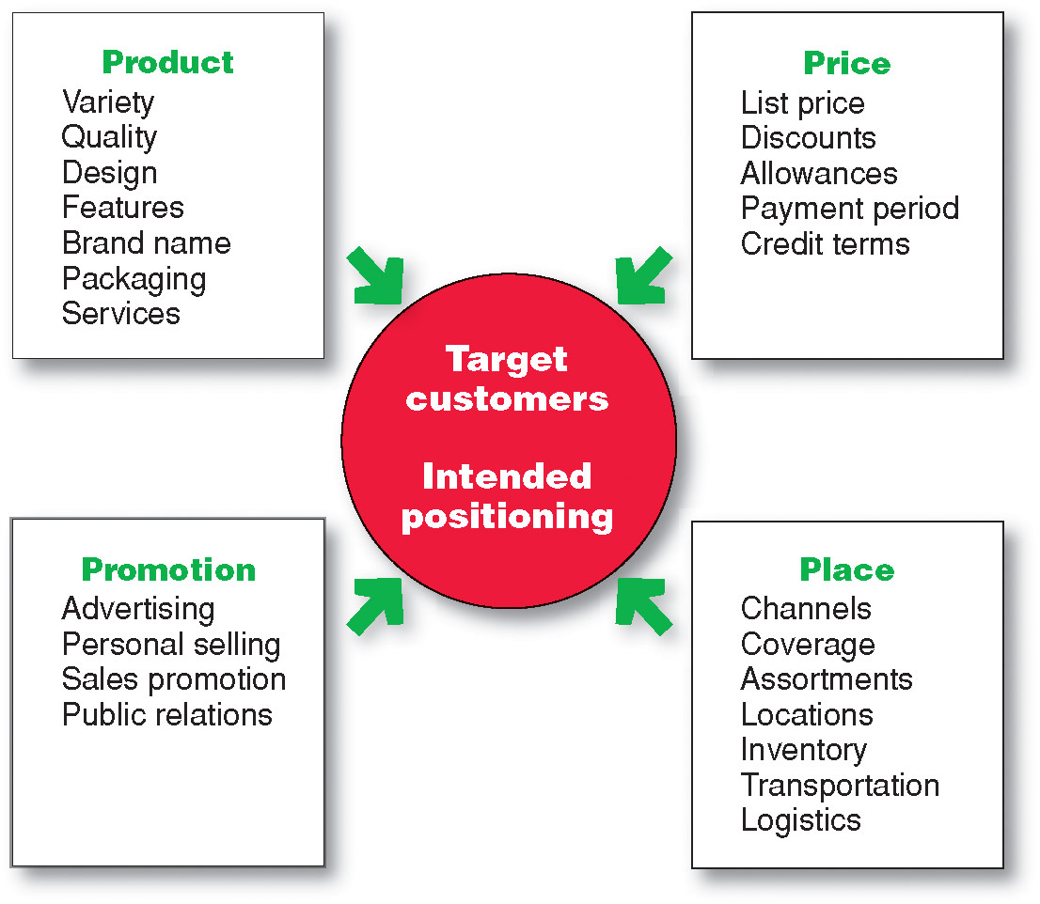
Marketing Strategy and the Marketing Mix
Developing an Integrated Marketing Mix
Copyright ©2014 by Pearson Education, Inc. All rights reserved
Notes:
The many possibilities can be collected into four groups of variables—the four Ps. Figure 2.5 shows the marketing tools under each P.
Product means the goods-and-services combination the company offers to the target market. Thus, a Ford Escape consists of nuts and bolts, spark plugs, pistons, headlights, and thousands of other parts. Ford offers several Escape models and dozens of optional features. The car comes fully serviced and with a comprehensive warranty that is as much a part of the product as the tailpipe.
Price is the amount of money customers must pay to obtain the product. For example, Ford calculates suggested retail prices that its dealers might charge for each Escape. But Ford dealers rarely charge the full sticker price. Instead, they negotiate the price with each customer, offering discounts, trade-in allowances, and credit terms. These actions adjust prices for the current competitive and economic situations and bring them into line with the buyer’s perception of the car’s value.
Place includes company activities that make the product available to target consumers. Ford partners with a large body of independently owned dealerships that sell the company’s many different models. Ford selects its dealers carefully and strongly supports them. The dealers keep an inventory of Ford automobiles, demonstrate them to potential buyers, negotiate prices, close sales, and service the cars after the sale.
Promotion refers to activities that communicate the merits of the product and persuade target customers to buy it. Ford spends more than $1.9 billion each year on U.S. advertising to tell consumers about the company and its many products. Dealership salespeople assist potential buyers and persuade them that Ford is the best car for them. Ford and its dealers offer special promotions—sales, cash rebates, and low financing rates—as added purchase incentives.
An effective marketing program blends the marketing mix elements into an integrated marketing program designed to achieve the company’s marketing objectives by delivering value to consumers. The marketing mix constitutes the company’s tactical tool kit for establishing strong positioning in target markets.
Some critics think that the four Ps may omit or underemphasize certain important activities. For example, they ask, “Where are services?” Just because they don’t start with a P doesn’t justify omitting them. The answer is that services, such as banking, airline, and retailing services, are products too. We might call them service products. “Where is packaging?” the critics might ask. Marketers would answer that they include packaging as one of many product decisions. All said, as Figure 2.5 suggests, many marketing activities that might appear to be left out of the marketing mix are included under one of the four Ps. The issue is not whether there should be four, six, or ten Ps so much as what framework is most helpful in designing integrated marketing programs.
It is interesting to ask how to make the 4Ps more customer centric. This leads to a redefining of the 4Ps to the 4Cs as follows:
Product—Customer solution
Price—Customer cost
Place—Convenience
Promotion—Communication

Slide 25
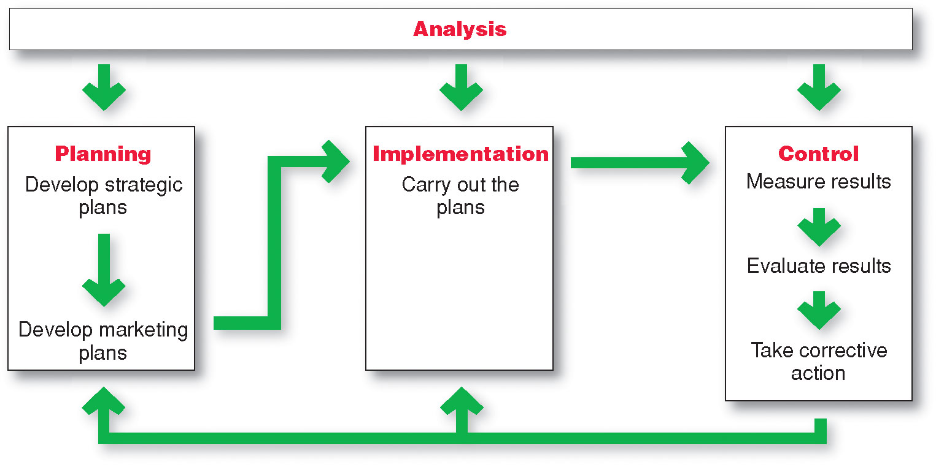
Managing the Marketing Effort
Copyright ©2014 by Pearson Education, Inc. All rights reserved
Notes:
Managing the marketing process requires the four marketing management functions shown in Figure 2.6—analysis, planning, implementation, and control. The company first develops company-wide strategic plans and then translates them into marketing and other plans for each division, product, and brand. Through implementation, the company turns the plans into actions. Control consists of measuring and evaluating the results of marketing activities and taking corrective action where needed. Finally, marketing analysis provides information and evaluations needed for all the other marketing activities.

Slide 26
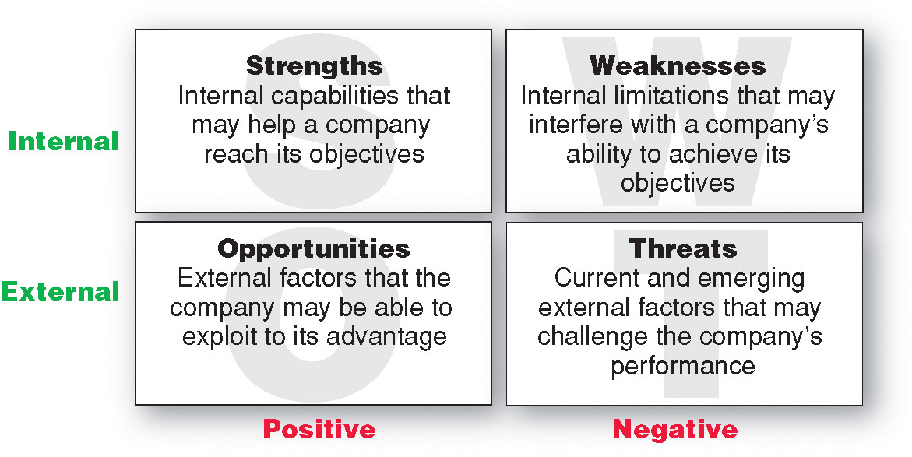
Managing the Marketing Effort
Marketing Analysis – SWOT Analysis
Copyright ©2014 by Pearson Education, Inc. All rights reserved
Notes:
Marketing Analysis
Managing the marketing function begins with a complete analysis of the company’s situation. The marketer should conduct a SWOT analysis (pronounced “swat” analysis), by which it evaluates the company’s overall strengths (S), weaknesses (W), opportunities (O), and threats (T) (see Figure 2.7). Strengths include internal capabilities, resources, and positive situational factors that may help the company serve its customers and achieve its objectives. Weaknesses include internal limitations and negative situational factors that may interfere with the company’s performance. Opportunities are favorable factors or trends in the external environment that the company may be able to exploit to its advantage. And threats are unfavorable external factors or trends that may present challenges to performance.
The company should analyze its markets and marketing environment to find attractive opportunities and identify environmental threats. It should analyze company strengths and weaknesses as well as current and possible marketing actions to determine which opportunities it can best pursue. The goal is to match the company’s strengths to attractive opportunities in the environment, while simultaneously eliminating or overcoming the weaknesses and minimizing the threats. Marketing analysis provides inputs to each of the other marketing management functions.

Slide 27

Managing the Marketing Effort
Market Planning—Parts of a Marketing Plan
Executive summary
Marketing situation
Threats and opportunities
Objective and issues
Action programs
Budgets
Controls
Marketing strategy
Copyright ©2014 by Pearson Education, Inc. All rights reserved
Notes:
Marketing planning involves choosing marketing strategies that will help the company attain its overall strategic objectives. A detailed marketing plan is needed for each business, product, or brand. What does a marketing plan look like? Our discussion focuses on product or brand marketing plans.
Table 2.2 outlines the major sections of a typical product or brand marketing plan. (See Appendix 1 for a sample marketing plan.) The plan begins with an executive summary that quickly reviews major assessments, goals, and recommendations. The main section of the plan presents a detailed SWOT analysis of the current marketing situation as well as potential threats and opportunities. The plan next states major objectives for the brand and outlines the specifics of a marketing strategy for achieving them.
A marketing strategy consists of specific strategies for target markets, positioning, the marketing mix, and marketing expenditure levels. It outlines how the company intends to create value for target customers in order to capture value in return. In this section, the planner explains how each strategy responds to the threats, opportunities, and critical issues spelled out earlier in the plan. Additional sections of the marketing plan lay out an action program for implementing the marketing strategy along with the details of a supporting marketing budget. The last section outlines the controls that will be used to monitor progress, measure return on marketing investment, and take corrective action.

Slide 28
Managing the Marketing Effort
Marketing Implementation
Implementing
Turns marketing plans into marketing actions to accomplish strategic marketing objectives
Addresses who, where, when, how
Copyright ©2014 by Pearson Education, Inc. All rights reserved
Notes:
A brilliant marketing strategy counts for little if the company fails to implement it properly.
Marketing implementation is the process that turns marketing plans into marketing actions to accomplish strategic marketing objectives.
Whereas marketing planning addresses the what and why of marketing activities, implementation addresses the who, where, when, and how.
Many managers think that “doing things right” (implementation) is as important as, or even more important than, “doing the right things” (strategy). The fact is that both are critical to success, and companies can gain competitive advantages through effective implementation. One firm can have essentially the same strategy as another, yet win in the marketplace through faster or better execution. Still, implementation is difficult—it is often easier to think up good marketing strategies than it is to carry them out.
In an increasingly connected world, people at all levels of the marketing system must work together to implement marketing strategies and plans. At Michelin, for example, marketing implementation for the company’s original equipment, replacement, industrial, and commercial tires requires day-to-day decisions and actions by thousands of people both inside and outside the organization. Marketing managers make decisions about target segments, branding, product development, pricing, promotion, and distribution. They talk with engineering about product designs, with manufacturing about production and inventory levels, and with finance about funding and cash flows. They also connect with outside people, such as advertising agencies to plan ad campaigns and the news media to obtain publicity support.

Slide 29
Managing the Marketing Effort
Marketing Department Organization
Functional organization
Geographic organization
Product management organization
Market or customer management
Copyright ©2014 by Pearson Education, Inc. All rights reserved
Notes:
Note to Instructor
Functional organization: This is the most common form of marketing organization with different marketing functions headed by a functional specialist.
Geographic organization: Useful for companies that sell across the country or internationally. Managers are responsible for developing strategies and plans for a specific region.
Product management: Useful for companies with different products or brands. Managers are responsible for developing strategies and plans for a specific product or brand.
Market or customer management organization: Useful for companies with one product line sold to many different markets and customers. Managers are responsible for developing strategies and plans for their specific markets or customers.
Customer management involves a customer focus and not a product focus for managing customer profitability and customer equity.

Slide 30
Managing the Marketing Effort
Marketing Control
Controlling
evaluating of results
taking of corrective action to achieve objectives
Operating control
Strategic control
Copyright ©2014 by Pearson Education, Inc. All rights reserved
Notes:
Because many surprises occur during the implementation of marketing plans, marketers must practice constant marketing control—evaluating the results of marketing strategies and plans and taking corrective action to ensure that the objectives are attained. Marketing control involves four steps. Management first sets specific marketing goals. It then measures its performance in the marketplace and evaluates the causes of any differences between expected and actual performance. Finally, management takes corrective action to close the gaps between goals and performance. This may require changing the action programs or even changing the goals.
Operating control involves checking ongoing performance against the annual plan and taking corrective action when necessary. Its purpose is to ensure that the company achieves the sales, profits, and other goals set out in its annual plan. It also involves determining the profitability of different products, territories, markets, and channels. Strategic control involves looking at whether the company’s basic strategies are well matched to its opportunities. Marketing strategies and programs can quickly become outdated, and each company should periodically reassess its overall approach to the marketplace.

Slide 31

Measuring and Managing
Return on Marketing Investment
Return on Marketing Investment (Marketing ROI)
Return on marketing investment
is net return from a marketing investment divided by the costs of the marketing investment.
provides a measurement of the profits generated by investments in marketing activities.
Copyright ©2014 by Pearson Education, Inc. All rights reserved
Notes:
Measuring return on marketing investment has become a major marketing emphasis. But it can be difficult How do you measure the specific return on a media investment?
Marketing performance—the practice of measuring, learning from, and improving upon marketing strategies and tactics over time—is taking hold. More companies are now working to connect the dots between marketing activities and results than ever before.
One important marketing performance measure is return on marketing investment (or marketing ROI). Marketing ROI is the net return from a marketing investment divided by the costs of the marketing investment. It measures the profits generated by investments in marketing activities.
there is no consistent definition of marketing ROI. For instance, returns like advertising and brand-building impact aren’t easily put into dollar returns.
A company can assess marketing ROI in terms of standard marketing performance measures, such as brand awareness, sales, or market share. Many companies are assembling such measures into marketing dashboards—meaningful sets of marketing performance measures in a single display used to monitor strategic marketing performance. The marketing dashboard gives marketers the detailed measures they need to assess and adjust their marketing strategies.
A marketing dashboard could track brand equity and trends, share of voice, market share, online sentiment, and marketing ROI in key markets worldwide, for company brands and also for competing brands.
Increasingly, however, beyond standard performance measures, marketers are using customer-centered measures of marketing impact, such as customer acquisition, customer retention, customer lifetime value, and customer equity. These measures capture not only current marketing performance but also future performance resulting from stronger customer relationships.
We can view marketing expenditures as investments that produce returns in the form of more profitable customer relationships. Marketing investments result in improved customer value and satisfaction, which in turn increases customer attraction and retention. This increases individual customer lifetime values and the firm’s overall customer equity. Increased customer equity, in relation to the cost of the marketing investments, determines return on marketing investment.
Regardless of how it’s defined or measured, the marketing ROI concept is here to stay. “In good times and bad, whether or not marketers are ready for it, they’re going to be asked to justify their spending with financial data,” says one marketer. Adds another, marketers “have got to know how to count.”

