Slide 1
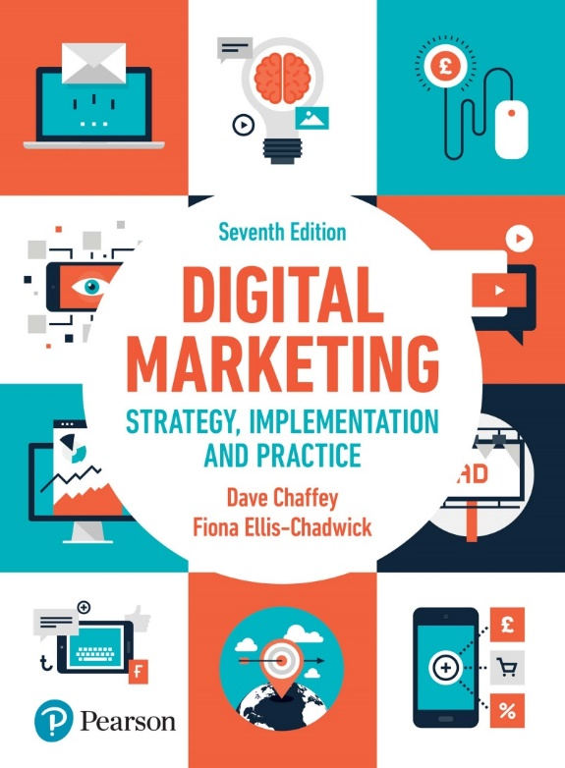
Chapter 1
Introducing Digital Marketing

Slide 2
Chapter 1 – Introducing Digital Marketing
Main Topics:
How digital marketing has transformed marketing
What are digital and multichannel marketing
Introduction to digital marketing strategy
Introduction to digital marketing communications
Case Study: eBay thrives in the global market place.

Slide 3
How digital marketing has transformed marketing?
Digital marketing is about:
Audiences: What audience interactions we need to understand and manage.
Digital marketing involves the following “5Ds” of managing digital marketing interactions:
Digital devices: Our audiences interact with business using a combination of smart phones, tablets, desktop computers, gaming devices…
Digital platforms: Most of interactions on these devices are through a browser or apps from the major platforms e.g. Twitter, Instagram…
Digital media: Different communication channels for reaching and engaging audiences are available including advertising, email and messaging…
Digital data: The insight businesses collect about their audience profiles and their interactions with businesses now needs to be protected by law in most counties.
Digital technology: The marketing technology that businesses use to create interactions from websites and mobile apps to in-store kiosks and email campaigns.

Slide 4
Figure 1.1 Customer lifecycle marketing touchpoint summary for a retailer
The sequence of online and offline touchpoints a customer or buyer takes during a buying process or customer experience. Online this may include a range of digital platforms, communications media, websites, pages and engagement devices.
Many ways available to communicate with prospects and customers
across different touchpoints in the customer life cycle
Source: Smart Insights (2017)
Notes:
Figure 1.1, which outlines the customer lifecycle, shows the practical opportunities and challenges of managing digital marketing today. It shows some of the many ways available to communicate with prospects and customers across different touchpoints in the customer lifecycle.
It shows the importance of integrating communications, including paid, owned and earned media integrating with a web, mobile, email or in-store based experience. Within each of these activities there are many options for reaching and targeting audiences – for example, within social media there are paid and organic options across all the seven main social networks (Facebook, Instagram, LinkedIn, SnapchatTM, PinterestTM, Twitter and YouTube).

Slide 5
What are digital and multichannel marketing?
Digital media: Communications are facilitated through content and interactive services delivered by different digital technology platforms including the Internet, web, mobile phone, TV and digital signage (electronic signage).
Digital marketing can be defined as:
Achieving marketing objectives through applying digital media data and technology.
The application of digital media, data and technology integrated with traditional communications to achieve marketing objectives.

Slide 6
Online company presence: Different forms of online media controlled by a company including their website, blogs, email list and social media presences. Today, commonly known as ‘owned media’.
In practice, digital marketing focuses on managing different forms of online company presence , such as company websites, mobile apps and social media company pages, integrated with online communications techniques including search engine marketing, social media marketing, online advertising, email marketing and partnership arrangements with other websites
These techniques are used to acquire new customers, providing services to existing customers, and develop the customer relationship through CRM

Slide 7
Customer relationship management (CRM): Using digital communications technologies to maximise sales to existing customers and encourage continued usage of online services through techniques including a database, personalised web messaging, customer services, chatbots (a computer program designed to simulate conversation with human users), email and social media marketing.
Multichannel (omnichannel) marketing: Customer communications and product distribution are supported by a combination of digital and traditional channels at different points in the buying cycle or ‘path to purchase’. With the range of mobile and IoT touchpoints, some have expanded the term to omnichannel marketing.
IoT >> Internet of Things

Slide 8
Paid, owned and earned media
To help develop a strategy to reach and influence potential customers online, it’s commonplace to refer to three main types of media channels that marketers need to consider today:
1/ Paid media: These are bought media where there is investment to pay for visitors, reach or conversions through search, display ad networks or affiliate marketing. Offline, traditional media such as print and TV advertising and direct mail remain important for some brands such as consumer goods brands.
2/ Owned media: This is media owned by the brand. Online this includes a company’s own websites, blogs, email list, mobile apps or their social presence on Facebook, LinkedIn or Twitter. Offline owned media may include brochures or retail stores.

Slide 9
3/ Earned media: Traditionally, earned media has been the name given to publicity generated through PR (public relations) invested in targeting influencers to increase awareness about a brand. Now earned media also includes word of mouth that can be stimulated through viral and social media marketing, and conversations in social networks, blogs and other communities.

Slide 10
There is an overlap between the 3 different type of media.
This overlap requires integration of campaigns resources and infrastructure through Application programming interfaces (APIs, e.g. Facebook API) and widgets (a simple application extension).
API : Method of exchanging data between systems such as websites services.
Notes:
Figure 1.2 The intersection of the three key online media types

Slide 11
The marketing technology landscape
The categories of the modern technology options
software that acts as a bridge between database and applications
Facebook, twitter,…
Notes:
Figure 1.3 Scott Brinker’s categorisation of modern marketing technology options – digital platforms include Facebook, Google, LinkedIn and Twitter

Slide 12
Introduction to digital marketing strategy
Key considerations:
Key features of digital marketing strategy
Applications of digital marketing
Benefits of digital marketing

Slide 13
Key features of digital marketing strategy
The interaction and integration between digital channels and traditional channels is a key part of digital marketing strategy development.
>> Digital marketing strategy is essentially a channel marketing strategy and it needs to be integrated with other channels as part of multichannel marketing.

Slide 14
Key features of digital marketing strategy
An effective digital marketing strategy should:
be aligned with business and marketing strategy (for example, many companies use a rolling three-year plan and vision).
be consistent with the types of customers who use and can be effectively reached through the channel.
define a compelling, differential value proposition for the channel.
specify the mix of online and offline communication tools used to attract visitors to the company website.
support the customer journey through the buying process as they select and purchase products using the digital channel in combination with other channels.
manage the online customer lifecycle through the stages of attracting visitors to the website, converting them into customers and retention and growth.

Slide 15
Applications of digital marketing
Digital media and technologies can be used as follows:
• Advertising medium. Display ads on publisher sites or social networks can be used to create awareness of brands and demands for products or services.
• Direct-response medium. Targeted search advertising enables companies to drive visits to a site when consumers shows intent to purchase, such as searching for a flight to a destination.
• Platform for sales transactions. Online flight booking is now the most common method for booking flights, both for consumers and business travellers.
• Lead-generation method. For booking business flights, tools can be provided that help identify and follow up corporate flight purchases.

Slide 16
• Distribution channel, such as for distributing digital products. Today, airlines sell more insurance services than previously.
• Customer service mechanism. For example, customers may ‘self-serve’ more cost-effectively by reviewing frequently asked questions.
• Relationship-building medium. A company can interact with its customers to better understand their needs and publicise relevant products and offers. For example, easyJetTM uses its email newsletter and tailored alerts about special deals to encourage repeat flight bookings.

Slide 17
Benefits of digital marketing
• Identifying. The Internet can be used for marketing research to find out customers’ needs and wants.
• Anticipating. The Internet provides an additional channel by which customers can access information and make purchases.
• Satisfying. A key success factor in e-marketing is achieving customer satisfaction through the electronic channel, which raises issues, such as is the site easy to use, does it perform adequately.

Slide 18
Benefits of digital marketing
The benefits of digital marketing and how the 5Ss of digital marketing can be applied:
1) Sell– Grow sales : Includes direct online sales and sales from offline channels influenced online
2) Serve– Add value : Achieved through giving customers extra benefits online
3) Speak– Get closer to customers: Creating a two-way dialogue through web interactions
4) Save– Save costs : Achieved through online email, reduce staff, print and postage costs.
5) Sizzle– Extend the brand online: Achieved through providing new propositions, new offers and new experiences online

Slide 19
Mini Case 1.2 Zalando exploits the power of digital media and distribution to grow a multi-billion Euro business in less than 5 years.
Notes:
Figure 1.4 The new Zalando campus in Berlin
The case helps bring to life how a successful application of a digital marketing strategy can be used to drive the growth of a new to the world business. This case also emphasises the importance of planning and the opportunities afforded by trading in global digital markets.

Slide 20
Alternative digital business models
Business and consumer business models:
Organisations require clarity on the type of business model they will develop.
Digital marketing opportunities are often described in terms of the extent to which an organisation is transacting with consumers
Business-to-consumer (B2C): Commercial transactions between an organisation and consumers
Business-to-business (B2B): Commercial transactions between an organisation and other organisations (inter-organisational marketing).

Slide 21
Direct-to-customer model: A brand which has previously communicated to its customers via intermediaries such as media sites or wholesalers communicates directly via digital media such as social networks, email and websites.
Consumer-to-consumer (C2C): Informational or financial transactions between consumers, but usually mediated through a business site.
Consumer-to-business (C2B): Consumers approach the business with an offer.
E-government: The use of Internet technologies to provide government services to citizens.

Slide 22
Figure 1.5 Summary and examples of transaction alternatives between businesses, consumers and governmental organisations
Notes:
Figure 1.5 highlights the multiple opportunities to engage and transact with different types of markets and Figure 1.6 shows the distinction between the buy and sell side of e-commerce. It may be useful to consider the organisational implications of each of these arenas of trade. For example, on the buy-side, terms and conditions are very different to the sell-side of e-commerce.

Slide 23
What is the difference between e-commerce and digital business?
Electronic commerce (e-commerce): All financial and informational electronically mediated exchanges between an organisation and its external stakeholders.
>> E-commerce is often further subdivided into:
Sell-side e-commerce: E-commerce transactions between a supplier organisation and its customer.
Buy-side e-commerce: E-commerce transactions between a purchasing organisation and its suppliers.

Slide 24
Figure 1.6 The distinction between buy-side and sell side of e-commerce

Slide 25
What is the difference between e-commerce and digital business?
Social commerce :Social commerce is a subset of e-commerce that encourages participation and interaction of customers in rating, selecting and buying products through group buying. This participation can occur on an e-commerce site or on third-party sites.
Electronic business: (e-business) or digital business Electronically mediated information exchanges, both within an organisation and with external stakeholders supporting the range of business processes.

Slide 26
Different forms of functionality of digital presence
The five main types of site or mobile app functions:
1- Transactional e-commerce (enable purchase products online)
2- Services-orientated relationship-building for lead-building and support (This provides information to stimulate purchase and build relationships)
3- Brand-building (This type of site or app provides an experience to support the brand.)
4- Publisher or media site (This provides news, entertainment or information or news about a range of topics and typically has an advertising or affiliate revenue model)
5 -Social network or community (enabling community interactions between different consumers (C2C model))

Slide 27
Challenges in developing and managing digital marketing strategy
• There are unclear responsibilities for the many different digital marketing activities.
• No specific objectives are set for digital marketing.
• Insufficient budget is allocated for digital marketing because customer demand for online services is under estimated and competitors potentially gain market share through superior online activities.
• Budget is wasted as different parts of an organisation experiment with using different techniques, martech (marketing and technology) suppliers without achieving economies of scale.
• New online value propositions for customers are not developed since the Internet is treated as ‘just another channel to market’ without review of opportunities to offer improved, differentiated online services.
• Results from digital marketing are not measured or reviewed effectively, so actions can-not be taken to improve effectiveness

Slide 28
Strategic framework for developing a digital strategy Figure 1.8 A generic digital marketing strategy development process

Slide 29
Introduction to digital marketing communications
KPI Key Performance Indicators
Notes:
Figure 1.9 RACE: Reach–Act (Interact)–Convert–Engage

Slide 30
RACE (Reach/Act/convert/Engage) is a frame-work developed by Smart Insights (2010) to help marketers manage and improve the commercial value that their organisations gain from digital marketing.
RACE consists of four steps designed to help engage prospects, customers and fans with brands throughout the customer lifecycle:
• Step 1: Reach – Build awareness of a brand, its products and services on other sites and in offline media and build traffic by driving visits to web and social media presences.

Slide 31
• Step 2: Act – Engage audience with brand on its website or other online presence to encourage them to interact with a company or other customers. The aim of the Act stage is lead generation, i.e. to gain permission to market to a prospect using email, SMS or mobile app notifications
• Step 3: Convert – Achieve conversion to generate sales on web presences and offline.
• Step 4: Engage – Build customer relationships through time to achieve retention goals

Slide 32
The key types of digital media channels
There are many online communications tools that marketers must review as part of their communications strategy or as part of planning an online marketing campaign.
The online marketing tools are divided into six main groups.

Slide 33
Figure 1.10 Six categories of digital communications tools or media channels
Public Relations
Source: Chaffey and Smith (2017)
Notes:
1 Search engine marketing. Gaining visibility on a search engine to encourage click-through to a website when the user types a specific keyword phrase. Two key search marketing techniques are paid placements or sponsored links using pay-per-click, and placements in the natural or organic listings using search engine optimisation where no charge is made for clicks from the search engine.
2 Online PR. Maximising favourable mentions of your company, brands, products or web-sites on third-party websites such as social networks, blogs, podcasts or feeds that are likely to be visited by your target audience. Also includes responding to negative mentions and conducting public relations via a site through a social media news centre or blog, for example.
3 Online partnerships. Creating and managing long-term arrangements to promote your online services on third-party websites or through email communications. Different forms of partnership include link building, affiliate marketing, aggregators such as price comparison sites like MoneysupermarketTM (www.moneysupermarket.com), online sponsorship and co-marketing.
4 Display advertising. Use of online ads such as banners and rich media ads to achieve brand awareness and encourage click-through to a target site.
5 Opt-in email marketing. Placing ads in third-party e-newsletters or the use of an in-house list for customer activation and retention. Buying or renting lists of email addresses is considered as a spamming technique and not permitted under the privacy legislation described in Chapter 4. 6 Social media marketing. Companies participate and advertise within social networks and communities to reach and engage their audience. Viral marketing or online word-of-mouth messages are closely related to this. Here content is shared or messages are for-warded to help achieve awareness and, in some cases, drive respons

Slide 34
Benefits of digital media
1/ Interactivity :
• the customer initiates contact;
• the customer is seeking information or an experience (pull);
• it is a high-intensity medium – the marketer will have 100 per cent of the individual’s attention when he or she is viewing a website;
• a company can gather and store the response of the individual;
• individual needs of the customer can be addressed and taken into account in future dialogues.

Slide 35
Figure 1.11 Summary of communication models for (a) traditional media, (b) new media
Notes:
Figure 1.11(a) shows how traditional media are predominantly push media where the marketing message is broadcast from company to customer, although interaction can be encouraged through direct response to phone, website or social media page. However, online it is often the customer who initiates contact and is seeking information through researching information on a website. In other words, it is a ‘pull’ mechanism where it is particularly important to have good visibility in search engines when customers are entering search terms relevant to a company’s products or services.

Slide 36
2/ Intelligence :
Digital media and technology can be used as a relatively low-cost method of collecting marketing research, particularly about customer perceptions of products and services.
3/ Individualisation :
Interactive marketing communications can be tailored to the individual at relatively low costs, unlike in traditional media.

Slide 37
4/ Integration :
The Internet can be used as an integrated communications tool as part of supporting a multichannel customer journey are the following:
• The Internet can be used as a direct-response tool, enabling customers to respond to offers and promotions publicised in other media.
• The website can have a direct response or callback facility built into it. *
E.g. A customer service representative will contact a customer by phone when the customer fills in the website their name, phone number and a suitable time to ring.
• The Internet can be used to support the buying decision, even if the purchase does not occur via the website, through assisted selling via live chat or phone. E.g. Include a web-specific phone number in website that encourages customers to ring a representative in the call centre for support.

Slide 38
Figure 1.13 Channels requiring integration as part of integrated digital marketing strategy

Slide 39
5/ Industry restructuring
The company’s should consider its representation on intermediary sites by answering questions such as :
‘Which intermediaries should we be represented on?’ and ‘How do our offerings compare to those of competitors in terms of features, benefits and price?’.
6/ Independence of location
With Electronic media it is possible to reach the global market. This gives opportunities to sell into international markets
The Internet makes it possible to sell to a country without a local sales or customer service force.

Slide 40
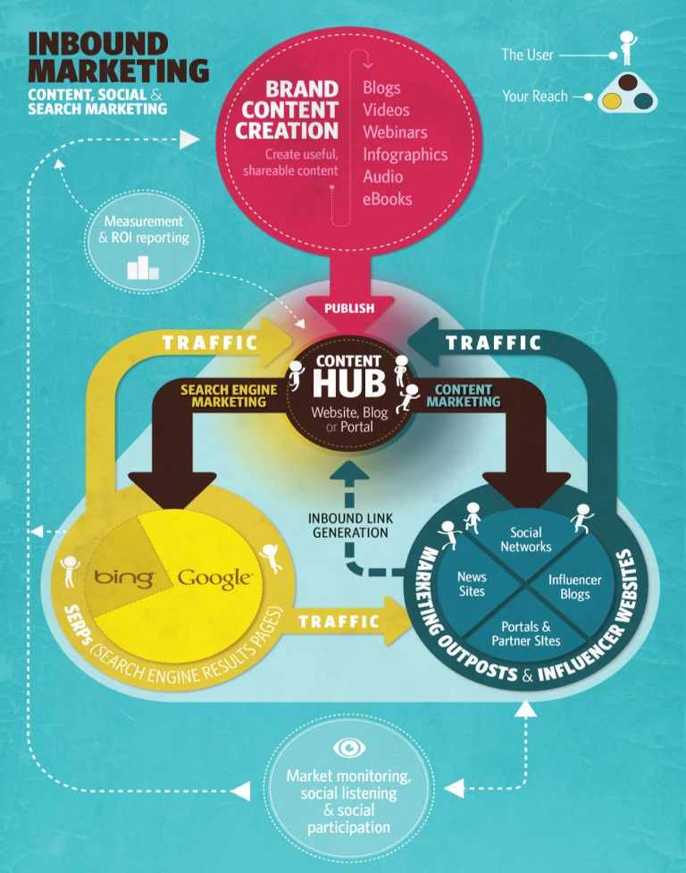
Key communication concepts for digital marketing
Permission marketing
Content marketing
Customer engagement
Source: Smart Insights (2015a)
Notes:
Figure 1.15 The content marketing hub

Slide 41
1/ Permission marketing: Customers agree (opt in) to be involved in an organisation’s marketing activities, usually as a result of an incentive.
Permission marketing is about seeking the customer’s permission before engaging them in a relationship and providing something in exchange.
The traditional approach can be viewed as interruption marketing. (without permission)
Interruption marketing: Marketing communications that disrupt customers’ activities.

Slide 42
2 /Content marketing: The management of text, rich media, audio and video content aimed at engaging customers and prospects to meet business goals published through print and digital media including web and mobile platforms which is readapted and orgonized to different forms of web presence, such as publisher sites, blogs, social media and comparison sites.
3/ Customer engagement:
Customer engagement: Repeated interactions through the customer lifecycle encouraged by online and offline communications aimed at strengthening the long-term emotional, psychological and physical investment a customer has with a brand.

Slide 43
Case study: eBay thrives in a global marketplace
Key content:
Mission
Revenue model
Proposition
Competition
Objectives and strategy
Case Question: Discuss how eBay has had to evolve its online brand proposition and communicate it to achieve continued growth

