Slide 1
CHAPTER 9
Marketing Implementation and Control

Slide 2
Introduction
Throughout the history of business, many firms and their top executives have emphasized strategic planning at the expense of strategic implementation.
Marketing implementation is the process of executing the marketing strategy by creating and performing specific actions that will ensure the achievement of the firm's marketing objectives.
To track the implementation process, firms must have ways of evaluating and controlling marketing activities, as well as monitoring performance to determine whether marketing goals and objectives have been achieved

Slide 3
Strategic Issues in Marketing Implementation
Marketing strategies almost always turn out differently than expected:
Intended marketing strategy is what the firm wants to happen—it is the firm's planned strategic choices that appear in the marketing plan itself.
Realized marketing strategy is the strategy that actually takes place.
•More often than not, the difference between the intended and the realized strategy is a matter of the implementation of the intended strategy.

Slide 4
The Link Between Strategic Planning and Implementation
The three most common issues in this relationship are:
1-Interdependency
2-Evolution
3-Separation

Slide 5
1-Interdependency[Exhibit 11.1]
Although it is true that the content of the marketing plan determines how it will be implemented, it is also true that how the marketing strategy is to be implemented determines the content of the marketing plan.
Certain marketing strategies define their implementation by default.

Slide 6
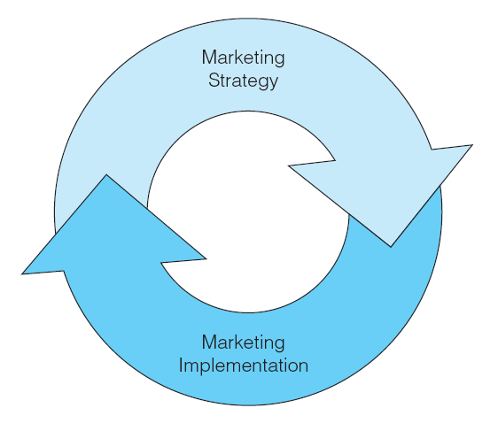
The Symbiotic Relationship Between Marketing Strategy and Marketing Implementation

Slide 7
2-Evolution
Like the firm’s strategy, marketing implementation must adapt to constantly changing environmental factors.
Because planning and implementation are intertwined, both must constantly evolve to fit the other.
Marketing implementation, much like the development of marketing strategy, often results from trial and error.

Slide 8
3-Separation
Middle- or upper-level managers often do strategic planning; however, the responsibility for implementation almost always falls on lower-level managers and frontline employees.
Top executives often do not understand the unique problems associated with implementing marketing strategy.

Slide 9
The Separation of Planning and Implementation

Slide 10
The Elements of Marketing Implementation [Exhibit 11.3]
The Elements of Marketing Implementation
1-Marketing Strategy
2-Shared Goals and Values
3--Marketing Structure
4-Systems and Processes
5-Resources
6-People (Human Resources)
Employee selection and training
Employee evaluation and compensation
Employee motivation, satisfaction and commitment
7-Leadership
-This 7 elements must work together for strategy to be implemented effectively.

Slide 11
The Elements of Marketing Implementation

Slide 12
1-Marketing Strategy
• The firm’s planned marketing program.

Slide 13
2- Shared Goals and Values
• Shared Goals and Values among all employees within the firm are the "glue" of successful implementation—they bind the entire organization together as a single, functioning unit.
• When all employees share the firms goals and values, all actions will be more closely aligned and directed toward the betterment of the organization.
•Institutionalizing shared goals and values within a firms culture is a long-term process.
• The primary means of creating shared goals and values is through employee training and socialization programs.
• Although creating shared goals and values is a difficult process, the rewards are worth the effort.

Slide 14
3- Marketing Structure
• refers to the methods of organizing a firm's marketing activities, the formal lines of authority, and the division of labor within the marketing function.
• It will be centralization versus decentralization:
a) Centralized structure—the top of the marketing hierarchy coordinates and manages all marketing activities and decisions.
Decentralized structure—the frontline of the firm coordinates and manages marketing activities and decisions.
• The decision to centralization or decentralization marketing activities is a trade-off between reduced costs and enhanced flexibility.
• There is no one correct way to organize the marketing function.
• The right marketing structure will depend on the:
Specific firm.
The nature of its internal and external environment,and its chosen marketing strategy.

Slide 15
4- Systems and Processes
Are collections of work activities that absorb a variety of inputs to create information and communication outputs that ensure the consistent day-to-day operation of the firm.

Slide 16
5- Resources
Can include a wide variety of tangible and intangible assets that can be brought together during marketing implementation.
Regadless of the type of resources, the amount of resources availble can make or break a marketing strategy.

Slide 17
6- People (Human Resources)
The quality, diversity, and skill of a firm's human resources can also make or break implementation.
A number of Human Resources activites are vitally important to marketing implementation:
a) Employee selection and training—matching employees' skills and abilities to the marketing tasks to be performed.
b) Employee evaluation and compensation—tying employee rewards to performance levels on required marketing activities.
c) Employee motivation, satisfaction, and commitment—the extent to which employees have the motivation to implement the strategy, their overall feelings of job satisfaction, and the commitment they feel toward the organization and its goals.

Slide 18
7- Leadership
Includes how managers communicate with employees, as well as how they motivate their people to implement the marketing strategy.
Today business leaders must be courageous enough to take a long-term view of corporate success-one that often sacrifices short-term gains for the sake of the future.
go to https://youtu.be/B0w-ASaOb94

Slide 19
Approaches to Marketing Implementation
• Managers can use a variety of approaches in implementing marketing strategy and motivating employees to perform implementation activities.
•Four of these approaches :
1-Implementation by Command
2-Implementation through Change
3-Implementation through Consensus
4-Implementation as Organizational Culture

Slide 20
1-Implementation by Command
The firm's top executives develop and select the marketing strategies, which are transmitted to lower levels where frontline managers and employees implement them.
Advantages of this approach:
a)It makes decision making much easier.
b)It reduces uncertainty as to what is to be done to implement the marketing strategy.
Disadvantages of this approach:
a)It does not consider the feasibility of implementing the strategy.
b)It divides the firm into strategists and implementers, and does not consider how strategy and implementation affect each other.
c)It can create employee motivation problems.

Slide 21
2-Implementation through Change
Executives focus explicitly on implementation by modifying the firm in ways that will ensure successful implementation.
Advantages of this approach:
a)It is used successfully by many firms.
b)It achieves a good balance between command and consensus.
Disadvantages of this approach:
a)It still suffers from the separation of planning and implementation.
b)It may not fully resolve issues of employee motivation.
c) It can take a great deal of time to design and implement.

Slide 22
3-Implementation through Consensus
Upper- and lower-level managers from many areas and levels work together to evaluate and develop marketing strategies.
Advantages of this approach:
a) It moves some of the decision-making authority closer to the frontline of the firm.
b) Lower-level managers often have a stronger commitment and motivation to the strategy to see that it is properly implemented.
c)It can help to ensure the coordination of the strategy across the entire firm.
Disadvantages of this approach:
a) It works best in complex, uncertain, and highly unstable environments.
b) It often retains the barrier between strategists and implementers.
c) It requires ongoing, open communication within the firm—something that may be difficult to achieve.

Slide 23
4-Implementation as Organizational Culture
Marketing strategy and its implementation become extensions of the firm's mission, vision, and organizational culture.
Advantages of this approach:
a)It completely dissolves the barrier between strategists and implementers.
b)It makes implementation much easier to accomplish.
Disadvantages of this approach:
a)It requires a strong corporate culture—something that does not happen overnight.
b)It requires extensive employee training and socialization.

Slide 24
Internal Marketing and Marketing Implementation
The practice of internal marketing comes from service industries, where it was first used as a means of making all employees aware of the need for customer satisfaction.
Internal marketing refers to the use of a marketing-like approach to motivate, coordinate, and integrate employees toward the implementation of the firm's marketing strategy.
The goals of internal marketing are:
1.to help all employees understand and accept their roles in implementing the marketing strategy
2.to create motivated and customer-oriented employees
3.to deliver external customer satisfaction

Slide 25
The Internal Marketing Approach
Every employee has two customers: external and internal. If the internal customers do not receive proper information and training about the strategy and are not motivated to implement it, then it is unlikely that the external customers will be satisfied completely.
Unlike traditional approaches, the internal marketing approach places the responsibility for implementation on all employees regardless of their level within the firm.

Slide 26
The Internal Marketing Process [Exhibit 11.5]
The product, price, distribution, and promotion elements of the internal marketing program are similar to the elements in the external program.
There are five elements of the internal marketing programs:
a)Internal products refer to marketing strategies that must be “sold” internally, as well as to any employee tasks, behaviors, attitudes, or values necessary to ensure implementation.

Slide 27
b)Internal prices include the increased effort and changes that employees must exhibit in implementing the strategy. Employees pay these prices through what they must do, change, or give up when implementing the marketing strategy.
c) Internal distribution refers to the internal communication of the marketing strategy.
d)Internal promotion involves communication aimed at informing and persuading employees about the merits of the marketing strategy.

Slide 28
The Internal Marketing Process

Slide 29
The internal marketing approach requires an integration of many factors:
a)The recruitment, selection, and training of employees must be considered an important part of implementation.
b)Top executives must be completely committed to the strategy and the overall marketing plan.
c)Employee compensation programs must be linked to the implementation of the marketing strategy.
d)The firm should be characterized by open communication among all employees, regardless of their level in the firm.
e)The firm's structure, policies, and processes should match the marketing strategy.

Slide 30
Evaluating and Controlling Marketing Activities
Actual marketing performance typically differs from expected performance for one of four reasons:
1.The marketing strategy was inappropriate or unrealistic.
2.The implementation was inappropriate for the strategy.
3.The implementation process was mismanaged.
4.The internal and/or external environments changed substantially between the development of the marketing strategy and its implementation.

Slide 31
To reduce the difference between what actually happened and what the company expected and to correct any of these four problems marketing activities must be evaluated and controlled on an ongoing basis.
It is important that the potential for implementation failures be managed strategically by having a system of marketing controls in place that allows the firm to spot potential problems before they cause real trouble.

Slide 32
Formal marketing controls are activities, mechanisms, or processes designed by the firm to help ensure the successful implementation of the marketing strategy.
The elements of formal control influence the behaviors of employees before and during implementation,and are used to assess performance outcomes at the completion of the implementation process.

Slide 33
These elements are referred to:
1- Input Controls (prior to implementation)
Recruiting, selecting, and training employees
Resource allocation decisions.
2-Process Controls (during implementation)
Commitment to the strategy
System for evaluating and compensating employees.
3-Output Controls (after implementation)
Performance standards
Marketing audits

Slide 34
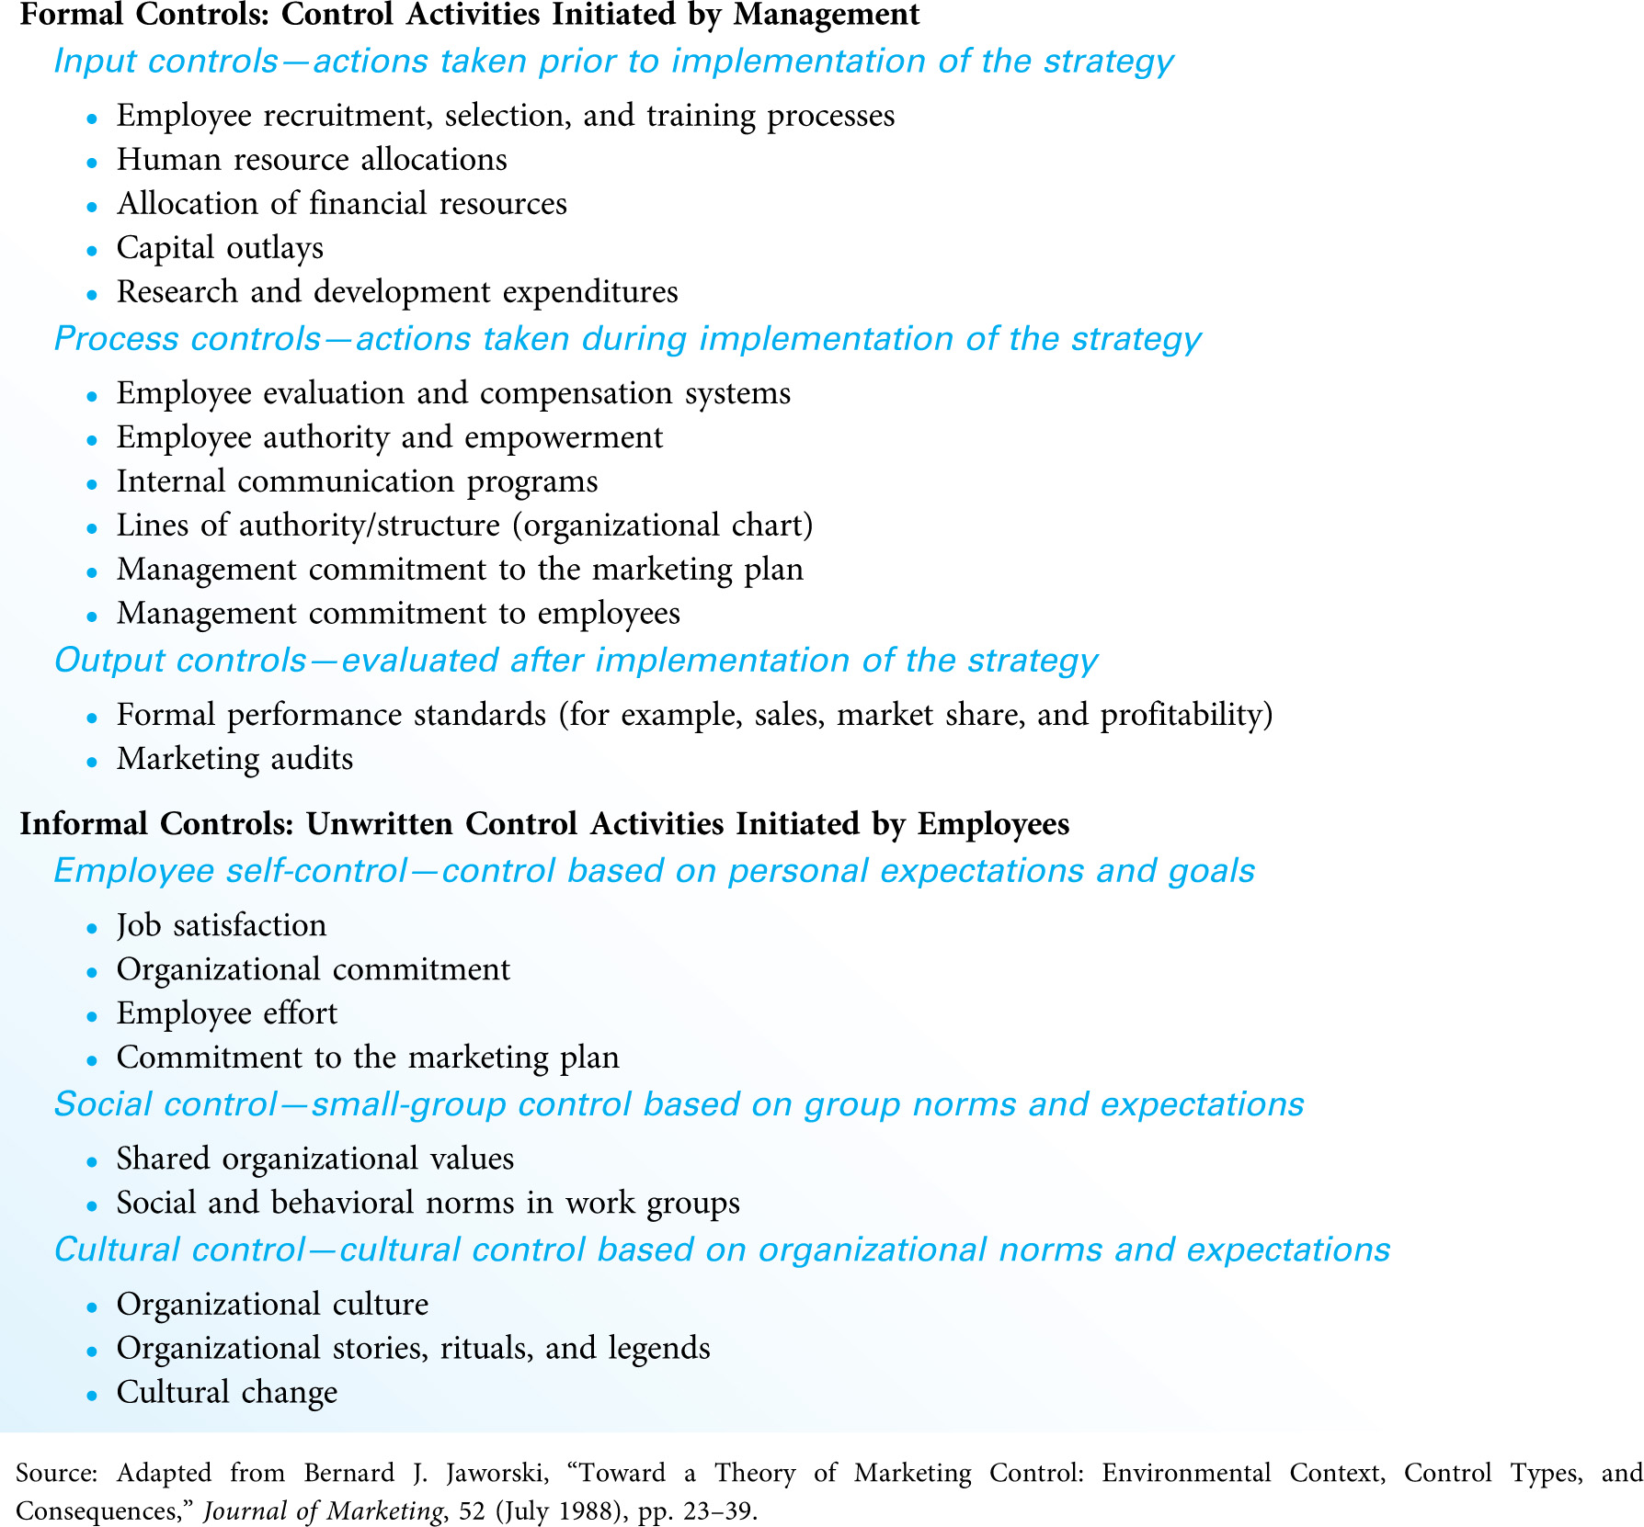
Formal Marketing Controls [Exhibit 11.6]
Add by: DR.Heyam Al Mousa
34

Slide 35
Formal marketing controls
Informal controls are unwritten, employee-based mechanisms that subtly affect the behaviors of employees, both as individuals and in groups.
There are three types of informal control:
a)Employee self-control—employees manage their own behaviors by establishing personal objectives and monitoring their results.
b)Social control—the standards, norms, and ethics found in workgroups within the firm.
c)Cultural control—the behavioral and social norms of the entire firm.

Slide 36
Marketing implementation is most effective and efficient when every employee, guided by the same organizational values or beliefs, has a commitment to the same organizational goals.

Slide 37
Scheduling Marketing Activities
Successful implementation requires that employees know the specific activities for which they are responsible and the timetable for completing each activity.
Creating a master schedule of marketing activities can be a challenging task because of the wide variety of activities required to execute the plan, the sequential nature of many activities, and the fact that time is of the essence in implementing the plan.

Slide 38
•The basic steps involved in creating a schedule and timeline for implementation include the following:
Identify the specific activities to be performed
Determine the time required to complete each activity.
Determine which activities must precede others.
Arrange the proper sequence and timing of all activities.
Assign responsibility

Slide 39
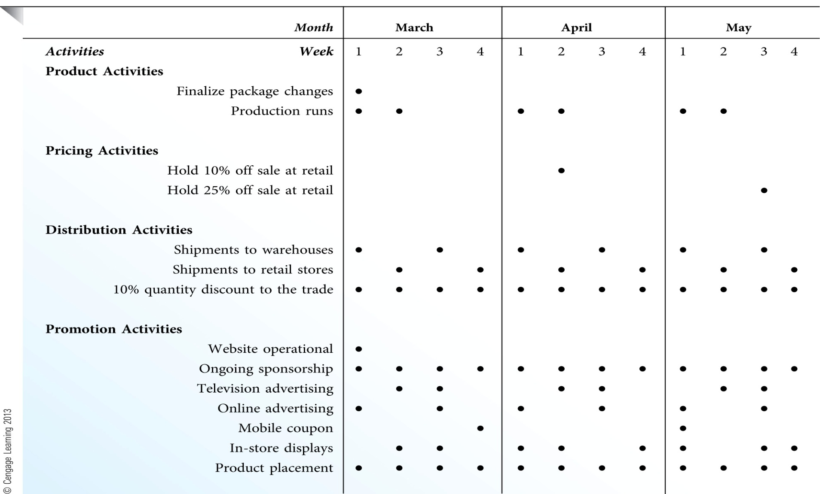
A Hypothetical 3-Month Marketing Implementation Schedule
39

