Slide 1
Chapter 9
Selecting the Sample
1
Copyright © 2014 Pearson Education, Inc.

Slide 2
Learning Objectives
To become familiar with sample design terminology
To understand the differences between probability and nonprobability sampling methods
To learn how to take four types of probability samples: simple random samples, systematic samples, cluster samples, and stratified samples

Slide 3
Learning Objectives
To learn how to take four types of nonprobability samples: convenience samples, purposive samples, referral samples, and quota samples
To acquire the skills to administer different types of samples, including online samples
To be able to develop a sample plan

Slide 4
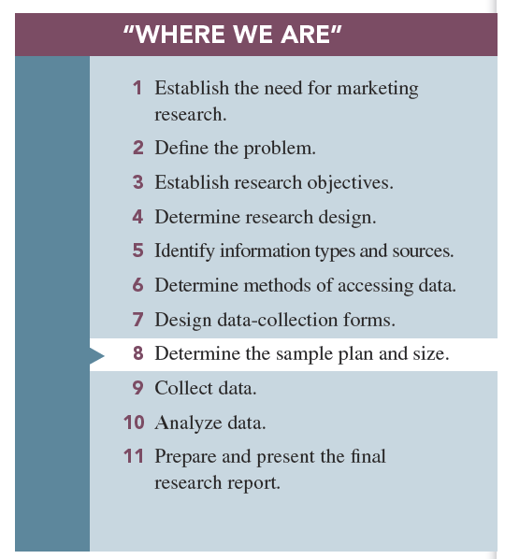

Slide 5
Basic Concepts in Sampling
Population: the entire group under study as defined by research objectives

Slide 6
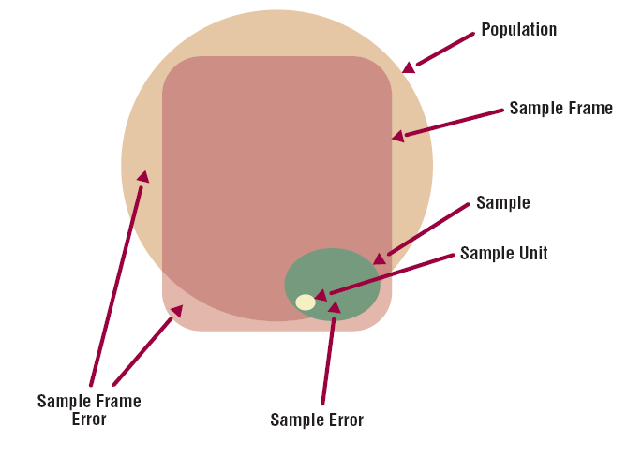
Basic Concepts in Sampling
FIGURE 9.1 Basic Sampling Concepts

Slide 7
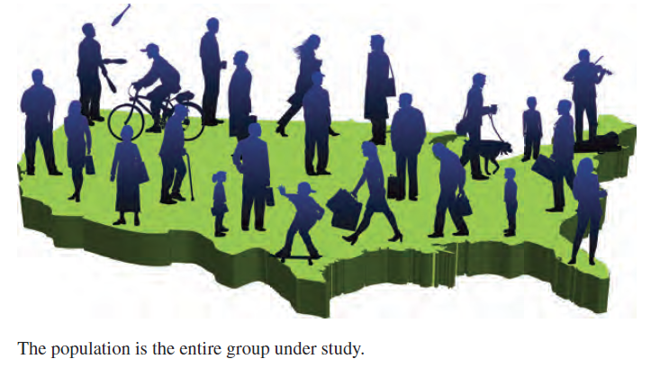
Population

Slide 8
Census
A census is an accounting of the complete population.
The U.S. census is taken every 10 years by the U.S. Census Bureau (www.census.gov).

Slide 9
Basic Concepts in Sampling
Sample: a subset of the population that should represent the entire group
Sample unit: the basic level of investigation

Slide 10
Basic Concepts in Sampling
A sample frame: a master list of the entire population
Sampling frame error: the degree to which the sample frame fails to account for all of the population

Slide 12
Basic Concepts in Sampling
Sampling error: any error in a survey that occurs because a sample is used

Slide 13
Reasons for Taking a Sample
Practical considerations such as cost and population size
Inability of researcher to analyze huge amounts of data generated by census

Slide 14
Basic Sampling Methods
Probability samples: ones in which members of the population have a known chance (probability) of being selected into the sample
Nonprobability samples: instances in which the chances (probability) of selecting members from the population into the sample are unknown

Slide 15
Probability Sampling Methods
Simple random sampling
Systematic sampling
Cluster sampling
Stratified sampling

Slide 16
Probability Sampling:
Simple random sampling: the probability of being selected into the sample is “known” and equal for all members of the population.

Slide 17
Simple Random Sampling
The random device method involves using an apparatus of some sort to ensure that every member of the population has the same chance of being selected into the sample.

Slide 18
Simple Random Sampling
The random numbers method involves small populations that are easily accommodated by the physical aspects of the device.

Slide 19
Probability Sampling
Systematic sampling: way to select a random sample from a directory or list that is much more efficient than simple random sampling

Slide 20
Probability Sampling
Cluster sampling: method in which the population is divided into subgroups, called “clusters,” each of which could represent the entire population

Slide 21
Probability Sampling
Area sampling is a form of cluster sampling; the geographic area is divided into clusters.

Slide 22
Area (Cluster) Sampling
One-step area sample: the researcher may believe the various geographic areas (clusters) to be sufficiently identical to allow concentrating his or her attention on just one area and then generalizing the results to the full population.
Two-step area sample: the researcher selects a random sample of areas, and then he or she decides on a probability method to sample individuals within the chosen areas.

Slide 23
Cluster (Area) Sampling
Disadvantage: the cluster specification error occurs when the clusters are not homogeneous.

Slide 24
Probability Sampling
Stratified sampling: separates the population into different subgroups and then samples all of these subgroups

Slide 25
Stratified Sampling
FIGURE 9.2
Stratified Simple
Random Sampling

Slide 26
Nonprobability Sampling
With nonprobability sampling methods selection is not based on fairness, equity, or equal chance.
Convenience sampling
Purposive sampling
Referral sampling
Quota sampling

Slide 27
Nonprobability Sampling
Convenience samples: samples drawn at the convenience of the interviewer
Purposive samples: requires a judgment or an “educated guess” as to who should represent the population

Slide 28
Nonprobability Sampling
Referral samples: require respondents to provide the names of prospective respondents
Quota samples: specified percentages of the total sample for various types of individuals to be interviewed

Slide 29
Online Sampling Techniques
Online panels: large numbers of individuals who have agreed to participate in online surveys
River samples: created via the use of banners, pop-ups, or other online devices that invite website visitors to take part in the survey
E-mail list samples: purchased or otherwise procured from someone or some company that has compiled email addresses of opt-in members of the population of interest

Slide 30
All rights reserved. No part of this publication may be reproduced, stored in a retrieval system, or transmitted, in any form or by any means, electronic, mechanical, photocopying, recording, or otherwise, without the prior written permission of the publisher. Printed in the United States of America.

