Slide 1
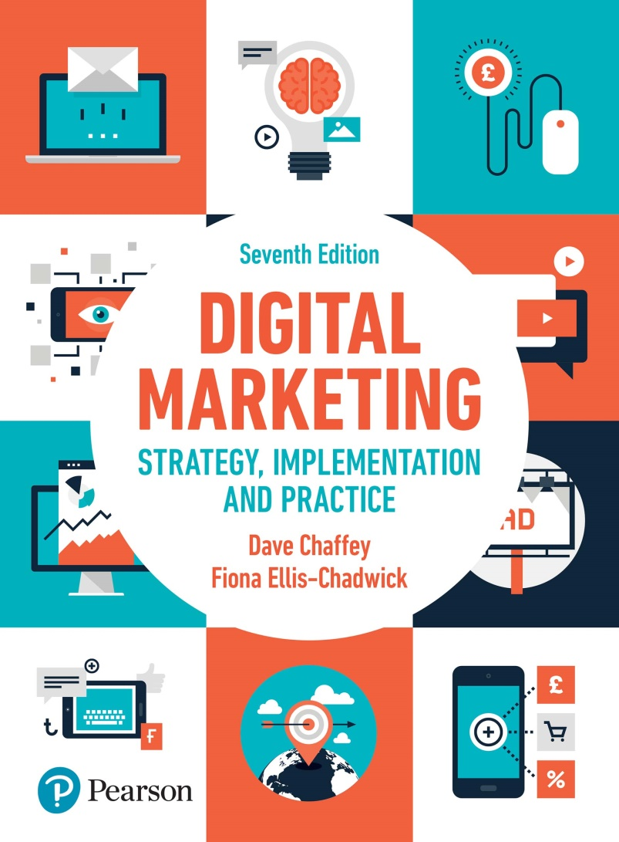
DIGITAL MARKETING STRATEGY, IMPLEMENTATION AND PRACTICE Seventh Edition
Part 3
Digital marketing: implementation and practice
Chapter 9
Marketing communications using digital media channels

Slide 2
Chapter 9 Marketing Communications using digital media channels
Main topics
Search engine marketing
Online public relations and influencer relationship management
Online partnerships including affiliate marketing
Interactive display advertising
Opt-in email marketing and mobile messaging
Social media and viral marketing
Offline promotion techniques
Case study: Facebook – a Titan of the digital age

Slide 3
Search Engine marketing (SEM)
Two main types:
Search engine optimisation
Paid search (pay-per-click) marketing (PPC)
Source: Reprinted by permission of Google, Inc. Google™ search engine is a trademark of Google, Inc.
Notes:
Figure 9.2 Search engine results page in Google ( www.google.co.uk ) illustrating the natural and paid listings

Slide 4
Figure 9.3 Popularity of different Google Search features for a selection of 10,000 keywords
Source: MozCast (http://mozcast.com/features)

Slide 5
What is SEO? Improving positions in the natural listings.
Processes include:
Crawling
Indexing
Ranking or scoring
Query request and results serving

Slide 6
Figure 9.4 Click-through rates depending on position in the natural search results
Source: Advanced Web Ranking (2018)

Slide 7
Figure 9.5 Stages involved in producing search engine listing for the natural listing

Slide 8
Advantages and disadvantages of SEO
Advantages
Traffic driver
Highly targeted
Potentially low cost
Dynamic
Disadvantages
Lack of predictability
Time for results to be implemented
Complexity and dynamic nature
Ongoing investment
Poor for developing awareness in comparison with other media channels

Slide 9
Best practice in SEO:
Search engine submission
Index inclusion
Key-phrase analysis
On-page optimisation
External linking
SEO for mobile devices

Slide 10
Paid search marketing
Examples Google Ads and Microsoft Bing
Advantages
Advertiser is not paying for the ads to be displayed
PPC advertising is highly targeted
Good accountability
Predictability
Technically simpler than SEO
Remarketing
Prospecting with the customer match
Branding
Disadvantages
Competitive and expensive
Inappropriate
Requires specialist knowledge
Time-consuming
Irrelevant

Slide 11
Figure 9.7 Google Ads campaign structures: (a) clothing retailer; (b) restaurant chain

Slide 12
Online influences and influencers relationship management
What is online public relations?
Public relations are about reputations. The main online activity are media relations or managing outreach with different online influences or key opinion leaders.

Slide 13
Advantages and disadvantages of online public relations
Advantages
Reach cost
Credibility
SEO
Disadvantages
Limited control unlike online advertising
May generate negative as well as positive comments
Notes:
Figure 9.8 Smart Insights blog ( www.smartinsights.com ) showing content available from within a category of ‘social media marketing’

Slide 14
Online partnerships including affiliate marketing
Affiliate marketing is known as pay-per-performance marketing.
Digital marketers have options for this type of marketing:
Aggregators
review sites
Reward sites
Voucher code sites
Uber bloggers
Everyone else

Slide 15
Figure 9.9 The affiliate marketing model (note that the tracking software and fee payment may be managed through an independent affiliate network manager)

Slide 16
Best practice in managing affiliate marketing
Affiliate networks
Commission
Cookie expiry period
Create links

Slide 17
Interactive Display Advertising
An advertiser pays for the placement of an advert on a third-party site.
Source: IAB (https://www.adweek.com/digital/iab-unveils-own-ad-tech-org-chart-147533/)
Notes:
Figure 9.10 Ad buying ecosystem

Slide 18
Advantages and disadvantages of display advertising
Advantages
Reach to drive awareness
Direct response
Retargeting
Advertising now available for smaller advertisers
Indirect response
Media multiplier or halo effect
Brand interactions
Targeting
Cost dynamic updates
Disadvantages
Relatively low click-throughs
Relatively high costs
Brand reputation

Slide 19
Figure 9.11 Behavioural ad targeting process

Slide 20
Opt-in email marketing and mobile messaging
What is email marketing?
Opt-in email marketing:
Cold-email campaign
Co-branded email
Third party e-newsheet
Inbound email marketing

Slide 21
Advantages and disadvantages of email marketing
Advantages
Disadvantages
Deliverability
Renderability
Email response decay
Communication preferences
Resource intensive
Relatively low cost
Direct-response mechanism
Faster deployments
Ease of personalisation
Options for testing
Integration

Slide 22
Social media and viral marketing
Viral marketing is closely related to social media and is a marketing approach which involves harnessing the network effect of the Internet; can be effective in reaching large number of people rapidly
Notes:
Figure 9.12 MQ charity Facebook page

Slide 23
Online promotion techniques
Source: The Hitwise UK Media Impact Report, September 2006
Notes:
Figure 9.13 Sky spend by medium compared with market share of UK internet searches, 5 June–6 March

