Slide 1
Chapter 8
Understanding Measurement, Developing Questions, and Designing the Questionnaire
1
Copyright © 2014 Pearson Education, Inc.

Slide 2
Learning Objectives
To understand the basics of measurement regarding people, places, and things
To recognize the three types of measures used by marketing researchers
To examine three scale formats commonly used by marketing researchers
To see other scale formats commonly used in marketing research

Slide 3
To appreciate the basic functions of a questionnaire
To learn the dos and don’ts of question wording
To learn the basics of questionnaire organization
To understand the advantages of computer-assisted questionnaire design software
To comprehend coding of questionnaires

Slide 4
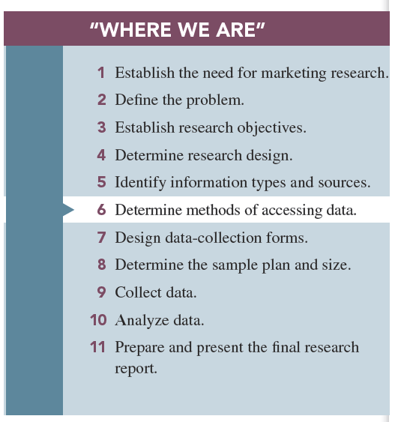

Slide 5
Basic Concepts in Measurement
Measurement: determining how much of a property is possessed by an object.
What are we really measuring? We are measuring properties sometimes called characteristic, attributes or qualities of object.
Object include consumers, brands, stores, advertisements, or what ever construct is of interest to the researcher working with a particular manager.

Slide 6
Properties: specific features or characteristics of an object that can be used to distinguish it from another object.
-Objective properties are physically verifiable characteristics such as age, gender, or number of bottles purchased.

Slide 7
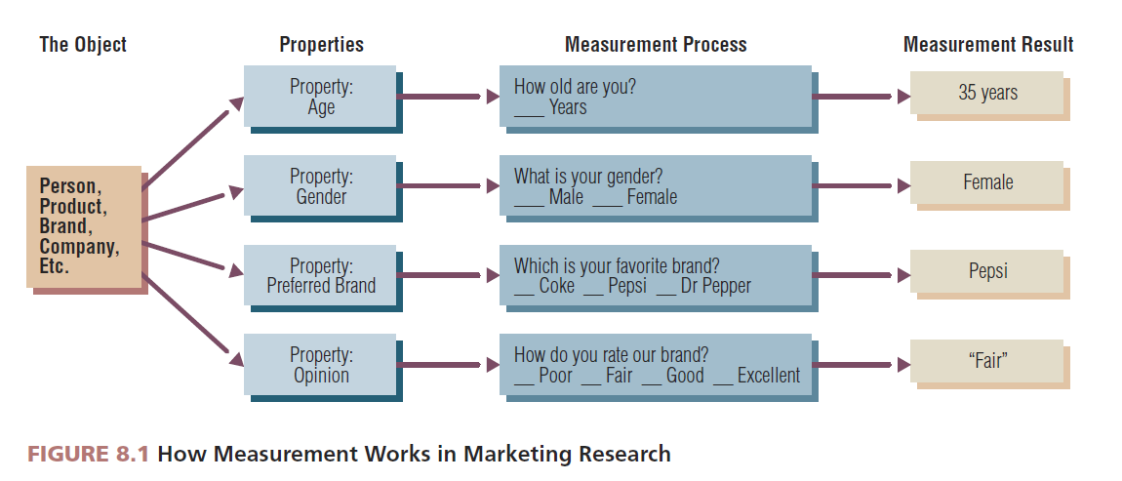

Slide 8
Subjective properties cannot be directly observed because they are mental constructs such as a person’s attitudes, opinions, or intentions.
Subjective properties are mental constructs.
Subjective properties are unobservable and intangible.
For subjective properties, researchers must translate mental constructs onto an intensity continuum.

Slide 9
Scale development is designing questions and response formats to measure the subjective properties of an object.
Notes:
Added slide

Slide 10
Types of Measures
We will describe three measures used by SPSS;
1-Nominal scales: those that use only labels
Such as are you Married? –Yes( ) –No( )
-What is your brand name of TV at home?
-Sony ( ) –LG( ) -Samsung( )
2-Ordinal scales: those with which the researcher can rank-order the respondents or responses
Such as “If you are manger in OSN company you will make the price of monthly payment
-Higher than ----
-About the same -----
-Lower than ----
Notes:
Changed title

Slide 11
3-Scale measures: those in which the distance between each level is known.
-There are two types of scale measures;
a)Interval scales: those in which the distance between each descriptor is equal
-such as “Make your evaluation of each item listed to our product”
strongly
agree agree
Low pickup 1 2 3 4 5
Low price
b)Ratio scales: ones in which a true zero exists
-Such as “Please indicate your age?”
------------ year. *Go to p.206 for Example

Slide 12
Interval Scales Commonly Used in Marketing Research
Marketing researchers use standard scales rather than inventing new ones for each research project.
Marketing researcher often measure subjective properties of consumers.
There are various terms and labels given to these construct, including attitudes, opinions, evaluations, beliefs, impression, perceptions, feeling and intentions, because these constructs are unobservable. The marketing researcher must develop some means of allowing respondents to express the direction and intensity of their impression in a convenient and understandable manner.

Slide 13
1-Likert Scale
An interval scale commonly used by marketing researchers is the Likert scale, in which respondents are asked to indicate their degree of agreement or disagreement on a symmetric agree–disagree scale for each of a series of statements.

Slide 14
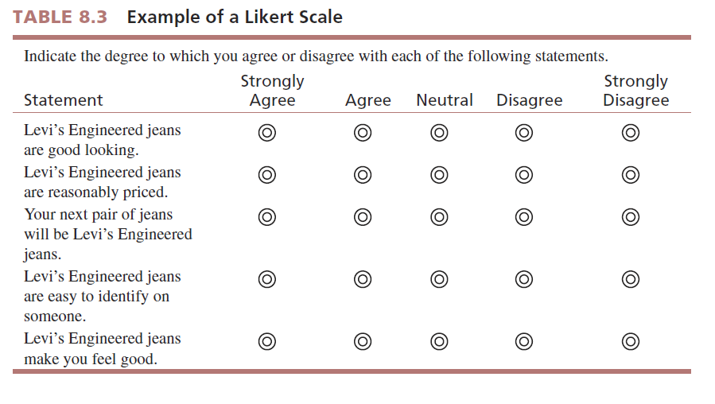

Slide 15
2-Lifestyle Inventory
A special application of the Likert scale question form called the lifestyle inventory takes into account the values and personality traits of people as reflected in their unique activities, interests, and opinions (AIOs) toward their work, leisure time, and purchases.
Go to p.209 for example

Slide 16
Lifestyle Inventory ( Likert scale)

Slide 17
3-The Semantic Differential Scale
A semantic differential scale contains a series of bipolar adjectives for the various properties of the object under study, and respondents indicate their impressions of each property by indicating locations along its continuum.
A concern with this type of scale is the halo effect, in which a general overall feeling about a brand or store could bias responses on its specific properties.
It is good way to measure a brand, company or store image.

Slide 18
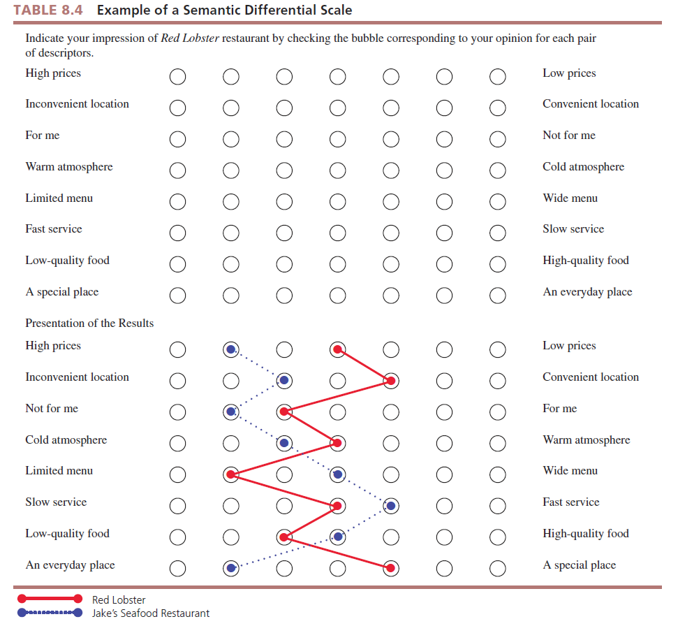

Slide 19
4-Stapel Scale
The Stapel scale relies on positive and negative numbers, typically ranging from +5 to –5.
The Staple scale is easier to construct than the semantic differential scale because the researcher does not need to come up with bipolar adjectives for each attribute.
Notes:
Definitions for symmetric and nonsymmetric

Slide 20
More Interval Scales Used in Marketing Research
Should the scale include a neutral point?
Should the scale be symmetric or nonsymmetric?

Slide 21
A symmetric interval scale is “balanced,” as it has equal amounts of positive and negative positions, and typically it has “no opinion” or “neutral” separating the negative and positive sides.
A nonsymmetric interval scale has mainly degrees of positive positions and would be more appropriate because most people do not think in degrees of negative importance.

Slide 22
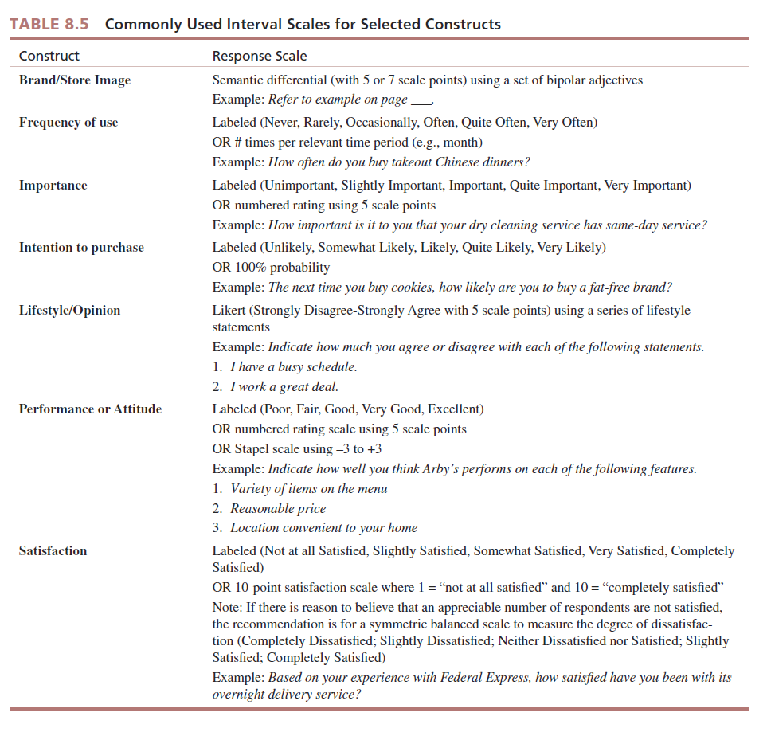

Slide 23
Reliability and Validity of Measurement
A measurement used by marketing researcher should be;
1-Reliability: respondent responds in the same or a similar manner to an identical or nearly identical measure.
2-Validity: accuracy of the measurement

Slide 24
Designing A Questionnaire
A questionnaire is the vehicle used to present the questions the researcher desires respondents to answer.
A Questionnaire serves six key functions;
1-Translates the research objectives into specific questions asked of respondents.
2-Standardizes those questions and the response categories so every participant responds to identical stimuli.
Notes:
Add definition for questionnaire

Slide 25
3- By its wording ,question flow, and appearance, it fosters cooperation and keeps respondents motivated throughout the interview.
4-Serves as an enduring record of the research .
5-Depending on the data collection mode used, such as online, can speed up the process of data analysis.
6-Contains the information on which reliability and validity assessments may be made.

Slide 26
Questionnaire Design Process
Questionnaire design is a systematic process in which the researcher contemplates various question formats, considers a number of factors characterizing the survey at hand, ultimately words the various questions carefully, and organizes the questionnaire’s layout.

Slide 27
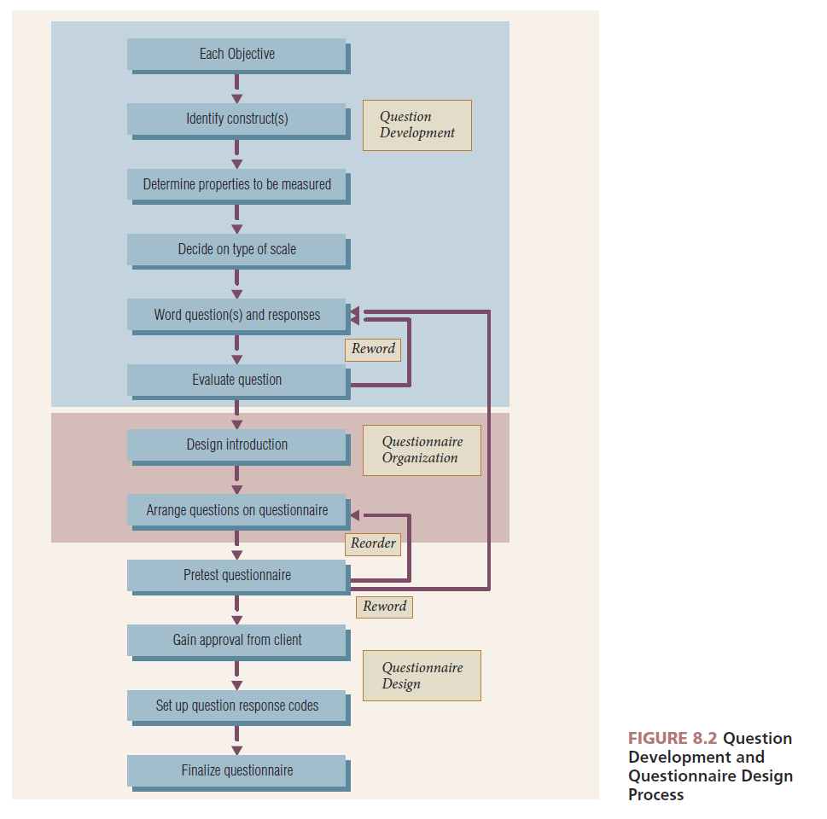

Slide 28
The researcher should strive to minimize question bias.
Question bias is the ability of a question’s wording or format to influence respondents’ answers.

Slide 29
Developing Questions
Questionnaire development is the practice of selecting appropriate response formats and wording questions that are understandable, unambiguous, and unbiased.
Marketing researchers take great care in developing research questions that measure the following:
1-Attitudes
2-Beliefs
3-Behaviors
4-Demographics

Slide 30
Words to Avoid in Questionnaire Development
All
Every
Never
Ever
Always
Any
Anybody

Slide 31
Why Avoid These Words?
These words: all, any, anybody, best, ever, every, never, etc. are all EXTREME ABSOLUTES….
They place respondents in a situation where they must either fully agree or they must completely disagree with the extreme position in the question.
Do you always observe traffic signs?
Would you say all cats have four legs?

Slide 32
Four “Dos” of Question Wording
Question evaluation is scrutinizing the wording of a question to ensure that question bias is minimized and that the question is worded so that respondents understand it and can respond to it with relative ease.

Slide 33
We strongly advise ensuring that ;
The question should be focused on a single issue or topic. “What type of hotel do you stay in on a trip?” Pleasure or business trip? En route or final destination?
The question should be brief.
3.The question should be grammatically simple, if possible, by using only simple sentence structure-even if two separate sentences are necessary to communicate the essence of the question.
4.The question should be crystal clear.
-such as “How many children do you have?”
And your study need the children under 18 years so the clear questions is
“How many children under the age of
18 years live with you?”

Slide 34
Four “Dont’s” of Question Wording
1.The question should not “lead” the respondent to a particular answer. “Don’t you see any problem with using credit cards for online purchases?”
2. The question should not have “loaded” wording or phrasing. Use universal beliefs…Since our Founding Fathers gave us the right to bear arms….

Slide 35
The question should not be “double-barreled” , that ask two questions at the same time>
The question should not use words that overstate the condition…do not use “dramatics.” “Would you buy sunglasses that protect your eyes from harmful ultraviolent rays that cause blindness?”

Slide 36
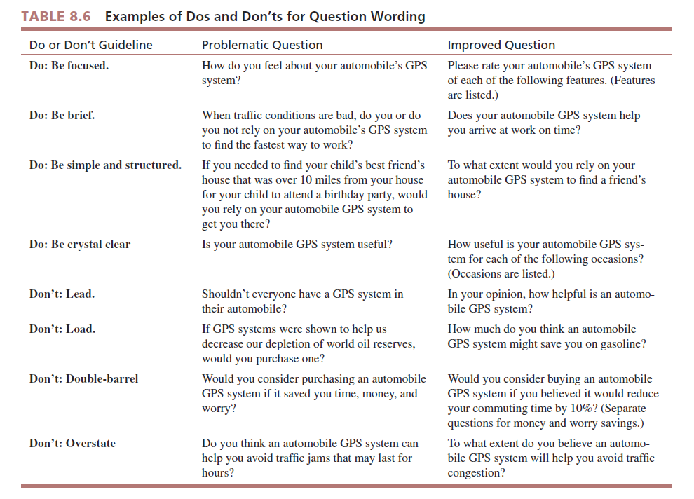

Slide 37
Questionnaire Organization
Questionnaire organization is the sequence of statements and questions that make up the questionnaire.
It is important because the questionnaire appearance and ease of flow affect the quality of the information gathered.
We should started with introduction and then actual flow of questions on the questionnaire.

Slide 38
Two critical aspects of questionnare organization
First; The Introduction
The introduction sets the stage; it is what a potential respondent reads or hears before he or she begins answering survey questions.
We discuss five functions that are accomplished by the introduction;
1- the interviewer introduces himself at the beginning of a survey there are two options
an undisguised survey, the sponsor is identified
but with a disguised survey, the sponsor’s name is not divulged to respondents.

Slide 39
The decision about wither to use a disguised survey depends on the surveys objectives, possible undue influence with knowledge of the client, or desire not to alert competitors of the survey.
2- The general purpose of the survey should be described clearly and simply.
3- Prospective respondents must be made aware of how and why they were selected.

Slide 40
4-Prospective respondents must be asked for their participation in the survey.
-Incentives are offers to do something for the respondent to increase the probability that the respondent will participate in the survey.
-Two methods tend to reduce anxieties and, therefore, increase participation;
The first is ensuring anonymity; means the respondents is not known and, there for, may not be identified.
The second method is confidentiality; means the respondents identify is not to be divulged to client or any other third part.

Slide 41
5- Last function of introduction is to qualify prospective respondents if they are to be screed for their appropriateness to take part in the survey.

Slide 42
Second; Question Flow
Question flow pertains to the sequencing of questions or blocks of questions, including any instructions, on the questionnaire.
Once the individual qualifies to take the survey, the next questions may erve a “warm-up” function.
Warm-up questions are simple and easy-to-answer questions that are used to get the respondents’ interest and to demonstrate the ease of responding to the research request.

Slide 43
Transitions are statements or questions used to let the respondent know that changes in question topic or format are about to happen, such as “Now, I would like to ask you a few questions about your family “TV viewing habits”
Response to a skipped question affects which question will be answered next.

Slide 44
The final section is Classification questions are used to classify respondents.
Demographics questions, sometimes called classification questions, are used to classify respondents into various groups for purposes of analysis.

Slide 45
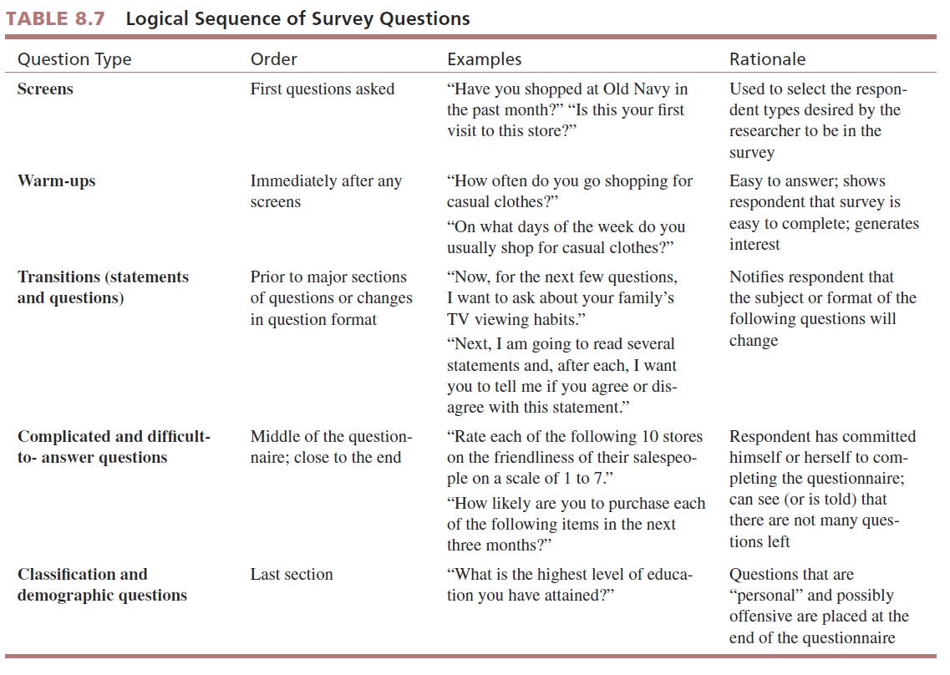

Slide 46
Computer-Assisted Questionnaire Design
Computer-assisted questionnaire design refers to software that allows users to use computer technology to develop and disseminate questionnaires and to retrieve and analyze data gathered by the questionnaire.
The functions of computer-assisted questionnaire design programs:
1- Question creation; the typical questionnaire design program will query the user on , for example “What type of question to use-how many response categories to include.

Slide 47
-Usually, the program offers a selections list of question types such as closed-ended ,numeric. Or scaled-response questions.
-The program may even have a question library feature such as demographics, importance, satisfaction, usage or performance.

Slide 48
2-Skip and Display Logic
Skip logic lets the questionnaire designer direct the online survey to ask questions based on previous answers.
Display logic is similar to skip logic. The survey displays or asks questions that are appropriate based on the respondent’s prior answers.

Slide 49
3-Data collection and creation of data files
4- Data Analysis and Graphs
Many of the software programs for questionnaire design have provisions for data analysis, graphic presentations and report formats of results.
Advantages:
Easier
Faster
Friendlier
More flexibility

Slide 50
Coding The Questionnaire
A final task in questionnaire design is coding.
Codes are numbers associated with question responses to facilitate data entry and analysis.
Here are the basic rules for questionnaire coding;
1- Every closed-ended question should have a code number associated with every possible response.
2- Use single-digit code numbers, beginning with 1.
3- Use the same coding system for questions with identical response options regardless of where these question are positioned in the questionnaire.

Slide 51
4- Remember that a “check all that apply” question is just a special case of “yes” or “no” question, so use 1(=yes) and 0(=no)
5- Whenever possible, set up the coding system before the questionnaire in finalized.

Slide 52
Pretesting The Questionnaire
A pretest is a dry run of a questionnaire to find and repair difficulties that respondents encounter while taking the survey.

Slide 53
All rights reserved. No part of this publication may be reproduced, stored in a retrieval system, or transmitted, in any form or by any means, electronic, mechanical, photocopying, recording, or otherwise, without the prior written permission of the publisher. Printed in the United States of America.

