Slide 1
Chapter 7s
Class 2

Slide 2
Break-Even Analysis
Technique for evaluating process and equipment alternatives
Objective is to find the point in dollars and units at which cost equals revenue
Requires estimation of fixed costs, variable costs, and revenue
Notes:
This chart introduces breakeven analysis and the breakeven or crossover chart. As you discuss the assumptions upon which this techniques is based, it might be a good time to introduce the more general topic of the limitations of and use of models. Certainly one does not know all information with certainty, money does have a time value, and the hypothesized linear relationships hold only within a range of production volumes. What impact does this have on our use of the models?

Slide 3
Break-Even Analysis
Fixed costs are costs that continue even if no units are produced
Depreciation, taxes, debt, mortgage payments
Variable costs are costs that vary with the volume of units produced
Labor, materials, portion of utilities
Contribution is the difference between selling price and variable cost
Notes:
This chart introduces breakeven analysis and the breakeven or crossover chart. As you discuss the assumptions upon which this techniques is based, it might be a good time to introduce the more general topic of the limitations of and use of models. Certainly one does not know all information with certainty, money does have a time value, and the hypothesized linear relationships hold only within a range of production volumes. What impact does this have on our use of the models?

Slide 4
Break-Even Analysis
–
900 –
800 –
700 –
600 –
500 –
400 –
300 –
200 –
100 –
–
Total revenue line
Break-even point
Total cost = Total revenue
Profit corridor
Total cost line
Cost in dollars
Variable cost
Loss corridor
Fixed cost
| | | | | | | | | | | |
0 100 200 300 400 500 600 700 800 900 1000 1100
Figure S7.5
Volume (units per period)
Notes:
This chart introduces breakeven analysis and the breakeven or crossover chart. As you discuss the assumptions upon which this techniques is based, it might be a good time to introduce the more general topic of the limitations of and use of models. Certainly one does not know all information with certainty, money does have a time value, and the hypothesized linear relationships hold only within a range of production volumes. What impact does this have on our use of the models?

Slide 5
Break-Even Analysis
BEP_{x} = break-even point in units
BEP$ = break-even point in dollars
P = price per unit (after all discounts)
x = number of units produced
TR = total revenue = Px
F = fixed costs
V = variable cost per unit
TC = total costs = F + Vx
Break-even point occurs when
TR = TC
or
Px = F + Vx
F
P - V
BEP_{x} =
Notes:
This chart introduces breakeven analysis and the breakeven or crossover chart. As you discuss the assumptions upon which this techniques is based, it might be a good time to introduce the more general topic of the limitations of and use of models. Certainly one does not know all information with certainty, money does have a time value, and the hypothesized linear relationships hold only within a range of production volumes. What impact does this have on our use of the models?

Slide 6
Break-Even Analysis
BEP_{x} = break-even point in units
BEP$ = break-even point in dollars
P = price per unit (after all discounts)
x = number of units produced
TR = total revenue = Px
F = fixed costs
V = variable cost per unit
TC = total costs = F + Vx
BEP$ = BEP_{x} P
= P
=
=
F
P - V
Profit = TR - TC
= Px - (F + Vx)
= Px - F - Vx
= (P - V)x - F
F
(P - V)/P
F
1 - V/P
Notes:
This chart introduces breakeven analysis and the breakeven or crossover chart. As you discuss the assumptions upon which this techniques is based, it might be a good time to introduce the more general topic of the limitations of and use of models. Certainly one does not know all information with certainty, money does have a time value, and the hypothesized linear relationships hold only within a range of production volumes. What impact does this have on our use of the models?

Slide 7
Break-Even Example
Fixed costs = $10,000 Material = $.75/unit
Direct labor = $1.50/unit Selling price = $4.00 per unit
F
1 - (V/P)
$10,000
1 - [(1.50 + .75)/(4.00)]
BEP$ = =
$10,000
.4375
= = $22,857.14
F
P - V
$10,000
4.00 - (1.50 + .75)
BEP_{x} = = = 5,714

Slide 8
Break-Even Example
50,000 –
40,000 –
30,000 –
20,000 –
10,000 –
–
Revenue
Break-even point
Total costs
Dollars
Fixed costs
| | | | | |
0 2,000 4,000 6,000 8,000 10,000
Units

Slide 9
Problem S7.23
An electronic firm is currently manufacturing an item that has a variable cost of $0.5 per unit and a selling price of $1.00 per unit. Fixed costs are $14,000. Current volume is 30,000 units. The firm can substantially improve the product quality by adding a new piece of equipment at an additional fixed cost of $6,000. Variable cost would increase to $0.60, but volume should jump to 50,000 units due to a higher quality product. Should the company buy the new equipment?

Slide 10
Problem S7.23
Option A: Stay as is
Option B: add new equipment
Therefore, the company should stay with the current equipment.

Slide 11
Break-Even Example
Multiproduct Case
F
BEP$ =
∑ 1 - x (W_{i})
V_{i}
P_{i}
where V = variable cost per unit
P = price per unit
F = fixed costs
W = percent each product is of total dollar sales
i = each product

Slide 12
Multiproduct Example
Fixed costs = $3,000 per month
Annual Forecasted
Item Price Cost Sales Units
Sandwich $5.00 $3.00 9,000
Drink 1.50 .50 9,000
Baked potato 2.00 1.00 7,000

Slide 13
Multiproduct Example
Fixed costs = $3,000 per month
Annual Forecasted
Item Price Cost Sales Units
Sandwich $5.00 $3.00 9,000
Drink 1.50 .50 9,000
Baked potato 2.00 1.00 7,000
Annual Weighted
Selling Variable Forecasted % of Contribution
Item (i) Price (P) Cost (V) (V/P) 1 - (V/P) Sales $ Sales (col 5 x col 7)
Sandwich $5.00 $3.00 .60 .40 $45,000 .621 .248
Drinks 1.50 .50 .33 .67 13,500 .186 .125
Baked 2.00 1.00 .50 .50 14,000 .193 .096
potato
$72,500 1.000 .469

Slide 14
Multiproduct Example
F
BEP$ =
∑ 1 - x (W_{i})
V_{i}
P_{i}
Fixed costs = $3,000 per month
Annual Forecasted
Item Price Cost Sales Units
Sandwich $5.00 $3.00 9,000
Drink 1.50 .50 9,000
Baked potato 2.00 1.00 7,000
$3,000 x 12
.469
= = $76,759
Daily sales
$76,759
312 days
= = $246.02
Annual Weighted
Selling Variable Forecasted % of Contribution
Item (i) Price (P) Cost (V) (V/P) 1 - (V/P) Sales $ Sales (col 5 x col 7)
.621 x $246.02
$5.00
= 30.6 ≈ 31
sandwiches
per day
Sandwich $5.00 $3.00 .60 .40 $45,000 .621 .248
Drinks 1.50 .50 .33 .67 13,500 .186 .125
Baked 2.00 1.00 .50 .50 14,000 .193 .096
potato
$72,500 1.000 .469

Slide 15
Problem S7.27
As a manager of the St. Cloud Theatre Company, you have decided that concession sales will support themselves. The following table provides the information you have been able to put together thus far:
Item Selling Price Variable Cost % of Revenue
Soft Drink $1.00 $0.65 25
Wine $1.75 $0.95 25
Coffee $1.00 $0.30 30
Candy $1.00 $0.30 20
Last year’s manager, Jim Freeland, has advised you to be sure to add 10% of variable cost as a waste allowance for all categories.
You estimate labor cost to be $250.00 ( 5 booths with 2 people each). Even if nothing is sold, your labor cost will be $250.00, so you decide to consider this a fixed cost. Booth rental, which is contractual cost at $50.00 for each booth per night is also a fixed cost.
A. What is the break-even volume per evening performance?
B. How much wine would you expect to sell at the break-even point?

Slide 16
Problem S7.27
(a) total fixed cost = labor ($250) + booth rental (5 × $50) = $500.
F
BEP$ =
∑ 1 - x (W_{i})
V_{i}
P_{i}
500
0.507
= = $76,759

Slide 17
Expected Monetary Value (EMV) and Capacity Decisions
Determine states of nature
Future demand
Market favorability
Analyzed using decision trees
Hospital supply company
Four alternatives

Slide 18
Expected Monetary Value (EMV) and Capacity Decisions
Market favorable (.4)
$100,000
Market unfavorable (.6)
-$90,000
Large plant
Market favorable (.4)
$60,000
Medium plant
Market unfavorable (.6)
-$10,000
Small plant
Market favorable (.4)
$40,000
Do nothing
Market unfavorable (.6)
-$5,000
$0

Slide 19
Expected Monetary Value (EMV) and Capacity Decisions
Market favorable (.4)
$100,000
Market unfavorable (.6)
-$90,000
Large plant
Market favorable (.4)
$60,000
Medium plant
Large Plant
Market unfavorable (.6)
-$10,000
Small plant
EMV = (.4)($100,000) + (.6)(-$90,000)
Market favorable (.4)
$40,000
Do nothing
EMV = -$14,000
Market unfavorable (.6)
-$5,000
$0

Slide 20
Expected Monetary Value (EMV) and Capacity Decisions
-$14,000
Market favorable (.4)
$100,000
Market unfavorable (.6)
-$90,000
Large plant
$18,000
Market favorable (.4)
$60,000
Medium plant
Market unfavorable (.6)
-$10,000
Small plant
$13,000
Market favorable (.4)
$40,000
Do nothing
Market unfavorable (.6)
-$5,000
$0

Slide 21
Problem S7.28
James Lawson's Bed and Breakfast, in a small historic Mississippi town, must decide how to subdivide (remodel) the large old home that will become its inn. There are three alternatives: Option A would modernize all baths and combine rooms, leaving the inn with four suites, each suitable for two to four adults.
Option B would modernize only the second floor; the results would be six suites, four for two to four adults, two for two adults only.
Option C (the status quo option) leaves all walls intact. In this case, there are eight rooms available, but only two are suitable for four adults, and four rooms will not have private baths. Below are the details of profit and demand patterns that will accompany each option:
Alternatives High P Average P A (modernize all) $90,000 0.5 25,000 0.5 B (modernize 2nd) $80,000 0.4 $70,000 0.6 C (status quo) $60,000 0.3 $55,000 0.7
Which option has the highest expected monetary value EMV?

Slide 22
Problem S7.28
Option A: EMV = (90,000 × .5) + (25,000 × .5) =
45,000 + 12,500 = $57,500
Option B: EMV = (80,000 × .4) + (70,000 × .6) =
32,000 + 42,000 = $74,000
Option C: EMV = (60,000 × .3) + (55,000 × .7) =
18,000 + 38,500 = $56,500
Therefore, Option B (modernize 2nd) has the highest EMV.

Slide 23
Problem S7.28
Decision tree solution:

Slide 24
Net Present Value (NPV)
In general:
F = P(1 + i)^{N}
where F = future value
P = present value
i = interest rate
N = number of years
Solving for P:
F
(1 + i)^{N}
P =

Slide 25
Net Present Value (NPV)
In general:
F = P(1 + i)^{N}
where F = future value
P = present value
i = interest rate
N = number of years
While this works fine, it is cumbersome for larger values of N
Solving for P:
F
(1 + i)^{N}
P =

Slide 26
NPV Using Factors
F
(1 + i)^{N}
P = = FX
where X = a factor from Table S7.1 defined as
= 1/(1 + i)^{N} and F = future value
Year 6% 8% 10% 12% 14%
1 .943 .926 .909 .893 .877
2 .890 .857 .826 .797 .769
3 .840 .794 .751 .712 .675
4 .792 .735 .683 .636 .592
5 .747 .681 .621 .567 .519
Portion of Table S7.1

Slide 27
Present Value of an Annuity
An annuity is an investment which generates uniform equal payments
S = RX
where X = factor from Table S7.2
S = present value of a series of uniform annual receipts
R = receipts that are received every year of the life of the investment

Slide 28
Present Value of an Annuity
Portion of Table S7.2
Year 6% 8% 10% 12% 14%
1 .943 .926 .909 .893 .877 2 1.833 1.783 1.736 1.690 1.647
3 2.676 2.577 2.487 2.402 2.322
4 3.465 3.312 3.170 3.037 2.914
5 4.212 3.993 3.791 3.605 3.433

Slide 29
Present Value of an Annuity
$7,000 in receipts per for 5 years
Interest rate = 6%
From Table S7.2
X = 4.212
S = RX
S = $7,000(4.212) = $29,484

Slide 30
Problem S7.33
Tim Smunt has been asked to evaluate two machines. After some investigation, he determines that they have the costs shown in the following table. He is told to assume that:
(a) The life of each machine is 3 years,
(b) The company thinks it knows how to make 12% on investments no more risky than this one.
Determine via the present value method, which machine Tim should recommend.

Slide 31
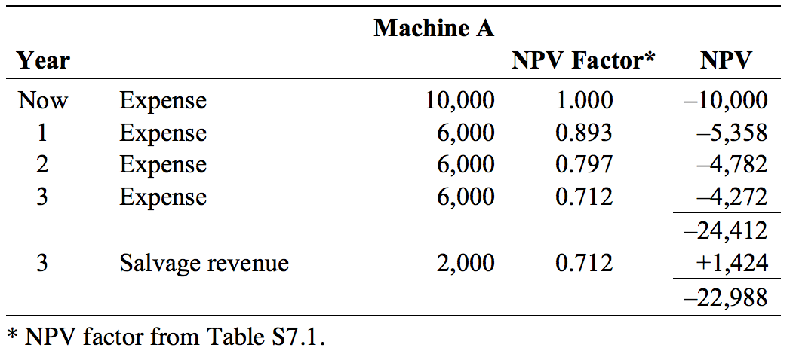
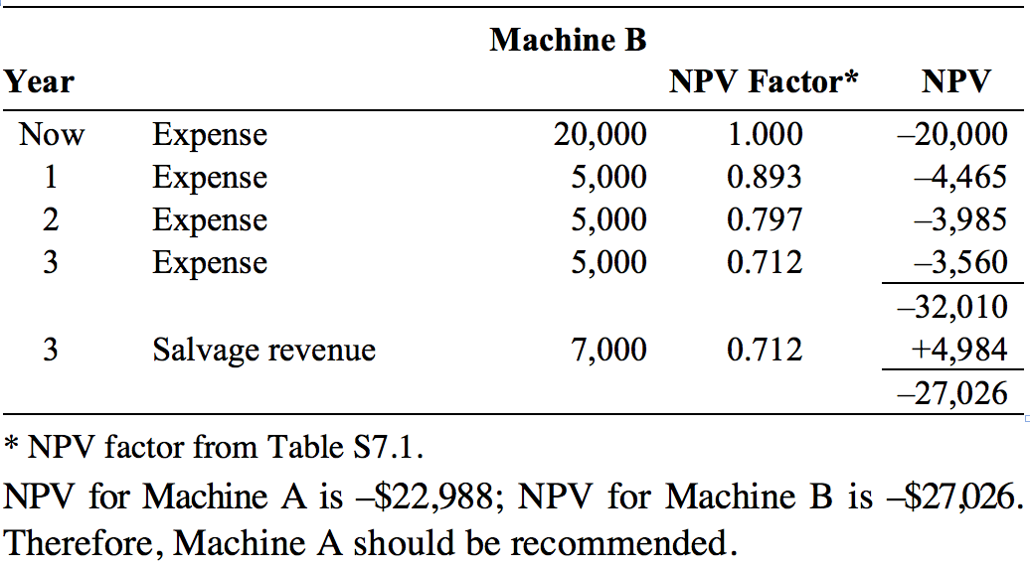
Problem S7.33

