Slide 1
Chapter 7s
Class 1

Slide 2
Design and Effective Capacity
Design capacity is the maximum theoretical output of a system
Normally expressed as a rate
Effective capacity is the capacity a firm expects to achieve given current operating constraints
Often lower than design capacity
Notes:
This slide can be used to frame a discussion of capacity.
Points to be made might include:
- capacity definition and measurement is necessary if we are to develop a production schedule
- while a process may have “maximum” capacity, many factors prevent us from achieving that capacity on a continuous basis.
Students should be asked to suggest factors which might prevent one from achieving maximum capacity.

Slide 3
Utilization and Efficiency
Utilization is the percent of design capacity achieved
Utilization = Actual output/Design capacity
Efficiency is the percent of effective capacity achieved
Efficiency = Actual output/Effective capacity

Slide 4
Bakery Example
Actual production last week = 148,000 rolls
Effective capacity = 175,000 rolls
Design capacity = 1,200 rolls per hour
Bakery operates 7 days/week, 3 - 8 hour shifts
Design capacity = (7 x 3 x 8) x (1,200) = 201,600 rolls
Notes:
It might be useful at this point to discuss typical equipment utilization rates for different process strategies if you have not done so before.

Slide 5
Bakery Example
Actual production last week = 148,000 rolls
Effective capacity = 175,000 rolls
Design capacity = 1,200 rolls per hour
Bakery operates 7 days/week, 3 - 8 hour shifts
Design capacity = (7 x 3 x 8) x (1,200) = 201,600 rolls
Utilization = 148,000/201,600 = 73.4%
Notes:
It might be useful at this point to discuss typical equipment utilization rates for different process strategies if you have not done so before.

Slide 6
Bakery Example
Actual production last week = 148,000 rolls
Effective capacity = 175,000 rolls
Design capacity = 1,200 rolls per hour
Bakery operates 7 days/week, 3 - 8 hour shifts
Design capacity = (7 x 3 x 8) x (1,200) = 201,600 rolls
Utilization = 148,000/201,600 = 73.4%
Efficiency = 148,000/175,000 = 84.6%
Notes:
It might be useful at this point to discuss typical equipment utilization rates for different process strategies if you have not done so before.

Slide 7
Bakery Example
Actual production last week = 148,000 rolls
Effective capacity = 175,000 rolls
Design capacity = 1,200 rolls per hour
Bakery operates 7 days/week, 3 - 8 hour shifts
Efficiency = 84.6%
Efficiency of new line = 75%
Expected Output = (Effective Capacity)(Efficiency)
= (175,000)(.75) = 131,250 rolls
Notes:
It might be useful at this point to discuss typical equipment utilization rates for different process strategies if you have not done so before.

Slide 8
Problem S7.7
southeastern Oklahoma State University’s business program has the facilities and faculty to handle an enrollment of 2,000 new students per semester. However, in an effort to limit class sizes to a “reasonable” level (under 200, generally), Southeastern’s dean, Tom Choi, placed a ceiling on enrollment of 1,500 new students. Although there was ample demand for business courses last semester, conflicting schedules allowed only 1,450 new students to take business courses. What are the utilization and efficiency of this system?

Slide 9
Solution:
Design capacity = 2,000 students
Effective capacity = 1,500 students
Actual output = 1,450 students

Slide 10
Problem S7.8
under ideal conditions, a service bay at a fast lube can serve 6 cars per hour. the effective capacity and efficiency of a fast lube service bay are known to be 5.5 and 0.880, respectively. what is the minimum number of service bays fast lube needs to achieve an anticipated production of 200 cars per 8-hour day

Slide 11
Solution:
Actual or expected output = Effective capacity*Efficiency
5.5 cars × 0.880 = 4.84 cars.
In one 8-hour day, one bay accommodates (8 hr * 4.84 cars per hr) = 38.72 cars
To do 200 cars per day it requires,
(200 cars) / (38.72 cars/bay) = 5.17 or 6 bays

Slide 12
Process Times for Stations, Systems, and Cycles
The process time of a station is the time to produce a unit at that single workstation
The process time of a system is the time of the longest process in the system … the bottleneck
The process cycle time is the time it takes for a product to go through the production process with no waiting

Slide 13
A Three-Station Assembly Line
A
B
C
2 min/unit
4 min/unit
3 min/unit
Figure S7.4

Slide 14
Capacity Analysis
Two identical sandwich lines
Lines have two workers and three operations
All completed sandwiches are wrapped
Bread
Fill
Toast
Order
15 sec/sandwich
20 sec/sandwich
40 sec/sandwich
Wrap
30 sec/sandwich
Bread
Fill
Toast
37.5 sec/sandwich
15 sec/sandwich
20 sec/sandwich
40 sec/sandwich

Slide 15
Capacity Analysis
Bread
Fill
Toast
Order
15 sec
20 sec
40 sec
Wrap
30 sec
Bread
Fill
Toast
37.5 sec
15 sec
20 sec
40 sec
Toast work station has the longest processing time – 40 seconds
The two lines each deliver a sandwich every 40 seconds so the process time of the combined lines is 40/2 = 20 seconds
At 37.5 seconds, wrapping and delivery has the longest processing time and is the bottleneck
Capacity per hour is 3,600 seconds/37.5 seconds/sandwich = 96 sandwiches per hour
Process cycle time is 30 + 15 + 20 + 40 + 37.5 = 142.5 seconds

Slide 16
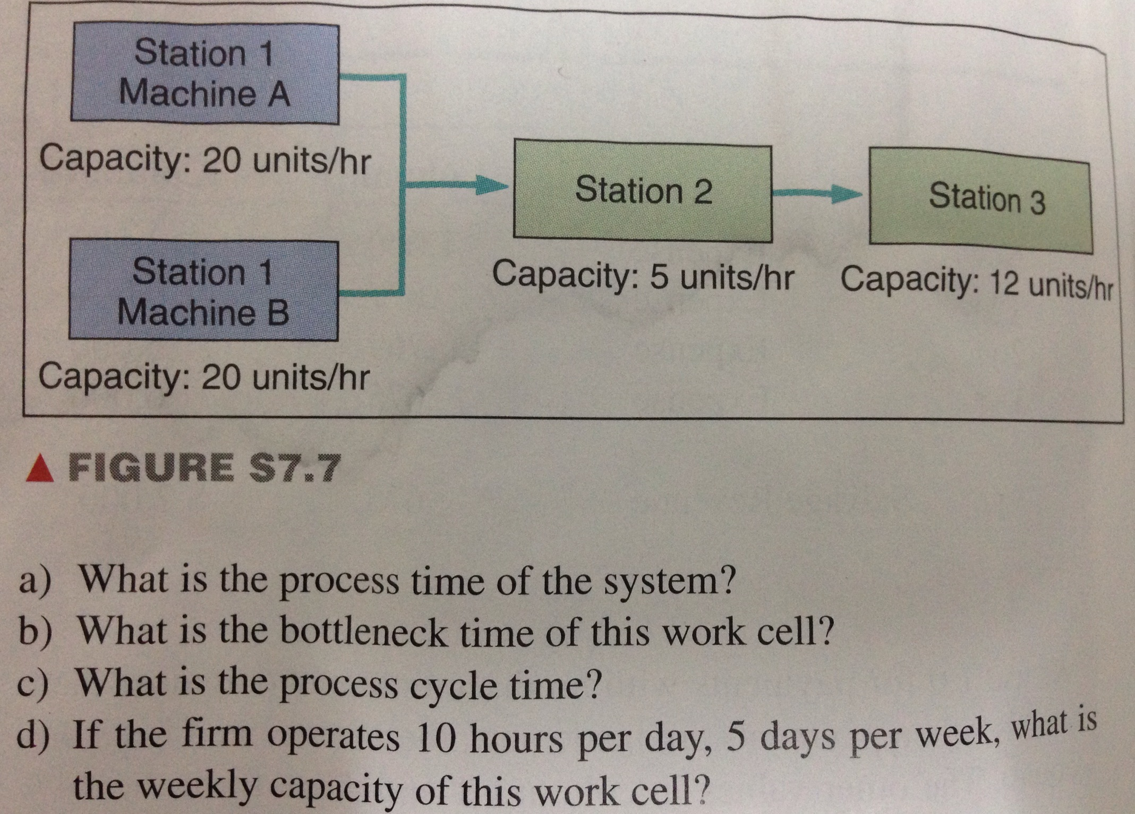

Slide 17
Problem S7.11
Solution:
Stat.1_A
0.05 hr/unit
Stat.2
0.2 hr/unit
Stat.3
0.08333 hr/unit
Stat.1_B
0.05 hr/unit
(a) System process time = bottleneck time = 0.2 hr/unit
(b) Bottleneck time = 0.2 hr/unit
(c) Process cycle time = 0.05 hr+0.2 hr+0.08333 hr
= 0.3333 hr = 20 min
(d) Weekly capacity= total time in a week/bottleneck time
= (10hr*5days)/0.2 = 250 units/week

Slide 18
Capacity Analysis
Standard process for cleaning teeth
Cleaning and examining X-rays can happen simultaneously
Cleaning
Check in
Takes X-ray
Develops X-ray
24 min/unit
Dentist
Check out
2 min/unit
2 min/unit
4 min/unit
X-ray exam
8 min/unit
6 min/unit
5 min/unit

Slide 19
Capacity Analysis
Cleaning
Check in
Takes X-ray
Develops X-ray
24 min/unit
Dentist
Check out
2 min/unit
2 min/unit
4 min/unit
X-ray exam
8 min/unit
6 min/unit
5 min/unit
All possible paths must be compared
Cleaning path is 2 + 2 + 4 + 24 + 8 + 6 = 46 minutes
X-ray exam path is 2 + 2 + 4 + 5 + 8 + 6 = 27 minutes
Longest path involves the hygienist cleaning the teeth
Bottleneck is the hygienist at 24 minutes
Hourly capacity is 60/24 = 2.5 patients
Patient should be complete in 46 minutes

Slide 20
Problem S7.14
Klassen Toy Company, Inc., assembles two parts (parts1 and 2): Part 1 is first processed at workstation A for 15 minutes per unit and then processed at workstation B for 10 minutes per unit.
Part 2 is simultaneously processed at workstation C for 20 minutes per unit. Work stations B and C feed the parts to an assembler at workstation D, where the two parts are assembled. The time at workstation D is 15 minutes.
a) What is the bottleneck of this process?
b) What is the hourly capacity of the process?

Slide 21
Problem S7.14
Solution:
Station A
15 min/unit
Station B
10 min/unit
Station D
15 min/unit
Station C
20 min/unit
(a) System process time = bottleneck time = 20 min/unit
(b) Hourly capacity = time in an hour/bottleneck time
= 60min/20 = 3 units/hr
* Process cycle time = 25 min + 15 min = 40 min

