Slide 1
Chapter 7
Evaluating Survey Data Collection Methods
1
Copyright © 2014 Pearson Education, Inc.

Slide 2
Learning Objectives
To learn the four basic alternative modes for gathering survey data
To understand the advantages and disadvantages of each of the various data collection modes
To comprehend the factors researchers consider when choosing a particular survey method

Slide 3
Learning Objectives
To become knowledgeable about the details of different types of survey data collection methods, such as personal interviews, telephone interviews, and computer-administered interviews, including online surveys

Slide 4
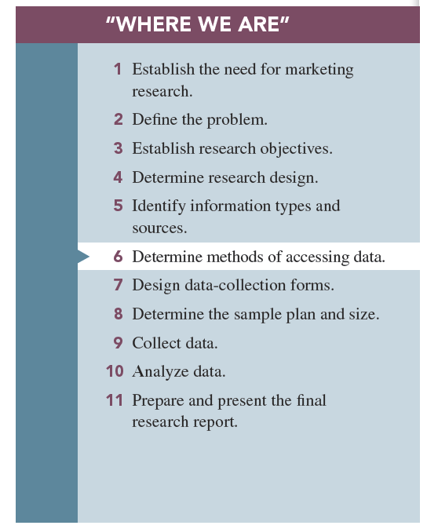

Slide 5
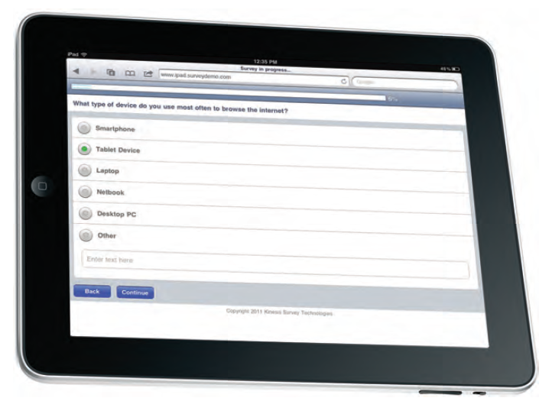
Contemporary Survey

Slide 6
Surveys
A survey involves interviews with a large number of respondents using a predesigned questionnaire.

Slide 7
Surveys
Four basic survey methods:
  Person-administered surveys
  Computer-assisted surveys
  Self-administered surveys
  Mixed-mode (hybrid) surveys

Slide 8
Advantages of Surveys
Standardization
Ease of administration
Ability to tap the “unseen”
Suitability to tabulation and statistical analysis
Sensitivity to subgroup differences

Slide 9
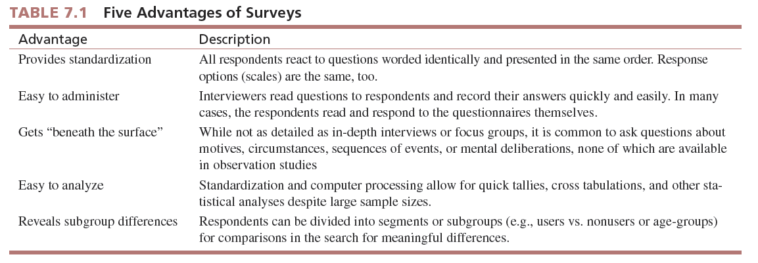

Slide 10
Four Alternative
Data Collection Modes
Person administered: an interviewer reads questions, either face-to-face or over the telephone, to the respondent and records his or her answers.
Computer administered: the interviewer basically verbalizes the questions while relying to some degree on computer technology to facilitate the interview work.

Slide 11
Four Alternative
Data Collection Modes
Self-administered: the respondent completes the survey on his or her own.
Mixed mode: a combination of two or more methods

Slide 12
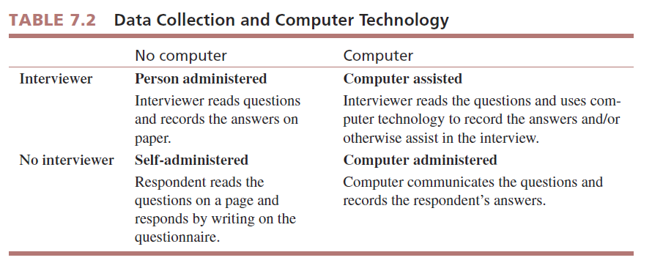

Slide 13
Person-Administered Surveys
(Without Computer Assistance)
A person-administered survey is one in which an interviewer reads questions, either face-to-face or over the telephone, to the respondent and records his or her answers.

Slide 14
Person-Administered Surveys
(Without Computer Assistance)
Advantages:
  Feedback
  Rapport
  Quality control
  Adaptability

Slide 15
Person-Administered Surveys
(Without Computer Assistance)
Disadvantages:
  Humans make errors
  Slow speed
  High cost

Slide 16
Person-Administered Surveys
(Without Computer Assistance)
Disadvantages:
  Interview evaluation: apprehensive they are answering the question “correctly.” Feel they are being “evaluated.” Especially a problem with sensitive topics such as hygiene, finances, political opinions, etc.

Slide 17
Computer-Administered Surveys
Advantages:
  Breadth of user-friendly features
  Relatively inexpensive
  Reduction of interview evaluation concern in respondents

Slide 18
Computer-Administered Surveys
Disadvantages:
  Requires computer-literate and Internet-connected respondents

Slide 19
Self-Administered Surveys
A self-administered survey is one in which the respondent completes the survey on his or her own.
Traditional “paper and pencil” survey

Slide 20
Self-Administered Surveys
Advantages:
  Reduced cost
  Respondents control pace at which they answer
  No interview-evaluation apprehension

Slide 21
Self-Administered Surveys
Disadvantages:
  Respondent controls the survey—does not send in on time or does not send in.
  Lack of monitoring—no one to explain or encourage respondents.
  High questionnaire requirements—it must be perfect.

Slide 22
Mixed-Mode (Hybrid) Surveys
Mixed-mode surveys use multiple data collection methods.
It has become increasingly popular to use mixed-mode surveys in recent years.

Slide 23
Mixed-Mode (Hybrid) Surveys
Advantages:
  Multiple advantages to achieve data collection goal
  Example: May use online surveys to quickly reach portion of population with Internet access and may use telephone calling to reach those without Internet access.

Slide 24
Mixed-Mode (Hybrid) Surveys
Disadvantages:
  Mode affects response?
  Additional complexity

Slide 25
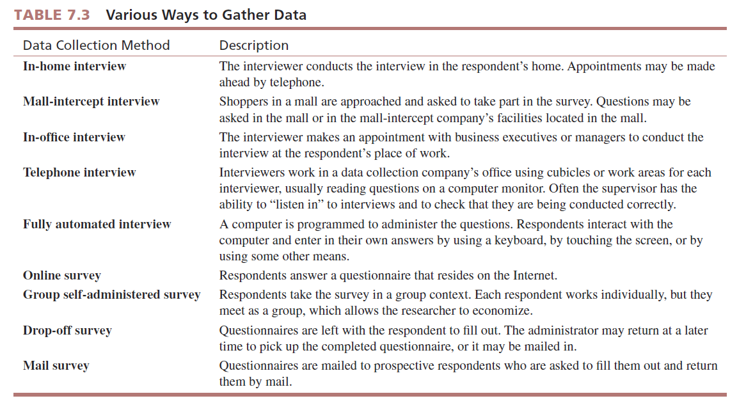

Slide 26
In-Home Surveys
An in-home survey is conducted by an interviewer in the home of the respondent.

Slide 27
Person-Administered Surveys
In-Home Interview
Key advantages:
  Conducted in the privacy of the home, which facilitates interviewer–respondent rapport

Slide 28
Person-Administered Surveys
(Without Computer Assistance)
Primary administration method for many years until development of communications systems and advancement in computer technology

Slide 29
Mall-Intercept Surveys
The mall-intercept survey is one in which the respondent is encountered and questioned while he or she is visiting a shopping mall.

Slide 30
Mall-Intercept Surveys
Key advantages:
  Mall-intercept interviews are conducted in large shopping malls, and they are less expensive per interview than are in-home interviews.

Slide 31
Mall-Intercept Surveys
Key disadvantages:
  Only mall patrons are interviewed.
  Respondents may feel uncomfortable answering the questions in the mall.

Slide 32
In-Office Surveys
In-office surveys take place in person while the respondent is in his or her office or perhaps in a company lounge area.

Slide 33
In-Office Surveys
Key advantage:
  Useful for interviewing busy executives

Slide 34
In-Office Surveys
Key disadvantages:
  Relatively high cost per interview
  Gaining access is sometimes difficult

Slide 35
Central Location Telephone Surveying
Involves a field data collection company installing several telephone lines at one location from which interviewers make calls.

Slide 36
Central Location Telephone Surveying
Key advantages:
  Fast turnaround
  Good quality control
  Reasonable cost

Slide 37
Central Location Telephone Surveying
Key disadvantage:
  Restricted to telephone communication

Slide 38
CATI
The most advanced telephone interview companies have computerized the central location telephone interviewing process with systems called computer-assisted telephone interviews (CATI).

Slide 39
Computer-Administered Surveys
Key advantages:
  Computer eliminates human interviewer error
  Simultaneous data input to computer file
  Good quality control

Slide 40
Fully Automated Survey
Some companies have developed fully automated surveys in which the survey is administered by a computer but not online.
In the research industry, this approach is known as completely automated telephone survey (CATS).

Slide 41
Fully Computerized Survey (Not Online)
Key advantages:
  Respondent responds at his or her own pace
  Computer data file results

Slide 42
Online Interviews
The Internet-based questionnaire in which the respondent answers questions online has become the industry standard for surveys in virtually all high-Internet-penetration countries.

Slide 43
Fully Computerized Online Surveys
Key advantages:
  Ease of creating and posting
  Fast turnaround
  Computer data file
  Results

Slide 44
Fully Computerized Online Surveys
Key disadvantage:
  Marketing researchers were quick to realize that online surveys presented design challenges and opportunities related to fostering cooperation in potential respondents.

Slide 45
Group Self-Administered Survey
A group self-administered survey entails administering a questionnaire to respondents in groups rather than individually for convenience and to gain economies of scale.

Slide 46
Group Self-Administered Survey
Key advantages:
  Cost of interviewer eliminated
  Economical for assembled groups of respondents

Slide 47
Group Self-Administered Survey
Key disadvantage:
  Must find groups and secure permission to conduct the survey

Slide 48
Drop-Off Survey
The drop-off survey is sometimes called “drop and collect,” in which the survey representative approaches a prospective respondent, introduces the general purpose of the survey to the prospect, and leaves it with the respondent to fill out on his or her own.

Slide 49
Drop-Off Survey
Key advantages:
  Cost of interviewer eliminated
  Appropriate for local market surveys

Slide 50
Drop-Off Survey
Key disadvantage:
  Generally not appropriate for large-scale national survey

Slide 51
Mail Survey
A mail survey is one in which the questions are mailed to prospective respondents who are asked to fill them out and return them to the researcher by mail.

Slide 52
Self-Administered Surveys
Mail Survey
Key disadvantage:
  Nonresponse, which refers to questionnaires that are not returned
  Self-selection bias, which means that those who do respond are probably different from those who do not fill out the questionnaire and return it

Slide 53
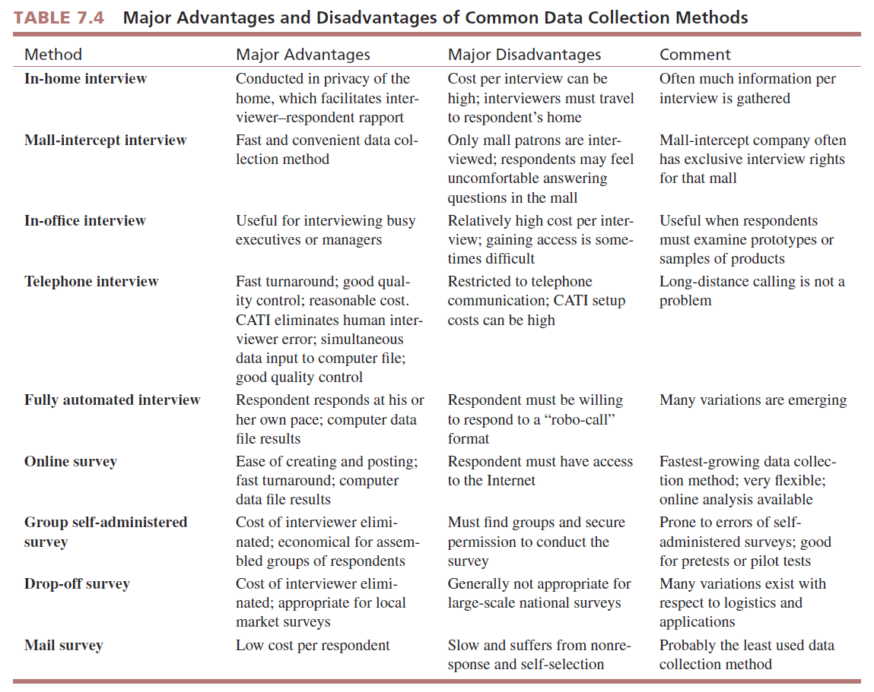

Slide 54
Choice of Survey Method
In selecting a data collection mode, the researcher balances quality against the following:
  Time available for data collection
  Money available for data collection
  Type of respondent interaction required (such as sampling a product, viewing an ad, etc.)

Slide 55
Choice of Survey Method
In selecting a data collection mode, the researcher balances quality against the following:
  Incidence rate: screen by online or telephone
  Cultural/infrastructure considerations: Scandinavian countries dislike strangers in homes. Canada is more open. In India, <10% have phones.

Slide 56

All rights reserved. No part of this publication may be reproduced, stored in a retrieval system, or transmitted, in any form or by any means, electronic, mechanical, photocopying, recording, or otherwise, without the prior written permission of the publisher. Printed in the United States of America.

