Slide 1
E-Marketing/7E Chapter 7
Connected Consumers Online

Slide 2
Chapter 7 Objectives
After reading Chapter 7, you will be able to:
Discuss general statistics about the internet population.
Describe the internet exchange process and the technological, social/cultural and legal context in which consumers participate in this process.
Outline the broad individual characteristics, psychology, and consumer resources that consumers bring to the online exchange.
Highlight the five main categories of outcomes that consumers seek from online exchanges.

Slide 3
The Customer’s Story
A typical one-hour adventure in the life of a 25-year-old professional, Justin:
Tunes his iPod to the latest Diggnation podcast while his TV is tuned to a soccer game and his smartphone and iPad tablet are within reach.
Picks up iPad to find a blog mentioned during the podcast, sees a video on the blog, tunes it on his TV set and texts a friend about the video.
Justin searches for the video title on Google and finds a job posting on Vimeo, an online video-posting site.

Slide 4
The Customer’s Story, cont.
He posts a link to the video and Vimeo site to his Twitter stream.
Justin is the new consumer: a multitasker attending to different electronic media simultaneously.
How can a marketer capture dollars from advertising online, selling music downloads, charging fees for social media subscriptions?

Slide 5
Consumers in the 21st Century
85% of U.S. consumers used the internet in 2012.
Less connected groups tend to be:
Older
Less educated
Hispanic
Lower income or disability

Slide 6
Consumers in the 21st Century, cont.
Approximately 1.8 billion people have access to the internet, 32.7% of the global population.
Top ten countries account for 60% of all users and adoption rates range from 10-84%.
internet usage in developed nations has reached a critical mass, leading marketers to ask more questions about consumer behavior on the internet.

Slide 7
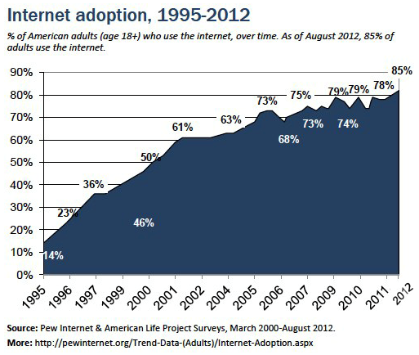
Internet Reaches Maturity: 1995-2012

Slide 8
Consumer Behavior Online
Many consumer behavior principles that describe offline buyer behavior also apply to online behavior.
Exhibit 7.2 explains some consumer behavior theories for online buyer behavior.
Scarcity
Popularity
Affinity
Authority
Consistency
Reciprocity

Slide 9
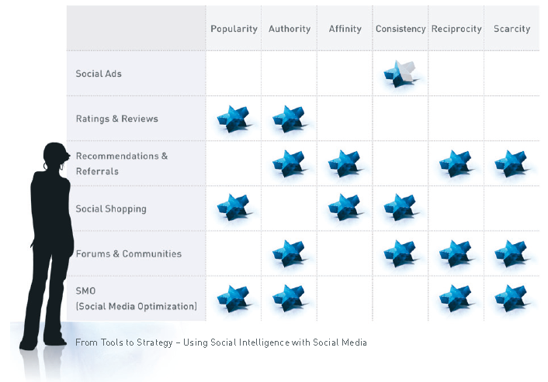
Social Psychology of Social Shopping

Slide 10
The Internet Exchange Process
Exchange is a basic marketing concept.
It refers to the act of obtaining a valued object by offering something in return.
Exchange occurs within the following contexts:
Technological
Social/cultural
Legal

Slide 11
The Online Exchange Process
Technological, Social/Cultural, Legal Contexts
Marketing Stimuli
Outcomes
Connect
Create
Enjoy
Learn
Trade
Give
Individual
Characteristics
Resources
Internet Exchange

Slide 12
Technological Context
66-77% of online Americans connect to the internet at home with broadband.
Broadband users enjoy more multimedia games, music, and entertainment because they download quickly.
The typical U.S. home has 26 different electronic devices for media and communication.
Web 2.0 technologies are driving marketing strategies and tactics.

Slide 13
2012 U.S. Daily Media Use (Minutes/day)

Slide 14
Social and Cultural Contexts
Three cornerstones for attracting customers online:
Reputation: Brand image and reputation are based on the market’s perception.
Relevance: Consumers don’t like being interrupted with irrelevant communication.
Engagement: Marketers must provide relevant content or entertainment.

Slide 15
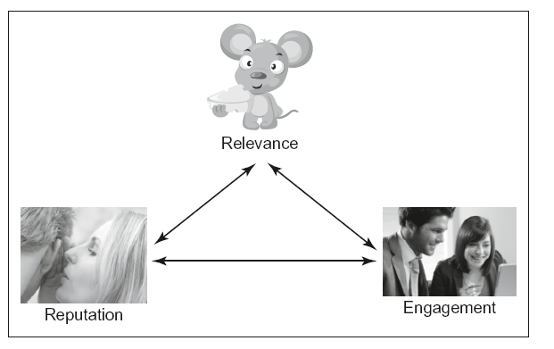
Engaging Customers With Relevant Content

Slide 16
Legal Context
In spite of the Can-Spam act the number of unsolicited emails was 71.9% in June 2012.
When the recording industry sued illegal music file downloaders, consumer behavior was affected.
In 2002, 37% of online consumers shared music files, but the percentage has dropped.
The Recording Industry Association of America still claims $12.5B in annual losses from music piracy.

Slide 17
Individual Characteristics & Resources
Individual characteristics affect internet use.
Demographics such as age, income, education, ethnicity, and gender.
Attitudes toward technology.
Online skill and experience.
Goal orientation.

Slide 18
Consumer Resources
Consumers perceive value as benefits minus costs.
These costs constitute a consumer’s resources for exchange:
Money
Time
Energy
Psychic costs

Slide 19
U.S. Combined Home/Work Internet Usage

Slide 20
Exchange Outcomes
There are 6 basic things that people do online:
Connect
Create
Enjoy
Learn
Trade
Give
Each is ripe with marketing opportunity.

Slide 21
Connecting Online in the U.S.

Slide 22
Creating & Uploading Content in the U.S.

Slide 23
Entertainment Online in the U.S.

Slide 24
Top 10 Search Terms for 2011
 | Google |  | Yahoo! |  | Bing
Rank | Term | Rank | Term | Rank | Term
1 | Rebecca Black | 1 | iPhone | 1 | Fauja Singh
2 | Google+ | 2 | Casey Anthony | 2 | Katy Perry
3 | Ryan Dunn | 3 | Kim Kardashian | 3 | The cardinals
4 | Casey Anthony | 4 | Katy Perry | 4 | Harry Potter
5 | Battlefield 3 | 5 | Jennifer Lopez | 5 | Adele
6 | iPhone 5 | 6 | Lindsay Lohan | 6 | Rory Mcllroy
7 | Adele | 7 | American Idol | 7 | Japan Earthquake
8 | Tepco | 8 | Jennifer Aniston | 8 | Job crisis
9 | Steve Jobs | 9 | Japan Earthquake | 9 | Foreclosures
10 | iPad2 | 10 | Osama Bin Laden | 10 | Weather disasters

Slide 25
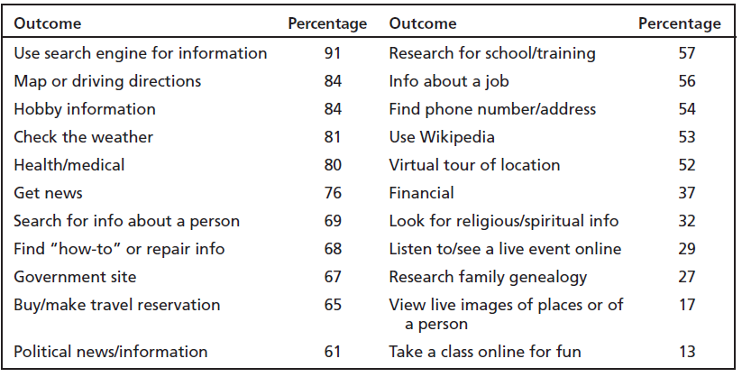
Learning and Getting Information

Slide 26
Trading Online in the U.S.

Slide 27
Giving Online
Trendwatcher.com mentions “Generation Generosity” as one of the top global consumer trends.
25% of Americans made an online donation to charity in 2011.
Kickstarter.com offers a Web platform for individuals seeking funding for creative projects.

Slide 28
All rights reserved. No part of this publication may be reproduced, stored in a retrieval system, or transmitted, in any form or by any means, electronic, mechanical, photocopying, recording, or otherwise, without the prior written permission of the publisher. Printed in the United States of America.
Copyright © 2014 Pearson Education, Inc.
Publishing as Prentice Hall

Slide 29
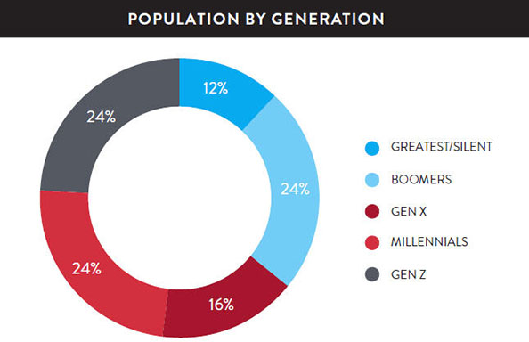
Millennials
Greatest Generation (1901-1924)
Silent Generation (1925-1945)
Baby Boomers (1946-1964)
Generation X (1965-1976)
Millennials/Gen Y (1977-1995) --Younger Millennials (18-27) --Older Millennials (28-36)
Generation Z (1995-Present)

