Slide 1
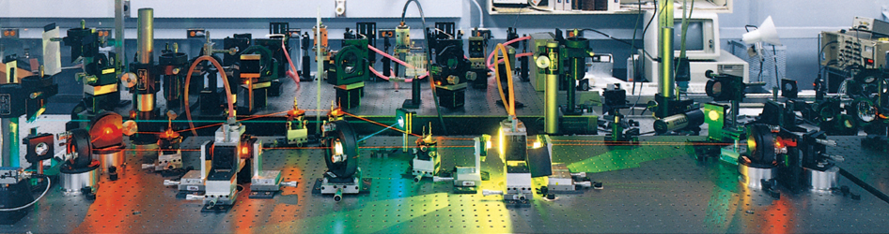
Quantum Theory and the Electronic Structure of Atoms

Slide 2
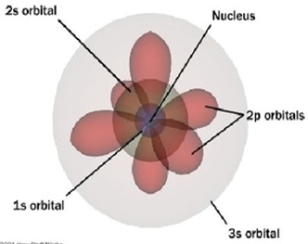
Quantum numbers
Quantum numbers are used to differentiate between electrons
i. In quantum theory, each electron in an atom is assigned a set of four quantum numbers.
ii. Three of these give the location of the electron, and the fourth gives the orientation of the electron within the orbital
iii. Definitions of numbers

Slide 3
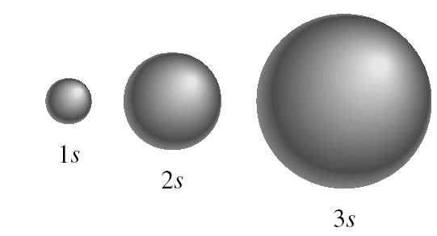
quantum numbers (n, l, m_{l}, m_{s})
principal quantum number n
n = 1, 2, 3, 4, ….
distance of e⁻ from the nucleus
n=1
n=2
n=3

Slide 4
quantum numbers: (n, l, m_{l}, m_{s})
angular momentum quantum number l
for a given value of n, l = 0, 1, 2, 3, … n-1
l = 0 s orbital
l = 1 p orbital
l = 2 d orbital
l = 3 f orbital
n = 1, l = 0
n = 2, l = 0 or 1
n = 3, l = 0, 1, or 2
Shape of the “volume” of space that the e⁻ occupies

Slide 5
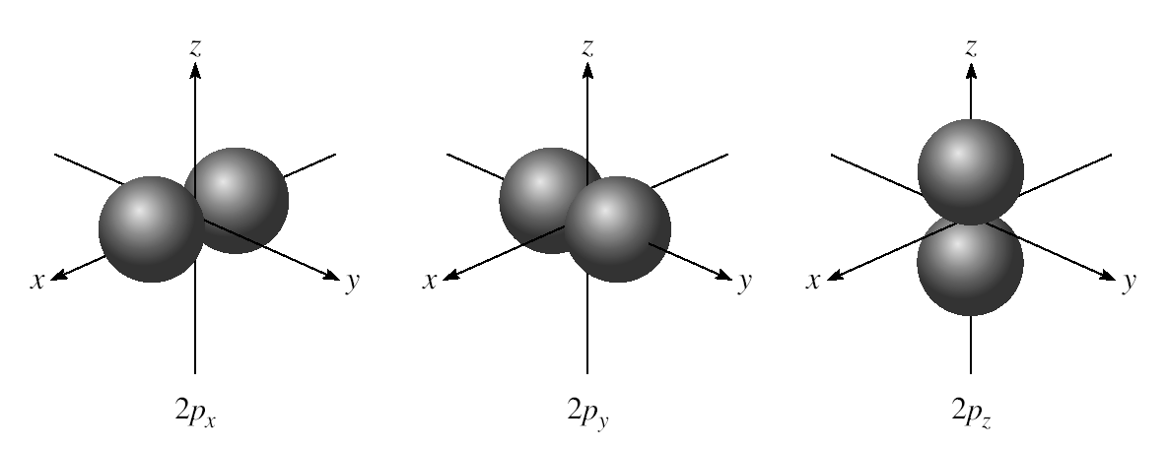
l = 0 (s orbitals)
l = 1 (p orbitals)

Slide 6
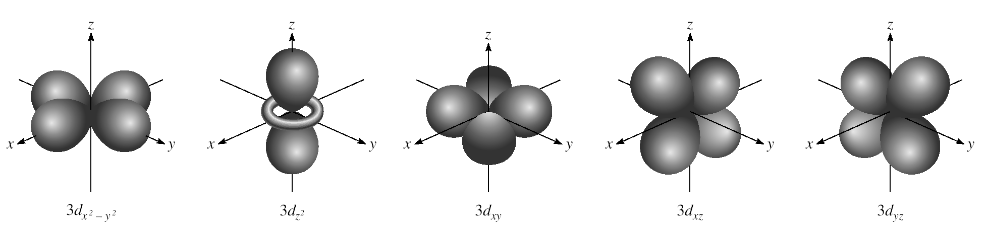
l = 2 (d orbitals)

Slide 7
quantum numbers: (n, l, m_{l}, m_{s})
magnetic quantum number m_{l}
for a given value of l
m_{l} = -l, …., 0, …. +l
if l = 1 (p orbital), m_{l} = -1, 0, or 1
if l = 2 (d orbital), m_{l} = -2, -1, 0, 1, or 2
orientation of the orbital in space

Slide 8
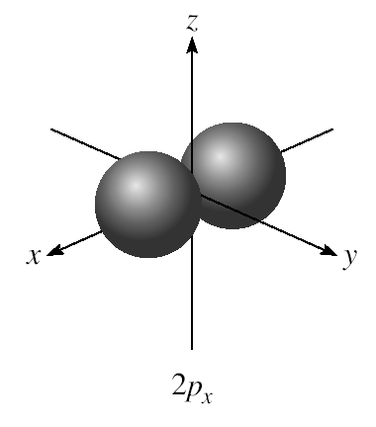
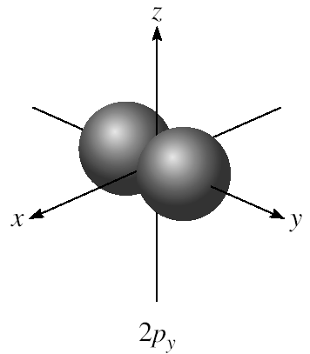
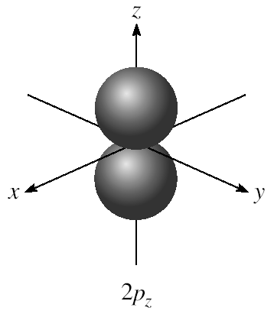
m_{l} = -1, 0, or 1
3 orientations is space

Slide 9
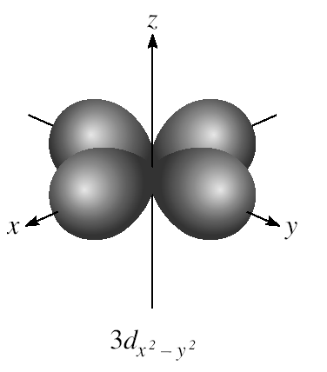
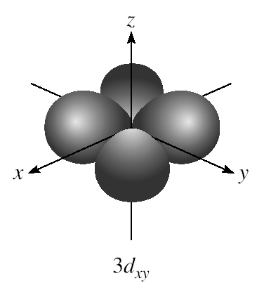
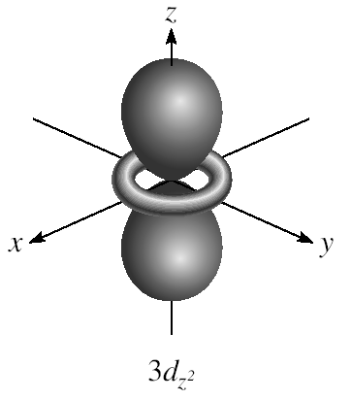
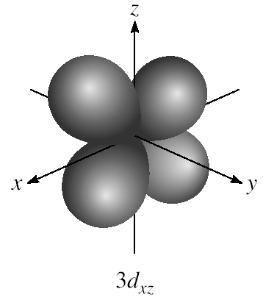
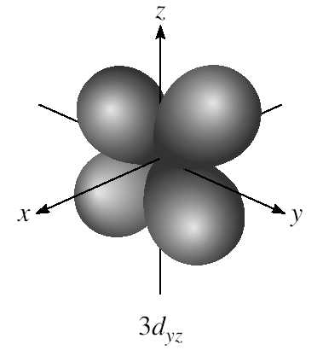
m_{l} = -2, -1, 0, 1, or 2
5 orientations is space

Slide 10
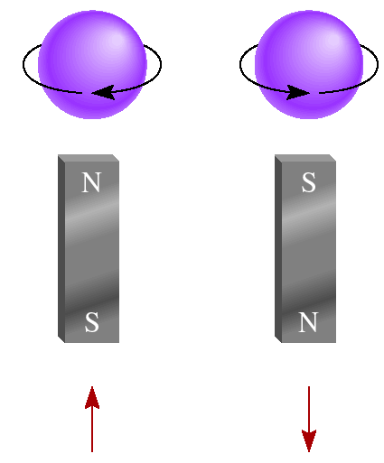
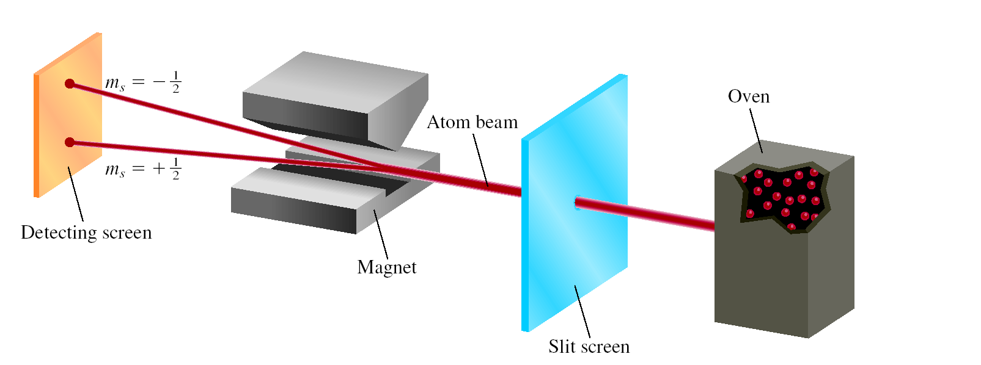
(n, l, m_{l}, m_{s})
spin quantum number m_{s}
m_{s} = +½ or -½
m_{s} = +½
m_{s} = -½

Slide 11
quantum numbers: (n, l, m_{l}, m_{s})
Existence (and energy) of electron in atom is described
by its unique wave function ψ.
Pauli exclusion principle - no two electrons in an atom
can have the same four quantum numbers.
Each seat is uniquely identified (E, R12, S8)
Each seat can hold only one individual at a time

Slide 12
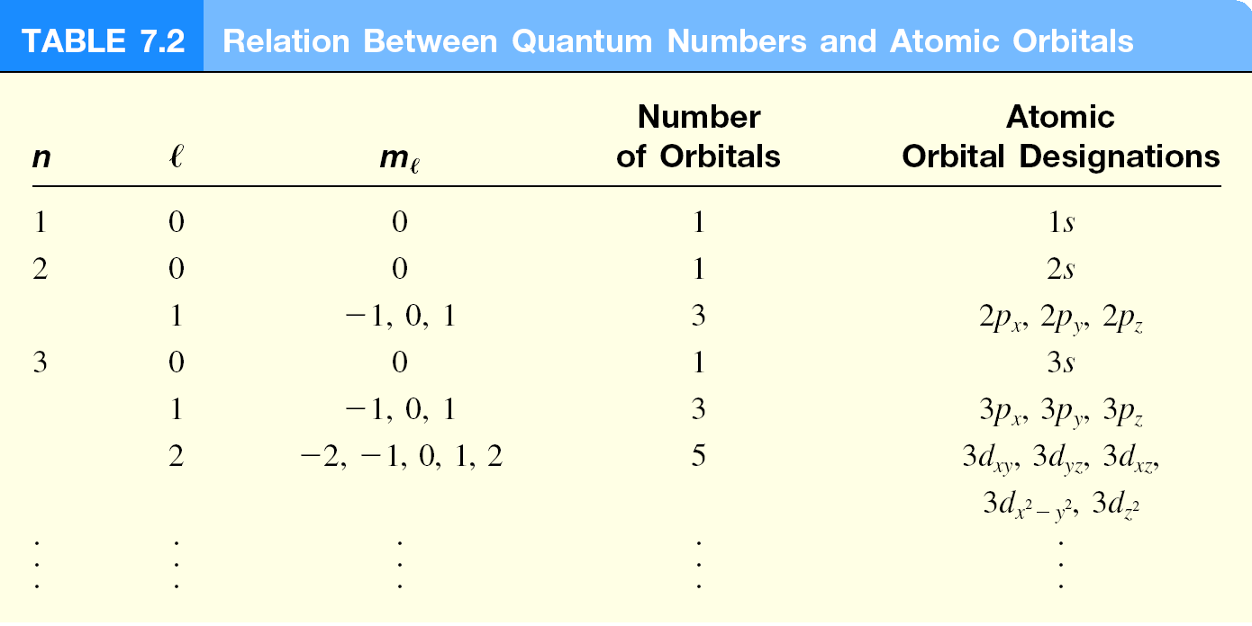

Slide 13
quantum numbers: (n, l, m_{l}, m_{s})
Shell – electrons with the same value of n
Subshell – electrons with the same values of n and l
Orbital – electrons with the same values of n, l, and m_{l}
How many electrons can an orbital hold?
If n, l, and m_{l} are fixed, then m_{s} = ½ or - ½
ψ = (n, l, m_{l}, ½)
or ψ = (n, l, m_{l}, -½)
An orbital can hold 2 electrons

Slide 14
How many 2p orbitals are there in an atom?
n=2
If l = 1, then m_{l} = -1, 0, or +1
2p
3 orbitals
l = 1
How many electrons can be placed in the 3d subshell?
n=3
If l = 2, then m_{l} = -2, -1, 0, +1, or +2
3d
5 orbitals which can hold a total of 10 e⁻
l = 2

Slide 16
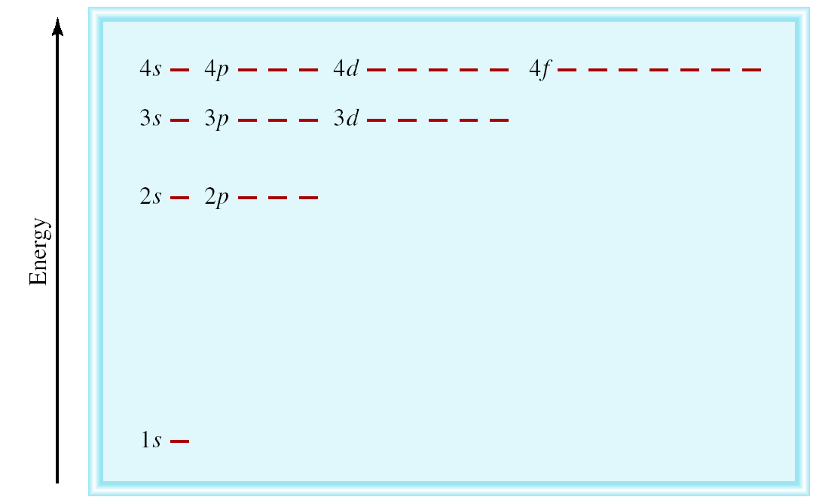
^{The Energies of Orbitals}
Energy of orbitals in a single electron atom
Energy only depends on principal quantum number n
n=3
n=2
n=1

Slide 17
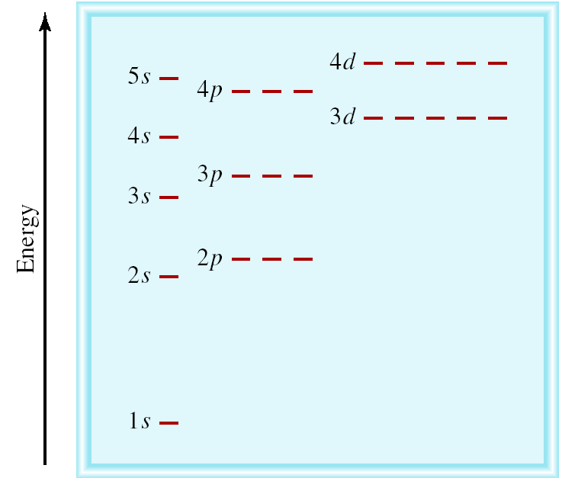
Energy of orbitals in a multi-electron atom
Energy depends on n and l
n=3 l = 2
n=3 l = 1
n=3 l = 0
n=2 l = 1
n=2 l = 0
n=1 l = 0

Slide 18
“Fill up” electrons in lowest energy orbitals (Aufbau principle)
?
?
Li 3 electrons
Be 4 electrons
B 5 electrons
C 6 electrons
B 1s²2s²2p¹
Be 1s²2s²
Li 1s²2s¹
H 1 electron
He 2 electrons
He 1s²
H 1s¹

Slide 19
The most stable arrangement of electrons in subshells is the one with the greatest number of parallel spins (Hund’s rule).
C 6 electrons
N 7 electrons
O 8 electrons
F 9 electrons
Ne 10 electrons
Ne 1s²2s²2p⁶
C 1s²2s²2p²
N 1s²2s²2p³
O 1s²2s²2p⁴
F 1s²2s²2p⁵

Slide 20
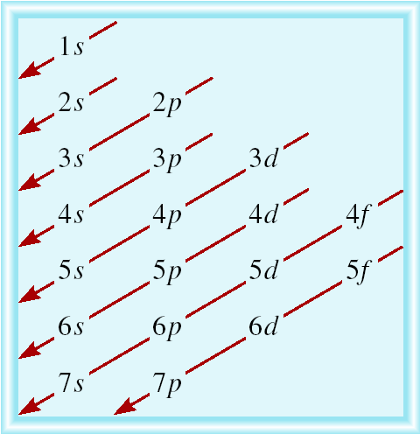
Order of orbitals (filling) in multi-electron atom
1s < 2s < 2p < 3s < 3p < 4s < 3d < 4p < 5s < 4d < 5p < 6s

Slide 21
Electron configuration is how the electrons are distributed among the various atomic orbitals in an atom.
number of electrons
in the orbital or subshell
1s¹
principal quantum
number n
angular momentum
quantum number l
Orbital diagram
H
1s¹

Slide 22
What is the electron configuration of Mg?
Mg 12 electrons
1s < 2s < 2p < 3s < 3p < 4s
1s²2s²2p⁶3s²
2 + 2 + 6 + 2 = 12 electrons
Abbreviated as [Ne]3s²
[Ne] 1s²2s²2p⁶
What are the possible quantum numbers for the last (outermost) electron in Cl?
Cl 17 electrons
1s < 2s < 2p < 3s < 3p < 4s
1s²2s²2p⁶3s²3p⁵
2 + 2 + 6 + 2 + 5 = 17 electrons
Last electron added to 3p orbital
n = 3
l = 1
m_{l} = -1, 0, or +1
m_{s} = ½ or -½

Slide 23
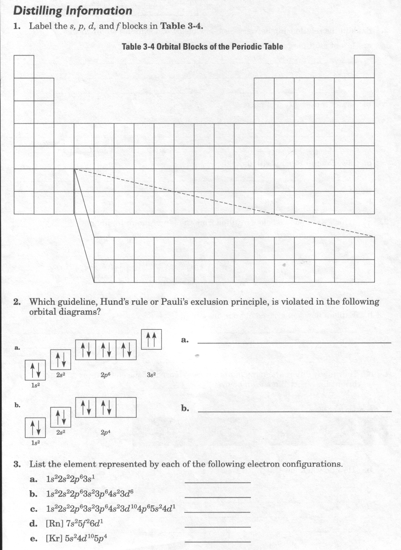

Slide 24
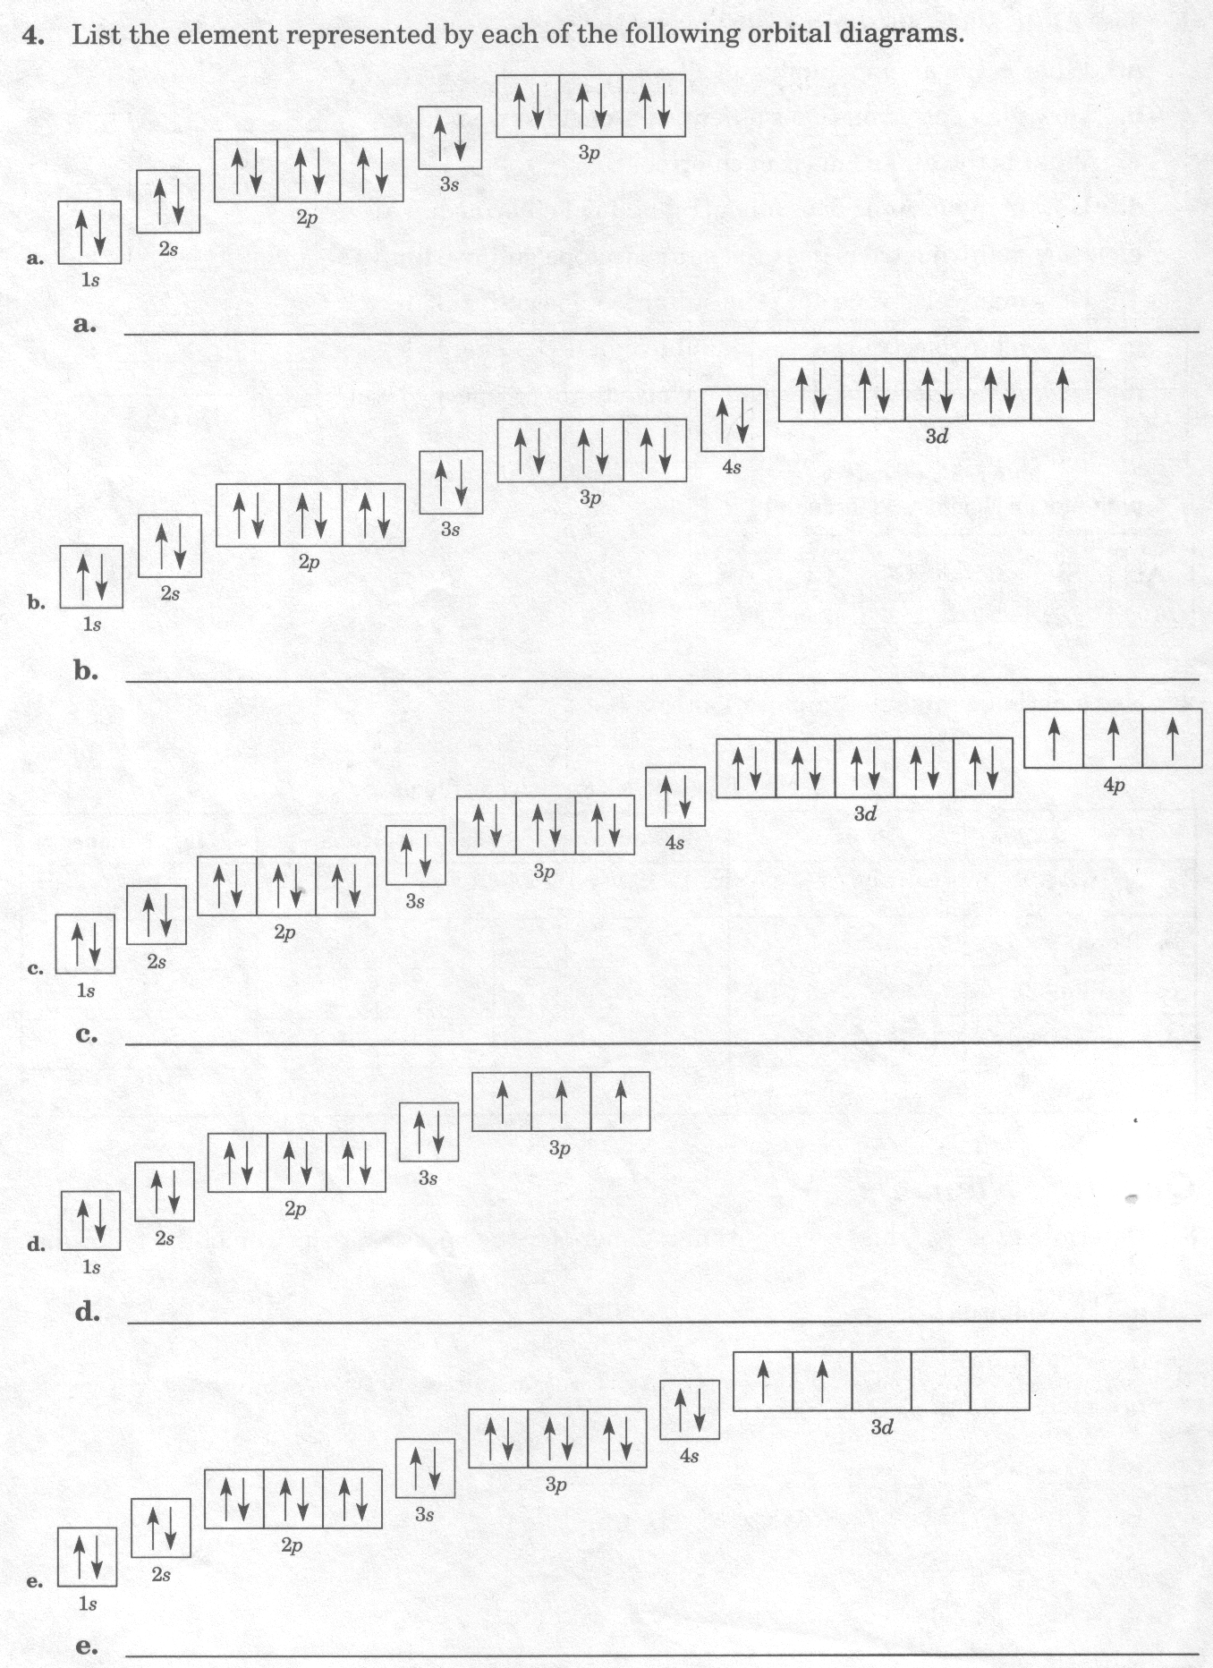

Slide 25
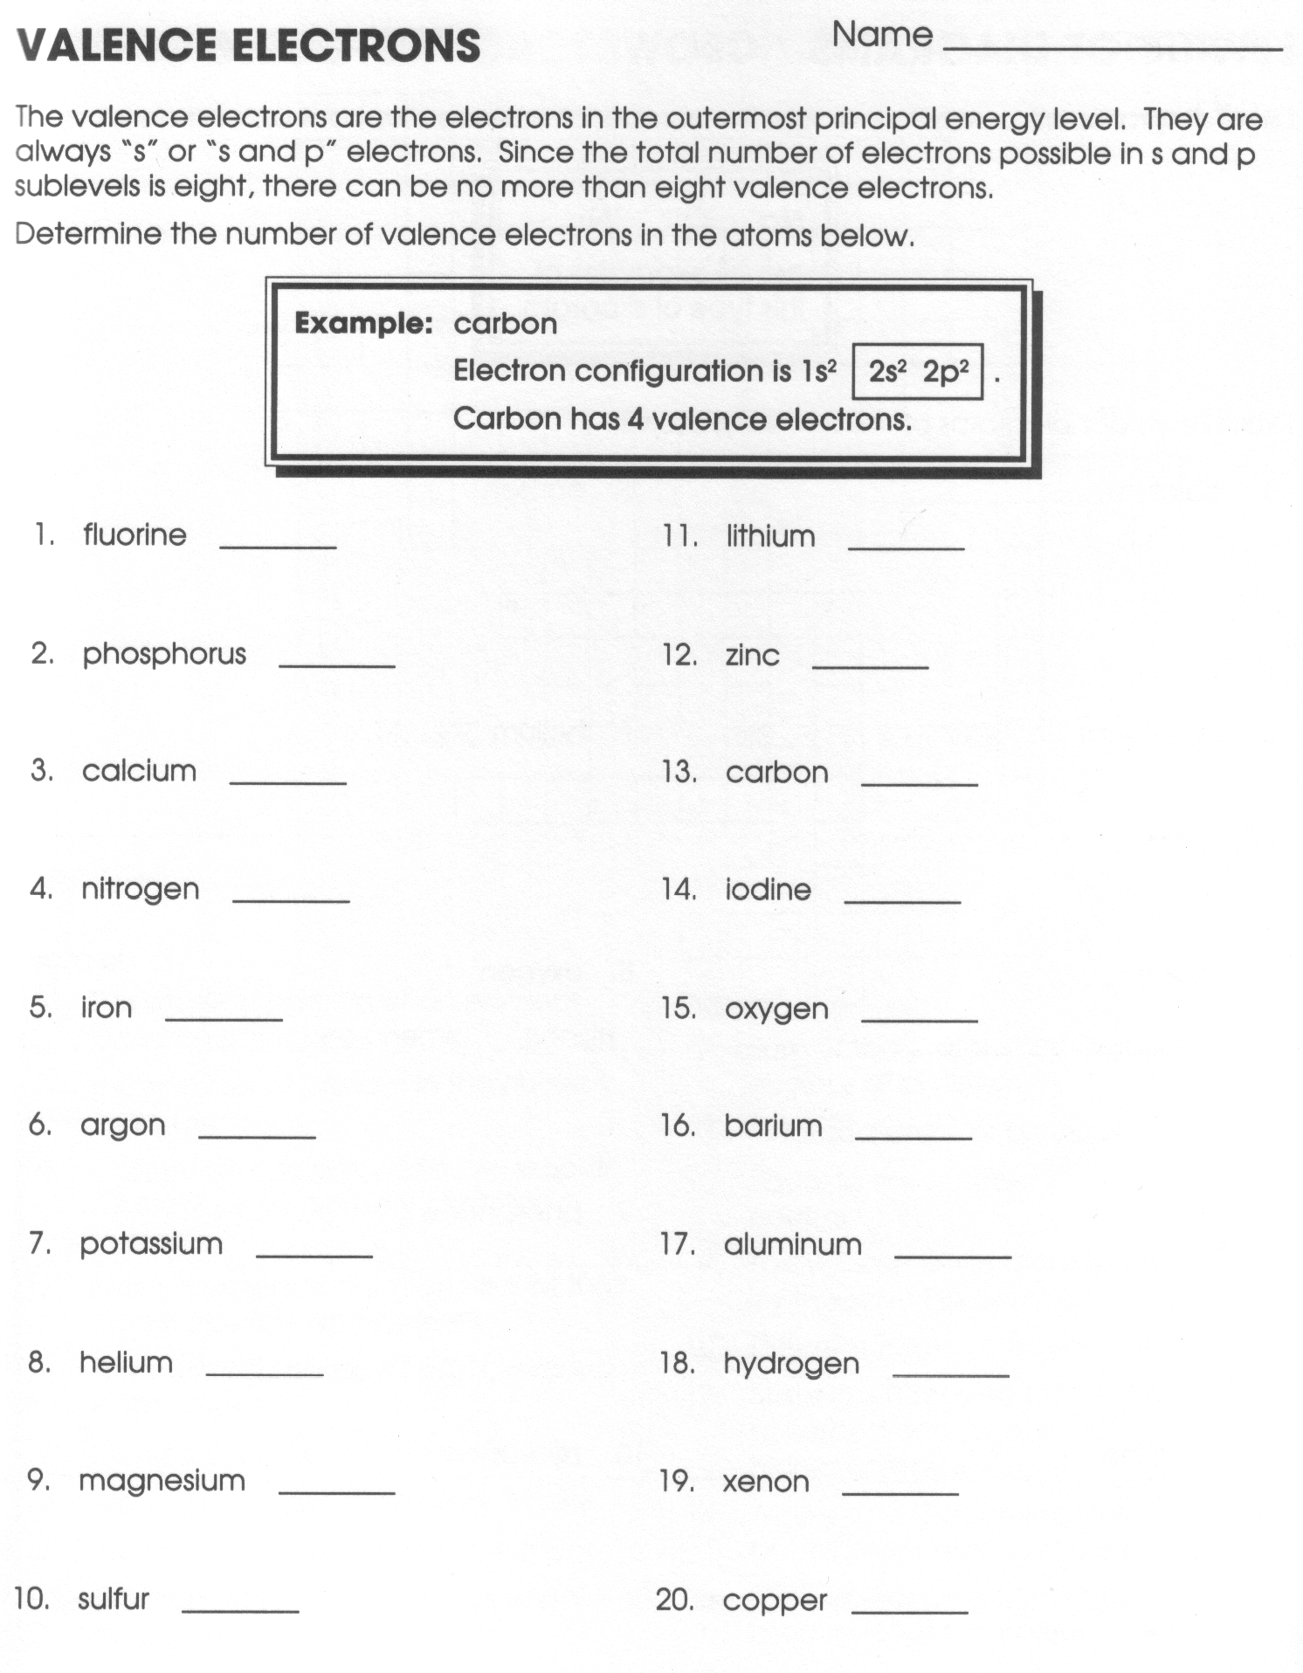

Slide 26
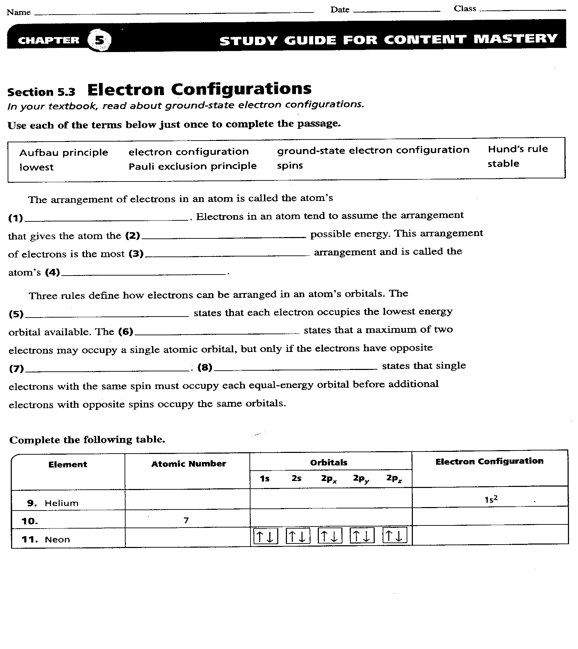

Slide 27
