Slide 1
Chapter 6
Qualitative Research Techniques
Copyright © 2014 Pearson Education, Inc.

Slide 2
Learning Objectives
To understand basic difference between quantitative and qualitative research techniques
To learn the pros and cons of using observation as a means of gathering data
To discover what focus groups are and how they are conducted and analyzed

Slide 3
Learning Objectives
To become acquainted with online focus groups and their advantages
To become familiar with other qualitative methods used by marketing researchers

Slide 4
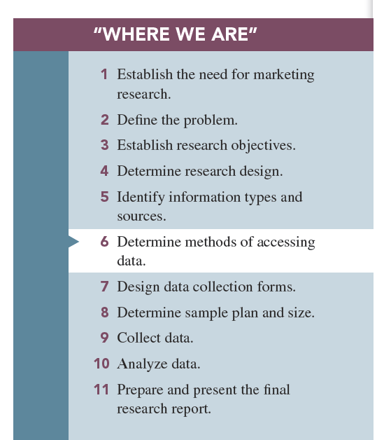

Slide 5
Categories of Research
Quantitative research: research involving the use of structured questions in which response options have been predetermined and a large number of respondents involved

Slide 6
Categories of Research
Qualitative research: research involving collecting, analyzing, and interpreting data by observing what people do and say

Slide 7
Categories of Research
Pluralistic research: combination of both quantitative and qualitative research methods in order to gain the advantages of both

Slide 8
Observation Techniques
Observation methods: techniques in which the researcher relies on his or her powers of observation rather than communicating with a person in order to obtain information

Slide 9
Observation Techniques
Types of observation:
Direct versus indirect
Overt versus covert
Structured versus unstructured
In situ versus invented

Slide 10
Observation Techniques
Direct observation: observing behavior as it occurs
Indirect observation: observing the effects or results of the behavior rather than the behavior itself
Archives: secondary sources, such as historical records, that can be applied to the present problem
Physical traces: tangible evidence of some past event

Slide 11
Observation Techniques
Covert observation: subject is unaware that he or she is being observed, such as mystery shopping.
Overt observation: respondent is aware that he or she is being observed, such as Arbitron’s PPM, which monitors the media to which a consumer is exposed.

Slide 12
Observation Techniques
Structured—researcher identifies beforehand which behaviors are to be observed and recorded (often there is a checklist).
Unstructured—all behavior is observed, and the observer determines what is to be recorded.

Slide 13
Observation Techniques
In situ observation: the researcher observes the behavior exactly as it happens.
Invented observation: the researcher creates the situation.

Slide 14
Observation Techniques
Appropriate conditions for use of observation:
Short time interval—event must begin and end in a reasonably short time. You cannot “observe” a process of purchasing that lasts months.
Public behavior—cannot observe private behaviors.
Faulty recall conditions—behaviors are so “automatic” that consumer cannot recall them.

Slide 15
Observation Techniques
Advantages of observational data
Insight into actual, not reported, behaviors
No chance for recall error
Better accuracy
Less cost

Slide 16
Observation Techniques
Limitations of observational data
Small number of subjects
Subjective interpretations
Inability to pry beneath the behavior observed
Motivations, attitudes, and other internal conditions are unobserved

Slide 17
Focus Groups
Focus groups are small groups of people brought together and guided by a moderator through an unstructured, spontaneous discussion for the purpose of gaining information relevant to the research problem.

Slide 18
Types of Focus Groups
Traditional: Select 6 to 12 persons and meet in a dedicated room with one-way mirror for client viewing, for about two hours.

Slide 19
Types of Focus Groups
Contemporary: Online and the client can observe the online activity from remote locations; may have 25 or even 50 respondents; allow client interaction; may take place in nontraditional locations.

Slide 20
How a Focus Group Works
Moderator: responsible for creating the correct atmosphere in the group and guiding discussion
Focus group report: summarizes the information provided by the focus group participants relative to the research questions

Slide 21
Newer Focus Groups
Online focus group: a form of contemporary focus groups, one in which the respondents and/or clients communicate and/or observe by use of the Internet

Slide 22
Online Focus Groups
Advantages:
No physical setup is necessary.
Transcripts are captured on file in real time.
Participants can be in widely separated geographical areas.
Participants are comfortable in their home or office environments.
The moderator can exchange private messages with individual participants.

Slide 23
Online Focus Groups
Disadvantages:
Observation of participants’ body language is not possible.
Participants cannot physically inspect products or taste food items.
Participants can lose interest or become distracted.

Slide 24
Advantages of Focus Groups
Generate fresh ideas
Allow clients to observe their participants
May be directed at understanding a wide variety of issues
Allow fairly easy access to special respondent groups

Slide 25
Disadvantages of Focus Groups
Representativeness of participants
Dependence on the moderator
Interpretation sometimes difficult

Slide 26
When Should Focus Groups Be Used?
Focus groups should be used when the research objective is to describe rather than predict.
How do consumers describe a better package?
How would they describe their satisfaction with our service?
How could they describe their ideas for an ad campaign?

Slide 27
When Should Focus Groups Not Be Used?
Focus groups should not be used when the research questions require a prediction or when a major decision affecting the company’s livelihood rests on the research results.

Slide 28
Some Objectives of Focus Groups
To generate ideas
To understand consumer vocabulary
To reveal consumer goods, motives, perceptions, and attitudes about products or services
To understand findings from quantitative studies

Slide 29
Operational Aspects of Traditional Focus Groups
How many people should be in a focus group?
Who should be in the focus group?
How should focus group participants be recruited and selected?

Slide 30
Operational Aspects of Traditional Focus Groups
Where should a focus group meet?
When should the moderator become involved in the research project?
How are focus group results reported and used?
What other benefits do focus groups offer?

Slide 31
Other Qualitative Techniques
In-depth interview (IDI) is a set of probing questions posed one-on-one to a subject by a trained interviewer so as to gain an idea of what the subject thinks about something or why he or she behaves a certain way.
Laddering attempts to discover how product attributes are associated with consumer values.

Slide 32
Other Qualitative Techniques
Protocol analysis involves placing a person in a decision-making situation and asking him or her to verbalize everything he or she considers when making a decision.

Slide 33
Other Qualitative Techniques
Projective techniques involve situations in which participants are placed in (projected into) simulated activities in the hopes that they will divulge things about themselves that they might not reveal under direct questioning

Slide 34
Common Projective Techniques
Word association test: involves reading words to a respondent who then answers with the first word that comes to his or her mind
Sentence completion: respondents are given incomplete sentences and asked to complete them in their own words

Slide 35
Physiological Measurements
Physiological measurements: involves monitoring a respondent’s involuntary responses to marketing stimuli via the use of electrodes and other equipment
Pupilometer—determines interest by measuring amount of dilation of the pupil of the eye
Galvanometer—determines level of excitement by measuring electrical activity on the respondent’s skin

Slide 36
All rights reserved. No part of this publication may be reproduced, stored in a retrieval system, or transmitted, in any form or by any means, electronic, mechanical, photocopying, recording, or otherwise, without the prior written permission of the publisher. Printed in the United States of America.

