Slide 1
Topic 5
(Textbook - Chapter 6)
CPU Scheduling

Slide 2
Chapter 6: CPU Scheduling
Basic Concepts
Scheduling Criteria
Scheduling Algorithms
Thread Scheduling

Slide 3
Objectives
To introduce CPU scheduling, which is the basis for multiprogrammed operating systems
To describe various CPU-scheduling algorithms

Slide 4
Basic Concepts
Maximum CPU utilization obtained with multiprogramming
CPU–I/O Burst Cycle – Process execution consists of a cycle of CPU execution and I/O wait
CPU burst followed by I/O burst
CPU burst distribution is of main concern

Slide 5
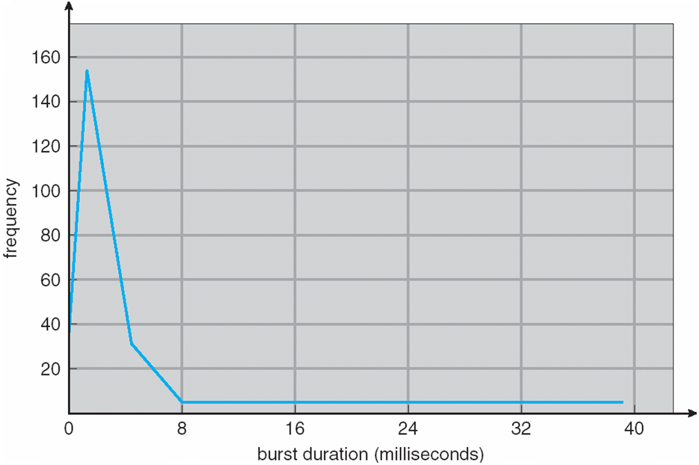
Histogram of CPU-burst Times

Slide 6
CPU Scheduler
Short-term scheduler selects from among the processes in ready queue, and allocates the CPU to one of them
  Queue may be ordered in various ways
CPU scheduling decisions may take place when a process:
  1. Switches from running to waiting state
  2. Switches from running to ready state
  3. Switches from waiting to ready
  Terminates
Scheduling under 1 and 4 is nonpreemptive
All other scheduling is preemptive
  Consider access to shared data
  Consider preemption while in kernel mode
  Consider interrupts occurring during crucial OS activities

Slide 7
Dispatcher
Dispatcher module gives control of the CPU to the process selected by the short-term scheduler; this involves:
  switching context
  switching to user mode
  jumping to the proper location in the user program to restart that program
Dispatch latency – time it takes for the dispatcher to stop one process and start another running

Slide 8
Scheduling Criteria
CPU utilization – keep the CPU as busy as possible
Throughput – # of processes that complete their execution per time unit
Turnaround time – amount of time to execute a particular process
Waiting time – amount of time a process has been waiting in the ready queue
Response time – amount of time it takes from when a request was submitted until the first response is produced, not output (for time-sharing environment)

Slide 9
Scheduling Algorithm Optimization Criteria
Max CPU utilization
Max throughput
Min turnaround time
Min waiting time
Min response time

Slide 10
First- Come, First-Served (FCFS) Scheduling
Process Burst Time
P₁ 24
P₂ 3
P₃ 3
Suppose that the processes arrive in the order: P₁ , P₂ , P₃
The Gantt Chart for the schedule is:
Waiting time for P₁ = 0; P₂ = 24; P₃ = 27
Average waiting time: (0 + 24 + 27)/3 = 17

Slide 11
FCFS Scheduling (Cont.)
Suppose that the processes arrive in the order:
P₂ , P₃ , P₁
The Gantt chart for the schedule is:
Waiting time for P₁ = 6; P₂ = 0; P₃ = 3
Average waiting time: (6 + 0 + 3)/3 = 3
Much better than previous case
Convoy effect - short process behind long process
  Consider one CPU-bound and many I/O-bound processes

Slide 12
Shortest-Job-First (SJF) Scheduling
Associate with each process the length of its next CPU burst
  Use these lengths to schedule the process with the shortest time
SJF is optimal – gives minimum average waiting time for a given set of processes
  The difficulty is knowing the length of the next CPU request
  Could ask the user

Slide 13
Example of SJF
ProcessArriva l Time Burst Time
P₁ 0.0 6
P₂ 2.0 8
P₃ 4.0 7
P₄ 5.0 3
SJF scheduling chart
Average waiting time = (3 + 16 + 9 + 0) / 4 = 7

Slide 14
Determining Length of Next CPU Burst
Can only estimate the length – should be similar to the previous one
  Then pick process with shortest predicted next CPU burst
Can be done by using the length of previous CPU bursts, using exponential averaging
Commonly, α set to ½
Preemptive version called shortest-remaining-time-first

Slide 15
Prediction of the Length of the Next CPU Burst

Slide 16
Examples of Exponential Averaging
α =0
  τ_{n+1} = τ_{n}
  Recent history does not count
α =1
  τ_{n+1} = α t_{n}
  Only the actual last CPU burst counts
If we expand the formula, we get:
    τ_{n+1} = α t_{n}+(1 - α)α t_{n} ₋₁ + …
    +(1 - α )^{j} α t_{n} _{-j} + …
    +(1 - α )^{n +1} τ₀
Since both α and (1 - α) are less than or equal to 1, each successive term has less weight than its predecessor

Slide 17
Example of Shortest-remaining-time-first
Now we add the concepts of varying arrival times and preemption to the analysis
ProcessA arri Arrival TimeT Burst Time
P₁ 0 8
P₂ 1 4
P₃ 2 9
P₄ 3 5
Preemptive SJF Gantt Chart
Average waiting time = [(10-1)+(1-1)+(17-2)+5-3)]/4 = 26/4 = 6.5 msec

Slide 18
Priority Scheduling
A priority number (integer) is associated with each process
The CPU is allocated to the process with the highest priority (smallest integer ≡ highest priority)
  Preemptive
  Nonpreemptive
SJF is priority scheduling where priority is the inverse of predicted next CPU burst time
Problem ≡ Starvation – low priority processes may never execute
Solution ≡ Aging – as time progresses increase the priority of the process

Slide 19
Example of Priority Scheduling
ProcessA arri Burst TimeT Priority
P₁ 10 3
P₂ 1 1
P₃ 2 4
P₄ 1 5
P₅ 5 2
Priority scheduling Gantt Chart
Average waiting time = 8.2 msec

Slide 20
Round Robin (RR)
Each process gets a small unit of CPU time (time quantum q), usually 10-100 milliseconds. After this time has elapsed, the process is preempted and added to the end of the ready queue.
If there are n processes in the ready queue and the time quantum is q, then each process gets 1/n of the CPU time in chunks of at most q time units at once. No process waits more than (n-1)q time units.
Timer interrupts every quantum to schedule next process
Performance
  q large ⇒ FIFO
  q small ⇒ q must be large with respect to context switch, otherwise overhead is too high

Slide 21
Example of RR with Time Quantum = 4
Process Burst Time
P₁ 24
P₂ 3
P₃ 3
The Gantt chart is:
Typically, higher average turnaround than SJF, but better response
q should be large compared to context switch time
q usually 10ms to 100ms, context switch < 10 usec

Slide 22
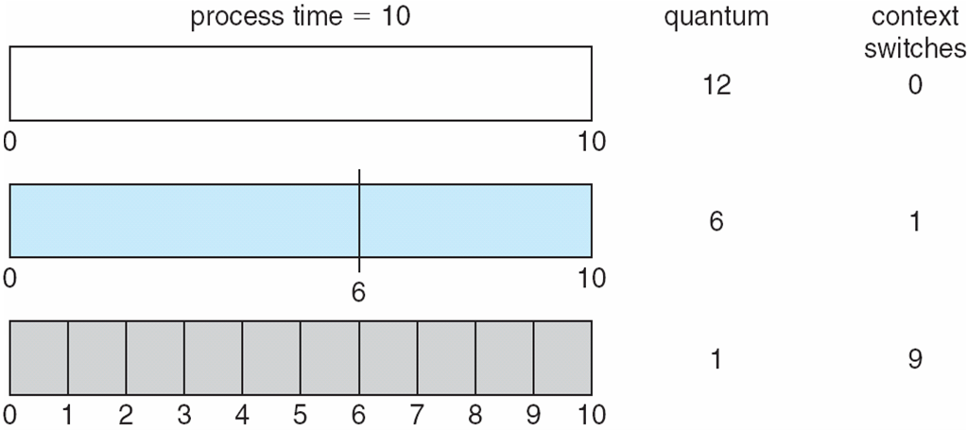
Time Quantum and Context Switch Time

Slide 23
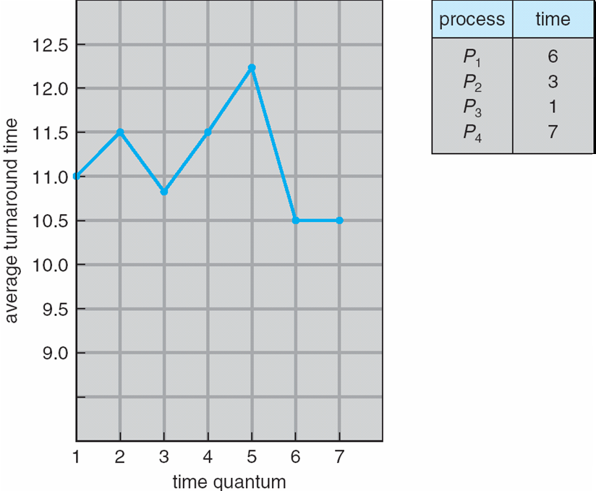
Turnaround Time Varies With The Time Quantum
80% of CPU bursts should be shorter than q

Slide 24
Multilevel Queue
Ready queue is partitioned into separate queues, eg:
  foreground (interactive)
  background (batch)
Process permanently in a given queue
Each queue has its own scheduling algorithm:
  foreground – RR
  background – FCFS
Scheduling must be done between the queues:
  Fixed priority scheduling; (i.e., serve all from foreground then from background). Possibility of starvation.
  Time slice – each queue gets a certain amount of CPU time which it can schedule amongst its processes; i.e., 80% to foreground in RR
  20% to background in FCFS

Slide 25
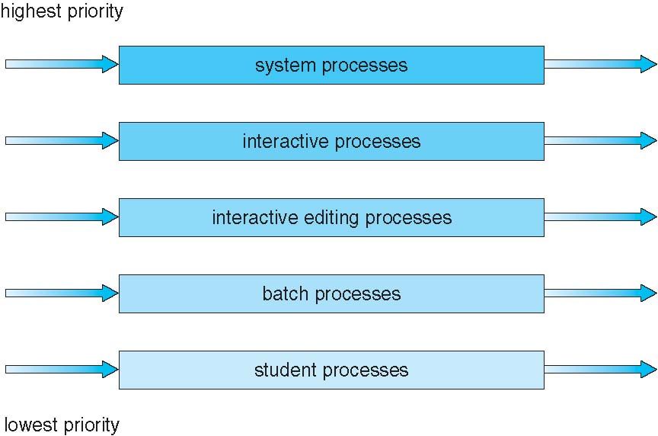
Multilevel Queue Scheduling

Slide 26
Multilevel Feedback Queue
A process can move between the various queues; aging can be implemented this way
Multilevel-feedback-queue scheduler defined by the following parameters:
  number of queues
  scheduling algorithms for each queue
  method used to determine when to upgrade a process
  method used to determine when to demote a process
  method used to determine which queue a process will enter when that process needs service

Slide 27
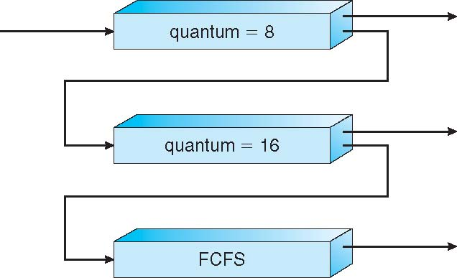
Example of Multilevel Feedback Queue
Three queues:
  Q₀ – RR with time quantum 8 milliseconds
  Q₁ – RR time quantum 16 milliseconds
  Q₂ – FCFS
Scheduling
  A new job enters queue Q₀ which is served FCFS
    When it gains CPU, job receives 8 milliseconds
    If it does not finish in 8 milliseconds, job is moved to queue Q₁
  At Q₁ job is again served FCFS and receives 16 additional milliseconds
    If it still does not complete, it is preempted and moved to queue Q₂

Slide 28
Thread Scheduling
Distinction between user-level and kernel-level threads
When threads supported, threads scheduled, not processes
Many-to-one and many-to-many models, thread library schedules user-level threads to run on LWP
  Known as process-contention scope (PCS) since scheduling competition is within the process
  Typically done via priority set by programmer
Kernel thread scheduled onto available CPU is system-contention scope (SCS) – competition among all threads in system

Slide 29
Pthread Scheduling
API allows specifying either PCS or SCS during thread creation
  PTHREAD_SCOPE_PROCESS schedules threads using PCS scheduling
  PTHREAD_SCOPE_SYSTEM schedules threads using SCS scheduling
Can be limited by OS – Linux and Mac OS X only allow PTHREAD_SCOPE_SYSTEM

Slide 30
Pthread Scheduling API
#include <pthread.h>
#include <stdio.h>
#define NUM_THREADS 5
int main(int argc, char *argv[]) {
int i, scope;
pthread_t tid[NUM THREADS];
pthread_attr_t attr;
/* get the default attributes */
pthread_attr_init(&attr);
/* first inquire on the current scope */
if (pthread_attr_getscope(&attr, &scope) != 0)
fprintf(stderr, "Unable to get scheduling scope\n");
else {
if (scope == PTHREAD_SCOPE_PROCESS)
printf("PTHREAD_SCOPE_PROCESS");
else if (scope == PTHREAD_SCOPE_SYSTEM)
printf("PTHREAD_SCOPE_SYSTEM");
else
fprintf(stderr, "Illegal scope value.\n");
}

Slide 31
Pthread Scheduling API
/* set the scheduling algorithm to PCS or SCS */
pthread_attr_setscope(&attr, PTHREAD_SCOPE_SYSTEM);
/* create the threads */
for (i = 0; i < NUM_THREADS; i++)
pthread_create(&tid[i],&attr,runner,NULL);
/* now join on each thread */
for (i = 0; i < NUM_THREADS; i++)
pthread_join(tid[i], NULL);
}
/* Each thread will begin control in this function */
void *runner(void *param)
{
/* do some work ... */
pthread_exit(0);
}

Slide 32
End of Chapter 6

