Slide 1
Chapter 5
Secondary Data and Packaged Information

Slide 2
Learning Objectives
To learn what secondary data are, how this information is used, and how we may classify different types of secondary data, including internal and external databases
To understand the advantages and disadvantages of secondary data
To learn how to evaluate secondary data

Slide 3
To learn how to use the U.S. Census Bureau’s new American Community Survey
To know what packaged information is and the differences between syndicated data and packaged services
To understand the advantages and disadvantages of packaged information
To see some of the various areas in which packaged information may be applied

Slide 4
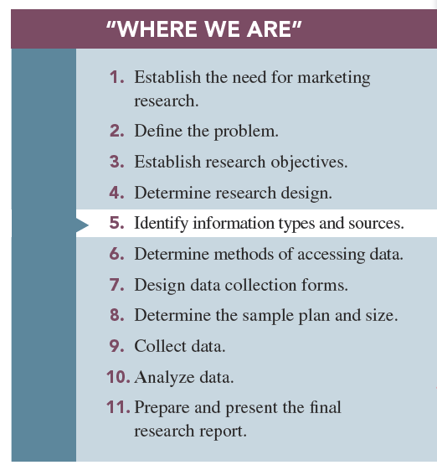

Slide 5
Secondary data Primary Versus Secondary Data
Data needed for marketing management decision can be grouped in two types:
1-Primary data: information that is developed or gathered by the researcher specifically for the research project at hand
2-Secondary data: information that has previously been gathered by someone other than the researcher and/or for some other purpose than the research project at hand

Slide 6
Uses of Secondary Data
The are so many uses of secondary data that it is rare for marketing research project to be conducted without including some of this information.
Some projects may be based exclusively on secondary data.

Slide 7
The applications of secondary data range from predicting broad changes in cultures “way of life” to specific applications, such as selecting a street address location for a new car wash.
Applications include economic-trend forecasting, corporate intelligence, international data, public opinion, and historical data.
Decision Analyst.

Slide 8
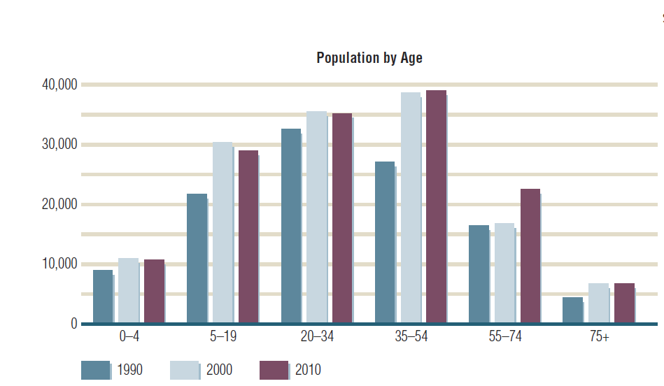
An Example of Secondary Data
FIGURE 5.1
Census Data May Be Used to Assess Changes in Age Distributions for a Market

Slide 9
Classification of Secondary Data
Secondary data may be classified as either
1-Internal secondary data are data that have been collected within the firm, such as sales records, purchase requisitions, and invoices.
- Internal secondary data is used for database marketing Database marketing is the process of building and maintaining customer (internal) databases and other (internal) databases for the purpose of contacting, transacting, and building relationships. Examples: CRM and data mining.

Slide 10
Internal databases consist of information gathered by a company, typically during the normal course of business transactions.
Companies use their internal databases for purposes of direct marketing and to strengthen relationships with customers, which is referred to as customer relationship management (CRM).
Notes:
definition

Slide 11
A database refers to a collection of data and information describing items of interest.
Vehicle Registration Database
A record is a unit of information in a database.
SS# XXXYYZZZZ
Fields: subcomponents of information composing records.
-Brand
-Color
-Year
-Model

Slide 12
Data mining is the name for software that helps managers make sense out of seemingly senseless masses of information contained in databases.
Micromarketing refers to using a differentiated marketing mix for specific customer segments, sometimes fine-tuned for the individual shopper.
Notes:
datamining

Slide 13
Ways Companies Use Databases
1-To identify prospects
2-To decide which customers should receive a particular offer
3-To deepen customer loyalty
4-To reactivate customer purchases
5-To avoid serious customer mistakes
What companies do with infromations collected for their internal databases can present ethical problems.

Slide 14
2-External Secondary Data
External databases are databases supplied by organizations outside the firm.
We can classify external data into three sources:
a-Published
b-Syndicated services data
c-Databases
Notes:
Add definition

Slide 15
Published sources: sources of information prepared for public distribution and normally found in libraries or a variety of other entities, such as trade organizations , professional organizations, and company.
Many published sources are now being made available via the internet.
Notes:
Add definition

Slide 16
-Published sources of secondary information come from:
1-Government.
2- Nonprofit organization.
3-Colleges.
4- Trade and professional association.
5- For-profits entities.
b)Syndicated services data: provided by firms that collect data in a standard format and make them available to subscribing firms such as highly specialized and not available in libraries.

Slide 17
c) External databases: databases supplied by organizations outside the firm.
Online information databases: are sources of secondary data searchable by search engines online.
- Some online databases are available free of charge, and others are available from commercial sources that provide subscibers password access for a fee.

Slide 18
Advantages of Secondary Data
1-Are obtained quickly
2-Are inexpensive
3-Are readily available
4-Enhance existing primary data
5-May achieve research objective

Slide 19
Disadvantages of Secondary Data
1-Reporting units may be incompatible: secondary data are provide in reporting unites, such as country, city, metro area, state, zip code.
-Core-based statistical areas: are geographic reporting units used by the Census Bureau.
- Geodemographics : is the term used to describe the classification of arbitrary , usually small geographic areas in terms of the charscteristics of their inhabitants.

Slide 20
2-Measurement units do not match
3-Class definitions are not usable
4-May be outdated
5-May not be credible
These problems exist because secondary data have not been collected specifically to address the problem at hand but have been collected for some other purpose.

Slide 21
Evaluating Secondary Data
To determine the reliability of secondary information, marketing researchers must evaluate it.
There is five questions that are useful in evaluating secondary data:
1-What was the purpose of the study?
Users of secondary data should try to understand the true purpose of study they are using as secondary data.

Slide 22
2- Who collected the information?
Not all research studies that are available sources of secondary data are conducted in an objective manner, you must ask who conducted the study.
3-What information was collected?
It may be crucial to know exactly what was measured in a report using the results.

Slide 23
4-How was the information attained?
Evaluate the method used to collect, the primary data now available to you as secondary data. You will be much better at doing this when you finish this course.
5-How consistent is the information with other information?
If two or more sources of secondary data differ, you should investigate why did they measure the same entity? Did they use different methods to collect their data?

Slide 24
Key Sources of Secondary Data for Marketers
Go to table 5.1 in p.130 there are some lists of the major sources that are useful in marketing research.
Notes:
2014 census.gov.

Slide 25
American Community Survey (ACS)
American community survey (ACS) may represent the most significant change in the availability of secondary data to used for marketing research purposes in several decades.
Notes:
Title changed from “new key data source from U.S. census bureau”

Slide 26
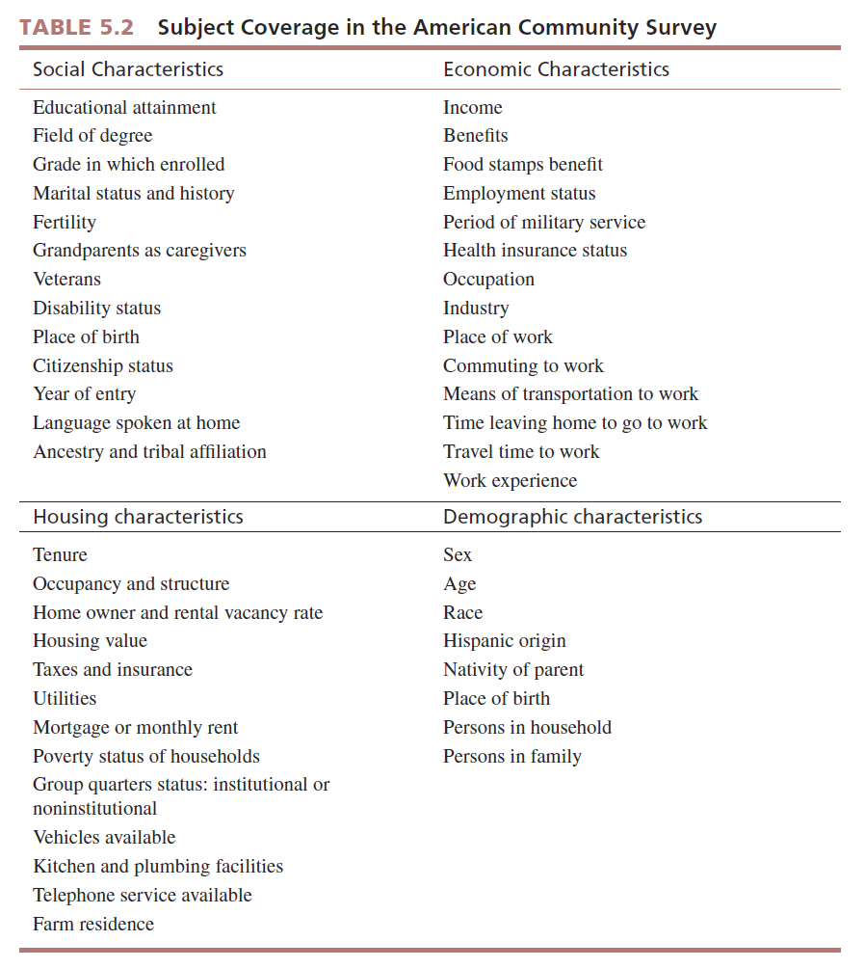

Slide 27
Final words on secondary informatin What Is Packaged Information?
Packaged information is a type of secondary data in which the data collected and/or the process of collecting the data are prepackaged for all users.
There are two broad classes of packaged information:
1-Syndicated data
2-Packaged services

Slide 28
1-Syndicated data are collected in a standard format and made available to all subscribers.
2-The term packaged services refers to a prepackaged marketing research process that is used to generate information for a particular user.
Unlike syndicated data, the data from a packaged service will differ for each client.

Slide 29
This information is purchased by clients with the aim of better understanding who their customers are, where they are located, how to find them, and how to reach them.

Slide 30
Syndicated data are a form of external , secondary data that are supplied from a common database to subscribers for a service fee.
Such as information is typically detailed information that is valuable to firms in given industry and is not available in libraries.

Slide 31
Advantages of Syndicated Data
Shared costs
Quality of the data collected typically very high
Speed with which data are collected and made available for decision making.

Slide 32
Disadvantages of Syndicated Data
Buyers have little control over what information is collected.
Firms often must commit to long-term contracts when buying syndicated data.
No strategic information advantage exists in purchasing syndicated data.

Slide 33
Advantages of Packaged Services
The experience of the research firm offering the service
Reduced cost of the research
Increased Speed of the research service

Slide 34
Disadvantages of Packaged Services
The inability to customize services.
The service firm not being knowledgeable about the clients industry.
Notes:
Add disadv – pg 108

Slide 35
Marketing Applications of Packaged Information
1-Measuring consumer attitudes and opinions:
Marketers are interested in consumers attitudes toward privet brands versus national brands the quality of product ,and claims of health benefits.
2-Market segmentation ; there are several marketing research firms that offer a packaged service of providing client firms with sophisticated methods of identifying members of their target market, locating these members, and providing information that will help develop promotional materials to efficiently reach these target markets.

Slide 36
3-Monitoring media usage and promotion effectiveness
Monitoring consumer buzz or consumer-generated media (CGM): is content created by forums, user groups, and other social media platforms.
Monitoring and effectiveness of print media: when promotional materials are placed in a newzpaper, direct mail piece, website, or magazine or on the package itself, marketers want to know hat gets consumers attention and what they think of the message.

Slide 37
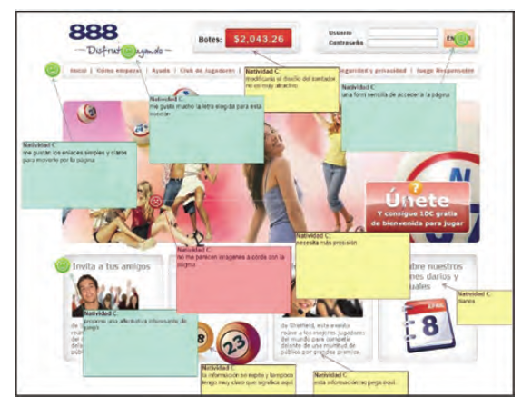
Measuring Print Media

Slide 38
Market tracking studies
Nielsen tracking studies are longitudinal studies that monitor a variable, such as sales or market share, over time.

