Slide 1
Chapter 5
Secondary Data and Packaged Information

Slide 2
Learning Objectives
To learn what secondary data are, how this information is used, and how we may classify different types of secondary data, including internal and external databases
To understand the advantages and disadvantages of secondary data
To learn how to evaluate secondary data

Slide 3
Learning Objectives
To learn how to use the U.S. Census Bureau’s new American Community Survey
To know what packaged information is and the differences between syndicated data and packaged services
To understand the advantages and disadvantages of packaged information
To see some of the various areas in which packaged information may be applied

Slide 4
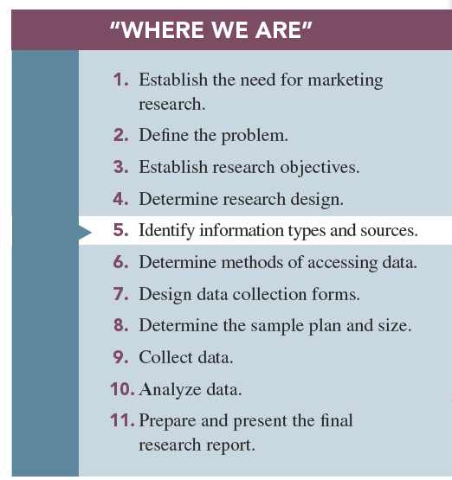

Slide 5
Primary Versus Secondary Data
Primary data: information that is developed or gathered by the researcher specifically for the research project at hand
Secondary data: information that has previously been gathered by someone other than the researcher and/or for some other purpose than the research project at hand

Slide 6
Uses of Secondary Data
Secondary data has many uses in marketing research, and sometimes the entire research project may depend on the use of secondary data.
Applications include economic-trend forecasting, corporate intelligence, international data, public opinion, and historical data.

Slide 7
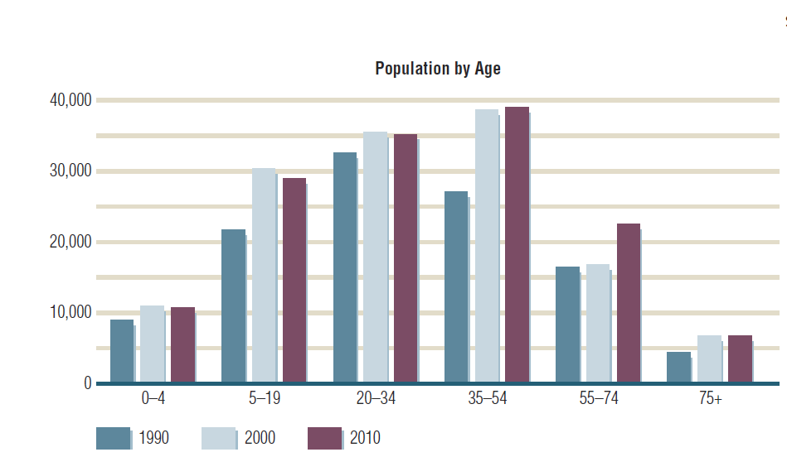
An Example of Secondary Data
FIGURE 5.1
Census Data May Be Used to Assess Changes in Age Distributions for a Market

Slide 8
Classification of Secondary Data
Internal secondary data are data that have been collected within the firm, such as sales records, purchase requisitions, and invoices.
Internal secondary data is used for database marketing. Database marketing is the process of building and maintaining customer (internal) databases and other (internal) databases for the purpose of contacting, transacting, and building relationships. Examples: CRM and data mining.

Slide 9
Internal Databases
Internal databases consist of information gathered by a company, typically during the normal course of business transactions.
Companies use their internal databases for purposes of direct marketing and to strengthen relationships with customers, which is referred to as customer relationship management (CRM).
Notes:
definition

Slide 10
Internal Databases
A database refers to a collection of data and information describing items of interest.
Vehicle Registration Database
A record is a unit of information in a database.
SS# XXXYYZZZZ
Fields: subcomponents of information composing records.
Brand
Color
Year
Model

Slide 11
Internal Databases
Data mining is the name for software that helps managers make sense out of seemingly senseless masses of information contained in databases.
Micromarketing refers to using a differentiated marketing mix for specific customer segments, sometimes fine-tuned for the individual shopper.
Notes:
datamining

Slide 12
Ways Companies Use Databases
To identify prospects
To decide which customers should receive a particular offer
To deepen customer loyalty
To reactivate customer purchases
To avoid serious customer mistakes

Slide 13
External Secondary Data
External databases are databases supplied by organizations outside the firm:
Published
Syndicated services data
Databases
Notes:
Add definition

Slide 14
External Secondary Data
Published sources: sources of information prepared for public distribution and normally found in libraries or a variety of other entities, such as trade organizations.
Notes:
Add definition

Slide 15
External Secondary Data
Syndicated services data: provided by firms that collect data in a standard format and make them available to subscribing firms—highly specialized and not available in libraries.

Slide 16
External Secondary Data
External databases: databases supplied by organizations outside the firm, such as online information databases (e.g., IBISWorld, FACTIVA, Ebsco, and ProQuest).

Slide 17
Advantages of Secondary Data
Are obtained quickly
Are inexpensive
Are readily available
Enhance existing primary data
May achieve research objective

Slide 18
Disadvantages of Secondary Data
Reporting units may be incompatible
Measurement units do not match
Class definitions are not usable
May be outdated
May not be credible

Slide 19
Evaluating Secondary Data
What was the purpose of the study?
Who collected the information?
What information was collected?
How was the information attained?
How consistent is the information with other information?

Slide 20
Key Sources of Secondary Sources for Marketers
Census of the Population
Conducted every 10 years
Economic Census
Conducted every five years
Go to http://2010.census.gov
Notes:
2014 census.gov.

Slide 21
American Community Survey (ACS)
ACS will do the following:
Survey 3 million Americans every year
Provide updated information on key demographics
Provide forecasts for future years
Notes:
Title changed from “new key data source from U.S. census bureau”

Slide 22
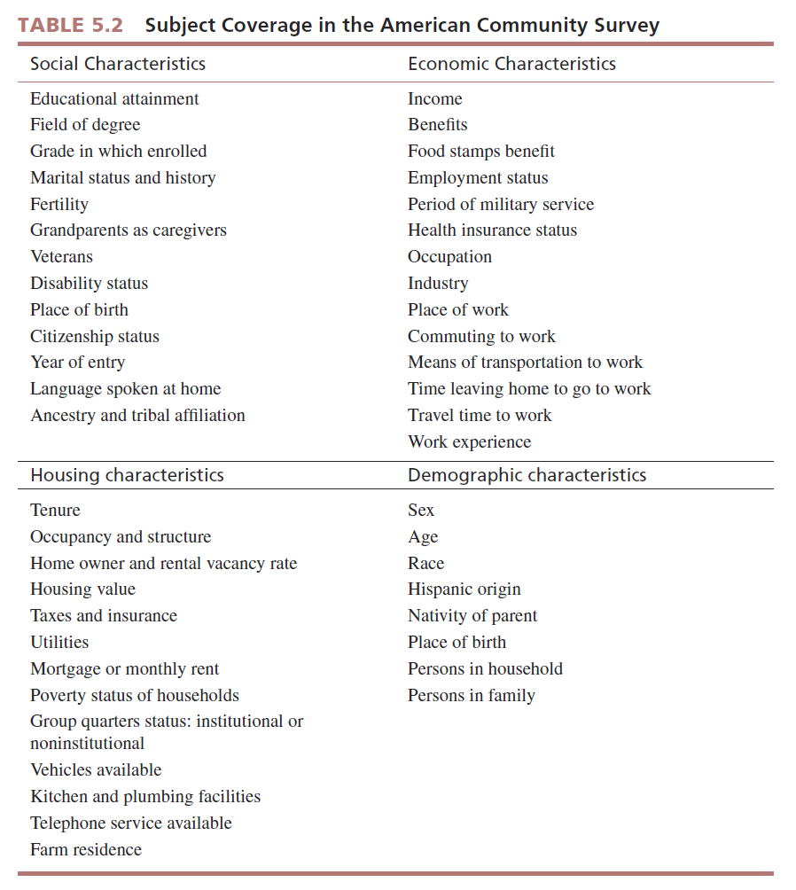

Slide 23
How to Use the ACS
American Factfinder is the tool used for searching data collected by the ACS.
To begin, go to www.census.gov/acs.

Slide 24
Example ACS Search
FIGURE 5.2
Searching Topics
Allows You to
Select the Type of
Information You Seek

Slide 25
What Is Packaged Information?
Packaged information is a type of secondary data in which the data collected and/or the process of collecting the data are prepackaged for all users.
There are two broad classes of packaged information:
Syndicated data
Packaged services

Slide 26
Packaged Information
Syndicated data are collected in a standard format and made available to all subscribers. For example, Marketing Evaluations, Inc., offers several Q Scores® services.

Slide 27
Packaged Information
The term packaged services refers to a prepackaged marketing research process that is used to generate information for a particular user.
Unlike syndicated data, the data from a packaged service will differ for each client.

Slide 28
Packaged Information
Esri’s Tapestry™ Segmentation uses a ready-made, prepackaged process to profile residential neighborhoods.
This information is purchased by clients with the aim of better understanding who their customers are, where they are located, how to find them, and how to reach them.

Slide 29
Advantages of Syndicated Data
Shared costs
Quality of the data collected typically very high
Speed

Slide 30
Disadvantages of Syndicated Data
Buyers have little control over what information is collected.
Firms often must commit to long-term contracts when buying syndicated data.
No strategic information advantage exists in purchasing syndicated data.

Slide 31
Advantages of Packaged Services
The experience of the research firm offering the service
Reduced cost of the research
Speed of the research service

Slide 32
Disadvantages of Packaged Services
Aspects of a project cannot be customized.
The company providing the packaged service may not know the idiosyncrasies of a particular industry.
Notes:
Add disadv – pg 108

Slide 33
Marketing Applications of Packaged Information
Measuring consumer attitudes and opinions
Market segmentation
Monitoring media usage and promotion effectiveness
Monitoring consumer buzz or consumer-generated media (CGM)
Monitoring and effectiveness of print media

Slide 34
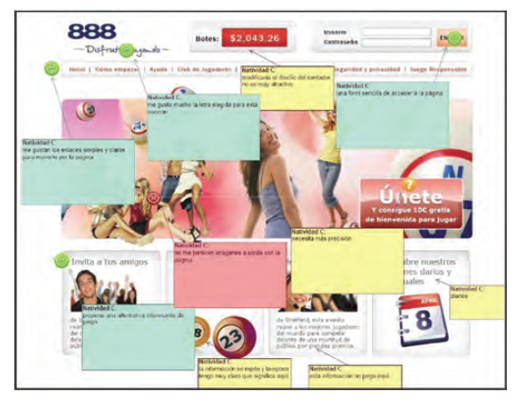
Measuring Print Media

Slide 35
Marketing Applications of Packaged Information
Market tracking studies
Nielsen tracking studies are longitudinal studies that monitor a variable, such as sales or market share, over time.

Slide 36
All rights reserved. No part of this publication may be reproduced, stored in a retrieval system, or transmitted, in any form or by any means, electronic, mechanical, photocopying, recording, or otherwise, without the prior written permission of the publisher. Printed in the United States of America.

