Slide 1
Corporate Finance Thirteenth Edition Stephen A. Ross / Randolph W. Westerfield / Jeffrey F. Jaffe / Bradford D. Jordan
Chapter 4
Discounted Cash Flow Valuation
© McGraw Hill LLC. All rights reserved. No reproduction or distribution without the prior written consent of McGraw Hill LLC.

Slide 2
Key Concepts and Skills
Be able to compute the future value and/or present value of a single cash flow or series of cash flows.
Be able to compute the return on an investment.
Be able to use a financial calculator and/or spreadsheet to solve time value problems.
Understand perpetuities and annuities.

Slide 3
Chapter Outline
4.1 Valuation: The One-Period Case
4.2 The Multiperiod Case
4.3 Compounding Periods
4.4 Simplifications
4.5 Loan Amortization
4.6 What Is a Firm Worth?

Slide 4
4.1 Valuation: The One-Period Case
If you were to invest $10,000 at a rate of 12 percent interest for one year, your investment would grow to $11,200.
$1,200 would be interest ($10,000 × .12)
$10,000 is the principal repayment ($10,000 × 1)
$11,200 is the total due. It can be calculated as:
$11,200 = $10,000 × (1.12)
The total amount due at the end of the investment is called the Future Value (F V).

Slide 5
One-Period Case Future Value
In the one-period case, the formula for FV can be written as:
FV = PV × (1 + r)
Where PV is present value (that is, the value today), and r is the appropriate interest rate.
Notes:
It may be helpful to identify r as the opportunity cost.

Slide 6
Present Value - I
If you were to be promised $11,424 due in one year when interest rates are 12 percent, your investment would be worth $10,200 in today’s dollars.
The amount that a borrower would need to set aside today to be able to meet the promised payment of $11,424 in one year is the Present Value (P V).
Note that $11,424 = $10,200 × (1.12).

Slide 7
Present Value – II
In the one-period case, the formula for P V can be written as:
Where C₁ is cash flow at Date 1, and r is the appropriate interest rate. We could also write the formula as:
PV = FV₁/1 + r
Notes:
9523
9523-9800= - >>>>>> less than 5%

Slide 8
Net Present Value – I
The net present value (N P V) of an investment is the present value of the expected cash flows, less the cost of the investment.
Suppose an investment that promises to pay $10,000 in one year is offered for sale for $9,500. Your interest rate is 5 percent. Should you buy?

Slide 9
Net Present Value – II
The present value of the cash inflow is greater than the cost. In other words, the N P V is positive, so the investment should be purchased.
Notes:
9523-9500=

Slide 10
Net Present Value – III
In the one-period case, the formula for N P V can be written as:
N P V = −Cost + P V
If we had not undertaken the positive N P V project considered on the last slide, and instead invested our $9,500 elsewhere at 5 percent, our F V would be less than the $10,000 the investment promised, and we would be worse off in F V terms:
$9,500 × 1.05 = $9,975 < $10,000

Slide 11
4.2 The Multiperiod Case
The general formula for the future value of an investment over many periods can be written as:
Where
P V is present value,
r is the appropriate interest rate, and
t is the number of periods over which the cash is invested.

Slide 12
Multiperiod Case Future Value
Suppose a stock currently pays a dividend of $1.10, which is expected to grow at 40 percent per year for the next five years.
What will the dividend be in five years?
Notes:
1.10* 40% = 0.44$
0.44$*5 = 2.2$ (Total interests)
1.10$ (principle) + 2.2$ (total interest) = 3.3$

Slide 13
Future Value and Compounding - I
Notice that the dividend in year five, $5.92, is considerably higher than the sum of the original dividend plus five increases of 40 percent on the original $1.10 dividend:
$5.92 > $1.10 + 5 × [$1.10 × .40] = $3.30
This is due to compounding.

Slide 14
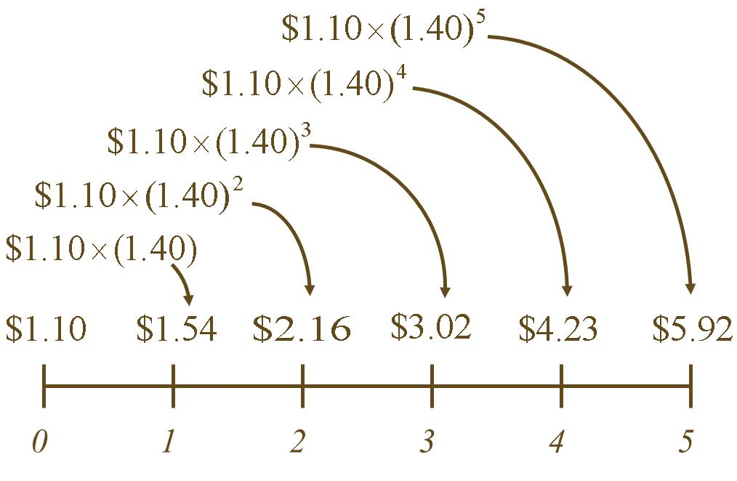
Future Value and Compounding – II
Access the text alternative for slide images.
Notes:
1.54 -1.10 = 0.44*1.4 >>> 1
1.10

Slide 15
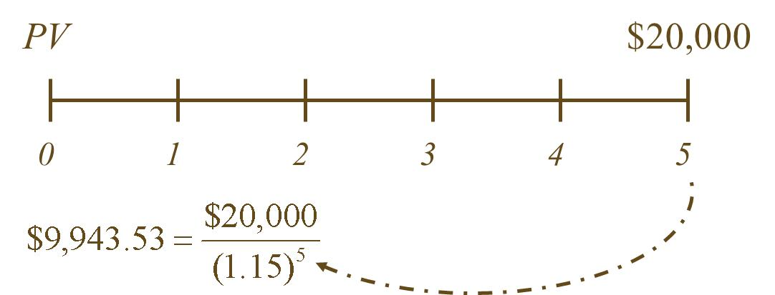
Present Value and Discounting
How much would an investor have to set aside today in order to have $20,000 five years from now if the current rate is 15 percent?

Slide 16
Finding the Number of Periods
If we deposit $5,000 today in an account paying 10 percent, how long does it take to grow to $10,000?
Notes:
Rule of 72 says that 72/r gives an estimate of the number of periods it will take something (e.g., an investment) to double.

Slide 17
What Rate Is Enough?
Assume the total cost of a college education will be $50,000 when your child enters college in 12 years. You have $5,000 to invest today. What rate of interest must you earn on your investment to cover the cost of your child’s education?
About 21.15%.
Notes:
b^{1/n} = ^{n}√b

Slide 18
Calculator Keys
Texas Instruments B A-II Plus
F V = future value.
P V = present value.
I/Y = periodic interest rate.
P/Y must equal 1 for the I/Y to be the periodic rate.
Interest is entered as a percent, not a decimal.
N = number of periods.
Remember to clear the registers (C L R T V M) after each problem.
Other calculators are similar in format.
Notes:
We are providing information on the Texas Instruments BA-II Plus—other calculators are similar. We choose this calculator since it is one that is allowable for use in taking the CFA exam and TI provides a simulator software that can be used in class. If you recommend or require a specific calculator other than this one, you may want to make the appropriate changes.
Note: the more information students have to remember to enter, the more likely they are to make a mistake. For this reason, I normally tell my students to set P/Y = 1 and leave it that way. Then I teach them to work on a period basis, which is consistent with using the formulas. If you want them to use the P/Y function, remind them that they will need to set it every time they work a new problem and that CLR TVM does not affect P/Y.
If students are having difficulty getting the correct answer, make sure they have done the following:
Set decimal places to floating point (2nd Format, Dec = 9 enter) or show 4 to 5 decimal places if using and HP
Double check and make sure P/Y = 1
Make sure to clear the TVM registers after finishing a problem (or before starting a problem). It is important to point out that CLR TVM clears the FV, PV, N, I/Y, and PMT registers. C/CE and CLR Work DO NOT affect the TVM keys.

Slide 19
Multiple Cash Flows - I
Consider an investment that pays $200 one year from now, with cash flows increasing by $200 per year through Year 4. If the interest rate is 12 percent, what is the present value of this stream of cash flows?
If the issuer offers this investment for $1,500, should you purchase it?

Slide 20
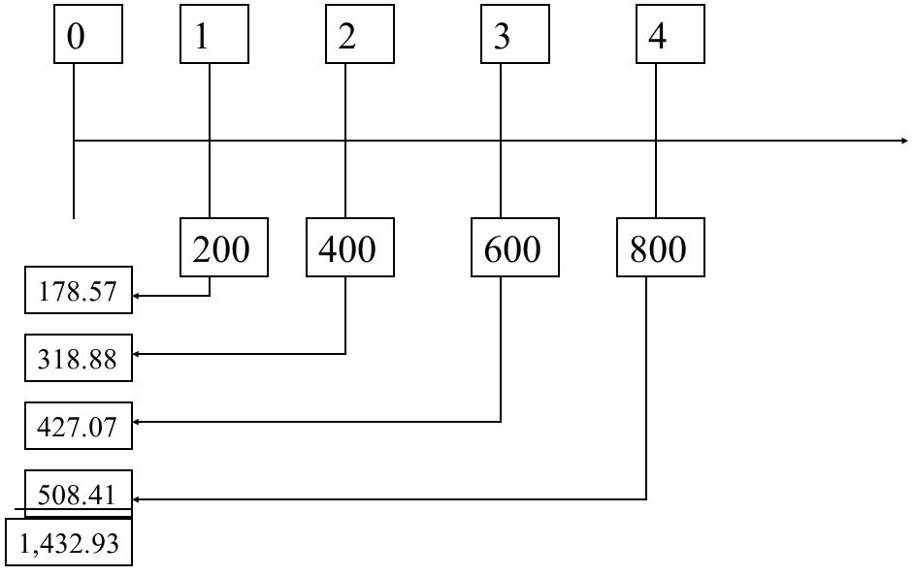
Multiple Cash Flows – II
Present Value < Cost → Do Not Purchase
Access the text alternative for slide images.
Notes:
NPV= -1500 + 1432= -

Slide 21
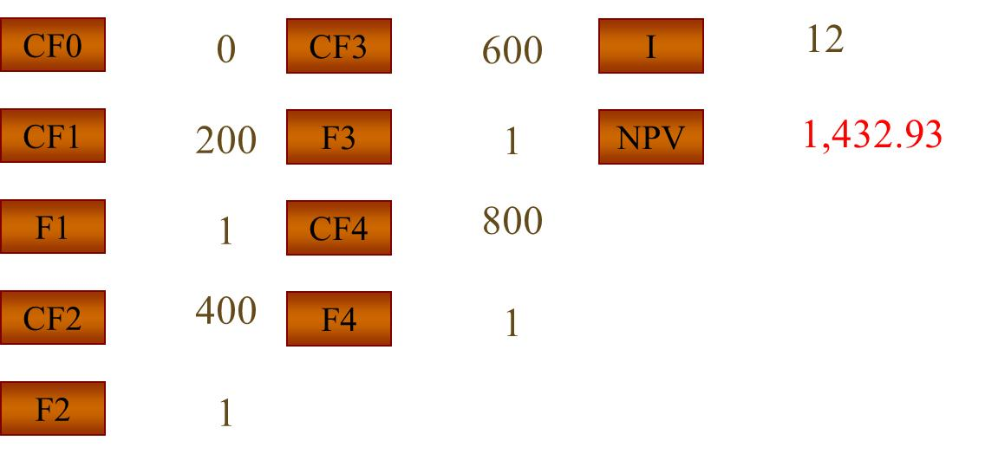
Valuing “Lumpy” Cash Flows
First, set your calculator to one payment per year.
Then, use the cash flow menu:
Access the text alternative for slide images.

Slide 22
4.3 Compounding Periods
Compounding an investment m times a year for T years provides for future value of wealth:

Slide 23
Compounding Periods
For example, if you invest $50 for 3 years at 12 percent interest compounded semiannually, your investment will grow to:

Slide 24
Effective Annual Rates of Interest – I
A reasonable question to ask in the above example is “what is the effective annual rate of interest on that investment?”
The effective annual rate (E A R) of interest is the annual rate that would give us the same end-of-investment wealth after 3 years:

Slide 25
Effective Annual Rates of Interest – II
So, investing at 12.36 percent compounded annually is the same as investing at 12 percent compounded semiannually.
Notes:
12.36%

Slide 26
Effective Annual Rates of Interest - III
Find the E A R of an 18 percent A P R loan that is compounded monthly.
What we have is a loan with a monthly interest rate of 1½ percent.
This is equivalent to a loan with an annual interest rate of 19.56 percent.

Slide 27
E A R on a Financial Calculator
Texas Instruments B A I I Plus
Keys
description:
Opens interest rate conversion menu
Sets 12 payments per year
Sets 18 A P R
19.56

Slide 28
Continuous Compounding
The general formula for the future value of an investment compounded continuously over many periods can be written as:
Where
C₀ is the initial investment,
r is the A P R,
t is the number of years, and
e is a transcendental number approximately equal to
is a key on your calculator.
Notes:
e is a transcendental number because it transcends the real numbers.

Slide 29
4.4 Simplifications
Perpetuity
A constant stream of cash flows that lasts forever.
Growing perpetuity
A stream of cash flows that grows at a constant rate forever.
Annuity
A stream of constant cash flows that lasts for a fixed number of periods.
Growing annuity
A stream of cash flows that grows at a constant rate for a fixed number of periods.

Slide 30
Perpetuity
A constant stream of cash flows that lasts forever

Slide 31
Perpetuity: Example
What is the value of a British consol that promises to pay £15 every year for ever?
The interest rate is 10 percent.

Slide 32
Growing Perpetuity
A growing stream of cash flows that lasts forever
Access the text alternative for slide images.
Notes:
-1,000,000+(100,000/ 0.1-0.02)= 1,250,000
NPV= po

Slide 33
Growing Perpetuity: Example
The expected dividend next year is $1.30, and dividends are expected to grow at 5 percent forever.
If the discount rate is 10 percent, what is the value of this promised dividend stream?
Access the text alternative for slide images.
Notes:
It is important to note to students that in this example the Year 1 cash flow was given. If the current dividend were $1.30, then we would need to multiply it by one plus the growth rate to estimate the Year 1 cash flow.

Slide 34
Annuity
A constant stream of cash flows with a fixed maturity

Slide 35
Annuity: Example I
If you can afford a $400 monthly car payment, how much car can you afford if interest rates are 7 percent on 36-month loans?

Slide 36
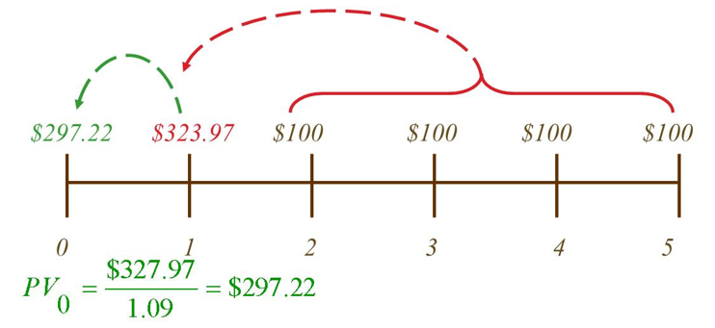
Annuity: Example II
What is the present value of a four-year annuity of $100 per year that makes its first payment two years from today if the discount rate is 9 percent?
Access the text alternative for slide images.
Notes:
Ordinary Annuity vs. Annuity Due: It should be emphasized that annuity factor tables (and the annuity factors in the formulas) assume that the first payment occurs one period from the present, with the final payment at the end of the annuity’s life. If the first payment occurs at the beginning of the period, then FVs have one additional period for compounding and PVs have one less period to be discounted. Consequently, you can multiply both the future value and the present value by (1 + r) to account for the change in timing. The values can also be computed directly by changing the setting in the financial calculator.

Slide 37
Growing Annuity
A growing stream of cash flows with a fixed maturity
Access the text alternative for slide images.

Slide 38
Growing Annuity: Example I
A defined-benefit retirement plan offers to pay $20,000 per year for 40 years and increase the annual payment by 3 percent each year. What is the present value at retirement if the discount rate is 10 percent?
Access the text alternative for slide images.

Slide 39
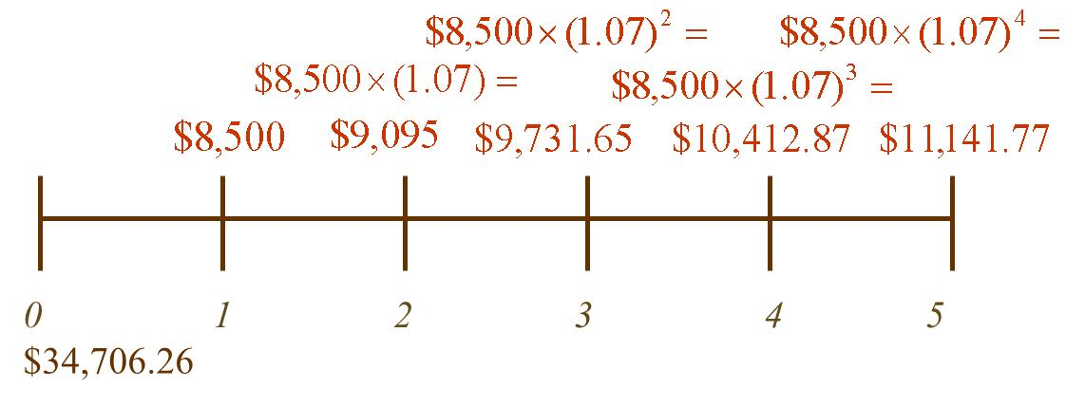
Growing Annuity: Example II
You are evaluating an income-generating property. Net rent is received at the end of each year. The first year’s rent is expected to be $8,500, and rent is expected to increase 7 percent each year. What is the present value of the estimated income stream over the first five years if the discount rate is 12 percent?
Access the text alternative for slide images.

Slide 40
4.5 Loan Amortization
Pure discount loans are the simplest form of loan. The borrower receives money today and repays a single lump sum (principal and interest) at a future time.
Interest-only loans require an interest payment each period, with full principal due at maturity.
Amortized loans require repayment of principal over time, in addition to required interest.

Slide 41
Pure Discount Loans
Treasury bills are excellent examples of pure discount loans. The principal amount is repaid at some future date, without any periodic interest payments.
If a T-bill promises to repay $10,000 in 12 months and the market interest rate is 7 percent, how much will the bill sell for in the market?
Notes:
Remind students that the value of an investment is the present value of expected future cash flows.
1 N; 10,000 FV; 7 I/Y; CPT PV = –9,345.79

Slide 42
Interest-Only Loan
Consider a five-year, interest-only loan with a 7 percent interest rate. The principal amount is $10,000. Interest is paid annually.
What would the stream of cash flows be?
Years 1 to 4: Interest payments of .07(10,000) = 700.
Year 5: Interest + principal = 10,700.
This cash flow stream is similar to the cash flows on corporate bonds, and we will talk about them in greater detail later.

Slide 43
Amortized Loan with Fixed Principal Payment
Consider a $50,000, 10 year loan at 8 percent interest. The loan agreement requires the firm to pay $5,000 in principal each year plus interest for that year.
Year | Beginning Balance | Total Payment | Interest Paid | Principal Paid | Ending Balance
1 | $50,000 | $50,001 | $4,000 | $5,000 | $45,000
2 | $45,000 | $45,002 | $3,600 | $5,000 | $40,000
3 | $40,000 | $40,003 | $3,200 | $5,000 | $35,000
4 | $35,000 | $35,004 | $2,800 | $5,000 | $30,000
5 | $30,000 | $30,005 | $2,400 | $5,000 | $25,000
6 | $25,000 | $25,006 | $2,000 | $5,000 | $20,000
7 | $20,000 | $20,007 | $1,600 | $5,000 | $15,000
8 | $15,000 | $15,008 | $1,200 | $5,000 | $10,000
9 | $10,000 | $10,009 | $800 | $5,000 | $5,000
10 | $5,000 | $5,010 | $400 | $5,000 | $0
Notes:
4000/10000= 40%

Slide 44
Amortized Loan with Fixed Payment
Each payment covers the interest expense plus reduces principal
Consider a four-year loan with annual payments. The interest rate is 8 percent, and the principal amount is $5,000.
What is the annual payment?
4 N.
8 I ∕ Y.
5,000 PV.
C P T P M T = −1,509.60.
Year | Beginning Balance | Total Payment | Interest Paid | Principal Paid | Ending Balance
1 | $ 5,000 | $ 1,509.60 | $ 400.00 | $ 1,109.60 | $ 3,890.40
2 | $ 3,890.40 | $ 1,509.60 | $ 311.23 | $ 1,198.37 | $ 2,692.03
3 | $ 2,692.03 | $ 1,509.60 | $ 215.36 | $ 1,294.24 | $ 1,397.79
4 | $ 1,397.79 | $ 1,509.60 | $ 111.82 | $ 1,397.78 | $ 0.02 | (rounding)

Slide 45
4.6 What Is a Firm Worth?
Conceptually, a firm should be worth the present value of the firm’s cash flows.
The tricky part is determining the size, timing, and risk of those cash flows.

Slide 46
Quick Quiz
How is the future value of a single cash flow computed?
How is the present value of a series of cash flows computed?
What is the N P V of an investment?
What is an E A R, and how is it computed?
What is a perpetuity? An annuity?

Slide 47
End of Main Content
© McGraw Hill LLC. All rights reserved. No reproduction or distribution without the prior written consent of McGraw Hill LLC.

Slide 48
Accessibility Content: Text Alternatives for Images

Slide 49
Future Value and Compounding – II – Text Alternative
Return to parent-slide containing images.
The timeline extends from 0 to year 5. The values are as follow: 0, $1.10. 1, $1.10 times 1.40 = $1.54 2, $1.10 times 1.40 squared = $2.16 3, $1.10 times 1.40 cubed = $3.02 4, $1.10 times 1.40 to the power 4 = $4.23 5, $1.10 times 1.40 to the power 5 = $5.92
Return to parent-slide containing images.

Slide 50
Multiple Cash Flows – II – Text Alternative
Return to parent-slide containing images.
The present values for each cash flow at different times are: 0, blank; 1, 200, 178.57; 2, 400, 318.88; 3, 600, 427.07; 4, 800, 508.41. The sum of all present values are: 1,432.93.
Return to parent-slide containing images.

Slide 51
Valuing “Lumpy” Cash Flows – Text Alternative
Return to parent-slide containing images.
CF0, 0
CF1, 200
F1, 1
CF2, 400
F2, 1
CF3, 600
F3, 1
CF4, 800
F4, 1
I, 12
NPV, 1,432.93
Return to parent-slide containing images.

Slide 52
Growing Perpetuity – Text Alternative
Return to parent-slide containing images.
The timeline begins at 0. At year 1 the amount is C. At year 2 the amount is C times (1+g). At year 3 the amount is C times (1+g) squared.
Return to parent-slide containing images.

Slide 53
Growing Perpetuity: Example – Text Alternative
Return to parent-slide containing images.
The timeline begins at 0. At year 1 the amount is $1.30. At year 2 the amount is $1.30 times (1.05). At year 3 the amount is $1.30 times (1.05) squared.
Return to parent-slide containing images.

Slide 54
Annuity: Example II – Text Alternative
Return to parent-slide containing images.
The time line shows the following amounts and calculation. Years 2 to 5 have an annuity of $100. Year 1 has $323.97 and the P V value of 297.22 is calculated as: $327.97 over 1.09 = $297.22.
Return to parent-slide containing images.

Slide 55
Growing Annuity – Text Alternative
Return to parent-slide containing images.
The timeline begins at 0. At year 1 the amount is C. At year 2 the amount is C times (1+g). At year 3 the amount is C times (1+g) squared and at year T the amount is C times (1+g) to the power T minus 1.
Return to parent-slide containing images.

Slide 56
Growing Annuity: Example I – Text Alternative
Return to parent-slide containing images.
A timeline beginning at 0 showing a growing annuity from years 1 to 40. The annuity each year has the following calculation: At year 1 the amount is $20,000. At year 2 the amount is $20,000 times (1.03). At year 40 the amount is $20,000 times (1.03) to the power 39.
Return to parent-slide containing images.

Slide 57
Growing Annuity: Example II – Text Alternative
Return to parent-slide containing images.
Year 1 the amount is $8,500. The $8,500 is taken times 1.07 in Year 2, times 1.07 squared in year 3, and so forth. Year 1 is $8,500. Year 2 is $9,095. Year 3 is $9,731.65. Year 4 is $10,412.87. Year 5 is $11,141.77. The total amount is $34,706.26
Return to parent-slide containing images.

