Slide 1
Chapter 4
Developing Competitive Advantage and Strategic Focus
Add by:DR.Heyam Al Mousa

Slide 2
Introduction
The synthesis of information gathered from the situation analysis is critical in developing competitive advantages and the strategic focus of the marketing plan.
SWOT (strengths, weaknesses, opportunities, and threats) analysis is a widely used tool for organizing and using the information gathered from the situation analysis. A SWOT analysis encompasses both the internal and external environments of the firm.
SWOT analysis is considered to be one of the most effective tools in the analysis of marketing data and information. SWOT analysis has many benefits; and is so useful and logical that many underestimate its value in planning. [Exhibit 4.1]

Slide 3
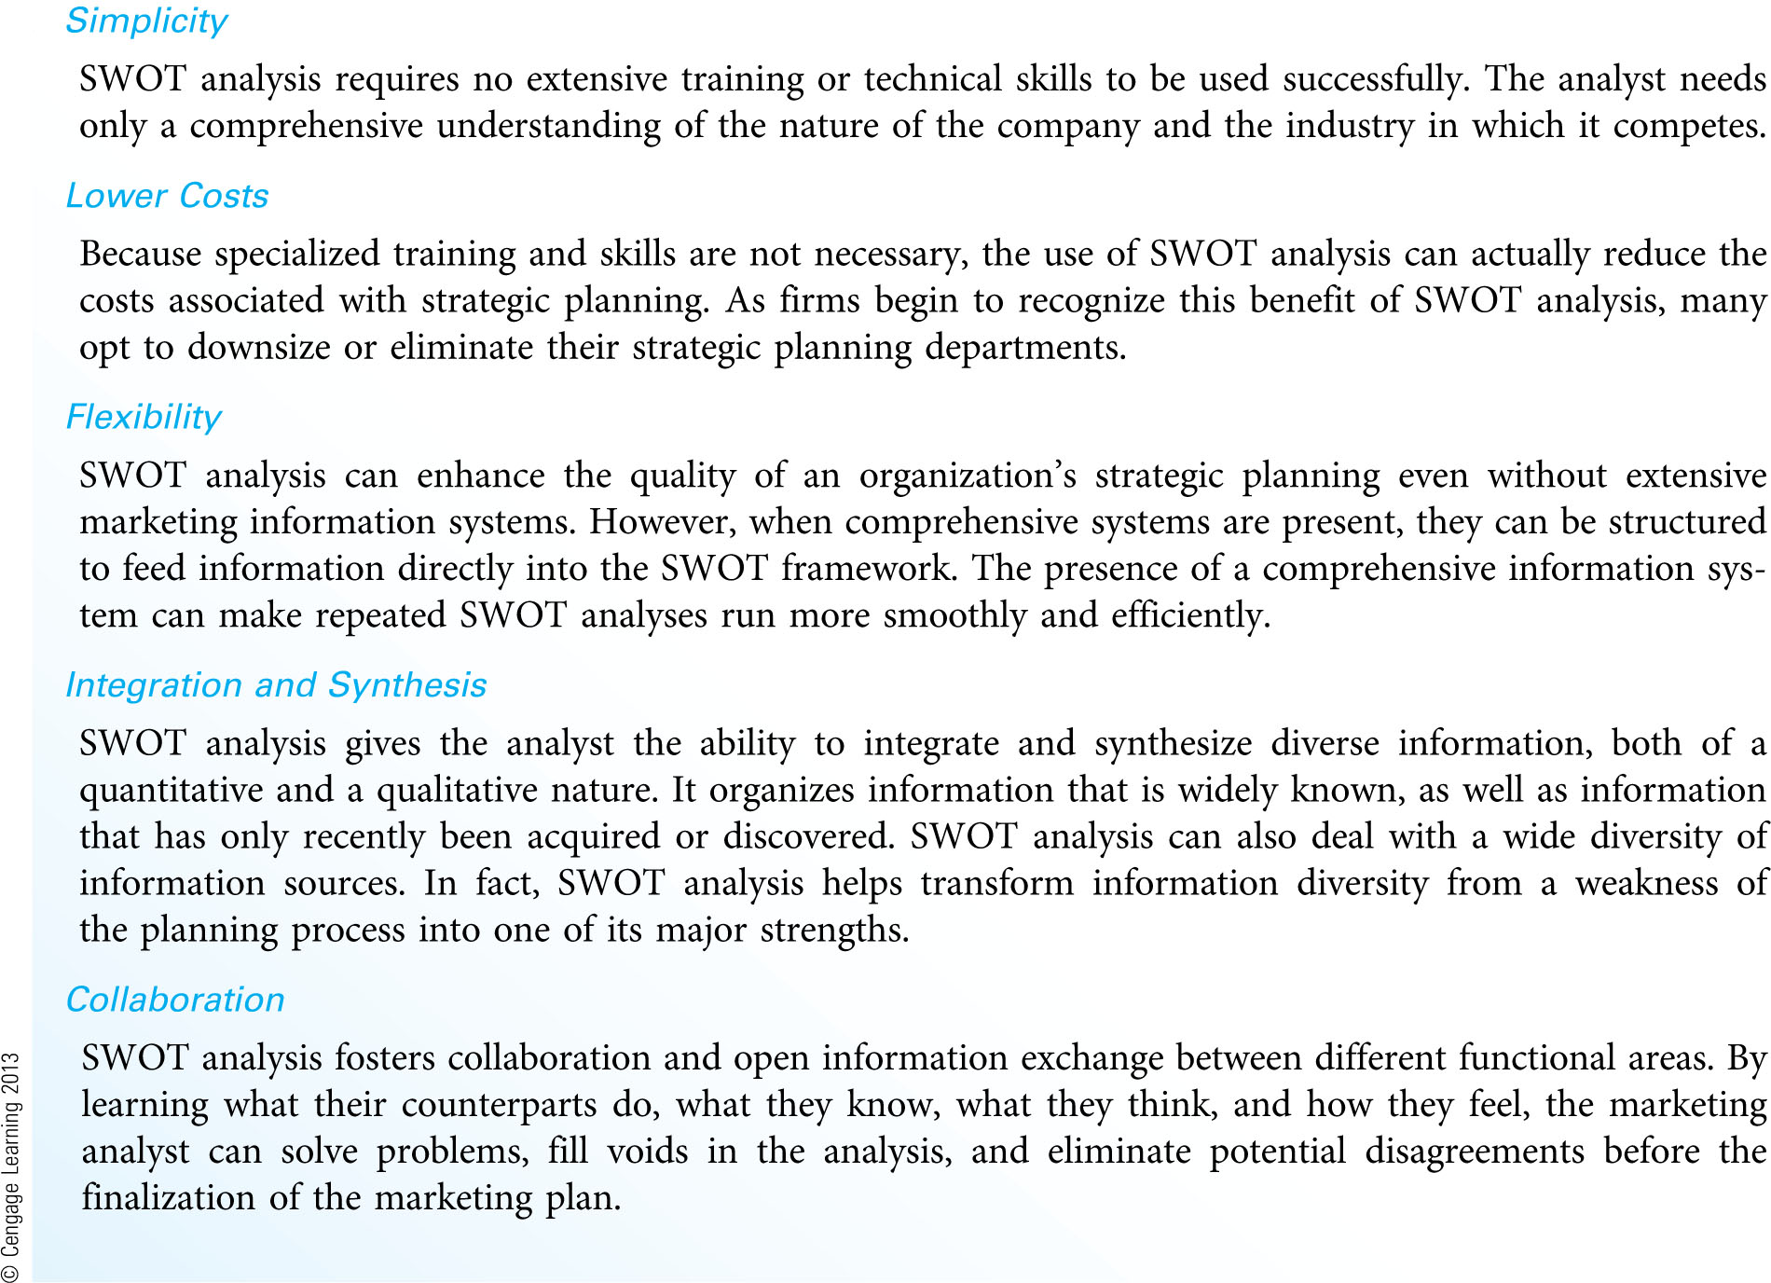
Major Benefits of SWOT Analysis (Exhibit 4.1)

Slide 4
Making SWOT Analysis Productive (Exhibit 4.2)
DIRECTIVES FOR A PRODUCTIVE SWOT ANALYSIS
-Stay Focused
A single, broad analysis leads to meaningless generalizations. Separate analyses for each product–market
combination are recommended.
-Search Extensively for Competitors
Although major brand competitors are the most important, the analyst must not overlook product, generic,
and total budget competitors. Potential future competitors must also be considered.
-Collaborate with Other Functional Areas
SWOT analysis promotes the sharing of information and perspective across departments. This cross-pollination
of ideas allows for more creative and innovative solutions to marketing problems.
-Examine Issues from the Customers’ Perspective
Customers’ beliefs about the firm, its products, and marketing activities are important considerations in
SWOT analysis. The views of employees and other key stakeholders must also be considered.
-Look for Causes, Not Characteristics
Rather than simply list characteristics of the firm’s internal and external environments, the analyst must also
explore the resources possessed by the firm and/or its competitors that are the true causes for the firm’s
strengths, weaknesses, opportunities, and threats.
-Separate Internal Issues from External Issues
If an issue would exist even if the firm did not exist, the issue should be classified as external. In the SWOT
framework, opportunities (and threats) exist independently of the firm and are associated with characteristics
or situations present in the economic, customer, competitive, cultural, technological, political, or
legal environments in which the firm resides. Marketing options, strategies, or tactics are not a part of the
SWOT analysis.

Slide 5
1-Stay Focused
A mistake planners often make in conducting SWOT analysis is to complete one generic analysis for the entire organization or business unit.
In most firms, there should be a series of analyses, each focusing on a specific product/market combination. The only time a single SWOT analysis would be appropriate is when an organization has only one product/market combination.

Slide 6
2-Search Extensively for Competitors
Information on competitors and their activities is an important aspect of a well-focused SWOT analysis. The key is not to overlook any competitor, whether a current rival or one on the horizon.
The firm will focus most of its efforts on brand competition. However, the firm must watch for any current or potential direct product substitutes.

Slide 7
3-Collaborate with Other Functional Areas
The final outcome of a properly conducted SWOT analysis should be a fusion of information from many areas.
While combining the SWOT analyses from individual areas, the marketing manager can identify opportunities for joint projects and cross selling of the firm's products.

Slide 8
4-Examine Issues from the Customers' Perspective
Every issue in a SWOT analysis should be examined from the customers' perspective. Marketing planners must also gauge the perceptions of each customer segment that the firm attempts to target.
Examining issues from the customers' perspective also includes the firm's internal customers: its employees.
Taking the customers’ perspective can help the firm interpret the clichés they might develop. [Exhibit 4.3]

Slide 9
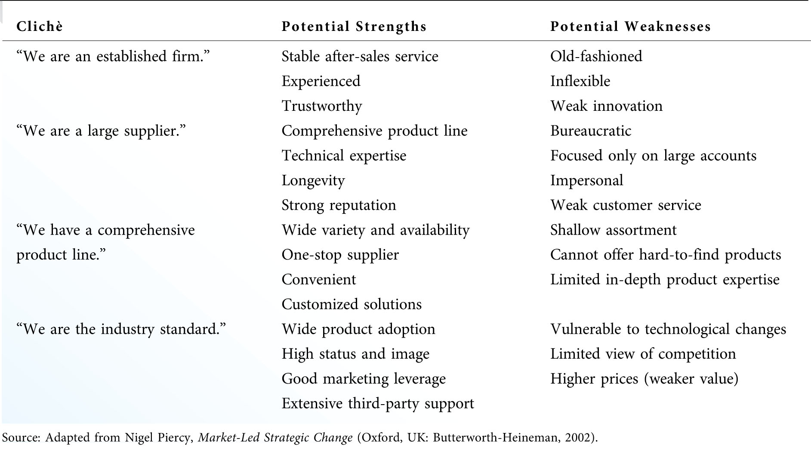
Breaking Down Managerial Clichés (Exhibit 4.3)

Slide 10
As the analysis progresses, the marketing manager should identify the most critical issues by looking at each one through the eyes of the firm’s customers. To do this, the manager must constantly ask questions such as these:
-What do customers (and noncustomers) believe about us as a company?
-What do customers (and noncustomers) think of our product quality, customer service, price and overall value, convenience, and promotional messages in comparison to our competitors?
-Which of our weaknesses translate into a decreased ability to serve customers(and decreased ability to convert noncustomers)?
- How do trends in the external environment affect customers (and noncustomers)?
- What is the relative importance of these issues, not as we see them but as customers see them?

Slide 11
5-Look for Causes, Not Characteristics
Many analysts simply list strengths, weaknesses, opportunities, and threats as descriptions or characteristics of the firm's internal and external environments without going deeper to consider the causes for these characteristics.
More often than not, the causes for each issue in a SWOT analysis can be found in the resources possessed by the firm and/or its competitors.

Slide 12
From a resource-based viewpoint, every organization can be considered as a unique bundle of tangible and intangible resources. Major types of these resources include the following:4
A)Financial Resources—cash, access to financial markets, physical facilities,equipment, raw materials, systems and configurations
B)Intellectual Resources—expertise, discoveries, creativity, innovation
C) Legal Resources—patents, trademarks, contracts
D) Human Resources—employee expertise and skills, leadership
E)Organizational Resources—culture, customs, shared values, vision, routines,working relationships, processes and systems
F)Informational Resources—customer intelligence, competitive intelligence,marketing information systems
G) Relational Resources—strategic alliances, relations with customers, vendors, and other stakeholders, bargaining power, switching costs
H) Reputational Resources—brand names, symbols, image, reputation

Slide 13
6-Separate Internal Issues from External Issues
Internal issues are the firm's strengths and weaknesses, while external issues refer to opportunities and threats in the firm's environment.
The key test to differentiate a strength or weakness from an opportunity or threat is to ask, "Would this issue exist if the firm did not exist?" If the answer is yes, the issue should be classified as external.
The failure to understand the difference between internal and external issues is one of the major reasons for a poorly conducted SWOT analysis.

Slide 14
SWOT-Driven Strategic Planning
The role of SWOT analysis is to help the marketing manager make the transition from a broad understanding of the marketing environment to the development of a strategic focus for the firm’s marketing efforts.
The issues that can be considered in a SWOT analysis are numerous and will vary depending on the particular firm or industry being examined. [Exhibit 4.4]

Slide 15
EXHI B I T 5.4 POTENTIAL ISSUES TO CONSIDER IN A SWOT ANALYSIS

Slide 16
1-Strengths and Weaknesses
Strengths and weaknesses exist either because of resources possessed (or not possessed) by the firm, or in the nature of the relationships between the firm and its customers, its employees, or outside organizations.
A strength is meaningful only when it serves to satisfy a customer need. When this is the case, that strength becomes a capability.
The marketing manager must also develop strategies to overcome the firm’s weaknesses, or find ways to minimize their negative effects.

Slide 17
2-Opportunities and Threats
Opportunities and threats exist outside the firm, independently of internal strengths, weaknesses, or marketing options. Opportunities and threats typically occur within the firm’s customer or external environments.
The marketing manager must develop strategies to take advantage of opportunities and minimize or overcome the firm's threats.

Slide 18
3-The SWOT Matrix
To utilize SWOT analysis successfully, the marketing manager must be cognizant of four issues:
a)The assessment of strengths and weaknesses must look beyond the firm's resources and product offering(s) to examine processes that are key to meeting customers' needs.
b)The achievement of the firm's goals and objectives depends on its ability to create capabilities by matching its strengths with market opportunities.
c)Firms can often convert weaknesses into strengths, or even capabilities, by investing strategically in key areas.
d)Weaknesses that cannot be converted into strengths become the firm’s limitations.

Slide 19
A SWOT matrix is a four-cell array that can be used to visually evaluate each element of a SWOT analysis. [Exhibit 4.5]
To begin the analysis, the manager must evaluate the issues within each cell of the matrix in terms of their magnitude and importance. This evaluation should be based on customers' perceptions.
It can be informative to quantitatively assess each cell of the SWOT matrix [Exhibit 4.6]
Elements with the highest total ratings (positive or negative) should have the greatest influence in developing the marketing strategy.

Slide 20
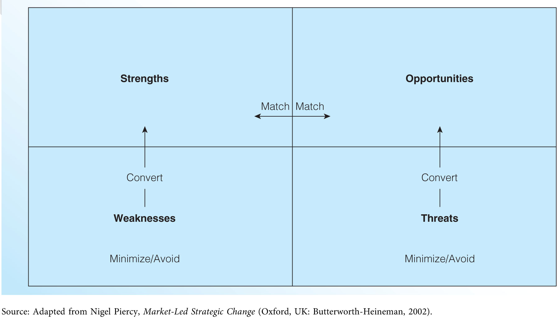
The SWOT Matrix (Exhibit 4.5)

Slide 21
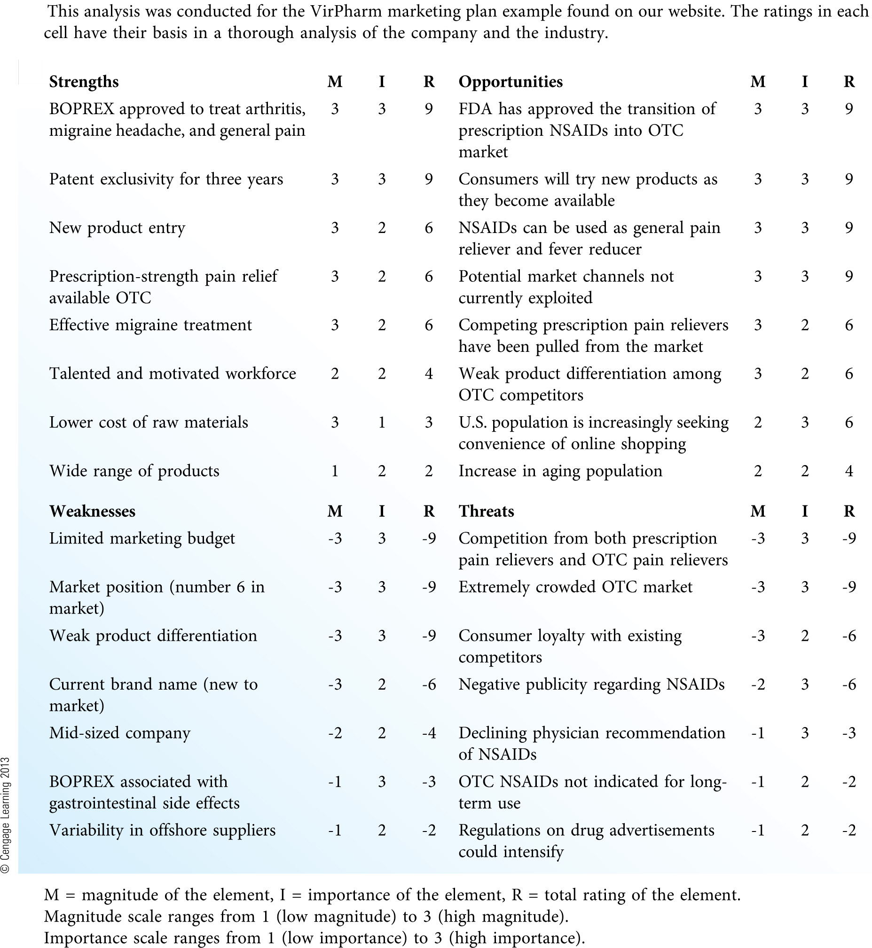
Quantitative Assessment of the SWOT Matrix (Exhibit 4.6)

Slide 22
Developing and Leveraging Competitive Advantages
The conversion of strengths into capabilities gives the firm a competitive advantage and allows it to serve customers' needs better than the competition. [Exhibit 4.7]
While competitive advantages most often stem from real strengths possessed by the firm or in real weaknesses possessed by rival firms, competitive advantages can also be based more on perception than reality.

Slide 23
EXHIBI T 4.7 COMMON SOURCES OF COMPETITIVE ADVANTAGE

Slide 24
Many successful firms have developed capabilities and competitive advantages based on one of three basic strategies: [Exhibit 4.8]
1-Operational excellence—focusing on efficiency of operations and processes, lower costs, and delivering good value to customers.
2-Product leadership—focusing on technology, product development, and delivering the most advanced, highest quality goods and services in the industry.
3-Customer intimacy—focusing on knowing customers, understanding their needs better than the competition, and developing long-term customer relationships.

Slide 25
To be successful, firms should be able to execute all three strategies. However, the most successful firms choose one area at which to excel and then actively manage customer perceptions so that customers believe that the firm does indeed excel in that area.
To implement any one of these strategies effectively, a firm must possess certain core competencies, as outlined in Exhibit 4.8

Slide 26
EXHIBIT
4
.
8 p.p 102
CORE COMPETENCIES NECESSARY FOR
COMPETITIVE ADVANTAGE STRATEGIES
Operational Excellence
—
Example Firms: Walmart, Southwest Airlines, Dell
Core Competencies
_
Low
-
cost operations
_
Totally dependable product supply
_
Expedient customer service
_
Effective demand management
Common Attributes of Operationally Excellent Firms
_
Delivery of compelling value through the use of low prices, standardized product offerings, and
convenient buying processes
_
Targeting a broad, heterogeneous market of pri
ce
-
sensitive buyers
_
Investing to achieve scale economies and efficiency
-
driven systems that translate into lower prices
for buyers
_
Developing information systems geared toward capturing and distributing information on
inventories, shipments, customer transactions, and costs in real time
_
Maintaining a system to avoid waste and highly reward efficiency improvement
Product Leadership
—
Example Firms: Pfizer, Intel, 3M
Core Competencies
_
Basic research/rapid research interpretation
_
Applied research geared toward product development
_
Rapid exploitation of market opportunities
_
Excellent marketing skills
Leading Firms Common Attributes of Product
-
_
Focusing their marketing plans on the rapid introduction of high
-
quality,
technologically
sophisticated products in order to create customer loyalty
_
Constantly scanning the environment in search of new opportunities; often making their own
products obsolete through continuous innovation
_
Targeting narrow, homogeneous market segments
_
Mainta
ining organizational cultures characterized by decentralization, adaptability,
entrepreneurship, creativity, and the expectation of learning from failure
Having an attitude of
‘‘
How can we make this work/
rather than
’’
‘‘
Why can
’
_
t we make this work?
’’
Customer Intimacy
—
Example Firms: Nordstrom, Amazon, Ritz
-
Carlton
Core Competencies
_
Exceptional skills in discovering customer needs
_
Problem
-
solving proficiency
_
Flexible product/solution customization
_
A customer relationship management mind
win) negotiation skills
-
set
_
A wide presence of collaborative (win
--
Intimate Firms
Common Attributes of Customer
-
_
Seeing customer loyalty as their greatest asset as they focus their efforts on developing and
ma
intaining an intimate knowledge of customer requirements
_
Consistently exceeding customer expectations by offering high
-
quality products and solutions
without an apology for charging higher prices
_
Decentralizing most decision
-
making authority to the customer
-
contact level
_
Regularly forming strategic alliances with other companies to address customers
’
needs in a
comprehensive fashion
_
Assessing all relationships with customers or alliance partner
s on a long
-
term, even lifetime basis

Slide 27
Establishing a Strategic Focus
The firm’s strategic focus is the overall concept or model that guides the firm as it weaves various marketing elements together into a coherent strategy.
A firm’s strategic focus is typically tied to its competitive advantages, or it can be geared toward compensating for the firm's weaknesses or defending against its vulnerabilities.
There are four general directions for a firm’s strategic efforts:
1.Aggressive (many internal strengths and external opportunities) Firms in this enviable position can develop marketing strategies to aggressively take on multiple opportunities.
2.Diversification (many internal strengths and external threats) Firms in this position have a great deal to offer, but external factors weaken their ability to pursue aggressive strategies.

Slide 28
3.Turnaround (many internal weaknesses and external opportunities) Firms often pursue turnaround strategies because they find themselves in the situation—often temporary—of having too many internal problems to consider strategies that will take advantage of external opportunities.
4.Defensive (many internal weaknesses and external threats) Firms take a defensive posture when they become overwhelmed by internal and external problems simultaneously.
*Many firms struggle with finding a focus that translates into a strategy that offers customers a compelling reason for purchasing the firm’s products.

Slide 29
The strategy canvas, developed by Professors Kim and Mauborgne in their book Blue Ocean Strategy, is a useful tool for identifying a strategic focus.
1.A strategy canvas is a tool for visualizing a firm’s strategy relative to other firms in a given industry. [Exhibit 4.9]
2.The central portion of the strategy canvas is the value curve, or the graphic representation of the firm’s relative performance in its industry.
3.The key to using the strategy canvas (and the key to developing a compelling strategic focus) lies in identifying a value curve that:
a)clearly depicts the firm’s strategic focus
b)is distinctively different from competitors.

Slide 30
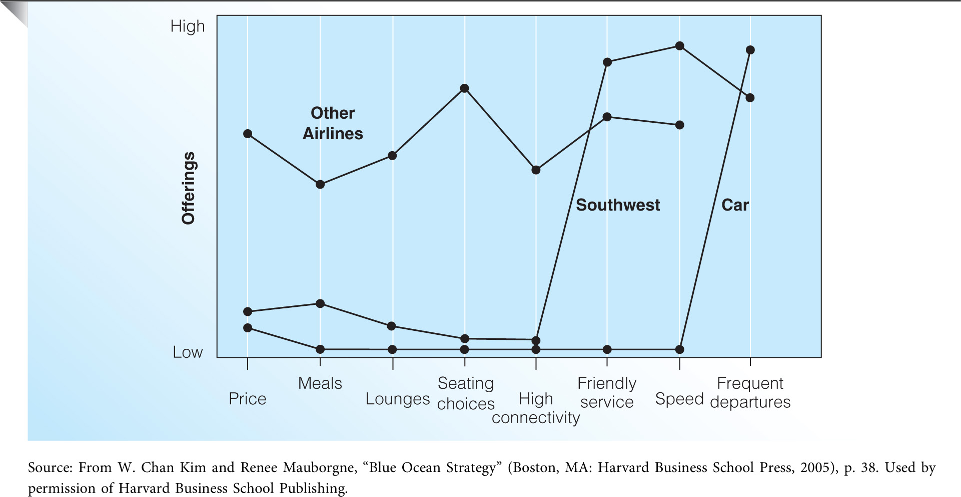
Strategy Canvas for Southwest Airlines (Exhibit 4.9)

Slide 31
Developing Marketing Goals and Objectives
Developing Marketing Goals
Attainability
Consistency
Comprehensiveness
Intangibility
Developing Marketing Objectives
Attainability
Continuity
Time Frame
Assignment of Responsibility

Slide 32
1-Developing Marketing Goals
Goals are statements of broad, desired accomplishments and do not contain specific information about where the organization presently stands or where it hopes to be in the future.
Goals indicate the direction in which the firm attempts to move, as well as the set of priorities it will use in evaluating alternatives and making decisions.

Slide 33
All marketing goals should have these characteristics:
a)Attainability—goals should be realistic and capable of being achieved
b)Consistency—goals must be consistent with each other and with the goals of other functional areas
c)Comprehensiveness—marketing goals should relate to the organization's goals and help to clarify the roles of all parties in the organization
d)Intangibility—marketing goals should be somewhat ambiguous and open-ended to motivate employees by promoting comparisons with rival firms

Slide 34
2-Developing Marketing Objectives
Objectives provide specific and quantitative benchmarks that can be used to gauge progress toward the achievement of the marketing goals.
A particular goal may require several objectives for its progress to be adequately monitored, usually across multiple business functions.
Goals without objectives are essentially meaningless because progress is impossible to measure.

Slide 35
All marketing objectives should have these characteristics:
a)Attainability—marketing objectives should be realistic given the internal and external environments of the firm
b)Continuity—objectives should be consistent with those set in previous periods (continuous objectives), or should be set to elevate the level of performance significantly (discontinuous objectives) [Exhibit 4.10]
c)Time frame—objectives should have an appropriate time frame to allow for accomplishment with reasonable levels of effort
d)Assignment of responsibility—an objective must identify the person, team, or unit responsible for achieving it.
**Establishing goals and objectives sets into motion a chain of decisions and serves as a catalyst for the subsequent stages in the planning process.

