Slide 1
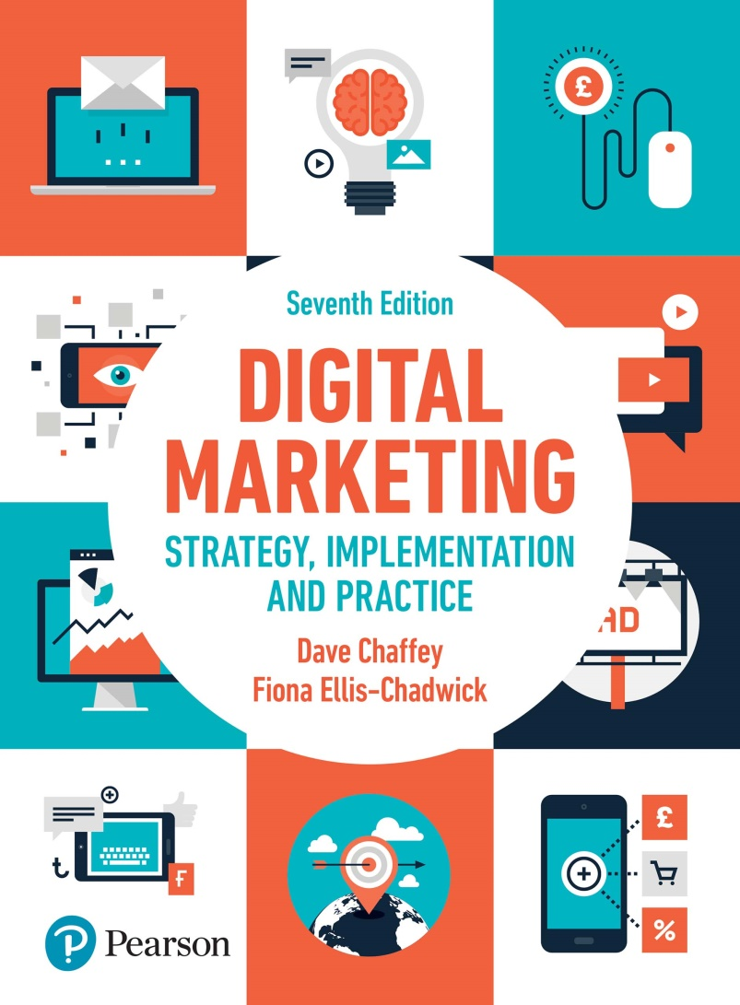
DIGITAL MARKETING STRATEGY, IMPLEMENTATION AND PRACTICE Seventh Edition
Part 2
Digital marketing strategy development
Chapter 4
Digital marketing strategy

Slide 2
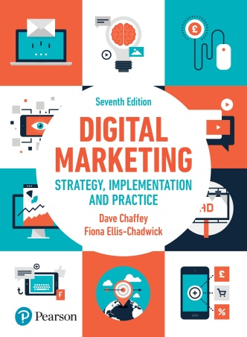
Chapter 4 Digital Marketing Strategy
Main topics
Digital marketing strategy and channel strategy management
Importance of integrated digital marketing strategy
How to structure a digital marketing strategy
Competitor analysis
Setting goals and objectives
Strategy formulation
Strategy implementation
Assessing different digital projects

Slide 3
Digital marketing strategy and channel strategy management
Notes:
Figure 4.1 Internal and External influences on digital marketing strategy

Slide 4
Figure 4.2 Typical shopper behaviour before a town-centre shopping trip
Source: Hart et al. (2017)

Slide 5
Figure 4.3 Digital access during town-centre visit
Source: Hart et al. (2017)

Slide 6
Importance of integrated digital marketing strategy
Notes:
Figure 4.4 Hierarchy of organisation plans including digital marketing plans

Slide 7
Table 4.2 Digital Marketing Planning failures and solutions
Potential failure or problem | Potential solution
Underestimated customer demand for online services Intense competition from existing and new market entrants who may spark digital disruption in sector through new business or revenue models Duplication of resources Insufficient resources and capabilities | Research demand, set objectives, allocate sufficient resources Analyse the market, especially the intensity of rivalry, anticipate competitive responses, plan a clear market entry strategy or potential changes to business and revenue models Improve internal communications to avoid different parts of the marketing organisation purchasing different tools or different agencies for performing similar online marketing tasks Ensure budget and specific specialist digital skills are available to support the strategic initiatives including ‘always-on’ activities to continuously engage audiences using search, social and email marketing

Slide 8
Table 4.2 Digital Marketing Planning failures and solutions (Continued)
Potential failure or problem | Potential solution
Relevant customer data not collected or utilised Lack of control Lack of senior management support | Research to ensure best possible knowledge of target customers; integrate customer data into existing systems Measure and analyse regularly to take corrective action to ensure achievement of objectives Ensure support for a long-term digital transformation plan as this will be needed to drive major strategic initiatives

Slide 9
How to structure a digital marketing strategy
Source: Chaffey and Smith (2012)
Notes:
Figure 4.5 The SOSTAC® planning framework applied to digital marketing strategy development

Slide 10
Situation Analysis
Source: Smart Insights (http://bit.ly/smartbenchmarking)
Notes:
Figure 4.6 A Digital marketing capability model

Slide 11
Consumer Profiles
Notes:
Figure 4.7 Character variables, beliefs, attitudes and shopping intentions

Slide 12
Competitor analysis
Intermediary analysis
Assessing opportunities and threats
Notes:
Figure 4.8 A generic digital channel-specific SWOT analysis showing typical opportunities and threats presented by digital media

Slide 13
Setting goals and objectives:
The online revenue contribution
Setting SMART objectives
Framework for objective setting
Notes:
Figure 4.10 The relationship between vision, goals, objectives and KPIs

Slide 14
Strategy formulation and implementation
Notes:
Figure 4.11 Using digital channels to support different organisational growth strategies

Slide 15
Key decisions in strategy development:
Market and product strategies
Business and revenue model strategies
Target marketing strategy
Positioning and differentiation
Customer engagement and social media strategy
Notes:
Figure 4.12 Dell IdeaStorm (www.ideastorm.com)

Slide 16
Key decisions in strategy development:
Multichannel distribution strategy
Multichannel communication strategy
Online communication mix and budget
Organisational capabilities and governance to support digital transformation

Slide 17
Figure 4.15 Customer lifecycle segmentation

Slide 18
Differential advantage
Notes:
Figure 4.16 Alternative positionings for online services

Slide 19
Figure 4.17 Influences on customers of multichannel decision making
Source: adapted from Dholakia et al. (2010)

Slide 20
Figure 4.18 Matrix for evaluating digital marketing business investment alternatives

Slide 21
Figure 4.19 Influences on customers of multichannel decision making
Source: adapted from Dholakia et al. (2010)

Slide 22
Figure 4.20 Channel coverage map showing the company’s preferred strategy for communications
with different customer segments with different value

Slide 23
Assessing different digital projects
The online lifecycle management grid
Generic digital marketing strategies to achieve objectives in the grid include:
Online value proposition strategy
Online targeted reach strategy
Offline targeted reach strategy
Online sales efficiency strategy
Offline sales impact strategy

Slide 24
Case study 4 – ASOS shifts the focus of high street retailing
Questions:
Apply the SOSTAC model to ASOS and highlight why it has become such a successful online fashion brand
Describe how ASOS uses elements of the marketing mix as part of its digital strategy
Discuss how ASOS has used digital to develop its differentiated market position
Notes:
Figure 4.21 ASOS brand wheel

