Slide 1
Chapter 4
Research Design
Copyright © 2014 Pearson Education, Inc.
1

Slide 2
Learning Objectives
To understand what research design is and why it is significant
To appreciate areas of ethical sensitivity in research design
To learn how exploratory research design helps the researcher gain a feel for the problem by providing background information, suggesting hypotheses, and prioritizing research objectives

Slide 3
To know the fundamental questions addressed by descriptive research and the different types of descriptive research
To explain what is meant by causal research and to describe types of experimental research designs
To know the different types of test marketing and how to select test-market cities

Slide 4
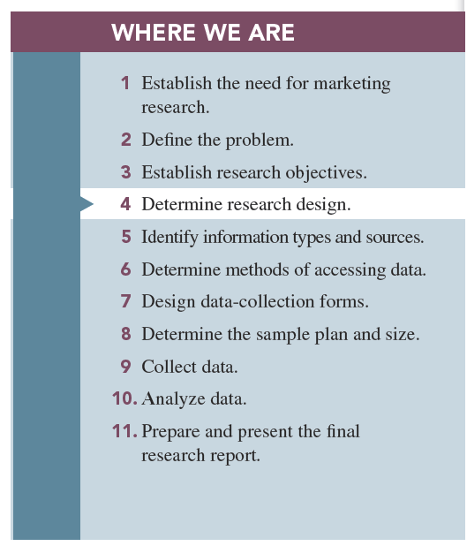

Slide 5
Research Design
Research design is a set of advance decisions that make up the master plan specifying the methods and procedures for collecting and analyzing the needed information.
Why Is Research Design Important?
-Good research design is the “first rule of good research.”

Slide 6
Early in the research process, as the problem and research objectives are forming, researchers can begin to understand which research design will be most appropriate.
Their aim is to match basic research designs to given problems and research objectives.
Knowledge of the needed research design allows advance planning so that the project may be conducted in less time and typically at a cost savings due to efficiencies gained in preplanning.

Slide 7
Three types of Objectives of Research Design
1-To gain background information and to develop hypotheses
2-To measure the state of a variable of interest
3-To test hypotheses that specify the relationships between two or more variables

Slide 8
Research Design: A Caution
In many cases, research is an iterative process.
By conducting one research project, we learn that we may need additional research, which may result in using multiple research designs.
Notes:
Check with Don regarding this text

Slide 9
Three Types of Research Designs:
1-Exploratory
2-Descriptive
3-Causal
-It may be perfectly legitimate to begin with any one of the three design and to use only that one design.

Slide 10
1- Exploratory research is most commonly unstructured, informal research that is undertaken to gain background information about the general nature of the research problem.
It is usually conducted when the researcher does not know much about the problems.
Notes:
Add definition

Slide 11
Uses of Exploratory Research
1-Gain background information: when very little is known the problem or when the problem has not been clearly formulated.
2- Define terms: an concepts, by conducting exploratory research to define a question such as “what is satisfaction with service quality?”
3-Clarify problems and hypothesis
4-Establish research priorities: exploratory research can help firm prioritize research topics.

Slide 12
Methods of conducting exploratory research
1-Secondary data analysis: the process of searching for interpreting existing information relevant to the research topic
2-Experience surveys: refer to gathering information from those to be knowledgeable on the issues relevant to the research problem
Key-informant technique: gathering information from those thought to be knowledgeable on the issues relevant to the problem
Lead-user survey: used to acquire information from lead users of a new technology
Notes:
Add two more definition; other definitions moved to next slide for space

Slide 13
3-Case analysis: a review of available information about a former situation(s) that has some similarities to the current research problem
4-Focus groups: small groups brought together and guided by a moderator through an unstructured, spontaneous discussion for the purpose of gaining information relevant to the research problem
Notes:
Add two more

Slide 14
2-Descriptive Research
Descriptive research is undertaken to describe answers to questions of who, what, where, when, and how.
It is desirable when we wish to project a study’s findings to a larger population, if the study’s sample is representative.

Slide 15
Classification of Descriptive Research studies
Two basic descriptive research studies are available to marketing researcher:
1- Cross-sectional studies
2-Longitudinal studies
1-Cross-sectional studies measure units from a sample of the population at only one point in time (or “snapshot”).
Sample surveys are cross-sectional studies whose samples are drawn in such a way as to be representative of a specific population.
These studies are usually presented with a margin of error.
Notes:
Add Sample Surveys; match order with text

Slide 16
For example: many magazines survey a sample of their subscribers and ask them questions ,such as their age, occupation, income, and educational.
2- Longitudinal studies repeatedly measure the same sample units of a population over time.
- Because it involve multiple measurements over time, they are often described as “movies” of the population.

Slide 17
To ensure the success of the longitudinal study, researcher must have access to the same members of the sample, called a panel ,so as to take repeated measurements.
Panels represent sample units who have agreed to answer questions at periodic intervals.
Notes:
Add term Panels with definition; maybe current Longitudinal bullets should be combined into one bullet based on text

Slide 18
There are two types of panels:
1-Continuous panels ask panel members the same questions on each panel measurement.
2-Discontinuous panels vary questions from one panel measurement to the next.
sometimes it referred to as omnibus panels (omnibus meaning “including or covering many things or classes”).

Slide 19
- Discontinuous panels are demographically matched to some larger entity, implying representativeness.
-Discontinuous panels represent sources of information that may be quickly accessed for a wide variety of purposes.
Brand-switching studies: studies examining how many consumers switched brands
Market-tracking studies: those that measure some variable(s) of interest—such as market share or unit sales—over time
Notes:
Possibly remove – not bolded or emphasized in text

Slide 22
3- Causal Research
Causality may be thought of as understanding a phenomenon in terms of conditional statements of the form “If x, then y.”
Causal relationships are often determined by the use of experiments, which are special types of studies.
An experiment is defined as manipulating an independent variable to see how it affects a dependent variable while also controlling the effects of additional extraneous variables.

Slide 23
Independent Variable and Dependent Variables
a) Independent variables are those variables that the researcher has control over and wishes to manipulate—the 4 P’s.
-Examples are level of ad expenditure, type of ad appeal, display location, method of compensating salespersons, price, and type of product.
b)Dependent variables are those variables that we have little or no direct control over but a strong interest in changing.

Slide 24
Example include sales, market share, customer satisfaction and more.
3- Extraneous variables are those variables that may have some effect on a dependent variable yet are not independent variables.

Slide 25
Experimental design is a procedure for devising an experimental setting such that a change in a dependent variable may be attributed solely to the change in an independent variable.
- Experimental design are procedures that allow experimenters to control for the effects on a dependent variable by any extraneous variable.

Slide 26
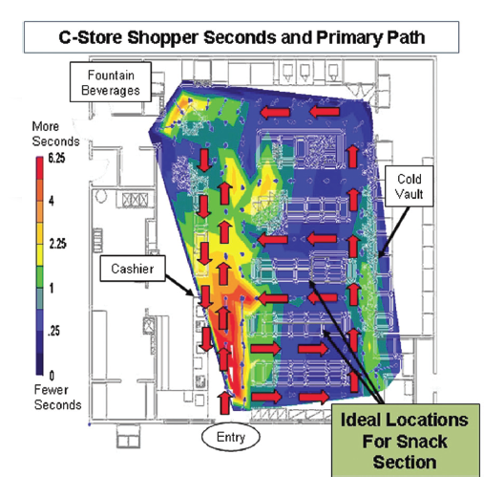
Example Store Experiment

Slide 27
Symbols of Experimental Design
O = measurement, or observation, of a dependent variable
X = manipulation, or change, of an independent variable
R = random assignment of subjects to experimental and control groups
E = experimental effect (change in the dependent variable due to the independent variable)
Notes:
Don – is this information required? Not emphasized in text

Slide 28
Pretest and Posttest
Pretest refers to the measurement of the dependent variable taken prior to changing the independent variable.
Posttest refers to measuring the dependent variable after changing the independent variable.

Slide 29
A “true” experimental design: isolates the effects of the independent variable on the dependent variable while controlling for the effects of any extraneous variables.
Quasi-experimental design: ones that do not properly control for the effects of extraneous variables on our dependent variable.

Slide 30
Control group: control of extraneous variables typically achieved by the use of a second group of subjects
Experimental group: the group that has been exposed to a change in the independent variable
Before-after with control group design may be achieved by randomly dividing subjects of the experiment in two groups:
The control group
The experimental group

Slide 31
How Valid Are Experiments?
An experiment is valid if the following are true:
1-The observed change in the dependent variable is due to the independent variable.
2-The results of the experiment apply to the “real world” outside the experimental setting.

Slide 32
Two forms of validity are used to assess the validity of an experiment:
1-Internal validity is concerned with the extent to which the change in the dependent variable is actually due to the change in the independent variable.
2-External validity refers to the extent that the relationship observed between the independent and dependent variables during the experiment is generalizable to the “real world.”

Slide 33
Types of Experiments
We can classify them in two broad class:
1-Laboratory experiments are those in which the independent variable is manipulated and measures of the dependent variable are taken in a contrived, artificial setting for the purpose of controlling the many possible extraneous variables that may affect the dependent variable.
2-Field experiments are those in which the independent variables are manipulated and the measurements of the dependent variable are made on test units in their natural setting.

Slide 34
Test Marketing
Test marketing is the phrase commonly used to indicate an experiment, study, or test that is conducted in a field setting.
Main uses of test markets:
a)To test sales potential for a new product or service
b)To test variations in the marketing mix for a product or service

Slide 35
We have 4 Types of Test Markets
1-The standard test market is one in which the firm tests the product or marketing-mix variables through the company’s normal distribution channels.
2-Controlled test markets are conducted by outside research firms that guarantee distribution of the product through prespecified types and numbers of distributors.

Slide 36
3- Electronic test markets are those in which a panel of consumers has agreed to carry identification cards that each consumer presents when buying goods and services.
4-Simulated test markets (STMs) are those in which a limited amount of data on consumer response to a new product is fed into a model containing certain assumptions regarding planned marketing programs, which generates likely product sales volume.

Slide 37
Selecting Test-Market Cities
-Three main criteria:
1-Representativeness
2-Degree of isolation
3-Ability to control distribution and promotion
Notes:
Add definitions – no definitions in the text

Slide 38
Pros and Cons of Test Marketing
Advantages:
Test marketing allows for the most accurate method of forecasting future sales, and it allows firms the opportunity to pretest marketing-mix variables.
Disadvantages:
Test markets do not yield infallible results.
Competitors may intentionally try to sabotage test markets.
Test markets bring about exposure of the product to the competition.
Test markets may create ethical problems.

