Slide 1
Chapter 4
Research Design
Copyright © 2014 Pearson Education, Inc.
1

Slide 2
Learning Objectives
To understand what research design is and why it is significant
To appreciate areas of ethical sensitivity in research design
To learn how exploratory research design helps the researcher gain a feel for the problem by providing background information, suggesting hypotheses, and prioritizing research objectives

Slide 3
Learning Objectives
To know the fundamental questions addressed by descriptive research and the different types of descriptive research
To explain what is meant by causal research and to describe types of experimental research designs
To know the different types of test marketing and how to select test-market cities

Slide 4
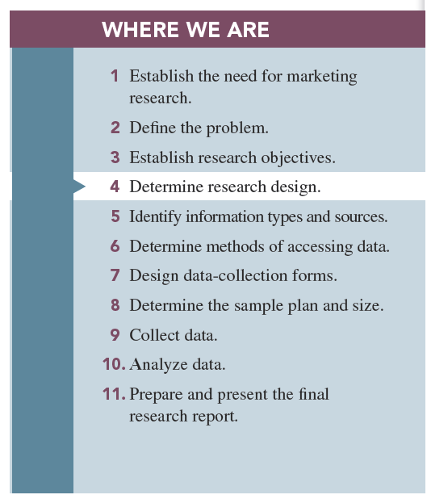

Slide 5
Research Design
Research design is a set of advance decisions that make up the master plan specifying the methods and procedures for collecting and analyzing the needed information.

Slide 6
Why Is Research Design Important?
Good research design is the “first rule of good research.”
Knowledge of the needed research design allows advance planning so that the project may be conducted in less time and typically at a cost savings due to efficiencies gained in preplanning.

Slide 7
Objectives of Research Design
To gain background information and to develop hypotheses
To measure the state of a variable of interest
To test hypotheses that specify the relationships between two or more variables

Slide 8
Research Design: A Caution
In many cases, research is an iterative process.
By conducting one research project, we learn that we may need additional research, which may result in using multiple research designs.
Notes:
Check with Don regarding this text

Slide 9
Three Types of Research Designs
Exploratory
Descriptive
Causal

Slide 10
Exploratory Research
Exploratory research is usually conducted at the outset of research projects.
It is usually conducted when the researcher does not know much about the problems.
Notes:
Add definition

Slide 11
Uses of Exploratory Research
Gain background information
Define terms
Clarify problems and hypothesis
Establish research priorities

Slide 12
Exploratory Research Methods
Secondary data analysis: the process of searching for interpreting existing information relevant to the research topic
Experience surveys: refer to gathering information from those to be knowledgeable on the issues relevant to the research problem
Key-informant technique: gathering information from those thought to be knowledgeable on the issues relevant to the problem
Lead-user survey: used to acquire information from lead users of a new technology
Notes:
Add two more definition; other definitions moved to next slide for space

Slide 13
Exploratory Research Methods
Case analysis: a review of available information about a former situation(s) that has some similarities to the current research problem
Focus groups: small groups brought together and guided by a moderator through an unstructured, spontaneous discussion for the purpose of gaining information relevant to the research problem
Notes:
Add two more

Slide 14
Descriptive Research
Descriptive research is undertaken to describe answers to questions of who, what, where, when, and how.
It is desirable when we wish to project a study’s findings to a larger population, if the study’s sample is representative.

Slide 15
Descriptive Research Classifications
Cross-sectional studies
Longitudinal studies
Notes:
Add Sample Surveys; match order with text

Slide 16
Descriptive Research Studies
Cross-sectional studies measure units from a sample of the population at only one point in time (or “snapshot”).
Sample surveys are cross-sectional studies whose samples are drawn in such a way as to be representative of a specific population.
These studies are usually presented with a margin of error.

Slide 17
Descriptive Research Studies
Longitudinal studies repeatedly measure the same sample units of a population over time.
Since they involve multiple measurements over time, they are often described as “movies” of the population.
Notes:
Add term Panels with definition; maybe current Longitudinal bullets should be combined into one bullet based on text

Slide 18
Descriptive Research Studies
Continuous panels ask panel members the same questions on each panel measurement.
Discontinuous panels vary questions from one panel measurement to the next.
These are sometimes referred to as omnibus panels (omnibus meaning “including or covering many things or classes”).

Slide 19
Discontinuous Panels
Discontinuous panels are demographically matched to some larger entity, implying representativeness.
Discontinuous panels represent sources of information that may be quickly accessed for a wide variety of purposes.
Notes:
Possibly remove – not bolded or emphasized in text

Slide 20
Continuous Panels
Brand-switching studies: studies examining how many consumers switched brands
Market-tracking studies: those that measure some variable(s) of interest—such as market share or unit sales—over time
Notes:
Add Market-Tracking Studies – change title of slide also

Slide 23
Causal Research
Causality may be thought of as understanding a phenomenon in terms of conditional statements of the form “If x, then y.”
Causal relationships are often determined by the use of experiments.

Slide 24
Experiments
An experiment is defined as manipulating an independent variable to see how it affects a dependent variable while also controlling the effects of additional extraneous variables.

Slide 25
Independent Variable
Independent variables are those variables that the researcher has control over and wishes to manipulate—the 4 P’s.
Examples are level of ad expenditure, type of ad appeal, display location, method of compensating salespersons, price, and type of product.

Slide 26
Dependent Variables
Dependent variables are those variables that we have little or no direct control over but a strong interest in changing.

Slide 27
Extraneous Variables
Extraneous variables are those variables that may have some effect on a dependent variable yet are not independent variables.

Slide 28
Experimental Design
Experimental design is a procedure for devising an experimental setting such that a change in a dependent variable may be attributed solely to the change in an independent variable.

Slide 29
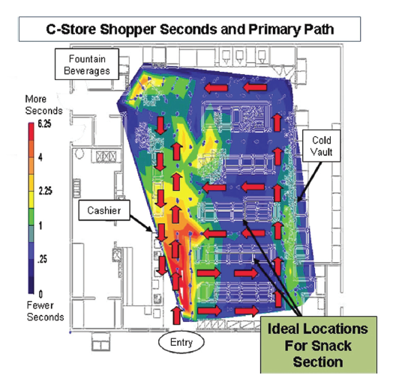
Example Store Experiment

Slide 30
Symbols of Experimental Design
O = measurement, or observation, of a dependent variable
X = manipulation, or change, of an independent variable
R = random assignment of subjects to experimental and control groups
E = experimental effect (change in the dependent variable due to the independent variable)
Notes:
Don – is this information required? Not emphasized in text

Slide 31
Pretest and Posttest
Pretest refers to the measurement of the dependent variable taken prior to changing the independent variable.
Posttest refers to measuring the dependent variable after changing the independent variable.

Slide 32
Experimental Design
A “true” experimental design: isolates the effects of the independent variable on the dependent variable while controlling for the effects of any extraneous variables.
Quasi-experimental design: ones that do not properly control for the effects of extraneous variables on our dependent variable.

Slide 33
Experimental Design
Before-after with control group design may be achieved by randomly dividing subjects of the experiment in two groups:
The control group
The experimental group
Notes:
Add before and after with control group

Slide 34
Experimental Design
Control group: control of extraneous variables typically achieved by the use of a second group of subjects
Experimental group: the group that has been exposed to a change in the independent variable
Notes:
Add definition for Quasi-Experimental Design; change title; Add definition for Experimental group

Slide 35
How Valid Are Experiments?
An experiment is valid if the following are true:
The observed change in the dependent variable is due to the independent variable.
The results of the experiment apply to the “real world” outside the experimental setting.

Slide 36
How Valid are Experiments?
Two forms of validity are used to assess the validity of an experiment:
Internal validity is concerned with the extent to which the change in the dependent variable is actually due to the change in the independent variable.
External validity refers to the extent that the relationship observed between the independent and dependent variables during the experiment is generalizable to the “real world.”

Slide 37
Types of Experiments
Laboratory experiments are those in which the independent variable is manipulated and measures of the dependent variable are taken in a contrived, artificial setting for the purpose of controlling the many possible extraneous variables that may affect the dependent variable.

Slide 38
Types of Experiments
Field experiments are those in which the independent variables are manipulated and the measurements of the dependent variable are made on test units in their natural setting.

Slide 39
Test Marketing
Test marketing is the phrase commonly used to indicate an experiment, study, or test that is conducted in a field setting.
Main uses of test markets:
To test sales potential for a new product or service
To test variations in the marketing mix for a product or service

Slide 40
Types of Test Markets
The standard test market is one in which the firm tests the product or marketing-mix variables through the company’s normal distribution channels.
Controlled test markets are conducted by outside research firms that guarantee distribution of the product through prespecified types and numbers of distributors.

Slide 41
Types of Test Markets
Electronic test markets are those in which a panel of consumers has agreed to carry identification cards that each consumer presents when buying goods and services.
Simulated test markets (STMs) are those in which a limited amount of data on consumer response to a new product is fed into a model containing certain assumptions regarding planned marketing programs, which generates likely product sales volume.

Slide 42
Selecting Test-Market Cities
Three main criteria:
Representativeness
Degree of isolation
Ability to control distribution and promotion
Notes:
Add definitions – no definitions in the text

Slide 43
Pros and Cons of Test Marketing
Advantages:
Test marketing allows for the most accurate method of forecasting future sales, and it allows firms the opportunity to pretest marketing-mix variables.

Slide 44
Pros and Cons of Test Marketing
Disadvantages:
Test markets do not yield infallible results.
Competitors may intentionally try to sabotage test markets.
Test markets bring about exposure of the product to the competition.
Test markets may create ethical problems.

Slide 45
All rights reserved. No part of this publication may be reproduced, stored in a retrieval system, or transmitted, in any form or by any means, electronic, mechanical, photocopying, recording, or otherwise, without the prior written permission of the publisher. Printed in the United States of America.

