Slide 1
Chapter 4
Class 4

Slide 2
Correlation
How strong is the linear relationship between the variables?
Correlation does not necessarily imply causality!
Coefficient of correlation, r, measures degree of association
Values range from -1 to +1

Slide 3
Correlation Coefficient
nΣxy - ΣxΣy
[nΣx² - (Σx)²][nΣy² - (Σy)²]
r =

Slide 4
y
y
(a) Perfect positive correlation: r = +1
x
(b) Positive correlation: 0 < r < 1
x
y
y
x
x
(c) No correlation: r = 0
(d) Perfect negative correlation: r = -1

Slide 5
Correlation
Coefficient of Determination, r², measures the percent of change in y predicted by the change in x
Values range from 0 to 1
Easy to interpret
For the Nodel Construction example:
r = .901
r² = .81

Slide 6
Problem 4.24
Howard Weiss, owner of a musical instrument distributorship, thinks that demand for bass drums may be related to the number of television appearances by the popular group Stone Temple Pilots during previous month. Weiss has collected the data shown in the following table:
A. Graph these data to see whether a linear equations might describe the relationship between the group's television shows and bass drum sales.
B. use the least squares regression method to derive a forecasting equation.
C. What is your estimate for bass drum sales if the Stone Temple Pilots Performed on TV nine times last month?
D. What are the correlation coefficient (r) and the coefficient of determination (r²) for this model, and what do they mean?
Demand for Bass Drums | 3 | 6 | 7 | 5 | 10 | 7
number of TV appearances | 3 | 4 | 7 | 6 | 8 | 5

Slide 7
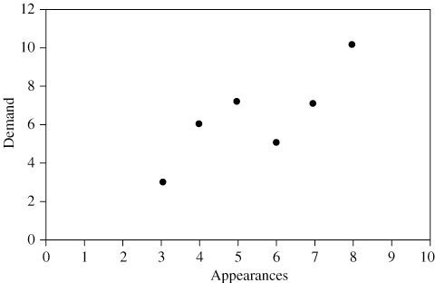
Problem 4.24
(a) Graph of demand
The observations obviously do not form a straight line but do tend to cluster about a straight line over the range shown.

Slide 8
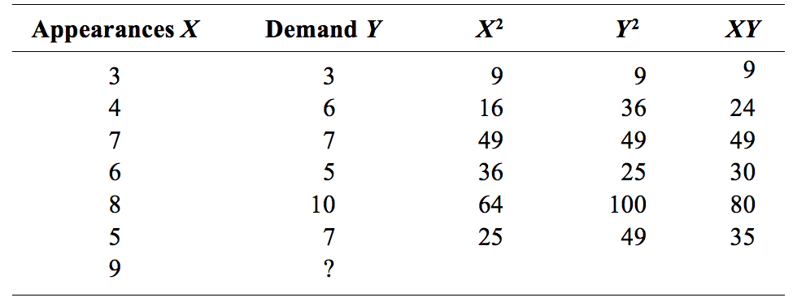
Problem 4.24
(b) Least-squares regression:

Slide 9
Problem 4.24
The following figure shows both the data and the resulting equation:

Slide 10
Problem 4.24
(c) If there are nine performances by Stone Temple Pilots, the estimated sales are:

Slide 11
Problem 4.24
(d)
R = .82 is the correlation coefficient, and R² = .68 means 68% of the variation in sales can be explained by TV appearances.

Slide 12
Multiple Regression Analysis
If more than one independent variable is to be used in the model, linear regression can be extended to multiple regression to accommodate several independent variables
^
y = a + b₁x₁ + b₂x₂ …
Computationally, this is quite complex and generally done on the computer

Slide 13
Multiple Regression Analysis
In the Nodel example, including interest rates in the model gives the new equation:
^
y = 1.80 + .30x₁ - 5.0x₂
An improved correlation coefficient of r = .96 means this model does a better job of predicting the change in construction sales
Sales = 1.80 + .30(6) - 5.0(.12) = 3.00
Sales = $300,000

Slide 14
Problem 4.36
Accountants at the firm Michael Vest, CPAs, believed that several traveling executives were submitting unusually high travel vouchers when they returned from business trips. First, they look a sample of 200 vouchers submitted from the past year. Then they developed the following multiple-regression equation relating expected travel cost to number of days on the road (x1) and distance traveled (x2) in miles:
y = $90.00 + $48.50 x₁ + $.40 x₂
The coefficient of correlation computed was .68
(a) If Wanda Fennell returns from a 300-mile trip that took her out of town for 5 days, what is the expected amount she should claim as expenses?
(b) Fennell submitted a reimbursement request for $685. What should the accountant do?
(c) Should any other variables be included? Which ones? Why?

Slide 15
Problem 4.36
(a)
Number of days on the road → X₁ = 5
and distance traveled → X₂ = 300
then:
Y = 90 + 48.5 × 5 + 0.4 × 300 =
90 + 242.5 + 120 = 452.5
Therefore, the expected cost of the trip is $452.50.
(b) The reimbursement request is much higher than predicted by the model. This request should probably be questioned by the accountant.

Slide 16
Problem 4.36
(c)
A number of other variables should be included, such as:
1. the type of travel (air or car)
2. conference fees, if any
3. costs of entertaining customers
4. other transportation costs—cab, limousine, special tolls, or parking
In addition, the correlation coefficient of 0.68 is not exceptionally high. It indicates that the model explains approximately 46% of the overall variation in trip cost. This correlation coefficient would suggest that the model is not a particularly good one.

Slide 17
Monitoring and Controlling Forecasts
Tracking Signal
Measures how well the forecast is predicting actual values
Ratio of running sum of forecast errors (RSFE) to mean absolute deviation (MAD)
Good tracking signal has low values
If forecasts are continually high or low, the forecast has a bias error

Slide 18
Monitoring and Controlling Forecasts
Tracking signal
RSFE
MAD
=
∑(actual demand in period i - forecast demand in period i)
(∑|actual - forecast|/n)
Tracking signal
=

Slide 19
Tracking Signal
Signal exceeding limit
+
0 MADs
–
Tracking signal
Upper control limit
Acceptable range
Lower control limit
Time

Slide 20
Tracking Signal Example
Cumulative
Absolute Absolute
Actual Forecast Forecast Forecast
Qtr Demand Demand Error RSFE Error Error MAD
1 90 100 -10 -10 10 10 10.0
2 95 100 -5 -15 5 15 7.5
3 115 100 +15 0 15 30 10.0
4 100 110 -10 -10 10 40 10.0
5 125 110 +15 +5 15 55 11.0
6 140 110 +30 +35 30 85 14.2

Slide 21
Tracking Signal Example
Cumulative
Absolute Absolute
Actual Forecast Forecast Forecast
Qtr Demand Demand Error RSFE Error Error MAD
Tracking Signal (RSFE/MAD)
1 90 100 -10 -10 10 10 10.0
2 95 100 -5 -15 5 15 7.5
3 115 100 +15 0 15 30 10.0
4 100 110 -10 -10 10 40 10.0
5 125 110 +15 +5 15 55 11.0
6 140 110 +30 +35 30 85 14.2
-10/10 = -1
-15/7.5 = -2
0/10 = 0
-10/10 = -1
+5/11 = +0.5
+35/14.2 = +2.5
The variation of the tracking signal between -2.0 and +2.5 is within acceptable limits

Slide 22
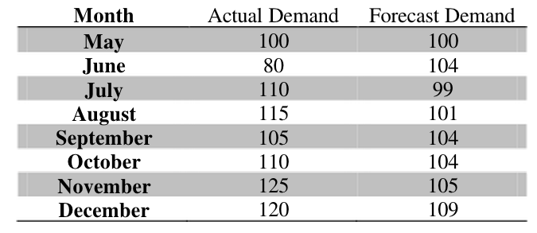
Problem 4.45
The following are monthly actual and forecast demand levels for May through December for units of a product manufactured by the N.Tamimi Pharmaceutical Company
What is the value of tracking signal as of the end of December?

Slide 23
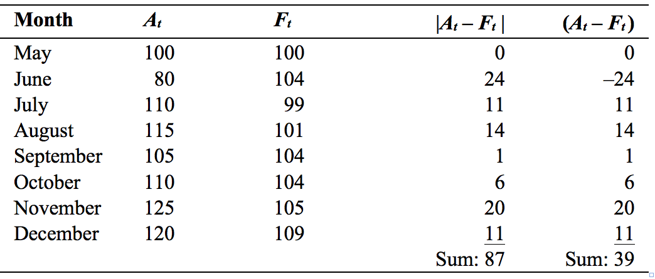
Problem 4.45

