Slide 1
Chapter 4
Class 3

Slide 2
Seasonal Variations In Data
The multiplicative seasonal model can modify trend data to accommodate seasonal variations in demand
Find average historical demand for each season
Compute the average demand over all seasons
Compute a seasonal index for each season
Estimate next year’s total demand
Divide this estimate of total demand by the number of seasons, then multiply it by the seasonal index for that season

Slide 3
Seasonal Index Example
Demand Average Average Seasonal
Month 2003 2004 2005 2003-2005 Monthly Index
Jan 80 85 105 90 94
Feb 70 85 85 80 94
Mar 80 93 82 85 94
Apr 90 95 115 100 94
May 113 125 131 123 94
Jun 110 115 120 115 94
Jul 100 102 113 105 94
Aug 88 102 110 100 94
Sept 85 90 95 90 94
Oct 77 78 85 80 94
Nov 75 72 83 80 94
Dec 82 78 80 80 94

Slide 4
Seasonal Index Example
Demand Average Average Seasonal
Month 2003 2004 2005 2003-2005 Monthly Index
0.957
Jan 80 85 105 90 94
Feb 70 85 85 80 94
Mar 80 93 82 85 94
Apr 90 95 115 100 94
May 113 125 131 123 94
Jun 110 115 120 115 94
Jul 100 102 113 105 94
Aug 88 102 110 100 94
Sept 85 90 95 90 94
Oct 77 78 85 80 94
Nov 75 72 83 80 94
Dec 82 78 80 80 94
average 2003-2005 monthly demand
average monthly demand
Seasonal index =
= 90/94 = .957

Slide 5
Seasonal Index Example
Demand Average Average Seasonal
Month 2003 2004 2005 2003-2005 Monthly Index
Jan 80 85 105 90 94 0.957
Feb 70 85 85 80 94 0.851
Mar 80 93 82 85 94 0.904
Apr 90 95 115 100 94 1.064
May 113 125 131 123 94 1.309
Jun 110 115 120 115 94 1.223
Jul 100 102 113 105 94 1.117
Aug 88 102 110 100 94 1.064
Sept 85 90 95 90 94 0.957
Oct 77 78 85 80 94 0.851
Nov 75 72 83 80 94 0.851
Dec 82 78 80 80 94 0.851

Slide 6
Seasonal Index Example
Demand Average Average Seasonal
Month 2003 2004 2005 2003-2005 Monthly Index
Jan 80 85 105 90 94 0.957
Feb 70 85 85 80 94 0.851
Mar 80 93 82 85 94 0.904
Apr 90 95 115 100 94 1.064
May 113 125 131 123 94 1.309
Jun 110 115 120 115 94 1.223
Jul 100 102 113 105 94 1.117
Aug 88 102 110 100 94 1.064
Sept 85 90 95 90 94 0.957
Oct 77 78 85 80 94 0.851
Nov 75 72 83 80 94 0.851
Dec 82 78 80 80 94 0.851
Forecast for 2006
Expected annual demand = 1,200
1,200
12
Jan x .957 = 96
1,200
12
Feb x .851 = 85

Slide 7
Seasonal Index Example
2006 Forecast
2005 Demand
2004 Demand
2003 Demand
140 –
130 –
120 –
110 –
100 –
90 –
80 –
70 –
Demand
| | | | | | | | | | | |
J F M A M J J A S O N D
Time

Slide 8
Problem 4.28
Attendance at Los Angeles's newest Disney-like attraction, Vacation World, has been as follows:
Compute seasonal indices using all of the data
Quarter | Guests (in thousands) | Quarter | Guests (in thousands)
Winter 07 | 73 | Summer 08 | 124
Spring 07 | 104 | Fall 08 | 52
Summer 07 | 168 | Winter 09 | 89
Fall 07 | 74 | Spring 09 | 146
Winter 08 | 65 | Summer 09 | 205
Spring 08 | 82 | Fall 09 | 98

Slide 9
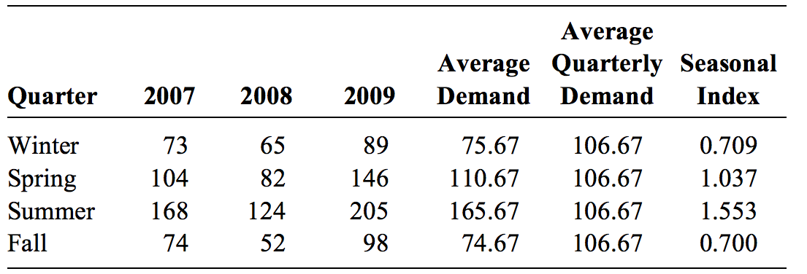
Problem 4.28

Slide 10
Problem 4.29
Central States Electric Company estimates its demand trend line (in millions of kilowatt hours) to be:
D = 77 + 0.43Q
where Q refers to the sequential quarter number and Q = 1 for winter 1986. In addition, the multiplicative seasonal factors are as follows:
Forecast energy use for the four quarters of 2011, beginning with winter.
Quarter | Factor (Index)
Winter | 0.8
Spring | 1.1
Summer | 1.4
Fall | 0.7

Slide 11
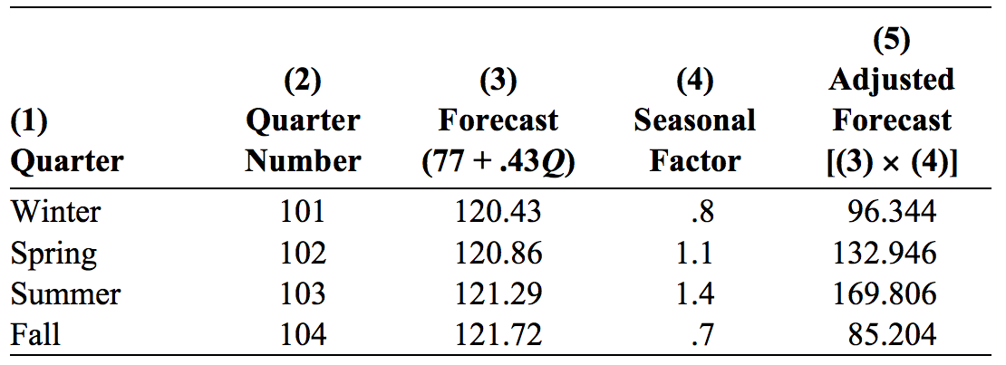
Problem 4.29
2011 is 25 years beyond 1986. Therefore, the 2011 quarter numbers are 101 through 104

Slide 12
Associative Forecasting
Used when changes in one or more independent variables can be used to predict the changes in the dependent variable
Most common technique is linear regression analysis
We apply this technique just as we did in the time series example

Slide 13
Associative Forecasting
Forecasting an outcome based on predictor variables using the least squares technique
^
Σxy - nxy
Σx² - nx²
y = a + bx
b =
^
where y = computed value of the variable to be predicted (dependent variable)
a = y-axis intercept
b = slope of the regression line
x = the independent variable though to predict the value of the dependent variable
a = y - bx

Slide 14
Associative Forecasting Example
Sales Local Payroll
($000,000), y ($000,000,000), x
2.0 1
3.0 3
2.5 4
2.0 2
2.0 1
3.5 7
4.0 –
3.0 –
2.0 –
1.0 –
Sales
| | | | | | |
0 1 2 3 4 5 6 7
Area payroll

Slide 15
Associative Forecasting Example
Sales, y Payroll, x x² xy
2.0 1 1 2.0
3.0 3 9 9.0
2.5 4 16 10.0
2.0 2 4 4.0
2.0 1 1 2.0
3.5 7 49 24.5
∑y = 15.0 ∑x = 18 ∑x² = 80 ∑xy = 51.5
∑xy - nxy
∑x² - nx²
51.5 - (6)(3)(2.5)
80 - (6)(3²)
x = ∑x/6 = 18/6 = 3
b = = = .25
y = ∑y/6 = 15/6 = 2.5
a = y - bx = 2.5 - (.25)(3) = 1.75

Slide 16
Associative Forecasting Example
^
y = 1.75 + .25x
Sales = 1.75 + .25(payroll)
If payroll next year is estimated to be
$600 million, then:
4.0 –
3.0 –
2.0 –
1.0 –
3.25
Sales
Sales = 1.75 + .25(6)
Sales = $325,000
| | | | | | |
0 1 2 3 4 5 6 7
Area payroll

Slide 17
Standard Error of the Estimate
A forecast is just a point estimate of a future value
This point is actually the mean of a probability distribution
4.0 –
3.0 –
2.0 –
1.0 –
3.25
Sales
| | | | | | |
0 1 2 3 4 5 6 7
Area payroll
Figure 4.9

Slide 18
Standard Error of the Estimate
∑(y - y_{c})²
n - 2
S_{y,x} =
where y = y-value of each data point
y_{c} = computed value of the dependent variable, from the regression equation
n = number of data points

Slide 19
Standard Error of the Estimate
Computationally, this equation is considerably easier to use
∑y² - a∑y - b∑xy
n - 2
S_{y,x} =
We use the standard error to set up prediction intervals around the point estimate

Slide 20
Standard Error of the Estimate
∑y² - a∑y - b∑xy
n - 2
39.5 - 1.75(15) - .25(51.5)
6 - 2
S_{y,x} = =
S_{y,x} = .306
4.0 –
3.0 –
2.0 –
1.0 –
3.25
The standard error of the estimate is
$30,600 in sales
Sales
| | | | | | |
0 1 2 3 4 5 6 7
Area payroll

Slide 21
Problem 4.24
Howard Weiss, owner of a musical instrument distributorship, thinks that demand for bass drums may be related to the number of television appearances by the popular group Stone Temple Pilots during previous month. Weiss has collected the data shown in the following table:
A. Graph these data to see whether a linear equations might describe the relationship between the group's television shows and bass drum sales.
B. use the least squares regression method to derive a forecasting equation.
C. What is your estimate for bass drum sales if the Stone Temple Pilots Performed on TV nine times last month?
Demand for Bass Drums | 3 | 6 | 7 | 5 | 10 | 7
number of TV appearances | 3 | 4 | 7 | 6 | 8 | 5

Slide 22
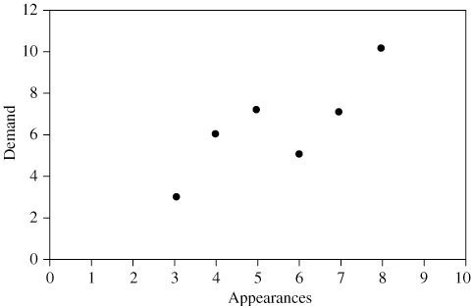
Problem 4.24
(a) Graph of demand
The observations obviously do not form a straight line but do tend to cluster about a straight line over the range shown.

Slide 23
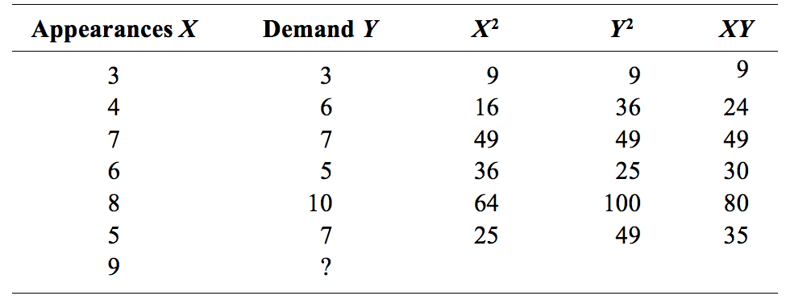
Problem 4.24
(b) Least-squares regression:

Slide 24
Problem 4.24
The following figure shows both the data and the resulting equation:

Slide 25
Problem 4.24
(c) If there are nine performances by Stone Temple Pilots, the estimated sales are:

