Slide 1
Chapter 4
Class 2

Slide 2
Exponential Smoothing
Form of weighted moving average
Weights decline exponentially
Most recent data weighted most
Requires smoothing constant (α)
Ranges from 0 to 1
Subjectively chosen
Involves little record keeping of past data

Slide 3
Exponential Smoothing
New forecast = last period’s forecast
+ α (last period’s actual demand
– last period’s forecast)
F_{t} = F_{t – 1} + α(A_{t – 1} - F_{t – 1})
where F_{t} = new forecast
F_{t – 1} = previous forecast
α = smoothing (or weighting) constant (0 ≤ α ≥ 1)

Slide 4
Exponential Smoothing Example
Predicted demand = 142 Ford Mustangs
Actual demand = 153
Smoothing constant α = .20
New forecast = 142 + .2(153 – 142)
= 142 + 2.2
= 144.2 ≈ 144 cars

Slide 5
Problem 4.4
A check-processing center uses exponential smoothing to forecast the number of incoming checks each month. The number of checks received in June was 40 million, while the forecast was 42 million. A smoothing constant of .2 is used.
A) What is the forecast for July?
B) If the center received 45 million checks in July, what would be the forecast for August?
C) Why might this be an inappropriate forecasting method for this situation?

Slide 6
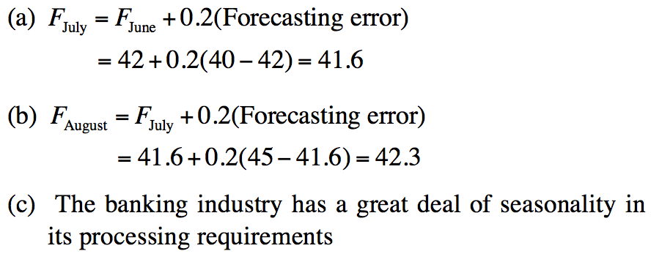
Problem 4.4
A) What is the forecast for July?
B) If the center received 45 million checks in July, what would be the forecast for August?
C) Why might this be an inappropriate forecasting method for this situation?

Slide 7
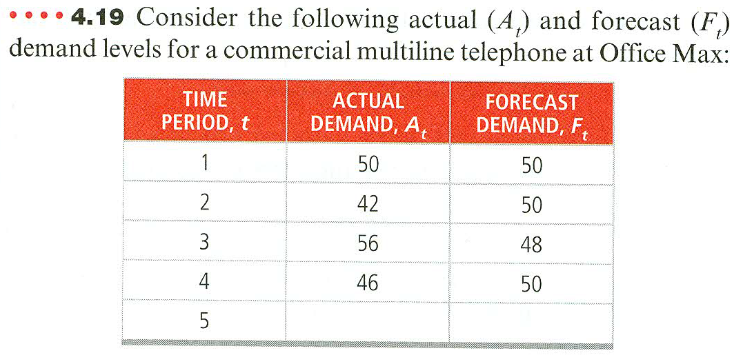
Problem 4.18
Consider the following actual (At) and forecast (Ft) demand levels for a product.
The first forecast, F 1 , was derived by observing A 1 and setting equal to A 1 . Subsequent forecast averages were derived by exponential smoothing. Using the exponential smoothing method, find the forecast for time period 5

Slide 8
Problem 4.18
We need to find the smoothing constant α.
We know in general that F_{t} = F_{t–1} + α(A_{t–1} – F_{t–1}); t = 2, 3, 4.
Choose either
t = 3 or t = 4 (t = 2 won’t let us find α because F₂ = 50 = 50 + α(50 – 50) holds for any α).
Let’s pick t = 3. Then F₃ = 48 = 50 + α(42 – 50)
or 48 = 50 + 42α – 50α
or –2 = –8α
So, .25 = α
Now we can find F₅ : F₅ = 50 + α(46 – 50)
F₅ = 50 + 46α – 50α = 50 – 4α
For α = .25, F₅ = 50 – 4(.25) = 49
The forecast for time period 5 = 49 units.

Slide 9
Common Measures of Error
Mean Absolute Deviation (MAD)
∑ |actual - forecast|
n
MAD =
Mean Squared Error (MSE)
∑ (forecast errors)²
n
MSE =

Slide 10
Common Measures of Error
Mean Absolute Percent Error (MAPE)
n
i = 1
100 ∑ |actual_{i} - forecast_{i}|/actual_{i}
n
MAPE =

Slide 11
Comparison of Forecast Error
Rounded Absolute Rounded Absolute
Actual Forecast Deviation Forecast Deviation
Tonnage with for with for
Quarter Unloaded α = .10 α = .10 α = .50 α = .50
1 180 175 5 175 5
2 168 176 8 178 10
3 159 175 16 173 14
4 175 173 2 166 9
5 190 173 17 170 20
6 205 175 30 180 25
7 180 178 2 193 13
8 182 178 4 186 4
84 100

Slide 12
Comparison of Forecast Error
∑ |deviations|
n
Rounded Absolute Rounded Absolute
Actual Forecast Deviation Forecast Deviation
Tonage with for with for
Quarter Unloaded α = .10 α = .10 α = .50 α = .50
MAD =
For α = .10
1 180 175 5 175 5
2 168 176 8 178 10
3 159 175 16 173 14
4 175 173 2 166 9
5 190 173 17 170 20
6 205 175 30 180 25
7 180 178 2 193 13
8 182 178 4 186 4
84 100
= 84/8 = 10.50
For α = .50
= 100/8 = 12.50

Slide 13
Comparison of Forecast Error
∑ (forecast errors)²
n
MSE =
Rounded Absolute Rounded Absolute
Actual Forecast Deviation Forecast Deviation
Tonage with for with for
Quarter Unloaded α = .10 α = .10 α = .50 α = .50
For α = .10
1 180 175 5 175 5
2 168 176 8 178 10
3 159 175 16 173 14
4 175 173 2 166 9
5 190 173 17 170 20
6 205 175 30 180 25
7 180 178 2 193 13
8 182 178 4 186 4
84 100
MAD 10.50 12.50
= 1,558/8 = 194.75
For α = .50
= 1,612/8 = 201.50

Slide 14
Comparison of Forecast Error
n
i = 1
100 ∑ |deviation_{i}|/actual_{i}
n
MAPE =
Rounded Absolute Rounded Absolute
Actual Forecast Deviation Forecast Deviation
Tonage with for with for
Quarter Unloaded α = .10 α = .10 α = .50 α = .50
For α = .10
1 180 175 5 175 5
2 168 176 8 178 10
3 159 175 16 173 14
4 175 173 2 166 9
5 190 173 17 170 20
6 205 175 30 180 25
7 180 178 2 193 13
8 182 178 4 186 4
84 100
MAD 10.50 12.50
MSE 194.75 201.50
= 45.62/8 = 5.70%
For α = .50
= 54.8/8 = 6.85%

Slide 15
Comparison of Forecast Error
Rounded Absolute Rounded Absolute
Actual Forecast Deviation Forecast Deviation
Tonnage with for with for
Quarter Unloaded α = .10 α = .10 α = .50 α = .50
1 180 175 5 175 5
2 168 176 8 178 10
3 159 175 16 173 14
4 175 173 2 166 9
5 190 173 17 170 20
6 205 175 30 180 25
7 180 178 2 193 13
8 182 178 4 186 4
84 100
MAD 10.50 12.50
MSE 194.75 201.50
MAPE 5.70% 6.85%

Slide 16
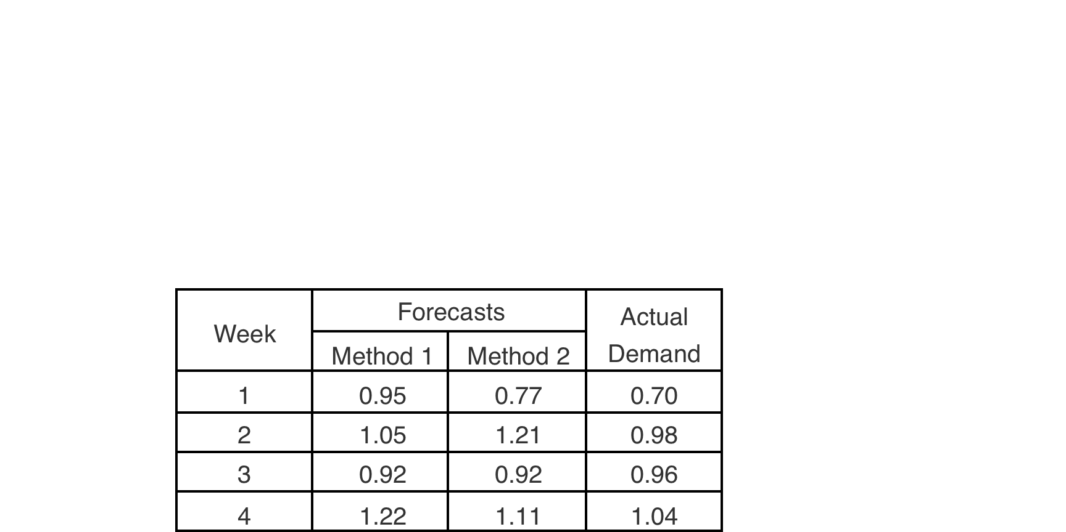
Problem 4.14
following are two weekly forecasts made by two different methods for the number of gallons of gasoline, in thousands, demanded at a local gasoline station. Also shown are actual demand levels in thousands of gallons:
What are the MAD and MSE for each method?

Slide 17
Problem 4.14
What are the MAD and MSE for each method?
Method 1: MAD: (0.20 + 0.05 + 0.05 + 0.20)/4 = .125 ← MSE : (0.04 + 0.0025 + 0.0025 + 0.04)/4 = .021
Method 2: MAD: (0.1 + 0.20 + 0.10 + 0.11) / 4 = .1275
MSE : (0.01 + 0.04 + 0.01 + 0.0121) / 4 = .018 ←

Slide 18
Exponential Smoothing with Trend Adjustment
When a trend is present, exponential smoothing must be modified
Forecast
including (FIT_{t}) =
trend
exponentially exponentially
smoothed (F_{t}) + (T_{t}) smoothed
forecast trend

Slide 19
Exponential Smoothing with Trend Adjustment
F_{t} = α(A_{t - 1}) + (1 - α)(F_{t - 1} + T_{t - 1})
T_{t} = β(F_{t} - F_{t - 1}) + (1 - β)T_{t - 1}
Step 1: Compute F_{t}
Step 2: Compute T_{t}
Step 3: Calculate the forecast FIT_{t} = F_{t} + T_{t}

Slide 20
Exponential Smoothing with Trend Adjustment Example
Forecast
Actual Smoothed Smoothed Including
Month(t) Demand (A_{t}) Forecast, F_{t} Trend, T_{t} Trend, FIT_{t}
1 12 11 2 13.00
2 17
3 20
4 19
5 24
6 21
7 31
8 28
9 36
10
Table 4.1

Slide 21
Exponential Smoothing with Trend Adjustment Example
Forecast
Actual Smoothed Smoothed Including
Month(t) Demand (A_{t}) Forecast, F_{t} Trend, T_{t} Trend, FIT_{t}
1 12 11 2 13.00
2 17
3 20
4 19
5 24
6 21
7 31
8 28
9 36
10
Step 1: Forecast for Month 2
F₂ = αA₁ + (1 - α)(F₁ + T₁)
F₂ = (.2)(12) + (1 - .2)(11 + 2)
= 2.4 + 10.4 = 12.8 units
Table 4.1

Slide 22
Exponential Smoothing with Trend Adjustment Example
Forecast
Actual Smoothed Smoothed Including
Month(t) Demand (A_{t}) Forecast, F_{t} Trend, T_{t} Trend, FIT_{t}
1 12 11 2 13.00
2 17 12.80
3 20
4 19
5 24
6 21
7 31
8 28
9 36
10
Step 2: Trend for Month 2
T₂ = β(F₂ - F₁) + (1 - β)T₁
T₂ = (.4)(12.8 - 11) + (1 - .4)(2)
= .72 + 1.2 = 1.92 units
Table 4.1

Slide 23
Exponential Smoothing with Trend Adjustment Example
Forecast
Actual Smoothed Smoothed Including
Month(t) Demand (A_{t}) Forecast, F_{t} Trend, T_{t} Trend, FIT_{t}
1 12 11 2 13.00
2 17 12.80 1.92
3 20
4 19
5 24
6 21
7 31
8 28
9 36
10
Step 3: Calculate FIT for Month 2
FIT₂ = F₂ + T₁
FIT₂ = 12.8 + 1.92
= 14.72 units
Table 4.1

Slide 24
Exponential Smoothing with Trend Adjustment Example
Forecast
Actual Smoothed Smoothed Including
Month(t) Demand (A_{t}) Forecast, F_{t} Trend, T_{t} Trend, FIT_{t}
1 12 11 2 13.00
2 17 12.80 1.92 14.72
3 20
4 19
5 24
6 21
7 31
8 28
9 36
10
15.18 2.10 17.28
17.82 2.32 20.14
19.91 2.23 22.14
22.51 2.38 24.89
24.11 2.07 26.18
27.14 2.45 29.59
29.28 2.32 31.60
32.48 2.68 35.16
Table 4.1

Slide 25
Exponential Smoothing with Trend Adjustment Example
35 –
30 –
25 –
20 –
15 –
10 –
5 –
0 –
Actual demand (A_{t})
Product demand
Forecast including trend (FIT_{t})
| | | | | | | | |
1 2 3 4 5 6 7 8 9
Time (month)
Figure 4.3

Slide 26
Problem 4.19
Income at the law firm of Smith and Wesson for the period February to July was as follows:
Month FEB MAR APR MAY JUNE JUL
Income 70.0 68.5 64.8 71.7 71.3 72.8
(In $ thousand)
Use trend-adjusted exponential smoothing to forecast the law firm’s August income. Assume that the initial forecast for February is $65,000 and the initial trend adjustment is 0.The smoothing constants selected are α = 0.1 and β =0.2

Slide 27
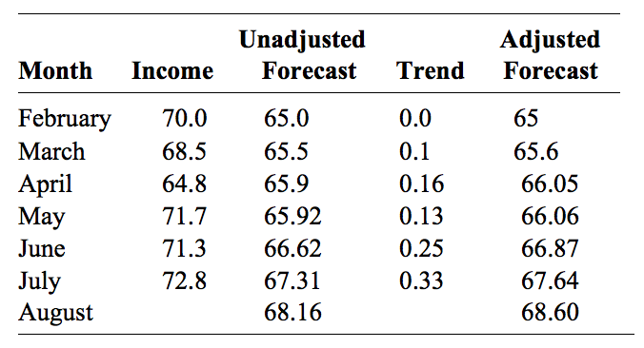
Problem 4.19

Slide 28
Trend Projections
Fitting a trend line to historical data points to project into the medium-to-long-range
Linear trends can be found using the least squares technique
^
y = a + bx
^
where y = computed value of the variable to be predicted (dependent variable)
a = y-axis intercept
b = slope of the regression line
x = the independent variable

Slide 29
Least Squares Method
Actual observation (y value)
Deviation₇
Deviation₅
Deviation₆
Values of Dependent Variable
Deviation₃
Deviation₄
Deviation₁
Deviation₂
^
Trend line, y = a + bx
Time period
Figure 4.4

Slide 30
Least Squares Method
Actual observation (y value)
Deviation₇
Deviation₅
Deviation₆
Least squares method minimizes the sum of the squared errors (deviations)
Values of Dependent Variable
Deviation₃
Deviation₄
Deviation₁
Deviation₂
^
Trend line, y = a + bx
Time period
Figure 4.4

Slide 31
Least Squares Method
Equations to calculate the regression variables
^
y = a + bx
Σxy - nxy
Σx² - nx²
b =
a = y - bx

Slide 32
Least Squares Example
Time Electrical Power
Year Period (x) Demand x² xy
1999 1 74 1 74
2000 2 79 4 158
2001 3 80 9 240
2002 4 90 16 360
2003 5 105 25 525
2004 6 142 36 852
2005 7 122 49 854
∑x = 28 ∑y = 692 ∑x² = 140 ∑xy = 3,063
x = 4 y = 98.86
∑xy - nxy
∑x² - nx²
3,063 - (7)(4)(98.86)
140 - (7)(4²)
b = = = 10.54
a = y - bx = 98.86 - 10.54(4) = 56.70

Slide 33
Least Squares Example
Time Electrical Power
Year Period (x) Demand x² xy
1999 1 74 1 74
2000 2 79 4 158
2001 3 80 9 240
2002 4 90 16 360
2003 5 105 25 525
2004 6 142 36 852
2005 7 122 49 854
∑x = 28 ∑y = 692 ∑x² = 140 ∑xy = 3,063
x = 4 y = 98.86
The trend line is
^
y = 56.70 + 10.54x
∑xy - nxy
∑x² - nx²
3,063 - (7)(4)(98.86)
140 - (7)(4²)
b = = = 10.54
a = y - bx = 98.86 - 10.54(4) = 56.70

Slide 34
Least Squares Example
Trend line,
y = 56.70 + 10.54x
160 –
150 –
140 –
130 –
120 –
110 –
100 –
90 –
80 –
70 –
60 –
50 –
^
Power demand
| | | | | | | | |
1999 2000 2001 2002 2003 2004 2005 2006 2007
Year

Slide 35
Least Squares Requirements
We always plot the data to insure a linear relationship
We do not predict time periods far beyond the database
Deviations around the least squares line are assumed to be random

Slide 36
Problem 4.25
The following gives the number of accidents that occurred on Florida State Highway 101 during the last 4 months:
Forecast the number of accidents that will occur in May, using least squares regression to derive a trend equation.
Month | Number of Accidents
January | 30
February | 40
March | 60
April | 90

Slide 37
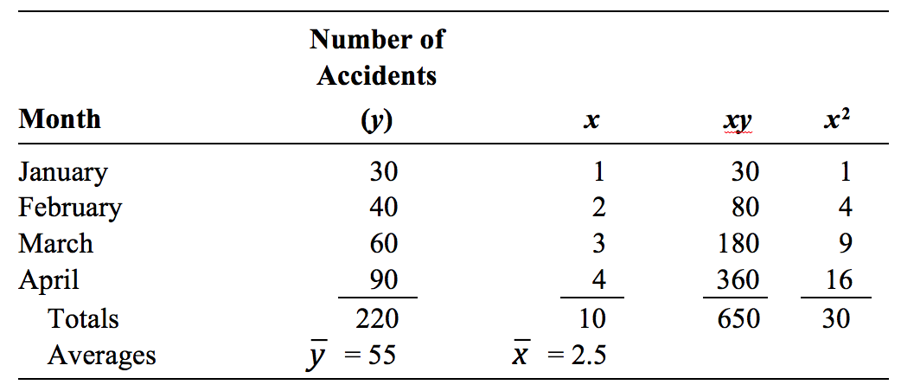
Problem 4.25

Slide 38
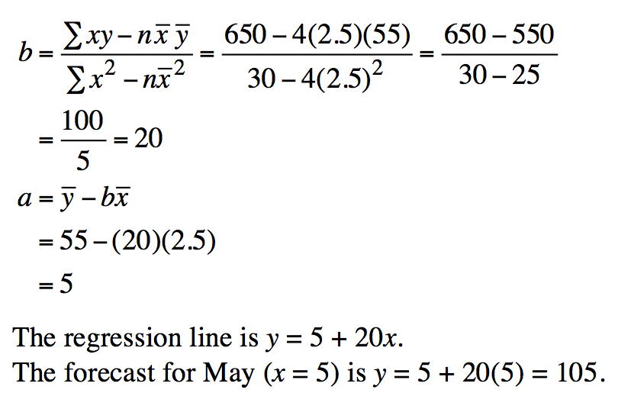
Problem 4.25

