Slide 1
Chapter 4

Slide 2
Naive Approach
Assumes demand in next period is the same as demand in most recent period
e.g., If May sales were 48, then June sales will be 48
Sometimes cost effective and efficient

Slide 3
Moving Average Method
Used if little or no trend
Used often for smoothing
Provides overall impression of data over time
∑ demand in previous n periods
n
Moving average =

Slide 4
Moving Average Example
Actual 3-Month
Month Shed Sales Moving Average
January 10
February 12
March 13
April 16
May 19
June 23
July 26
10
12
13
(10 + 12 + 13)/3 = 11 ²/₃
(12 + 13 + 16)/3 = 13 ²/₃
(13 + 16 + 19)/3 = 16
(16 + 19 + 23)/3 = 19 ¹/₃

Slide 5
Graph of Moving Average
Moving Average Forecast
30 –
28 –
26 –
24 –
22 –
20 –
18 –
16 –
14 –
12 –
10 –
Actual Sales
Shed Sales
| | | | | | | | | | | |
J F M A M J J A S O N D

Slide 6
Weighted Moving Average
Used when trend is present
Older data usually less important
Weights based on experience and intuition
∑ (weight for period n) x (demand in period n)
∑ weights
Weighted moving average
=

Slide 7
Weighted Moving Average
Weights Applied Period
3 Last month
2 Two months ago
1 Three months ago
6 Sum of weights
Actual 3-Month Weighted
Month Shed Sales Moving Average
10
12
13
[(3 x 13) + (2 x 12) + (10)]/6 = 12¹/₆
January 10
February 12
March 13
April 16
May 19
June 23
July 26
[(3 x 16) + (2 x 13) + (12)]/6 = 14¹/₃
[(3 x 19) + (2 x 16) + (13)]/6 = 17
[(3 x 23) + (2 x 19) + (16)]/6 = 20¹/₂

Slide 8
Potential Problems With Moving Average
Increasing n smooths the forecast but makes it less sensitive to changes
Do not forecast trends well
Require extensive historical data

Slide 9
Moving Average And Weighted Moving Average
30 –
25 –
20 –
15 –
10 –
5 –
Weighted moving average
Actual sales
Sales demand
Moving average
| | | | | | | | | | | |
J F M A M J J A S O N D
Figure 4.2

Slide 10
Exercise 4.1
Week of | Pints Used
August 31 | 360
September 7 | 389
September 14 | 410
September 21 | 381
September 28 | 368
October 5 | 374
The following gives the number of pints of
Type A blood used at Woodlawn Hospital in
the past six weeks.
Forecast the demand for the week of
October 12 using a three-week moving average.
b) Use a three week weighted moving average, with weights of .1, .3, and .6, using .6 for the most recent week. Forecast demand for the week of October 12.

Slide 11
Exercise 4.1
Forecast the demand for the week of October 12 using a three-week moving average.

Slide 12
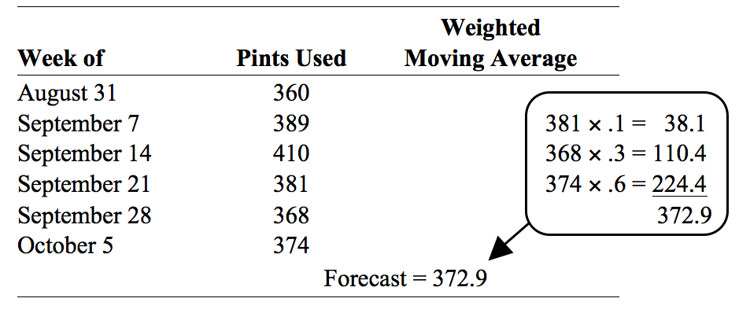
Exercise 4.1
b) Use a three week weighted moving average, with weights of .1, .3, and .6, using .6 for the most recent week. Forecast demand for the week of October 12.

