Slide 1
PHYS 476: Introduction to Nanoscience and Nanotechnology
(Elective course) - 2(2+0+0)
Lecturer: dr. Abeer Alshammari
Room no. 213- building 5
aalshammri@ksu.edu.sa

Slide 2
Chapter 3: Synthesis Routes
3.1 BOTTOM-UP APPROACHES
3.1.1 Physical vapour deposition (PVD)
3.2 TOP-DOWN APPROACHES
3.2.1 Mechanical alloying
3.2.2 Equal channel angular pressing (ECAP)
3.1.2 Chemical vapour deposition
3.2.3 High-pressure torsion (HPT)
3.1.3 Spray conversion processing
3.2.4 Accumulative roll bonding (ARB)
3.1.4 Sol–gel process
3.2.5 Nanolithography
3.1.5 Wet chemical synthesis
3.3 CONSOLIDATION OF NANOPOWDERS
3.1.6 Self-assembly
3.3.1 Shockwave consolidation
3.3.2 Hot isostatic pressing (HIP)
and cold isostatic pressing (CIP)
3.3.3 Spark plasma sintering

Slide 3
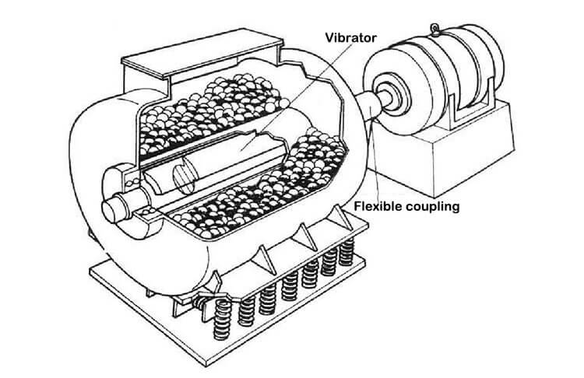
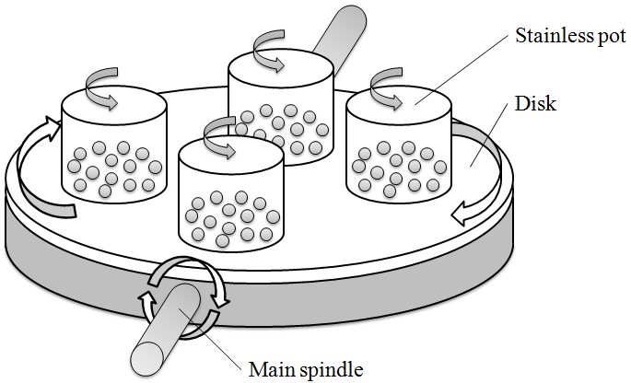
3.2 TOP-DOWN APPROACHES
3.2.1 Mechanical alloying
Mechanical alloying or milling is usually carried out in high-energy mills such as vibratory mills (Spex 8000 mixer/mill), planetary mills (Fritsch and Retsch) and attritor mills (Szegvari attritor and Simoloyer).
The vibratory mill has one vial, containing the sample and grinding balls and vibrates in all three directions. Because of the amplitude (about 50 mm) and speed (about 1200 rpm), the ball velocities are high (in the order of 5 m/s) and consequently the force of the ball’s impact is unusually high.
In planetary mill, the vials rotate around their own axes and at the same time around the axis of a disc on which they are mounted. The centrifugal force produced by the vials rotating around their own axes and that produced by the rotating support disk together act on the vial contents, consisting of material to be ground and the grinding balls. Since the vials and the supporting disc rotate in opposite directions, the centrifugal forces alternately act in opposite directions. Due to this, the balls run down the inside wall of the vial. This is followed by the material being ground and grinding balls being lifted off and travelling freely through the inner chamber of the vial and colliding against the opposing inside wall. Grinding vials and balls are available in eight different materials—agate, silicon nitride, sintered corundum, zirconia, chrome steel, Cr–Ni steel, tungsten carbide and plastic polyamide.
Vibratory mills
planetary mills

Slide 4
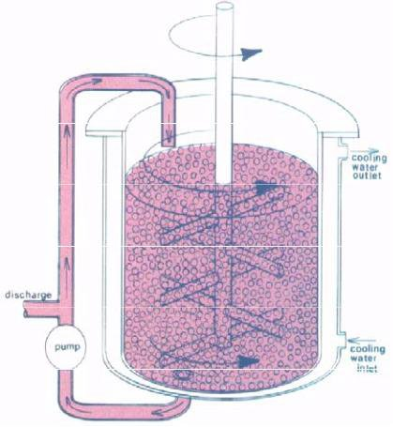
An attritor ball mill consists of a stationary vertical drum in which a vertical shaft rotates with a series of horizontal impellers attached to it. Set progressively at right angles to each other,
the impellers, through their rotation, energise the ball charge, causing powder size reduction
attritor mills
due to the impact between balls, between balls and the container wall, and between balls,
the agitator shaft and impellers.
The mechanism of nano-crystallization during high-energy ball milling was first proposed by H.J. Fecht in 1983. He summarised the phenomenon of the development of nanocrystalline microstructure into three stages;
Stage 1: Localization of deformation into shear bands with high dislocation density.
Stage 2: Dislocation, annihilation and recombination to form nanometre-scale sub-grains,
which extend throughout the sample with further milling.
Stage 3: Transformation of sub-grain boundary structure to randomly oriented high angle grain boundaries. Superplastic deformation processes such as grain boundary sliding causes self-organisation into a random nanocrystalline state.
The minimum grain size achievable by high-energy ball milling has been related to several physical properties of elemental metals. It is reported that the minimum grain size, dmin, is inversely proportional to the melting temperature for low melting FCC metals. However, for HCP and BCC systems as well as FCC elements with melting temperature above that of Pd (1555°C), dmin appears to be insensitive to the melting point.
Nanocrystallization by high-energy ball milling has also been demonstrated to help in extending the solid solubility of different solute elements into various solvent elements, as discussed in the previous chapter. This is basically due to the large fraction of grain boundaries in these nanocrystalline materials, which can accommodate large solute fractions.

Slide 5
3.2.2 Equal channel angular pressing (ECAP)
The principle of ECAP [or equal channel angular extrusion (ECAE)] is illustrated schematically in Fig. 3.18. For the die shown in the illustration, the internal channel is bent through an abrupt angle, φ, equal to 90°, and there is an
additional angle, ψ, equal to 0° in Fig. 3.19, which represents the outer arc of curvature where the two channels intersect. In this process, a rod-like
sample is pressed through the die using a plunger. Shear deformation occurs as the sample passes through the die. Despite the introduction of an intense strain as the sample passes through the shear plane, the sample ultimately emerges from the die without experiencing any change in the cross-sectional dimensions.
The ECAE process has been applied to various kinds of metals and alloys and has succeeded in producing ultrafine grain (UFG) microstructures. However, the major materials used are light metals like Al- and Mg-alloys and the trials for steels are limited

Slide 6
3.2.3 High-pressure torsion (HPT)
A method for fabrication of disc-type bulk nanostructured samples using high-pressure torsion is shown in Fig. 3.21. In HPT, the sample disk is strained in torsion under the applied pressure (P) of several GPa between two anvils. A lower holder rotates and surface friction forces the ingot to deform by shear. Due to the specific geometric shape of the sample, the main volume of the material is strained in conditions of quasihydrostatic compression under the applied pressure and the pressure of sample outer layers. As a result, in spite of large strain values, the deformed sample is not destroyed.
Using high-pressure torsion, the first nanocrystalline structures were developed in single crystals of Ni and Cu. It was found that the mean grain size had gradually decreased with increasing shear strain and had finally stabilized at the level of ~ 100 nm.

Slide 7
3.2.4 Accumulative roll bonding (ARB)
Accumulative roll bonding is the only SPD process using rolling deformation itself (Fig. 3.22). Rolling is the most advantageous metal working process for continuous production of plates, sheets and bars. However, the total reduction applied to the materials is substantially limited because of the decrease in the cross-sectional dimension of the materials with increasing reduction. In the ARB process, a 50% rolled sheet is cut into two, stacked to the initial thickness, and then rolled again. As is evident, the rolling in the ARB is not only a deformation process but also a bonding process (roll bonding). To achieve good bonding, the surface of the materials is degreased and wire brushed before stacking, and the roll bonding is sometimes carried out at elevated temperatures below the recrystallization
temperature of the materials. Repeating this ARB process a number of times can lead to very large plastic strain in the materials.
serious problem in the ARB process is fracture of the materials. Since a large amount of total plastic strain is
accumulated in the materials, the rolling is not a hydrostatic process; edge-cracks sometimes appear in the sheets, especially at higher cycles. In certain kinds of materials, such as Al–Mg alloy, the edge cracks largely propagate into the centre of the sheets.

Slide 8
3.2.5 Nanolithography
STM-based nanolithography
Patterns with a minimal size from 10–20 nm to 1 nm in ultrahigh vacuum (UHV) have been demonstrated. Nanometre-sized holes can be formed using low energy electrons from a scanning tunnelling microscope (STM) tip when a pulsed electric voltage is applied in the presence of sufficient gas molecules between the substrate and the tip. For example,
holes that are 7 nm deep and 6 nm wide on highly ordered pyrolytic graphite (HOPG) substrate were formed in nitrogen at a pressure of 25 bar by applying a 7 V pulse to the tip for 130 mins, with the distance between the tip and the substrate being 0.6–1 nm.
A possible mechanism is that the electric field induces the ionisation of gas molecules near the STM tip, and accelerates the ions towards the substrate. Ions bombard the substrate and, consequently, nanometre-sized holes are created.
AFM-based nanolithography
Direct contacting, writing or scratching is referred to as a mechanical action of the AFM tip that is used as a sharply pointed tool in order to produce fine grooves on sample surfaces. Although direct scratching creates grooves with high precision, low quality results are often obtained due to tip wear during the process. An alternative approach is to combine scratching on a soft resist polymer layer, such as PMMA or polycarbonate, as a mask for the etching process and subsequent etching to transfer the pattern to the sample surface. This method ensures reduced tip damage, but also precludes an accurate alignment to the structures underneath. A two-layer mask has been investigated as a further improvement.
For example, a mask coating consisting of a thin layer of polycarbonate of 50–100 m and a film of an easy-to-deform and fusible metal such as indium or tin was used to create 50 nm–wide structures.

Slide 9
Dip-pen nanolithography
In dip-pen nanolithography (DPN), the tip of an AFM operated in air is ‘inked’ with a chemical of interest and brought into contact with a surface. The ink molecules flow from the tip onto the surface similar to a fountain pen. The water meniscus that naturally forms between the tip and the surface enables the diffusion and transport of
the molecules, as shown in Fig. 3.24. Inking can be done by dipping the tip in a solution containing a small concentration of the molecules, followed by a drying step (e.g., blowing dry with compressed difluoroethane). Line widths down to 12 nm with spatial resolution of 5 nm have been demonstrated with this technique. Species patterned with DPN include conducting polymers, gold, dendrimers, DNA, organic dyes, antibodies and alkanethiols.

Slide 10
3.3 CONSOLIDATION OF NANOPOWDERS
The commercial application of nanomaterials beyond the boundaries of materials science laboratories is possible only on successful consolidation of these materials into bulk-sized components preserving the nanostructures. Due to the long duration of sintering at high temperature that is involved in conventional consolidation techniques, it is difficult to retain
the nanograin-size due to grain growth in such techniques.
The density of the green compact depends on the frictional forces of the powder particles that originate from electrostatic, van der Waals and surface adsorption forces. These forces are significantly high in nanoparticles, forming hard agglomerates and inter-agglomerates, which are relatively large. Further, nanoparticles contain a large number of pores which require not only higher temperature but also prolonged sintering times for their successful elimination; consequently, it becomes difficult to retain the grain size in the nanometre domain. Large pores undergo pore–boundary separation that restricts the attainment of full density in the consolidated nanoparticles. During sintering of nanoparticles, pores smaller than the critical size shrink, while larger pores undergo pore–boundary separation.
The fraction of grain boundaries in nanomaterials is large compared to that in coarse-grained materials. The density of the grain boundary regions is less than the grain interior due mainly to the relaxation of atoms in the grain boundaries; they also contain other lattice defects. Therefore, consolidated nanoparticles with retained nanostructure are expected to exhibit a density lower than the theoretical density of the bulk counterpart.

Slide 11
3.3.2 Hot isostatic pressing (HIP)
and cold isostatic pressing (CIP)
The process of using high hydrostatic pressure and high temperature to compress fine particles into coherent parts is termed ‘hot isostatic pressing’ (HIPing). This process provides a method for producing components from diverse powdered materials, including metals and ceramics.
In this process, the elemental blend is placed in a container, usually a steel can. The container is subjected to elevated temperatures, and very high vacuum to remove air and moisture from the powder, after which it is sealed and HIPed. The application of high inert gas pressures and elevated temperatures results in the removal of internal voids and creates a strong bond throughout the material. The result is a clean homogeneous material with a uniformly fine grain size and near 100% density.
In cold isostatic pressing (CIPing), pressure is applied from multiple directions to get better uniformity of compaction, compared to uniaxial pressing. There are two methods in isostatic pressing. In wet bag isostatic pressing, the powder is encased in a rubber sheath that is immersed in a liquid that transmits the pressure uniformly to the powder. In dry bag isostatic pressing, instead of immersing the tooling in a fluid, the tooling itself is built with internal channels into which high pressure fluid is pumped.
Fig. 3.27 Schematic of a hot isostatic pressing setup.

Slide 12
3.3.3 Spark plasma sintering
Applying rapid heating to sintering temperatures, leading to rapid sintering of nanocomposites.
Typical SPS processing parameters include:
• Applied pressure between 50 and 100MPa
• Pulse duration of ∼ 10 ms with on–off cycle of 2–2.5 ms
• Maximum pulse parameter of 10,000 A and 10 V
After applying the given pressure, samples are heated to the preset temperature (for a few minutes) and are ramped rapidly (∼ 150–500 K/min) to sintering temperatures with hold time of 3–5 min to complete the sintering. Samples are usually cooled to below 100°C within 5 minutes of the completion of sintering.
Densification of the green compact occurs in four stages: vacuum creation, pressure application, resistance heating and cooling down. SPS is carried out in vacuum to account for removal of gases, and results in a densely consolidated composite. Heating is accomplished by spark discharge between particles, which activates the surface by removing surface oxide.

Slide 13
SUMMARY
• Various techniques are available for the synthesis of nanoparticles and
nanostructured materials.
• The techniques available can be grouped broadly into the ‘top-down’ and ‘bottomup’
approaches.
• These techniques can also be classified, based on the state of the matter from
which the nanomaterials are synthesized.
• In bottom-up techniques, nanoparticles are prepared from the vapour or liquid
phase, while in top-down approaches, they are made from solids.
• The challenge in consolidation of nanoparticles is to retain the nanocrystallinity
after consolidation.
• Among the various techniques of consolidation, spark plasma sintering is popular.

